Slide 1
International Projects 2018-2019

Slide 2
International Committee
Committee members : Joe, Nilam, Ron D, Norma, Lois, Stephen B, Shirley, Barb welcoming Bruce S and anyone else interested!
Subcommittees:
Rift Valley WASH in School Global Grant project
Bugiri WASH in School project - Joe and Dennis Gray recently presented an overview of their Nov site visit. The project has been divided into 2 main phases and the current GG addresses the needs of Phase 1.

Slide 3
Nakuru WASH in Schools
Final report was approved in Jan 2019
Since 2010 RTE has successfully completed 3 GG partnerships with RC Nakuru totaling $750,000 Cdn, this project worth $135,524 US
This Grant was supported by 12 RC in D7070, other RC across the country, and as well as private foundations

Slide 4
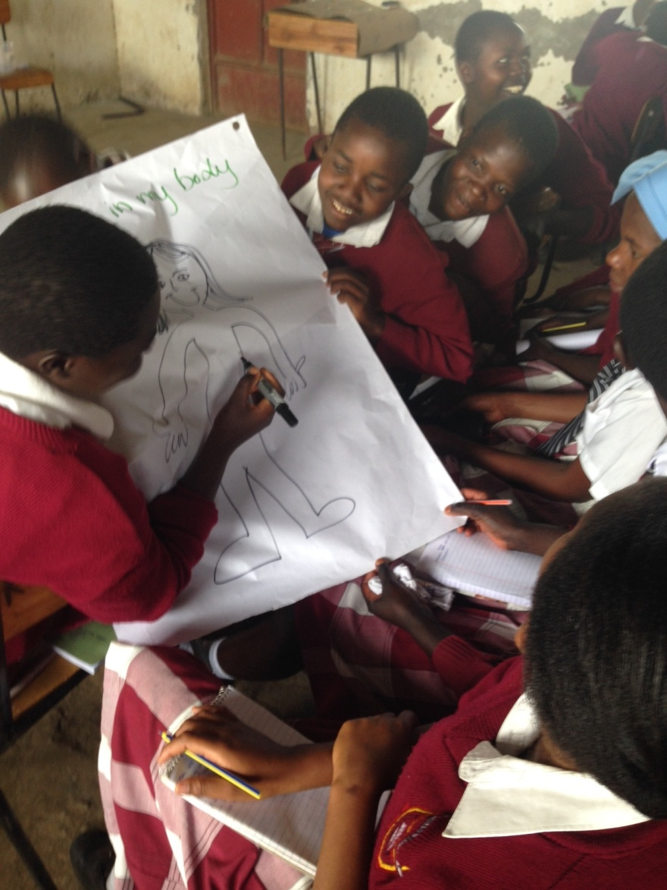
Nakuru WASH in Schools

Slide 5
Bugiri Site Visit

Slide 6
Gairaptur Bass Panchayat School
Based in India
Project brought forward by Stephen B who visited this school and was impressed with the work, oversight and vision of this school.
The school offers education to a number of lower income students with the goal of an equal opportunity for education for all.
Donation - $2000

Slide 7
Gairaptur Bass Panchayat School
“We have set out to give every child in the three villages where we live, an education similar to that which the politicians and bureaucrats insist upon for their children.”

Slide 8
Lead by the RC Scarborough, a District 7070 Grant was approved to assist the El Arca home in becoming financially sustainable through solar power. This equipment will increase the financial, environmental and impact sustainability of the home.
Donation $2000

Slide 9
Little Footprints Big Steps
LFBS entered into a partnership with Maxima Homes Haiti who matched funds to build housing for families affected by recent earthquake and hurricanes. Morgan Weinburg continues to work in Haiti primarily focusing on children and families.
Donation $2000

Slide 10
Housing in Haiti

Slide 11
Rising Out of the Ashes
ROOTA is a Canadian charity supported by the RC of Scarborough working with women and children in Egypt who live and work in the marginalized garbage picking community of Zabaleen. This project is to provide tablets ($220 cdn) for children in primary grades giving them the same experience for literacy as throughout the rest of the country.
Donation $660 for 3 tablets.

Slide 12
Transforming Faces

Slide 13
Transforming Faces
A project based in Peru
Ultimate goal to provide early care for children born with cleft lip and palate.
RTE is supporting training healthcare professionals to help deliver nutritional support to mothers and newborns with cleft lip who struggle to breastfeed
Donation $2000

Slide 14
Ethiopia MCH

Slide 15
Midwife Training
D 7070 is working with CUSO in Ethiopia to improve the clinical skills of midwives in underserviced areas.
Rotary is purchasing basic equipment to support student midwives while they are in their clinical placement. These are items often in short supply but essential for maternal health care.
Each $500 donation buys a Midwife Birth Kit. Our $2,000 donation became $30,000 with a CUSO match!

Slide 16
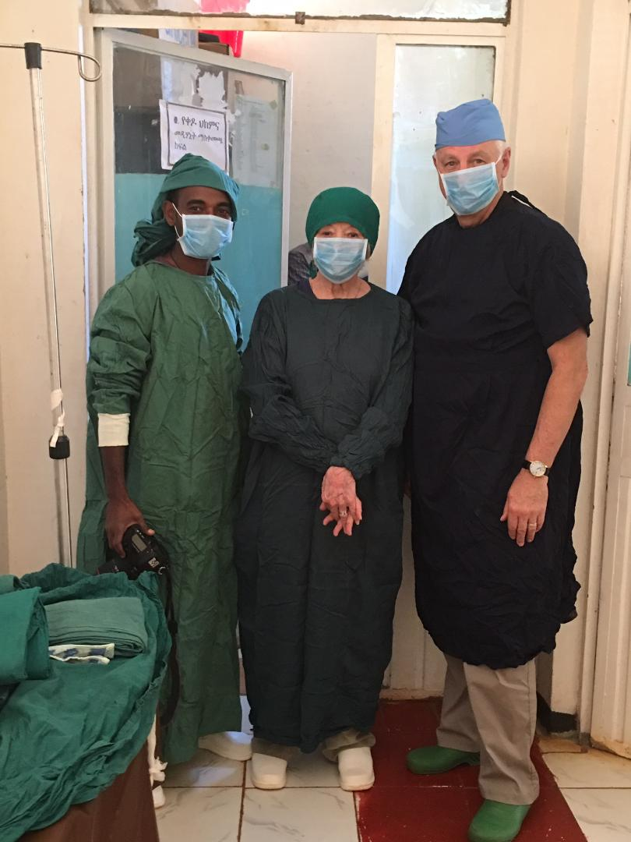
Ethiopia

Slide 17
Waste Pickers in Brasilia
Goal to improve health conditions of waste pickers in Brasilia garbage dumps & improve the water quality available to them.
Supported by RC of Taguatinga Brazil.
Vanessa and Rogerio Cruvinel spoke to the club on Oct 3. Since then RC Brighton has offered to support them in a Global Grant application.
The Board voted to put aside $3000 for that Global Grant once it has been approved.

Slide 18
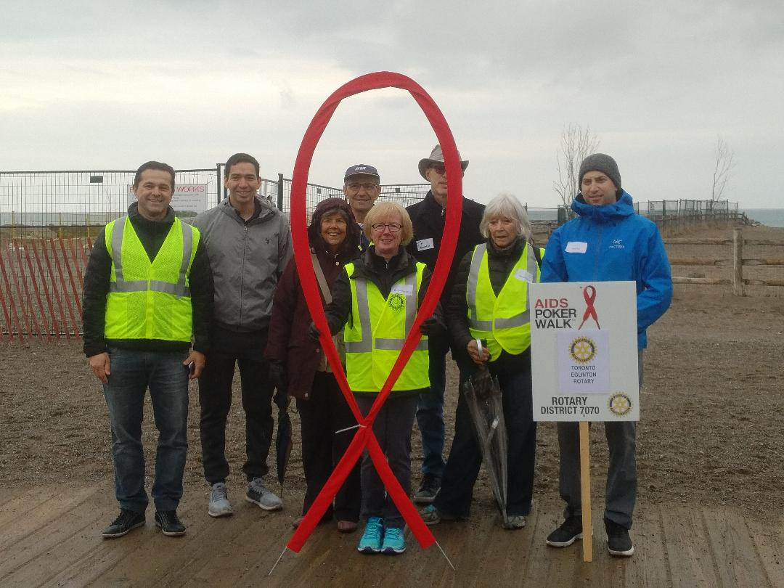
Rotary AIDS Walk 2018

Slide 19
Rotary AIDS Walk 2019
Saturday Apr 27 at the Leuty Pavilion the Beaches
75% of funds raised go to HIV Patients at the Karanda Mission Hospital in Zimbabwe; 25% go to Latino Positivos the District’s designated charity.
Our team needs your support and pledges!
http://toronto.rotaryaidswalk.ca
Join the Toronto Eglinton team or sponsor Ricardo (sponsor online or by cheque to Rotary Club of Toronto Eglinton Foundation)

Slide 20
ithe
Thank you for your ongoing support!

