Slide 1
UKRAINE 3D-PRINTED PROSTHETICS PROJECT
ROTARY TORONTO EGLINTON DISTRICT 7070
AND
ROTARY TERNOPIL CITY, UKRAINE DISTRICT 2232
REQUEST FOR FUNDING TO SUPPORT THE PROJECT
AND ACHIEVE THE $125,000 USD GOAL

Slide 2
The photo that inspired Rotary's 3D-printed prosthetics project
This little girl lost both legs in an explosion at the train station, where people were trying to flee.

Slide 3
INNOCENT VICTIMS
The little boy is the family's helper since his father was killed in the war.
How soon might the girl and her mother be mobile again?

Slide 4
Landmine Explosion Victim
This woman was on the way to her mother’s birthday celebration when she stepped on a landmine and lost both her limbs.

Slide 5
Being comforted by her Husband
Ukraine is the most heavily mined country in the world.
An estimated 2 million landmines have been scattered across the country, and demining will take decades.

Slide 6
Plaster Cast Mold for Prosthetic Socket
Measuring the plaster mold
Plaster molds take days to dry
3-D printed prosthetics skip this step
Once learned, a prosthetic socket can be printed in 8 hours

Slide 7
One of the two 3D printers donated by Canada to the Unbroken Rehabilitation Centre in Lviv, Ukraine.
3D-printed sockets.
Technicians undergo rigorous training.
It takes several months to achieve proficiency.

Slide 8
“We lost our limbs fighting for Ukraine – we now make prosthetics for other war amputees.”
“This is something that gives me strength to be able to help people. It has given me a purpose in life”
“When you give these to patients, the emotions you feel are like fireworks.”

Slide 9
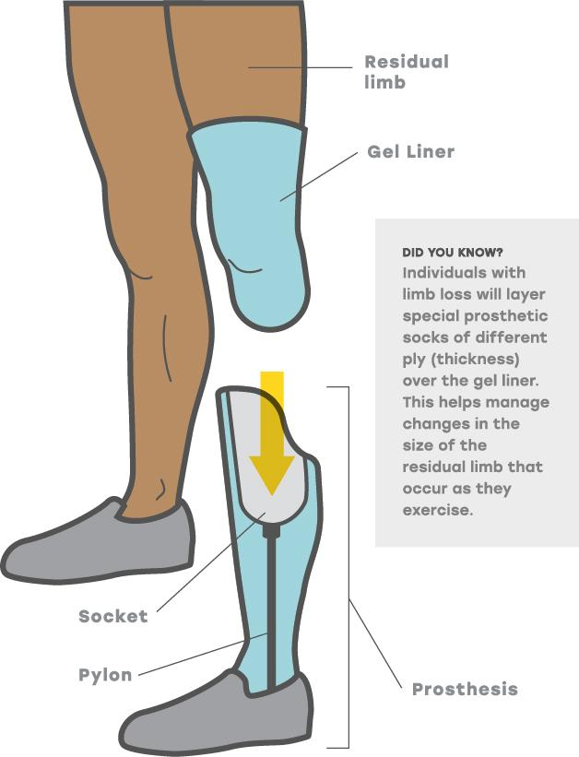

Slide 10
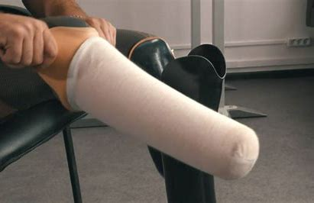

Slide 11
A crucial addition to the Unbroken site was two 3D printers purchased with donations from Canada’s Temerty Foundation.
The first soldier fitted with a prosthetic produced by a Canadian-supplied 3-D printer.

Slide 12
LEARNING TO WALK AGAIN
The sooner a prosthetic limb is provided, the quicker the patient can start rehabilitation.

Slide 13
The World’s Longest Marathon in Kyiv
Veterans and civilians walked and ran using new Canadian-made prosthetics.

Slide 14
Be a part of the solution
We need to raise $125,000 USD
Together, we can help bring this life-changing solution to Ukraine.
To donate, please visit our website rotarytorontoeglinton@gmail.com.

