Slide 1


UKRAINE 3D-PRINTED PROSTHETICS PROJECT
ROTARY TORONTO EGLINTON DISTRICT 7070
AND
ROTARY TERNOPIL CITY, UKRAINE DISTRICT 2232
  REQUEST FOR FUNDING TO SUPPORT THE PROJECT
  AND ACHIEVE THE $125,000 USD GOAL

Slide 2
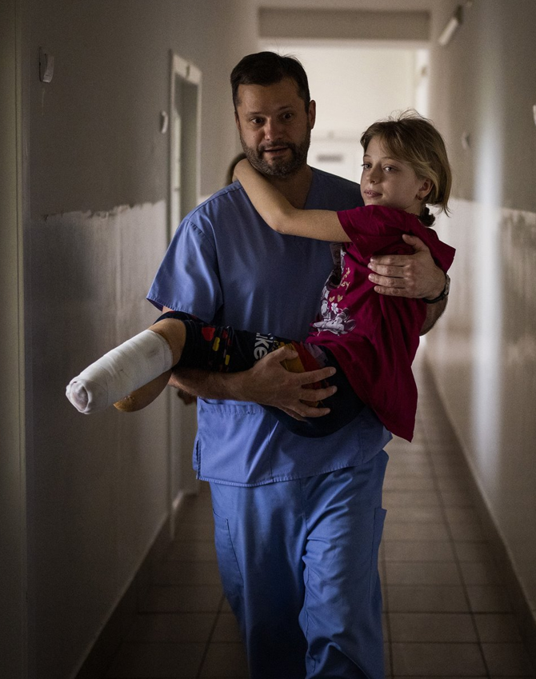
The photo that inspired Rotary's 3D-printed prosthetics project
This little girl lost both legs in an explosion at the train station, where people were trying to flee.

Slide 3
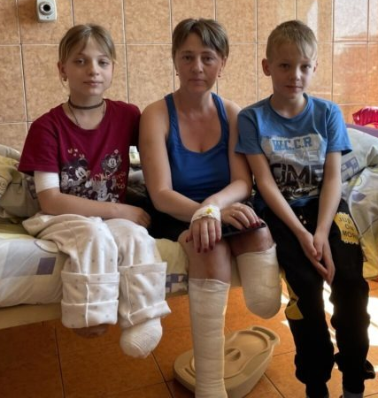
INNOCENT VICTIMS
The little boy is the family's helper since his father was killed in the war.
How soon might the girl and her mother be mobile again?

Slide 4
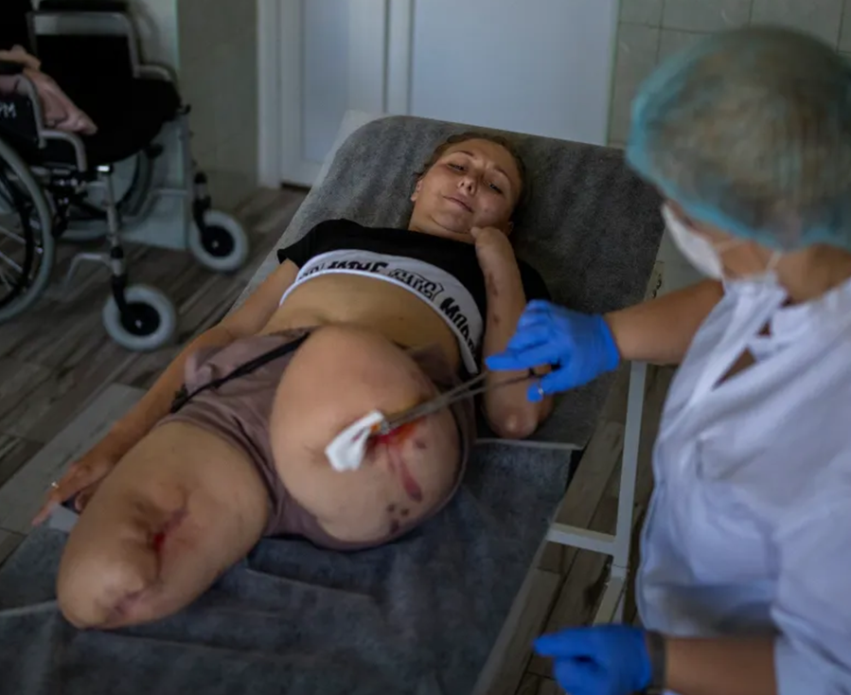
Landmine Explosion Victim
This woman was on the way to her mother’s birthday celebration when she stepped on a landmine and lost both her lower limbs.

Slide 5
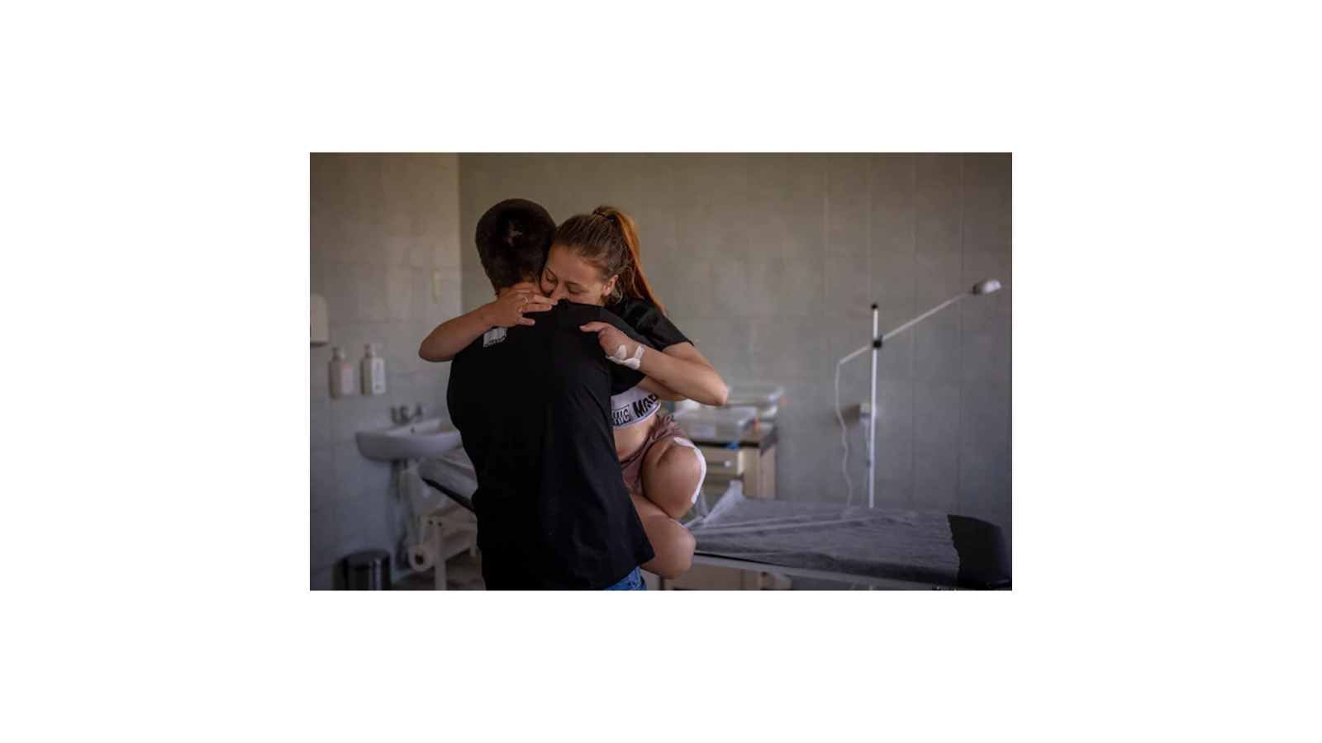
Being comforted by her Husband
Ukraine is the most heavily mined country in the world.
An estimated 2 million landmines have been scattered across the country, and demining will take decades.

Slide 6
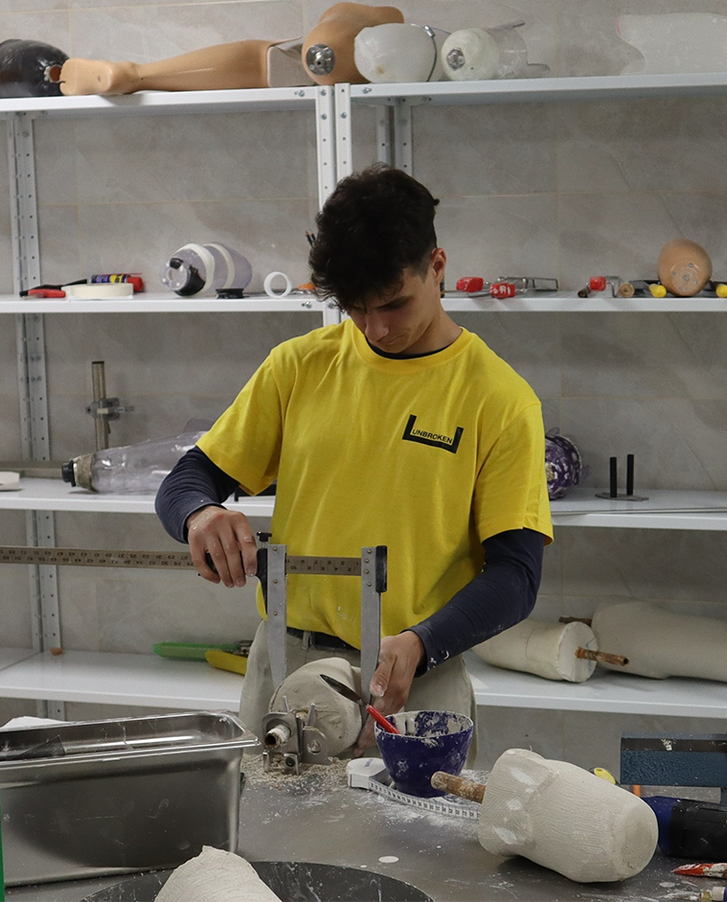
Plaster Cast Mold for Prosthetic Socket
Measuring the plaster mold
Plaster molds take days to dry
3D-printed prosthetics skip this step
Once learned, a prosthetic socket can be printed in 8 hours

Slide 7
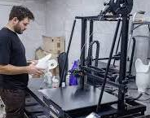
One of the two 3D printers donated by Canada to the Unbroken Rehabilitation Centre in Lviv, Ukraine.
3D-printed sockets.
Technicians undergo rigorous training.
It takes several months to achieve proficiency.

Slide 8
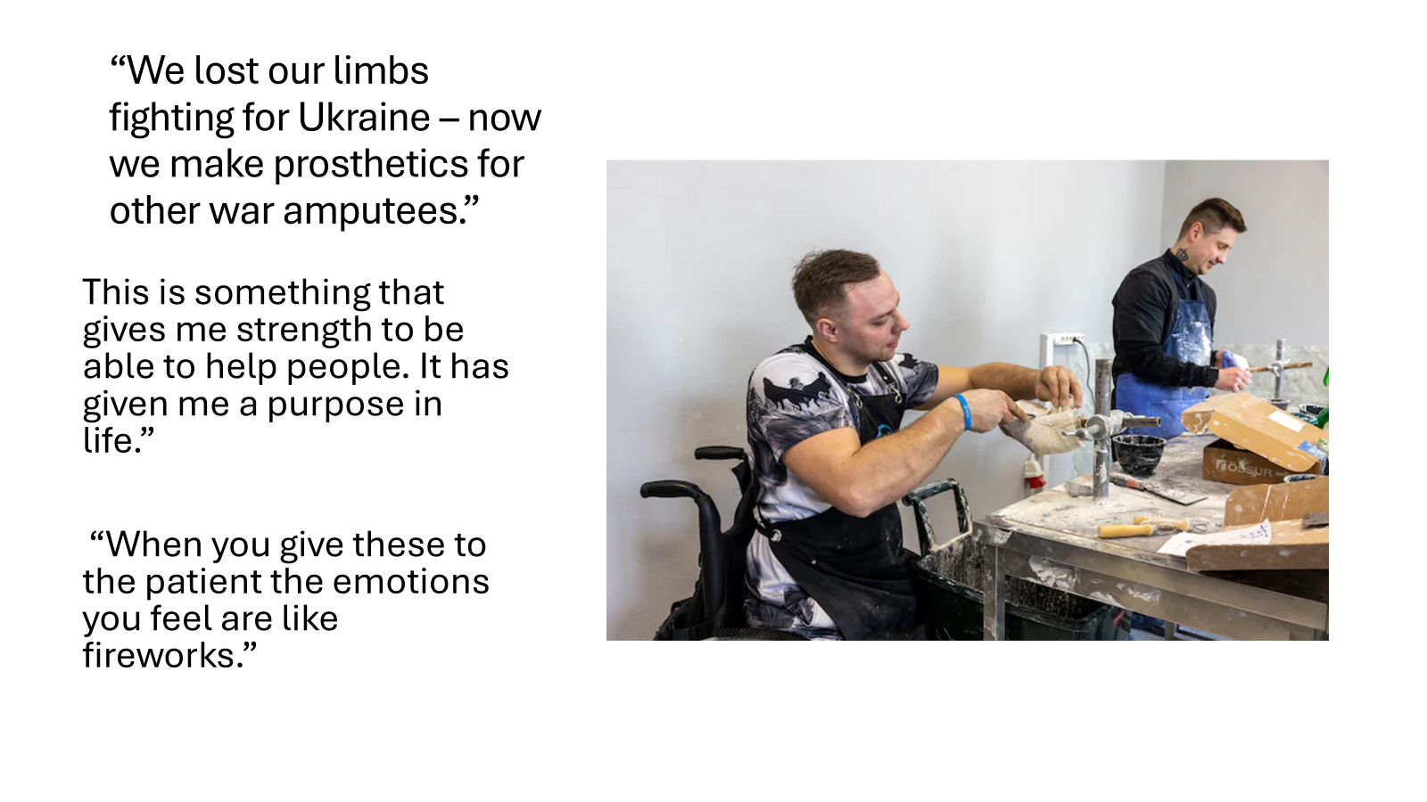
“We lost our limbs fighting for Ukraine – we now make prosthetics for other war amputees.”
“This is something that gives me strength to be able to help people. It has given me a purpose in life”
“When you give these to patients, the emotions you feel are like fireworks.”

Slide 9
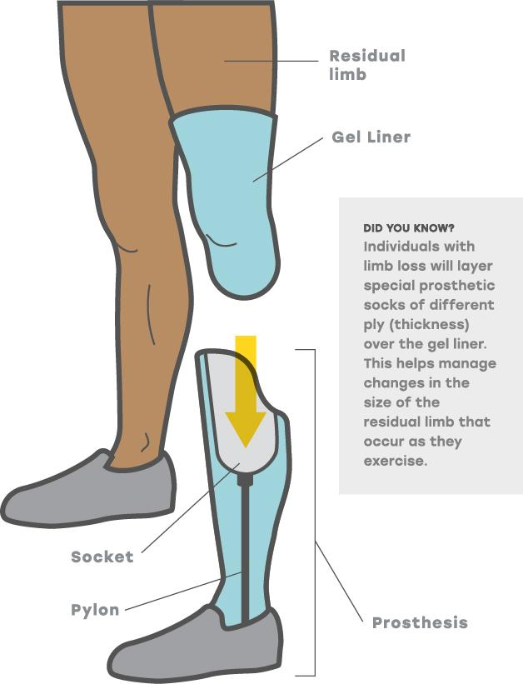

Slide 10
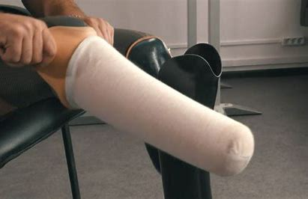

Slide 11
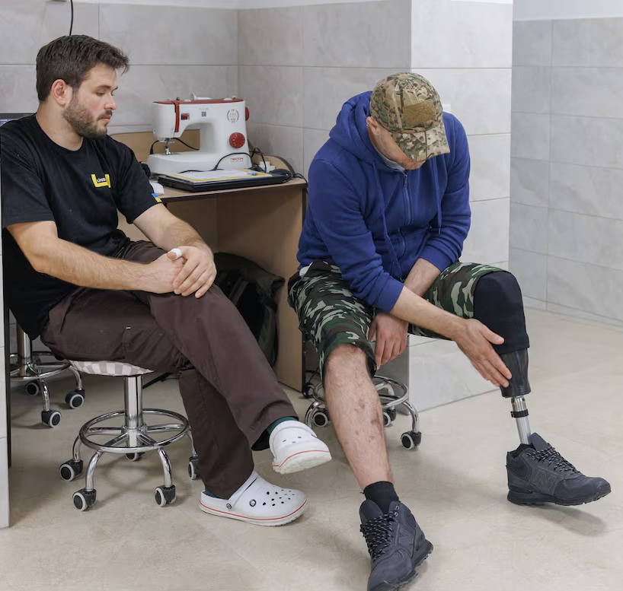
A crucial addition to the Unbroken site was two 3D printers purchased with donations from Canada’s Temerty Foundation.
The first soldier fitted with a prosthetic produced by a Canadian supplied 3D printer.

Slide 12
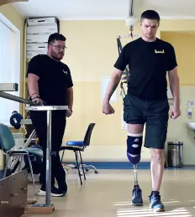
LEARNING
TO
WALK AGAIN
The sooner a prosthetic limb is provided, the quicker the patient can start rehabilitation.

Slide 13
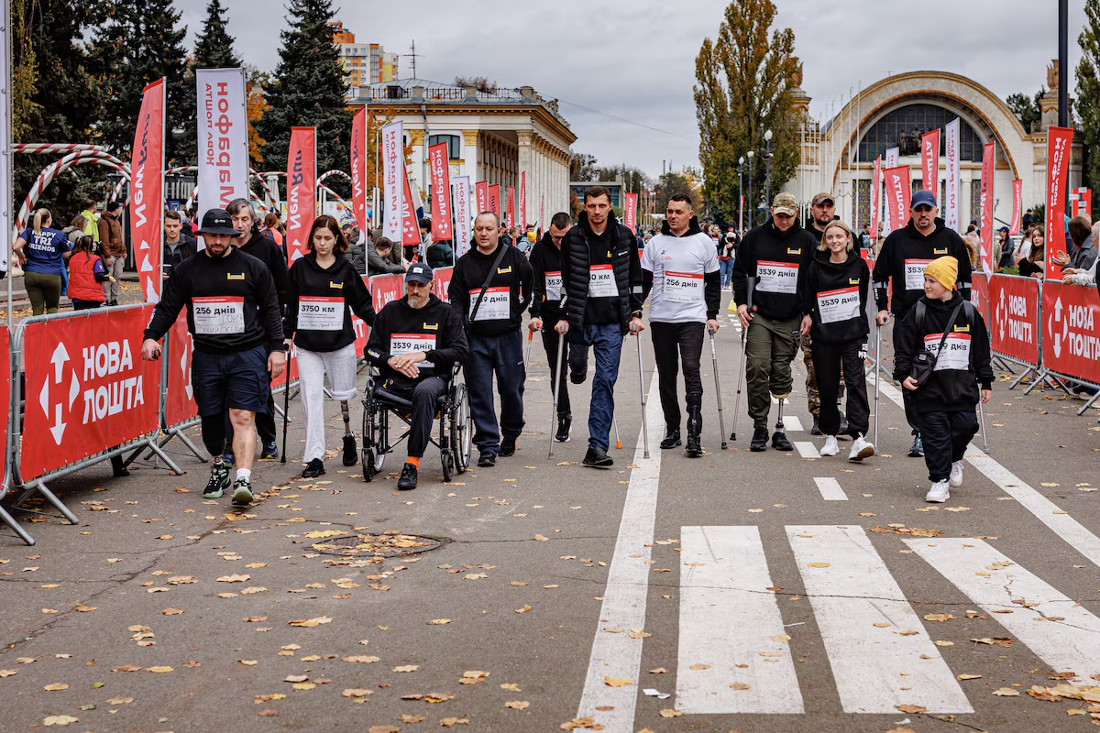
The World’s Longest Marathon in Kyiv
Veterans and civilians walked and ran using new Canadian funded prosthetics.

Slide 14
Be a part of the solution
We need to raise $125,000 USD
Together, we can help bring this life-changing solution to Ukraine.
To donate, please visit our website rotarytorontoeglinton@gmail.com

