Slide 1


Slide 2
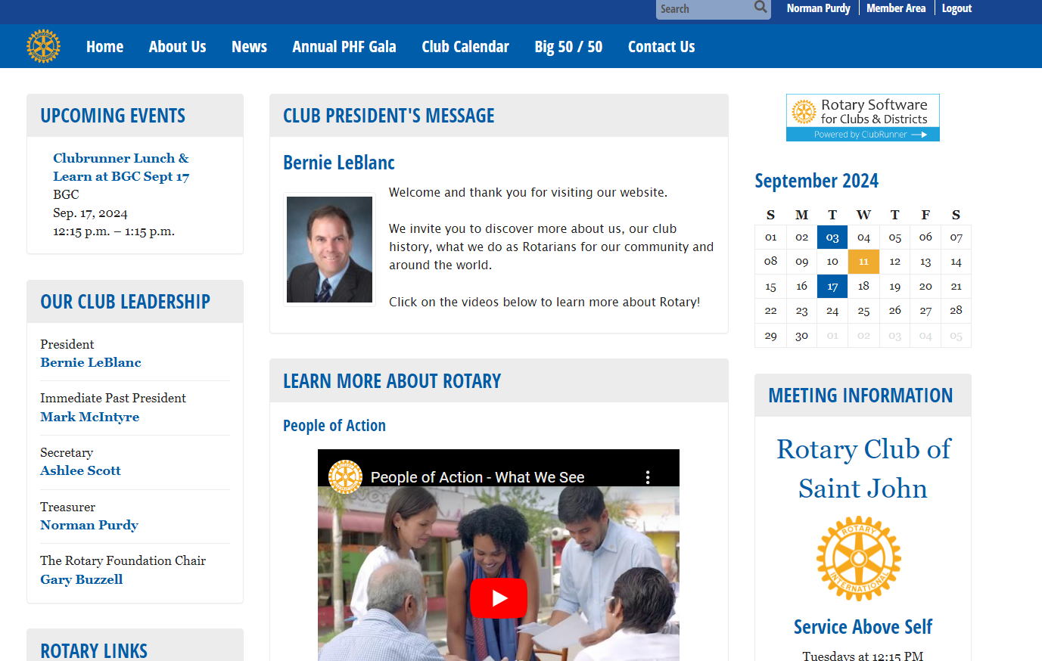
How to Use Clubrunner Effectively

Slide 3
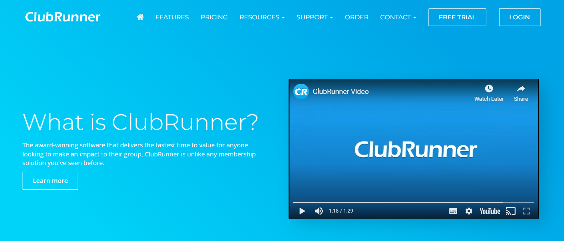
What is Clubrunner and What Can it Do?

Slide 4
What is Clubrunner and What Can it Do?
Today’s Agenda
Club website content overview
How to Log In to the member area
How to update your Profile
How to use Clubrunner Email Service
How to Set up Events and Speakers in Clubrunner
How to Update the Club Calendar
How to Link the Club Calendar to your personal or business Calendar
How to Learn more about Clubrunner functions

Slide 5
Clubrunner Basics for Members
Club website content overview

Slide 6
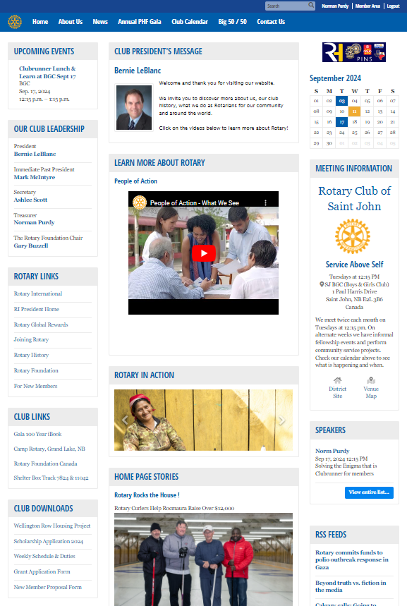
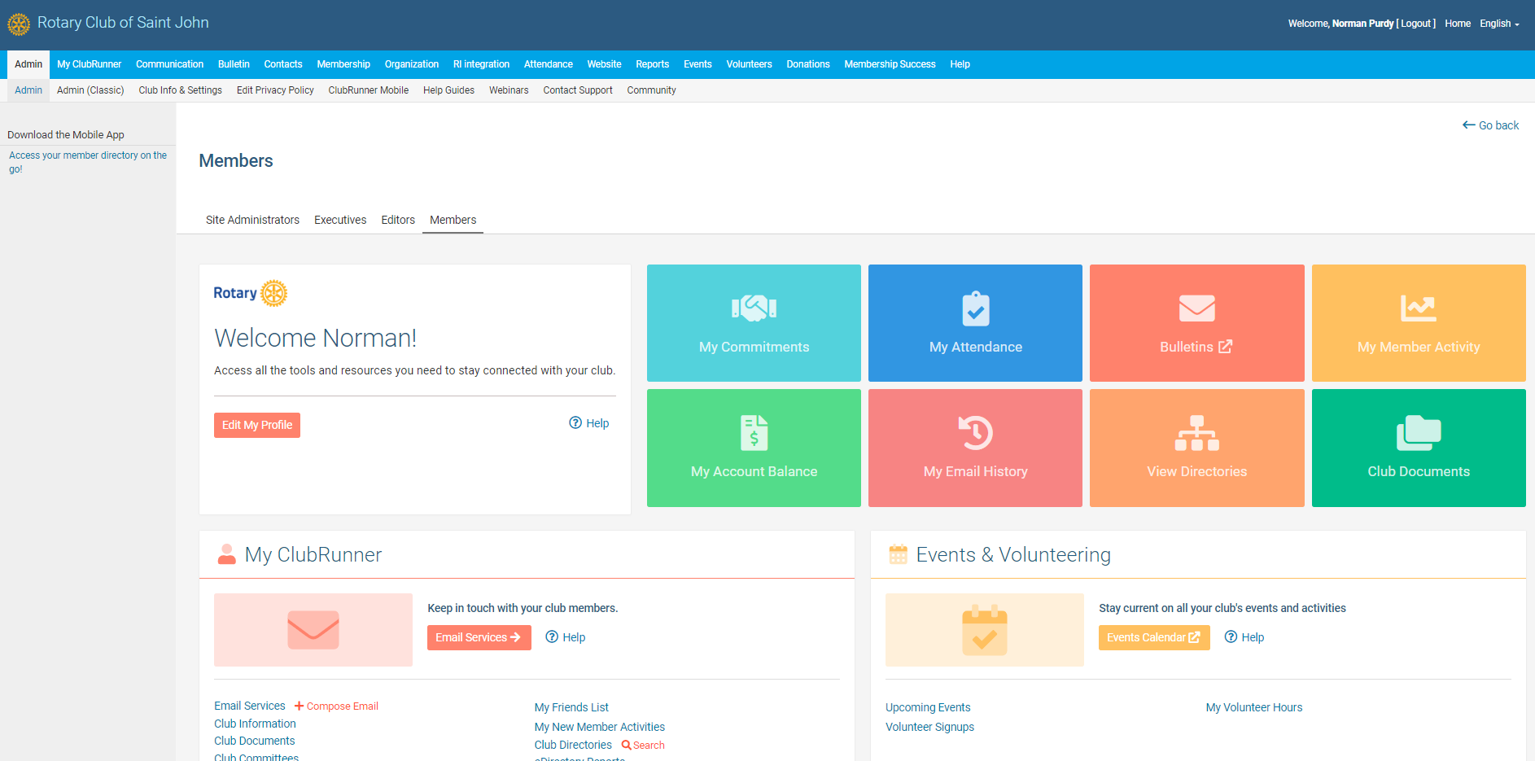
Clubrunner Basics for Members
Club website content overview : Public site / Member Features & Tools

Slide 7
Clubrunner Basics for Members
Club website content overview : Public site / Member Features & Tools
Public Information about the club
-CALENDAR
LEADERSHIP
LINKS
DOWNLOADS
NEWS
CONTACT LINK
MEETING INFORMATION
ROTARY RSS FEEDS

Slide 8
Clubrunner Basics for Members
Club website content overview : Public site / Member Features & Tools
Member Area view depends on role in the club – member is most basic
Note top navigation bar for basic and enhanced functions
Most used
- EMAIL
- EVENTS
- WEBSITE

Slide 9
Clubrunner Basics for Members
How to Log In to the member area

Slide 10
Clubrunner Basics for Members
How to Log In to the member area
A . Navigate to Home Page … www.sjrotary.ca
B. Click on Member Area in top right of page

Slide 11
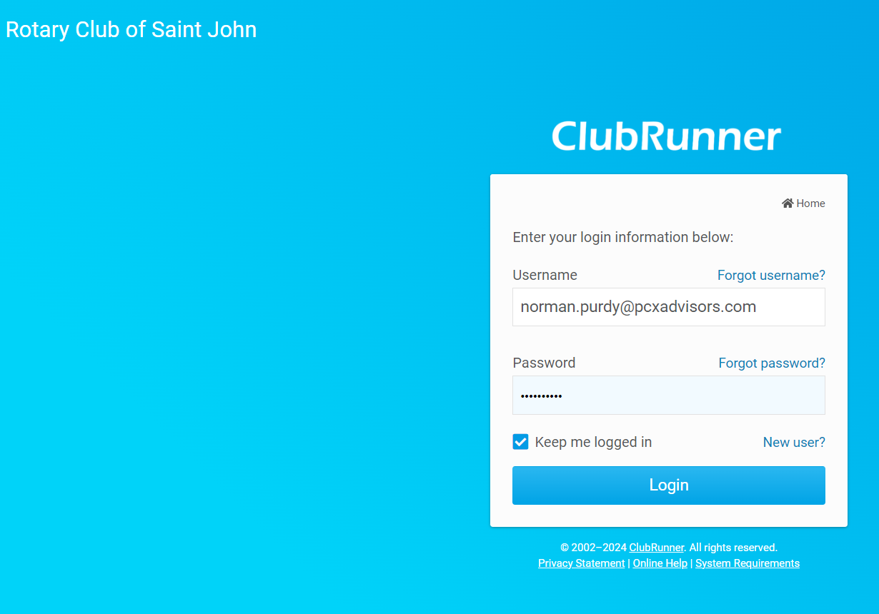
Clubrunner Basics for Members
How to Log In to the member area
A . Navigate to Home Page … www.sjrotary.ca
B. Click on Member Area in top right of page
Username: The primary email address in your profile
Password: A unique password that was assigned originally when you were set up as a new member.
Use forgot username and forgot password if you cannot remember
You will be sent information to help you login - then you can reset your password.
NOTE: your username and password are the same for all Rotary International sites ( Rotary Club Central & My Rotary)

Slide 12
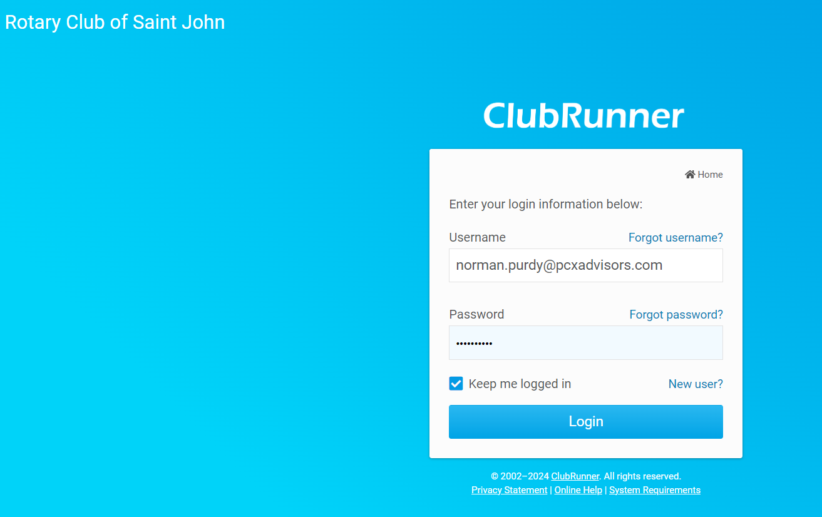
Clubrunner Basics for Members
How to Log In to the member area
A . Navigate to Home Page … www.sjrotary.ca
B. Click on Member Area in top right of page
Tips & Tricks:
Click the KEEP ME LOGGED IN box

Slide 13
Clubrunner Basics for Members
How to update your Profile

Slide 14
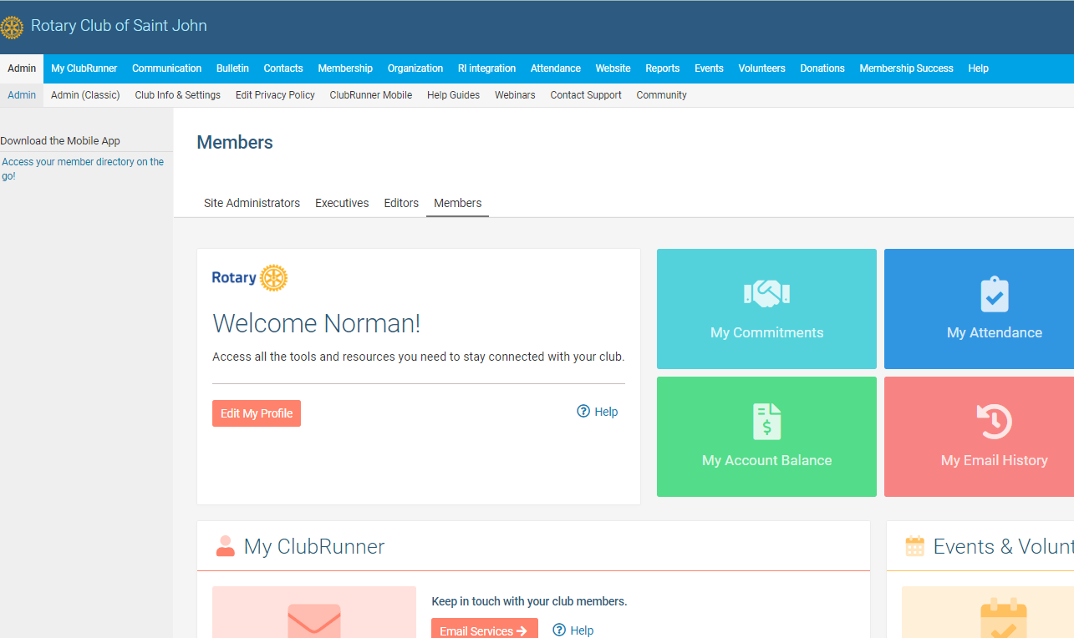
Clubrunner Basics for Members
How to update your Profile
Once in the member area
MEMBERS :
Click on the EDIT MY PROFILE button

Slide 15
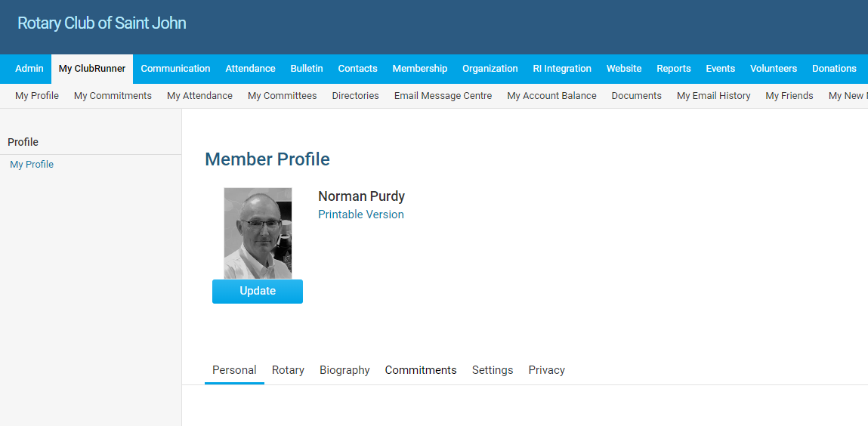
Clubrunner Basics for Members
How to update your Profile
Once in the member area :
ADMINS/EDITORS/DIRECTORS:
Click on MY CLUBRUNNER in the menu bar
then MY PROFILE in the sub menu bar

Slide 16
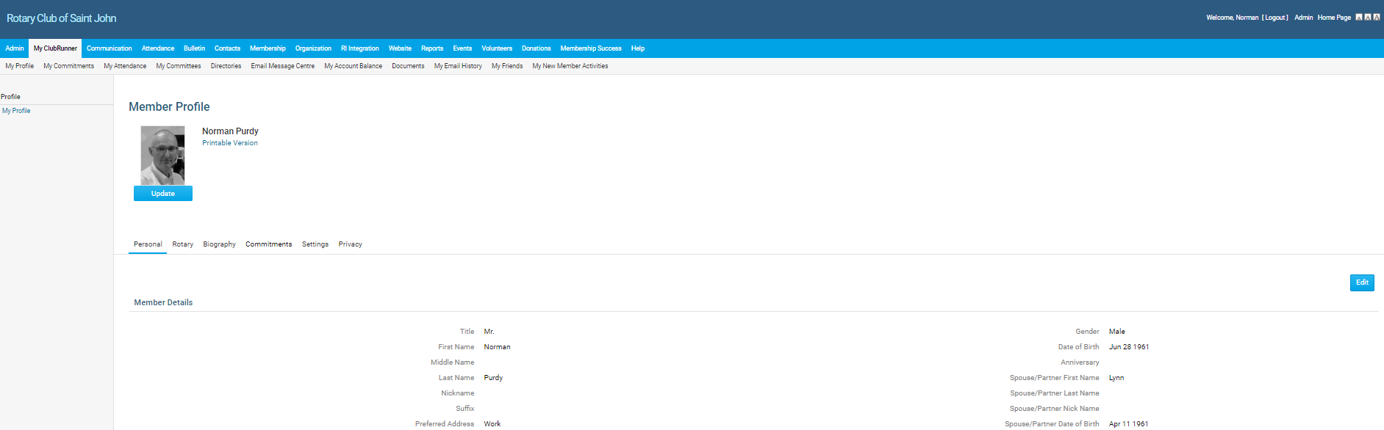

Clubrunner Basics for Members
How to update your Profile
Simply Click on EDIT button , enter the changes, and when complete, click on SAVE button

Slide 17
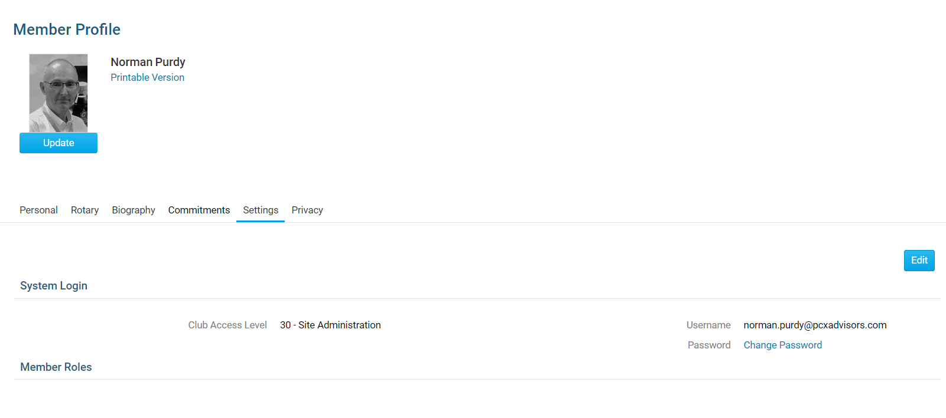
Clubrunner Basics for Members
How to update your Profile
To Change Password (note : You will need old password)

Slide 18
Clubrunner Basics for Members
How to use Clubrunner Email Service

Slide 19
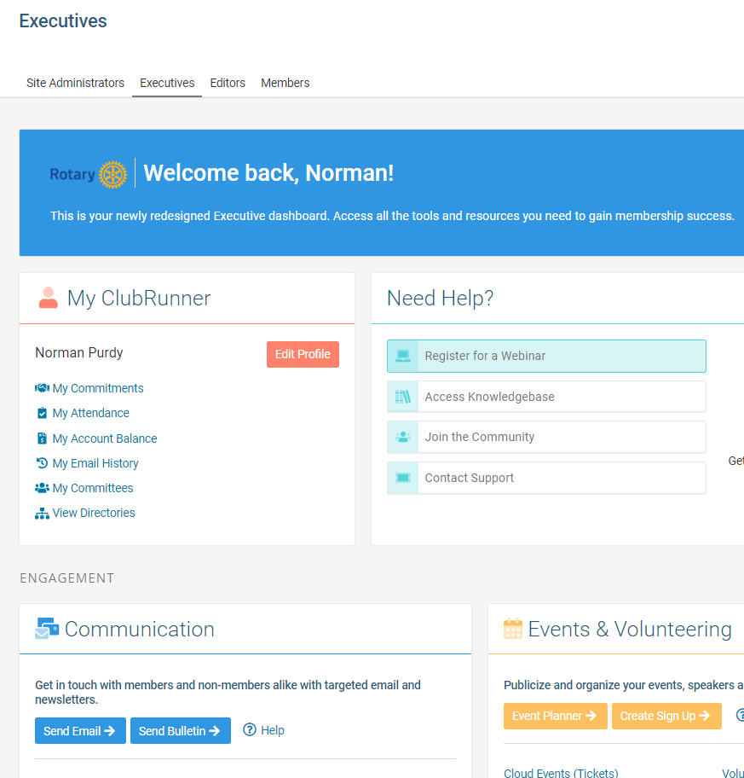
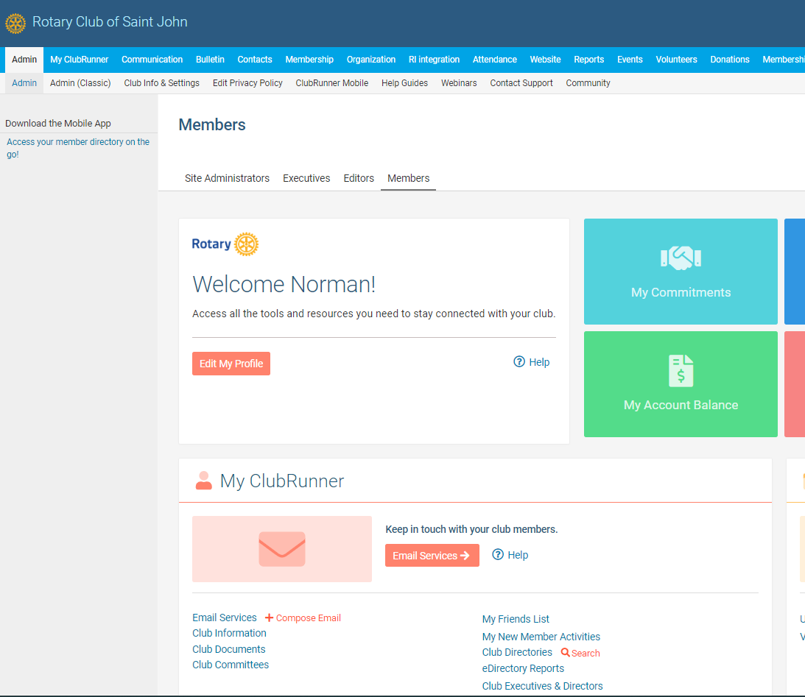
Clubrunner Basics for Members
How to use Clubrunner Email Service - OPEN THE EMAIL MENU
For Members:
For ADMINS/EDITORS/DIRECTORS:

Slide 20
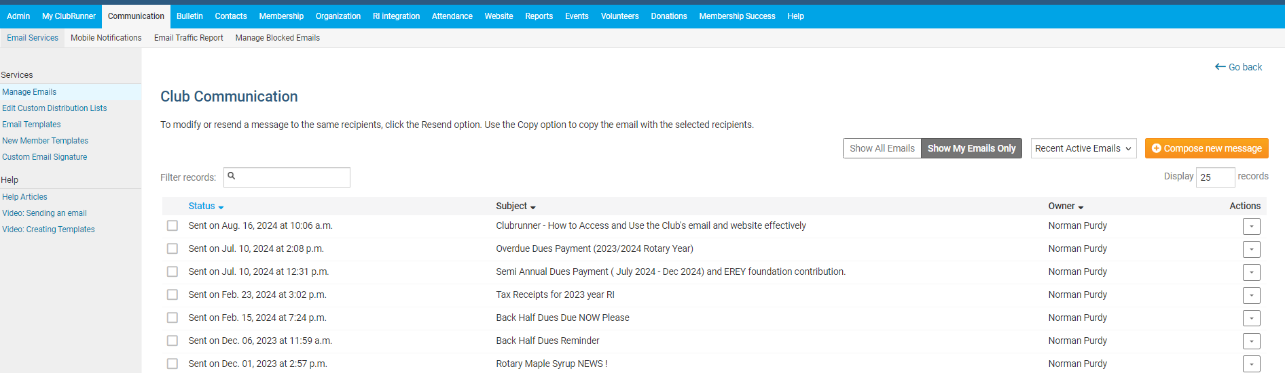
Clubrunner Basics for Members
How to use Clubrunner Email Service
TO COMPOSE AN EMAIL

Slide 21
Clubrunner Basics for Members
How to use Clubrunner Email Service
TO COMPOSE AN EMAIL

Slide 22
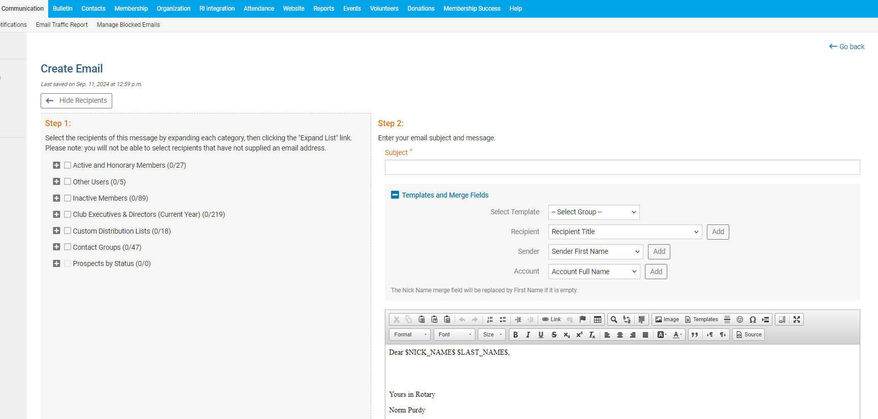
Clubrunner Basics for Members
How to use Clubrunner Email Service
1ST – SELECT RECIPIENTS

Slide 23
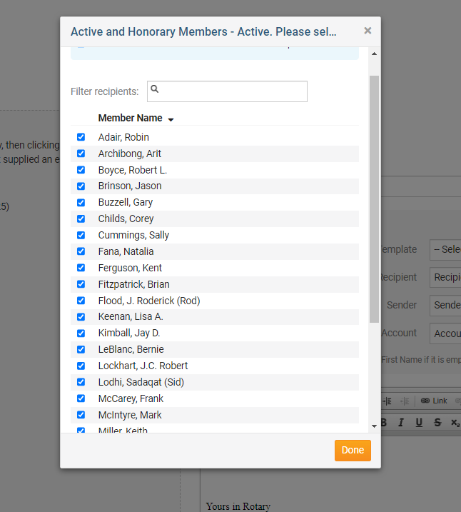
Clubrunner Basics for Members
How to use Clubrunner Email Service
1ST – SELECT RECIPIENTS USE “EXPAND” TO SELECT SPECIFIC PEOPLE TO RECEIVE MESSAGE – OR CHECK A BOX TO SEND EMAIL TO EVERYONE IN THAT BOX

Slide 24
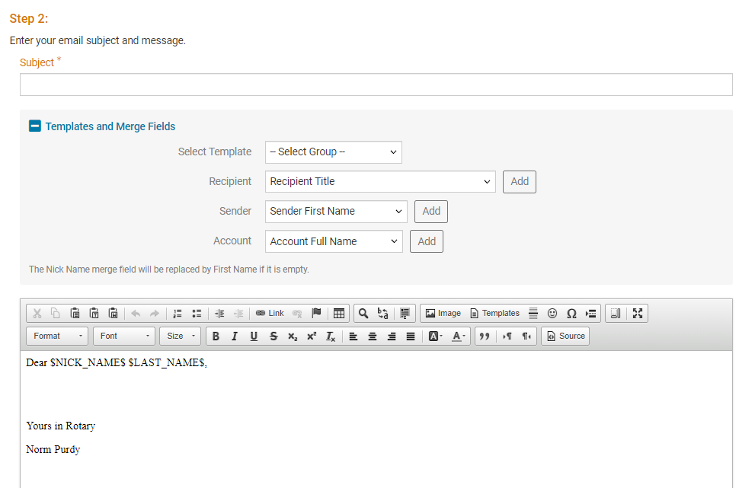
Clubrunner Basics for Members
How to use Clubrunner Email Service
2nd Compose Message
Enter subject line
You can use template / merge fields but this is not required. Just delete in the body of the email message.
Enter signature line

Slide 25
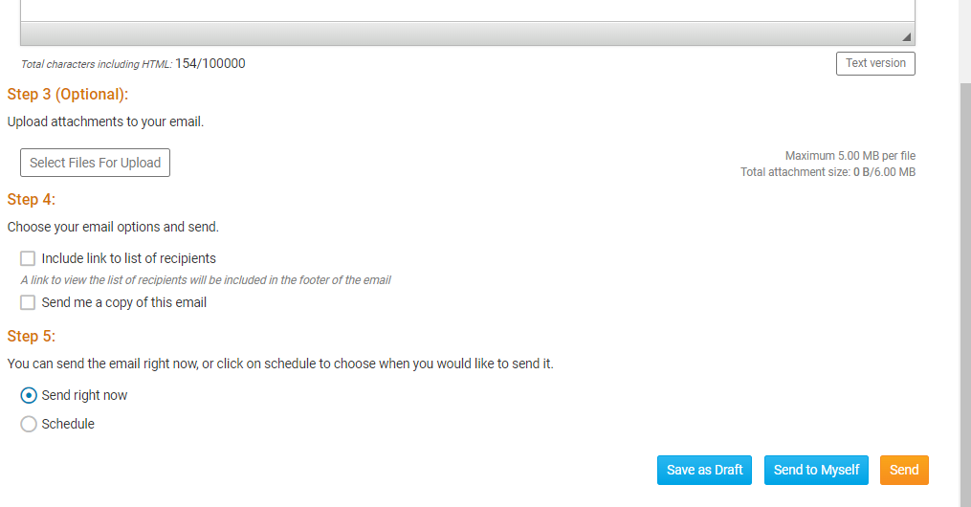
Clubrunner Basics for Members
How to use Clubrunner Email Service
3rd – upload optional attachments
4th – select
options
5th – send now or later
SEND

Slide 26
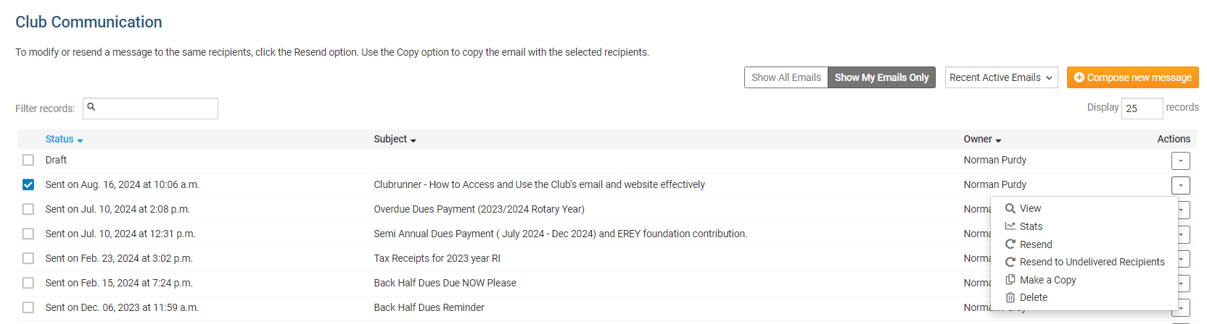
Clubrunner Basics for Members
How to use Clubrunner Email Service
TIPS AND TRICKS - To see who opened and read your email
Select a sent email and then click on Actions (select STATS from drop down menu )

Slide 27
Clubrunner Basics for Members
How to Set up Events and Speakers in Clubrunner

Slide 28
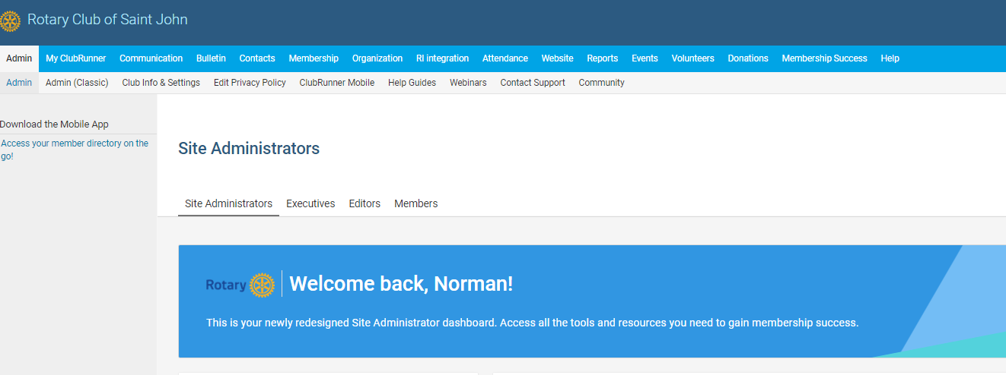
Clubrunner Basics for Members
How to Set up Events and Speakers in Clubrunner
NOTE : YOU MUST HAVE EDITOR/EXECUTIVE OR ADMIN STATUS TO CREATE EVENTS
Select EVENTS in the menu bar

Slide 29
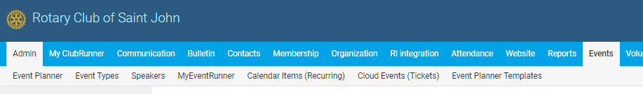
Clubrunner Basics for Members
How to Set up Events and Speakers in Clubrunner
Select EVENTS in the menu bar
Choose the type of event – EVENT, or SPEAKER, or CALENDER ITEM

Slide 30
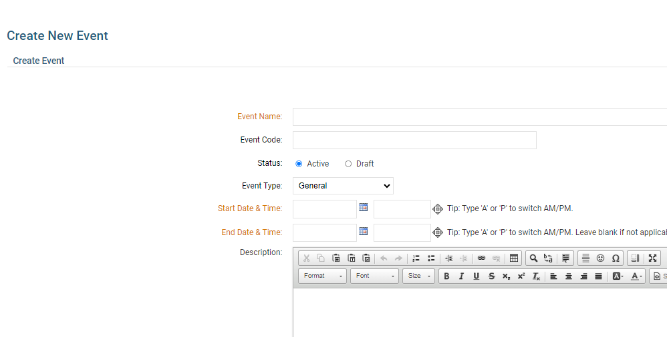
Clubrunner Basics for Members
Fill in details for the event

Slide 31
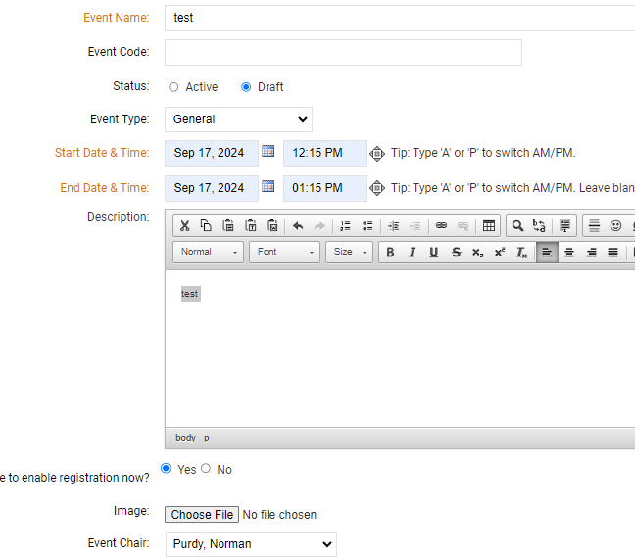
Clubrunner Basics for Members
Enable Registration to Collect responses and enter Chair Details ( to whom responses will be sent)

Slide 32
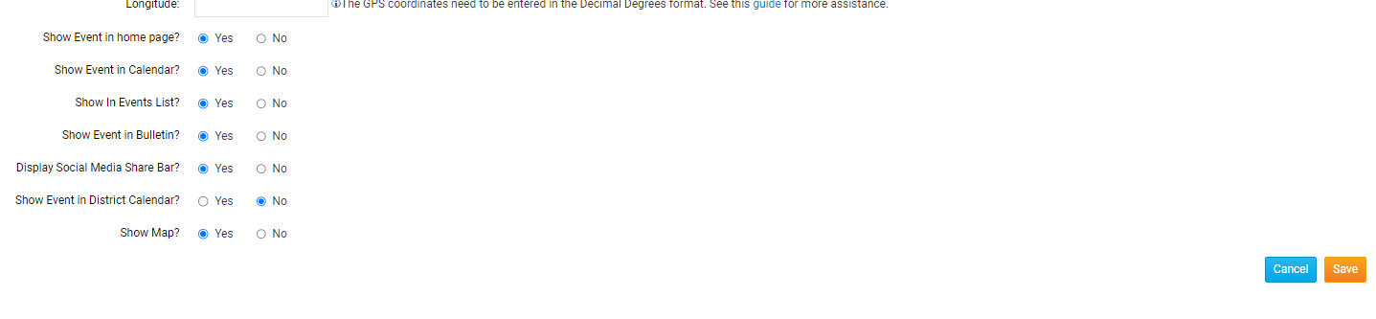
Clubrunner Basics for Members
Select options to make the event visible in Club Calendar and SAVE when done

Slide 33
Clubrunner Basics for Members
How to Update the Club Calendar

Slide 34
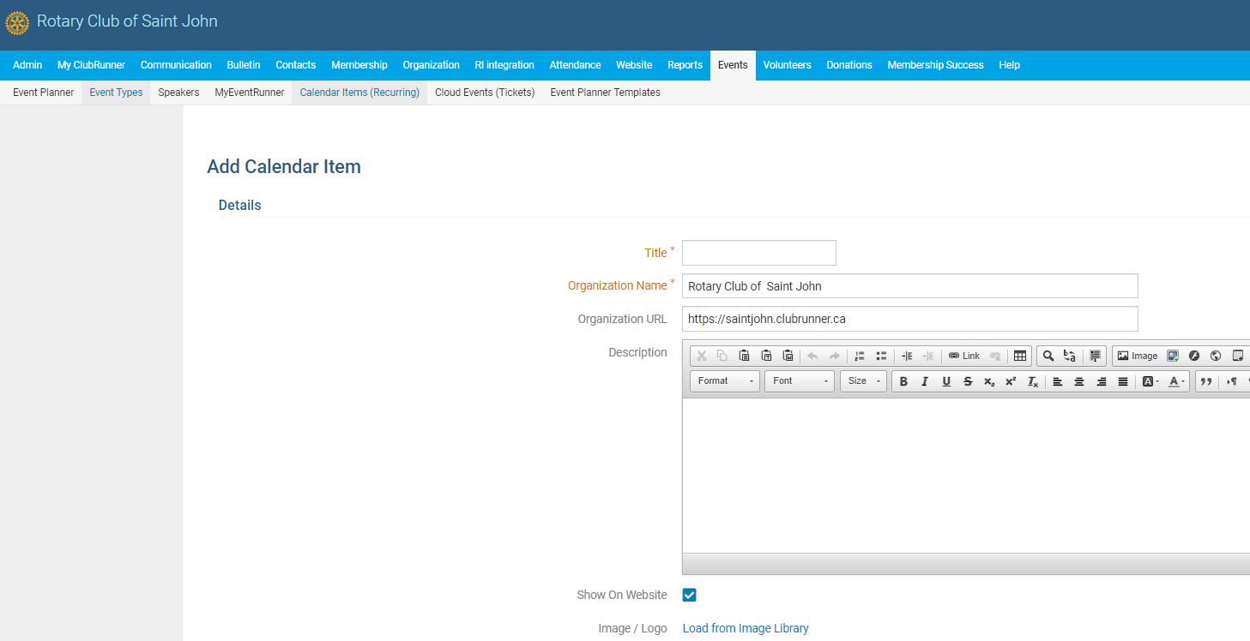
Clubrunner Basics for Members
How to Update the Club Calendar
Select Events in the Admin Bar menu
Select Calendar
Items (Recurring) from SubMenu
Exactly the same as adding an event – but no registration option.
You can make it a one time or a recurring event

Slide 35
Clubrunner Basics for Members
How to Link the Club Calendar to your
personal or business Calendar

Slide 36
Clubrunner Basics for Members
How to Link the Club Calendar to your personal or business Calendar (google/outlook/apple)
Go to HOME PAGE (NOT Member Area) and select CLUB CALENDAR on menu bar

Slide 37
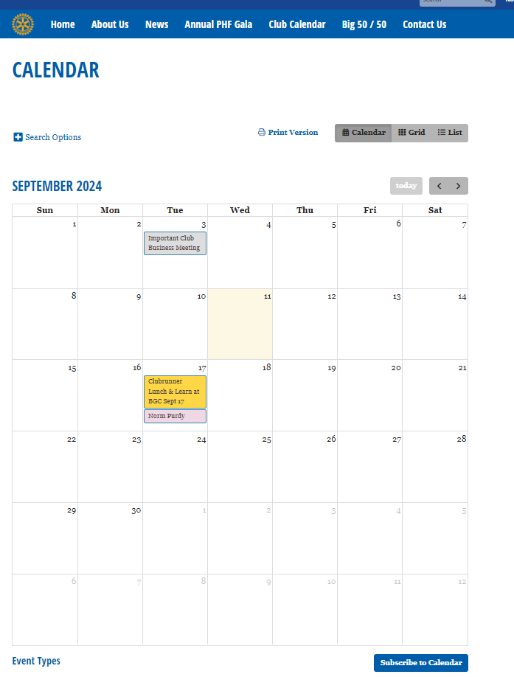
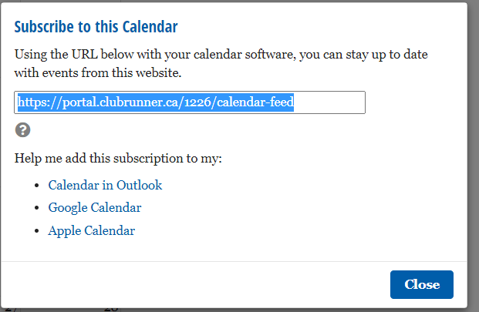
How to Use Clubrunner Effectively
How to Link the Club Calendar to your personal or business Calendar (google/outlook/apple)
Click on
SUBSCRIBE
TO
CALENDAR
BOX at bottom of page

Slide 38
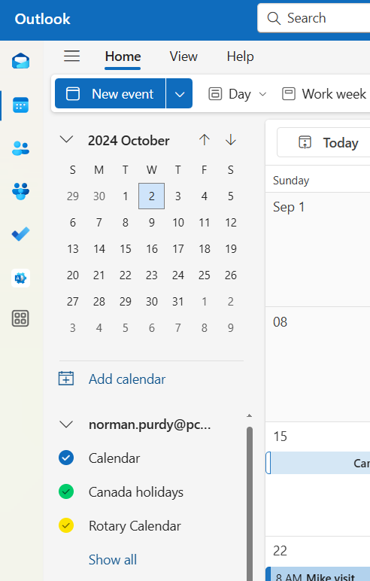
How to Use Clubrunner Effectively
How to Link the Club Calendar to your personal or business Calendar
OUTLOOK 365
Open Outlook
Select Calendr View
Select Home
Scroll down to Add Calendar

Slide 39
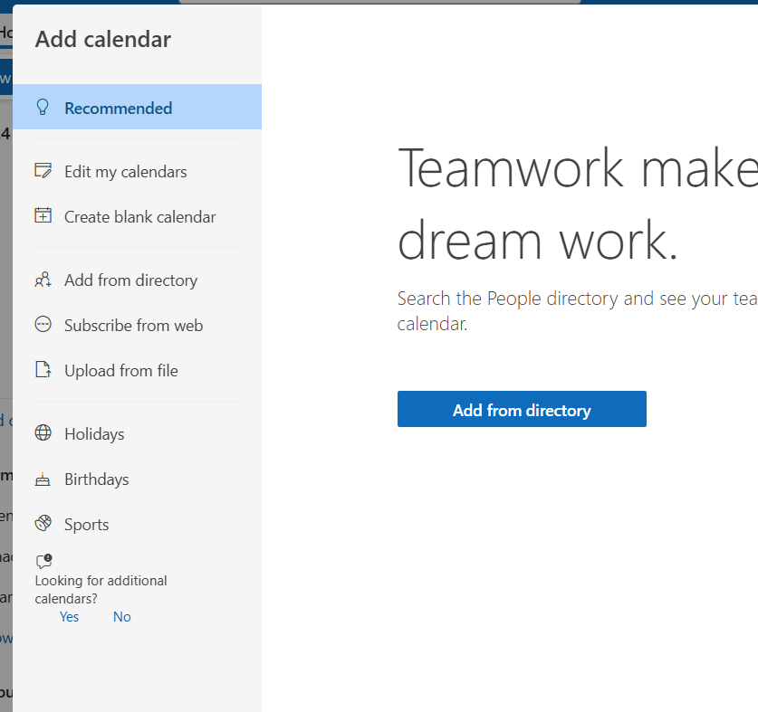
How to Use Clubrunner Effectively
How to Link the Club Calendar to your personal or business Calendar
OUTLOOK 365
Select Subcribe from web

Slide 40
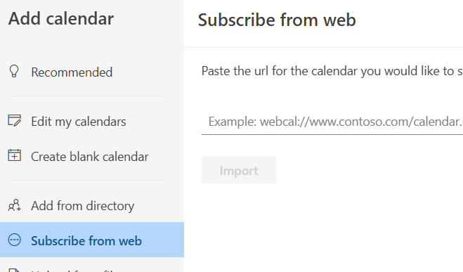
How to Use Clubrunner Effectively
How to Link the Club Calendar to your personal or business Calendar
Then paste the link from the Club website (from Club Calendar page)
Select IMPORT

Slide 41
Clubrunner Basics for Members
How to Learn more about Clubrunner functions

Slide 42
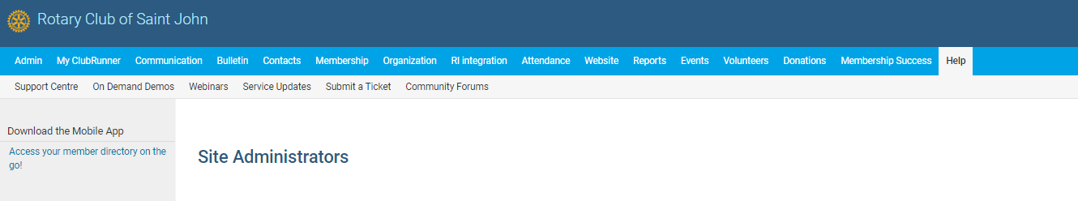
Clubrunner Basics for Members
How to Learn more about Clubrunner functions
There are helpful webinars and Q&A forums for almost any topic
Select Help in the Admin menu bar and Support Centre

Slide 43
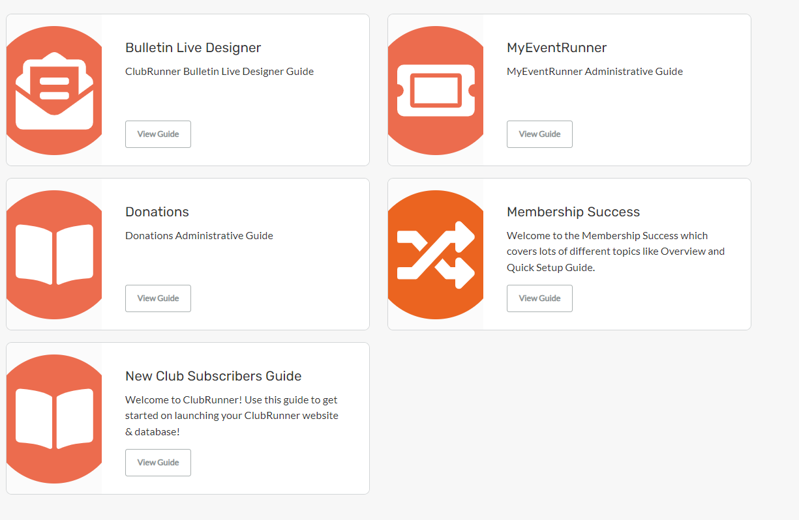
Clubrunner Basics for Members
Guides
Webinars
Website Design Help
Mobile App Help

Slide 44
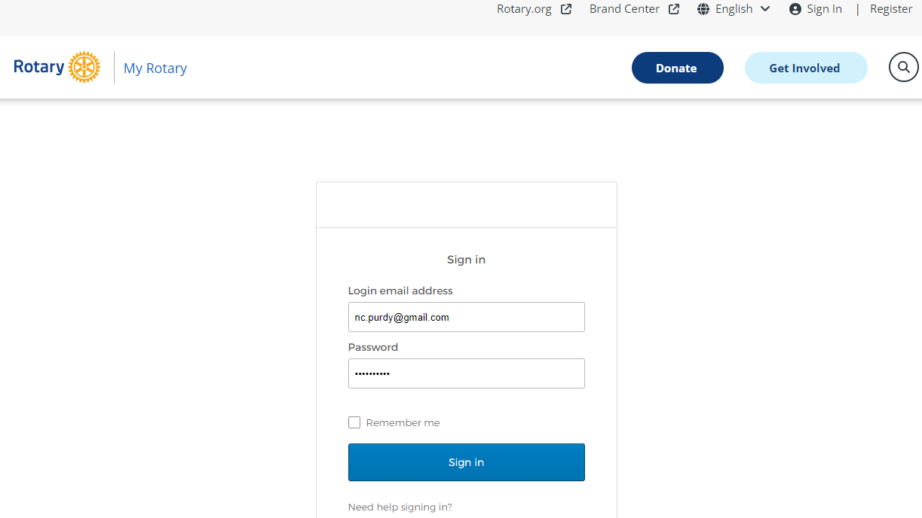
My Rotary linkage

