Slide 1



Slide 2

Club Vison:
Complete Wellness in Our Community

Slide 3
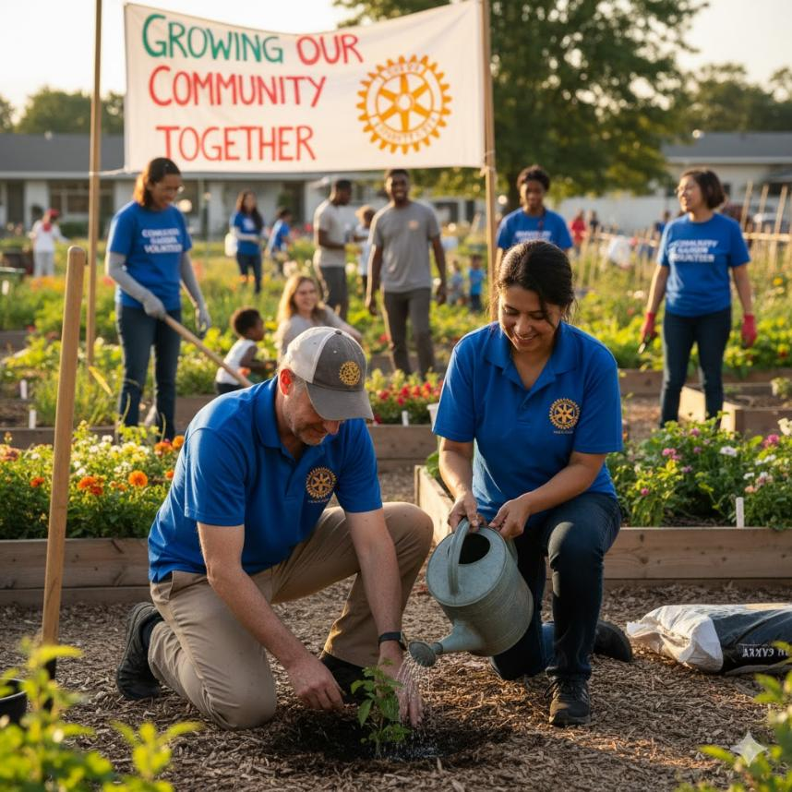
The Object of Rotary
To encourage and foster :
The ideal of service as a basis of worthy enterprise
The development of acquaintance as an opportunity for service
High ethical standards in business and professions,
The application of the ideal of service of each Rotarian's personal
business, and community life
The advancement of international understanding, goodwill, and peace

Slide 4
Our Club At a Glance
26 Active Members
2 Honorary Members
28 Members
7 Retired members
3 New members ( less than 2 years)
Average Years Membership in Rotary…..16.2 years ( not incl’ honorary members)
Average Meeting Attendance ……. 9-11 members ( about 30- 35%)

Slide 5
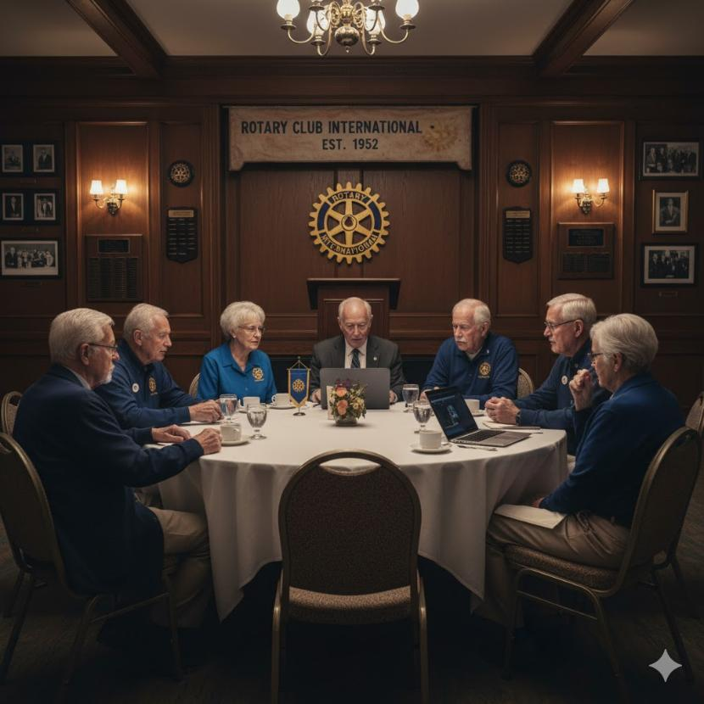
Our Club is Aging
Rotary has always been and continues to be a club for professional business people
40% of our membership is either retired or semi retired
The Rotary Club of Saint John is over 100 years old and has survived by attracting and retaining professional people who believe in the object of Rotary and want to give back to the community.
We must attract and retain new members to keep the club viable

Slide 6
Do You Agree ?

Slide 7
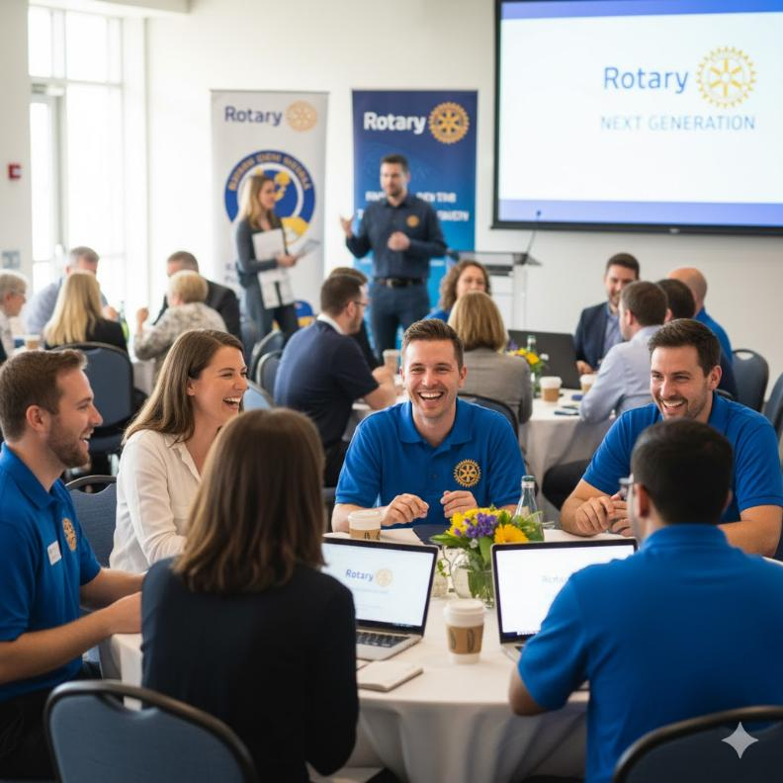
How Can we Attract and Retain New Members?

Slide 8

Attract & Retain New Members
Identify who (what types of people) we want to attract .
People who can control their schedule (can make time to attend meetings)
People with contacts and networks do help raise money for club projects
People willing to donate time and energy to club activities, community service projects
People of integrity and high moral standards
People with the potential to serve and take on leadership roles in the club

Slide 9
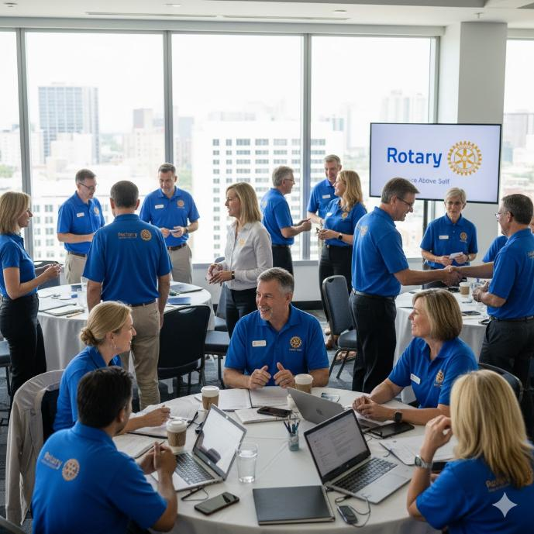
Attract & Retain New Members
Understand what Motivates these people
A desire to build their professional network (perhaps for purely short-term business development purposes but often for longer term connections)
A desire to give back to the community
A desire to expand and deepen their social networks and meet new people.

Slide 10
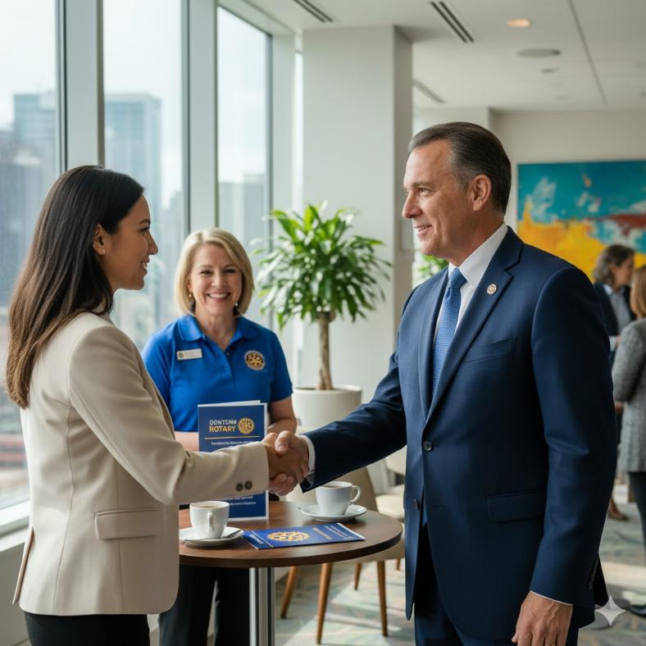
Attract & Retain New Members
3. Recruit new Members
Referrals
Advertising
Personal Appeals to Businesses
BUT……. There is a real risk that we may not be able meet expectations of new members
Will we help them expand their networks?
Will we help them meet like minded business professionals?
Will we offer them the opportunity to give back / serve / meet new people for social activities ?

Slide 11
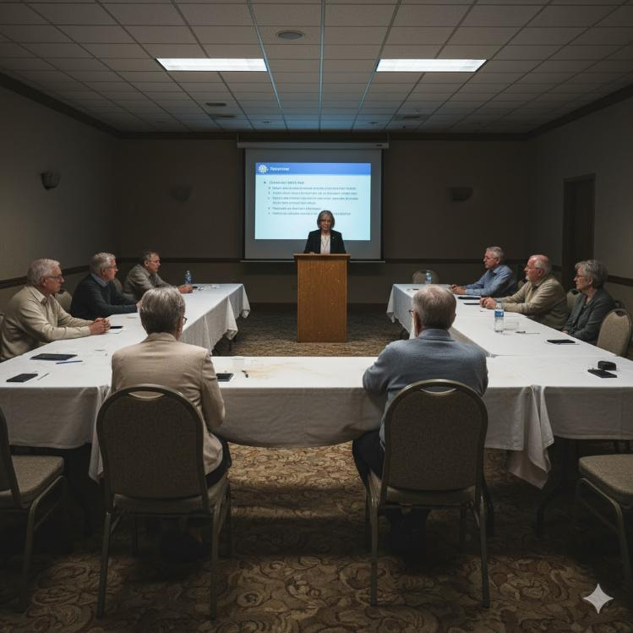
Attract & Retain New Members
RISK:
Imagine a new member’s experience :
They research learn about Rotary on line and are impressed with all the things Rotary has to offer.
They meet with the Club president and board members and learn about what out Club is all about.
They come to a club meeting – where there are 4 retired members and 5 active members.
And then…….????

Slide 12
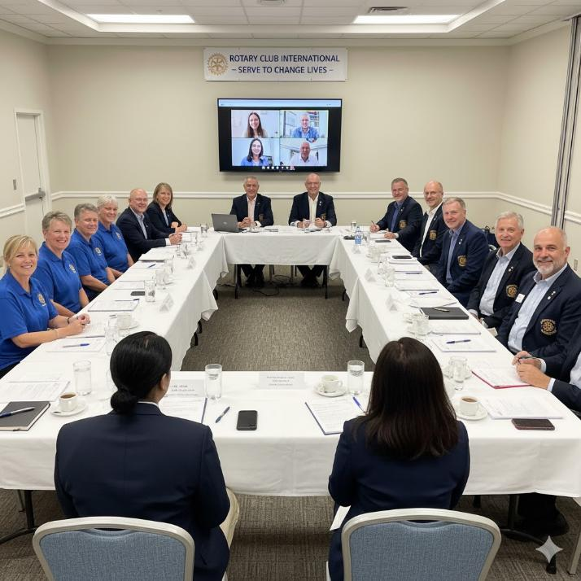
Attract & Retain New Members
4 . Intentionally and actively engage new members to retain them
How?
The most important thing active members can do attract and retain new members is to simply ….
Show Up at Meetings
To acknowledge new members and make them feel as though they have the opportunity to meet more that just the retired members – because that is why they joined. Strong attendance build confidence.
Because if the meetings are poorly attended what does that indicate to a new member?

Slide 13
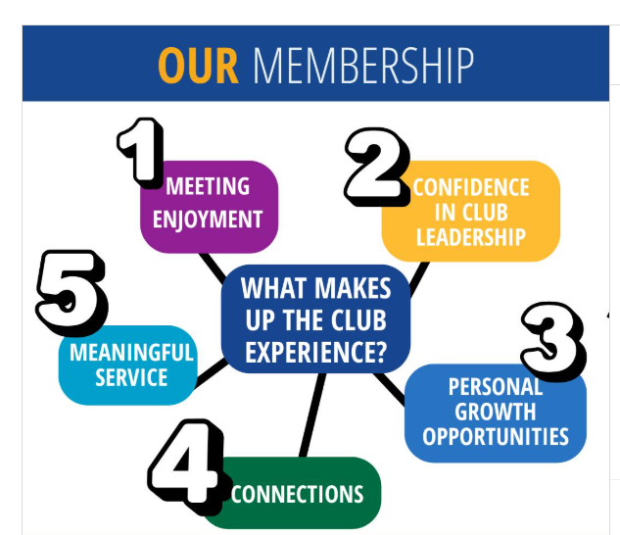
Our Club Leadership Commitment:
Better Meetings
More Fellowship Events
More Opportunities to Serve
Our Ask of Members:
Attend Meetings (on line and inperson)
Get Involved Again
Help Identify Prospective new Members

Slide 14

New Member Development Process
Attracting , engaging and retaining new Members takes work.
When we want to raise $60,000 for Rotary, we come together, we form a Gala Team, we set goals, we assign responsibilities, we have regular meetings to review progress. We take action and we succeed because it is important to us.
Is membership growth important to us ?

Slide 15
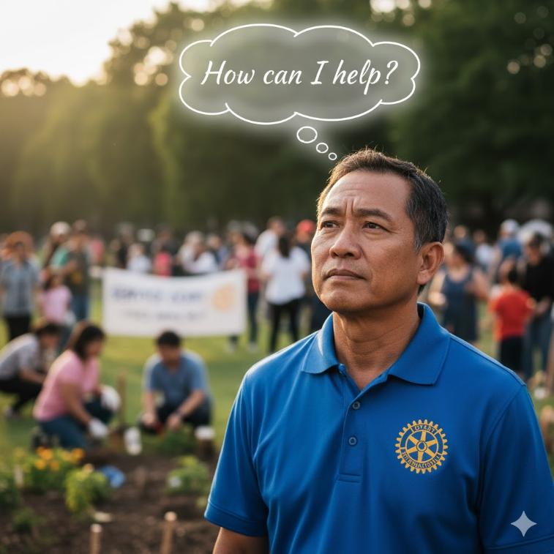
How You Can Help…
Come to club meetings.
Identify Prospective Members
Serve as Mentor/Sponsor for a new member
Serve on Membership the Development Team
Attend Prospect Meet & Greets
Participate in New Member Orientation Sessions

Slide 16
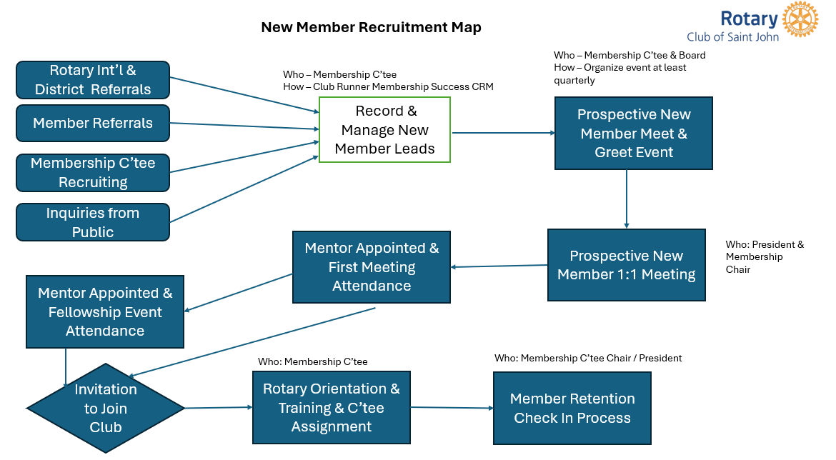
New Member Development Process
The Following Slides are the detailed steps / roles and responsibilities of Rotarians who are willing to serve as mentors and coordinators on the New Membership Development Team

Slide 17

New Member Recruitment Map
Who – Membership C’tee & Board
How – Organize event at least quarterly
Rotary Int’l & District Referrals
Who – Membership C’tee
How – Club Runner Membership Success CRM
Member Referrals
Record & Manage New Member Leads
Prospective New Member Meet & Greet Event
Membership C’tee Recruiting
Inquiries from Public
Mentor Appointed & First Meeting Attendance
Prospective New Member 1:1 Meeting
Who: President & Membership Chair
Mentor Appointed & Fellowship Event Attendance
Who: Membership C’tee
Who: Membership C’tee Chair / President
Invitation to Join Club
Rotary Orientation & Training & C’tee Assignment
Member Retention Check In Process

Slide 18
Process: Identify and Recruit New Prospects ( Leads)
Owner : Chair of Membership Development C’tee
Tools: Clubrunner Membership Success tab (includes tracking database and email templates), RI rereferral process,
Process Steps
Develop/Update Ideal New Member Criteria Profile document
Identify potential new leads by:
      Vocational gap analysis
      Member referral campaign
      RI/District Referrals
      Corporate Identification process
      Advertising/Promotion campaign
3. Rank lead attractiveness
FREQUENCY : at least monthly

Slide 19
Process: Record and Manage Leads
Owner : Chair of Membership Development C’tee
Tools: Clubrunner Membership Success tab (includes tracking database and email templates)
Process Steps
Receive Leads and Enter into Clubrunner Membership Success as Newl Prospects.
Respond to Lead requesting information and gauging interest. Enter data in Clubrunner.
Review responses and promote/transfer New Leads to Potential Prospects
Manage Potential Prospects in clubrunner as they proceed through the recruitment process.
Create ad hoc reports to update board on membership development progress.
FREQUENCY : at least weekly

Slide 20
Process: Organize and Manage Meet & Greet Event
Owner : Chair of Membership Development C’tee
Involved: Membership Development C’tee, President, Board Members, Sponsor/Mentor
Resources: RI Videos / Club Presentation / Club Website
Process Steps
Design/ Develop/Update Rotary Overview Presentation
Secure Budget allocation from Board
Select Date/Time & Venue
Invite Prospects and key members with RSVP invitation – follow up with reminders
Hold Event
Followup with 48 hrs with email to gauge level of interest
FREQUENCY : at least Quarterly

Slide 21
Process: Prospective New Member 1:1 Meeting
Owner : Chair of Membership Development C’tee
Involved: President, Past President, Sponsor/Mentor
Resources: Club Service Matrix, Membership Application Form
Process Steps:
Schedule 1:1 meeting ( usually a coffee date)
Gauge level of interest and suitability ( complete service matrix)
Answer prospect questions
Define club expectations and explain dues structure
Invite to attend meeting and or fellowship event.
Appoint Potential Mentor
Invite prospect to submit formal membership application at thier convenience
FREQUENCY : at least Quarterly

Slide 22
Process: Rotary Orientation & Training & C’tee Assignment
Owner : Chair of Membership Development C’tee
Involved: President, Past President, Sponsor/Mentor , Treasurer
Resources: Club Service Matrix, Membership Application Form, RI training materials, clubrunner
Process Steps:
Develop/Update Training Program
Invite new member to attend / take orientation training
Send dues invoice
Assign to Club Committee(s), facilitate introduction to C’tee chair(s)
Advise Sponsor/ Mentor of followup responsibilities
FREQUENCY : as required

Slide 23
Process: Manage New Member Retention
Owner : Chair of Membership Development C’tee
Involved: President, Sponsor/Mentor
Resources: Club Service Matrix, New Member Satisfaction Survey
Process Steps:
Develop/Update New Member Satisfaction Survey
Invite new member to complete survey within 3 months of joining
Review survey results
Schedule 1:1 meeting / call / checkin with new member to gauge experience to date
Identify areas for improvement
FREQUENCY : at least quarterly

