Slide 1

Ending Human Trafficking
A Rotary Initiative
Notes:
Good morning! Thank you
Info about human trafficking, Rotary’s Initiative to end it, and ideas for how your club can be involved.
Not just MN anymore Now all three Districts in MN have committed to this initiative for at least 3 years That’s MN, ND, western Wisconsin and parts of Ontario, Canada! So, we’re actually international now!
RI has identified HUMAN SLAVERY as one of next big global initiatives to address
And we really hope that every club will get involved. And it starts here today with all of you!

Slide 2
Objectives
Defining human trafficking
Rotary’s Initiative to end human trafficking
Ways your club can get involved
Notes:
This presentation will provide information about human trafficking, Rotary’s Initiative to end it, and ideas for how your club can be involved.

Slide 3
The exploitation or sale of a person into commercial sexual sevitude or forced labor.
Notes:
Human Trafficking is the exploitation or sale or a person into commercial sexual servitude or forced labor.
It is a human rights violation that involves individuals profiting from the exploitation of others. Human trafficking occurs when a person is forced or coerced into: A commercial sex act or Physical labor.
The money earned through the sex act or physical labor is kept by the trafficker. The victim of human trafficking is controlled by the trafficker.
Note: Although trafficking seems to imply transporting people across continents, most exploitation takes place close to home. Human Trafficking does not have to involve transportation across state lines or international borders. You’ve probably seen the news stories of the trafficked victims rescued from a van who had been brought into the country and held captive as sex slaves, and these cases do happen. But the majority of domestic minor sex trafficking victims are from the U.S. And a victim can be trafficked in their own community or their own home.

Slide 4
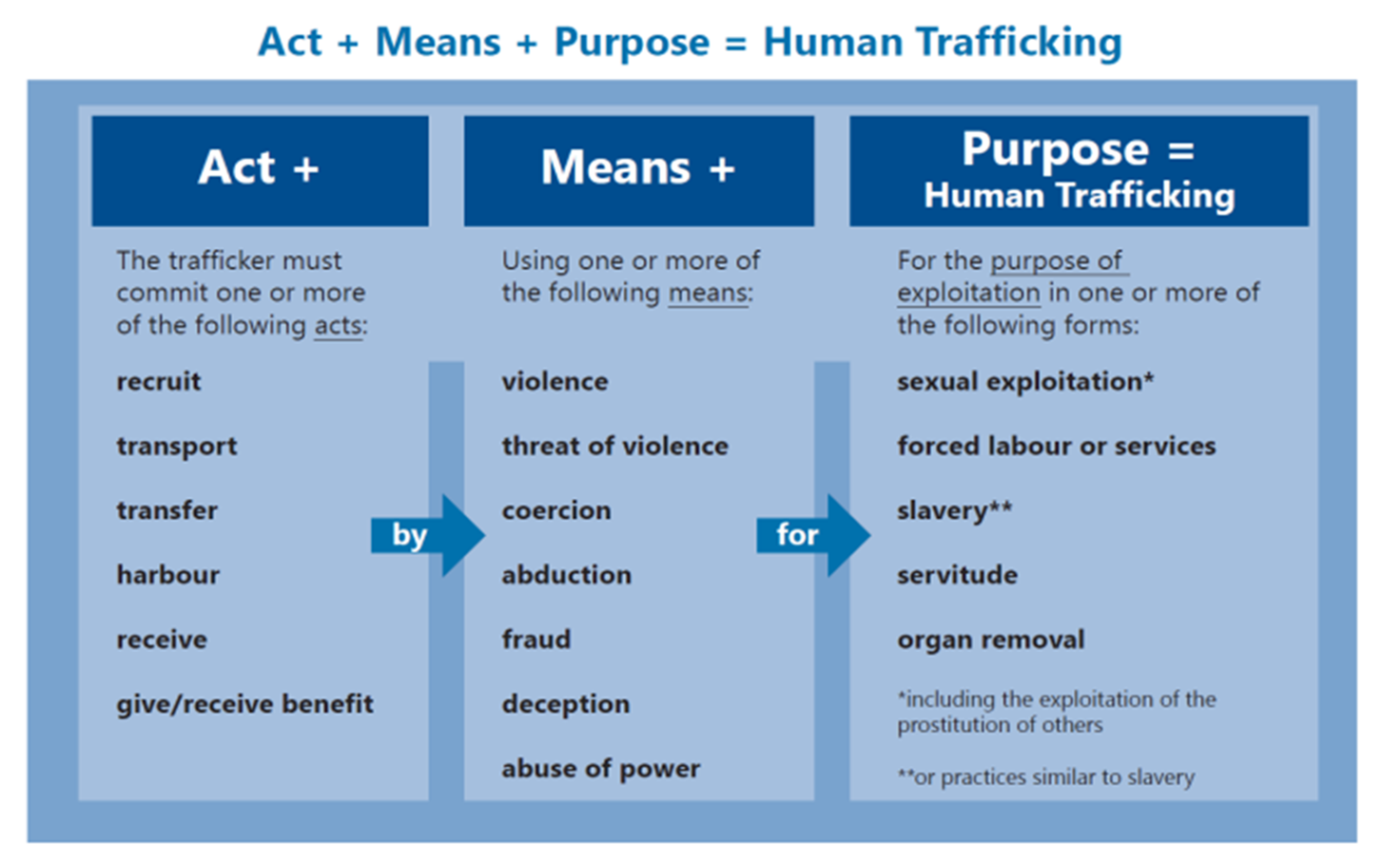
Notes:
Human trafficking occurs when a perpetrator, often referred to as a trafficker, takes any one of the enumerated Actions, and then employs the Means of force, fraud or coercion for the Purpose of compelling the victim to provide commercial sex acts or labor or services.
At a minimum, one element from each column must be present to establish a potential situation of human trafficking. The presence of force, fraud or coercion indicates that the victim has not consented of his or her own free will.
Remember that under federal law, any minor under the age of 18 years induced into commercial sex is considered to be a victim of sex trafficking— regardless of any indicators of force, fraud, or coercion.

Slide 5

“Slavery”
Human trafficking is
Modern Day Slavery
Labor Trafficking - Victims of labor trafficking can be found in many types of domestic and non-domestic situations. Victims are trapped into a cycle of debt, forcing them into involuntary servitude, debt bondage and slavery.
Sex Trafficking - Victims of sex trafficking may be children, teenagers or adults lured by false promises and ultimately forced into prostitution.
There are over 40 million estimated slaves living in the world today.
Notes:
(Rotary International refers to human trafficking as modern day slavery)
It estimated that more than 40 million people are enslaved around the world. (ILO)
(Note about estimates: victims are usually hidden in the shadows, so accurate statistics are often elusive.)
There are actually more slaves today than when slavery was legal.
And the numbers keep growing!
Human Trafficking includes both labor trafficking, where people are forced or coerced to work against their will -- in industries such as farming, construction, domestic service and manufacturing – for the profit of others.

Slide 6
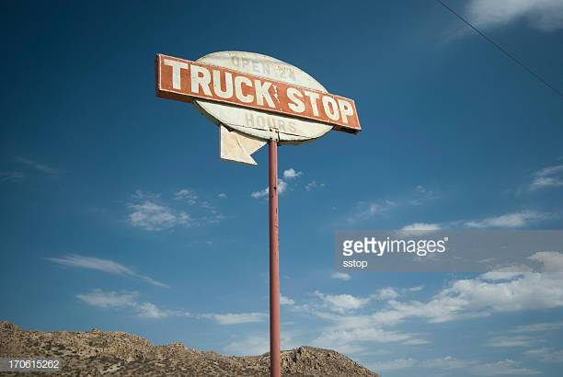
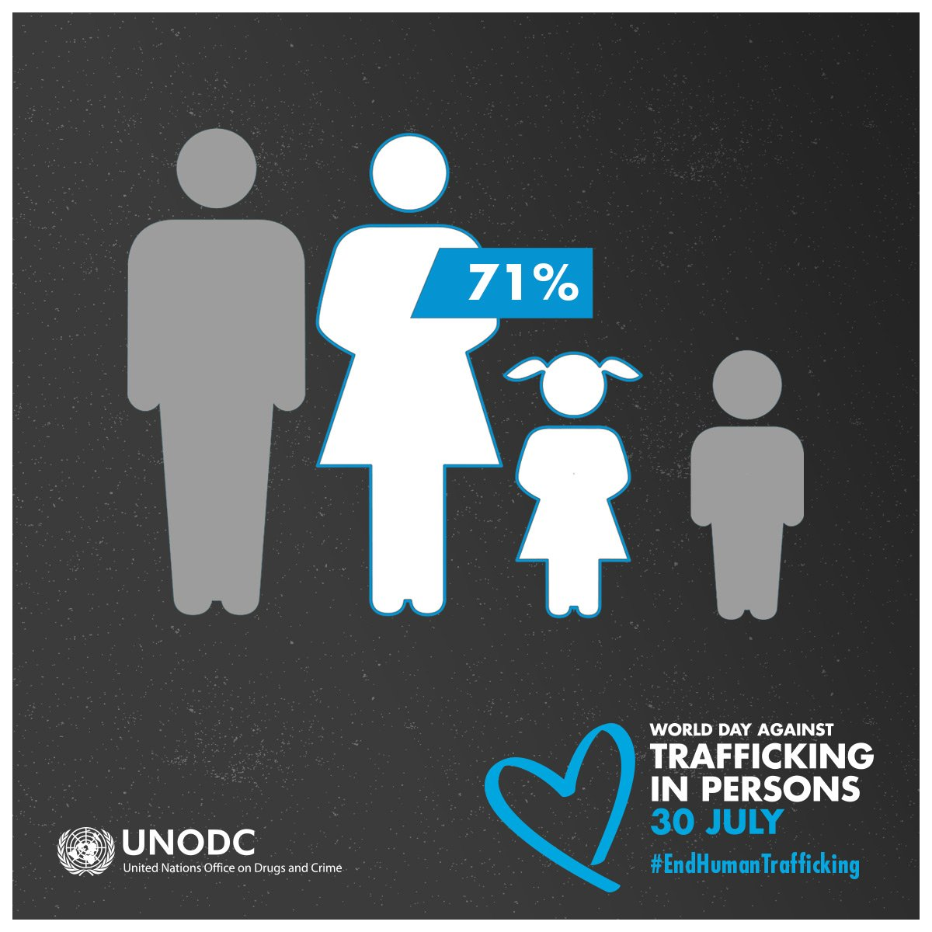
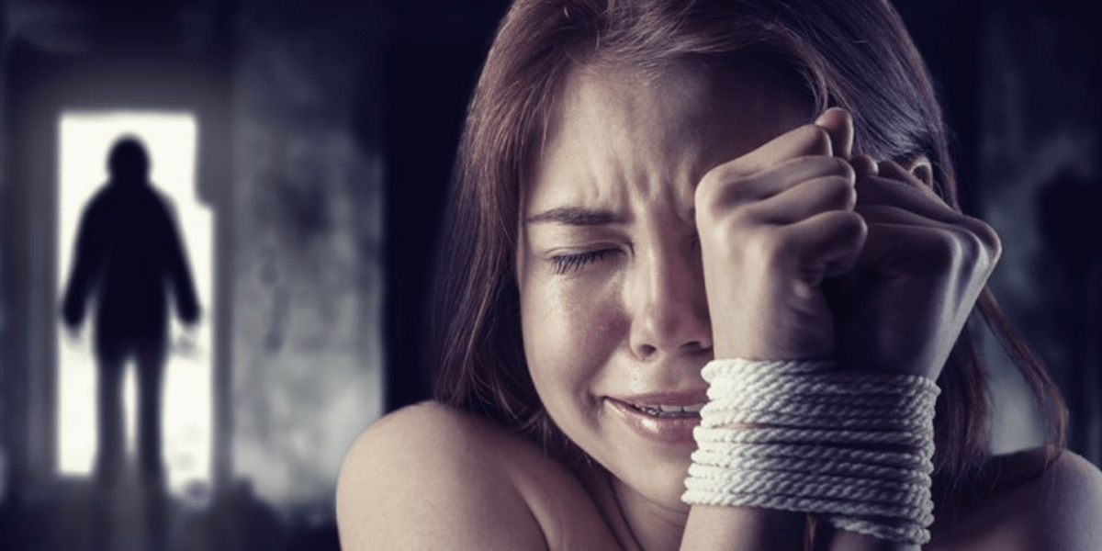
Sex Trafficking in the US
Labor
300,000 new sex trafficked
victims each year in the US
Notes:
In the US, 80% of trafficked victims are exploited for sex. (Office of Justice Programs)
Nearly half are children. And 80- 90% are women and girls. But males (mostly young boys) are also impacted. (Example of local case in the news just a couple of months ago.)
While Human Trafficking includes both labor and sex trafficking, because of these numbers, our Rotary efforts have focused primarily on sex trafficking – until now. The instances of labor trafficking are much higher in the northern part of the state and especially in the Dakotas. So our initiative will change its focus as we grow.
More women tend to be trafficked for sex and more men for labor

Slide 7
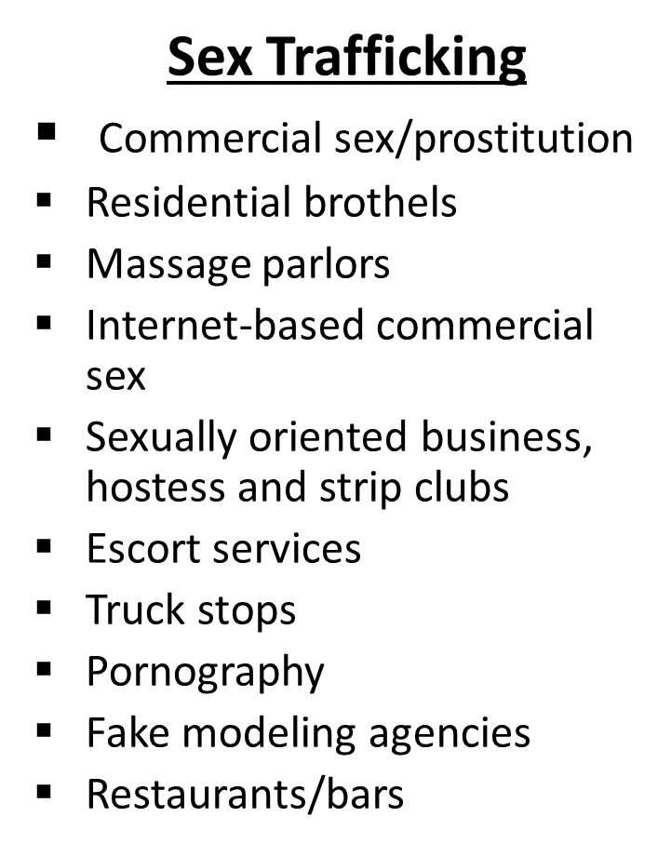
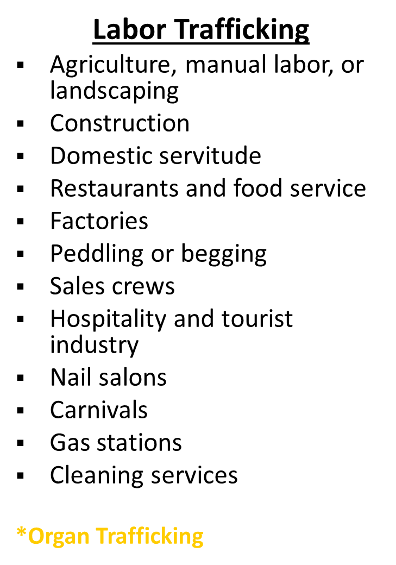
Examples of Human Trafficking
Notes:
What are some common industries where we see human trafficking occurring?

Slide 8
Human Trafficking is Big Business
Human trafficking is a $150 billion per year business globally:
  $99 billion in profits from sex trafficking
  $51 billion in profits from labor trafficking
Second largest black-market crime behind illegal drug trafficking.
Produces continuous profits - a person can be used over and over.
Source: International Labour Organization
Notes:
Human trafficking is BIG business -- $150 billion each year in profits!
Second largest and fastest growing criminal enterprise in world. Bigger even than illegal arms dealing
And there are big profits in secondary industries as well: Websites like Backpage and Grinder make millions in advertising.
(In the US, estimated annual profit per woman forced into commercial sex is $100,00. More than double per each child.)
One reason for the huge profits is because, unlike other commodities, human beings can be sold over and over again. You can sell a kilo of heroin only once; a trafficked youth can be sold 20-30 times per day, 365 day per year.

Slide 9
Human Trafficking in District 5580
“Traffickers like to work underground. They don’t necessarily want to work in big cities. They are drawn to small towns … because they feel like they won’t get caught. So areas that have a lot of agricultural farming, areas that have not a lot of law enforcement on patrol…those are areas that are also breeding grounds. Traffickers know that and they want to do some of their work there.”
-Scott Santoro, Homeland Security
Notes:
The FBI has ranked the The Twin Cities as having the 13th highest rate of child prostitution. And According to MnDOT, Minnesota recorded the nation’s third highest rate of human trafficking in 2015! Why? (bullets) Interstates – easily connects drivers to other states; they move girls around. Lots of malls, favorite recruiting spot. AND Modeling industry: many pimps pose as modeling agents to lure girls in.
Still, most of the recruitment happens online. The explosion of social media has given traffickers a direct path into teen’s living rooms.
A recent study found over 34,000 local advertisements for sex posted online in the Twin Cities. (Huge victory recently when the feds shut down Backpage. Now I believe Craig’s List is the biggest website for sex ads.)
But it is not just an urban issue: here in the suburbs, in rural areas, in every community across the state.
And in SLP? Recent sting in 2017 uncovered a huge international sex trafficking ring operating out of hotels in SLP and also in CA.

Slide 10
Midwest
Midwest region is known as a recruitment region.
Circuit – A series of cities among which prostituted people are moved.
  The “Minnesota Pipeline” which is a chain of states by which victims are moved through a series of locations from Minnesota to markets in New York or elsewhere.
  Truck traffic on I-35­­­­­­, the interstate that runs from Laredo, Texas to Duluth, Minnesota, can be carrying victims of sex trafficking.
  Truckers can load women and children into their cabs and transfer them to other trucks at truck stops along the way. They can park so close together that children can be moved without their feet even touching the ground – invisibly.
More profitable for traffickers
  Victims can make more per sex act compared to areas like Atlanta

Slide 11
Who Are the Victims?
Risk Factors
Childhood Sexual Abuse
Family Dysfunction
Isolation
Chemical Dependency
Immigration Status
Lack of Social Support
Runaway and Homeless Youth
Youth with Cognitive Disabilities
Emotional Distress
Poverty
LGBTQ
Youth
Lack of Education
Notes:
While some are kidnapped and taken violently, most victims are just vulnerable kids. Victims of human trafficking come from all backgrounds. Every single demographic is at risk. Traffickers prey on anyone vulnerable for any reason. Whatever will make them easier to recruit, manipulate, and control.
They prey on the desperation of people in poverty, offering false promises of jobs. In some cases they even coerce a family to sell one child so they can take care of the rest of their family.
Children and youth in foster care and group homes have the highest rate of child sex trafficking in the US. And runaway and homeless youth are also at high risk. In one study, nearly half of youth who engaged in commercial sex activity, said they did it because they did not have a place to stay.
But it’s important to note that young teenage girls may be at risk of being recruited simply by virtue of their normal maturation process: wanting to take risks, needing independence, feeling misunderstood, seeking romantic relationships, low self-esteem, and an enormous need for acceptance – This is normal, but makes young teens very susceptible to the recruitment tactics of traffickers and pimps.

Slide 12

Who Are the Victims?
11 - 14
Average age a child is
recruited into trafficking
5 - 40
Number of times
per day victims are
forced to have sex
7 years
Life expectancy of victims
Notes:
Most adults who are prostituted were first sold for sex before the age of 18.
The average age of first being sold into trafficking is 11-14. And that’s the average! Which means that many thousands of victims of sex trafficking are even younger.
Anyone have a daughter or grandchild, niece or neighbor who is 11 or 12? Story about my niece,
Recent story: Survivor who escaped her traffickers after 20 years. She was kidnapped and trafficked at 9. . . Moved around Southeast Asia, until her trafficker brought her back to Minnesota where she escaped.
But most don’t escape. The odds are 1 in 100. (Into Freedom)
And, if not rescued, the average victim dies within 7 years (from attacks, abuse, HIV or other diseases, overdose or suicide)
(The average victim of HT is raped over 6,000 times.) (Into Freedom)

Slide 13
How Does It Happen?
Notes:
How does it happen?
Victims are recruited at schools, malls, parties, bus stops, social hangouts – but mostly online and via social media.
Traffickers use a variety of recruitment and enticement tactics to manipulate and control their victims. Goes like this: online, a trafficker poses as a young men or teen, strikes up relationship with young girl via social media. Then he convinces her to meet, acts as her boyfriend, buys her things – clothes, jewelry, maybe drugs. He promises money or a better life.
The trafficker develops a relationship in order to develop trust, dependence and allegiance, making their victims even more vulnerable. Sometimes it’s just the attention that lures them in – being told you’re beautiful, being treated as an adult. For some who don’t have any experience with a positive relationship or family situation, the trafficker is the first person to show them that kind of attention.
Then eventually he coerces her to do this just once because they need the money. Or he tells his victim “if you loved me, you would do this.”

Slide 14
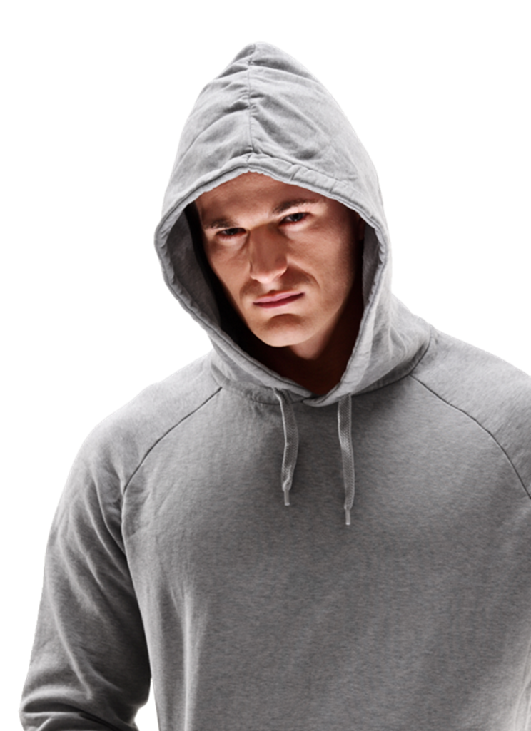

Trafficker Identification
Traffickers can be:
  U.S. Citizen
  Male or Female
  Adults or Minors
  Historical Victims
  Secondary Enforcers
ANY individual looking to profit from exploiting another person
Notes:
Similar to the victims, there is not a set list of characteristics that indicate if someone is a trafficker.
A trafficker may be a U.S. Citizen or foreign national, male or female with a diverse economic background; a trafficker may be an adult or a minor. Some traffickers have a background of being abused themselves.
Some traffickers are victims of human trafficking, who become secondary enforcers; this is where the trafficker has a former victim become a lookout or a recruiter. In pimp-controlled human trafficking instances, a pimp will have some of the victims, known as bottoms, as their secondary enforcers; while they are given special privileges, they may experience higher levels of abuse.
A trafficker is any individual who is looking to profit from exploiting youth.

Slide 15


Recruitment Locations
Schools
Malls
Parks
Bus and Train Stations
Shelters & Group Homes
Teen Parties
Social Media
Traffickers strategically prey on anyone that is mentally, physically, or economically vulnerable, and they target areas where vulnerable people can be found.
Notes:
While many of the locations on the current slide are where more vulnerable youth can be found, traffickers do frequent the mall and other locations where any youth can be found.

Slide 16
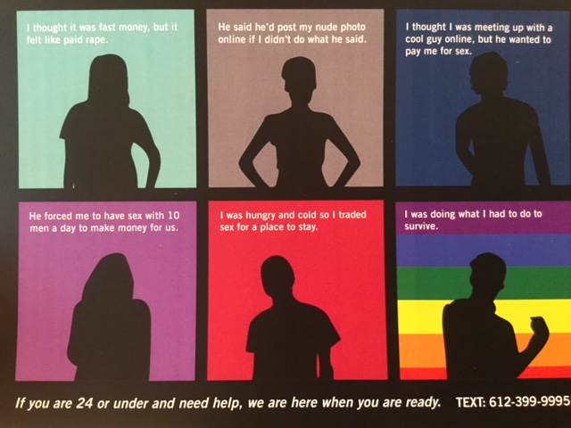
How Does It Happen?
Notes:
Or maybe he promises them jobs as dancers or models, but the dancing turns out to be at a strip club and the modeling turns into pornography.
Some trafficked victims don’t see themselves as victims. They have been manipulated to think their trafficker loves them. Often they lead a double life: at school during the day, home at night and sold for sex in between.
But then, eventually, if a victim says she doesn’t want to do this anymore or tries to leave, the trafficker is likely to turn violent, threaten blackmail or criminal consequences or harm to her family if she tries to leave. She may even be branded with tattoos.
Traffickers weld tremendous power over their victims, through seduction and manipulation. And they inflict irreparable harm, both physical and emotional.

Slide 17
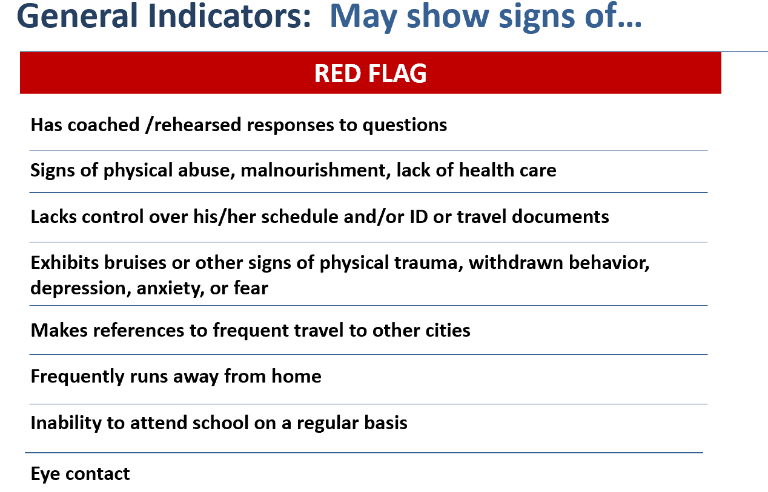
Red Flags
Notes:
So, what are the red flags that indicate that one of your friends may be a victim of human trafficking?
One indicator is when your friend seems to be giving you coached or rehearsed responses to questions you ask; you know your friends, you can tell when they are being truthful or not. You friend may have signs of physical abuse, malnourishment and/or lack of health care. Signs of violence: unexplained bruises, black eyes, cuts, or marks
Behaviors including fear, anxiety, depression, hyper vigilance, nervousness
Easily startled, agitated, or afraid
Unsure of where they are
Not in control of money or documents
Accompanied by older “boyfriend” / companion
Dressed to look older or inappropriately for the weather/situation
Name or symbol tattooed or branded on neck, chest, or arms

Slide 18
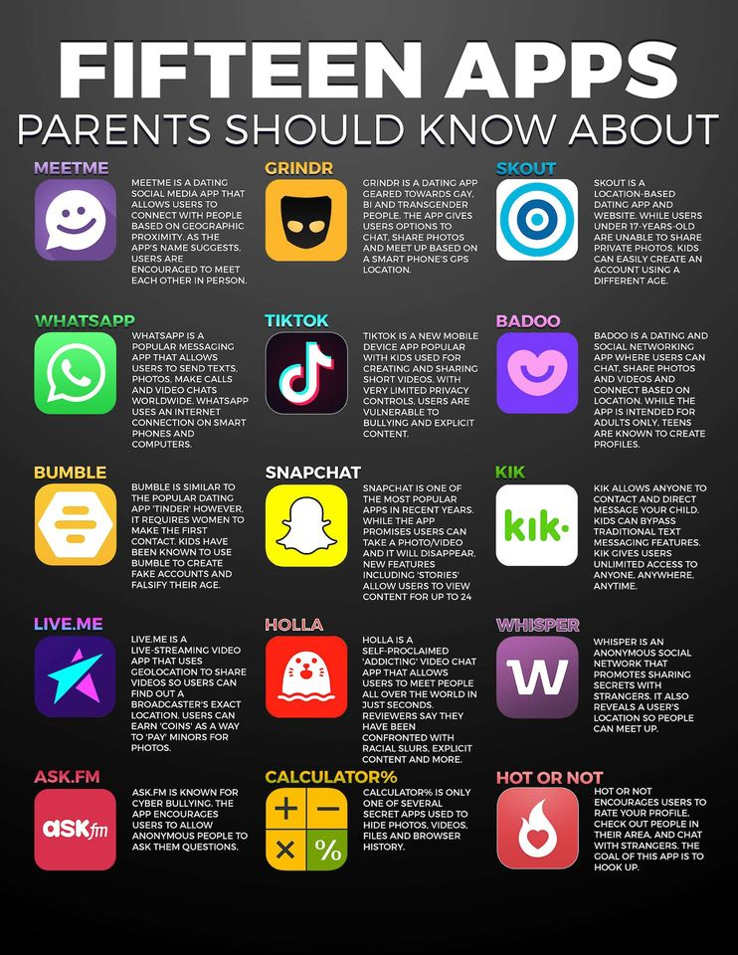
Notes:
Here's the full list of apps and their descriptions:
1) MEETME: A dating social media app that allows users to connect with people based on geographic proximity. App users are encouraged to meet in person.
2) WHATSAPP: Popular messaging app that allows users to send texts, photos, voicemails, and make calls and video chats.
3) BUMBLE: Similar to "Tinder." The dating app requires women to make the first contact. Kids have been known to create fake Bumble accounts that falsify their age
4) LIVE.ME: A live-streaming video app that uses geolocation to share videos so users can find out a broadcaster's exact location. Users can earn "cins" as a way to "pay" minors for photos.
5) ASK.FM: Known for cyberbullying. The app encourages users to allow anonymous people to ask them questions
6) GRINDR: A dating app geared towards the LGBT community. The app gives users options to chat, share photos, and meet up based on a phone's GPS.
7) TIKTOK: A new mobile device app popular with kids. It's used for creating and sharing short videos. With very limited privacy controls, users are vulnerable to cyber bullying and explicit content
8) SNAPCHAT: One of the most popular apps in recent years. While the app promises users can take a photo/video and it will disappear, new features, including "stories", allows users to view content for up to 24 hours. Snapchat also allows users to see your location.
9) HOLLA: A self-proclaimed "addicting" video chat app that allows users to meet people all over the world in just seconds. Reviewers say they have been confronted with racial slurs, explicit content and more.
10) CALCULATOR%: Only one of several secret apps used to hide photos, videos, files and browser history.
11) SKOUT: A location-based dating app and website. While users under 17 old are unable to share private photos, kids can easily create an account with an older age.
12) BADBOO: A dating and social networking app where users can chat, share photos and videos and connect based on location. While the app is intended for adults only, teens are known to create profiles.
13) KIK: Allows anyone to contact and direct message to your child. Kids can bypass traditional messaging features. KIK gives users unlimited access to anyone, anywhere, anytime.
14) WHISPER: An anonymous social network that promotes sharing secrets with strangers. It also reveals a user's location so people can meet up.
15) HOT OR NOT: Encourages users to rate your profile, check out people in their area and chat with strangers. The goal of the app is to hook up.

Slide 19
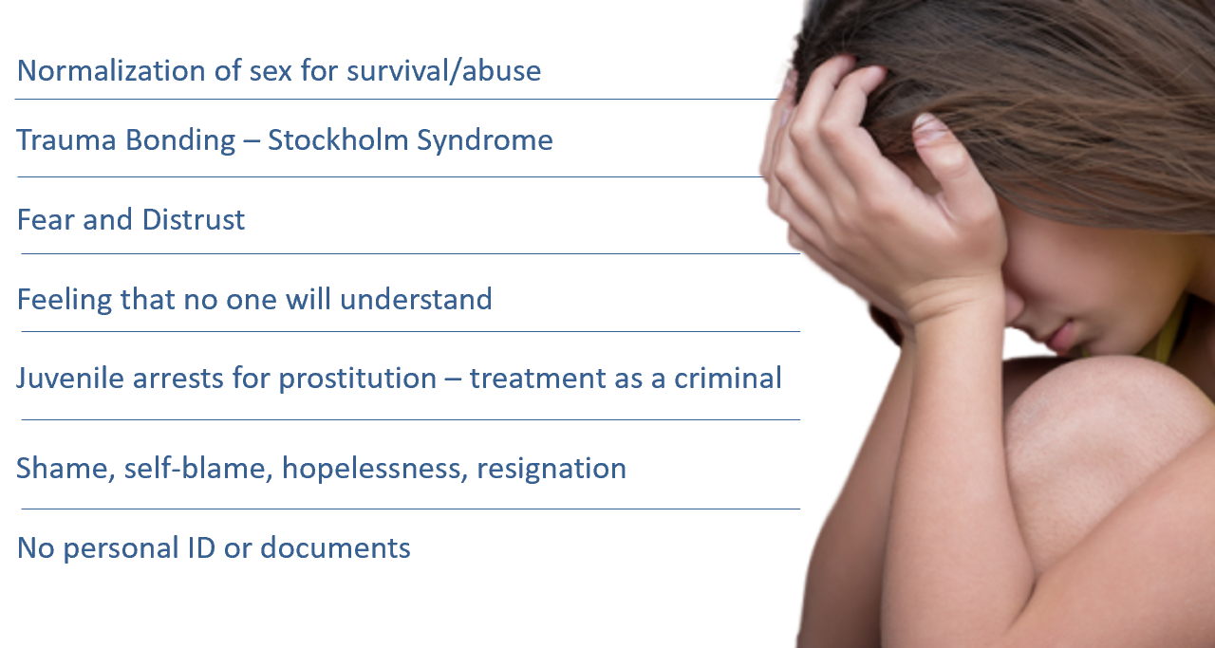
Why is it difficult for victims to get help…
Notes:
This slide shows why victims have a hard time identifying themselves as a victim.
Even though it appears that a victim may have many opportunities to leave a trafficking situation, the tactics that traffickers use to break a victim, as seen on the power and control wheel, makes it so that a victim feels that they are unable to ask for help or they may not even know that they can ask for help. Overall, a victim has a hard time even self-identifying that he/she is a victim.
Over time a victim will normalize the sex for survival purposes and so they can get through the abuse. Often the victim will bond with the trafficker. Once the trafficker has control over the victim through extreme abusive measures, the victim begins doubting themselves and will begin to believe the trafficker when he/she says they are the only person who cares about the victim.
Victims also have a hard time self identifying because they feel like no one will understand what they are going through and with juvenile arrests for prostitution and being treated like a criminal, the victim will begin blaming themselves. The victim will have feelings of shame, hopelessness and then finally resign themselves to the life they have as a victim. And if the trafficker takes the victims personal ID or documents, the victim if further lost.

Slide 20
Hotlines
In case of emergency CALL 911
Contact local law enforcement for all non-emergency reports
Report tips to the North Dakota Human Trafficking Task Force via ND SLIC tip-line for task force partner: https://www.ndslic.nd.gov/human-trafficking
Canadian Human Trafficking Hotline can be reached at 1-833-900-1010.
Minnesota Hotline is 866-223-1111 or text 612-399-9995

Slide 21
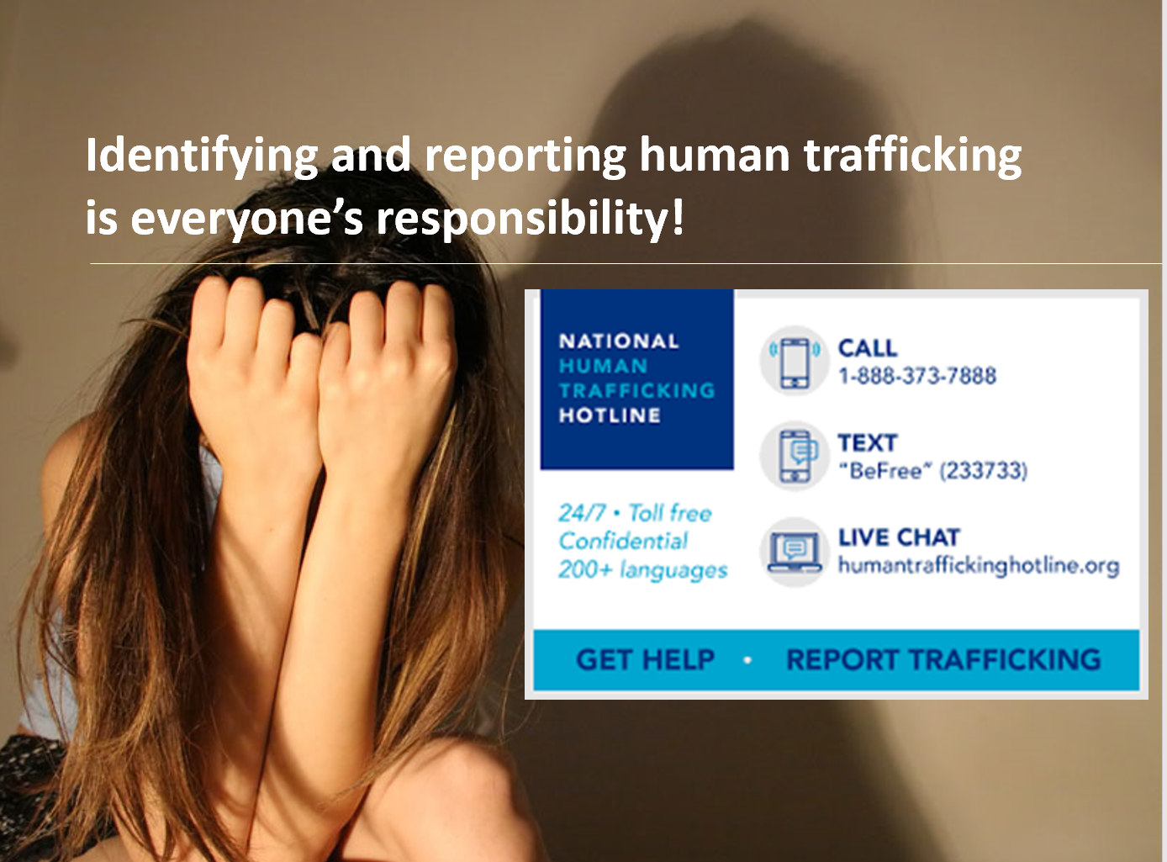
Notes:
If you think someone is being trafficked:
Call 888-373-7888 (National Sex Trafficking Hotline) or 911
Do NOT intervene or interact with someone you suspect is being trafficked. It can put both you and the victim at risk. Do NOT attempt to rescue anyone.
EDUCATION
Have protocol in place
In case of emergency CALL 911
Contact local law enforcement for all non-emergency reports
Write down all the information that you can about what you are seeing, the more details the better

Slide 22
What survivors want you to know…
  Think about things from our point of you, never say you “understand,” because you haven’t been there. But still try to put yourself in our shoes.
  Language counts. The words you use make a difference. Calling us “prostitutes” hurts us.
  We may act “hard” but we have to have the “wall” up for survival. Deep down we know we need help.
  We need more information about your services, and we need it to be in places where we can see it (public restrooms, bus stops, shelters, clinics, etc.)

Slide 23
How Do We End it?
Raise awareness
Educate children and youth
Reduce vulnerabilities / risk factors
Stop the demand
Notes:
So, there is a lot of wonderful work being done to help victims escape and to support survivors. But trafficking keeps happening. And growing!
To end it, we know we need to prevent it. To do that, we believe that we need to build awareness and educate our kids and our communities. And we need to address the risk factors that make people vulnerable to traffickers. And we need to stop the demand.

Slide 24
Why Rotary?
  Rotary is the largest global
  service organization in the world.
  Human Trafficking is the fastest growing
  and most widespread human rights
  violation in our world today.
3
Districts involved
25
100
Clubs have launched projects
5,000
Club champions
Rotarian ambassadors for change
Notes:
So, why is Rotary involved?
Rotary is uniquely positioned to solve global issues, with over 3 million Rotarians worldwide
Rotary has a successful track record – we have helped eradicate polio!
We can mobilize thousands of Rotary clubs to tackle this issue in their own communities.
Help clubs engage their local communities around this issue.
Rotary clubs can raise awareness of this issue in every community. And clubs can provide financial and volunteer support to local organizations to advance the work that is already being done in their communities.

Slide 25
Rotary’s Initiative to End Human Slavery
Mission
To end human trafficking in the communities covered by Districts 5950, 5960 and 5580 (Minnesota, North Dakota, Western Wisconsin and parts of Ontario).
  Provide Rotary Clubs with information, resources and toolkits to engage their communities and support local organizations working to end trafficking.

Slide 26
Raise Awareness
  CLUB CHAMPION – Online training on October 3rd from 9am to 11am
  Sponsor speakers
Host an event to raise awareness
Post awareness posters in public places
Use the power of social media
Talk about the issue with friends, family and colleagues
Notes:
Rotary’s focus will be on Awareness, Education and Prevention. And we hope every Rotary Club will join us in this initiative to end Human Trafficking.
So how can your Rotary club get involved?
First, identify a Club Champion, advocate/ committee chair/ liaison to the statewide initiative. We’ll provide you will lots of resources, toolkits, ideas for projects and even help with District grant proposals to fund your club projects.
There are lots of way Clubs can build awareness in their communities:
Schedule a speaker to address churches, schools, workplace, community groups, even book clubs.
Host an event to raise awareness and inform community members about this horrible crime. Community forum, 5k fundraiser,
Post awareness posters in public places
Use the power of social media: post articles on your website, share and re-post stories and events, invite your friends to join the cause. Our website will provide a forum for club stories and projects.
I encourage each of you to tell three friends/colleagues about this today.

Slide 27
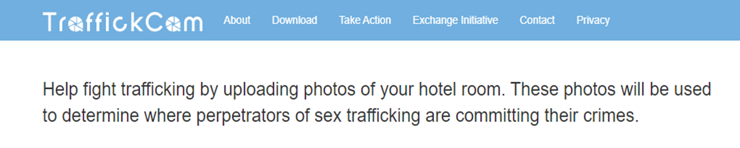
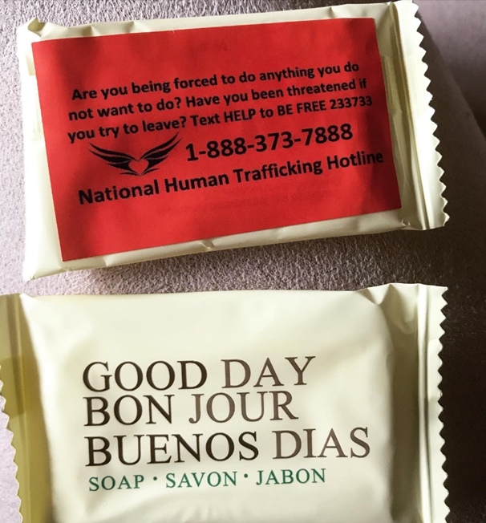

Slide 28
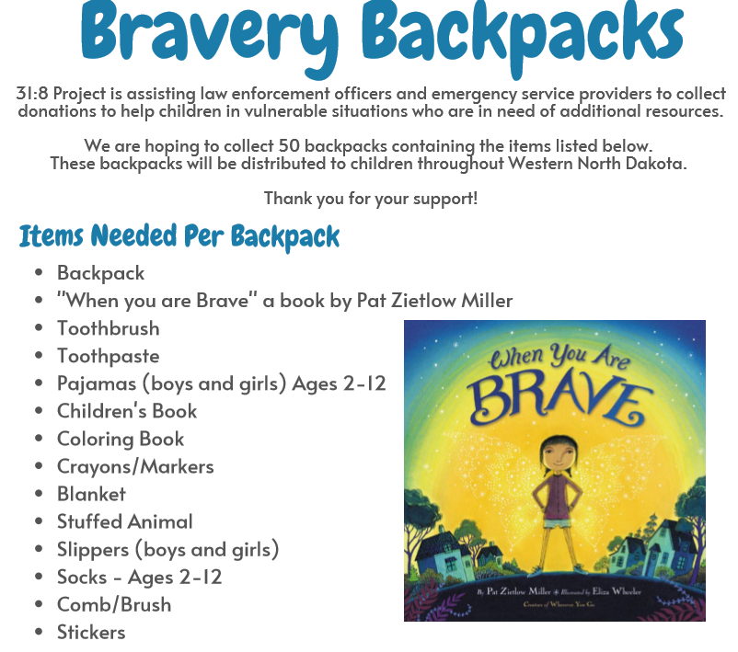

Slide 29
Educate Children, Parents, Teachers
Encourage your schools to bring Human Trafficking and assault prevention curriculum for students, parents & teachers
  Super Hero Kids, Not ME
  A.C.T. United
  I am Little Red
  Chosen – Shared Hope International
  Not a #Number – Love 146
  Netsmartz.org
Notes:
Work with local schools to educate students about sex trafficking so they can be wary, so that when the 13-year-old girl is chatting online with someone who tells her she looks sexy or could be a model and wants to meet her for coffee, she will recognize this as a recruitment tactic and stay away. And get help from an adult.
There are some wonderful organizations who offer trainings and curriculum. Mtka, EP, and several other local school districts are doing this as a result of their local Rotary Club’s urging.
Encourage your schools to host training programs for teachers and parents so they can better recognize the behaviors of a child being trafficked and reach out and offer support in an effective way.
Engage youth! Start an Interact Club if don’t already have one, and encourage them to be involved. Or work with any student service group – students are passionate about this issue!!!
EX: Student at Hopkins HS who is actively lobbying the legislature to adopt a state-wide curriculum
Student athletes at Breck created a video for their Girls Are Not For Sale campaign, which went viral online.

Slide 30
Stop the Demand
Support organizations that help men and boys understand the profound impact on trafficking victims
        Men As Peacemakers
        The Don’t Buy It Project
        The Defenders – Shared Hope International
Support programs that teach youth about respect and healthy relationships and not to dehumanize or objectify others
Stand up against it!
Notes:
And we have to stop the demand. Frankly, if there were no buyers, there’d be no sex trafficking. And that requires changing organizational practices, influencing policies and legislation, and, mostly, changing the cultural.
Clubs can support organizations like Men as Peacemakers or The Don’t Buy It Project to help men understand the profound impact on trafficking victims
You could support prevention programs aimed at teaching youth about respect and health relationships and not to dehumanize or objectify others.
And we all need to stand up against it. We have to start talking about this.

Slide 31
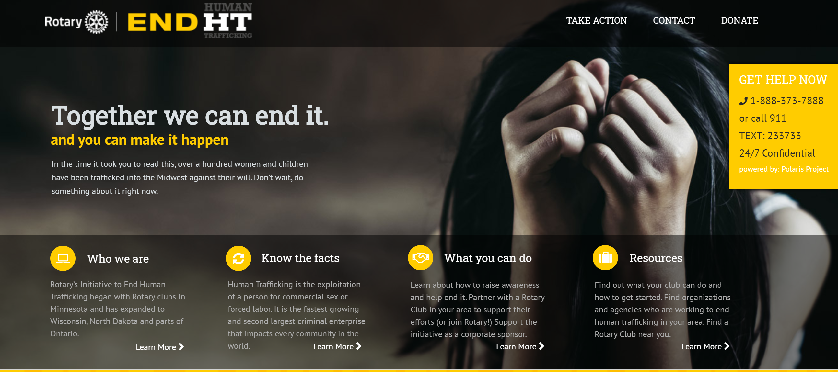
https://rotaryendht.org/
Notes:
Visit and share website

Slide 32
Discussion/Questions
Contact Information for District 5580 Human Trafficking Sub-Committee
  Stacy Schaffer - schaffer@318project.org or 701-321-1061 (Sub-Committee Chair)
  Lynn Hunt - lynnhunt@hugllc.com
  Mary Kay Verkeness - verkenrm@uslink.net
  Bob McLean - rotarybob5580@gmail.com
  Together we can end human trafficking!

