Slide 1
FERGUS FALLS NOON ROTARY
ANNUAL REPORT
FY 25-26
FY 26-27

Slide 2
FY 25-26 OPERATING ACCOUNT
INCOME $14,854
$480/Member
EXPENSES $13,621
$440/Member
BRAGS (10%)
ADMIN (23%)
DUES (57%)
$300/Member
RI DUES (27%)

Slide 3
FY 26-27 OPERATING BUDGET
INCOME $15,425
$532/Member
EXPENSES $14,575
$503/Member
BRAGS (10%)
ADMIN (29%)
DUES (61%)
$325/Member
RI DUES (22%)

Slide 4
FY 25-26 FUNDRAISING ACCOUNT
INCOME $33,788
$1,090/Member
EXPENSES $29,931
LDD25 (17%)
GRANTS (15%)
LDD26 (15%)
PEACHES (28%)

Slide 5
FY 26-27 FUNDRAISING BUDGET
INCOME $37,347
$1,288/Member
EXPENSES $35,090
Pete’s Trees
PEACHES (36%)
GRANTS (15%)
RMPI (9%)

Slide 6
FY 26-27 FUNDRAISING CHAMPIONS
INCOME $37,347
CARRYOVER $5,000
BE
INVOLVED
TODAY!
Bob
Pete’s Trees
PEACHES
GRANTS
RMPI
Bob & Brian

Slide 7

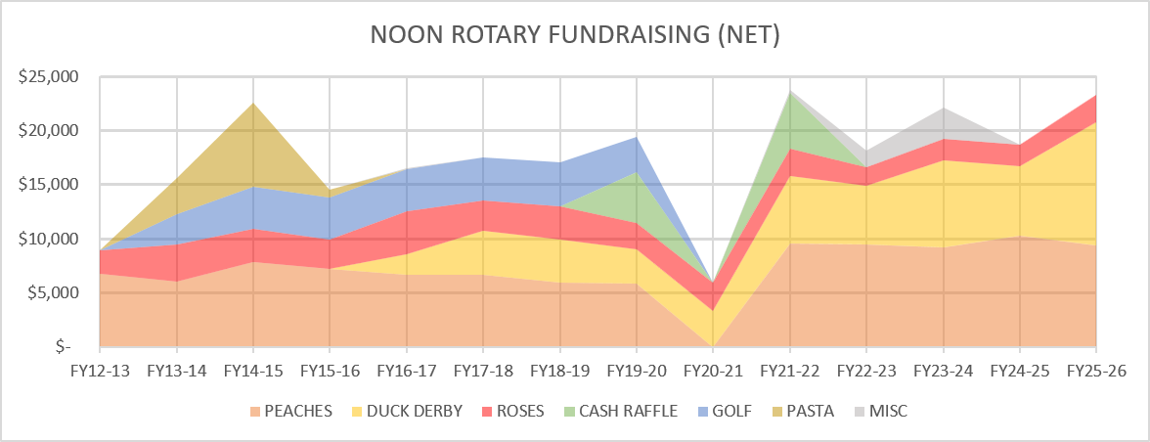
FUNDRAISING HISTORY
Two Duck Derbys
COVID

Slide 8

PROJECTS SUPPORTED
COMMUNITY PROJECTS
$12,425 – Polio Plus
$11,116 – Elmer & Andy
$10,123 – Josh The Otter
$ 9,500 – RYLA
$ 9,252 – Dictionary Project
$ 8,133 – Rotary Youth Exchange
$ 7,000 – YMCA
$ 4,680 – Imagination Library
$ 2,400 – Youth Team Sponsorship
– Salvation Amy
– Otter Orations
– RI Annual Fund
– Dollar For Scholars
CAPITAL PROJECTS
Splash Pad
Bolivia School
Apple Tree Dental
Pioneer Care Day Care Centers
Community Garden
Library
Humane Society
Helmets For Kids
Otter Cove
Chad School Supplies
Panama Water Project
Bolivia International Health Center
* Over Last 14 Years

Slide 9
INVOLVE
SOMEONE
TODAY!

