Slide 1
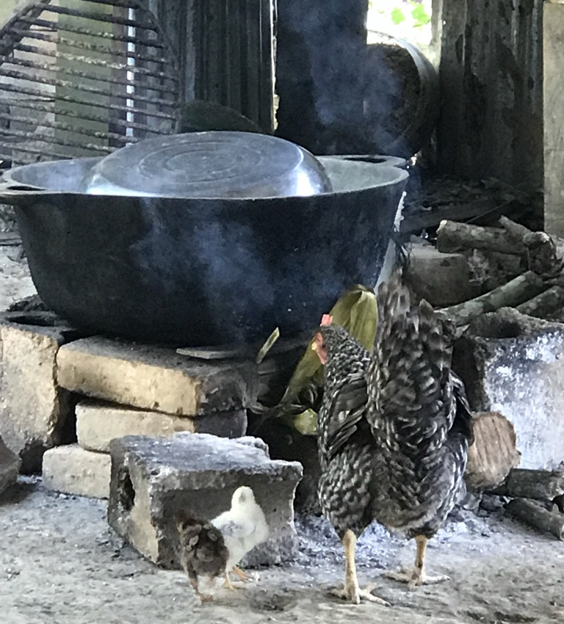
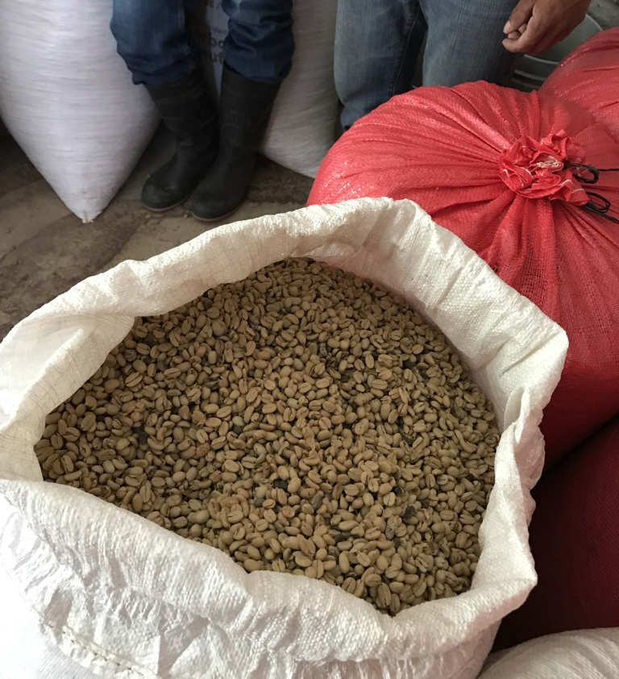
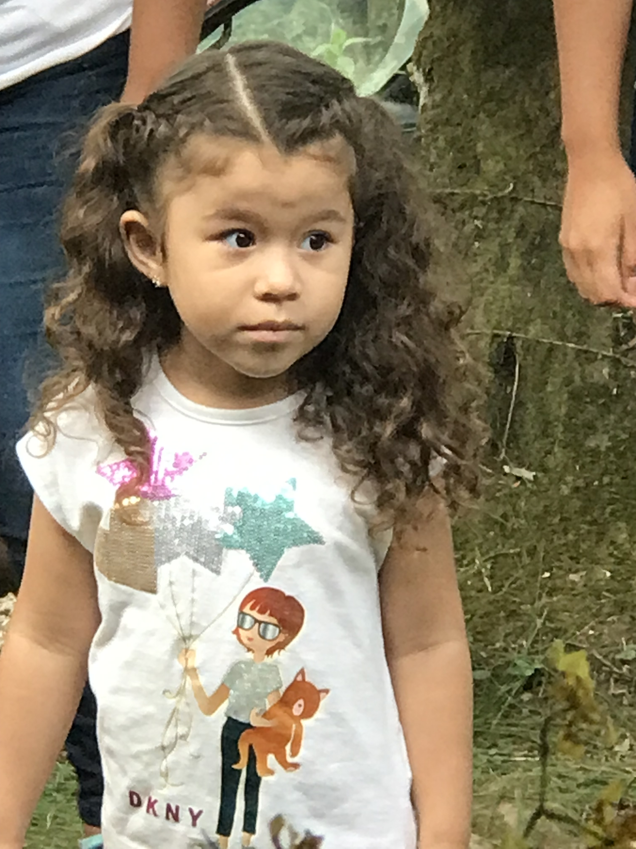
Rotary IPA continued:
Rapid Development 4 and Trade School
A new program focused on Economic Development

Slide 2

Background RD 1-3
RD- Rapid Development
Based on a Swiss program designed to address all the causes of poverty at one time
- education (youth and adult)
- economic development
- health care
- infrastructure/shelter
- sanitation
In 2020 Rotary-IPA applied and received a Rotary Global Grant which enabled the project to be done in three phases.
A total of 12 villages were included

Slide 3
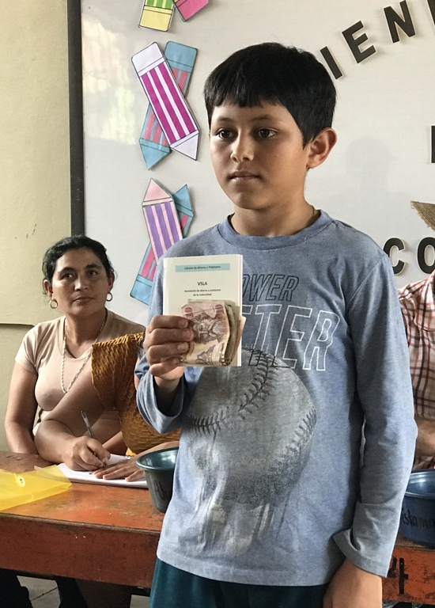
New program economic focus
In 2024 at the end of RD 1-3 we surveyed they villages and all the programs has shown good progress, the most effective program by far were the VSLA’s.
VSLA’s are a Village Saving and Loan.
Villagers commit to putting a portion of their coffee harvest pay into the account and adding to it monthly. They are learning how to save.
Once a village learns how to work together and start a VSLA they are able to accomplish many of the other components of RD on their own.

Slide 4
VSLA’s continued
The VSLA is owned and managed by the villagers (usually women)
The growth is driven by membership and contributions.
Once they have reached a goal IPA adds another $2000 to the fund, usually matching adding real value to the account.
The main use for loans has been for seasonal fertilizer needs
Some have started businesses, village markets, motorcycle repair shops, small farming (pigs, hens, cabbage)

Slide 5
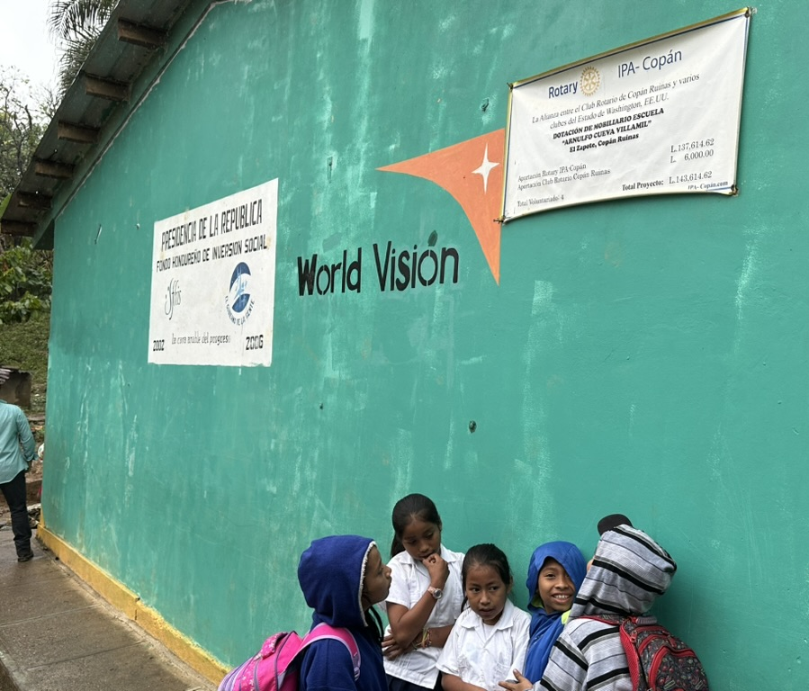
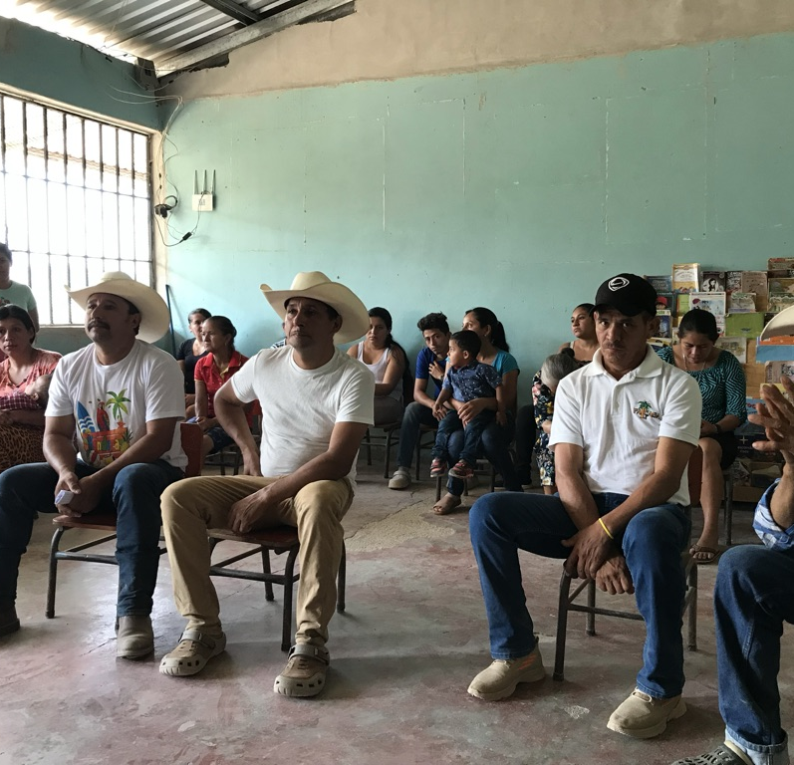
This year we identified and visited 18 villages in the hope of adding 8 villages to the new program.
The first thing that struck us was how far we have come
Many of the villages we visited had received help from NGO’s with poorly run projects.
Many projects never completed, promises made and not kept.
As a result they often showed a complete lack of trust toward us, and each other.
Often there is no hope, just daily existence. (the definition of real poverty!)
A manifestation of this is:
- A lack of any HOPE OR VISION for a changed future. (NGO story)
-A lack of interest or ability to organize.
All areas we overcome in our training

Slide 6
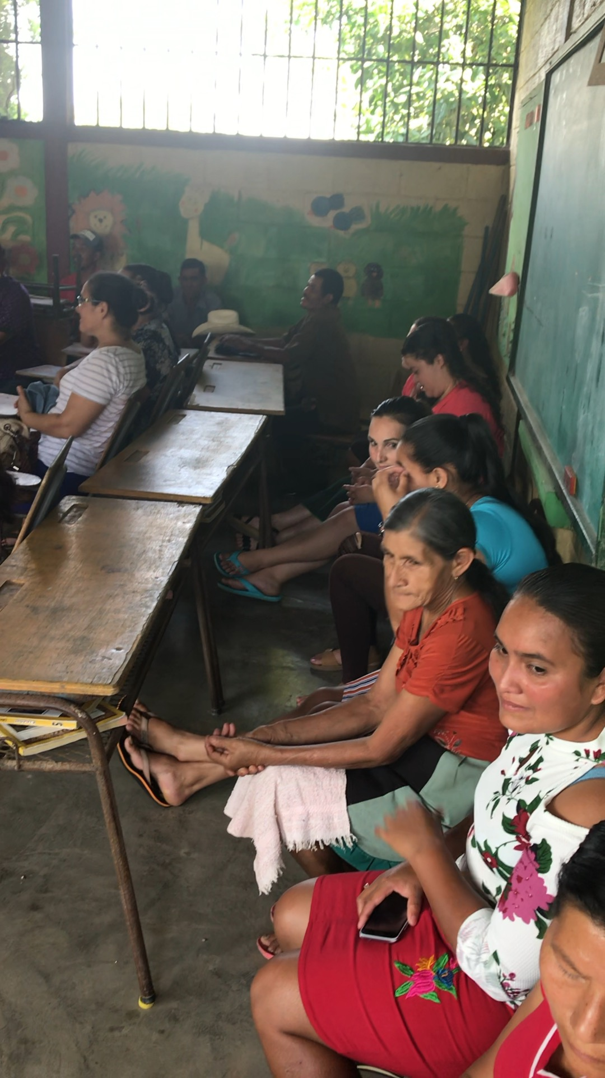
RD4- more focused on Economic Development
Due to a shift away from GG to local funding a smaller budget.
Focus is on two areas:
1. VSLAS
2. Introducing Trades
This fits well with the villager’s education level, adults third grade, most young people 6th.
It also fits well with the available resources and economic opportunities.

Slide 7
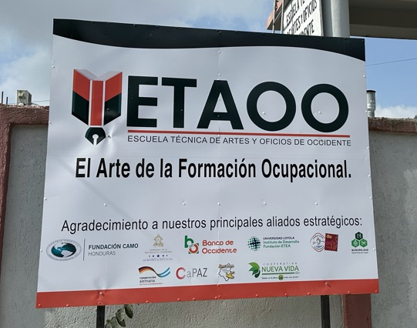
Trade School Component
We found an excellent Trade School in Santa Rosa two hours away, who were interested in developing a campus in our region.
Programs are affordable and one day a week (Saturdays) and take from 10-15 weeks to complete- Federally Certified.
Last fall we did a test run of welding and electrical students and they all did very well.
This trip was about finding a location in Copan region for a campus
We located Cashapa H.S. in Santa Rita

Slide 8
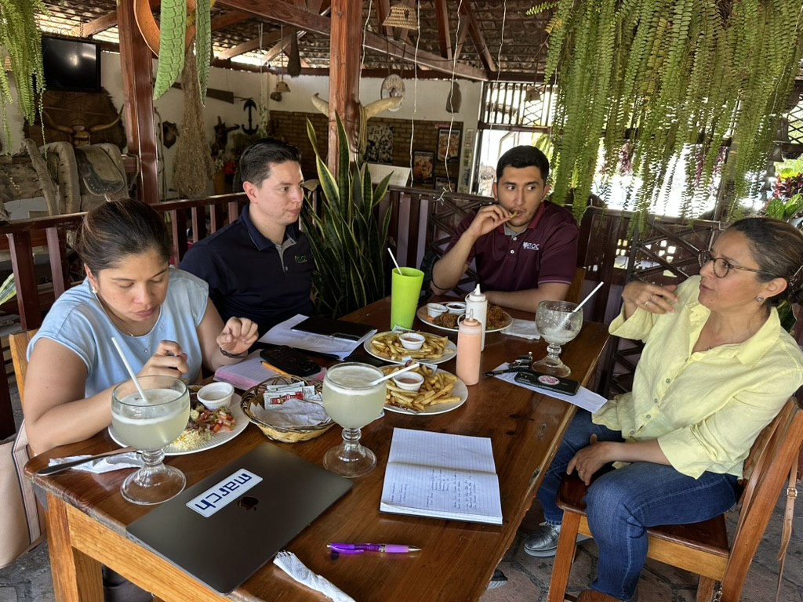
A Perfect Location and Partnership!
Four classrooms:
Woodshop
Sewing room
Kitchen
All purpose room with 3-phase electric
A partnership between ETAOO Trade School and Cashapa H.S. created by Rotary IPA who also provided funding for startup and student scholarships.
We will be offering 15 different classes in three cycles of five classes
Ultimately educating 180 students per year

Slide 9
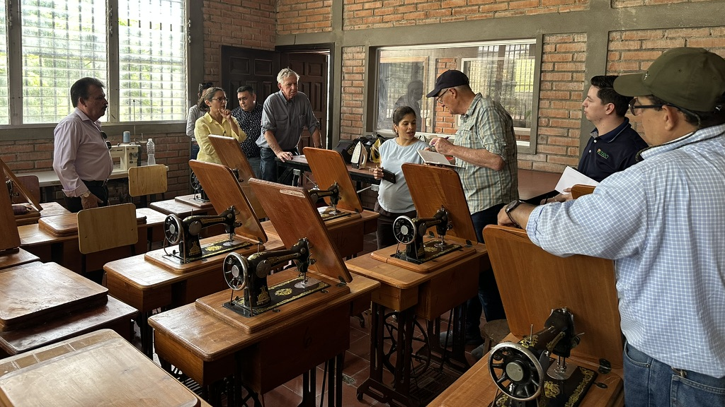
Sewing Room

Slide 10
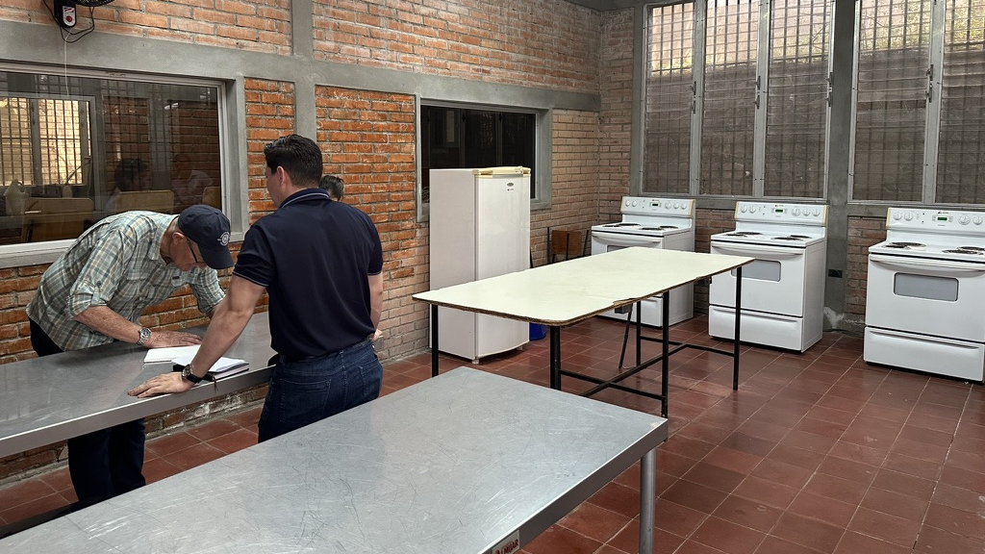
Fully Equipped Kitchen

Slide 11
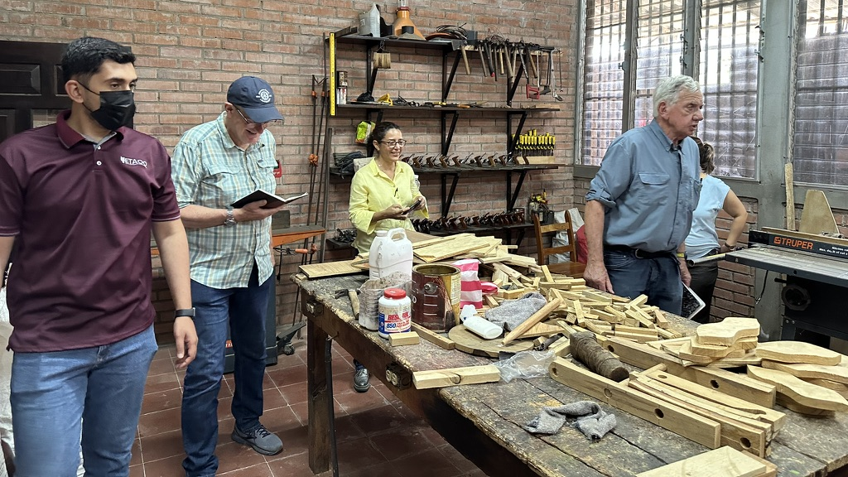
Wood Shop

Slide 12
Anticipated result of RD4:
Villagers will own a share of a well managed VSLA within their village.
Have a funding source to start businesses.
Villagers with the skills to start trade-based businesses.
Adding skills within the village that meet village needs.
Many will partner up on business tooling, El Narajal baking consortium.
Creating additional income sources.
Diversifying the economy from seasonal to year around.
Reversing the capital outflow from the village of coffee income.
Creates ‘Hope’ and ‘Vision’.

Slide 13
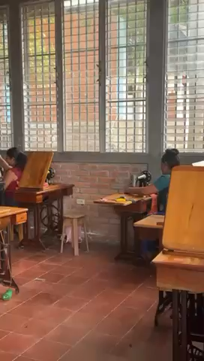
Opening day of the new Trade School

Slide 14
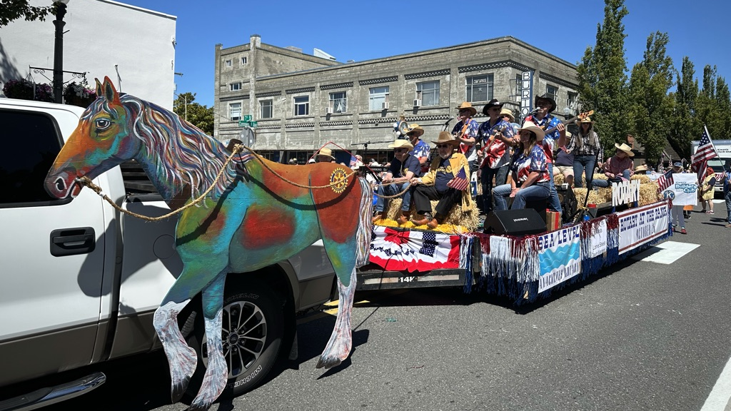
Thank you, Anacortes Rotary Club, for being the first to step up financially, toward making this Trade School happen!

