Slide 1
United Way Update – ALICE Families in Spokane County
Rotary Club of Spokane #21
June 15, 2023
John Dickson
President and CEO
Spokane County United Way

Slide 2
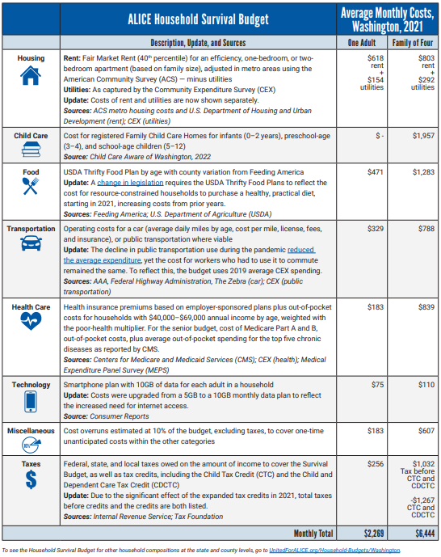
ALICE Household Survival Budget, Washington, 2021
  ALICE: Asset Limited, Income Constrained, Employed
  Families earning more than the Federal Poverty Level, but not enough to afford the basics where they live.
  Two pillars of the ALICE measures are household costs and income.
  The ALICE Household Survival Budget calculates the bare minimum cost of the household basics needed to live and work.
https://www.unitedforalice.org/washington

Slide 3
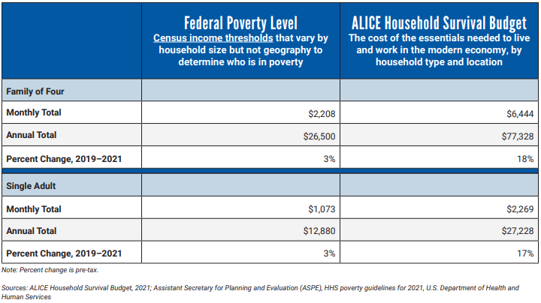
ALICE Household Survival Budget and Federal Poverty Level In Washington, 2021
https://www.unitedforalice.org/washington

Slide 4
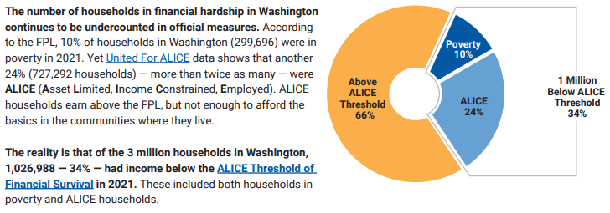
ALICE in Washington, 2021
https://www.unitedforalice.org/washington

Slide 5
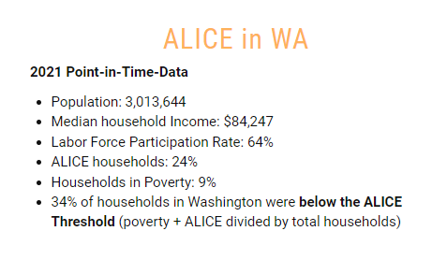
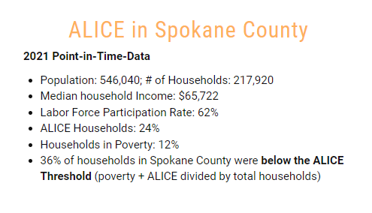
ALICE In WA and Spokane County, 2021
https://www.unitedforalice.org/county-reports/washington

Slide 6
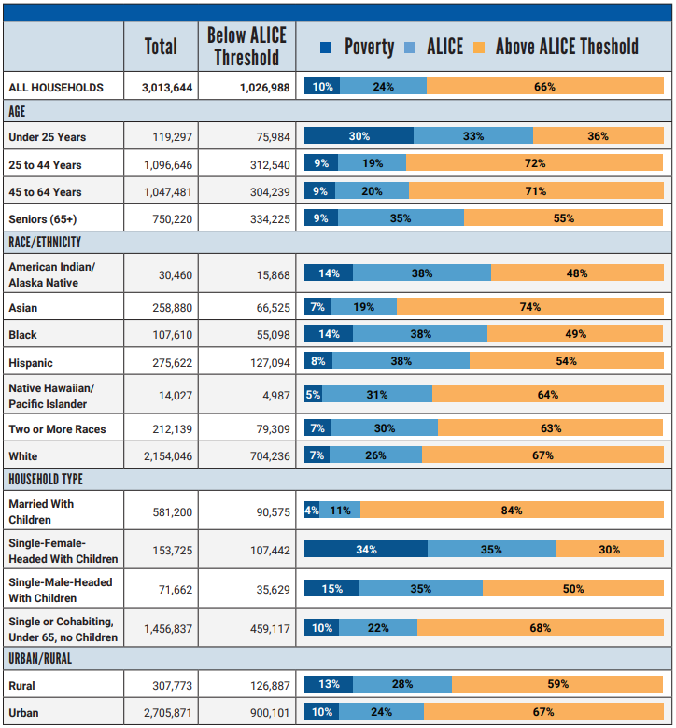
Household Financial Status and Key Demographics In Washington, 2021
https://www.unitedforalice.org/washington

Slide 7
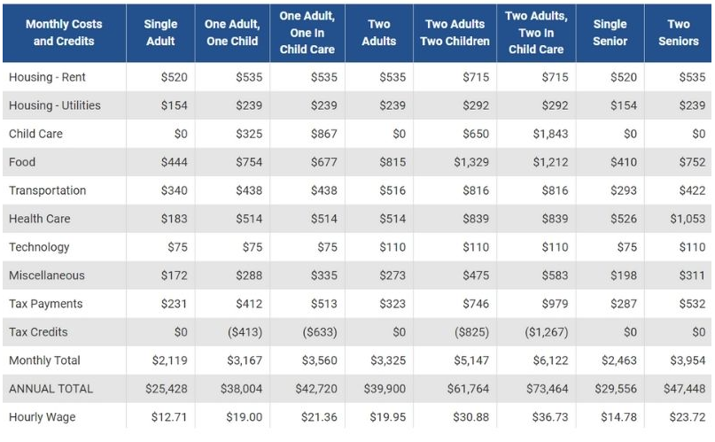
ALICE Thresholds of Financial Survival In Spokane County, 2021
https://www.unitedforalice.org/county-reports/washington

Slide 8
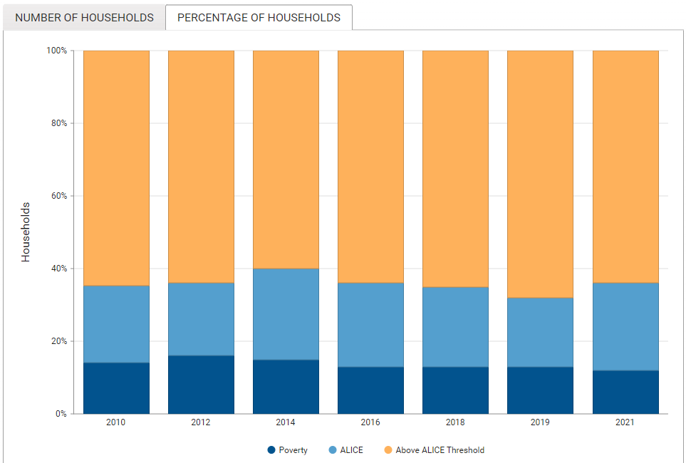
Households In Spokane County
https://www.unitedforalice.org/county-reports/washington

Slide 9
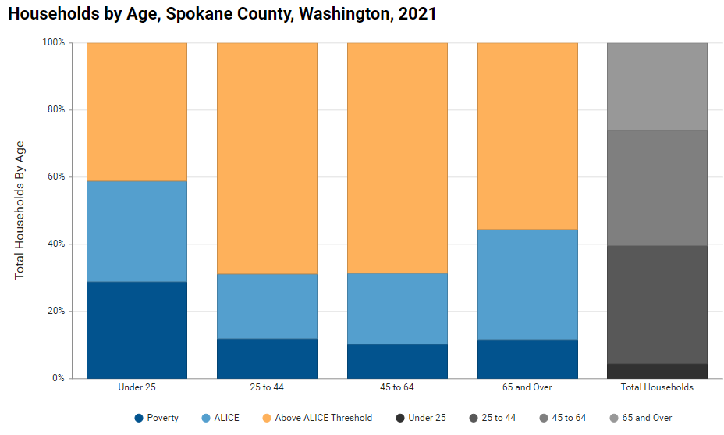
Households By Age In Spokane County
https://www.unitedforalice.org/county-reports/washington

Slide 10
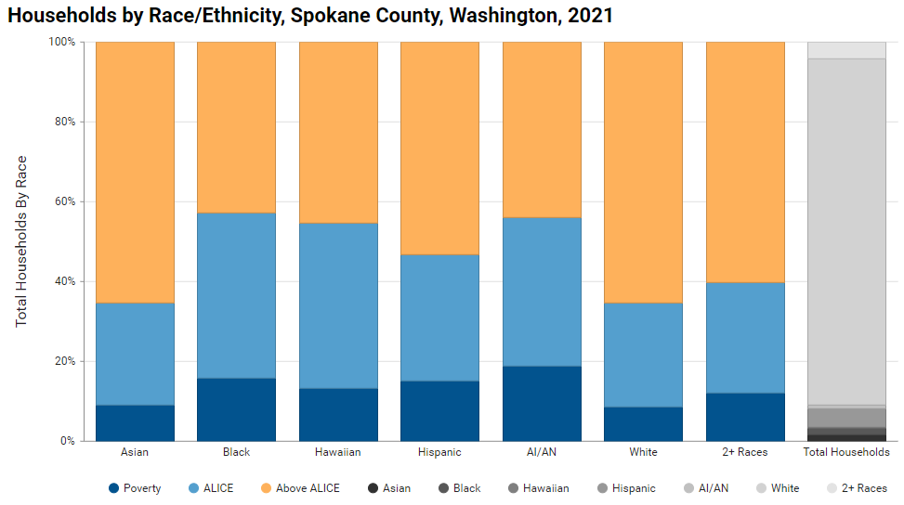
Households by Race/Ethnicity in Spokane County
https://www.unitedforalice.org/county-reports/washington

Slide 11
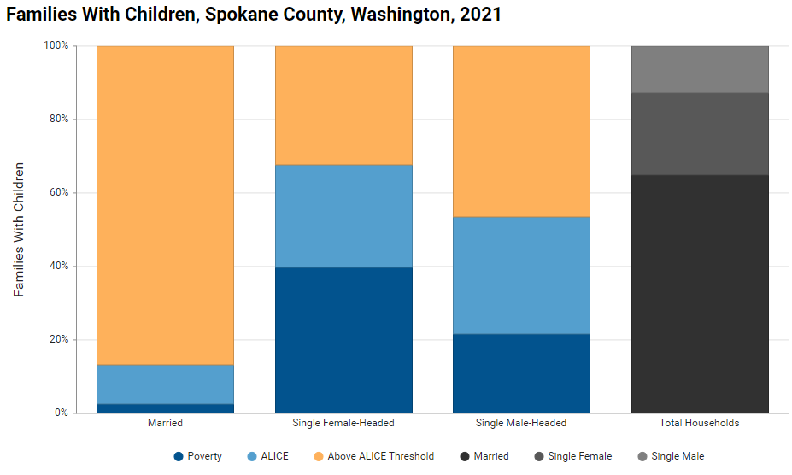
Families With Children In Spokane County
https://www.unitedforalice.org/county-reports/washington

Slide 12
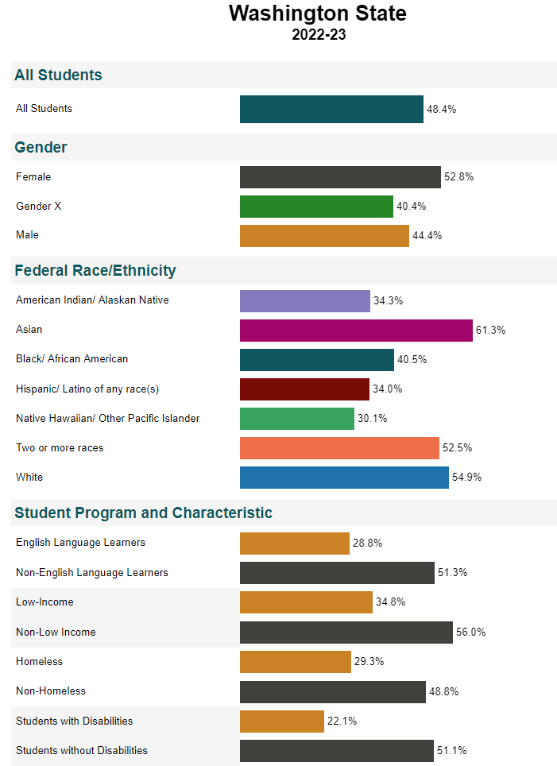
Washington State Kindergarten Readiness
44% of children in Spokane County are kindergarten ready
https://washingtonstatereportcard.ospi.k12.wa.us/ReportCard/ViewSchoolOrDistrict/103300

Slide 13
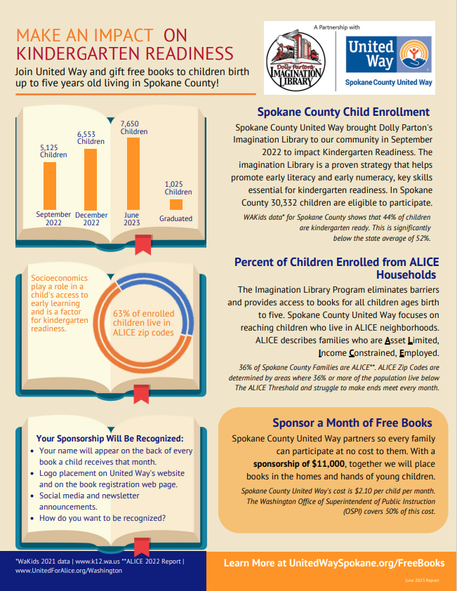
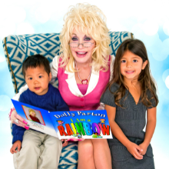
Dolly Parton’s Imagination Library
Dolly Parton’s Imagination Library sends a free, age-appropriate book monthly to every child enrolled in the program from birth to age 5. This early literacy program provides equitable access to books, increases Kindergarten readiness, and fosters a love of reading and books amongst our youngest learners.
https://www.unitedwayspokane.org/freebooks

Slide 14
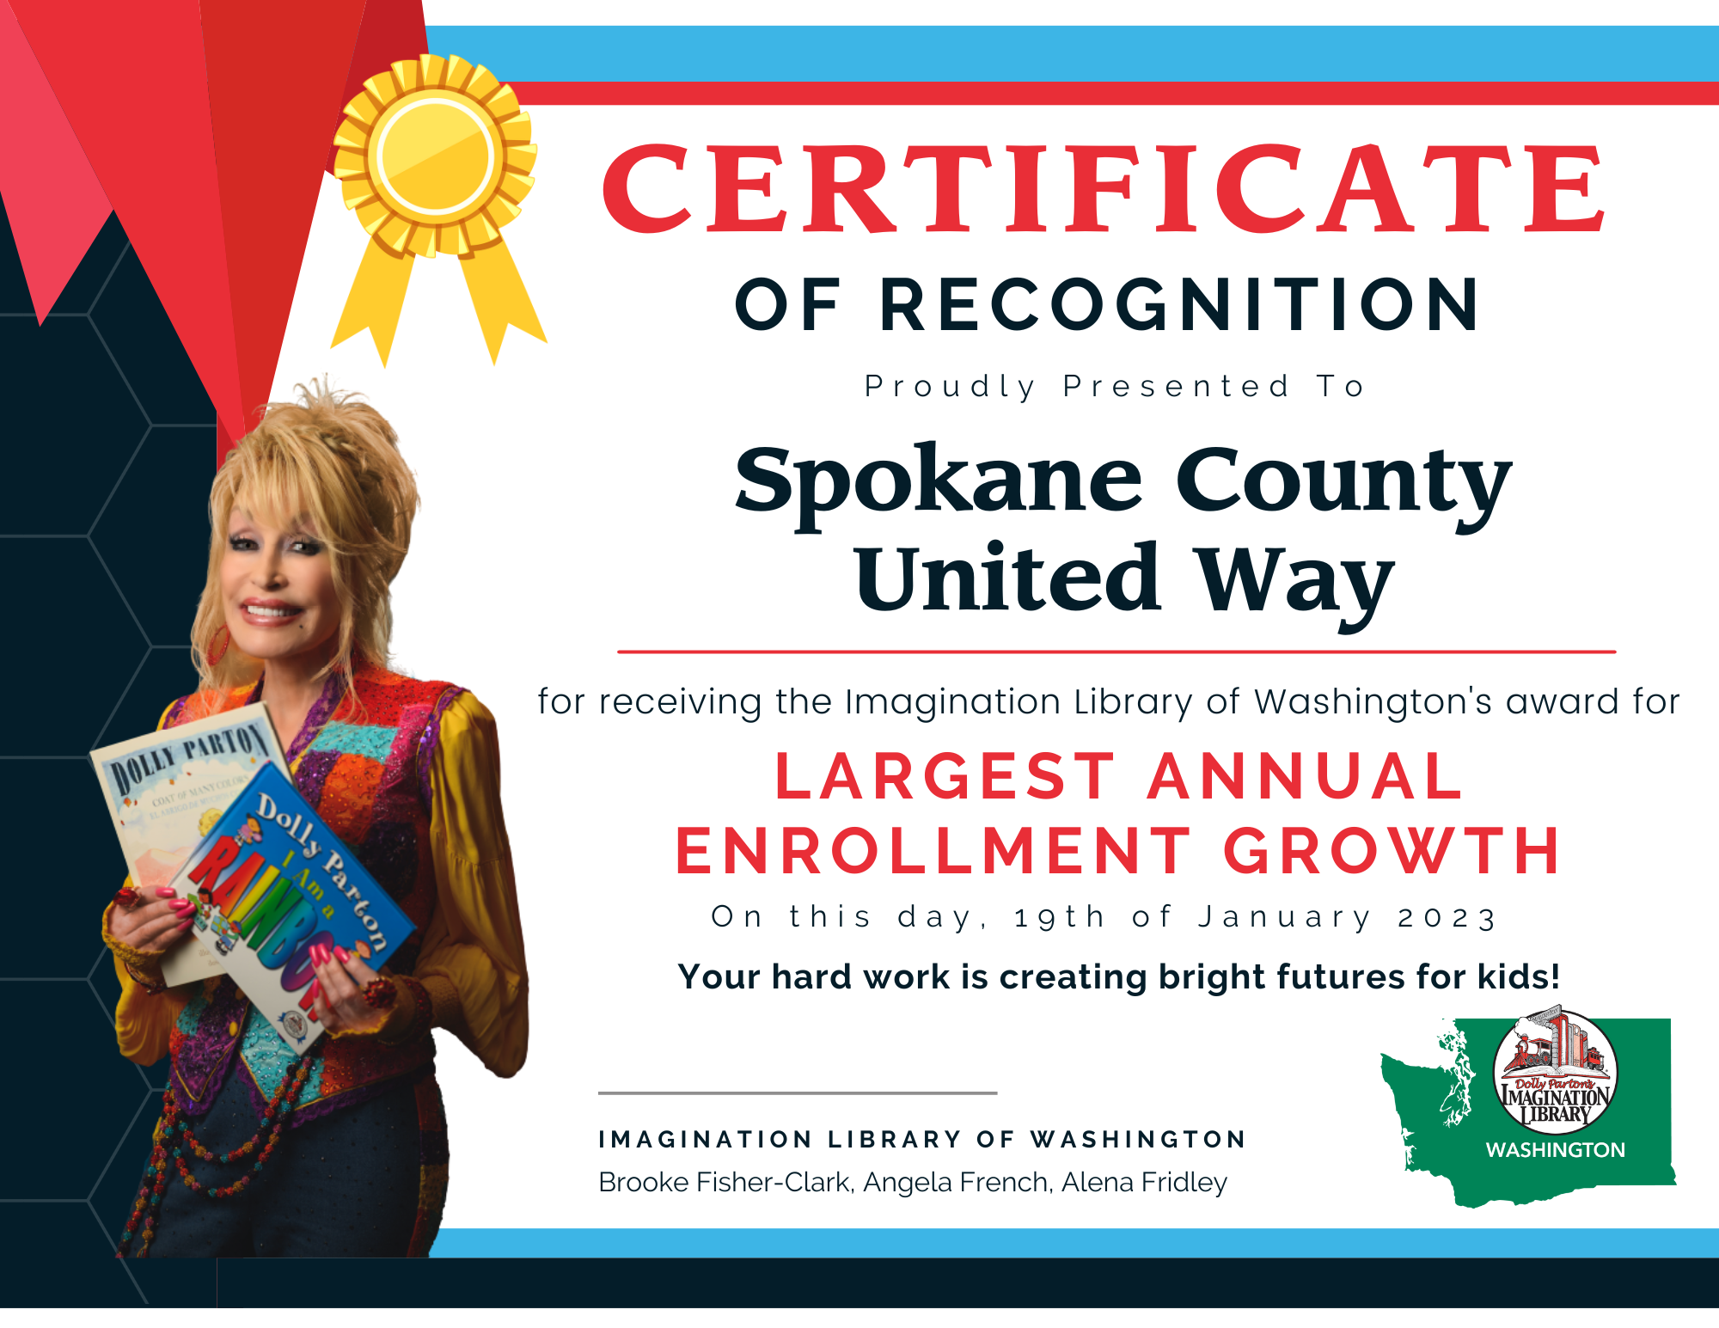
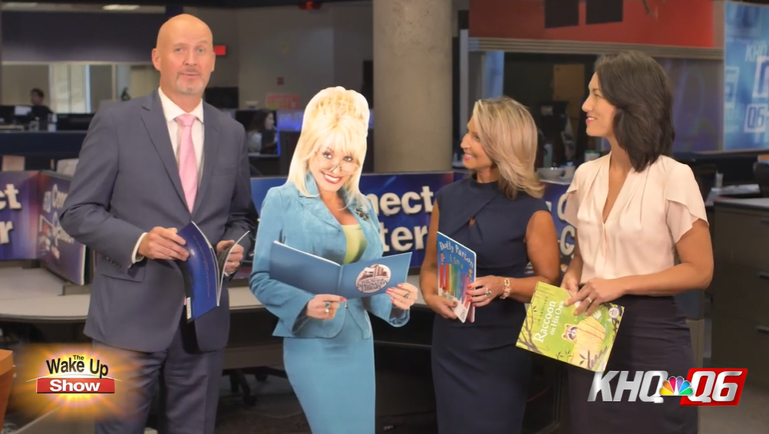
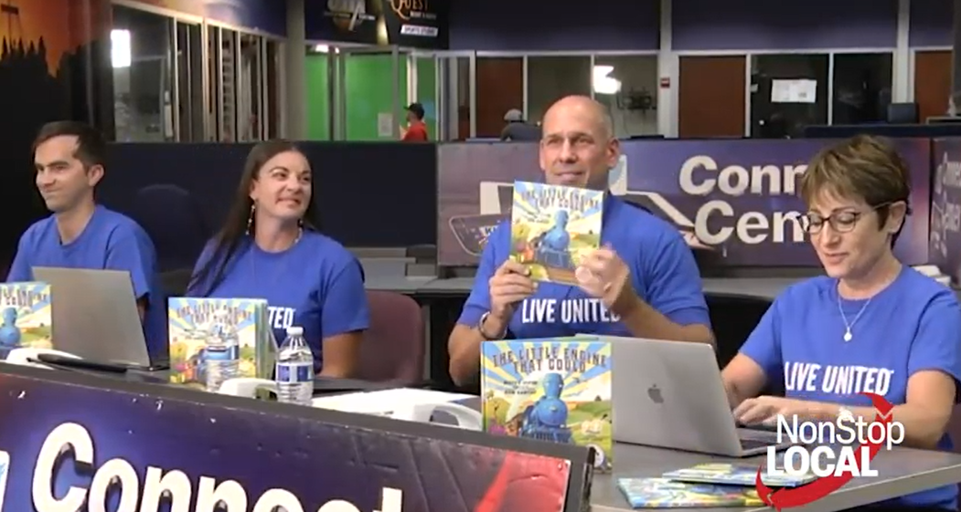

Spokane County United Way #1 in WA!
https://www.unitedwayspokane.org/freebooks

