Slide 1
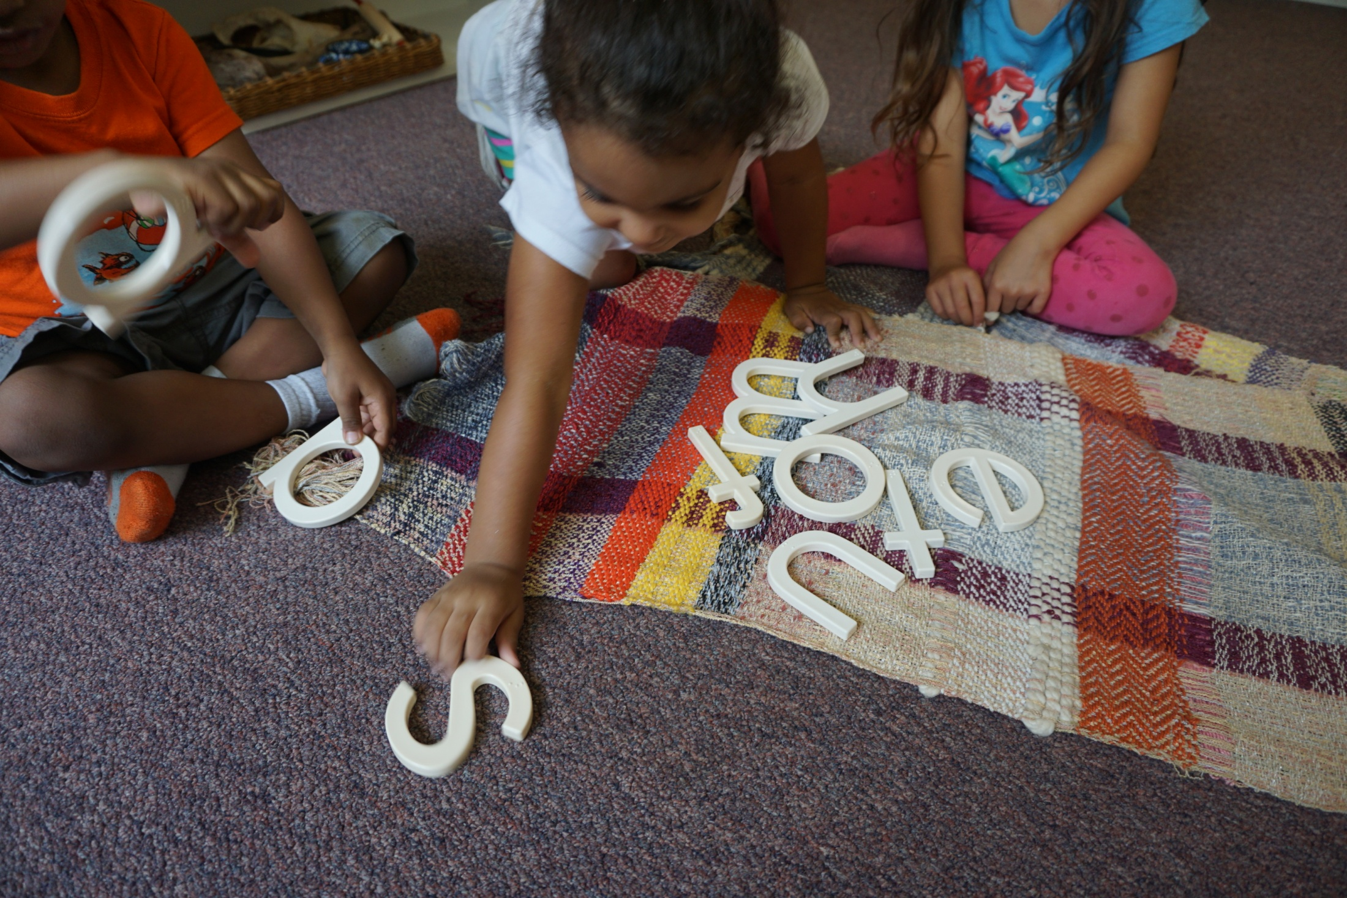
Souns
September 2016

Slide 2
Background
A $100,000 Global Grant for early literacy
In commemoration of 100 years of Rotary in Puerto Rico.
This will be the fourth early literacy, Souns based project undertaken in Puerto Rico.
We also participated in a Souns GG in Georgia.

Slide 3
Partners
Municipio de San Juan Head Start
New York Foundling Head Start, Santurce
Fundación para el Desarrollo del Hogar Propio Head Start, Caguas
Programa de Headstart Municipio de Mayagüez
Rotaractors
CR Cuidad de Turabo
CR Juncos
CR Mayagüez
CR Rio Piedras
CR San Juan

Slide 4
Grant History
This will be fourth Souns project in Puerto Rico since 2011 and one which has had the active participation of the Rotary Clubs in Districts 6900, 6990 and D7000.
Year initiated |  | 2011-12 |  | 2012-13 |  | 2013-14 |  | 2014-15
Grant Number |  | MG 76806 |  | MG 79436 |  | GG1412635 |  | GG 1523886
Amount |  | $27,000 |  | $18,000 |  | $37,400 |  | $40,000
Districts |  | D6990 |  | D6990 |  | D6900 |  | D6900
 |  | D7000 |  | D7000 |  | D7000 |  | D7000
Clubs |  | Ft. Lauderdale South |  | Ft. Lauderdale South |  | Peachtree City |  | Peachtree City
 |  | Rio Piedras |  | Rio pIedras |  | Rio Piedras |  | Henry County
 |  | San Juan |  |  |  | San Juan |  | Rio Piedras
 |  | Isla Verde Carolina |  |  |  |  |  | San Juan
 |  |  |  |  |  |  |  | Mayaguez
 |  |  |  |  |  |  |  | Juncos
 |  |  |  |  |  |  |  | Cuidad del Turabo
 |  |  |  |  |  |  |  | Rotaractors
# Classrooms |  | 135 |  | 90 |  | 103 |  | 200
# of Children |  | 2700 |  | 1800 |  | 2353 |  | 4000
Area impacted |  | Head Start |  | Head Start |  | Head Start |  | Head Start
 |  | San Juan |  | San Juan |  | Georgia |  | Mayaguez
 |  |  |  |  |  |  |  | San Juan
 |  |  |  |  |  |  |  | Caguas

Slide 5
Recap
Total Souns Grants in PR : $85,000 / Total Classrooms in PR : 425
We estimate over 10,000 children have been impacted since inception
If 100% of the sets are in-use and there are 20 children per classroom, the existing program can impact up to 8,500 preschoolers , year after year!

Slide 6
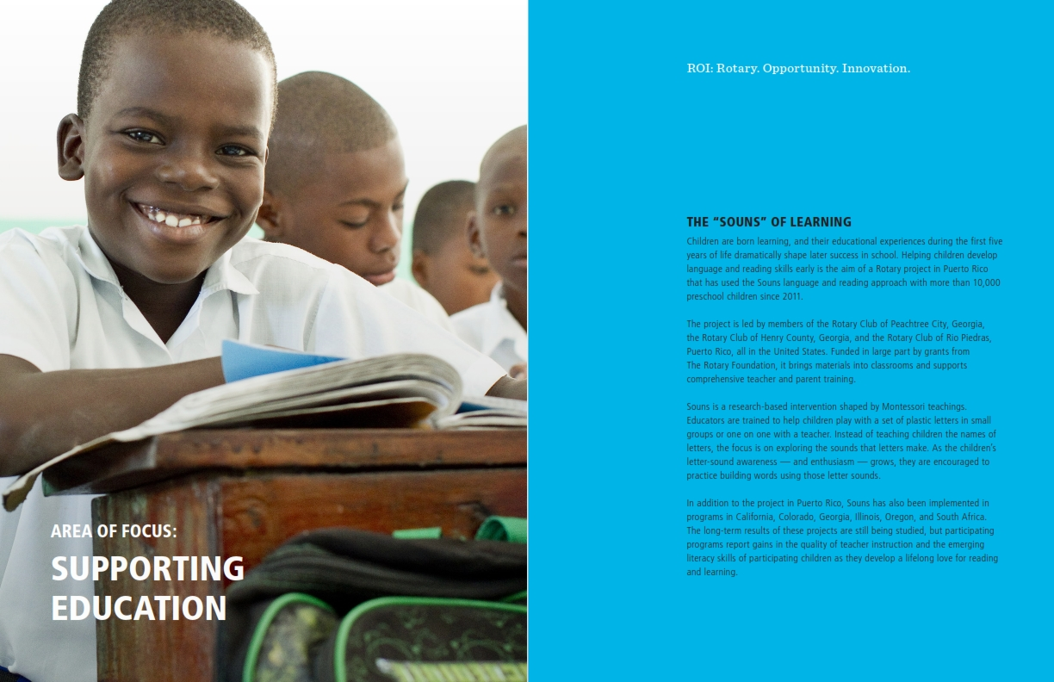
Area of Focus : Supporting Education

Slide 7
The Souns of Learning
Children are born learning, and their educational experiences during the first five years of life dramatically shape later success in school.
Helping children develop language and reading skills is the aim of a Rotary project in Puerto Rico that has used the Souns approach to learning to read with more than 10,000 preschool children since 2011.

Slide 8
Materials / Training
Projects have been led by members of the Rotary Club of Peachtree City, Georgia, the Rotary Club of Henry County, Georgia, and the Rotary Club of Rio Piedras, Puerto Rico.
Funded in large part by grants from the Rotary Foundation, the project bring early literacy materials into classrooms.
Teacher and parents are trained by Rotary Souns volunteers.

Slide 9
Exploring Letters Sounds
Souns is a research-based intervention shaped by Montessori teachings.
Educators are trained to help children play with a set of uniquely designed letters in small groups, or one-on-one with a teacher.
Instead of teaching children the names of letters, the focus is on exploring the sounds that letters make.
As the children’s letter–sound awareness and enthusiasm grows, they are encouraged to practice building words by listeing to the letter sounds in them.

Slide 10
Gains in Emerging Literacy Skills
In addition to Puerto Rico, Souns has been implemented in California, Colorado, Connecticut, Georgia, Illinois, Oregon, Texas and in several provinces in South Africa.
The long term results of these projects are still being studied, but participating programs report gains in the quality of teacher instruction and the emerging literacy skills of participating children as they develop a lifelong love for reading and learning.

Slide 11
Results
Georgia
Texas
SW GA Community Action Council reflects less than 2% of 2,163 children in 180 classes and 24 sites scored below expectations in letter-sound knowledge for the 2015/2016 period.
That result is significant as at least 10% of the student population are required to be special needs children per Head Start guidelines
PTISD reported that of 602 children :
    454 build words (75%)
    412 sound out words (68%)
    359 write words (60%)
    331 reads (55%)
    303 sound out sentences (50%)
    281 write sentences (47%)

Slide 12
Goals
(1) Build emergent readers so the children can direct their own future, and
(2) Prepare teachers to impact their classrooms in the same beneficial way for years to come.

Slide 13
Bringing Souns to the Classroom
Both students and teachers are beneficiaries to this project.
  The students build literacy skills
  The teachers receive training and materials to implement the Souns program year after year.
There are no expendables.
There is guardianship: If the letters are not being used, they must be returned for use in another classroom.

Slide 14
What is involved?
Literacy projects based on the Souns program include classroom materials funded by the grant request.
  Each classroom hosts 20 children a year.
  Classroom materials are re-usable year after year.
Training for the Souns program is an integral part of the project, but is freely given by Rotarian Volunteers serving Rotary.
  Teacher training is provided free of cost by Rotary Volunteers.
  Those from abroad pay their own travel, room and board.

Slide 15
Training
As the training of classroom teachers unfolds, on-site candidates for Souns teacher-trainers are identified and developed during the life of the project.
By the end of the project there are typically two to three on-site Souns teacher-trainers equipped to continue the work.
The intense, regular training and monitoring of teachers and the development of on-site teacher trainers ensures the sustainability of the Souns program well past the life of the grant.

Slide 16
Host Partner
Will support the work by participating in the training sessions, monitoring good practice in the classrooms through periodic visits, and collecting data and images for publicity opportunities and sharing them with the International Partner.
The host partner will also coordinate with the Souns trainers to ensure all of the details are addressed – making sure classroom materials are ready for distribution at the conclusion of the training session, introducing Rotary to the attendees, and sharing the story and purpose of Rotary, particularly its focus on literacy.

Slide 17
International Partner
Will participate as circumstances allow. Their club should be introduced to the project, briefed on the Souns for literacy program so they can share this work in their District.
One major assist as an international partner is to provide support for publicity, collecting anecdotes and images from the Host Club to send to newspapers and other publications, including Rotary.
Contributing to the final report is vital for the International partner.

Slide 18
Vision
To measure the impact of 3 matching grants over a five year timeframe (2011-2016) and double Souns outreach over the next three years (2016-1018).
Present 2-3 achievable goals per annum.

Slide 19
Goals 2016-2017
Engage participation of clubs where Head Start / Early Start have offices.
Procure funding and submit Global Grant for approval.

Slide 20
Goals 2017-2018
Launch SOUNS training in the following Head Start and Early Start training centers: Aguada, Caguas, Dorado, Fajardo, Guayama, Humacao, Manati and Quebradillas.
Coordinate hands- on training to coincide with visits of RI President John Germ and PRID Robert Hall (and RI Director Joe Mulkerrin).

Slide 21
Goals 2017-2018
Feature Head Start / Early Start Representative at District Conference
Plan on Rotarians from participating districts to attend a formal ribbon cutting ceremony.

Slide 22
Head Start – Early Start
Overseen by ACUDEN – Administración para el Cuidado y Desarrollo Integral de la Niñez.
The programs promote pre-school preparation for children of low income families.
They provide a learning environment supporting children’s growth in the areas of language, literacy, cognition, general knowledge, physical development, health, social development and learning focus.
19 Regional offices. Dra. Nayda Negron Montalvo Director / Dr. Edder Gonzalez Acosta Deputy Director.

Slide 23
Geographic Scope
Reach out to Rotary Clubs in Dorado, Fajardo, Guayama, Humacao/Palmas, Manati, Quebradillas and Vega Alta to explore partnerships with local Headstart offices in these municipalities.
As of 01.07.12 the structure of the population included 209,597 children between the ages of 0-4 and 225,853 children between the ages of 5-9.

Slide 24
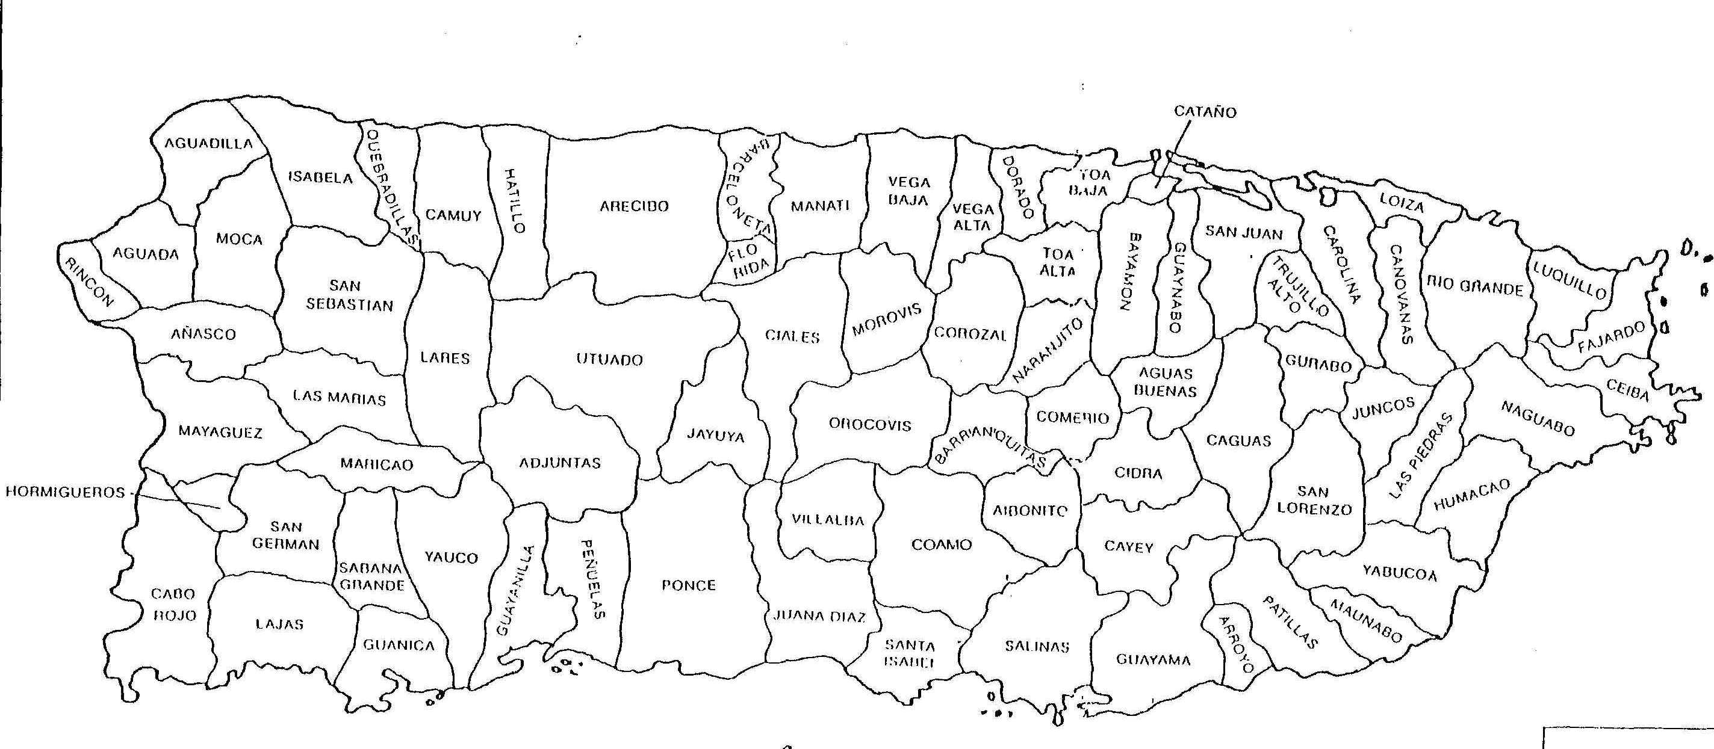
Actual/Target Market
Where Souns is currently present: (pins on map of Puerto Rico)

Slide 25
Funding
Global Grant Budget Total - $100,000 (500 classrooms)
Rotary Clubs combined contribution $25,000
District Match (combined) $31,250
TRF match $43,750
Funds are committed to clubs, but no funds are given to their district until grant approved.

Slide 26
Scalable : (funding at 20% of goal)
RC of SJ
D7000
RC of PC
D6990
Your Club
Your District

Slide 27
Target Clubs/Districts
California D5280
Colorado
Georgia D6900
Florida D6990
South Carolina
St. John D7020
Illinois
Oregon
South Africa
DG Sylvia Maisonet and RFC Pablo Roman on board.
Rotary clubs in Puerto Rico can participate in any capacity.
Obtain contact details for each of the past Souns District and Club participants.

