Slide 1
RURAL FAMILY GREENHOUSES
N. Oaxaca State, Mexico
URotary + Clinton Rotary + 2 Mexico City RC’s + 1 Oaxaca RC

Slide 3
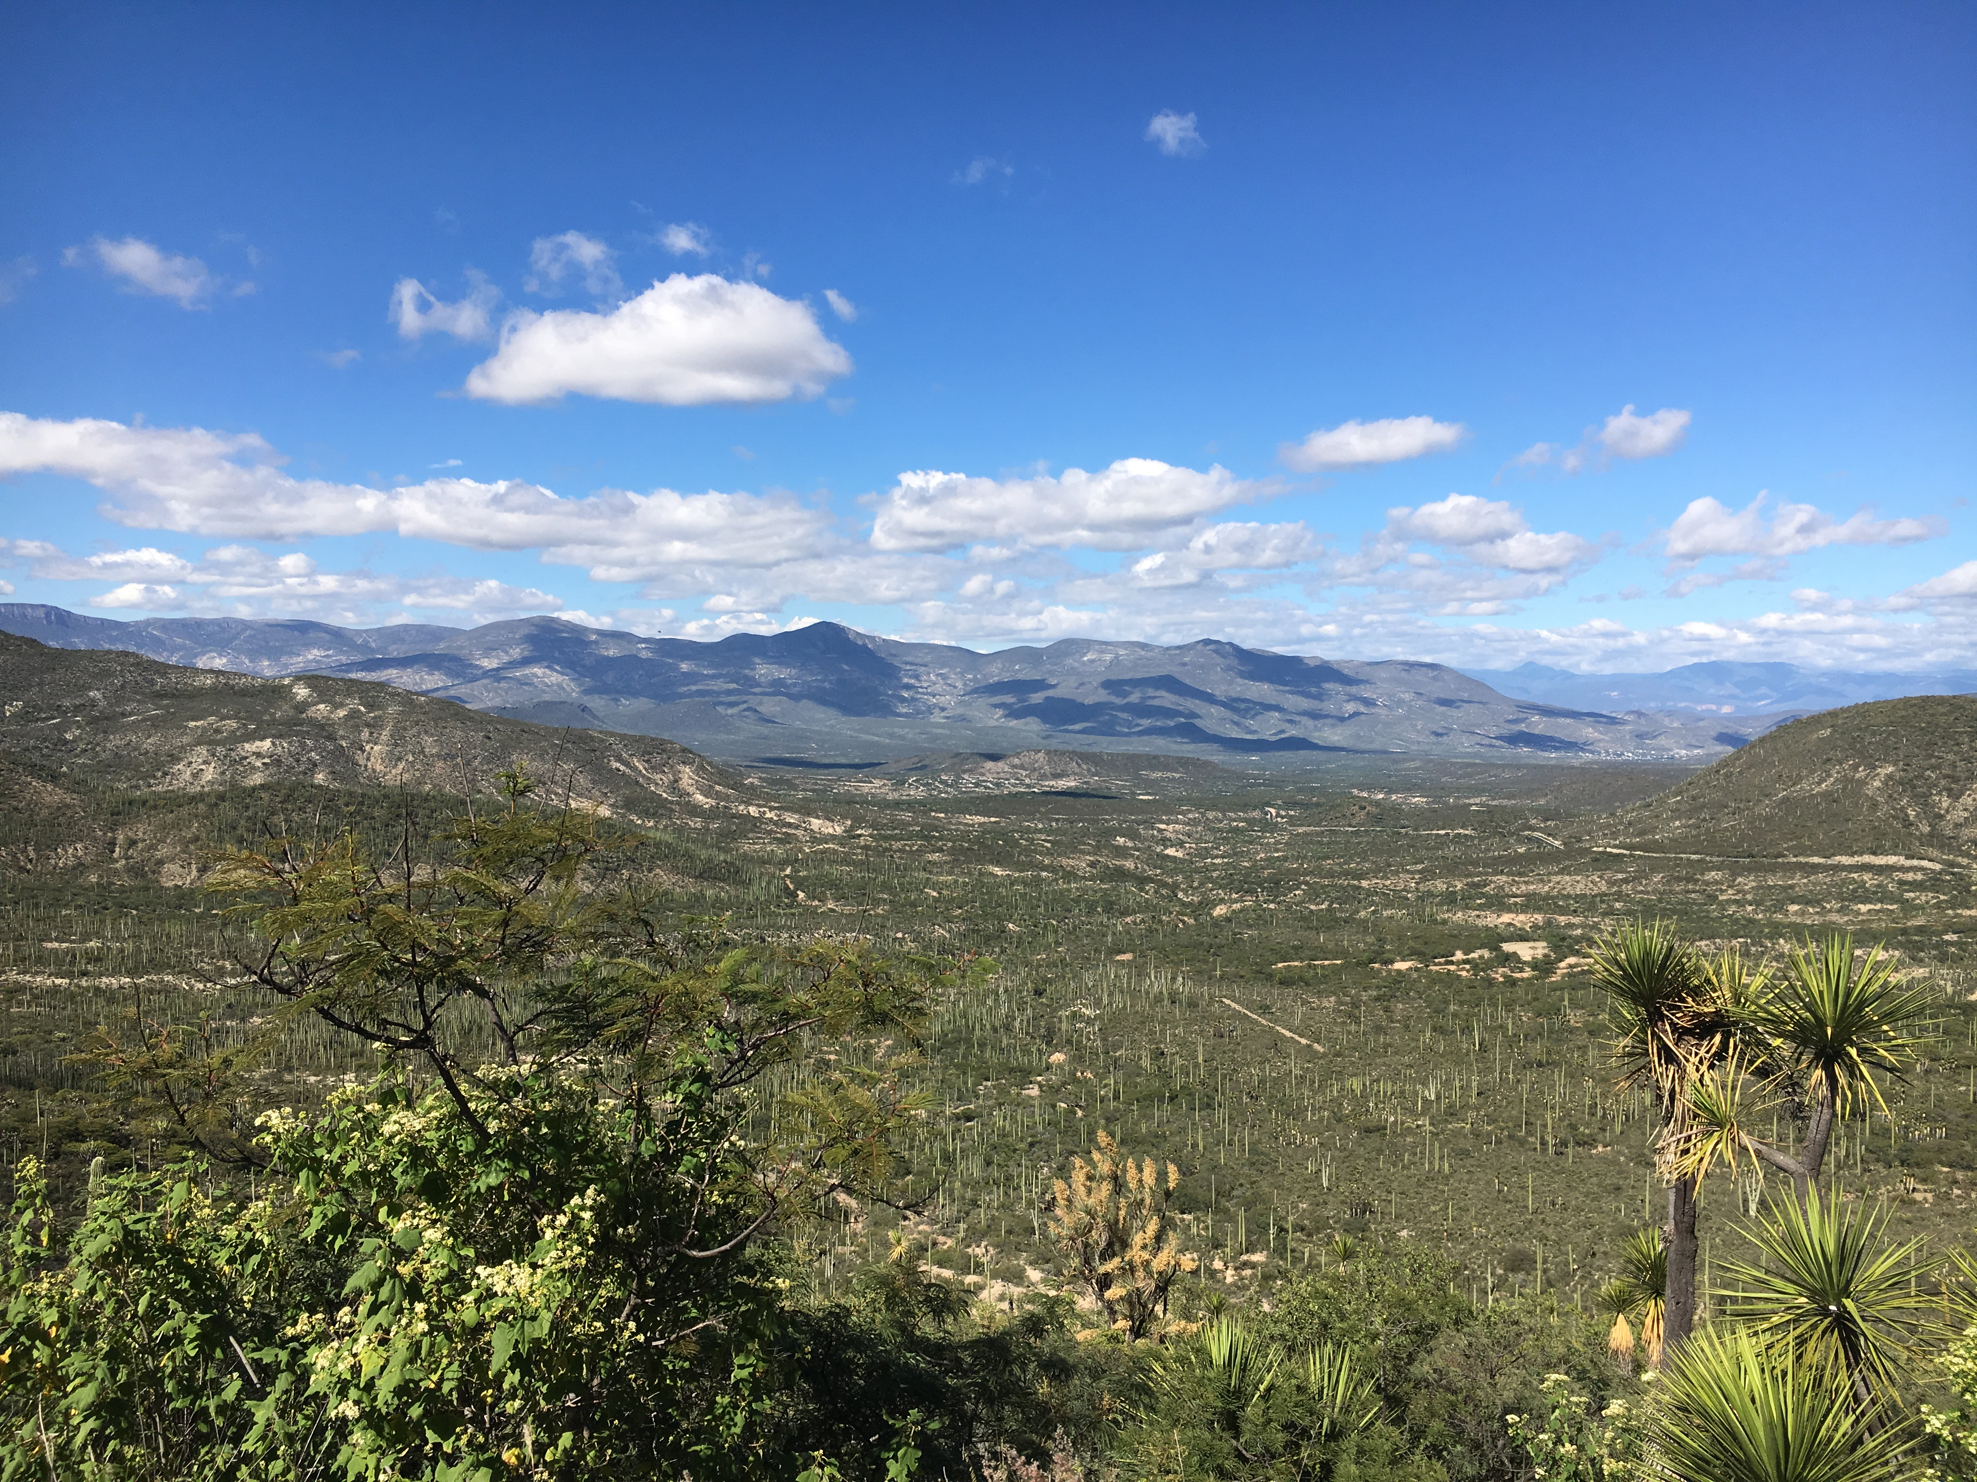

Slide 4
Mixteca area of N. Oaxaca
Extreme marginalization
Mixtec ethnic groups
Subsistence farming
Increasing drought; irregular rains
Food poverty:
land can no longer produce enough traditional corn & beans to support families

Slide 5
Beneficiaries
Marginalized farming villages
Devastated by climate change
Men leave farms to work in cities, abroad
Women left w/children & elders

Slide 6
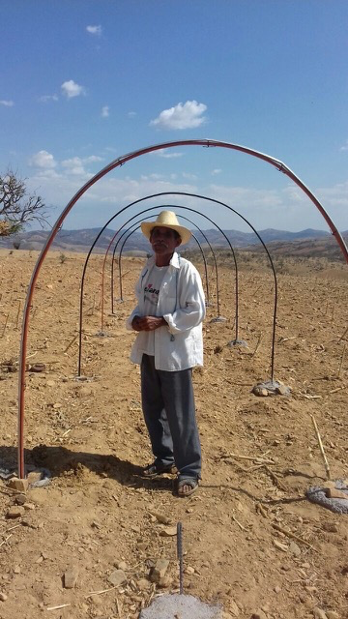

Slide 7
Rotary Solution: Family Greenhouses
Tested by Mexico City Rotarian born in Oaxaca
Help from local Huajuapan de León Rotarians, farmer volunteers
Team from Mexico City travelled many times to Oaxaca (5-hr. drive)
Farmers gave feedback, team tested materials, suppliers, crops, seed species, planting methods
Result: ea. greenhouse 10 m. X 5 m. X 3 m., cistern, drip irrigation, permeable mesh netting, improved soil for water retention
Ea. greenhouse produces 6-8 crops/yr. of tomatoes
Other crops: onions, chilies, cilantro, strawberries, beans, zucchini, herbs, etc.
Cost: est. US$325/greenhouse

Slide 8
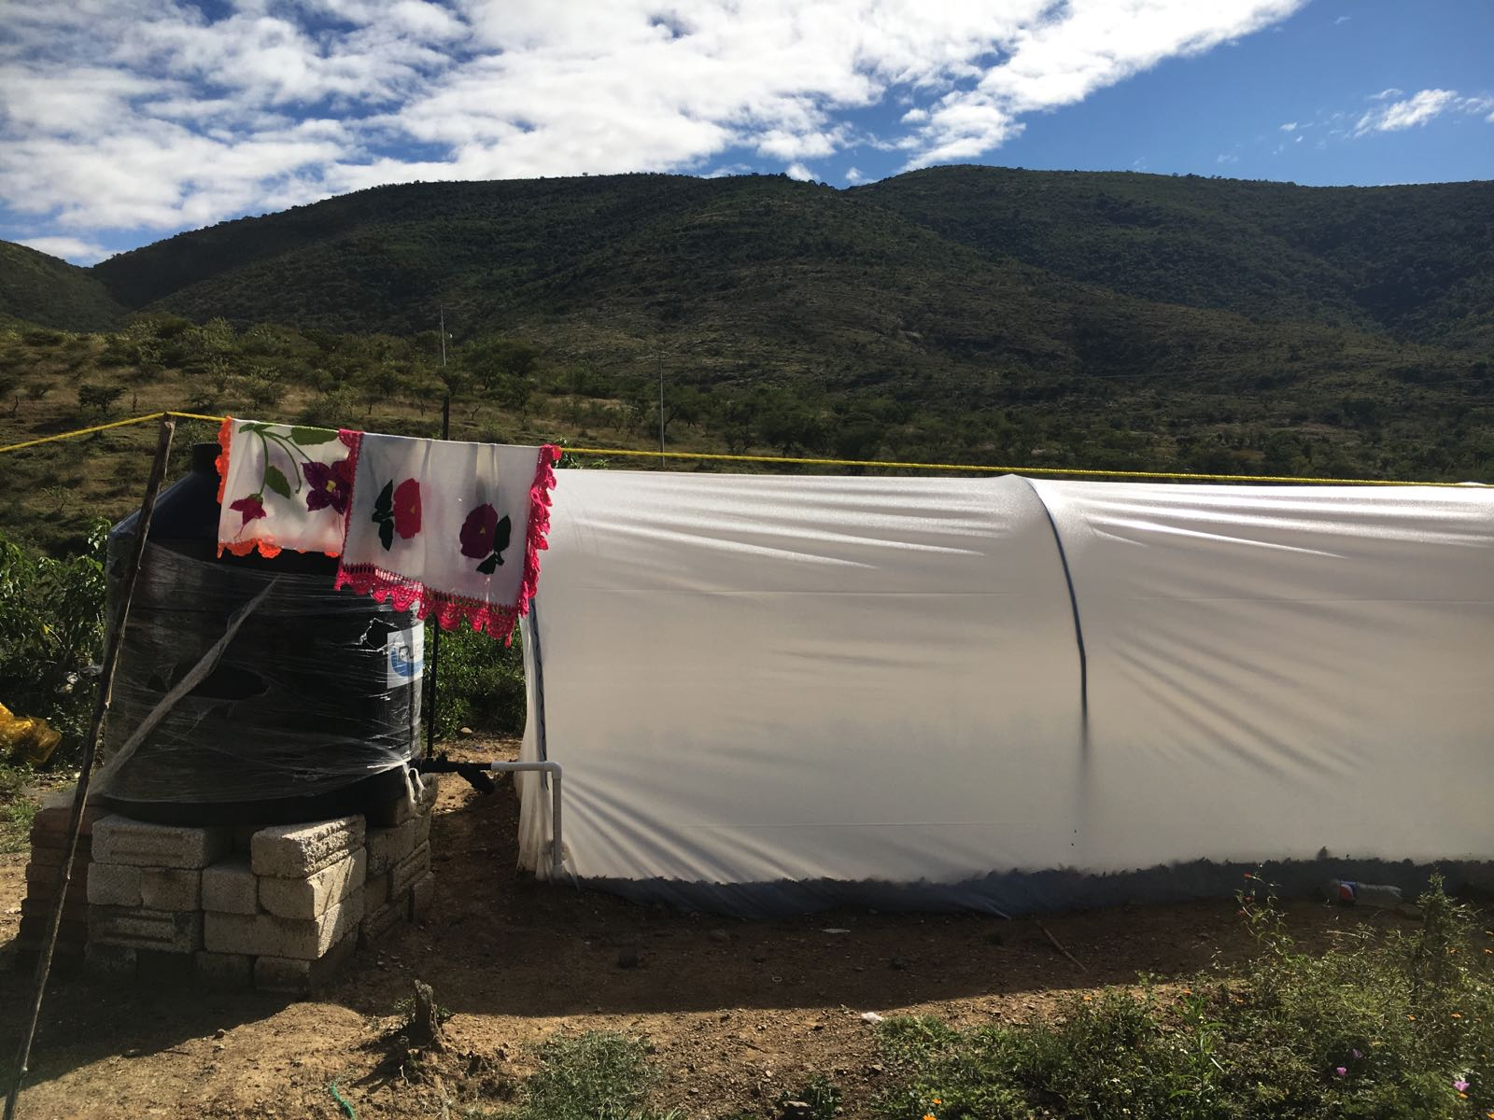

Slide 9
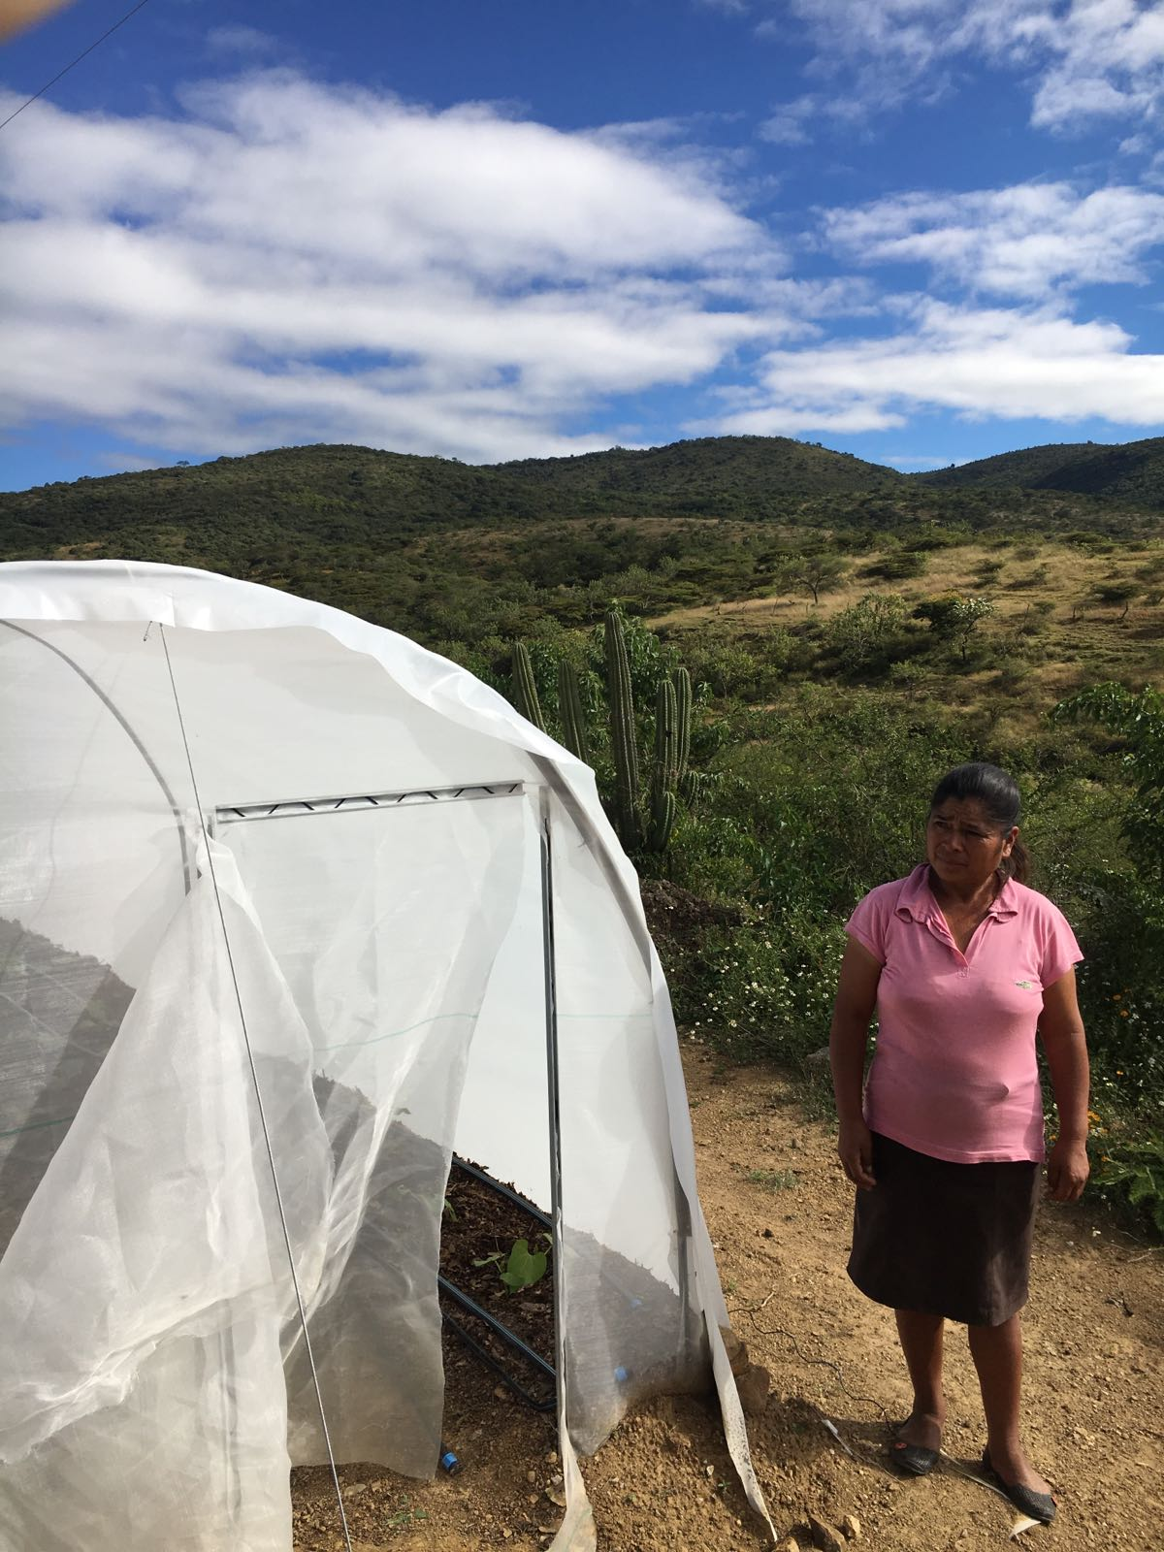

Slide 10
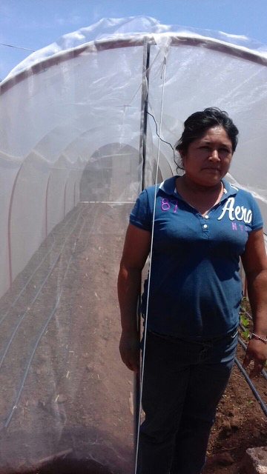

Slide 11
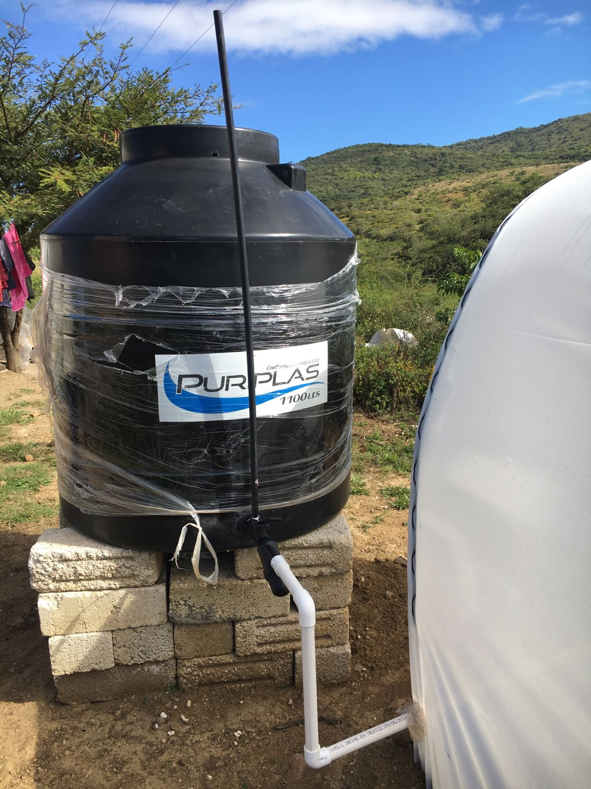

Slide 12
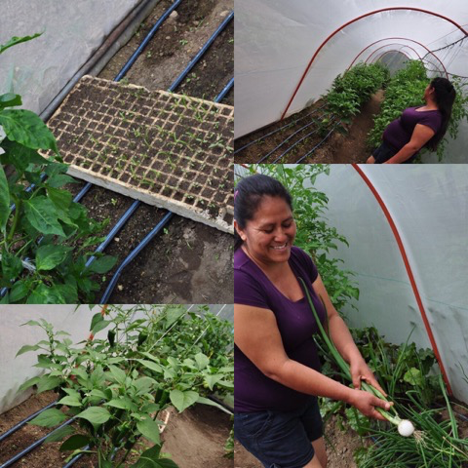

Slide 13
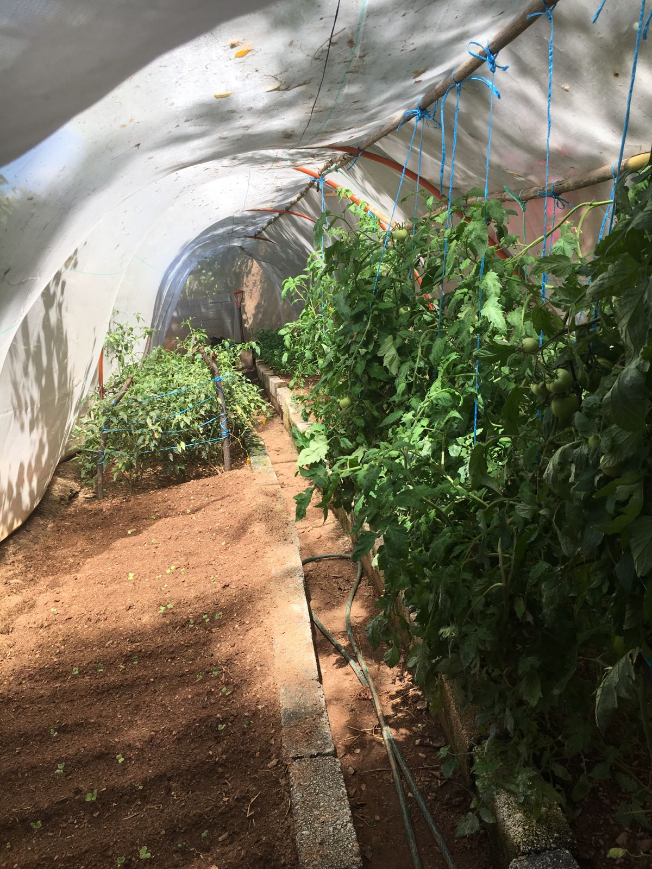

Slide 14
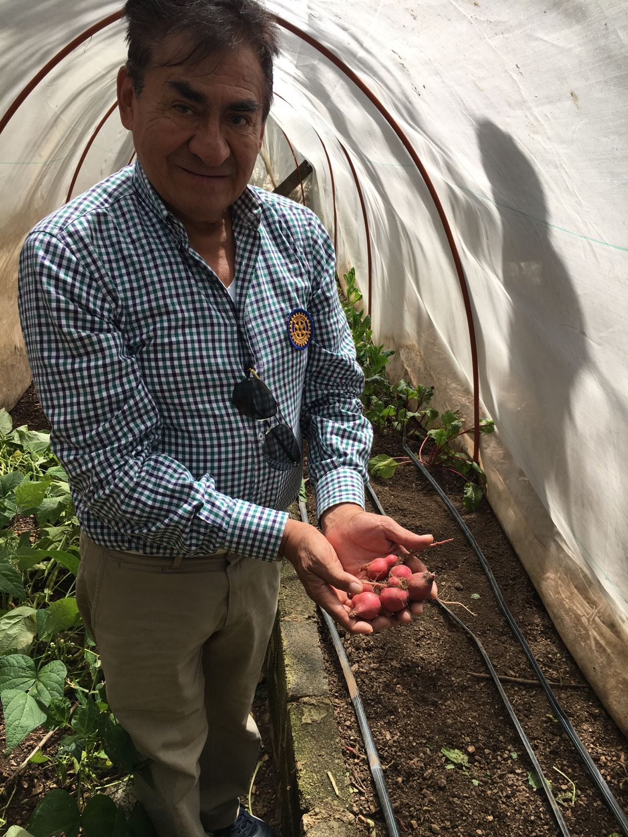

Slide 15
Success!
To date: 100+ greenhouses in countryside around Municipality of Huajuapan de León, Oaxaca, one of poorest areas of Mexico
6+ greenhouses at schools, orphanage
Sustainable - netting lasts est. 5-6 years
Organic - no pesticides; only natural fertilizers, compost
Collateral benefits: participants must be non-violent family w/children in school, plot of land, willing to sign agreement to maintain greenhouse, attend training
Education: rural schools incorporate greenhouses into curriculum, leading to study of plant biology, climate change, etc.
Families stay together, collaborate; more free time for other work
Great Rotarian collaboration: 6+ clubs so far
Good base for expanding family income-producing ventures

Slide 16
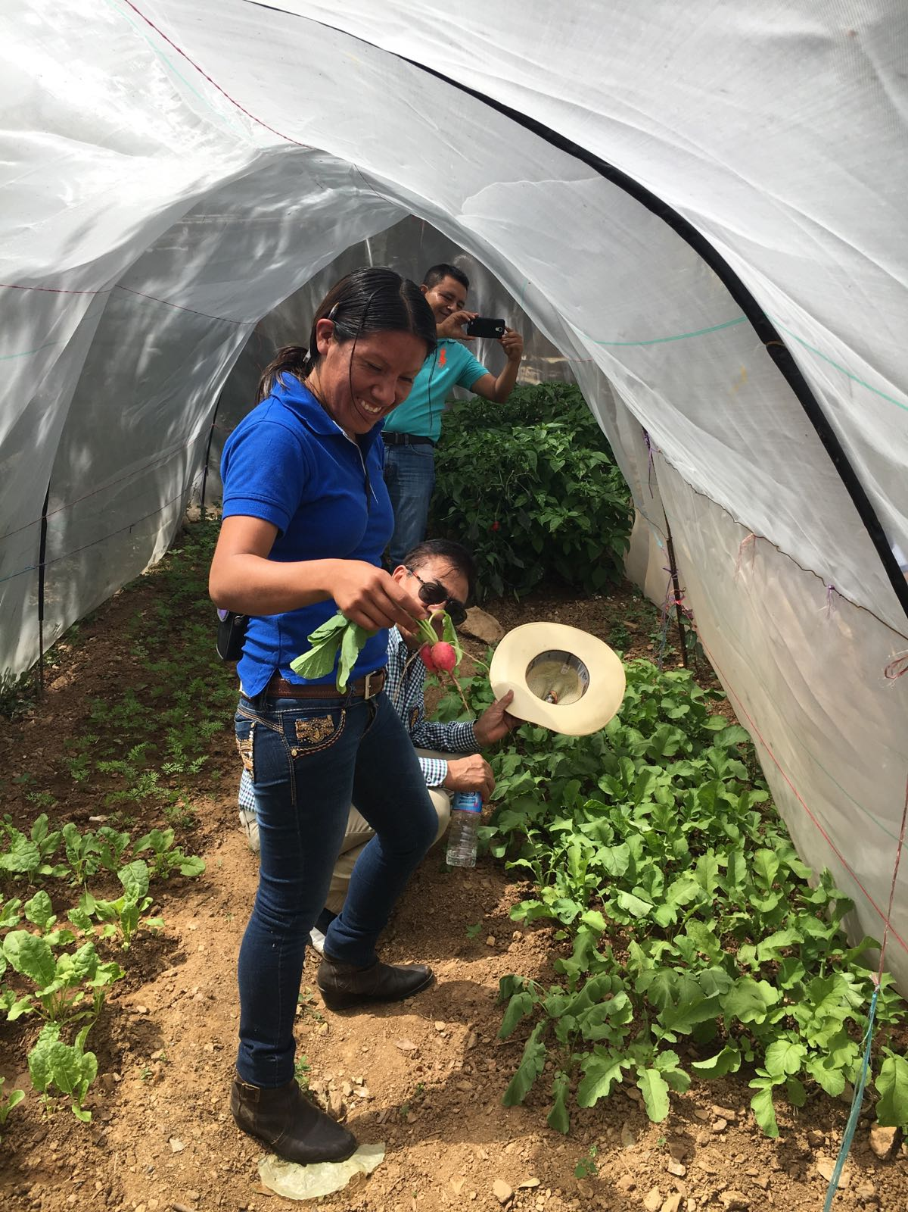

Slide 17
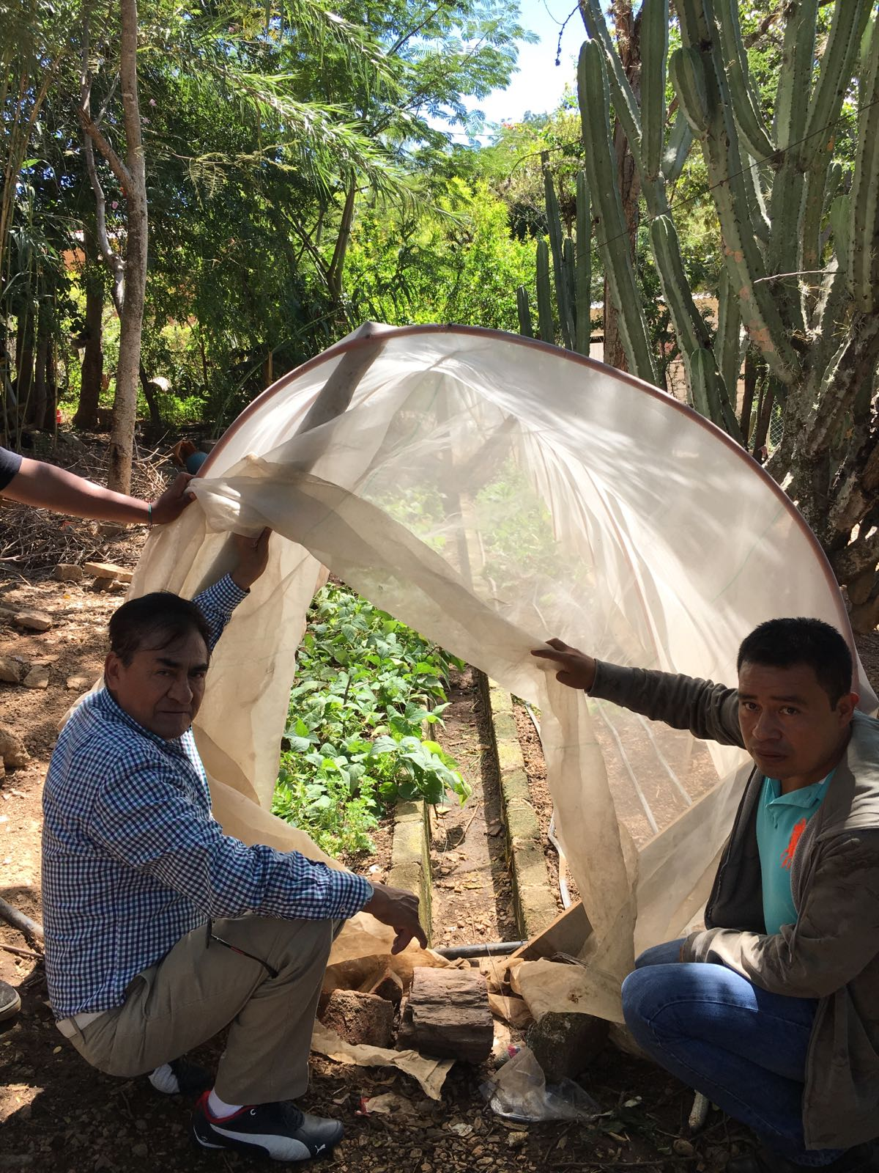

Slide 18
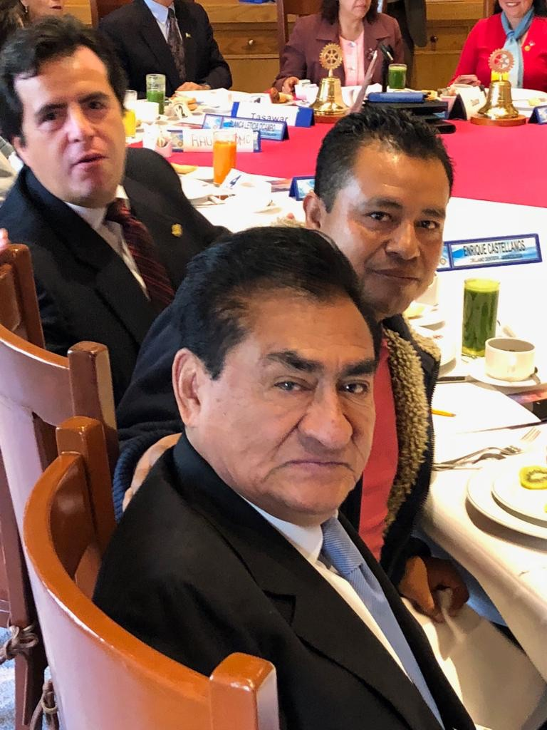
THE LEADERS:
Alejandro Flores (top) and
Claudio Cruz (bottom) - Club Rotario Plateros Centro Histórico, Mexico City; Victor Hugo Martínez (center), local project leader
Claudio is originally from Huajuapan de León, Oaxaca, and started the project
Alejandro (President-elect) led the Community Service Committee and supported his efforts
Victor has been the long-time project lead, educator and director on the ground in Huajuapan de León, near where he is from.

Slide 19
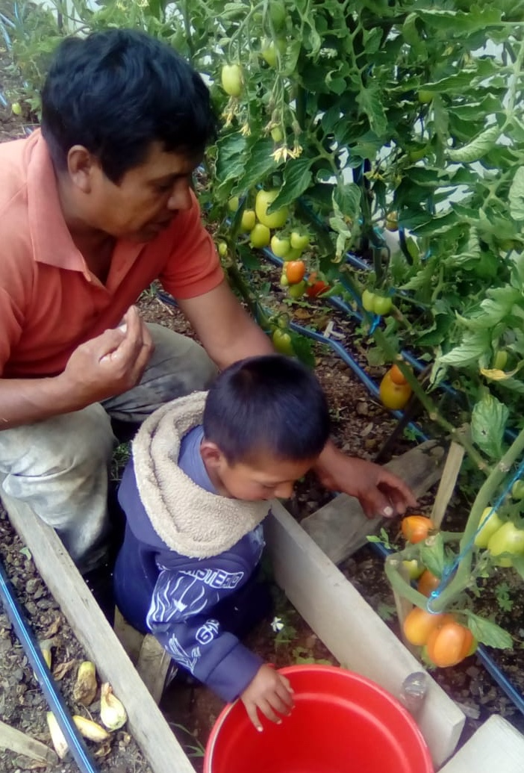

Slide 20
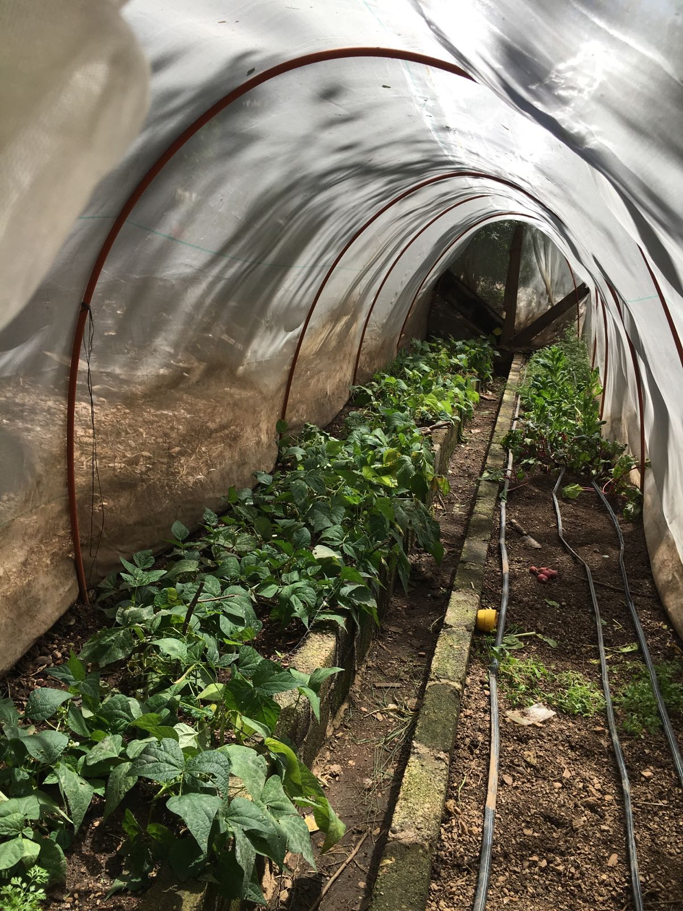

Slide 21
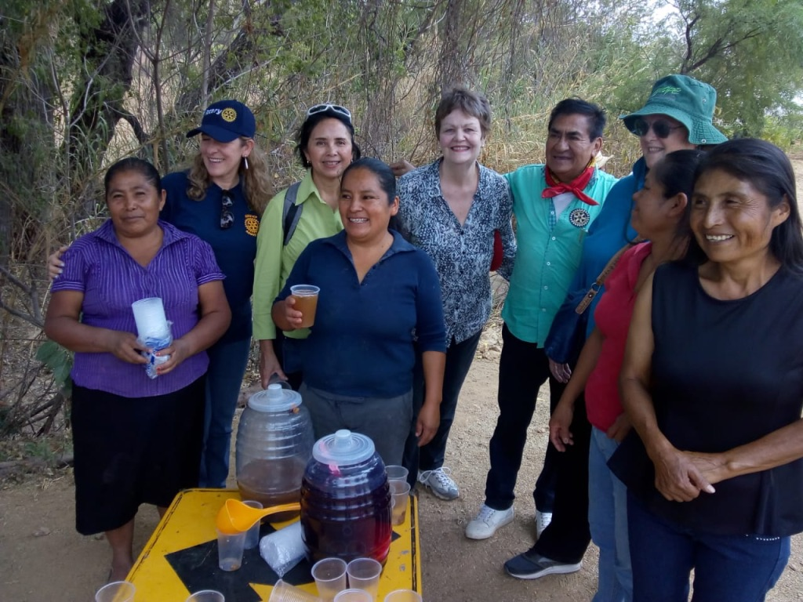

Slide 22
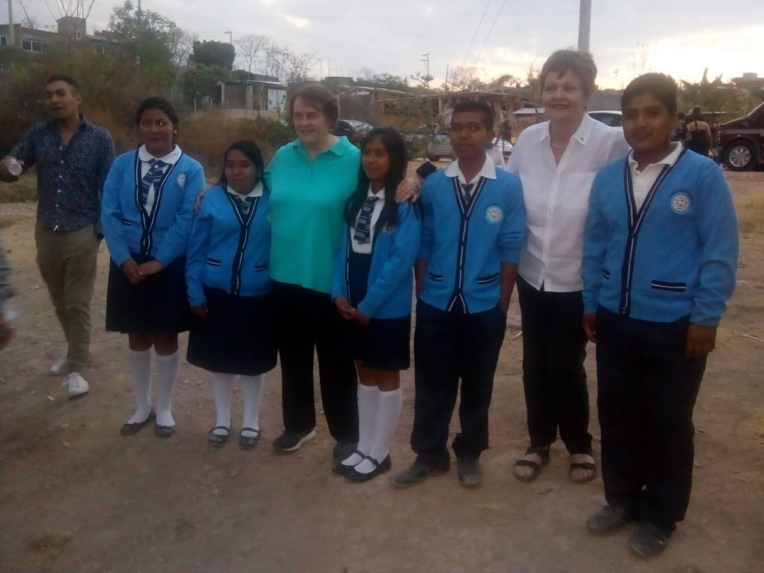

Slide 23
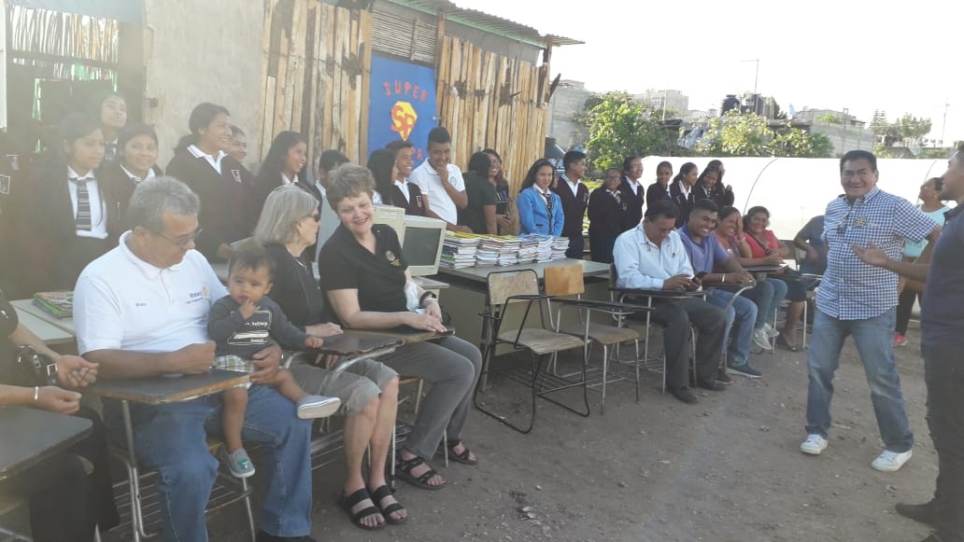

Slide 24
Project Goals
Keep families together - avoid father leaving land to look for work
Nutrition - especially children
Water conservation
Agricultural education, improved methodologies, new crops
Preserve & honor Mixtec language & culture
Economic self-sufficiency, participation of women
Rural school support; health education
Community development, cohesion, collaboration among rural farmers
Strengthening of Mexican Rotary, especially in poorer areas
Development of US-Mexico friendships

Slide 25
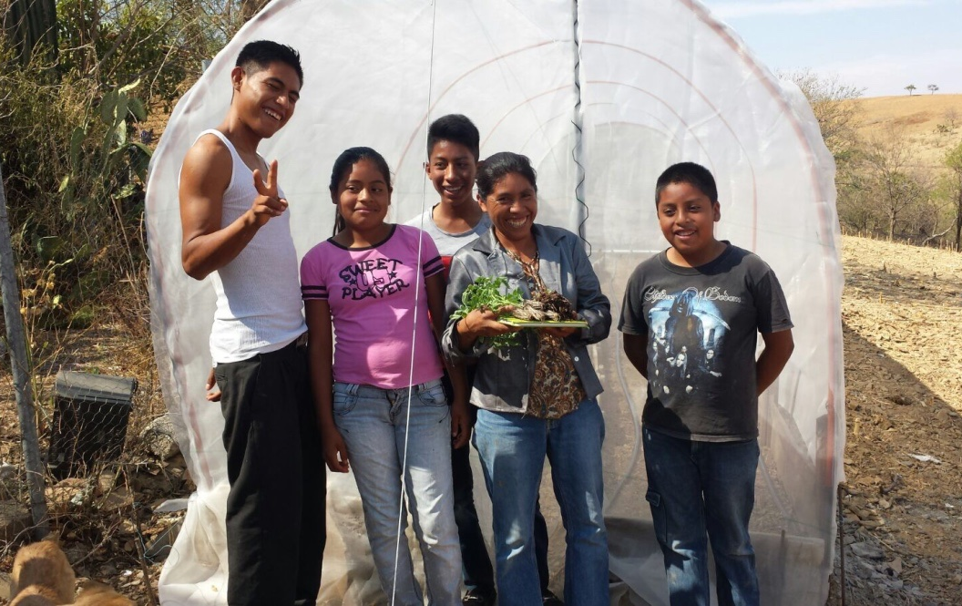
Young people with vegetables they have grown in greenhouse

Slide 26
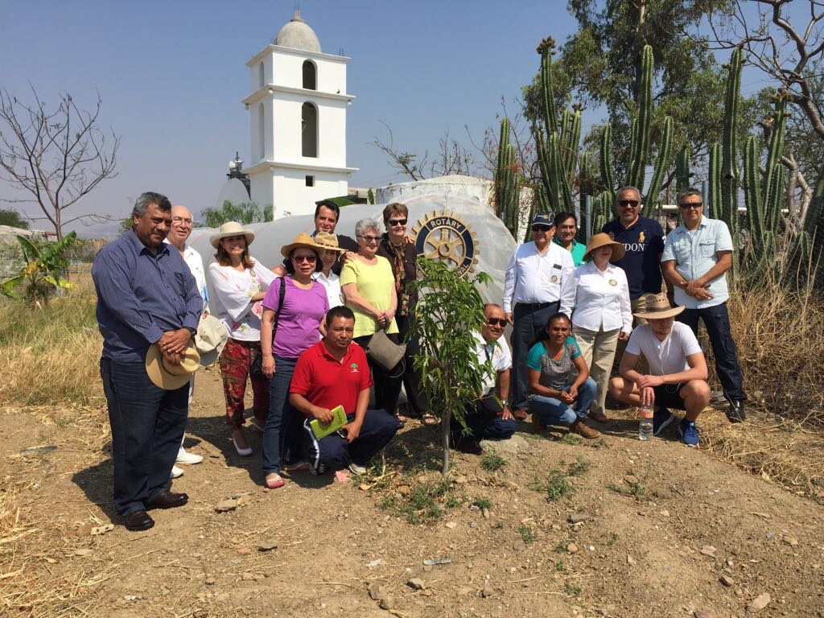

Slide 27
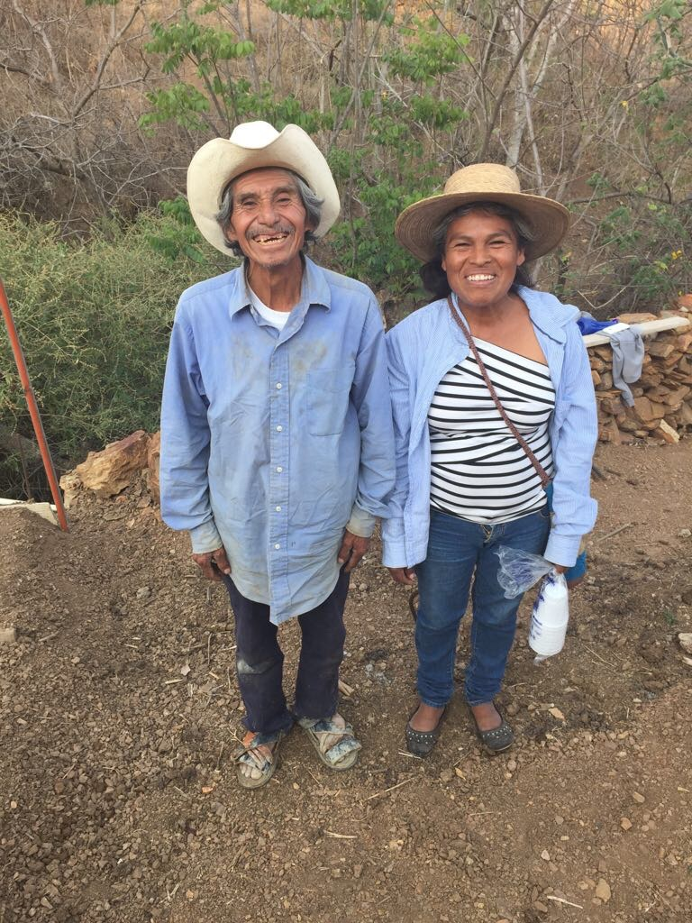

Slide 28
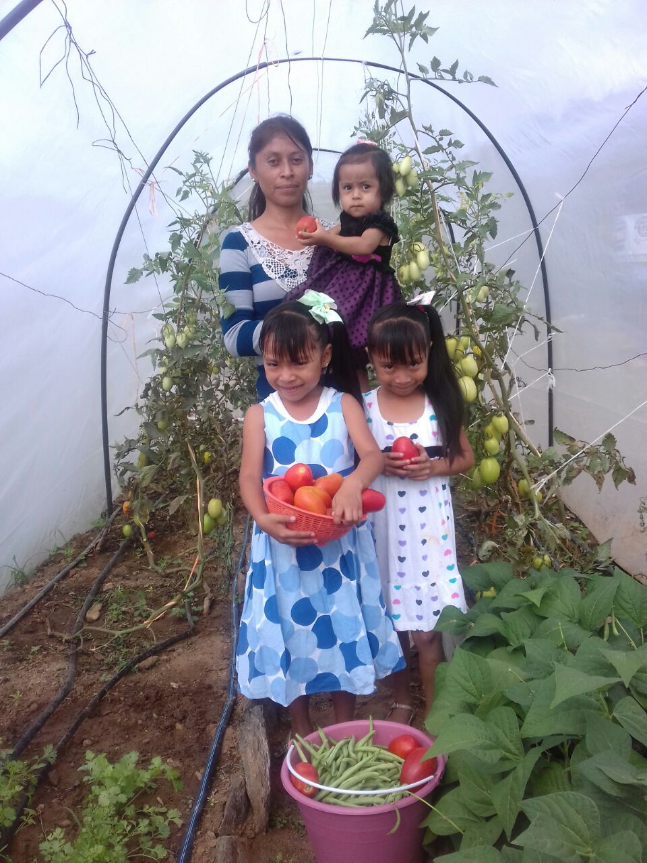
¡GRACIAS, ROTARY!

