Slide 1
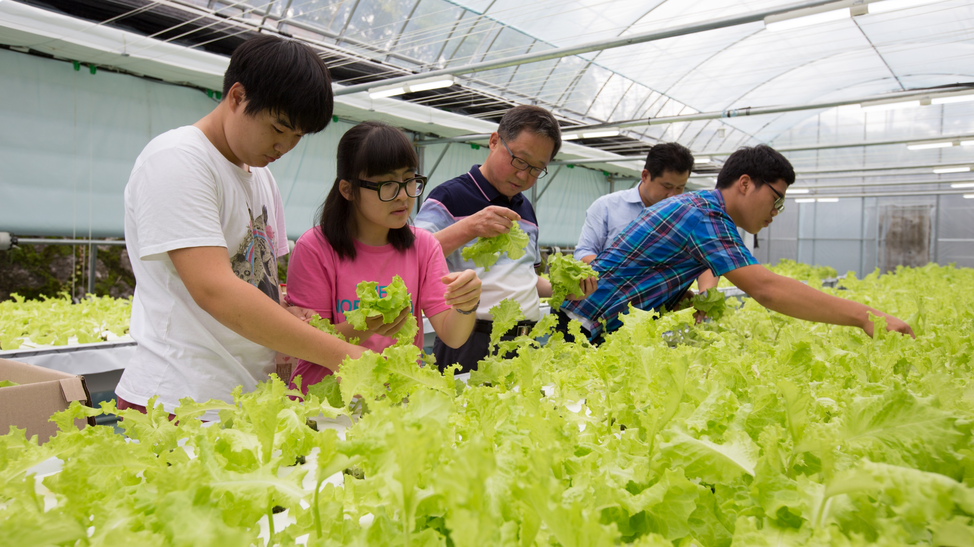
Vocational Service

Slide 2
Vocational Service
Through vocational service we:
  Serve others by using our unique skills to address community needs
  Empower others through training and skill development
  Inspire others to act with integrity by following Rotary’s guiding principles
One of Rotary’s Avenues of Service

Slide 3
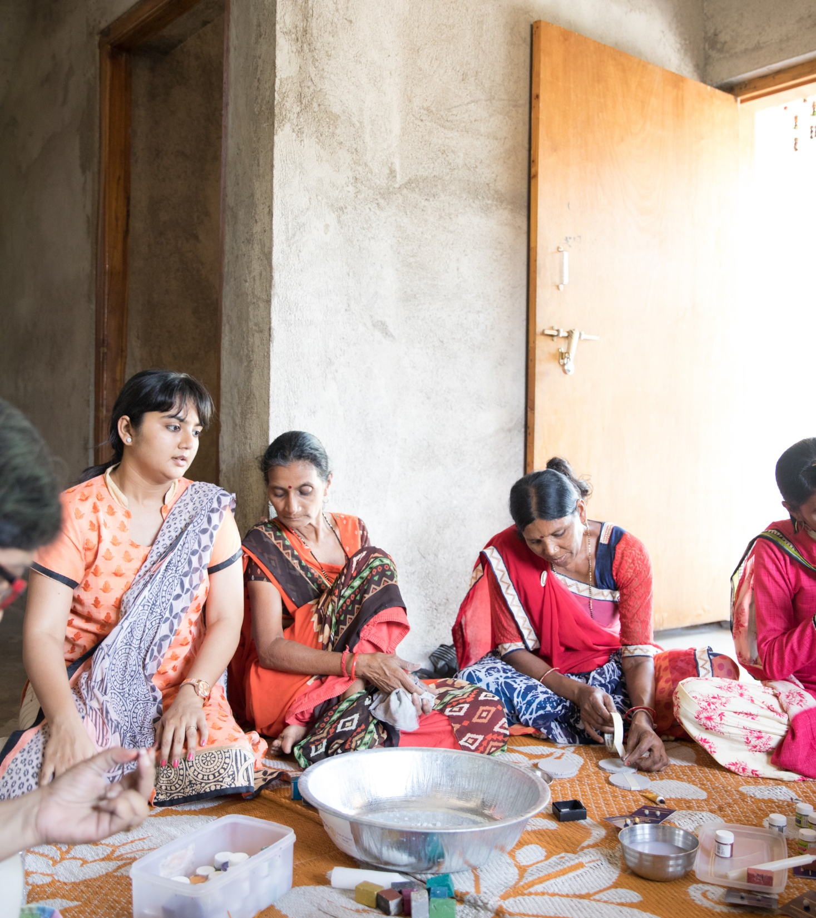
subhead
Vocational Service Includes:
Connecting our professions and professional networks with our club activities;
Using our expertise to address community problems and help others discover new vocational opportunities and interests;
Promoting Rotary’s commitment to integrity in our professional and personal lives;
Recognizing and advancing the worthiness of all professions.

Slide 4
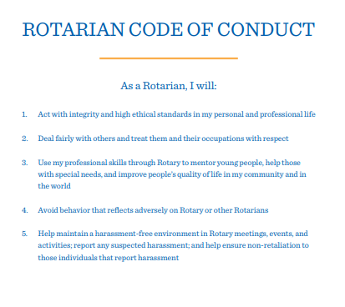
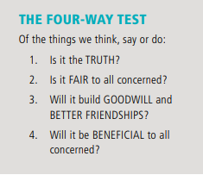
Integrity and ethics
Rotary emphasized integrity and high ethical standards. Two useful tools for providing a framework for ethical behavior include:

Slide 5
Vocational service Project ideas
Host a business networking event with non-Rotary professionals in your community.
Offer career counseling for unemployed or underemployed adults.
Mentor young people to achieve their career goals.
Apply your professional skills to a club or district service project.
Lend your expertise through your district’s resource network, by joining a Rotary Action Group, or by joining or starting a professionally-oriented Fellowship.
Work with your district Rotary Friendship Exchange chair to organize a vocationally-oriented exchange to explore how your profession is practiced in another country and introduce international friends to how yours is practiced in your country.
Work with your district Rotary Foundation Committee to organize a Vocational Training Team to travel abroad to teach local professionals about a particular field or to learn more about your own.

Slide 6
Advancing ETHICS at work
As leaders in our businesses and professions, we can advance high ethical standards by setting a positive example among colleagues and in our communities. Here are a few ideas to integrate ethics into daily work life:
Discuss and emphasize honesty, accountability, fairness, integrity, and respect when hiring, training and supervising employees;
Praise and encourage exemplary behavior;
Demonstrate personal commitment in relations with customers, vendors, associates, and partners by treating each interaction with care and consideration;
Promote socially and environmentally responsible practices in your businesses and organizations.

Slide 7
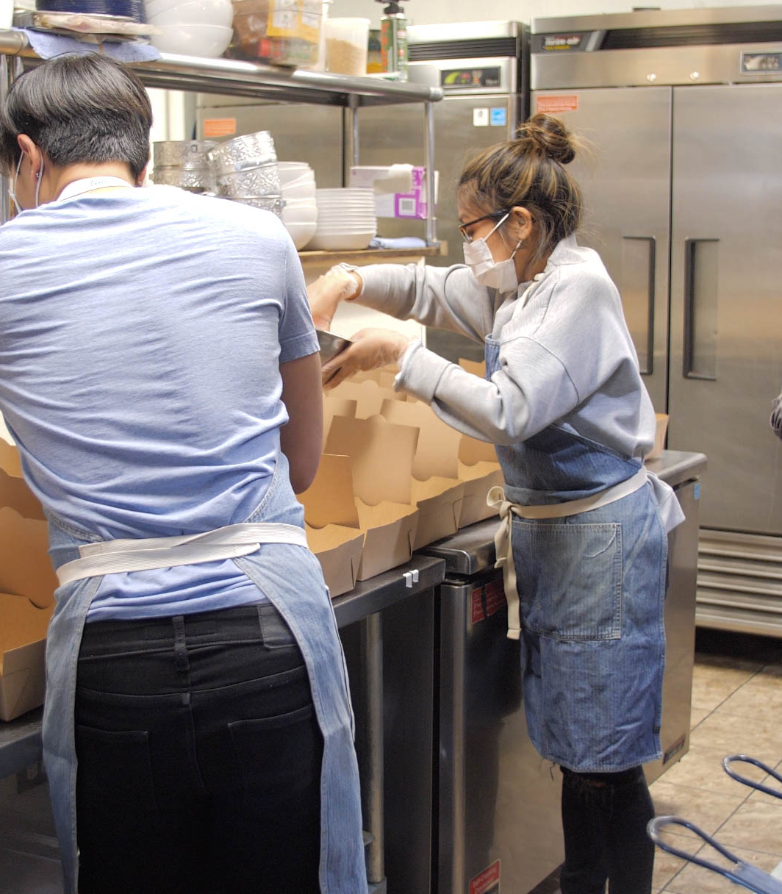
Rotary Fellowships
are international groups of participants who build community around shared professions, hobbies or identities.
Rotary has more than 90 Fellowships; join one related to your profession or consider organizing one if your field isn’t represented.
www.rotary.org/fellowships

Slide 8
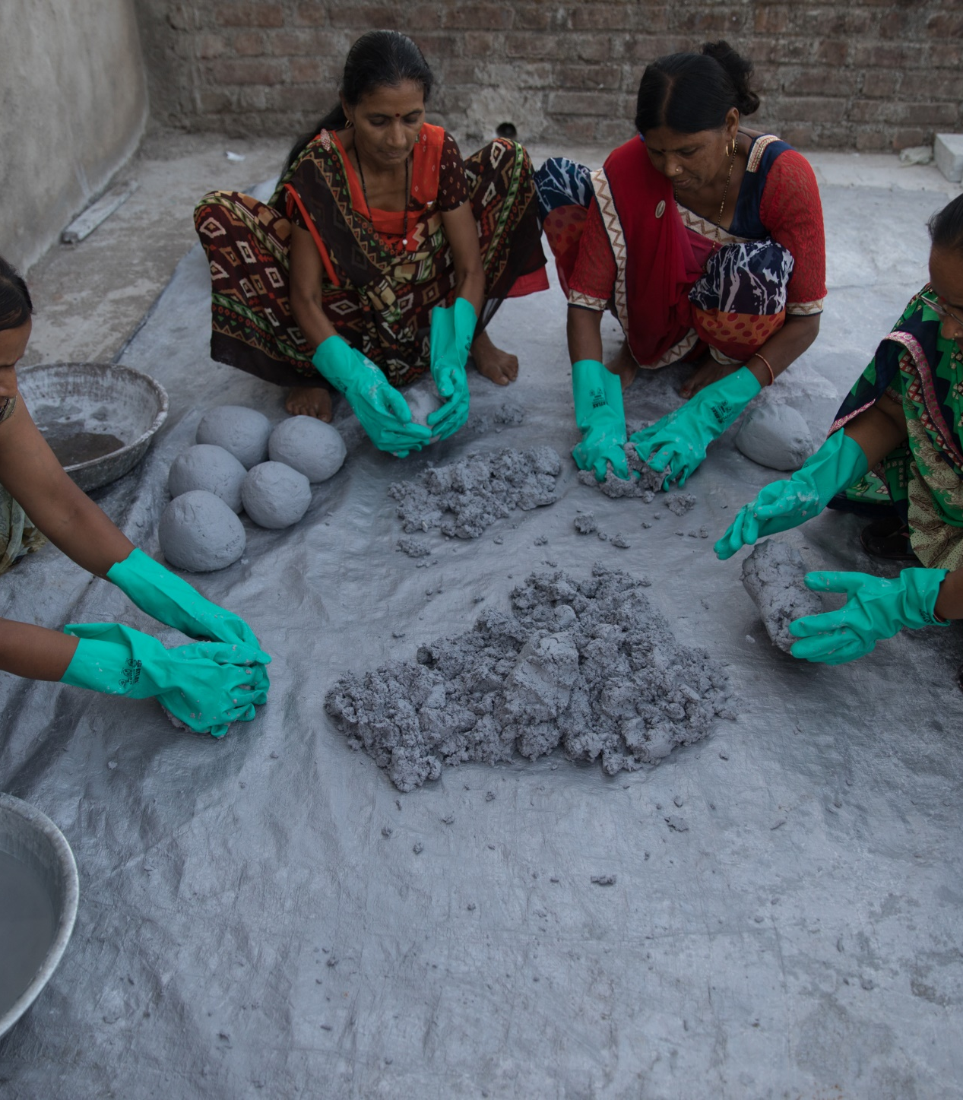
Rotary Action Groups
are international groups of Rotary members and friends who help clubs and districts plan and implement projects in a particular area of specialization
Join one of Rotary’s 26 Rotary Action Groups to lend your skills to support projects around the world.
www.rotary.org/actiongroups

Slide 9
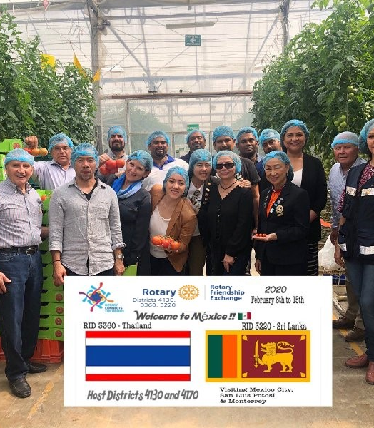
Rotary Friendship Exchange
a district program where teams of Rotary members and friends travel to an international district to explore another culture, undertake a service project, or explore a profession in partnership with local clubs.
Partnering districts determine the length of the exchange, group composition, itinerary, and arrange all details. Visitors are hosted in members’ homes and exchanges are reciprocal.
www.rotary.org/friendship-exchange

Slide 10
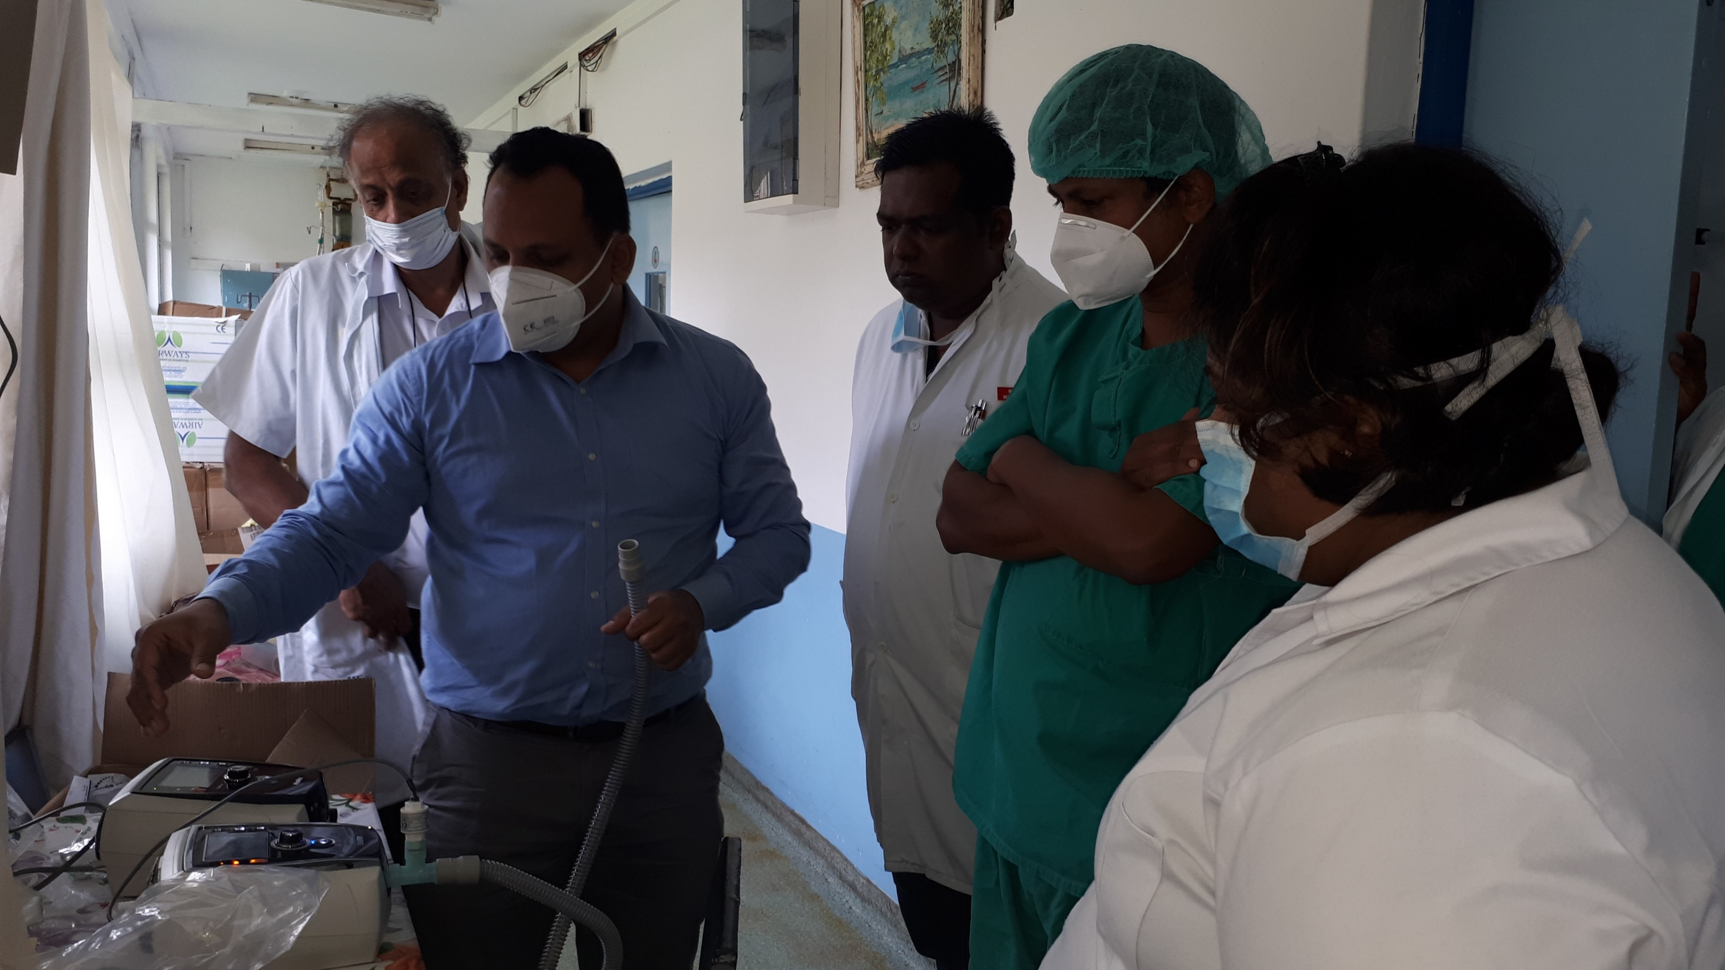
Vocational Training Teams
are groups of professionals who travel abroad either to teach local professionals about a particular field or to learn more about their own.
Teams can be funded by district grants and global grants.
Visit: www.rotary.org/grants

Slide 11
More Resources
The Rotary Service newsletter, a bimonthly digital publication, keeps the family of Rotary informed about service, including:
Project ideas to apply professional skills through service projects;
Supporting the professional development of individuals and communities in need;
Representing Rotary and promoting Rotary values in the workplace
Subscribe: www.rotary.org/newsletters
The Rotary Service in Action blog features weekly stories, resources, and best practices for community, international and vocational service.
Follow us: www.rotaryserviceblog.org/blog
Vocational Service in Action is a handy guide with information, resources, and project ideas related to vocational service.
Find inspiration, project partners, and share about your completed projects on Rotary Showcase.
Learn about organizing a vocational training team to conduct training and build capacity in collaboration with Rotary members in others of the world through Vocational Training Teams.

Slide 12
Support
Your district community service committee chair, appointed by your district governor, coordinates and promotes vocational service activities within the district.
Your district international service committee chair, appointed by your district governor, coordinates your district’s resource network of local experts who lend their professional expertise to local clubs as they plan related service projects.
Check your district’s website or with your district governor to identify both district leaders. Contact Rotary staff at rotary.service@rotary.org with questions.

Slide 13
QUESTIONS

