Slide 1
A Primer #1 for the Web Site of the
Rotary Club of Mineola-Garden City
By
Dr. Cornell C. Frank
Club Director of Communications
Club Web Site Administrator

Slide 2
SURVIVING DISAPPOINTMENT
THERE IS NO QUESTION ABOUT IT… No matter what you do, disappointment will make its way to your door. The issue is - if it will find a home and dwell with you constantly or do you stop it at the threshold of your home. It can very well be one or the other. God gives us the tools to keep it from taking permanent residence in your life.

Slide 3
Rotary Guiding Principles
Rotary’s over one hundred year track record of professionals joining together to use their skills and passion to make a difference in their communities is one that fosters pride in Rotarians worldwide. Rotary clubs should be familiar with Rotary’s guiding principles and values statements in order to carry out Rotary’s mission an understand our history of commitment to professionalism and service.

Slide 4
More on Rotary Service
In Rotary, Service is to encourage and foster the application of the ideal of service in each Rotarian’s personal, business, and community life.
Fundamentally, Rotary is a philosophy of life that undertakes to reconcile the ever present conflict between the desire to profit for one’s self and the duty and consequent impulse to serve others.
Source: 2016 Manual of Procedure

Slide 5
More of Service
Because they who serve must act, Rotary is not merely a state of mind, nor Rotary philosophy merely subjective, but must translate itself into objective activity;
And individual Rotarians and the Rotary club must put the theory of service into practice.
2016 Manual of Procedure.

Slide 6
Core Values
The following five values are fundamental traits of being a Rotarian.
These core values have been affirmed by Rotary boards and are strongly supported by Rotarians throughout the world:
Fellowship
Integrity
Diversity
Service
Leadership

Slide 7
Purpose of a Rotary Club
The purposes of this Rotary Club of Mineola-Garden City are to pursue the Object of Rotary, carry out successful projects based on the Five Avenues of Service, contribute to the advancement of Rotary by strengthening membership, support the Rotary Foundation, and develop leaders for this club and beyond.
2016 Manual of Procedure

Slide 8
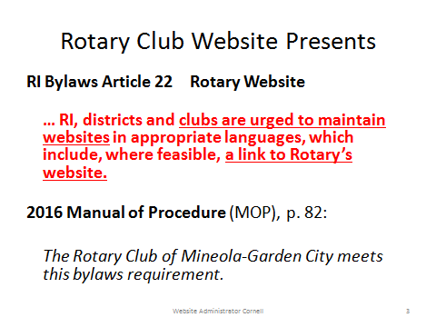

Slide 9
Step 1
Invoke your favorite Web or Internet Browser:
Google Chrome is best suited for our web site
Internet Explorer of Edge for Windows10
Mozilla Firefox is still a favorite
Safari and
Opera should also be suitable

Slide 10
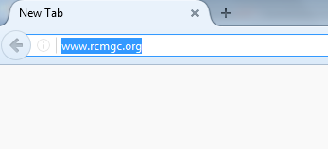
Step 2
In the address line enter www.rcmgc.org as shown below

Slide 11
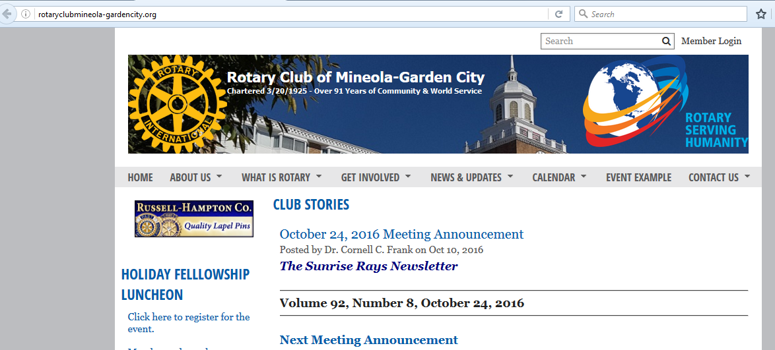
You will be rewarded with the
Public Home Page of our Club Web Site

Slide 12
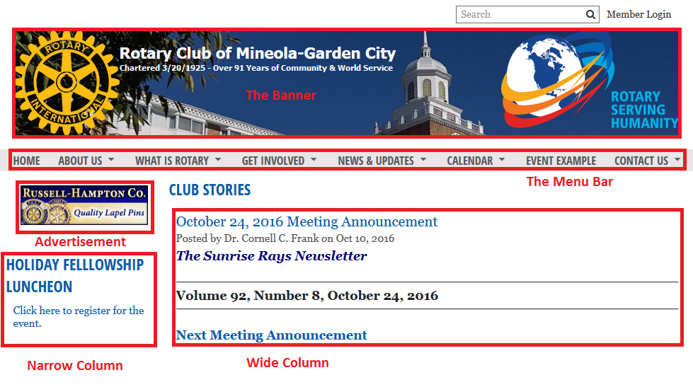
Home Page Areas

Slide 13

The Banner is for display only

Slide 14
The Menu Bar contains seven items;
About Us, What is Rotary, Get Involved, News & Updates, Calendar, Event Example and Contact Us.
Menu item marked with a triangle contain Sub-Menu items.
Use Home to return to the home page from any Sub-Menu.

Slide 15
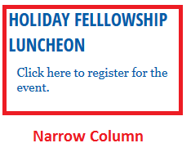
The Home Page Narrow Column
(currently) contains the following:
• Club Web Site Functionality Demo(s)
• Club Event Announcements
• Upcoming Events
• Meeting Place Information
• Links to web sites of the District, RI, RotaCare, RI Foundation and
Venue Map
• Calendar
• Rotary International up-to-date News.
Use your browser scroll bar to navigate “up” or “down” the page.
(or use your pointing mouse scrolling wheel – if present).

Slide 16
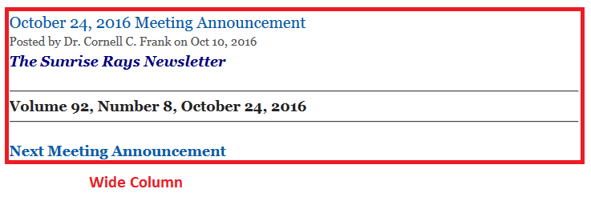
The Wide Column contains:
• Club Sunrise Rays Newsletters,
• other Club News Items and
• Videos, etc.
Use your browser scroll bar to navigate up or down the page.
(or use your pointing mouse scrolling wheel – if present).

Slide 17
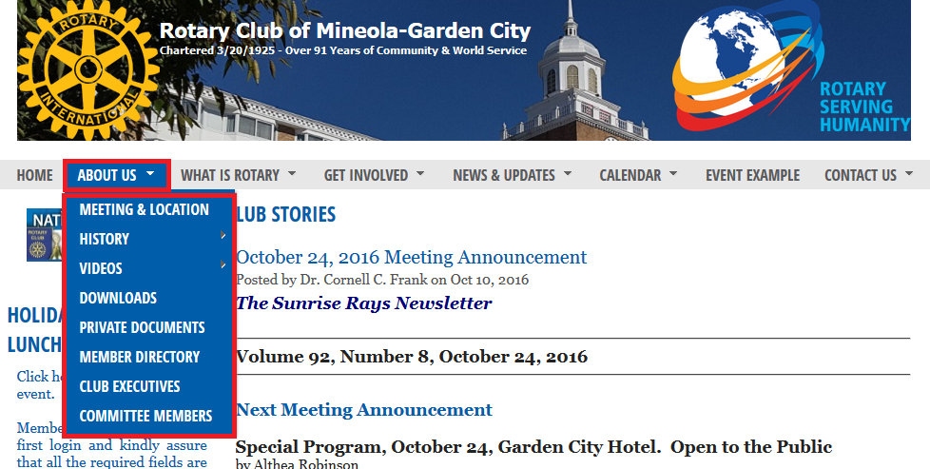
Step 3 –
Working with the Menu Bar:
Point to a Main Menu Item i.e. “About Us” and a “Sub Menu” (also known as a “pull-down menu”) will appear. Multiple sub-sub-menu items are indicated by an “upside-down triangle” to the right of the sub-menu.

Slide 18
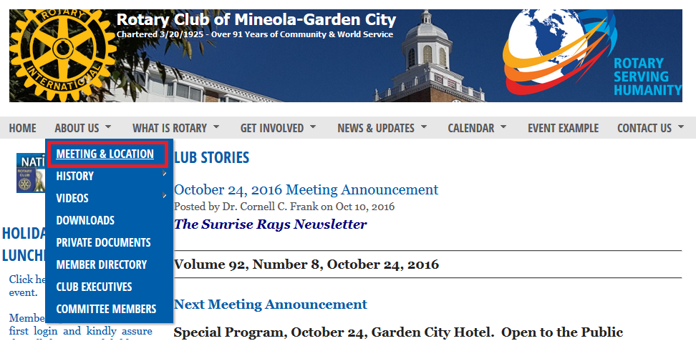
Scroll down to point to a sub-menu item…
Then see next screen

Slide 19
The process outlined in the previous two slides is often abbreviated,
(or shown), as:
>Menu Bar >About Us >Meeting and Location and leads to the information shown in the following slide

Slide 20
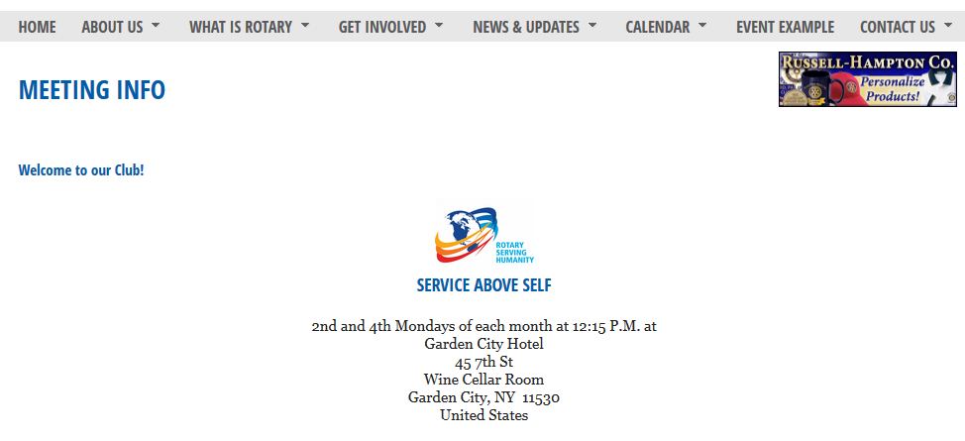
Click the left mouse button on selected Sub-Menu item and the selected information will appear as shown below:

Slide 21
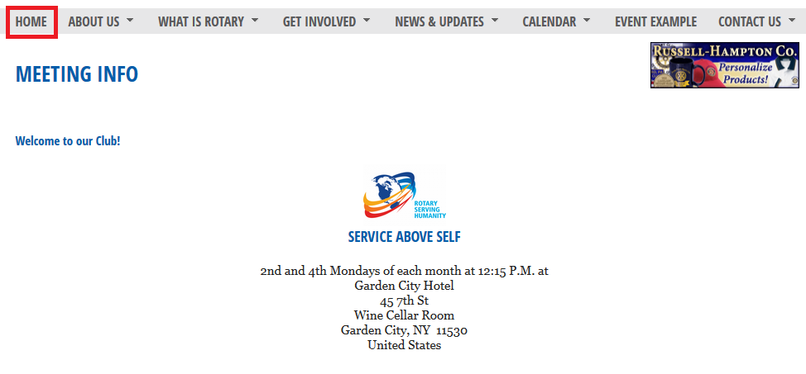
To return to the Home Page point and click on Menu

Slide 22
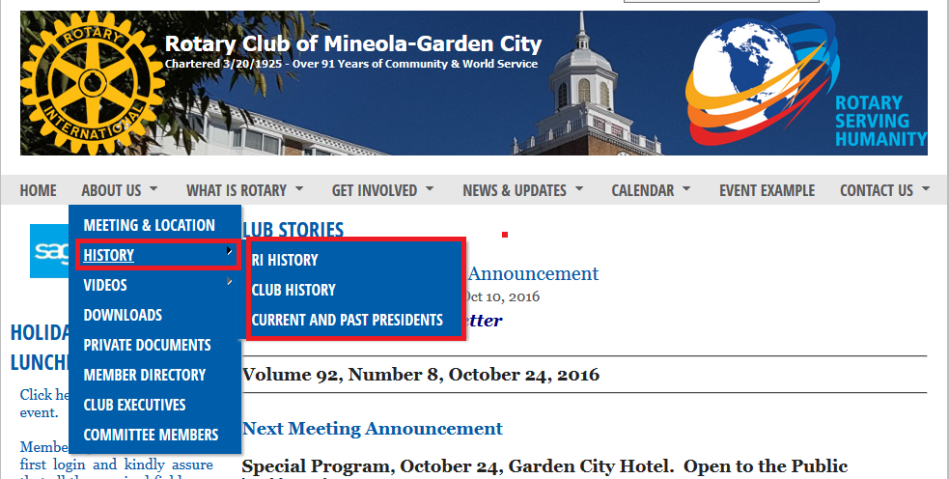
Some Sub-Menu items have another level of menus identified by another triangle. In such cases, move the mouse pointer to the right sub-sub-menu and then slide the mouse pointer down or up to the desired sub-sub menu.
(or pop-up)or p

Slide 23
Menu Bar Items
The first shown Menu Bar is just one of many available items
The shortcut notation for the first item is:
>Menu Bar >About Us >Meeting and Location
Additional selections are as follows:
>Menu Bar >History >RI History
>Menu Bar >History >Club History >Pages 1 to 5
>Menu Bar >History >Current and Past Presidents
>Menu Bar >Videos >RotaCare Video Journal
>Menu Bar >Videos >2015 Community Service Award
>Menu Bar >Videos >Current and historical photos
>Menu Bar >Downloads >Choose from shown listing

Slide 24
Menu Bar Items continued
>Menu Bar >Private Documents [requires log-in to gain
access to Club Bylaws, Club Constitution, Past Presidents]
>Menu Bar >Member Directory [requires log-in to gain
access to member information and member photos]
>Menu Bar >Club Executives [public side shows name only
private side shows function, contact info and photos]
>Menu Bar >Committee Members [same as above]
>Menu Bar >What is Rotary >The ABC’s of Rotary
>Menu Bar >What is Rotary >Join Leaders
>Menu Bar >What is Rotary >Exchange Ideas
>Menu Bar >What Is Rotary >Take Action

Slide 25

Selecting the following:
>Menu Bar >History >RI History will show the following RI History and more

Slide 26
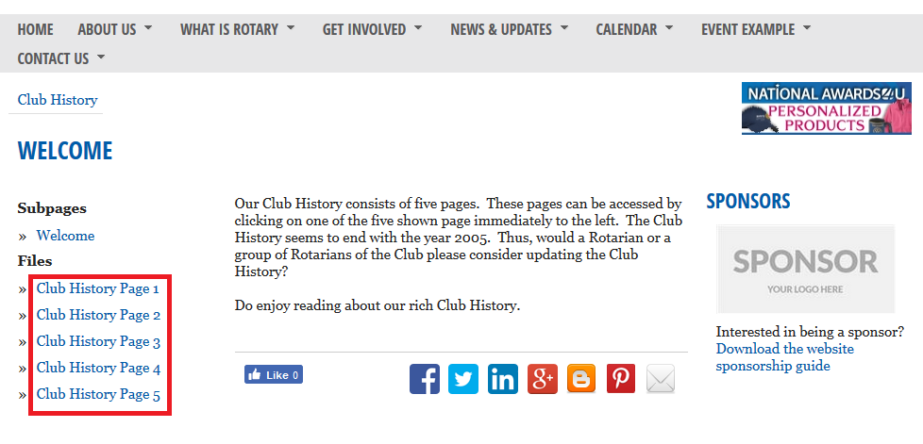
Selecting the following:
>Menu Bar >History >Club History then selecting Pages 1 to 5
(see red box) will show five pages of Club History

Slide 27
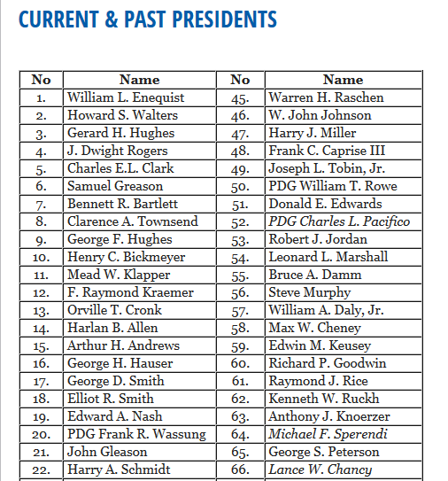
Selecting the following:
>Menu Bar >History >Current and Past Presidents will show a listing of

Slide 28

Selecting the following:
>Menu Bar >Videos >RotaCare Video Journal will show a Power Point Presentation

Slide 29
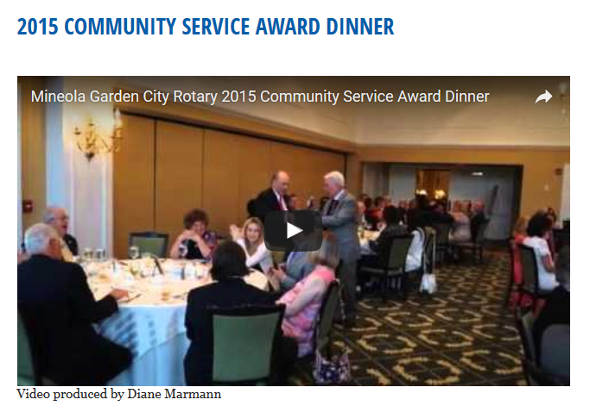
Selecting the following:
>Menu Bar >Videos >2015 Community Service Award will show a video of the:

Slide 30
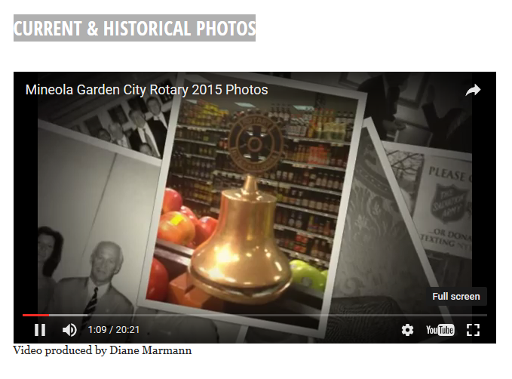
Selecting the following:
>Menu Bar >Videos >Current and historical photos will show:

Slide 31
Selecting the following:
>Menu Bar >Downloads >Choose from shown listing:
Primer for the RCMGC Web Site (the current PP presentation)
Retrieving Login & Password Power Point Presentation
Long Island's Champions for Families in jpg
Long Island's Campios for Families in .pdf
2016 Holiday Fellowship Luncheon
2016 Holiday Fellowship Luncheon RotaCare Caregivers' Ball Kick-Off Event - March 15, 2016 Save the Date for the RotaCare Ball on April 14, 2016
22nd Anniversary RotaCare CAREGIVERS' BALL Page 1
22nd Anniversary RotaCare CAREGIVERS' BALL Page 2
RYLA Handbook (RI 694)
RCP 41.050 (including 41.050.3)
RYLA Report Form
Rotary Holiday Party Ticket Order
Rotary Holiday Flyer
RotaCare Video Journal
RotaCare Flyer
Silent Auction-Raffle Donation Form
Garden City Republicans Annual Fall Gala Dinner

Slide 32
>Menu Bar >Private Documents requires log-in to gain access to
Club Bylaws,
Club Constitution,
Past Presidents.
Please see next slide

Slide 33
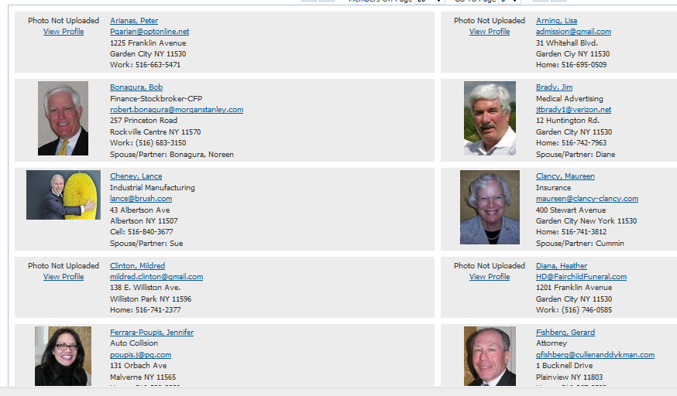
>Menu Bar >Member Directory
[requires log-in to gain access to member information and member photos]

Slide 34
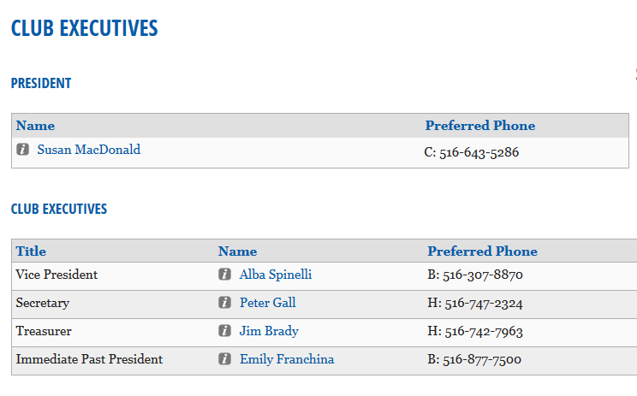
>Menu Bar >Club Executives [public side shows name] only
Notice only preferred phone number s shown to the public.
Abut UsAb

Slide 35
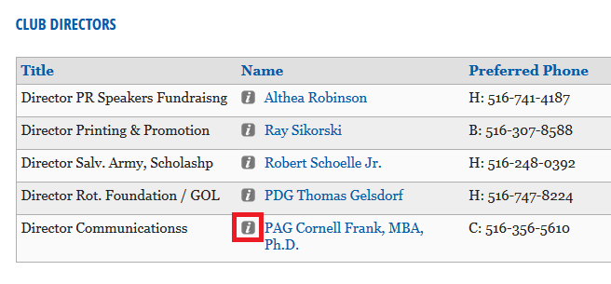
Point and click on the Business Card Information icon

Slide 36
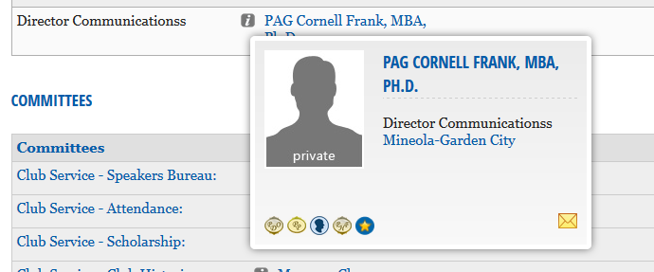
Notice the public has access to not additional information

Slide 37
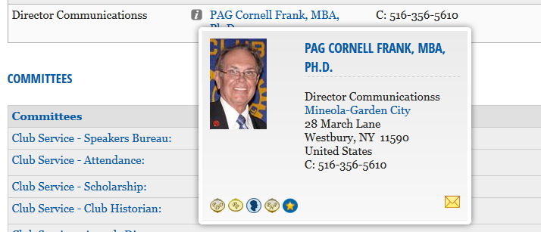
As opposed to all details being shown when a member is logged into the private side of our Web Site

Slide 38
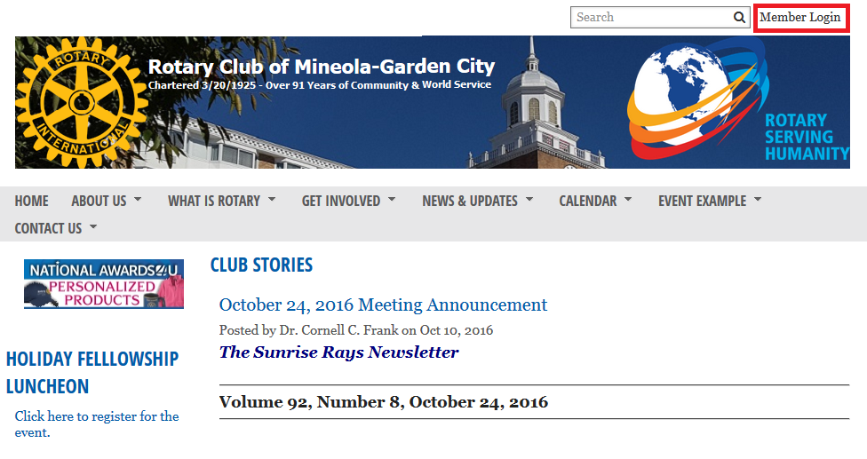
Now let us sign on to the private section - only members of our Rotary Club, in good standing, can login.
Point and click on “Member Login” in the upper right hand corner

Slide 39
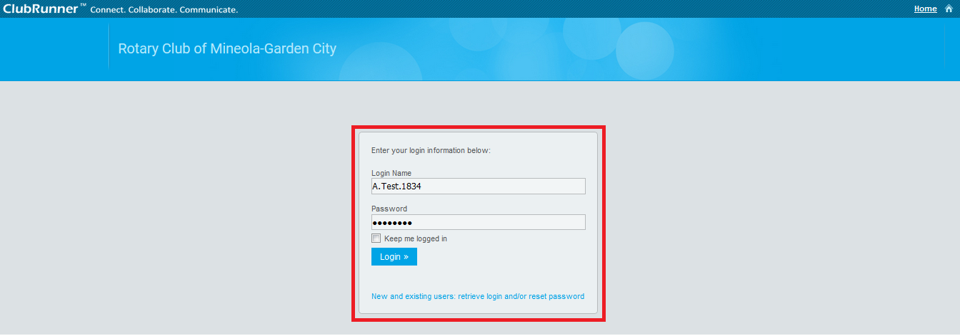
The Login Page appears
(let us focus on the square box shown on the next slide)

Slide 40
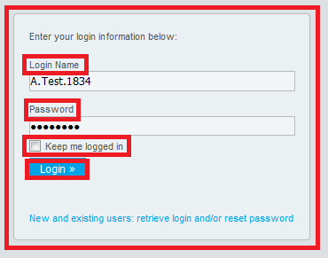
You will want to be in a position to recall your
“Login Name” and “Password” without hesitation.
Enter them in the appropriate location and check “Keep me logged in” only when you are using a private secure computer.
Finally point and click on “Login.”
(We have a separate Power Point Retrieving Your Login Tutorial in the Download section as well as a video on the home page in the wide section.

Slide 41
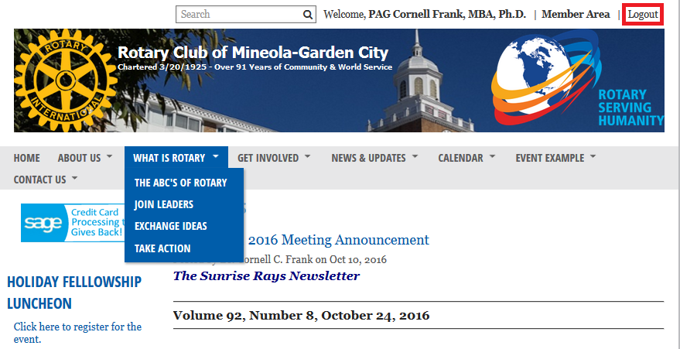
You are logged in to the private section when you see “Logout” in the upper right hand corner

Slide 42
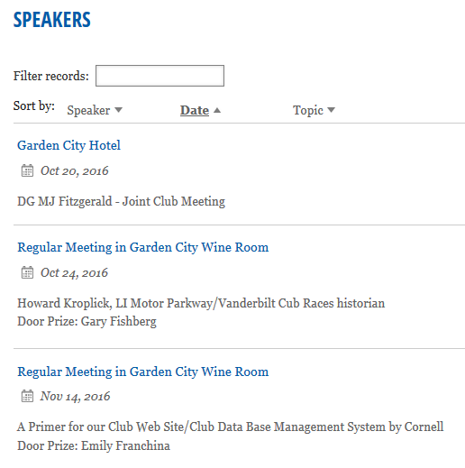
There are many other items you can explore on your own on the Menu Bar. However, as part of this demonstration, it may be worth while to explore the >Menu Bar >Calendar and its three sub-sub-menus >Speakers, and/or >Event Calendar and/or >Rotary Calendar

Slide 43
If you now repeat the steps:
>Menu Bar > About Us >Club Executives and point to any individual you as a member of this Rotary Club will be awarded with a business card showing full details of the preferred mailing address of the selected individual.

Slide 44
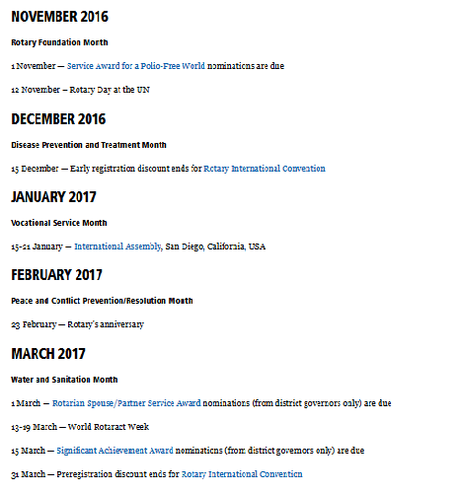
Rotary International Calendar

Slide 45
There is lots more to explore on our homepage and perhaps we can explore the many other items during future Rotary Meetings, set aside time, for “Rotary Club of Mineola-Garden City Web Site Minute” or regularly scheduled sessions like today’s session.

Slide 46
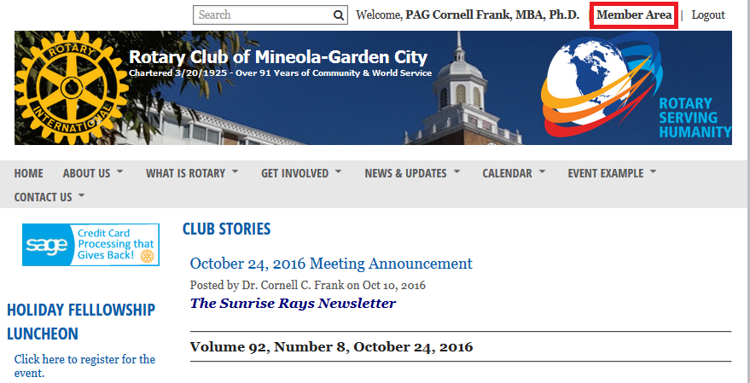
Just one more point for today, or a future meeting, and that is an overview on how members can post their own portrait pictures and update their own information. After you are logged into the private section point and click on Member Area (see below).

Slide 47
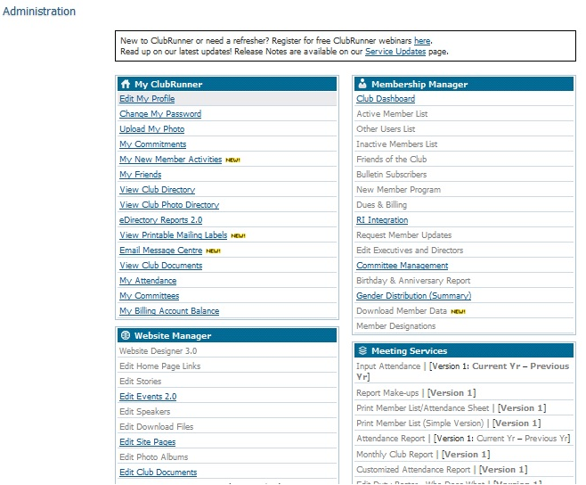
You will be taken to the Administration Page of the private side of our web site as shown below.

Slide 48
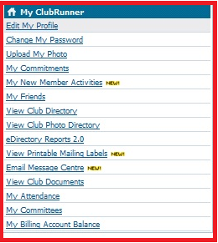
For this session, let us focus on two items in the “My ClubRunner” section.

Slide 49

Let us focus how to edit or update our own personal profile.
Point and click on “Edit My Profile.”

Slide 50
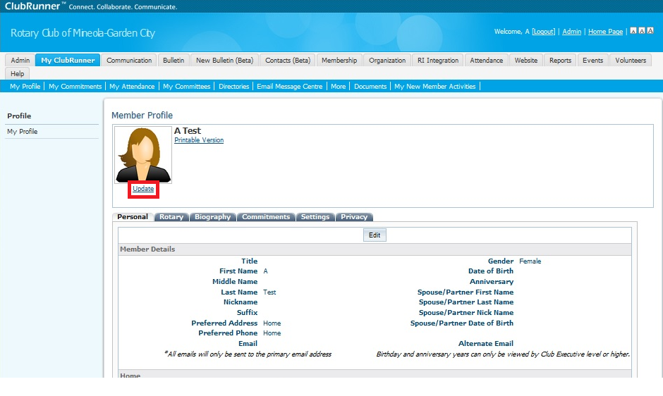
Let us focus on adding your portrait photo to your Member Profile. Your name should be shown where “A Test” appears below. You need a .pdf formatted image either on your computer or a flash drive. Point and click on Update shown below in red frame.
(Alternately, “Upload My Photo”, can be used from “My ClubRunner” menu).

Slide 51
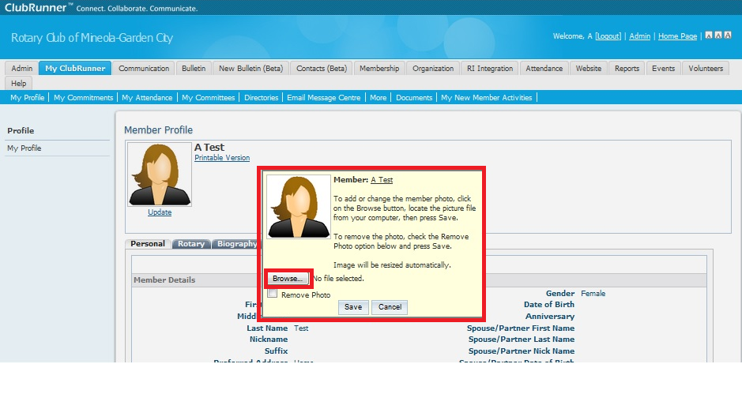
In the “Pop-Up Box,” point and click on “Browse” (see small red box) that will give you a chance to find your portrait photo on you computer or flash drive. Follow the given instructions. To remove a photo point and click on “Remove Photo.”

Slide 52
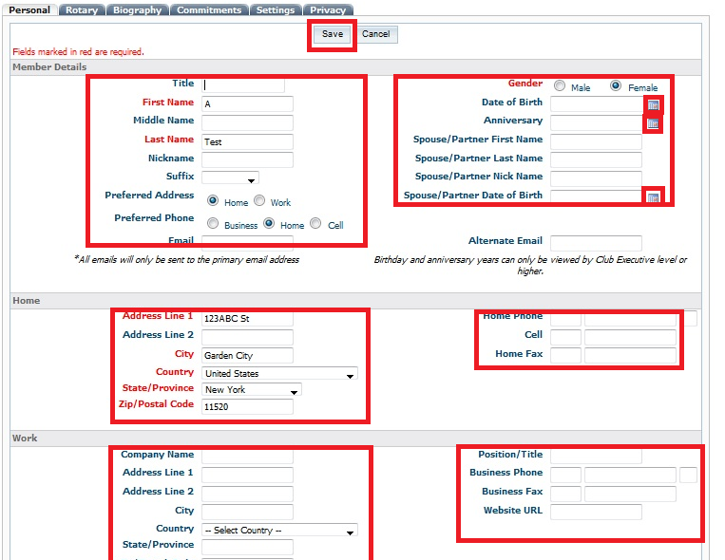
Please notice the five TABS under your Portrait Photo.
The Personal Tab is already highlighted. Point and click and “Edit.” In the left “Member Detail” box first select the” Preferred Address” and “Preferred Phone.” Then complete all fields. “Year” data is positively & absolutely not shared with other members but is used for statistical analysis only and does not identify anyone.

Slide 53
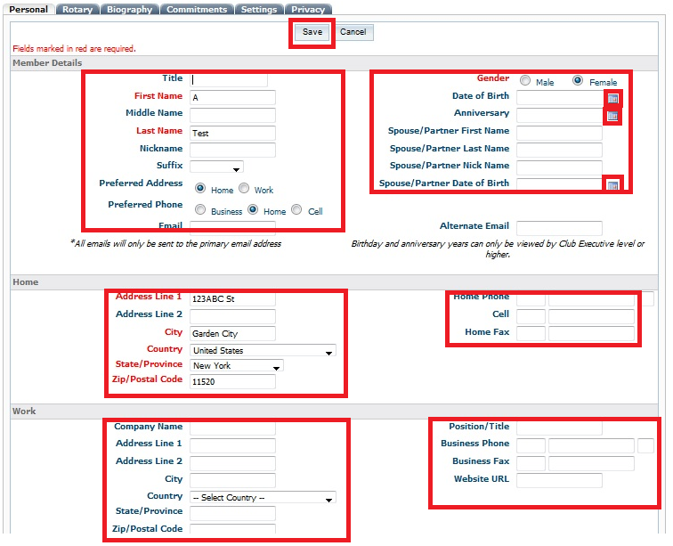

Slide 54
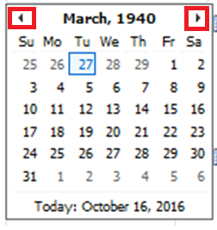
A note about the three “date” fields.
Point and click on the little calendar icon(s) to the right of the date field you wish to record. A larger calendar appears as shown below. If the month and year is correct then point and click on the date you wish to record and the date will be entered in the data base in the correct format . Point on the left or right arrow to change the month, one month at a click.

Slide 55
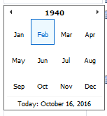
If the month needs to changed then point and click on the month of the calendar heading and the following will appear. You may now select the desired month.

Slide 56
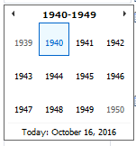
The year can be changed up or down by using the left and right arrows. Pointing and clicking on the year a second time presents the scenario shown below. Now ten years can be changed with one click.

Slide 57
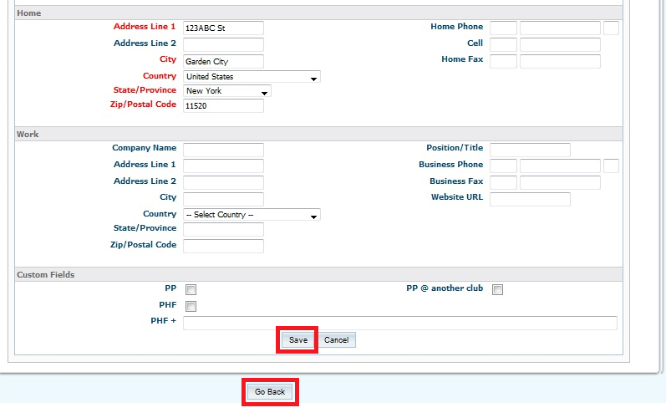
Please scroll down when done editing and depress “Save” otherwise your edits will be lost.

Slide 58
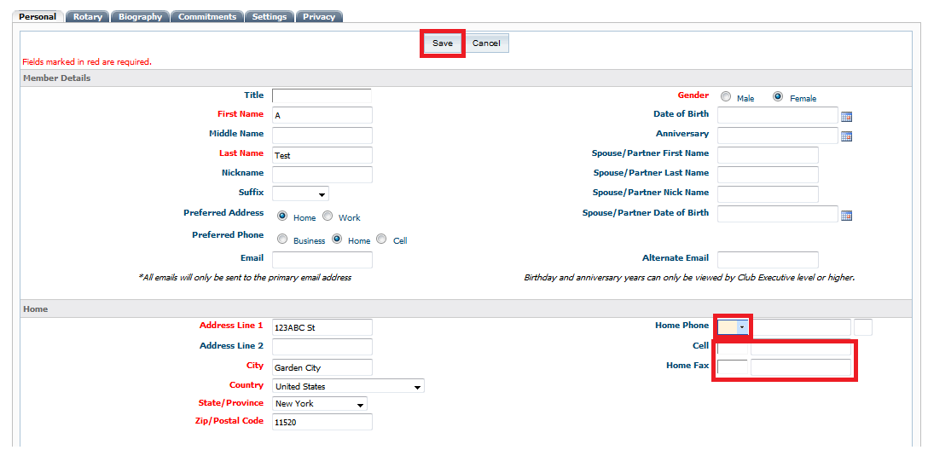
A note about phone numbers. Please notice a smaller box to the left of the larger box for your phone number(s). When you point to the right of the smaller phone a “down arrow” appears as shown below. Click on the arrow and select “United States” from the pop-up menu. An Inter-national Access code of “1” will be inserted. Then enter your appropriate phone number (for consistency or uniformity) in the following format in the larger box on the right hand side:
Area Code-Exchange-Four digit number that is 516-123-4567 Thank you!

Slide 59
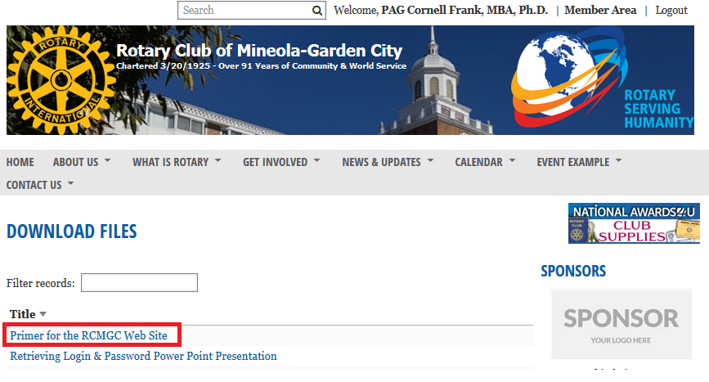
Instructions to load this Primer from the RCMGC Web Site
Select the following: >Menu Bar >About Us >Downloads
Point and click on the red highlighted “Primer for the RCMGC Web Site.”
The PPP will load onto your computer. Use “Ctrl+J” to open the download.

Slide 60
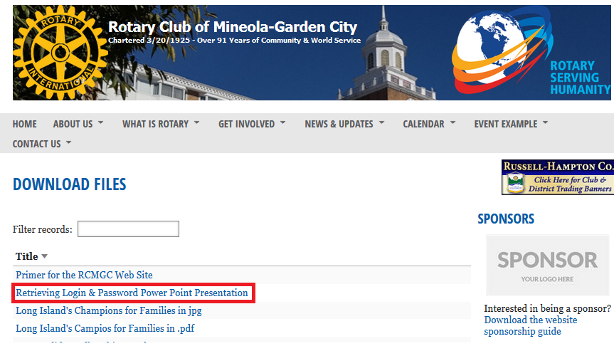
Instructions to load “Retrieving Login & Password” PPP from the RCMGC Web Site
Select the following: >Menu Bar >About Us >Downloads
Point and click on the red highlighted “Retrieving Login & Password PPP.”
The PPP will load onto your computer. Use “Ctrl+J” to open the download.

Slide 61
The End of the RCMGC
Website Primer #1

