Slide 1
INK 92: Rotary Showcase Prepared by Bec Lowery
Ink Spots

Slide 2
Rotary Showcase
Rotary Showcase
https://map.rotary.org/en/project/pages/project_showcase.aspx

Slide 3
What is Rotary Showcase?
?

Slide 4
Rotary Showcase
Sharing Tool
Content Source
It’s an online application that allows Rotarians/Rotaractors to share stories of their clubs’ successful projects with people around the world.
Project stories are a source for features in Rotary International blogs and newsletters.
Inspo-tool
Collective Impact Tracker
With the success stories posted on Showcase can serve as an inspiration and a model for other Rotary/Rotaract clubs.
It shows the impact of each Rotary project in terms of volunteers and volunteer hours, cash contributions, and in-kind donations.
Shows the collective impact of all reported projects.

Slide 6
Who can use Rotary Showcase?
?

Slide 7
How can I access Rotary Showcase?
?

Slide 8
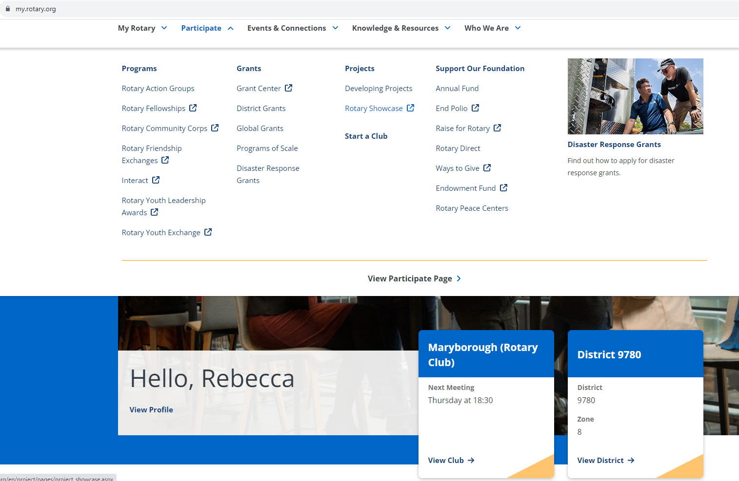

Slide 9
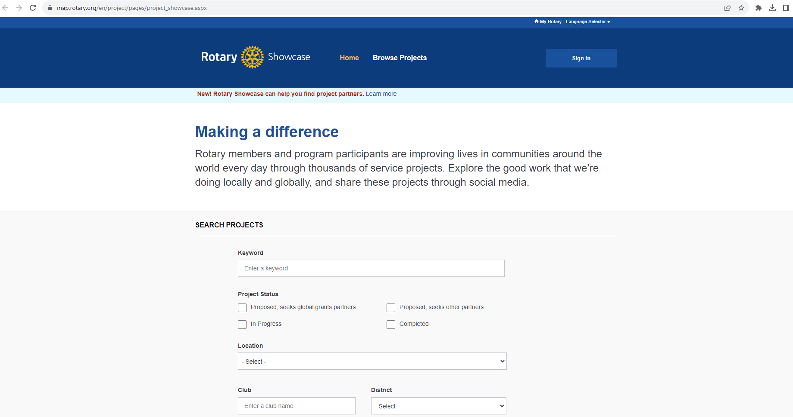

Slide 10
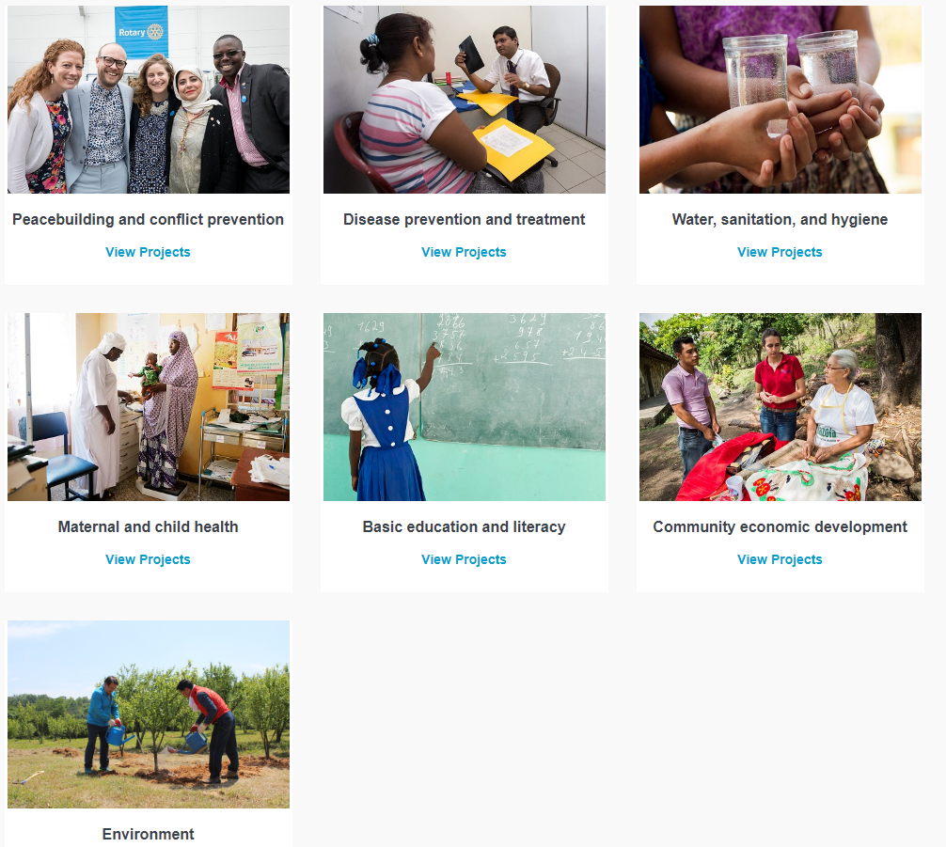

Slide 11
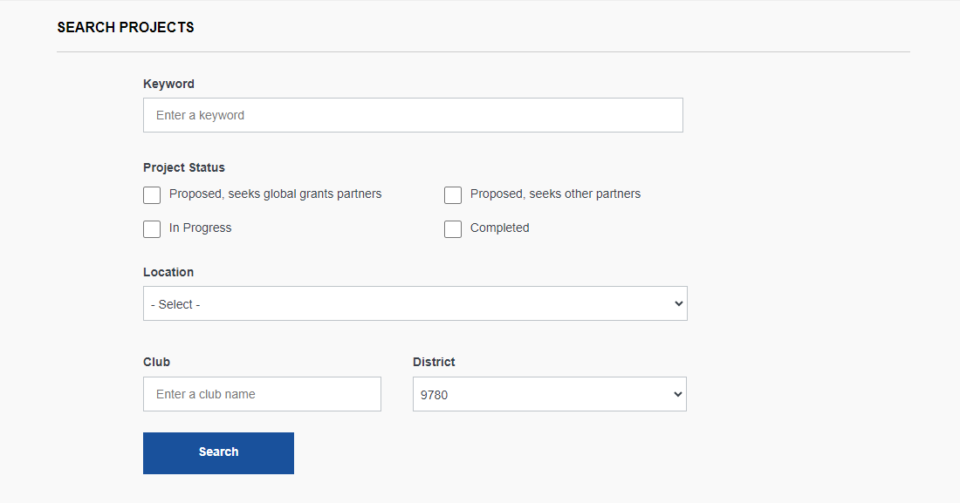

Slide 12
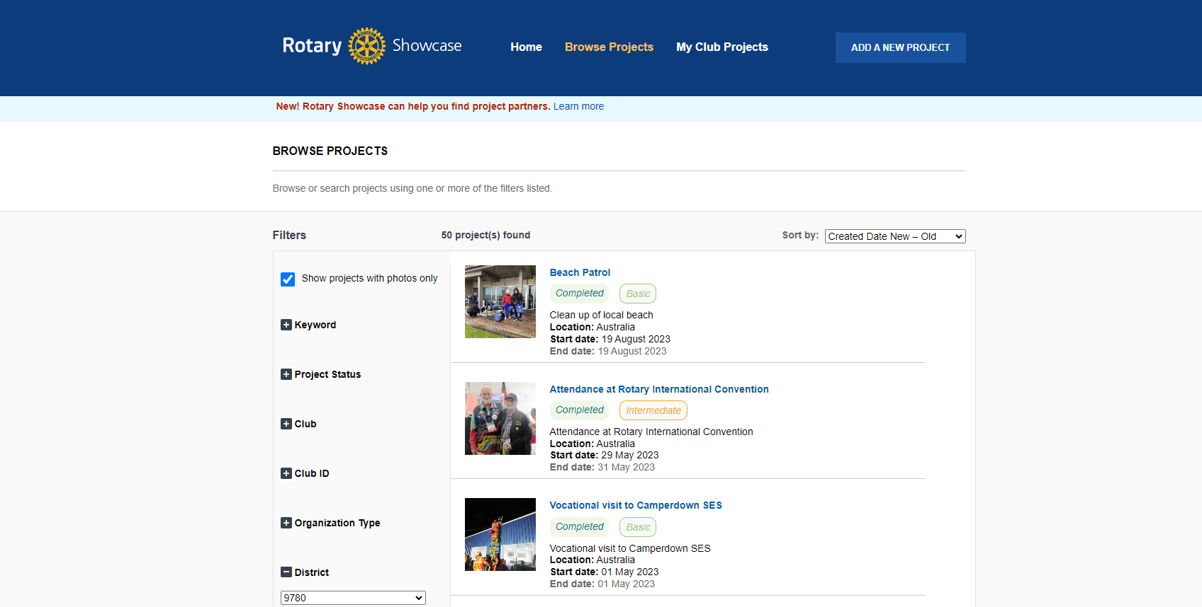
Filters

Slide 13
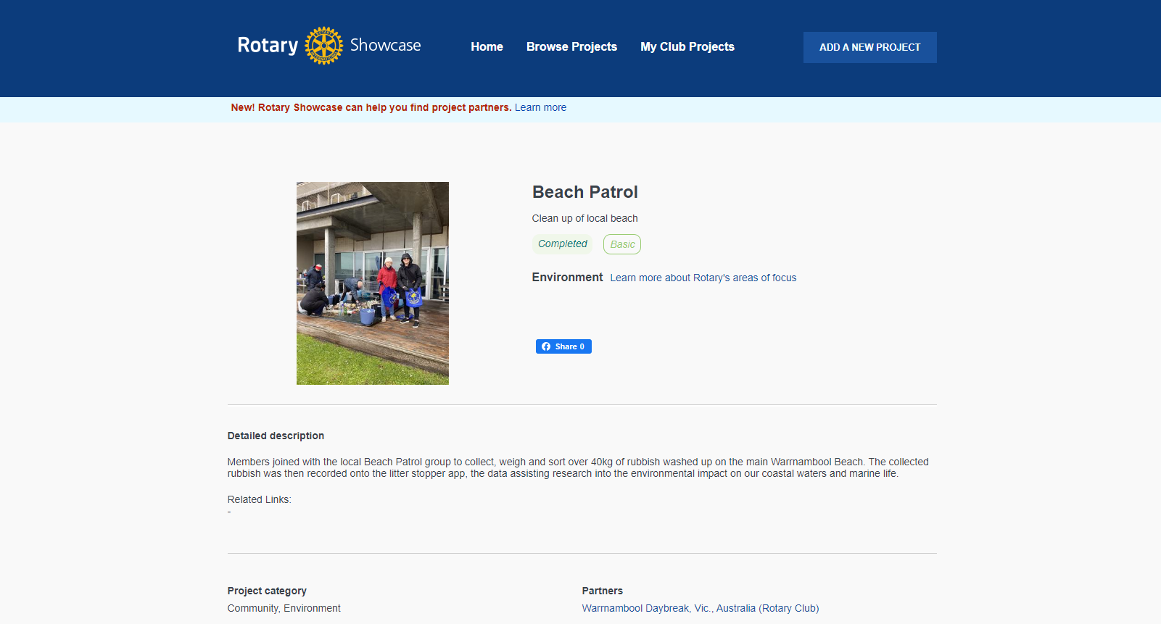

Slide 15
How can I share my Rotary clubs project stories on Showcase?
?

Slide 16
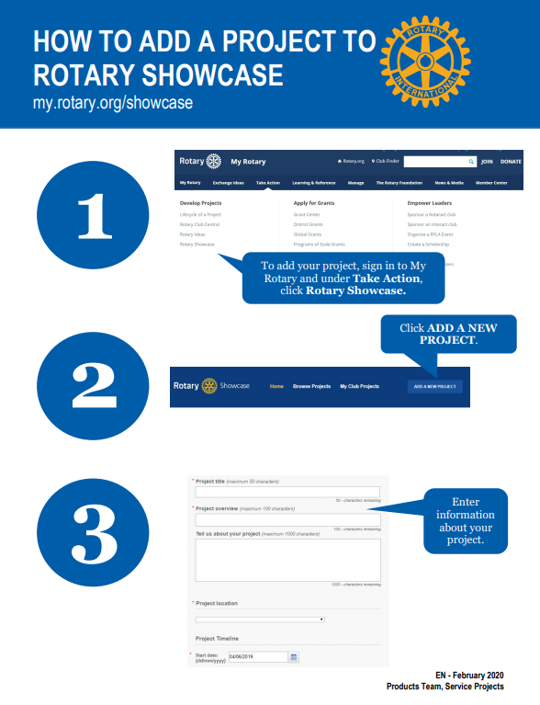
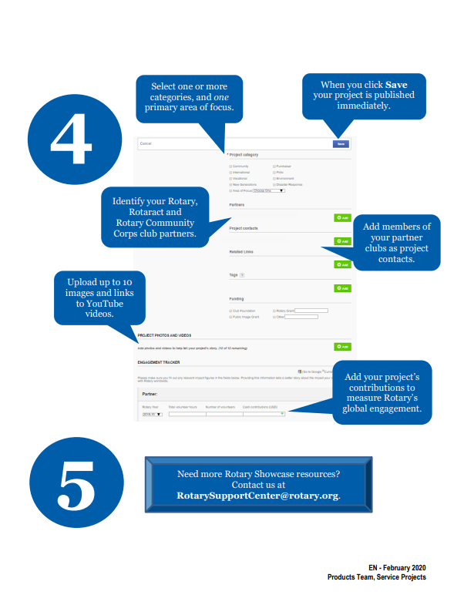

Slide 17
Summary
With Rotary Showcase you can start today to share the wonderful success stories of your Rotary/ Rotaract clubs projects to inspire others.
Or simply use it as an inspirational tool to find that next project you would like to be involved with and support.

Slide 18
The way to get started is to quit talking and begin doing.
Walt Disney

Slide 19
Thank you
Empowering girls
Peace building
Bec Lowery
bechouse@bigpond.com
Rotary.org
My.rotary.org
Rotary Showcase
Ending polio forever
Community economic development

