Slide 1
Mid-Term Report Rotary Club of Boise Southwest
July-December 2018

Slide 2
Goals 2018-2019
Area Goal Current
Membership 80 77
Foundation Giving $14,000 $11,970
Polio Plus Giving $1,500 $151
Service Projects 10 9
Volunteer Service hours 250/mo. 435 hrs./mo.

Slide 3
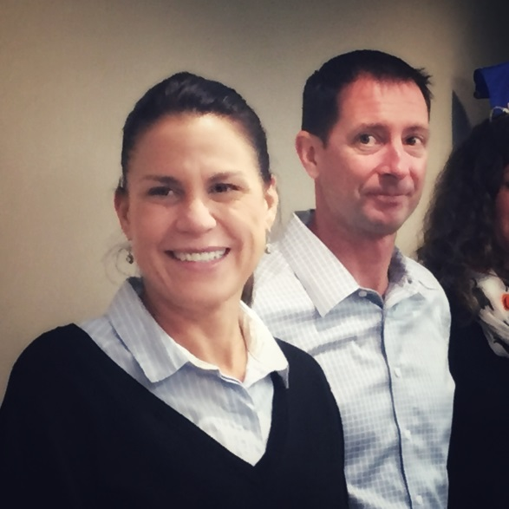
Membership
New members
Increased membership +2
Added 3 new members
Resignation-1 member
Rotary information meetings held –2
New membership category –FLEX member
Attend at least 3 meetings per quarter
Participate in club activities and service projects
Alternate Meetings
Held on third Friday of each month
Provides focus on some aspects of Rotary activities
InTouch Committee established to send cards/notes for get-well and sympathy and encourage attendance at club meetings
Official greeters at every meeting

Slide 4
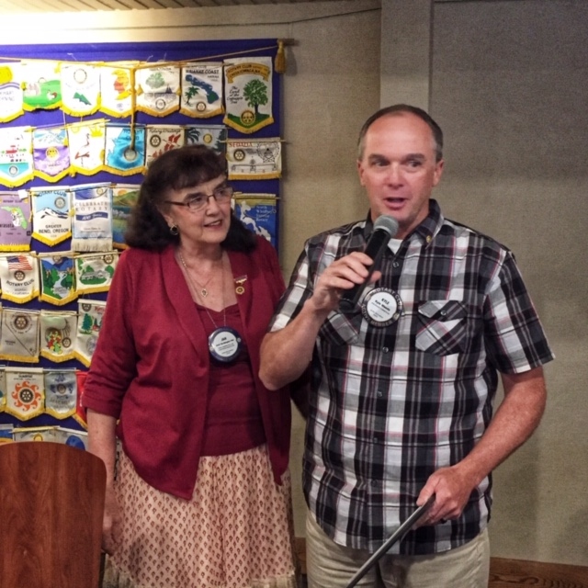
Rotarians of the Month
August
Kyle Woods

Slide 5
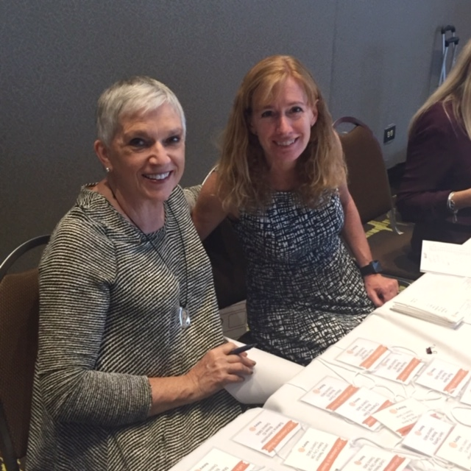
Rotarians of the Month
September
Julie Taylor

Slide 6
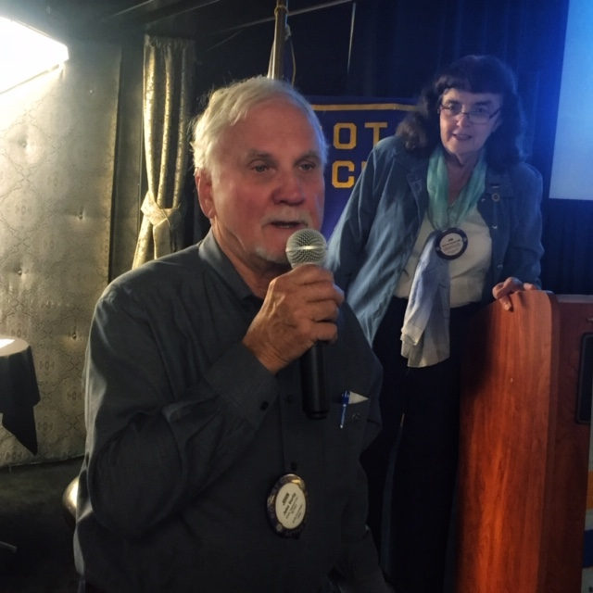
Rotarians of the Month
October
John Verity

Slide 7
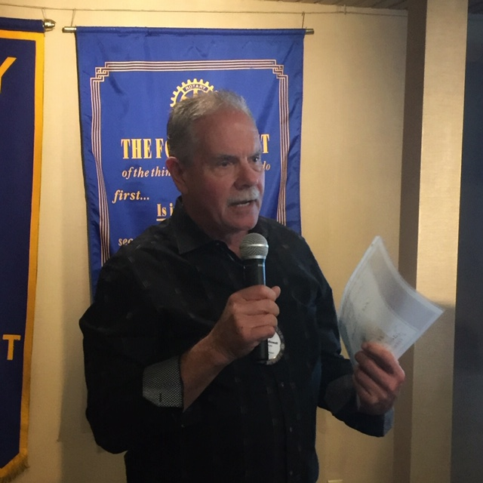
Rotarians of the Month
November
Rod McDowell

Slide 8
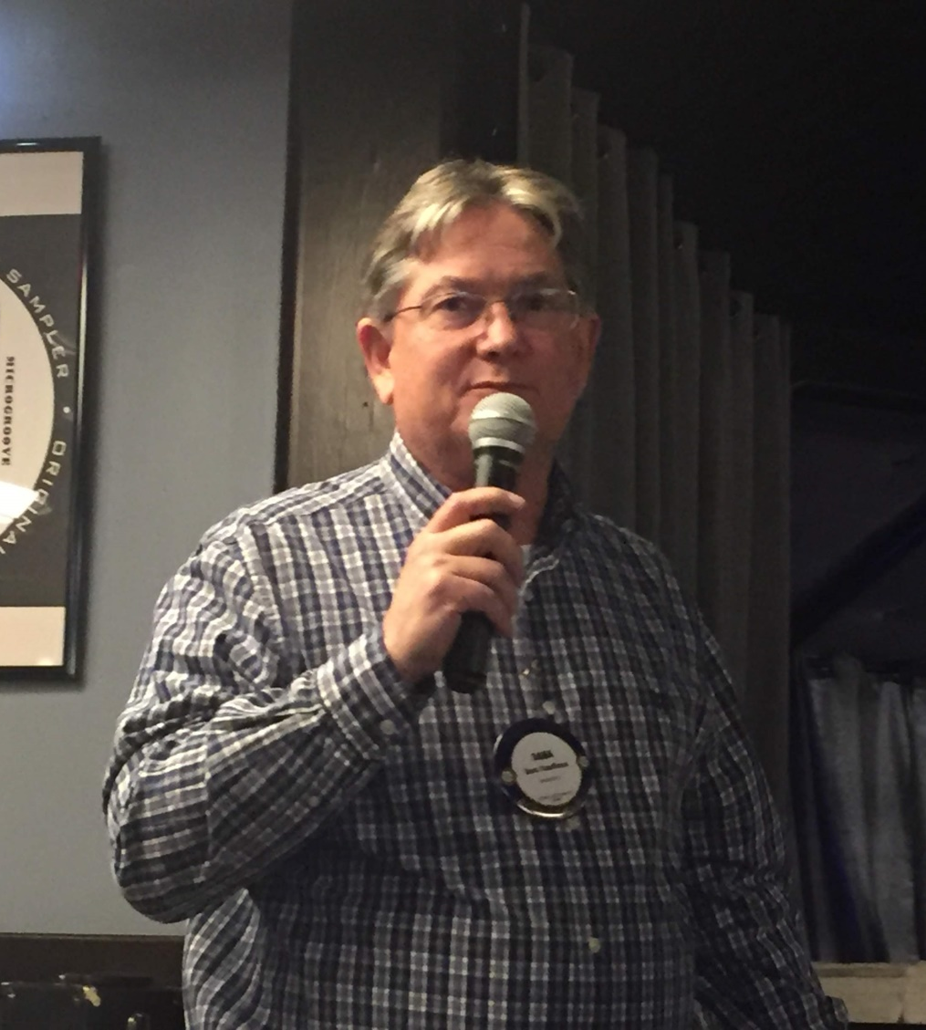
Rotarians of the Month
December
Dana Kauffman

Slide 9
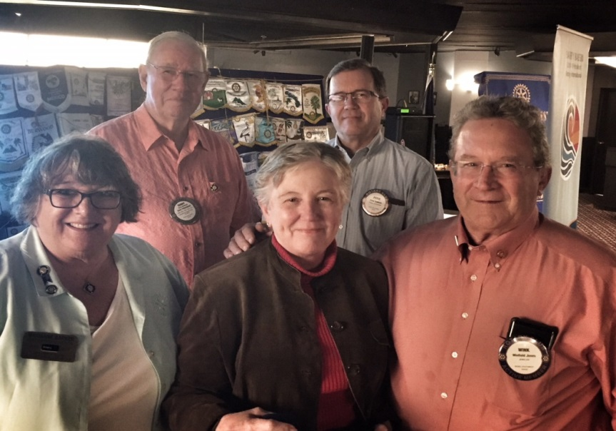
Rotary International Foundation
Rotary Foundation Month—Peter’s Points offered to all members throughout the month
Member donations--$5,971
27 Paul Harris recognitions to members for donations
Wink and Resa Jones
receive awards as
major donors

Slide 10
Rotary International Foundation
Global Grants to the Rotary International Foundation
Global grant for Semilla Nueva—Boise Southwest Rotary is the grant sponsor in the United States
Grants Committee: John Verity, Chair; Dennis Hanrahan, and Erin Hasler
Donations to the Polio Plus Fund
Mike Fease’s games to raise funds for Polio Plus
Donations from club members

Slide 11
Boise Southwest Rotary Foundation
Budget set for 2018-19 included:
Funding for the Whittier Christmas party with lunch, gifts for students, teachers, Santa, and photos provided
Funding for MISTI included funds for turkeys, food boxes from St. Mary’s
Food Bank, and additional purchases
Grants Awarded
Grants of $1,000 each to Silver Sage Girl Scouts and Jannus Economic Opportunities for programs that help girls and young women. Grant recipients selected by Grants Committee from nine grants requests.
(Grants Committee: Conrad Colby, chair; Terry Bowman, Doug Cooper, Erin Hasler, Bonnie Helms, Edenn Jablonski, John Verity, Kyle Woods)

Slide 12
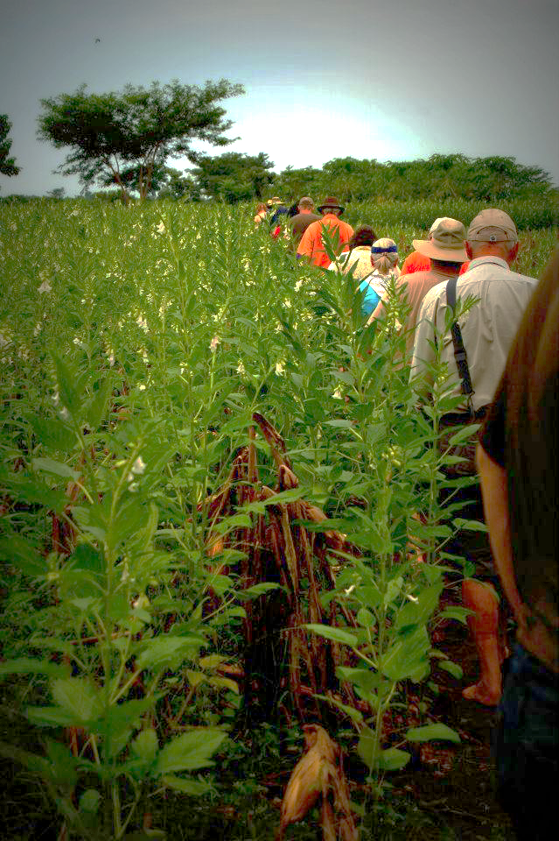
Boise Southwest Rotary Foundation
Paradise Fire Fund
Member donations-$1696 matched by Boise Southwest Foundation—check sent for $3,392—matched by Rotary District 5400 funds
International Grant
$2,500 allotted to the Semilla Nueva
Project in Guatemala

Slide 13
Service Projects
Bike Locks for Refugees
Tree Watering—District 5400
Farmstead—Whittier Elementary School
Make a Splash—Whittier Elementary School
Sorting Coats—Salvation Army
Rake-up Boise
Santa Paws—Humane Society
Christmas Party—Whittier Elementary School
Mountain States Tumor Institute—Christmas gifts and
boxes of food and household items

Slide 14
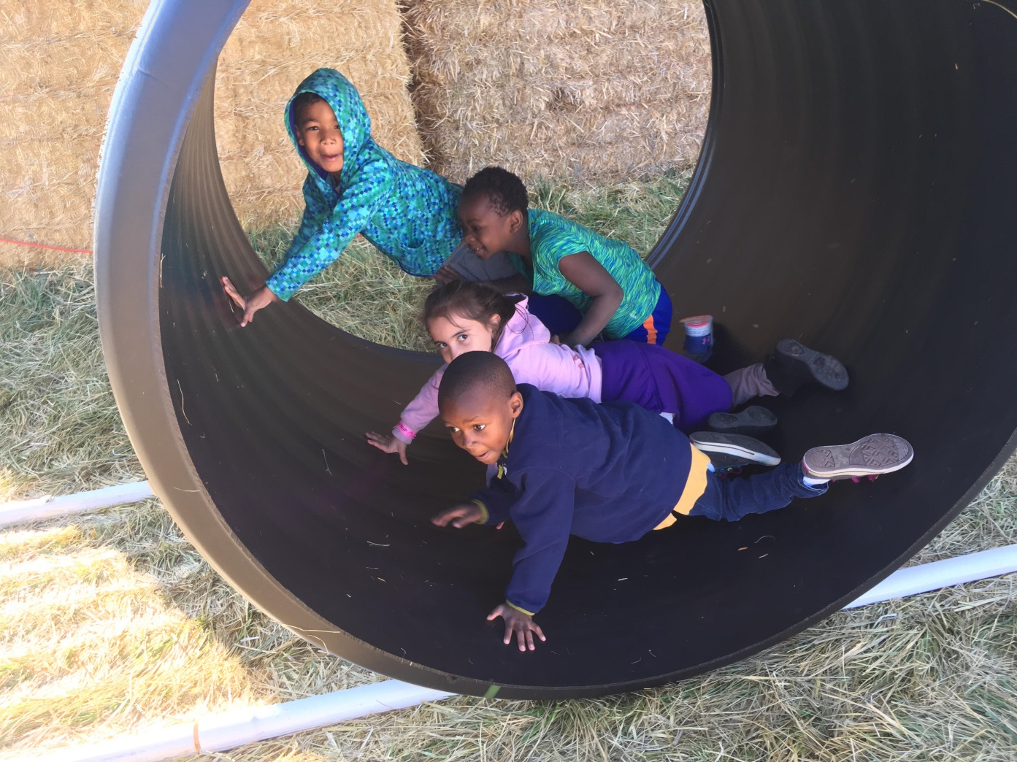

Slide 15
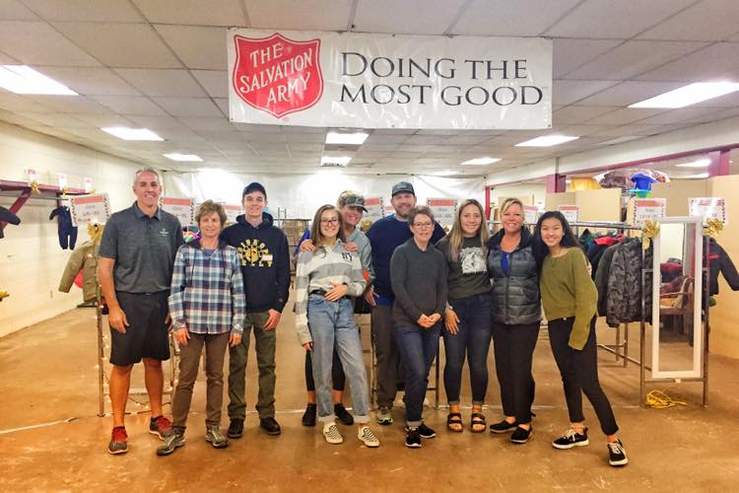

Slide 16
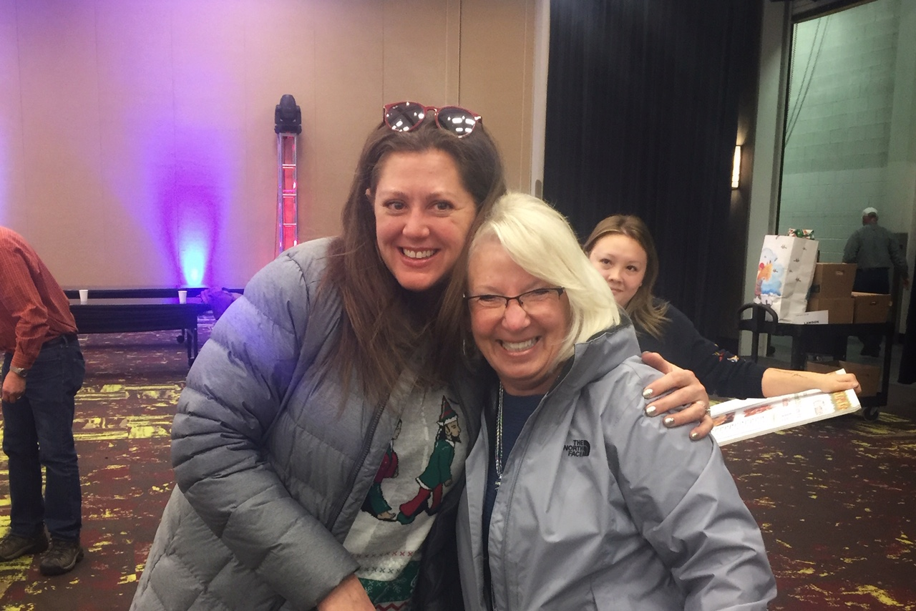
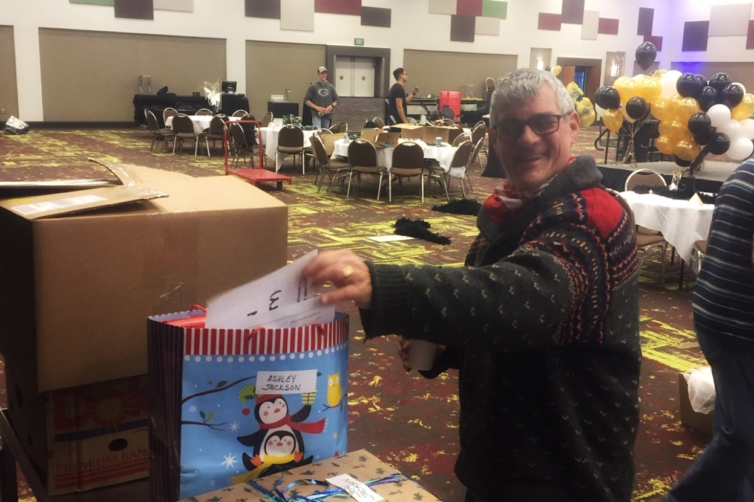

Slide 17
Club Administration
Updated calendars on Boise SW website and Facebook page
Posts of BSW activities on website and Facebook page in a timely fashion
Updated directory on Clubrunner—new members added
Updated directory published by International Mountain Press
Constitution revised and approved

Slide 18
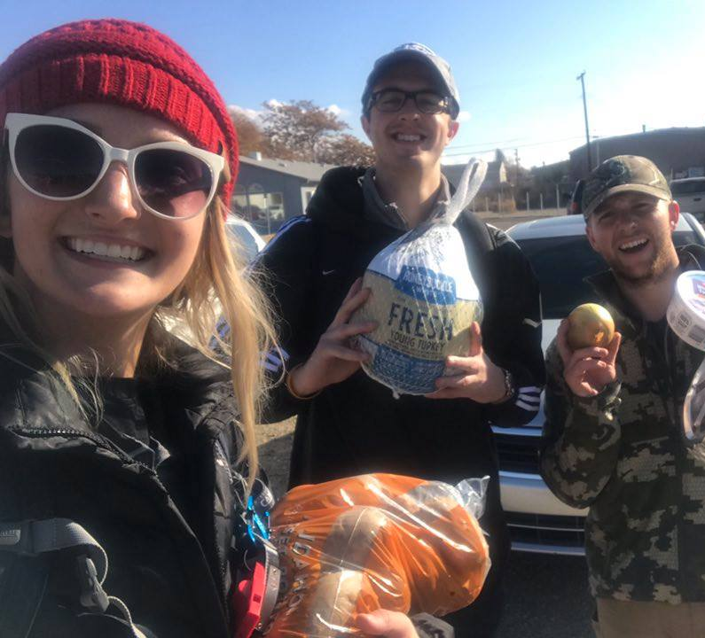
Club Administration
Bylaws revised to include new membership options and other changes—approved by Board and membership
Sponsored new Rotaract Club with Sunrise, Centennial, and Downtown clubs
Modified weekly sign-in sheet to identify guests with an interest in becoming members
Weekly newsletter changing over to RI branded newsletter template to permit access to newsletter on the website

Slide 19
International Student Exchange
Hosted exchange students from France and Spain
Outbound coordinator for District 5400 and committee member for training for North American Youth Exchange Network
Promotion of New Generation Service Exchange as possible program for District 5400

Slide 20
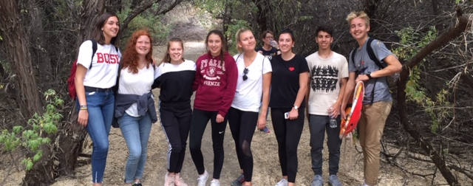
International Student Exchange
Approved support for 1½ exchange students next year—sharing expenses to allow Centennial to participate

Slide 21
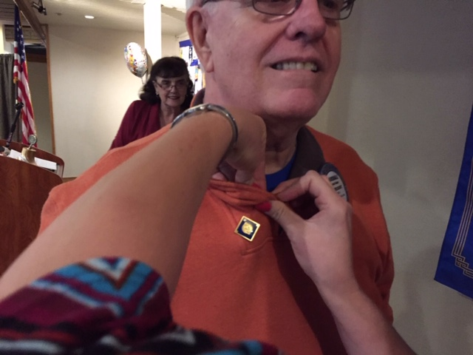
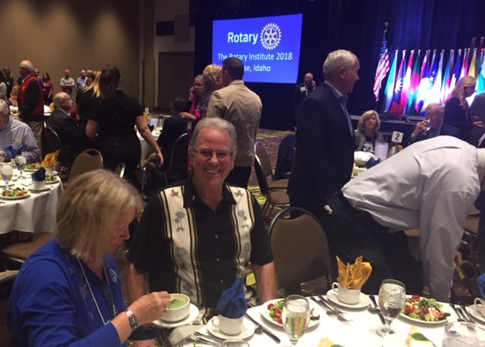
Program Highlights
Tour the Yanke Motor Museum and lunch
Celebration of 25, 30, 40, 45- year members
Zone Meeting-Boise Centre—All-club luncheon
Paulette Jordan—Democratic gubernatorial candidate
Brad Little—Republican gubernatorial candidate

Slide 22
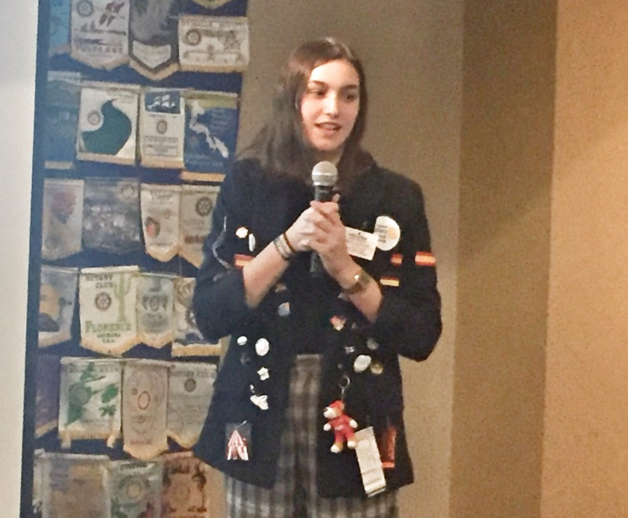
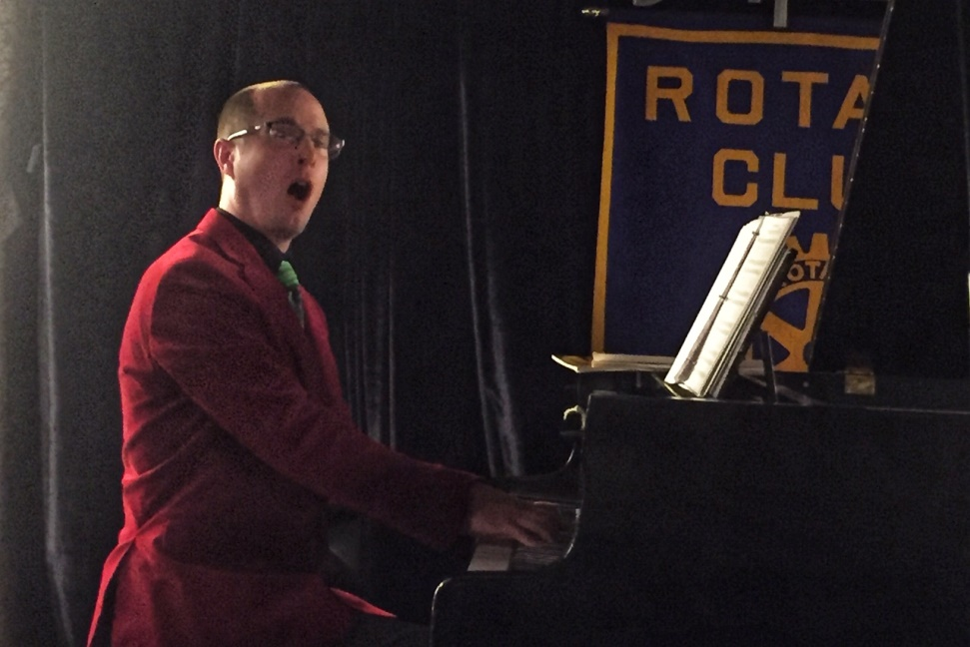
Program Highlights
Jennifer Deroin—District 5400 Governor
Helena Garcia Rodero—International Exchange Student
Laurie Zuckerman—Rotary Environmental Programs
Diane Mykelgard—Julie Davis Park renovations
Art Gregory—Radio museum
Chad Spears—Classic pianist
Rotary Moments

Slide 23
District Info & Sergeant at Arms
District 5400 Liason
Keeping club updated on District Deadlines
Establishing our club’s 2019 – 2020 Officers and Directors
Auditing District 5400 Matching Grants
Writing articles for District 5400 Newsletter
Sergeant-at-Arms
Raising funds for Whittier with happy dollars, fines and bake sales
This day in history Moment
Five Alive birthday celebration
New prayer every week to honor various religious groups

Slide 24
Upcoming Events
Saturday, February 9—Hearts in Service, Hillcrest Country Club, 6:00 p.m., delicious food and wine, awards, casino night—dress semi-formal

Slide 25
Upcoming Events
Thursday, March 7—Dixie Jazz and Crawfish Boil, Basque Center, 5:30 p.m. Rotary Awareness Day and fund-raiser for Boise High School band uniforms.
Tickets: Adults/children 13 and over--$25 until Feb. 7
$35 after February 1. Children 6-12--$15, under 6—free.

Slide 26
More Upcoming Events
Saturday, April 27, Spring Fling, Crane Creek Country Club, Rotary Club of Boise Southwest’s fundraiser. More details soon.
Friday/Saturday, May 17-18, District 5400 Conference, Boise Centre. More details soon.

Slide 27
Special thanks to the Set-up Committee Jim Baldwin, Erik Lund, Mike Markley, Jon Seetin, Dave Shaw

