Slide 1
District governor randy hart
Rotary international district 5000

Slide 2
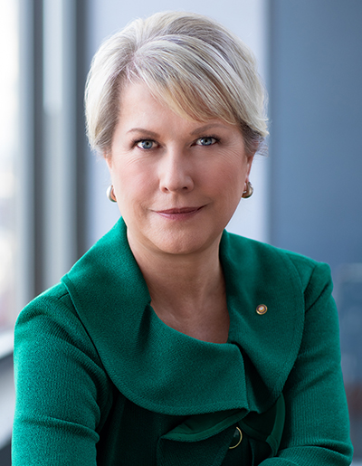
Rotary international president
Jennifer jones
Rotary Club of Windsor-Roseland
Ontario, Canada
V
Notes:
Jennifer Jones is the founder and president of Media Street Productions, an award-winning 27-year-old media company in Windsor, Ontario. She is a member of the Rotary Club of Windsor-Roseland.
Jennifer's talents have strengthened Rotary's reach and impact as she has served in roles including vice president, director, Rotary Foundation trustee, and co-chair of the End Polio Now: Make History Today fundraising campaign.

Slide 3
RI President Jennifer Jones imagines a Rotary where members act to make their dreams become reality and they make the most of their club experiences. She urges members to engage more with each other and use these connections to build partnerships that change the world.

Slide 4
jennifer’s Key messages
Advancing our commitment to Diversity, Equity, and Inclusion (DEI) by each of us doing our part to ensure Rotary is a welcoming and inclusive community. Learn more about DEI in Rotary, determine why DEI matters to your club, raise awareness of DEI including creating a DEI committee in your club that reflects the demographics of your community and take action on DEI.
Create a welcoming club experience: Comfort and Care. Ensure that the club environment and experience is welcoming, inclusive, and enjoyable for all members and participants.
Empowering girls. Continue past RI President Shekhar Mehta’s Girls Empowerment initiative, recognizing that empowered girls become empowered women.
Expanding our reach. How Rotary can make a measurable difference, while introducing Rotary to new audiences and potential partners and influencers.
V
Notes:
Rotary International President Jennifer Jones imagines a Rotary where members act to make their dreams become reality and make the most of their club experiences. During her year, Jones will focus on four presidential initiatives that Imagine Rotary: advancing our commitment to Diversity, Equity, and Inclusion (DEI); creating a welcoming club experience; empowering girls; and expanding our reach.

Slide 5
No child anywhere is safe until we’ve completely eradicated polio from this Earth and that is why we need donations to pay for 150,000 health workers who are in 60 countries, vaccinating 400 million children each year.
Please consider donating $50 to PolioPlus this year and joining the PolioPlus Society to pledge to donate $100 each year until Polio is completely eradicated. every child.
Notes:
He also asked that we continue to donate to PolioPlus.
On the polio eradication front, the effort was suspended and the assets were redeployed to fight COVID. Rotary was commended for being already set up to take action. This may mean, though, there might be an uptick in polio cases, but we’ll have to wait and see. In the news recently, the World Health Organization has certified Nigeria as polio free. This is a major milestone in Rotary's decades-long fight to eradicate polio from the earth. This means that, as of now, only two countries remain with endemic polio - Afghanistan and Pakistan. The entire African region has been declared polio-free. They have to be polio free for 3 years to be declared eradicated. Did you know that normally, the health workers are in 50 countries, vaccinating 400 million children each year to keep children from contracting polio? So, I urge you to not take your eye off this initiative and keep donating to the PolioPlus program. We cannot stop now or we will see polio come back.

Slide 6
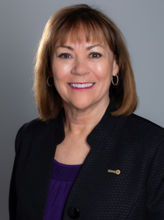
Zone 26/27
Vicki puliz
RI Director
Rotary Club of Sparks, Nevada
Notes:
On the Zone level, they support the Districts with information and assistance. We are in Zone 26 and combined with Zone 27, there are 14 states, 30 districts and 1,700 clubs. Vicki Puliz is the RI Director and a member of the Rotary Club of Sparks in Nevada. The Zone training team trains the District Governors Elect and Nominees. They have a Zone Institute each year, which by the way will be in Salt Lake City this November. Zone Institute is like spring training assembly on steroids and is now open to any Rotarian who like to attend. You meet people who are really deep into Rotary and this year is open to any Rotarian who wants to attend.

Slide 7
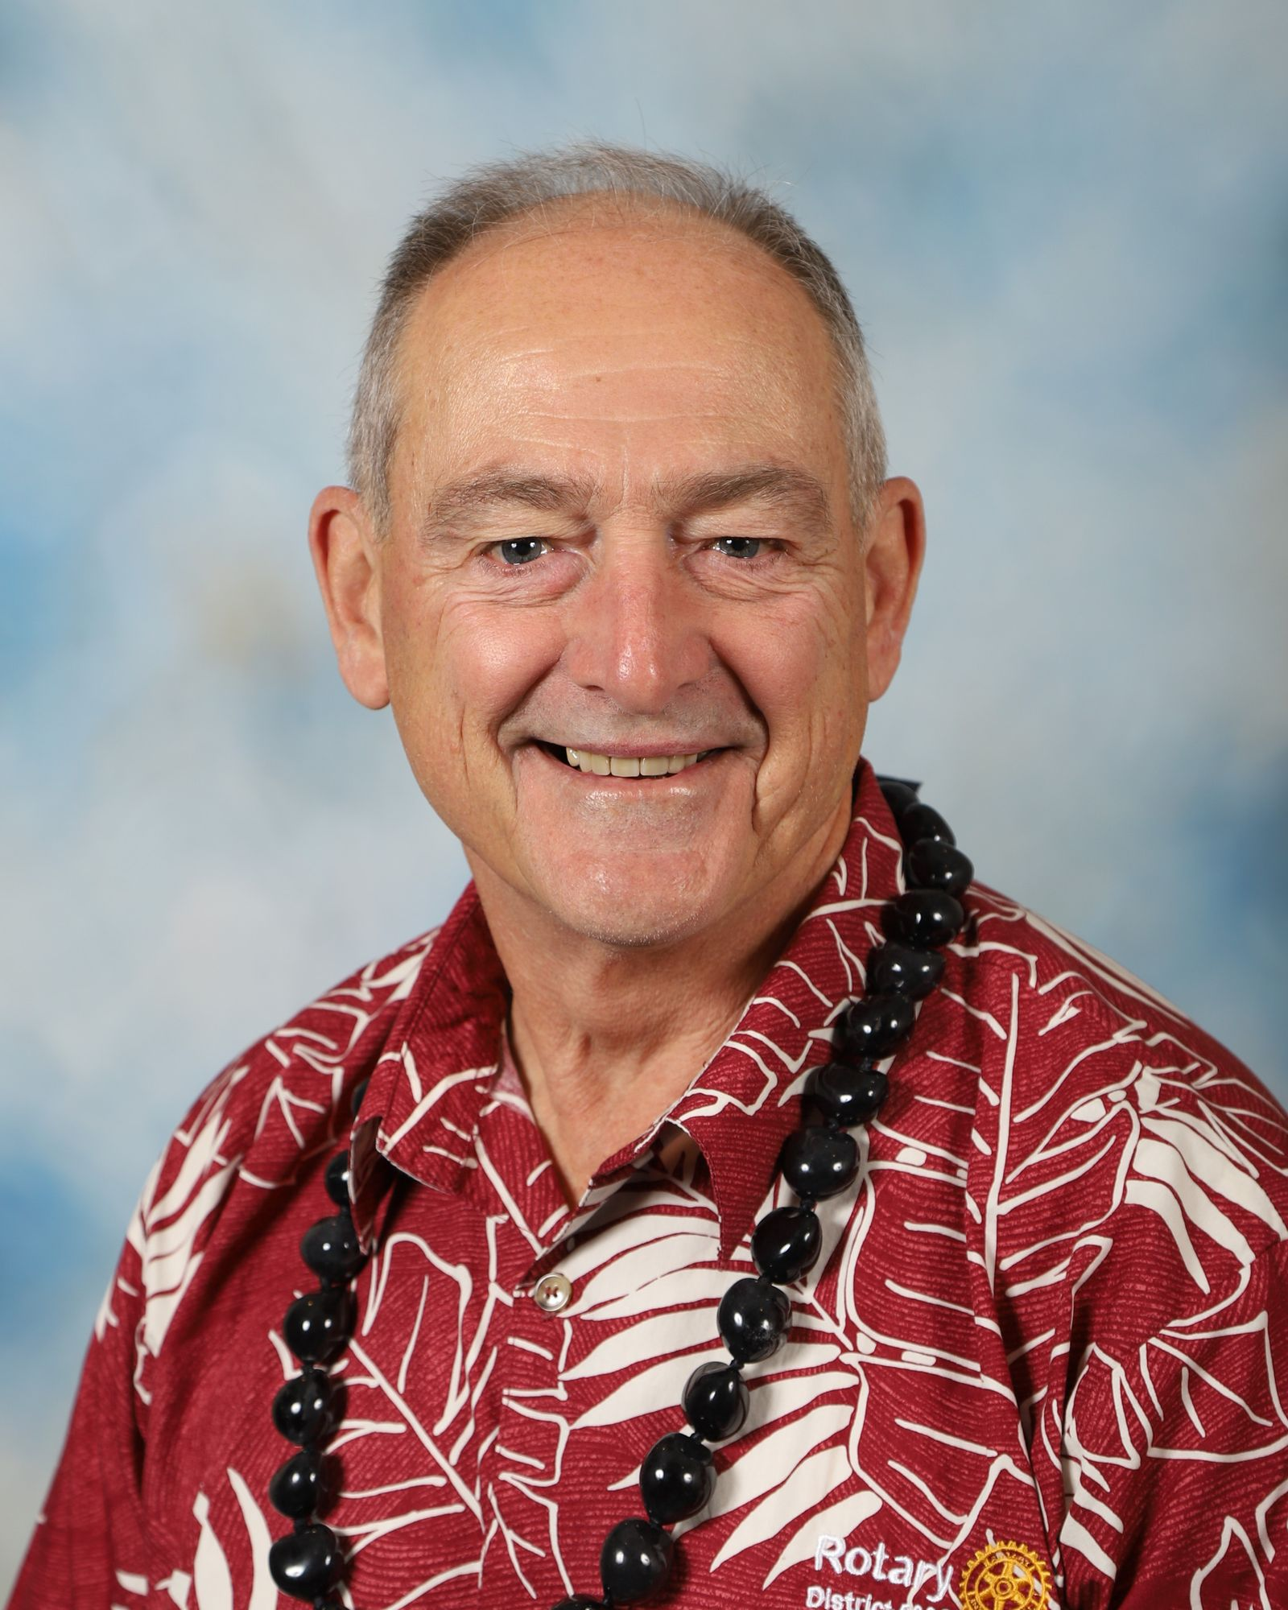
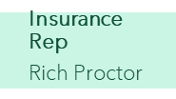
Rotary International District 5000
Vice Governor
Sandy Matsui
DGE
Mark Merriam
DGN
Ted Faigle
District Governor
Randy Hart
Organization chart 2022-2023
DGND
PDG Council
Sandy Matsui
Exec Secretary
Naomi Masuno
Chief of Staff
Ted Faigle
District Rotary Foundation Cmttee Chair
Del Green
Membership Chair (3)
Laine Kohama
Assistant Governors
District Treasurer
Corey Kawamoto
District Secretary
Sharon Scheele
Grants Stewardship
Laura Steelquist
Youth Service
Ryan Char
Rotaract Chair
Nicole Baltazar
Community Svc
Wally Wong
DRFC Vice Chair/Grants Subcommittee
Mark Harbison
Finance Committee (3)
Phil Sammer
District Trainer
Benson Medina
Triple Crown
Dave Mozdren
Interact- HS/MS
Vocational Svc
Nancy Cabral
New Club Advisor (3)
Laura Steelquist
Annual Giving
Dick May
Public Image
Co-Chairs
Scott Wishart
Josh Laguana
New Member Leads
Win Schoneman
Ombudsman
Gary Grimmer
White Hat Society
Paul Jurcsak
Interact-MS
Early Act
Lynn Goya
DEI Task Force
Kecia King
International Service (3)
James Ham
Endowment/MG
Rick Golba
Membership Attraction
Connie Ichinose Wendy Hornack
Legal Advisor
Del Green
Alumni
Steve Dyer
RYLA (Statewide)
Tim Hansen
Webmaster
Konrad Ikei
Awards
Beth Hoban
Candice Naito
Hawaii West- Nestorio Domingo
Hawaii East-Doug Adams
Maui Valley-Wendy Hornack
Maui Coast-Mariko Higashi
Oahu West-Arlene Estrella
Oahu Central-Josh Laguana
Oahu East-Jamie Apuna
Oahu Waikiki-Konrad Ikei
Oahu Downtown-Dave Mozdren
Oahu Windward-Kathleen Merriam
Kauai- Dani Dooley
Travel Coordinator
Jamie Apuna
PolioPlus
Roz Cooper
Peace Fellows
Alan Kusunoki
Youth Protection
Peter Evans
Social Media
Josh Laguana
Other Committees
Positions
New Club Development
Wendy Chang
Wendy Hornack
District Conference
Lori Williams
Jen Tanouye
District Grants
Dave Hamil
Scholarships
Alan Kusunoki
Youth Exchange
Tom Gross
District Resolution/ Legislation
DGE
Audit Team
Ron Young
Newsletter
District Leadership Team
June 10, 2022
Global Grants
James Ham/ Arjun Aryal
Disaster Fund
[Vacant]
Service Exchange
RI Convention Promotion
DGND

Slide 8
Randy’s area of focus: membership
subhead
Membership will be the focus this year, as have over the years, but let’s take it up a notch with focusing on engaging members and expanding our reach. With more hands, we can imagine more impactful projects and continuing our mark to be rainmakers.

Slide 9
D5000 Membership Goal = 10% NET Gain
As of July 2, 2022, D5000 has 1422 members
Club commitments = Net increase of ONE

Slide 10
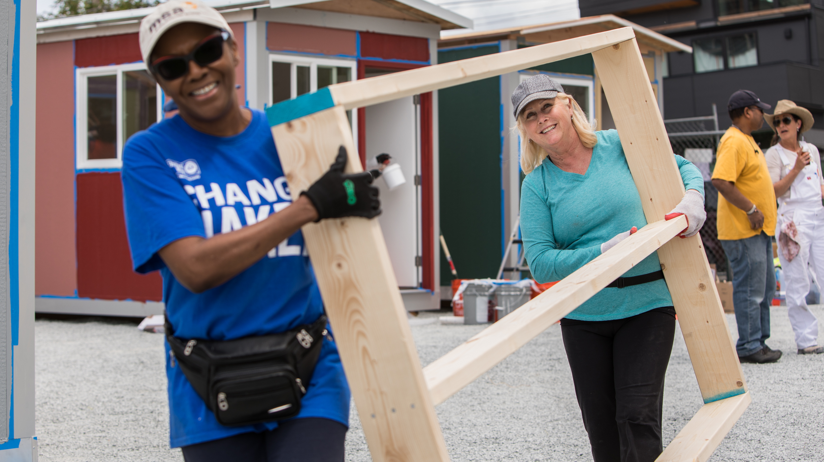
The Rotary Foundation helps Rotarians to
advance world understanding, goodwill, and peace by
improving health, providing quality education, improving the environment, and alleviating poverty.
Notes:
The Rotary Foundation’s mission is to advance world understanding, goodwill, and peace by improving health, providing quality education, improving the environment, and alleviating poverty.

Slide 11
subhead
District 5000 Grant $
(including club and World Fund matching funds)
2019-2020: $419,000
2020-2021: $306,000
2021-2022: $289,195
2022-2023: $303,050
Notes:
The Rotary Foundation grant funds and club cash fund our local and global projects to help people. This year we have about $303k for projects. This money comes from club donations made 3 years ago, plus money from the world fund, the clubs and we get about $12k from endowment earnings. Please continue your donations to The Rotary Foundation and check the Annual-Share box to see the money come back to you club for grants and consider a gift from your estate to the Foundation. If you saw the list of projects all the clubs did with grant funds, you would be totally impressed! Your club’s project with your grant funds helped a lot of people with your projects

Slide 12
Foundation Goals
EREY (Every Rotarian Every Year)
Per Capita
Notes:
Your gift to the Annual Fund helps Rotary clubs take action today to create positive change in communities at home and around the world. Your contributions help us strengthen peace efforts, provide clean water and sanitation, support education, grow local economies, save mothers and children, protect the environment, and fight disease.
The Every Rotarian Every Year initiative asks every Rotarian to support The Rotary Foundation every year. In addition to contributing to the Annual Fund on a regular basis, members are encouraged to get involved in a Foundation project or program.

Slide 13
District 5000 international projects 2022/2023
Nepal – December 2022
Fiji - March 2023

Slide 14
Rotary service opportunities
October 24-World Polio Day
November 26 – Rotary Gives
April 22- Rotarians at Work Day
Notes:
This new Rotary year, we again have opportunities in our State to do larger project together with the Rotary Gives Thanks day in November and Rotarians at Work day in April. I encourage you to band together with other clubs, Interactors, Rotaractors and partners to execute larger, impactful projects. World Polio day events on October 24^{th.}

Slide 15
Upcoming Webinars
Date | Day | Time | Webinar Topic | Recommended Audience
11-Jul | Mon | 6-7 pm | Presidents, Club Trainers, AGs | Presidents, Club Trainers, AGs
16-Jul | Sat | 9-11 am | Membership Training | Membership Chairs
25-Jul | Mon | 5:30-6:30 pm | Youth Service Chairs | Youth Service Chrs/Advisors
30-Jul | Sat | 9-11 am | Community Service Chairs | Community Service Chairs
6-Aug | Sat | 9-10 am | This Is Who We Are | Welcome to Rotary
8-Aug | Mon | 6-7 pm | Presidents and AGs | Presidents and AGs
8-Aug | Mon | 7-8 pm | Club Trainers & Membership Chairs | Club Trainers
13-Aug | Sat | 9-10 am | Youth Protection | Youth Service Chairs
22-Aug | Mon | 5:30-6:30 pm | Youth Service Chairs | Youth Service Chrs/Advisors
27-Aug | Sat | 9-10am | Social Media/Public Image 101 | Public Image Chairs
29-Aug | Mon | 7-8 pm | Foundation Planning | Foundion Chairs, Presidents
3-Sep | Sat | 9-11 am | Kuleana - A Course in Leadership | Leadership 101 - Invitees
5-Sep | Mon | Holiday
7-Sep | Wed | 6-7 pm | Presidents and AGs | Presidents and AGs
10-Sep | Sat | 9-10 am | Foundation Basics 101 | Open to All Rotarians
10-Sep | Sat | 10-11 am | Grant Qualifications | PE, PN, Treasurers, Fdn Chr
12-Sep | Mon | 7-8 pm | Club Trainers | Club Trainers
14-Sep | Wed | 6pm | President Elect Training | All PE's
24-Sep | Sat | 9-10 am | International Serv, Global Grants | Intntnal Svc Chairs, Presidents
24-Sep | Sat | 10-11am | PolioPlus | All
26-Sep | Mon | 5:30-6:30 pm | Youth Service Chairs | Youth Service Chrs/Advisors
1-Oct | Sat | 9-10:30 am | Board Training - Elections | Club Board Members
3-Oct | Mon | 6-7 pm | Presidents and AGs | Presidents and AGs
10-Oct | Mon | Holiday
10-Oct | Mon | 7-8 pm | Club Trainers | Club Trainers
12-Oct | Wed | 6pm | President Elect Training | All PE's
24-Oct | Mon |  | World Polio Day | Open to All

Slide 16
Support for clubs
Webinars
Online Rotary Learning Center
District Leadership Academy (starts in August. Past Presidents apply now)
Notes:
We want to continue to build a stronger district resource team to support the clubs. That would consist of district committees for Membership, The Rotary Foundation, the district conference and the Avenues of Service, especially Youth Service. Benson Medina, the District Trainer, is doing an awesome job with the webinars and training, but there is much more we can do for the clubs and that’s where your club trainer comes in. Benson will be working with them to help with training in your club, if needed. If you are interested in serving on the district level, please let me know. If anyone would like to apply for the District Governor for 2025-2026, applications will be accepted from August and the interview will be in late October.

Slide 17
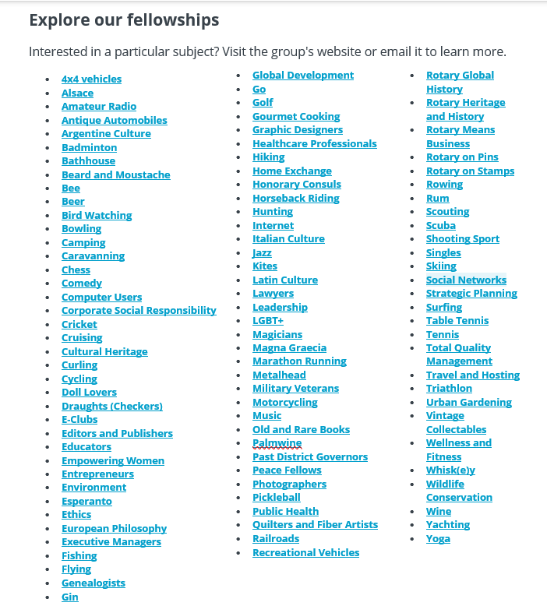
Notes:
Rotary Fellowships consist of members who share a common interest in recreational activities, sports, hobbies, or professions. These groups help expand skills, foster vocational development, and enhance the Rotary experience by exploring interests while developing connections around the world. Are you interested in a particular subject? Visit the group's website or email it to learn more.

Slide 18
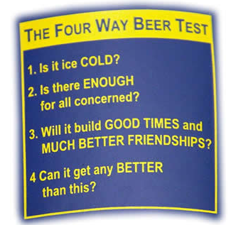
Examples of Rotary Fellowships
More than 90 Rotary Fellowships are now officially registered with Rotary International in 150+ countries
Notes:
Many fellowships also use their special interests to serve others. For example, the Fellowship of Canoeing Rotarians has organized cleanups of polluted rivers; members of the International Computer Users Fellowship of Rotarians have hosted training sessions for Rotarians and the general public; and members of the International Fellowship of Rotarian Scuba Divers join local Rotary clubs to undertake service projects on each of their diving trips.

Slide 19
Addiction Prevention www.rag-ap.org
AIDS and Family Health www.rfha.org
Alzheimer’s and Dementia http://adrag.org/
Blindness Prevention www.rag4bp.org
Blood Donation www.ourblooddrive.org
Clubfoot www.rag4clubfoot.org
Diabetes www.rag-diabetes.org
Disaster Assistance www.dna-rag.com
Domestic Violence Prevention www.ragfamsafe.org
Endangered Species www.endangeredrag.org
Environmental Sustainability www.esrag.org
Food Plant Solutions http://foodplantsolutions.org
Health Education and Wellness www.hewrag.org
Hearing www.ifrahl.org
Hepatitis www.ragforhepatitiseradication.org
Literacy www.litrag.org
Malaria https://ram-global.org
Mental Health http://ragonmentalhealth.org
Microfinance & Community Development http://ragm.org
Multiple Sclerosis www.rotary-ragmsa.org
Peace www.rotarianactiongroupforpeace.org
Polio Survivors and Associates www.rotarypoliosurvivors.com
Population and Development www.rifpd.org
Slavery Prevention https://ragas.online/
Water and Sanitation www.wasrag.org
Rotary Action groups
Independent, international, Rotary affiliated groups whose members have expertise and experience in a particular area of specialization. Aligned with Rotary’s priority to increase humanitarian impact, they use their knowledge and passion to help clubs and districts plan and carry out impactful service projects. Each group oversees its own governance, membership, and activities in accordance with RI policies.

Slide 20
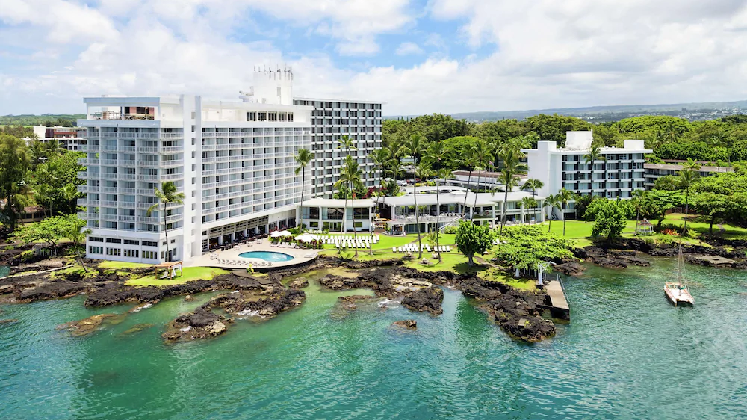
District Conference- may 19-21, 2023 celebrating in Hilo!

Slide 21
Notes:
Thank you for all of your hard work I look forward to working for you.

Slide 22
Notes:
Thank you for all of your hard work I look forward to working for you.

