Slide 1

BOISE SCHOOL DISTRICT
DEMOGRAPHICS
ENROLLMENT TRENDS
FREE/REDUCED LUNCH
LIMITED ENGLISH POPULATION

Slide 8
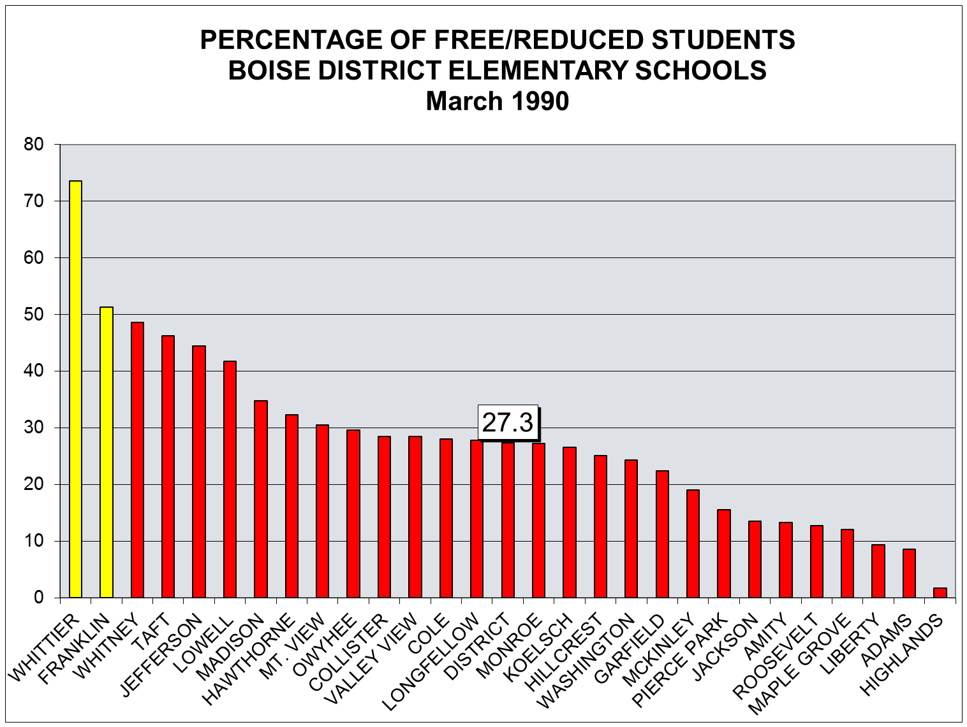
2 schools above 50%

Slide 9
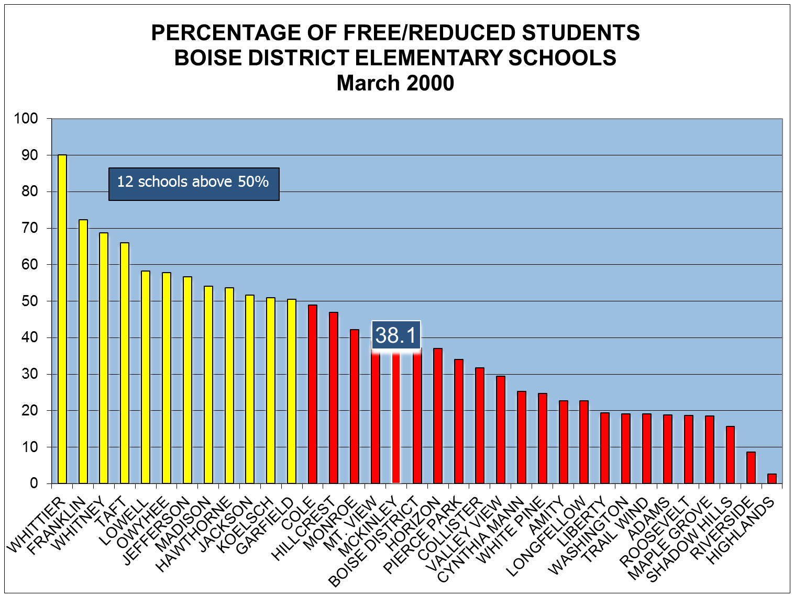

Slide 10
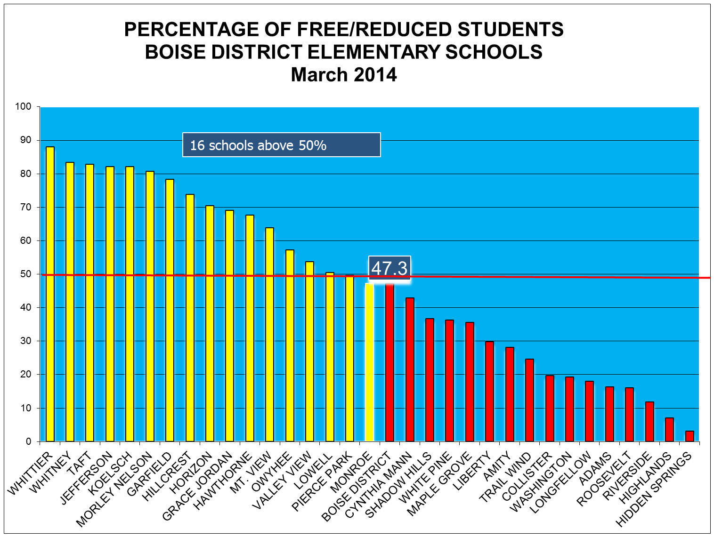

Slide 11
There are currently 1841 Limited English students in the Boise School District (about 7% of the total District population), and another 427 who have been exited in the past two years.

Slide 12
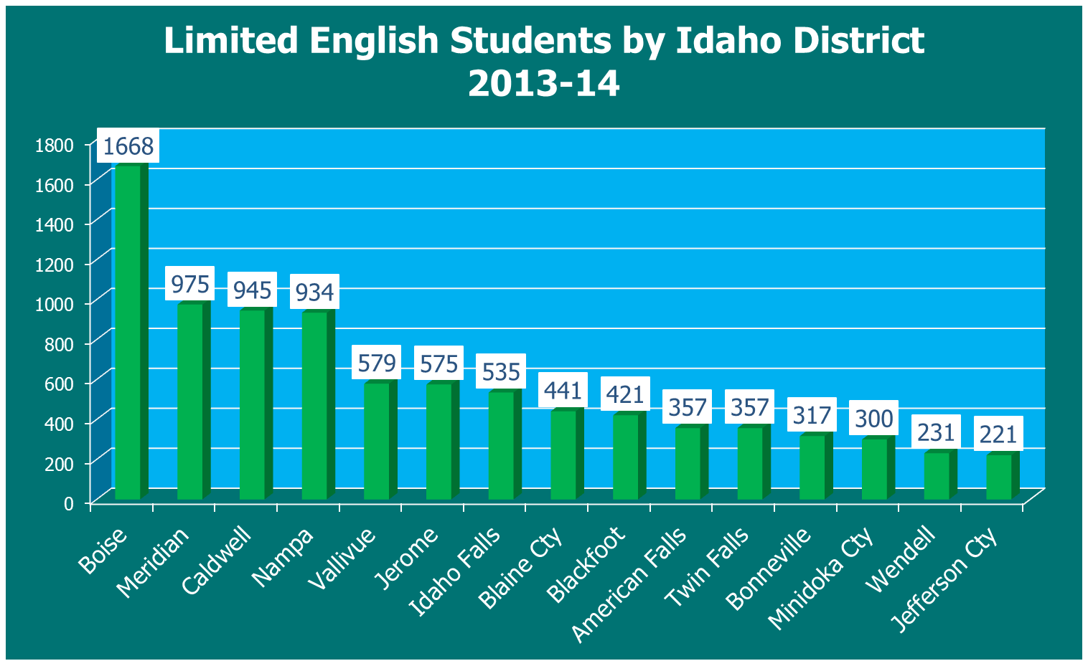
In terms of numbers, the Boise District has by far the largest population of Limited English students in the state of Idaho.

Slide 13
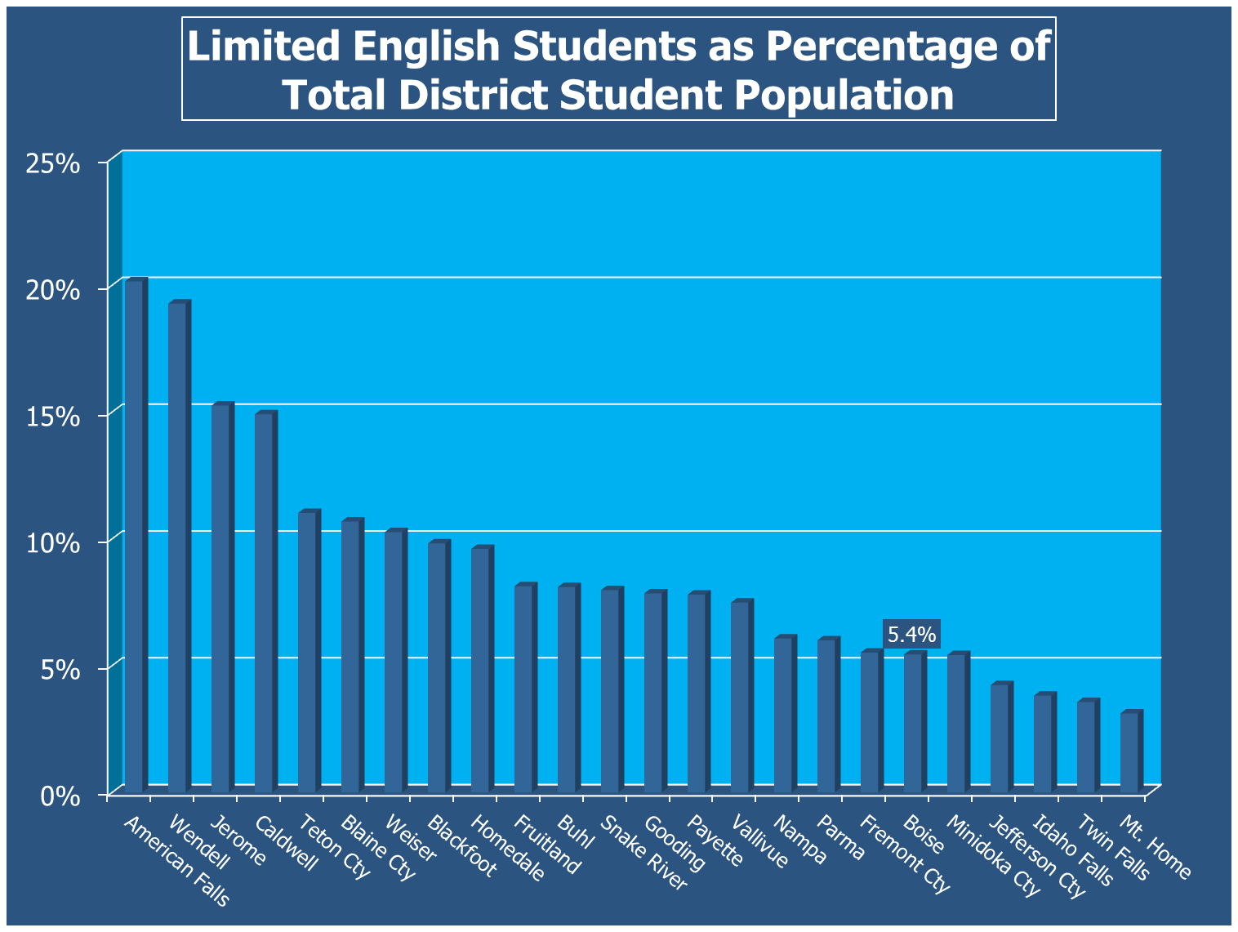

Slide 14
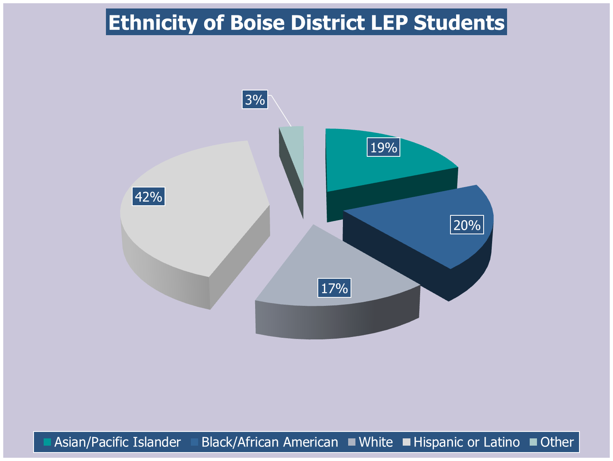

Slide 15
BOISE SCHOOL DISTRICT
ACHIEVEMENT
ADVANCED PLACEMENT
SAT
COLLEGE-GOING RATES

Slide 16
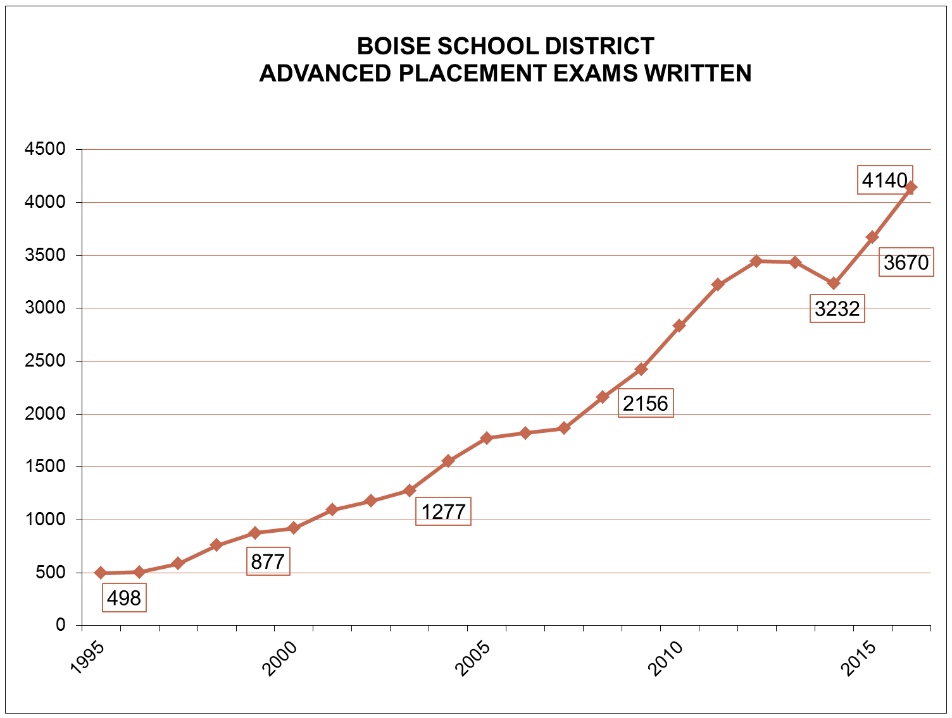

Slide 17
AP U.S. History Released Exam
72. Richard Nixon's 1968 political comeback to win the presidency can be partly attributed to:
(A) dissension within the Democratic party over Vietnam
(B) the defection of Black voters to the Republican party
(C) Nixon's cordial relations with the news media
(D) Nixon's great popularity as Eisenhower's vice president
(E) Nixon's promise of immediate withdrawal of American forces from Vietnam.

Slide 18
AP U.S. History Released Exam
72. Richard Nixon's 1968 political comeback to win the presidency can be partly attributed to:
(A) dissension within the Democratic party over Vietnam
(B) the defection of Black voters to the Republican party
(C) Nixon's cordial relations with the news media
(D) Nixon's great popularity as Eisenhower's vice president
(E) Nixon's promise of immediate withdrawal of American forces from Vietnam.
Correct answer: A 28% of students responded correctly

Slide 19
ADVANCED PLACEMENT EXAMINATIONS
FREE RESPONSE QUESTIONS
AP U.S. GOVERNMENT
AP CALCULUS AB

Slide 20
Sample AP Government Question
SOCIAL SECURITY RECEIPTS, SPENDING, AND RESERVE ESTIMATES, 2001–2035
In recent decades, entitlement programs have constituted a substantial portion
of the United States federal budget. Social Security is the largest entitlement
program in the United States. From the information in the chart and your
knowledge of United States government and politics, perform the following tasks.
(a) Define entitlement program.
(b) What is the primary source of revenue for the Social Security program?
(c) Identify one threat to the future of the Social Security program should the
trends depicted in the chart above continue.
(d) Describe one demographic trend that threatens the future of the Social
Security program AND explain how it is responsible for the threat that you
identified in (c).
(e) Explain how any one of the trends in the chart above would change if the age
of eligibility for Social Security were raised.
2009-10 Boise Pass Rate – 83% (21% “5” Scores)

Slide 21
Sample AP Human Geography Question
1. Walls and other barriers built by countries to establish their borders are some of the oldest and most controversial elements in the cultural landscape.
a. Identify three examples of walls or other barriers built by countries in the twentieth and twenty-first centuries.
b. Explain the purpose of one of the examples you identified in part a.
c. For each of the categories listed below, discuss a consequence faced by countries as a result of walls or other barriers established along their borders.
    i. social or political
ii. economic
iii. environmental

Slide 25
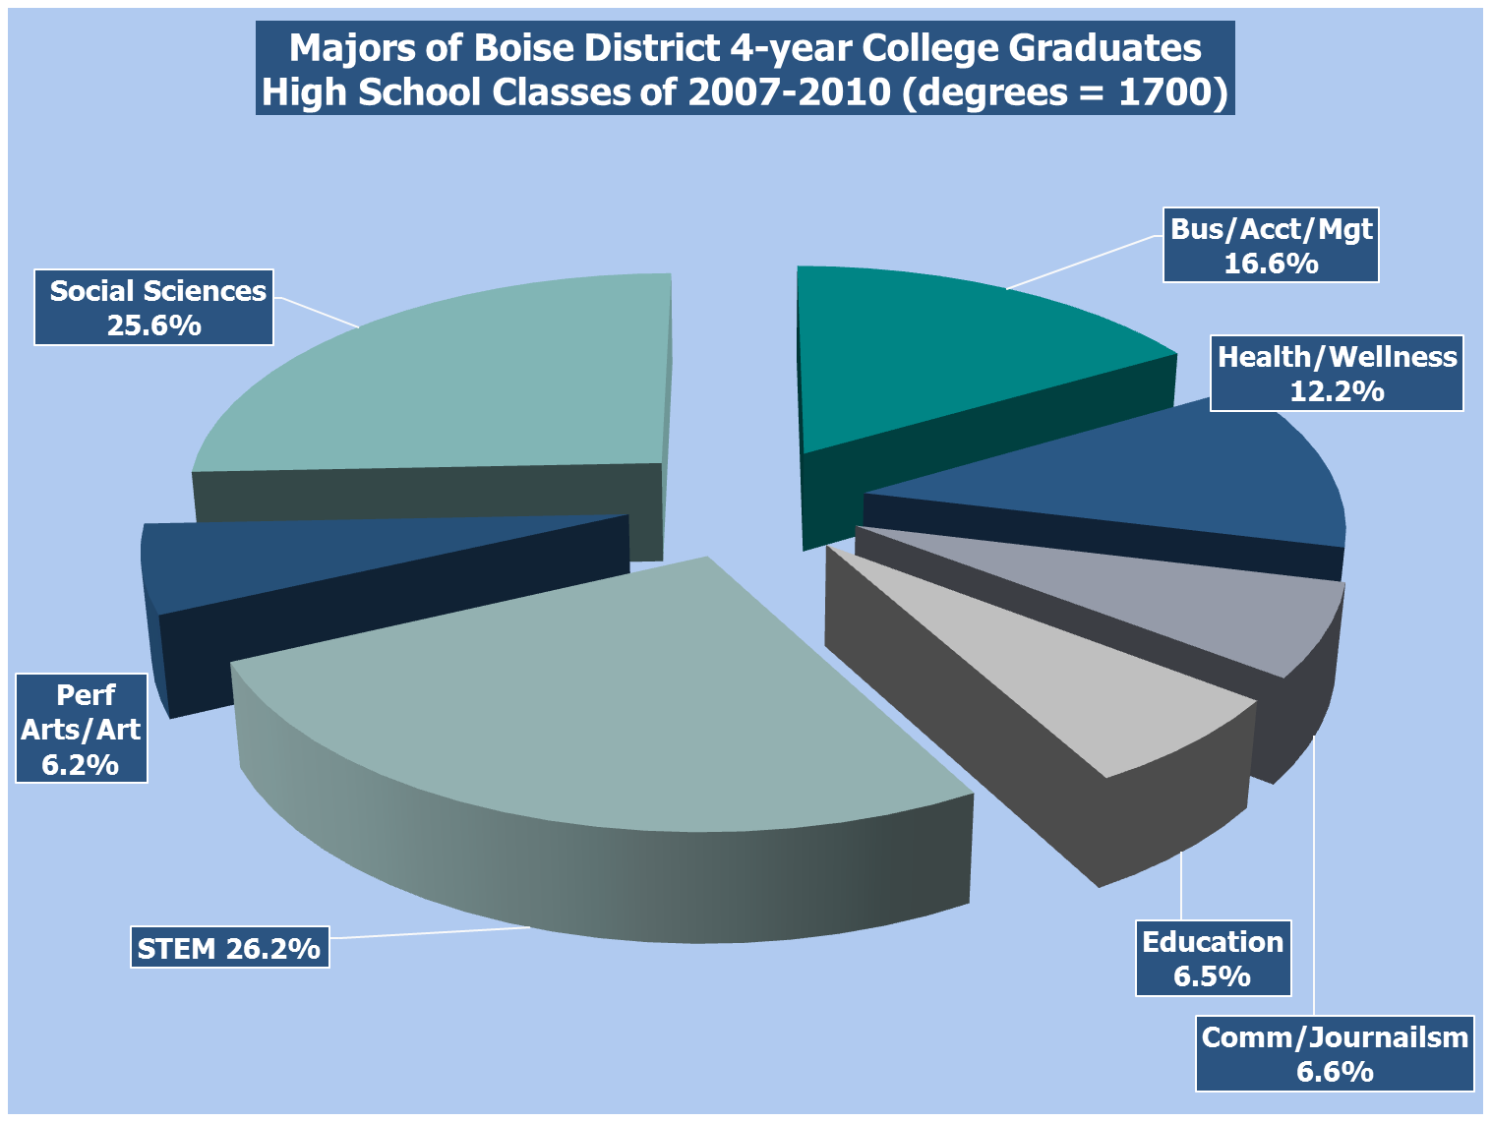

Slide 26
4-Year Degrees Granted by Major
Boise School District Classes 2007-2010
Major Number of Degrees
Biology 101
Business 98
Psychology 89
Communications 64
English 61
Health Science 52
History 51
Elementary Education 50
Mechanical Engineering 47
Political Science 42

Slide 28
Utah/Utah State Enrollees
Boise District Class of 2015
Average Average Average
School HS GPA Mth/Rdg SAT AP tests 3+
Utah 3.94 1206 6
Utah State 3.76 1144 5
Total 3.86 1180 5

