Slide 1


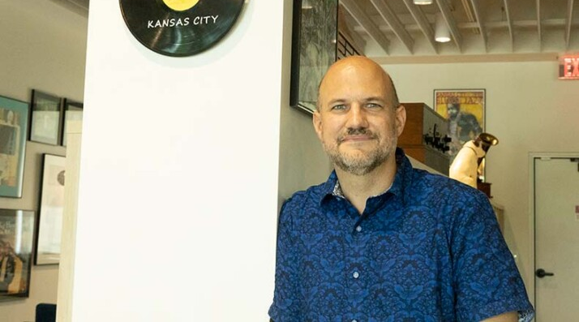

The Leawood Rotarian
The Leawood Rotarian
The Newsletter of the Leawood Rotary Club
Celebrating 30 Years! leawoodrotary.org April 13, 2025
Steve Everley
THE WEEK AHEAD:
THE WEEK AHEAD:
April 17 Meeting: 7:15 to 8:30 a.m.
Program: “The Listyning Room” – Kelsyn Rooks
The Lystyning Room, located at 3510 W. 95th St. in Leawood, is dedicated to the concept of social listening and learning. Committed to building a community resource anchored in celebrating the artistic, technical, historical, and social importance of recorded music.
Greeters: Mary Jo Holland, Lorna Jarrett, Roxanne Kerr-Lindsey,
Tom Koch, Arlene Ladegaard
Invocator: Diane Stoddard
FINAL CALL FOR RSVPs – MONDAY!!
FINAL CALL FOR RSVPs - MONDAY!
April 15: Happy Hour Tuesday, 4:30–6:00 p.m. Brass Onion at Prairie Fire
Please remember to RSVP by Monday, April 14th, to Arlene Ladegaard (arlene@designconnectioninc.com) or Terri GImlin (gimlin@sbcglobal.net)
if you plan to attend the Rotary social at the Brass Onion. The social is Tuesday April 15th from 4:30 to 6:00. There is some parking on the street and also a parking garage across the street from the restaurant. And, Brass Onion has valet parking available starting at 5:00. It's important to RSVP by Monday so we can be sure to have enough appetizers ordered for everyone. Brass Onion is located at 5501 West 135th Street,
Overland Park, KS 66224

Slide 2
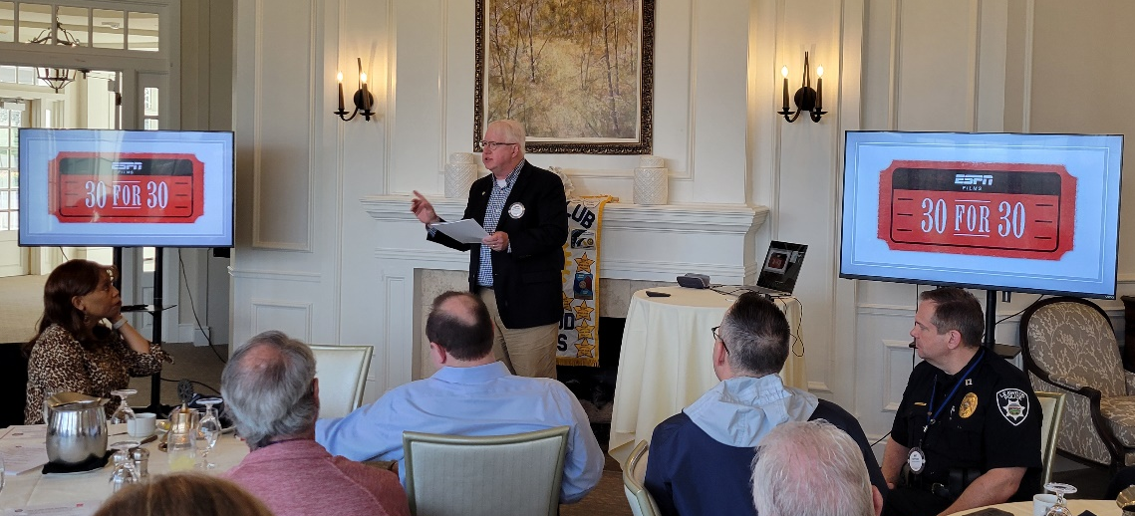
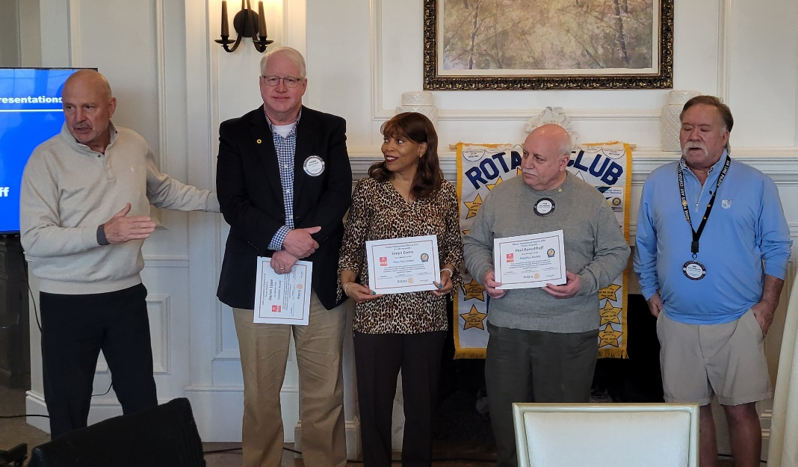

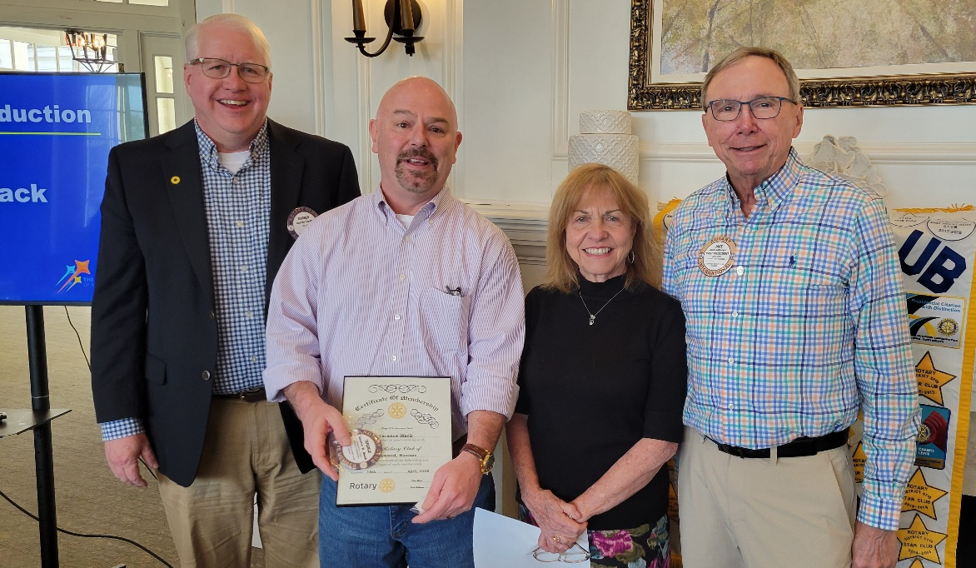

LAST WEEK (April 10, 2025):
LAST WEEK (April 10, 2025):
Fellow Rotarian Darren Lippe gave a very informative and entertaining historical program titled “How 116 Kansans Saved the U.S.A.” Edutainment at its finest, and there was no test. Thanks Darren!
Polio Plus Society Certificates were presented to Darren Lippe, Sonya Evans and Paul Rueschhoff.
The club inducted our newest member, Terence Mack. Welcome to Leawood Rotary, Terence!
2

Slide 3




Mark Your Calendars:
Mark Your Calendars:
April 22: We Make Pour Choices Society, 5:30–7:30 p.m.
Chuck and Ester Udell are hosting this gathering at their home: 4323 W. 112th St., Leawood, KS. Please bring a bottle of wine from New Zealand. If you plan to attend, please inform Paul Rueschhoff or Chris Sagovac, your Leawood Wine Guys!
April 25: Pints for Polio, 5:30–7:00 p.m. at Martin City Brewing Company in Mission Farms
April 29: Project Cure, 1 – 3:30 p.m. Project Cure Warehouse in the Hunt Midwest Subtropolis. If you wish to carpool, meet at 12:30p.m. in the parking lot just east of the UMB bank at I-435 and State Line. This is another great chance to do good and have some fun with your Rotarian friends. We will also be presenting Project Cure with a check for financial support.
April 29: Membership Committee Meeting, 4:30 p.m. at Jake Schloegel’s home: 2201 W. 120th Terrace, Leawood, KS, 66209
May 7: Happy Bottoms, 10 a.m. to Noon, 303 W. 79th St., Kansas City, MO 64114
Spread Awareness. Get Vaccinated. Save Lives.
Our work on polio eradication is proof that vaccines save lives. 3 billion children have been vaccinated against polio and the cases of polio have been reduced by 99.9% since 1988. But we know the job is not done until every child is vaccinated, and polio is stopped for good. Help us share the message that #VaccinesWork.
3

