Slide 1
Welcome to Red Hook Rotary Club!
Since 1955, dedicated to Service Above Self!
www.redhookrotaryclub.org

Slide 2
What is Rotary?
Rotary is a global network of 1.2 million neighbors, friends, leaders, and problem-solvers, in over 35,000 clubs worldwide, who see a world where people unite and take action to create lasting change – across the globe, in our communities, and in ourselves.

Slide 3
History of the Red Hook Rotary Club
Our club was chartered by the Rhinebeck Rotary club on February 23, 1955, the 50th anniversary of the founding of Rotary by Paul Harris.

Slide 4
Red Hook Rotary Today
We have 18 active and devoted members in a variety of professions:
Rev. Fred Cartier - Clergy (Retired) Christine Chale - Attorney Carl Dowden - Insurance Sales
Susan Ezrati - Pension Manager (Retired) Linda Greenblatt - Educator (Retired) Rebecca Kent - Pet Care Robert Latimer - Healthcare Administration
Timothy Lynch - Engineer, Architect Karen Mead-Cadorette - Landscaping
Michael Mills - Insurance Barry Ramage - Investments & Securities (Retired) Rev. Michael Shafer –Clergy (Retired) Susan Simon - Financial Planner Hon. Jonah Triebwasser - Municipal Judge
Jennifer Van Voorhis - Financial Services Bernard "Bud" Weaver - Real Estate Gale Wolfe - Aesthetician David Wright - Commercial Banking

Slide 5
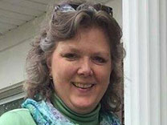
Red Hook Rotary Officers
President: Jennifer Van Voorhis (shown in photo)
Vice Presidents: Linda Greenblatt and David Wright
Secretary: Susan Ezrati
Treasurer: Timothy Lynch, PE
Club Foundation:
Chairman: Carl Dowden
Vice-Chairman: Timothy Lynch, PE
Secretary: Rev. Michael Shafer
Treasurer: Bud Weaver
Directors: Rev. Fred Cartier and Susan Simon

Slide 6
We usually meet on Tuesday mornings at 7:30 a.m. at Cancun’s Family Mexican Restaurant. . .

Slide 7
. . .but, since the start of Covid 19 we have been meeting online!

Slide 8
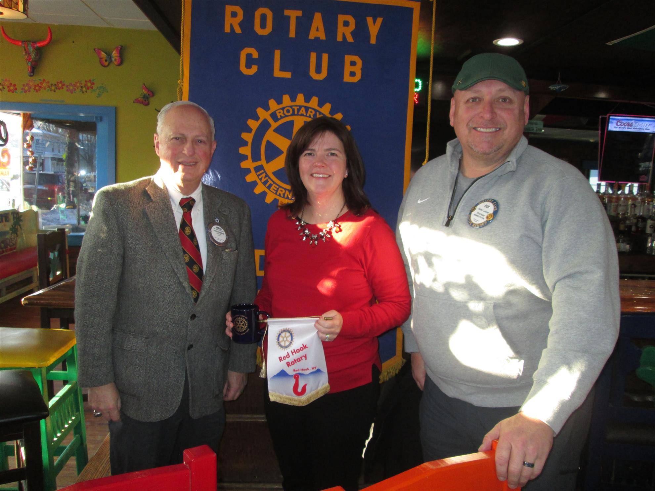
What we do as Rotarians:
We have a variety of guest speakers at our weekly meetings on a broad range of topics, such as:
Rotarian Christina Boryk, president of the Poughkeepsie South Rotary club. She is the executive director of “Rebuilding Together,” which is part of a national network of over 130 affiliates that works to restore and revitalize homes and neighborhoods across the country.

Slide 9
New Paltz Rotarians Bob Rich and Pascal Guirma with their friend Jim Ullrich. They spoke about their special project in the village of Guirgho in Burkina Faso, Africa. Their group, Friends of Guirgho’s, mission is to partner with rural schools in Burkina Faso, beginning with the village of Guirgho, to maximize the potential of every student by providing access to state-of-the-art educational tools and technology.

Slide 10
Franceska Macsali-Urbin, Site Manager for the Franklin D. Roosevelt Home and Museum and Eleanor Roosevelt’s Val-kill national historic sites in Hyde Park. In recognition of Women’s History Month, Franceska’s presentation was “Eleanor Roosevelt: The Evolution of a Woman Activist.”

Slide 11
And we are still having guest speakers during our Zoom meetings!
We are involved in many service projects in the Red Hook community and around the world, living each day by Rotary’s motto of Service Above Self.

Slide 12
We are proud to host international youth exchange students every year!
We have welcomed students from overseas and have sent Red Hook students around the world!

Slide 13
Students have come to us from, or have gone to . . .
Brazil
Japan
Thailand
Spain
Italy
France
Germany
Austria
And so many more!

Slide 14
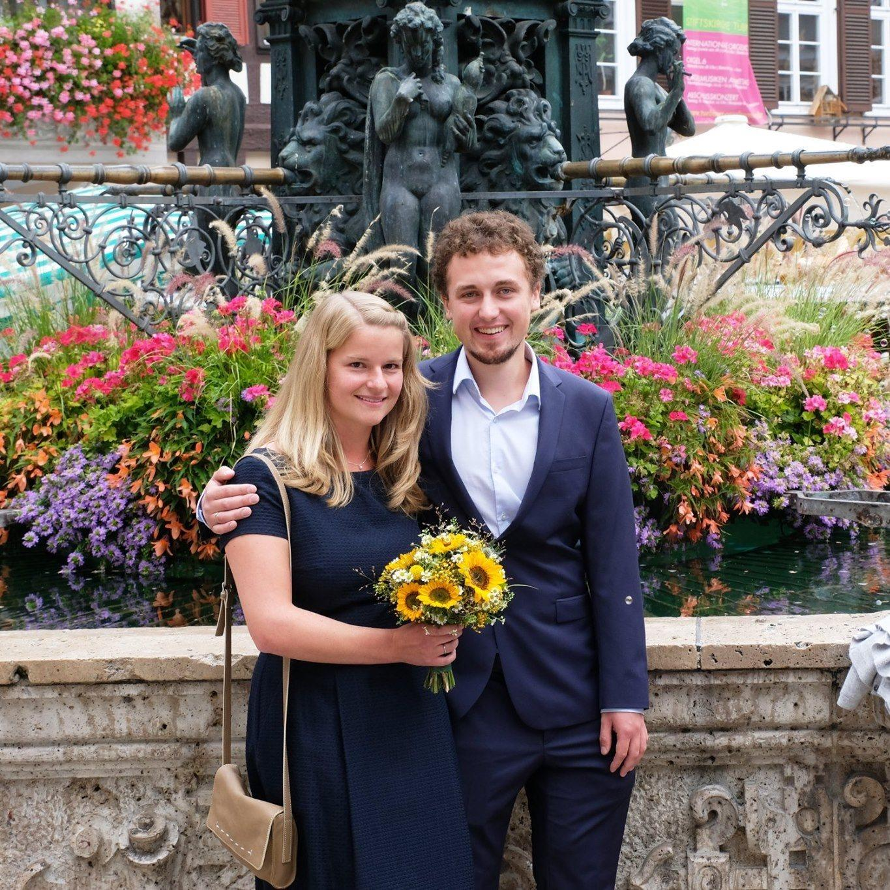
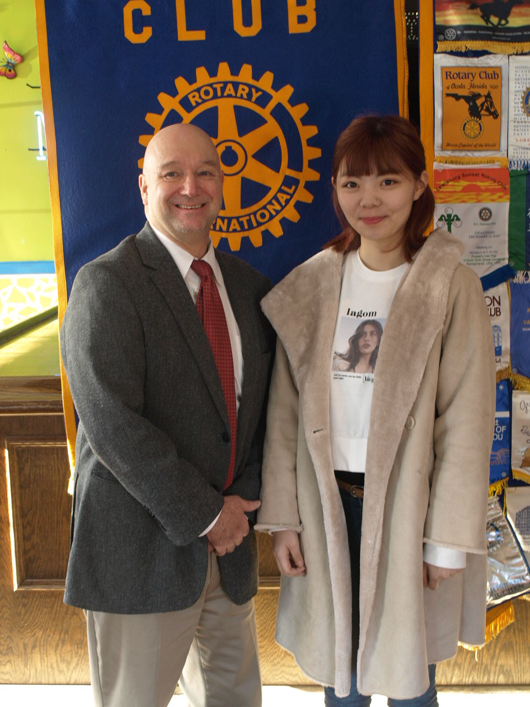
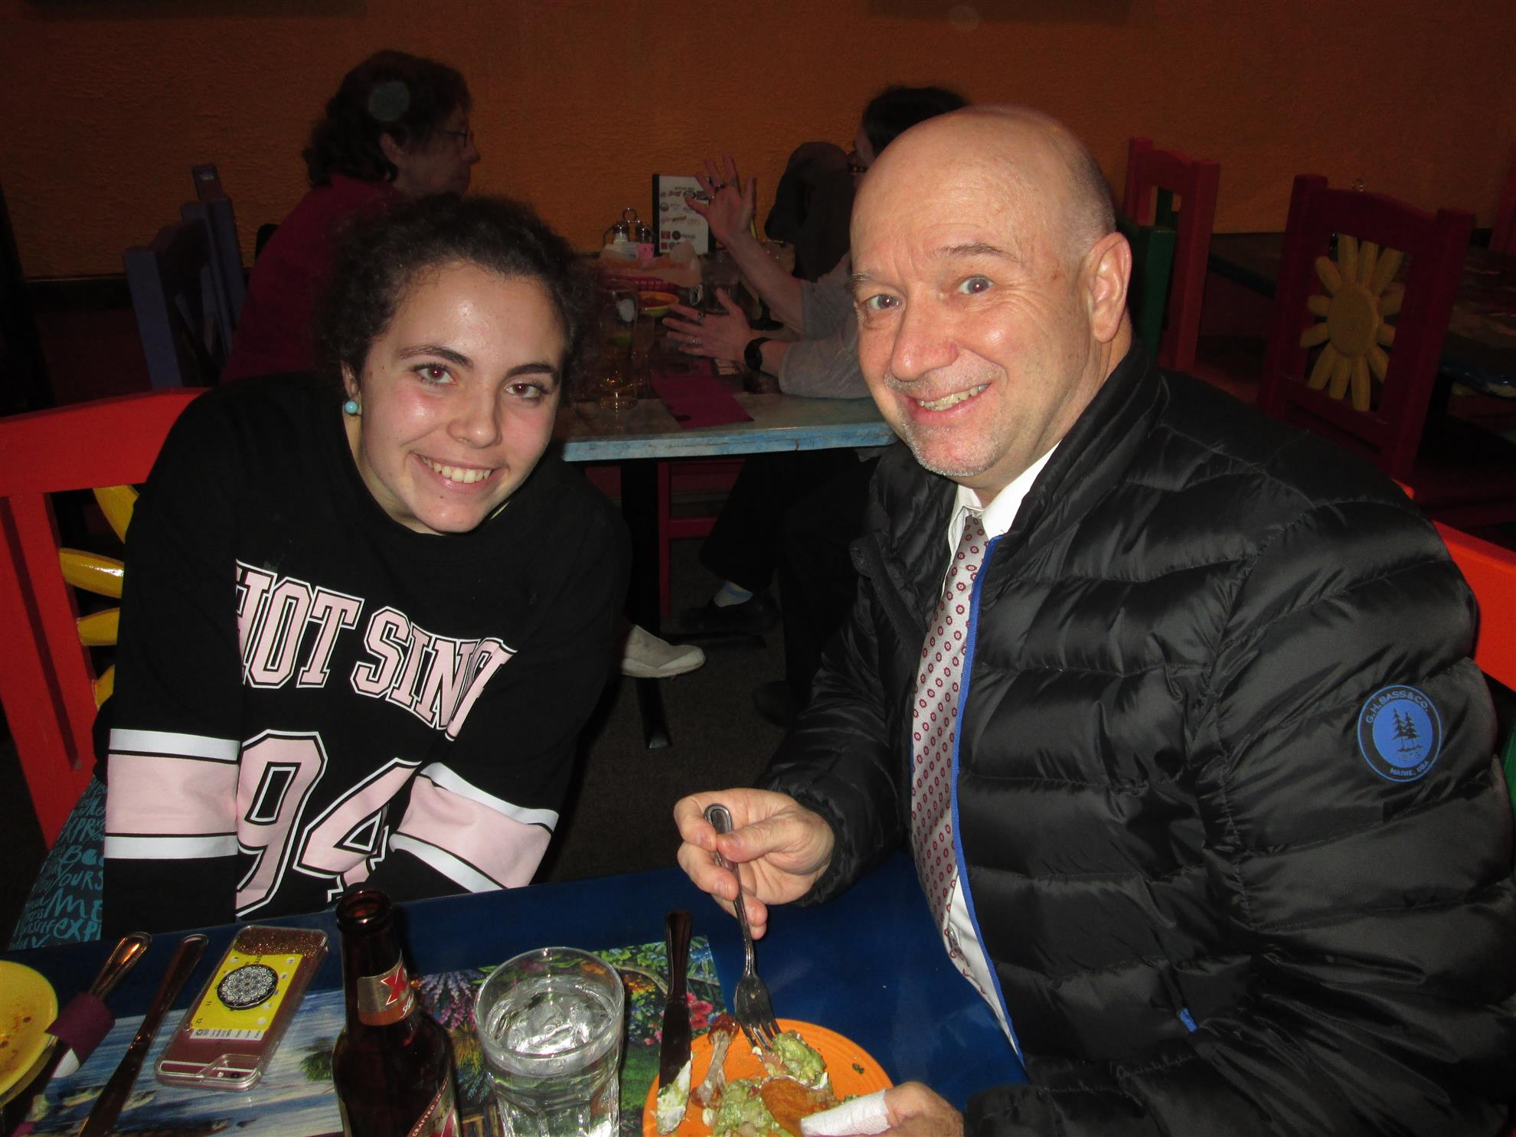
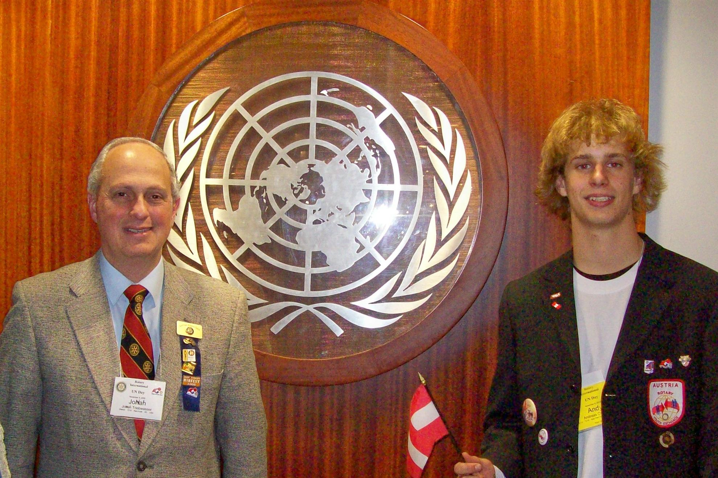
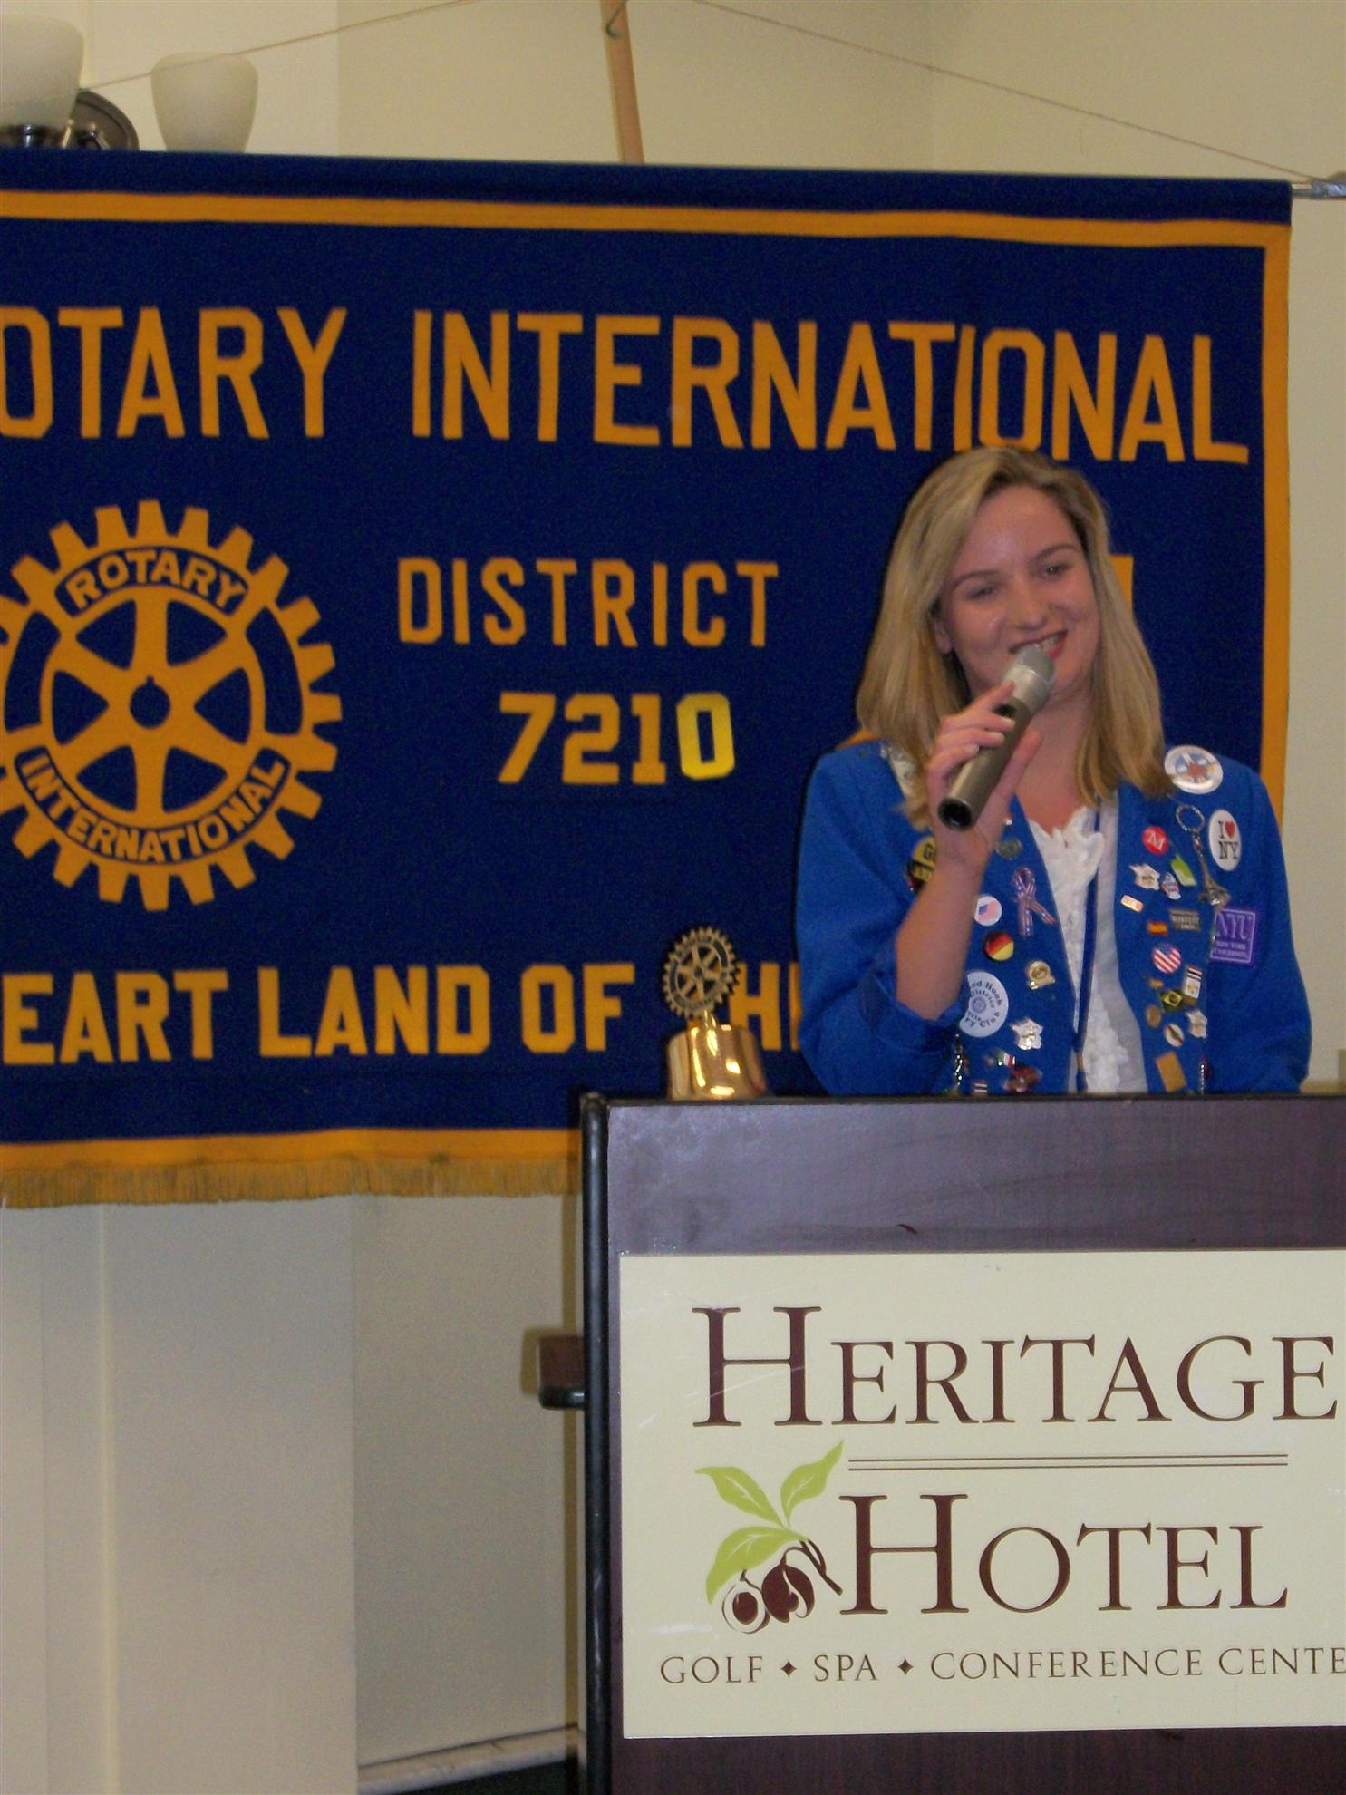
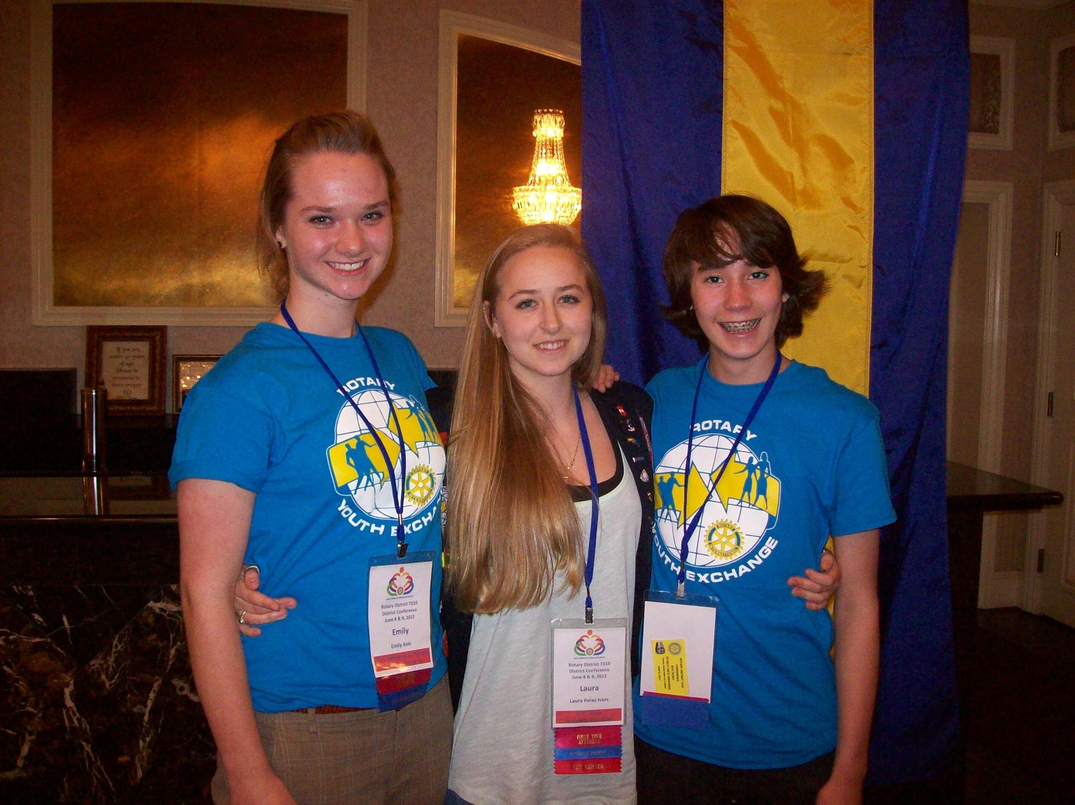
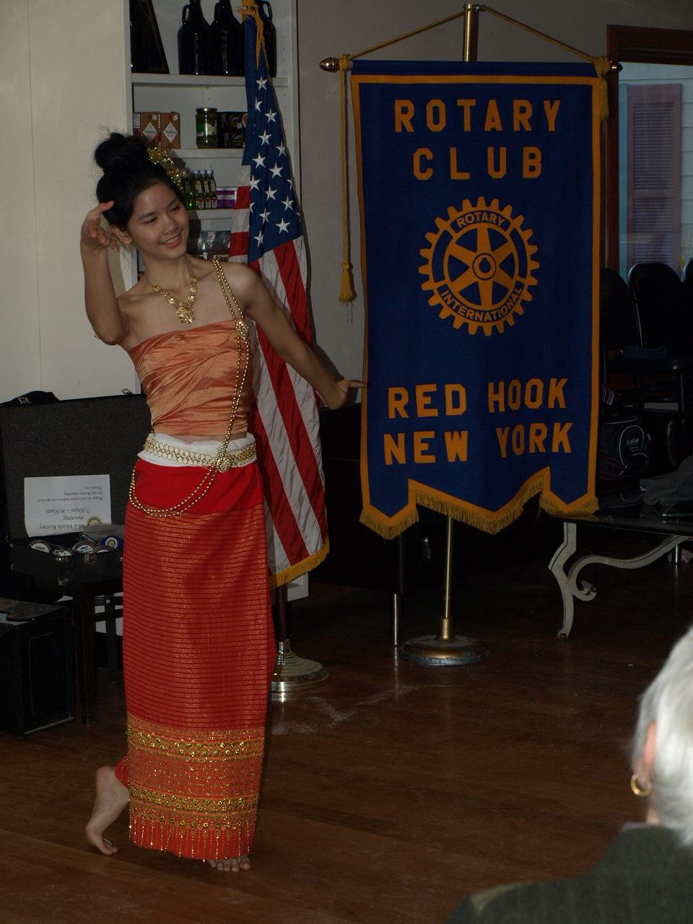
By supporting Youth Exchange, we support better understanding among people!

Slide 15
Speaking of youth, we are proud sponsors of the Red Hook High School Interact Club

Slide 16
Our Interact Club members have devoted themselves to sponsoring ShelterBox emergency relief tents and kits

Slide 17
They raise funds by baking pies in the high school home economics kitchen

Slide 18
What is ShelterBox?
ShelterBox works with disaster-hit families around the world, offering
emergency shelter and other essential items to support them in rebuilding their lives.

Slide 19
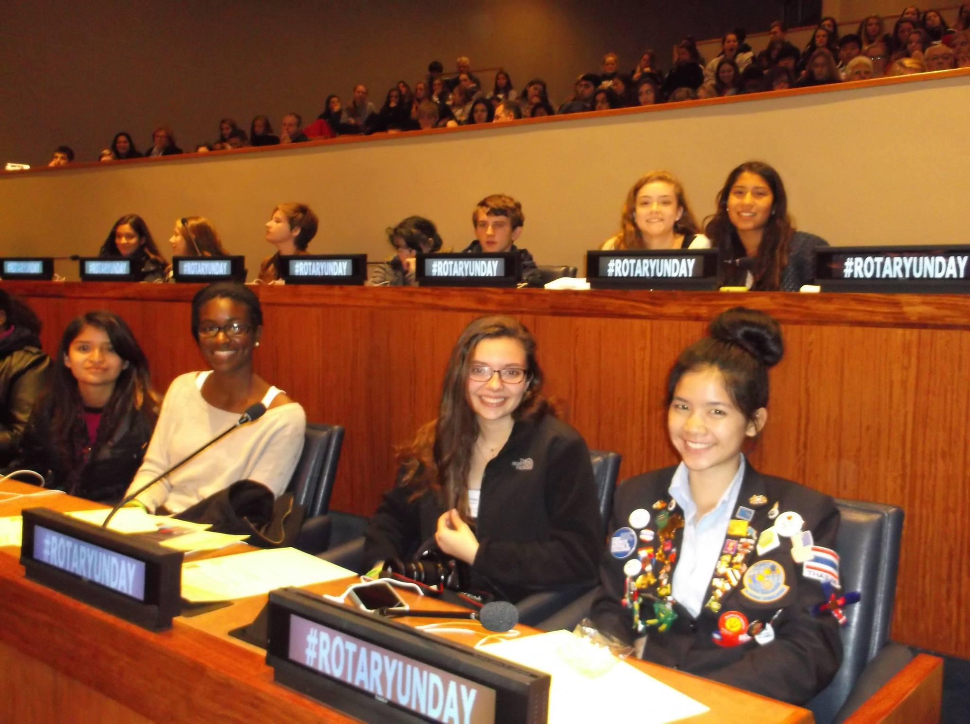
Our Interact Club members also foster world understanding by meeting teens from around the world at Rotary U.N. Day

Slide 20
We also proudly support RYLA
Rotary Youth Leadership Awards (RYLA) is an intensive leadership experience organized by Rotary clubs and districts where young people develop their skills as leaders while having fun and making connections.

Slide 21
We also sponsor academic and vocational scholarships for high school graduates each year.

Slide 22
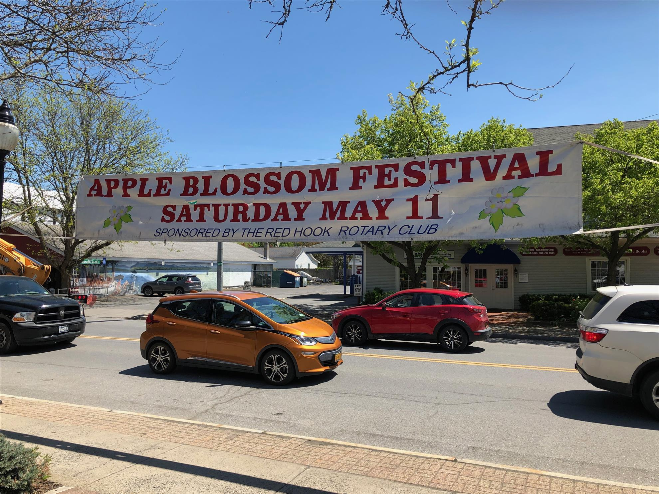
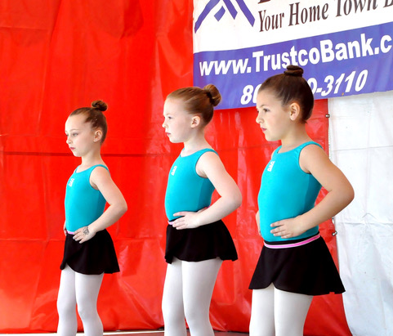
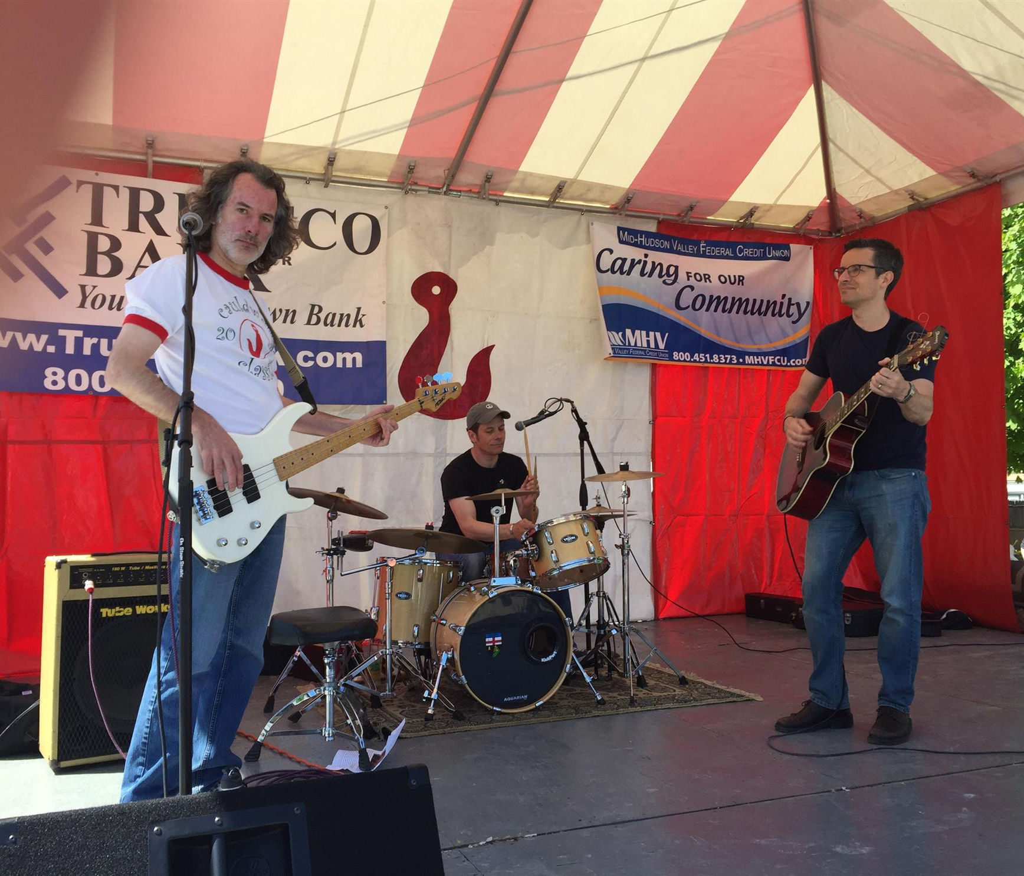
We are involved in the Red Hook Community.
Each year we sponsor the Apple Blossom Day festival, with hundreds of booths and thousands of visitors.

Slide 23
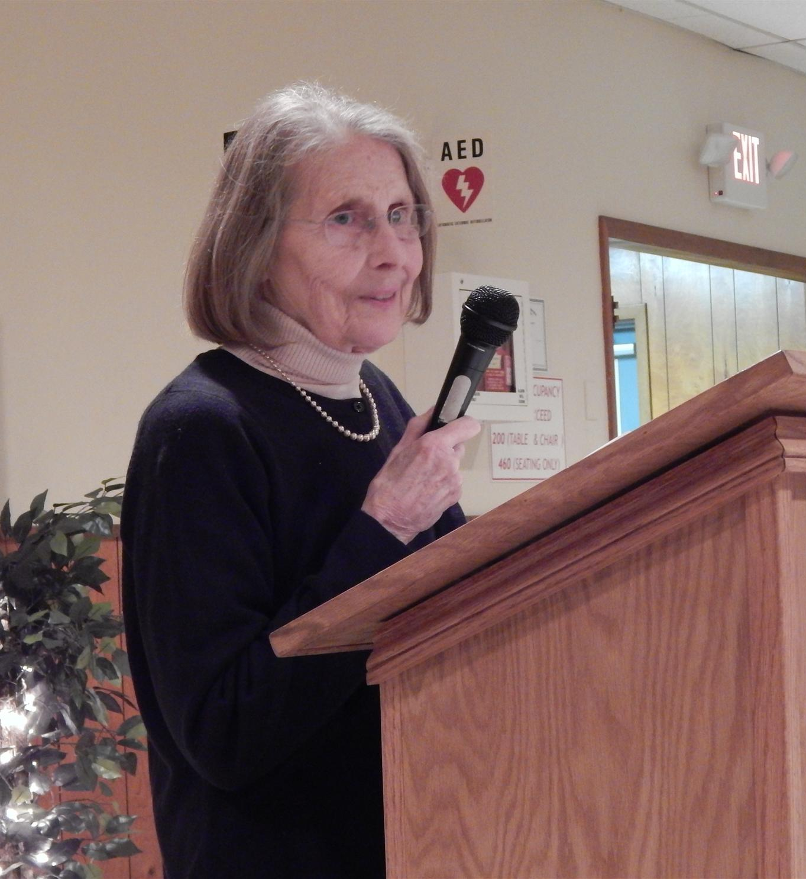
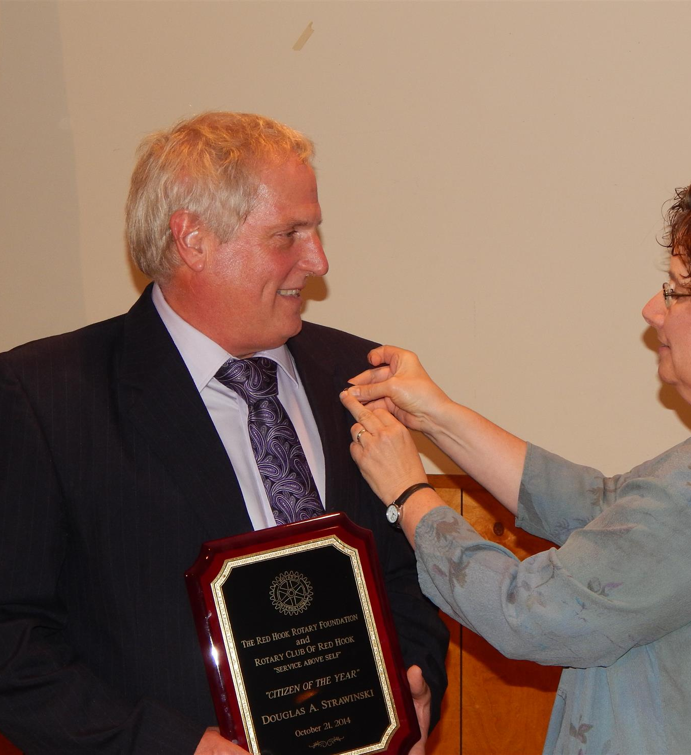
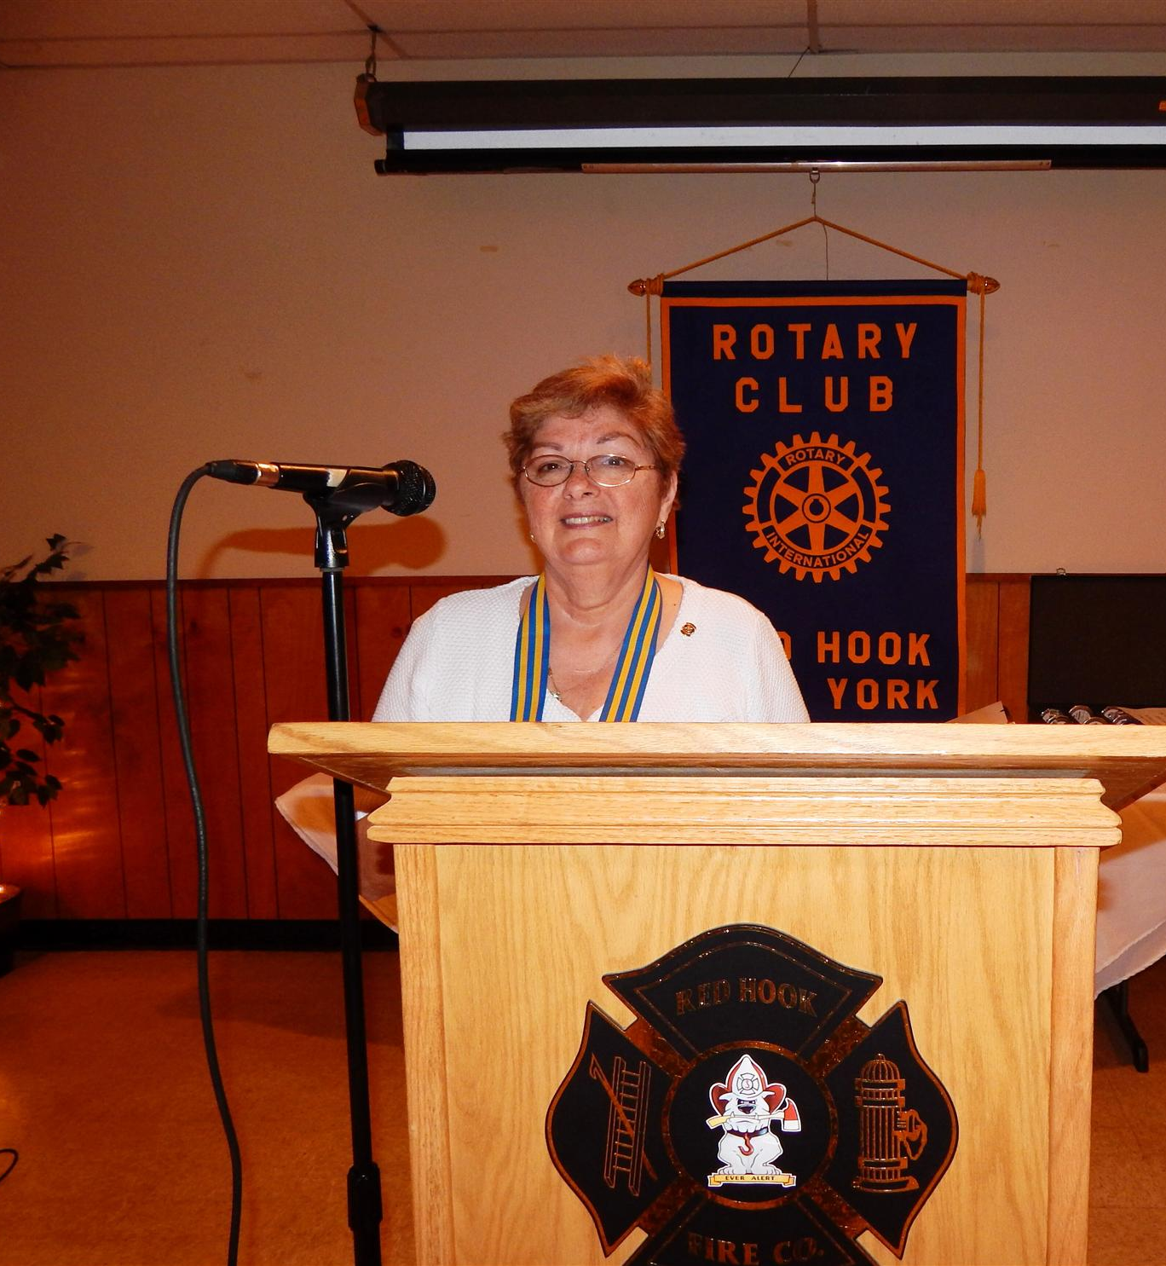
Each year we recognize an outstanding Citizen of the Year

Slide 24
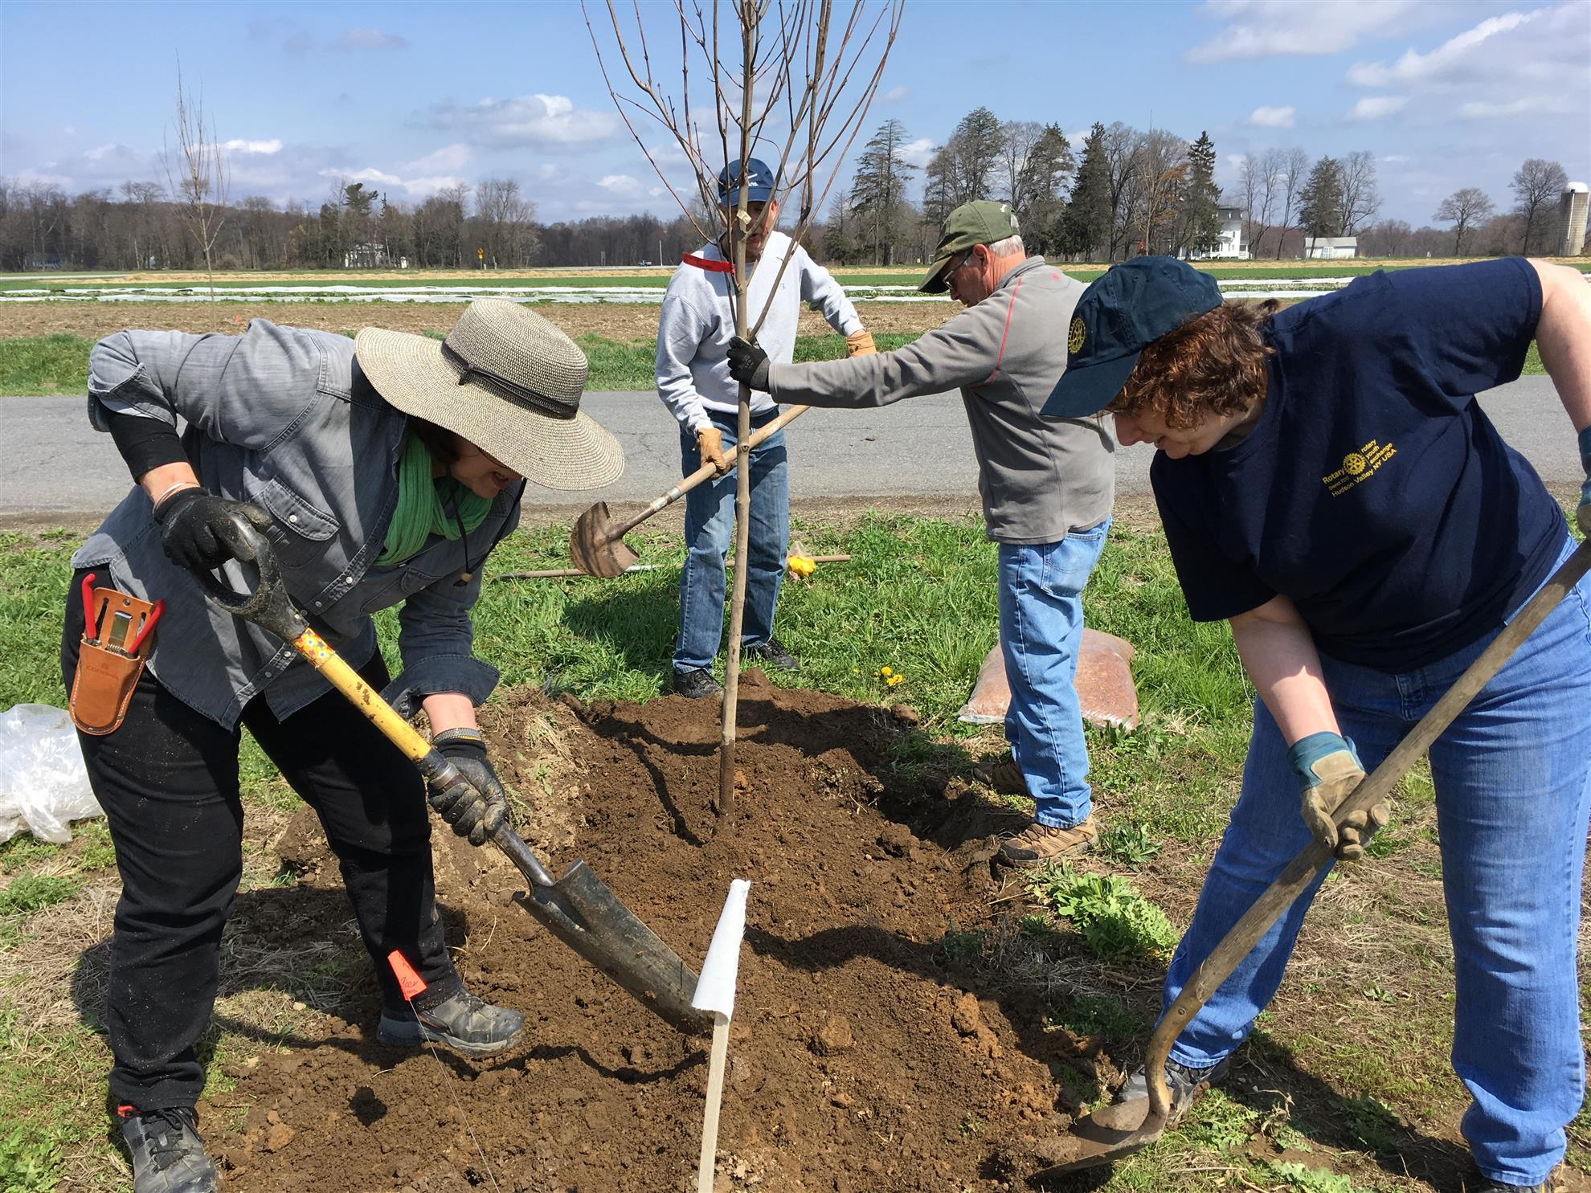
We participate in keeping Red Hook green by annually planting trees

Slide 25
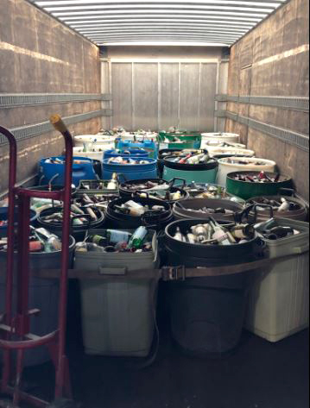
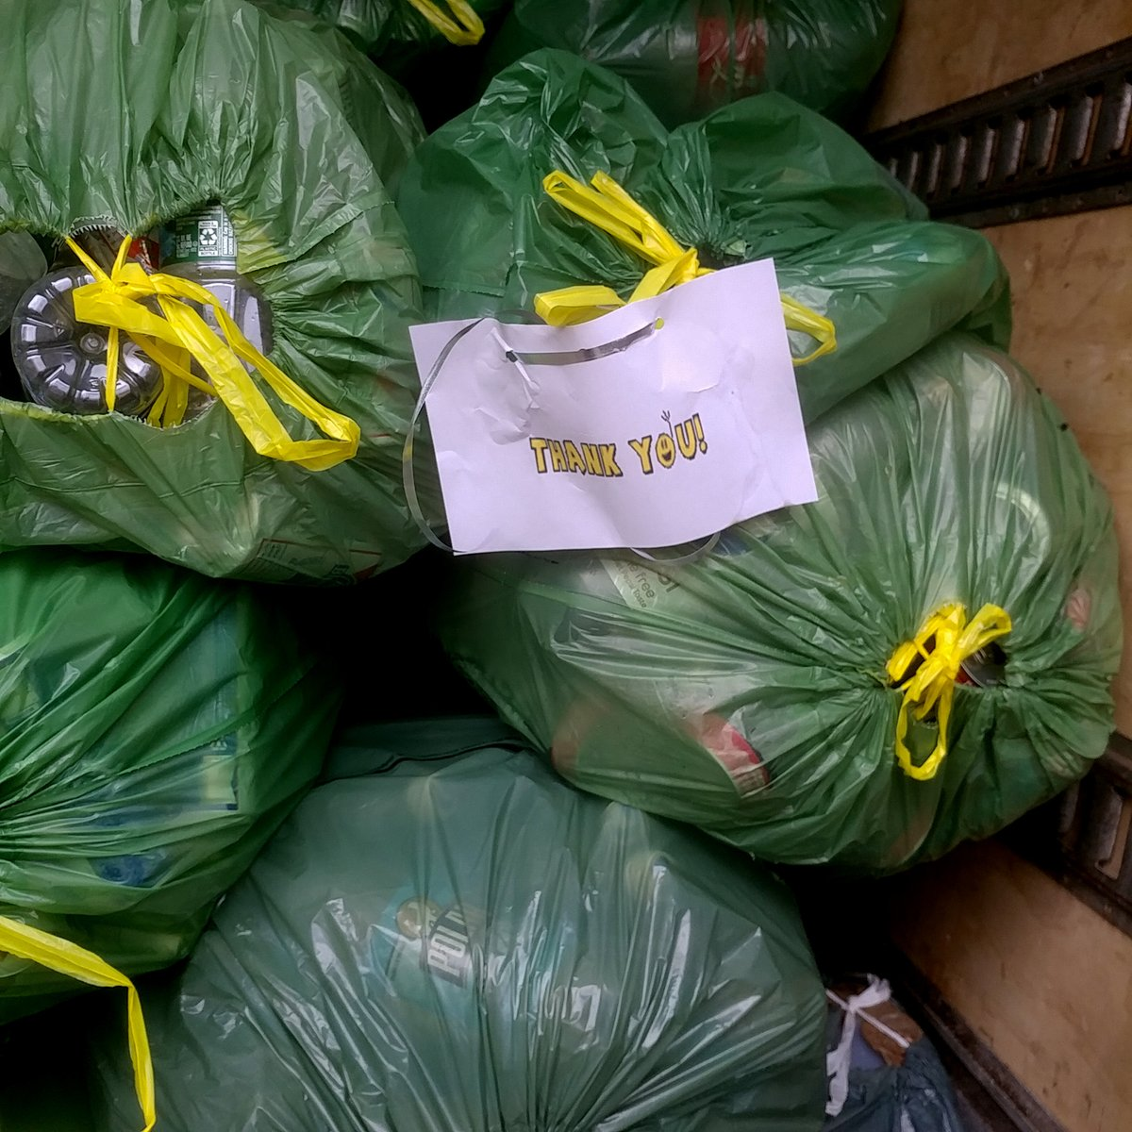
We supply personal hygiene items, while at the same time support recycling and reduce litter, through the Clink! bottle collection program

Slide 26
We spread the word about Rotary as a charter sponsor of RadioRotary

Slide 27
RadioRotary is heard every Sunday by 38,000 listeners in the Hudson Valley
Sundays - 6:25 a.m. - WBPM 92.9 www.wbpmfm.com or ask Alexa (or other smart speaker) to play “WBPM” and 9:30 a.m. WGHQ 920AM & 92.5 FM, WBNR 1260AM and WLNA 1420 www.realcountryhv.com or ask Alexa to (or other smart speaker) play “WBNR”

Slide 28
We are also heard around the world by podcast!
ITunes: https://itunes.apple.com/us/podcast/radiorotary/id1412396239?mt=2
Google Play Podcasts: https://www.google.com/podcasts?feed=aHR0cHM6Ly9hbmNob3IuZm0vcy81NGQxYjg4L3BvZGNhc3QvcnNz
Spotify: https://open.spotify.com/show/5OxiufAMMo49dh5bvorVG9
Stitcher https://www.stitcher.com/podcast/anchor-podcasts/radiorotary
Anchor: https://anchor.fm/radiorotary
RadioPublic: https://play.radiopublic.com/radiorotary-85n3Dz
Breaker: https://www.breaker.audio/radiorotary
Pocket Casts https://pca.st/Qdxz
Castbox: https://castbox.fm/channel/id1376565
Overcast: https://overcast.fm/itunes1412396239/radiorotary
Podbean: https://www.podbean.com/podcast-detail/9a4jb-71b94/RadioRotary-Podcast
Stitcher: https://www.stitcher.com/podcast/anchor-podcasts/radiorotary

Slide 29
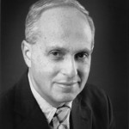
Our hosts are Rotarians with decades of broadcast experience: Sarah O’Connell- Claitor and Jonah Triebwasser

Slide 30
More than 575 shows from the past ten years can be heard on our website

Slide 31
Some topics that we have covered on air:
Polio plus
ShelterBox
Emergency Preparedness
Rotary and the Covid 19 Pandemic
Mental health and recovery
Autism
Service animals
. . . and so much more!

Slide 32
We’ve taken our RadioRotary microphones around the world to cover the Rotary International Conventions:
Hamburg, Germany
Toronto, Ontario, Canada
Atlanta, Georgia
Sydney, Australia
Lisbon, Portugal
New Orleans, Louisiana
Montreal, Quebec, Canada
Birmingham, England

Slide 33
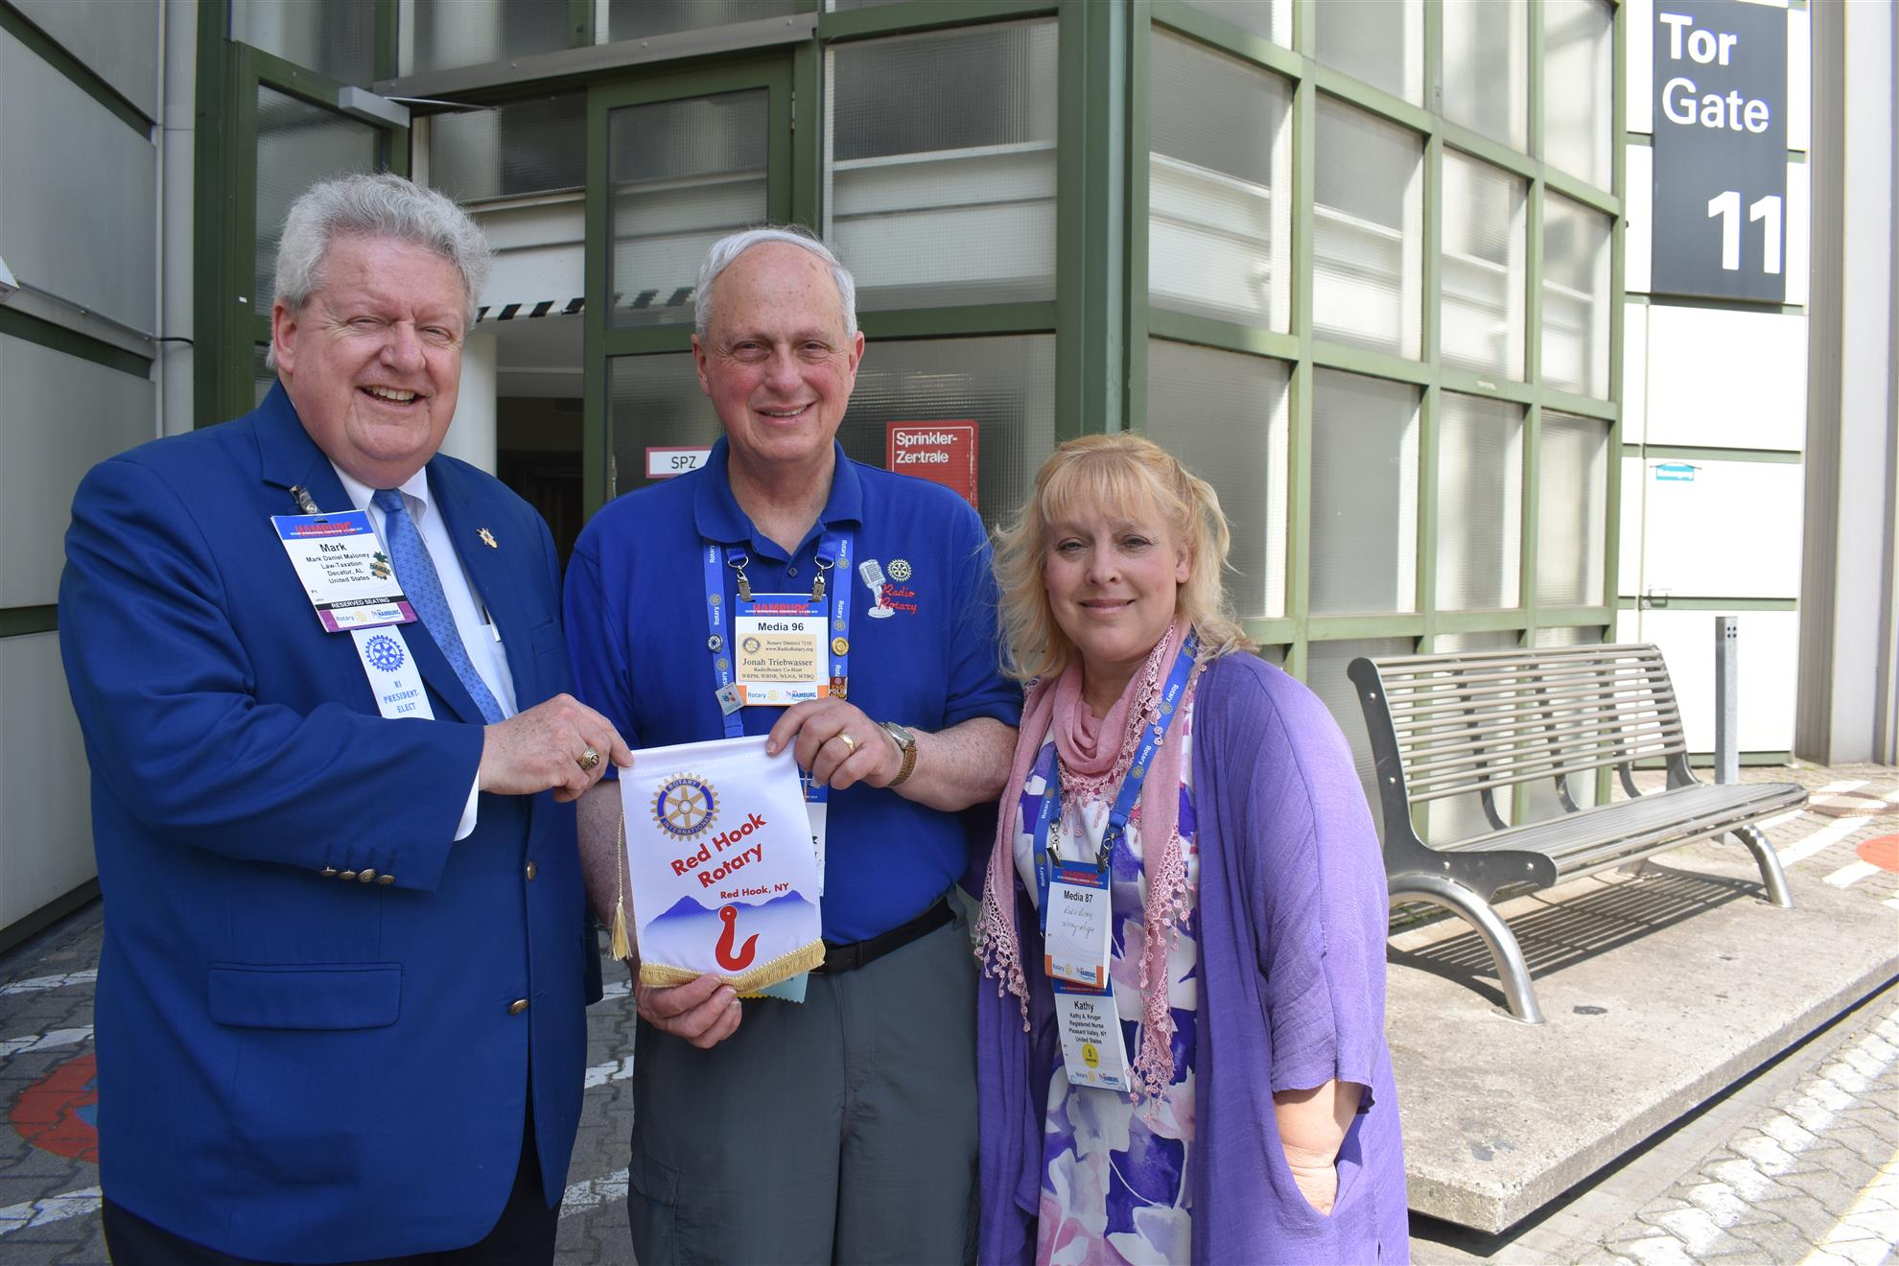
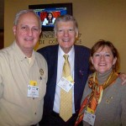
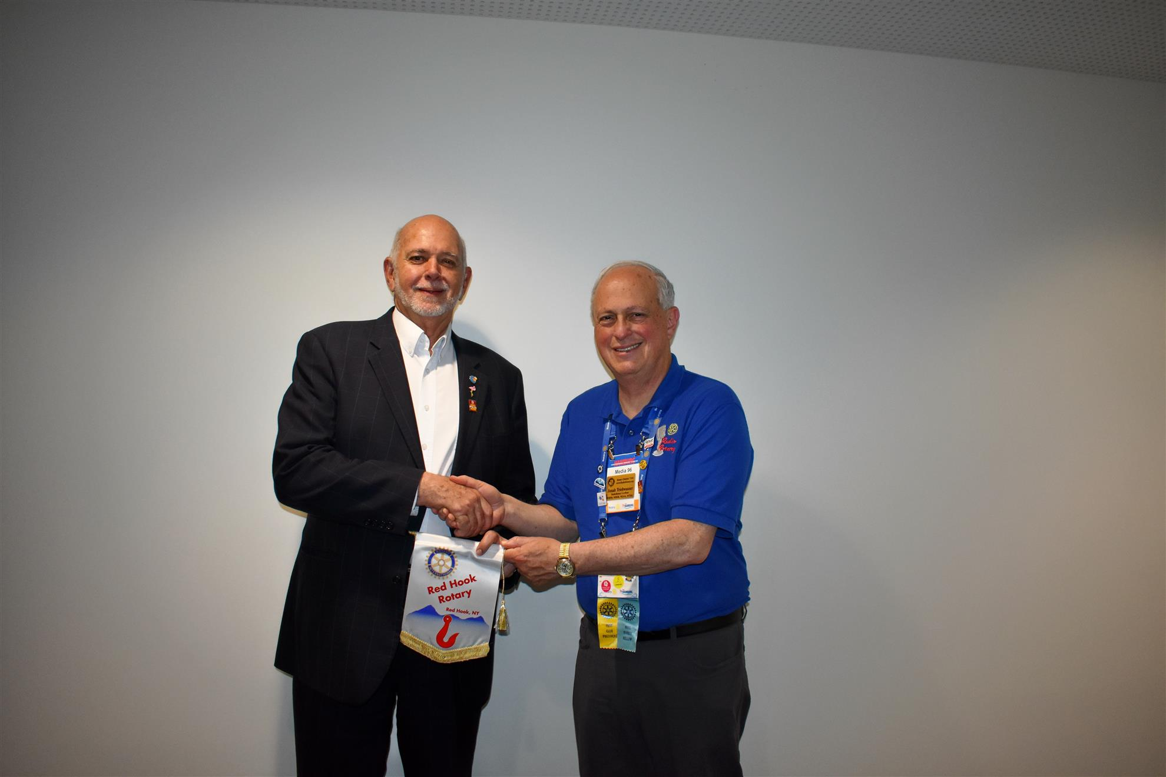
We’ve had exclusive interviews with Rotary International Presidents.

Slide 34
And with such notables as Dr. Jane Goodall

Slide 35
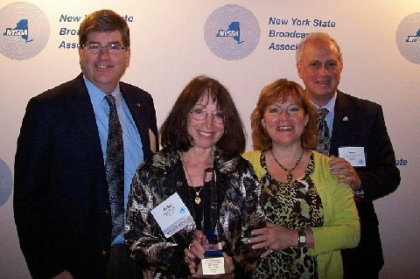
We have been recognized by the New York State Broadcasters Association with their public service award, twice!
RadioRotary Team L to R: Highland Rotarian and Station Manager Don Verity, Rotary eClub 7210 Rotarian and Former Producer Betty Renner; Millbrook Rotarian, Co-host, Sarah O'Connell-Claitor; and Red Hook Rotarian, Co-host Jonah Triebwasser

Slide 36
Listen every Sunday or any time!

Slide 37
RadioRotary is heard every Sunday by 38,000 listeners in the Hudson Valley
Sundays - 6:25 a.m. - WBPM 92.9 www.wbpmfm.com or ask Alexa (or other smart speaker) to play “WBPM” and 9:30 a.m. WGHQ 920AM & 92.5 FM, WBNR 1260AM and WLNA 1420 www.realcountryhv.com or ask Alexa to (or other smart speaker) play “WBNR”

Slide 38
We are also heard around the world by podcast!
ITunes: https://itunes.apple.com/us/podcast/radiorotary/id1412396239?mt=2
Google Play Podcasts: https://www.google.com/podcasts?feed=aHR0cHM6Ly9hbmNob3IuZm0vcy81NGQxYjg4L3BvZGNhc3QvcnNz
Spotify: https://open.spotify.com/show/5OxiufAMMo49dh5bvorVG9
Stitcher https://www.stitcher.com/podcast/anchor-podcasts/radiorotary
Anchor: https://anchor.fm/radiorotary
RadioPublic: https://play.radiopublic.com/radiorotary-85n3Dz
Breaker: https://www.breaker.audio/radiorotary
Pocket Casts https://pca.st/Qdxz
Castbox: https://castbox.fm/channel/id1376565
Overcast: https://overcast.fm/itunes1412396239/radiorotary
Podbean: https://www.podbean.com/podcast-detail/9a4jb-71b94/RadioRotary-Podcast
Stitcher: https://www.stitcher.com/podcast/anchor-podcasts/radiorotary

Slide 39
Thank you for your kind attention!

