Slide 1
ClubRunner Basics
TITLE
Rotary Club of Arlington Heights July 11, 2019

Slide 2
Exploring the New Home Page
Upcoming Events
Speakers
Club News
District website
Rotary links
RI Updates
Downloadable files

Slide 3
Exploring the New Home Page Menu
About our Club
Welcome
Upcoming Speakers
Club Officers & Directors
Charter Members
For Members
Directory
Meeting assignments
Birthdays
Make a payment
Calendar & Events
Stories (archived stories)
Link to Facebook page
Link to Santa Run website

Slide 4
Logging In
1. Click Member Login
2. Enter User Name & Password

Slide 5
Once you’ve logged in, you will have access to the Member Area.
Click here to go to the Admin Page.

Slide 6
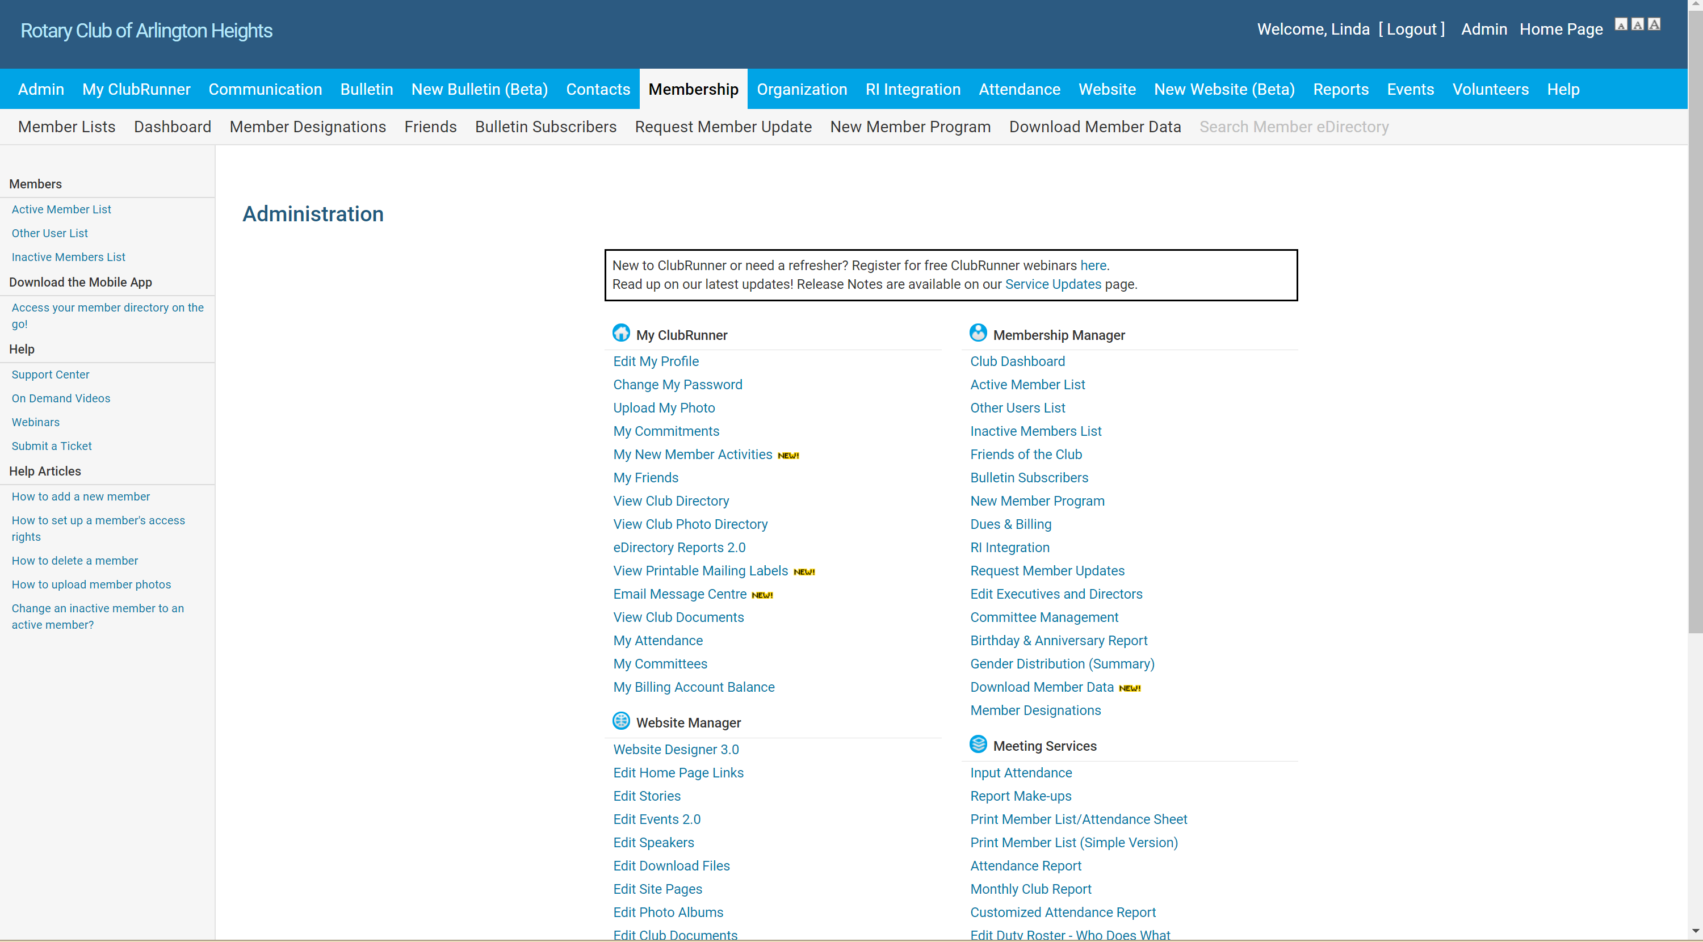
Navigation
Updating personal information
Most Tasks can be started from the
Administration Menu
Sending E-mail

Slide 7
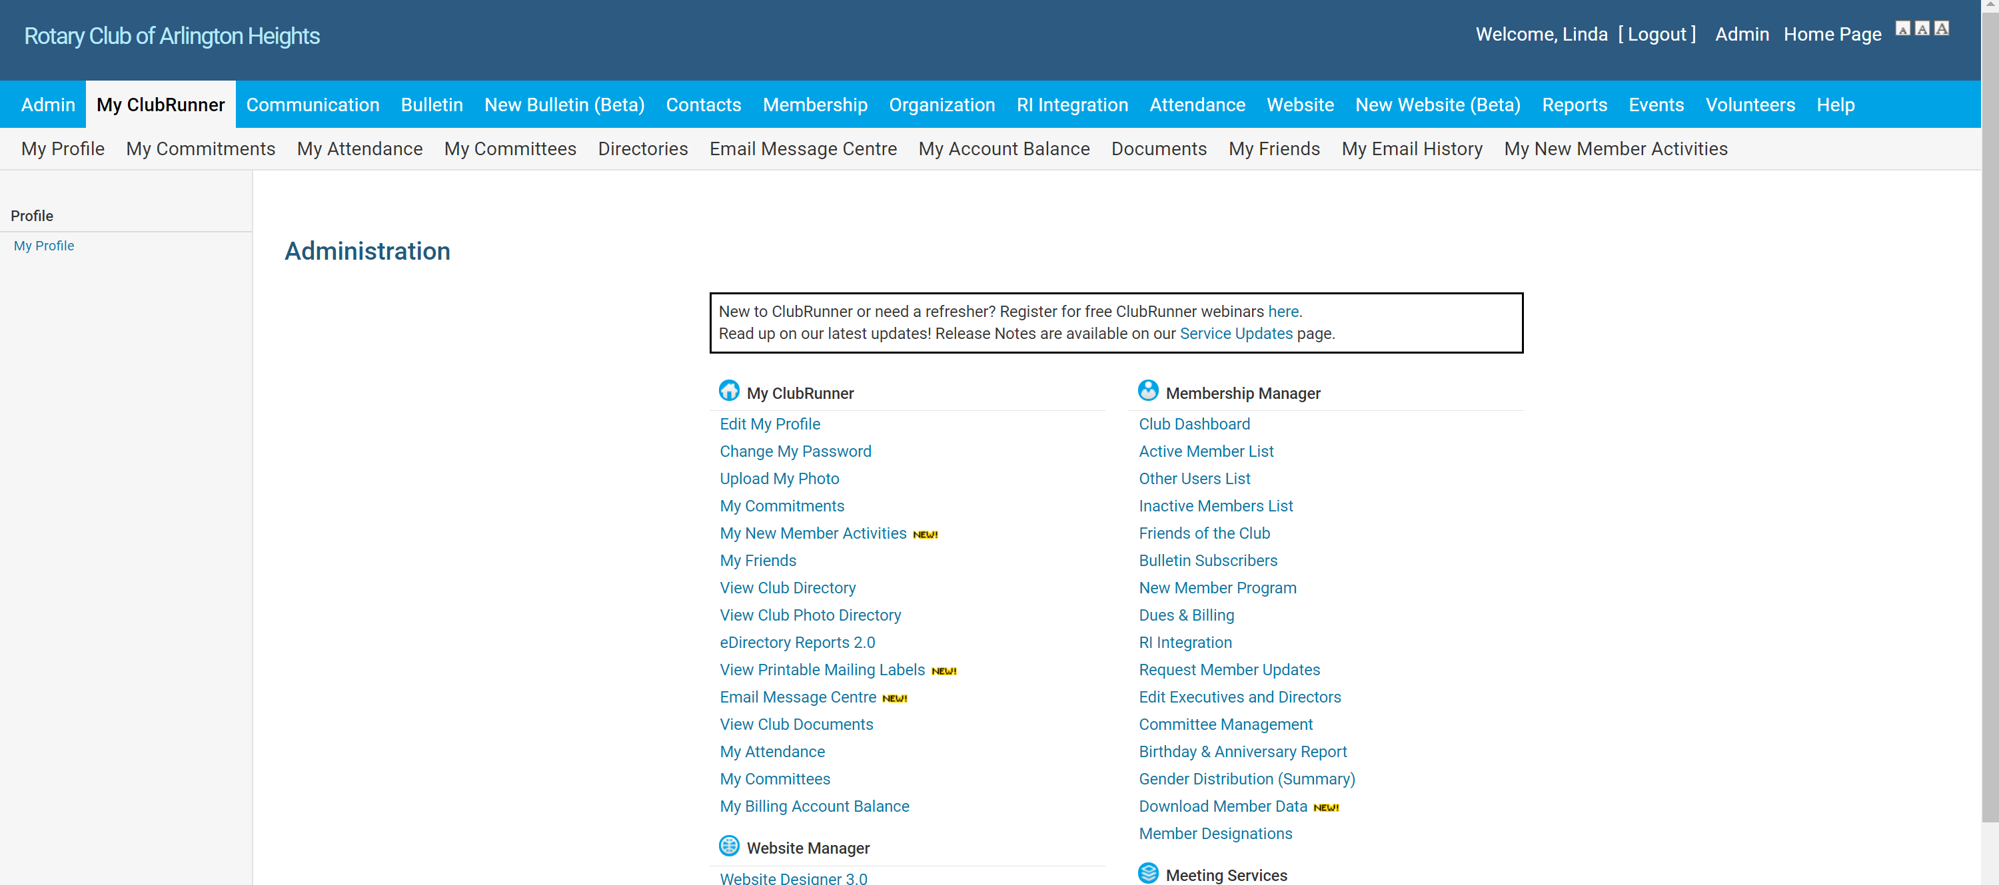
Tasks can also be started from the Navigation Bar
Updating personal information
Select My ClubRunner
Select My Profile

Slide 8
ClubRunner Access
Functions that all members can access:
Viewing and updating member information
Sending e-mail through ClubRunner
Setting up an event
Functions for Officers & Directors:
Membership management (add, terminate, or change status of members)
Updating club executives and officers
Recording attendance
Adding speakers

Slide 9
This is how different levels of access look
Member
Club Executive
Tasks with access have clickable links
Tasks without access are grayed out

Slide 10
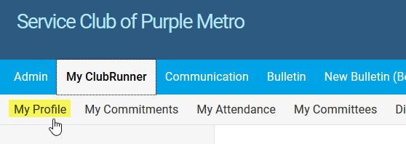
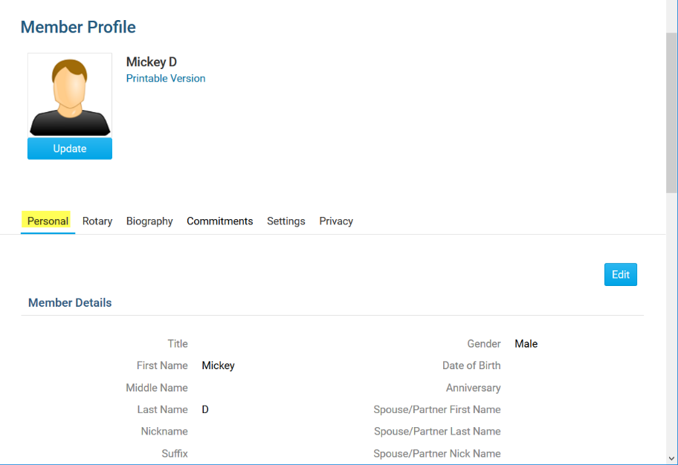
How to update your profile information
From the Navigation Bar click
MyClubRunner - My Profile:
Inside your profile, below your photo, there are several tabs such as: Personal | Rotary | Biography | etc. Select any of these tabs. These tabs contain all the different sections of your profile you can edit. Click the Edit button to edit your information. Click the Save button to save your changes.
1
2
Help article: How do I access & change my profile information?

Slide 11
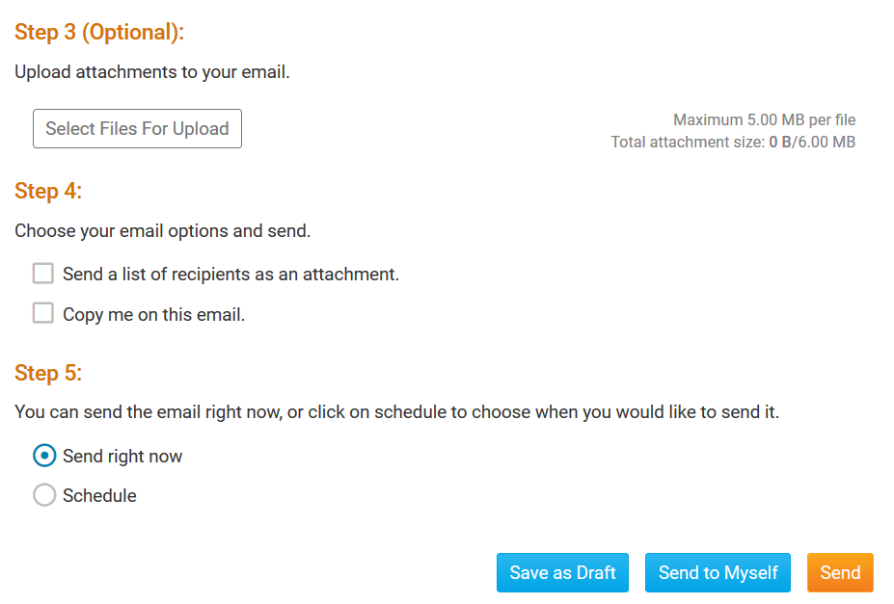
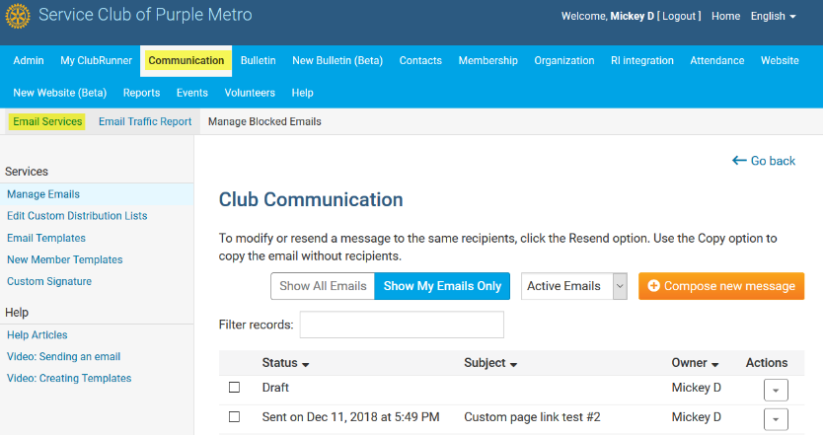
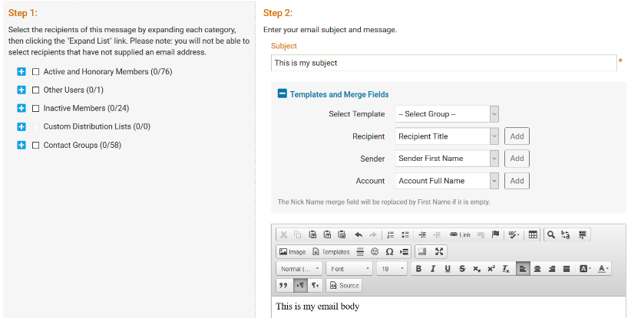
How to Send an E-mail
1
2
3
Along the top tabs click: Communication – Email Services, then Compose new message.
Step 1 = select your recipients Step 2 = compose the subject and body of email
Step 3 = add attachment Step 4 = send a list of recipients; cc yourself Step 5 = send now, or schedule email for later
Help article: How do I send email?

Slide 12
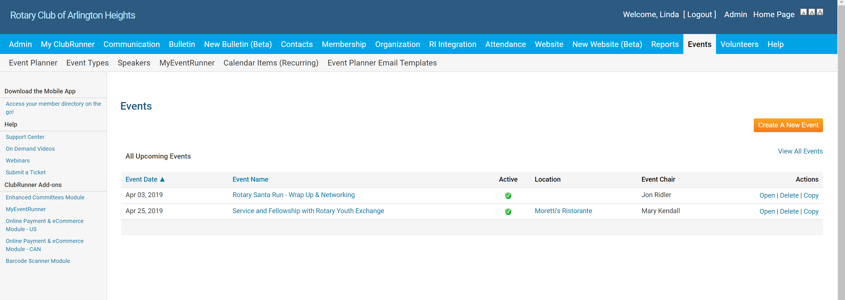
How to Add an Event
1. Click on Events in Navigation bar, then click on create a new event.
2. Enter Event Name and details

Slide 13
Adding an Event cont’d
If you want participants to register, then click yes to enable registration
Select Event chair
Add details on location
Determine where you want the event to be displayed
When everything is completed click Save
After you have created your event, you will be directed to the Event Services screen. Here you can edit the details of the event, setup your registration, payment settings and configure invitation emails.

