Slide 1

Committee Update: 6-month Review of CS&E Committee and Public Image
Notes:
AI-generated content may be incorrect. --- This presentation provides a comprehensive review of the Rotary Club's progress over the past six months, focusing on the Community Service & Environmental Committee and the Public Image Committee. We will cover achievements, engagement metrics, process improvements, upcoming events, and future plans.

Slide 2
Agenda
Intro: Rotary Action Plan
Public Image: Social Engagement Progress
Community Service & Environmental Committee Achievements
Grant Application and Review Process Enhancements
Proposed Annual Calendar of Events
Future Plans and Next Steps
Notes:
We will begin by reviewing the achievements of the Community Service & Environmental Committee, followed by the Public Image Committee's progress. Next, we'll discuss enhancements to the grant application process and proposed structural improvements for upcoming events. Finally, we will outline future plans and next steps for both committees.

Slide 3
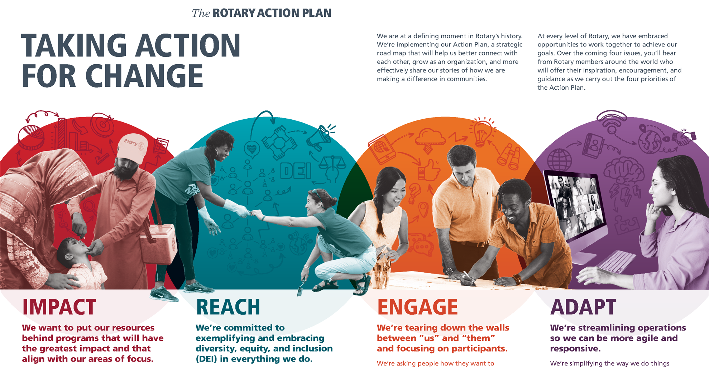

Slide 4
Public Image: Social Engagement Progress
Who are we engaging with and how can we better reach them?
Notes:
This section reviews the Public Image Committee’s efforts to increase the club’s visibility and engagement through digital platforms and outreach activities.

Slide 5
Content strategy
Platform growth
Facebook
Instagram
LinkedIn
Ramped up from <1 post each month per platform to 10+/mo/platform (average across platforms)
Variety of types of media (images, video, shared partner posts, polls)
Variety of content (upcoming speakers, post-project updates, recruitment, RI posts, etc) with a planned schedule
Reinforced messaging through club announcements
+15
+23
+12
followers (+1.4%)
followers (+4.8%)
followers (+10.6%)
Engagement growth
Facebook
Instagram
LinkedIn
4.3%
4.7%
6.8%
Target: 2.3 – 3.8%
July: 1.4%
Target: 4.9 – 5.6%
July: 0%
Target: 2.1 – 3.5%
July: 0%
Notes:
Platform growth (net new followers) achieved in 4 months
Engagement growth average from Aug-Nov, as compared to 0-1.4% engagement in July; compared to benchmarks for comparable orgs for target social media engagement rates --- Social media channels have seen increased follower counts, engagement rates, and content reach. Trends indicate growing community interest and improved interaction with our posts. Image source: Microsoft 365 content library

Slide 6
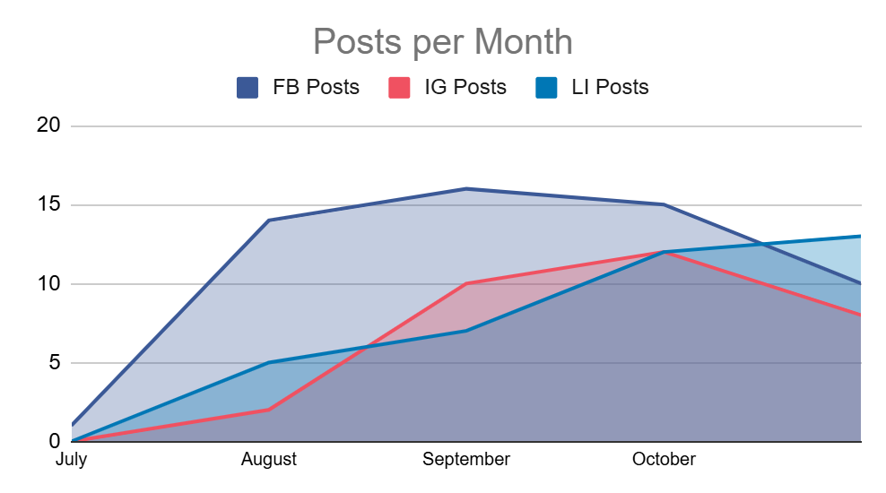
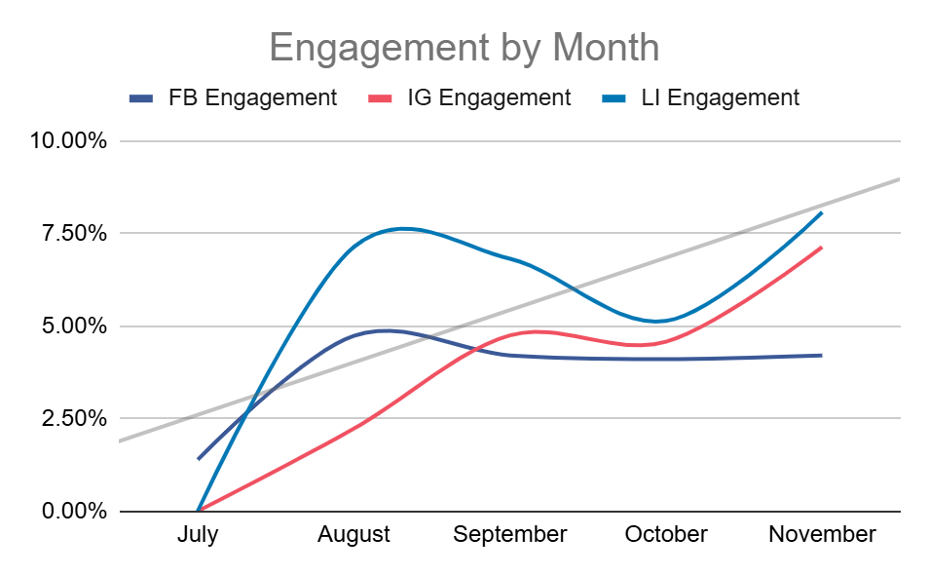
Social Media Engagement Statistics and Trends
Rising Follower Counts
Follower numbers have steadily increased, reflecting growing audience interest and reach.
Higher Engagement Rates
Engagement rates such as likes, shares, and comments have improved significantly over time.
Expanded Content Reach
Content reach has expanded, allowing posts to connect with a wider and more diverse audience.
*connection issues with FB/IG late November caused some posts to fail
Notes:
--- Social media channels have seen increased follower counts, engagement rates, and content reach. Trends indicate growing community interest and improved interaction with our posts. Image source: Microsoft 365 content library

Slide 7




KEY INSIGHTS & FUTURE PLANNING
Community Anchor
Largest audience (1,082 followers) with stable 4.3% engagement
Strategic Value: Broad reach for event promotion and community updates
"Community Event Calendar"
Event announcements and photo albums
Volunteer spotlights and recognition
Tag participants to expand reach organically
Explosive Growth Potential
Engagement tripled from 2.23% to 7.14% in just 4 months
23 new followers (+4.8% growth) - highest growth rate
Strategic Value: Visual storytelling is resonating strongly
"Visual Impact & Growth Engine"
Increase Reels featuring volunteer testimonials and event highlights
Behind-the-scenes Stories during events
Consistent branded hashtags (#WilmetteRotary, #ServiceInAction)
Cross-promote: Add Instagram handle to lunch bag labels
Hidden Powerhouse
Highest engagement rate despite smallest follower base
Consistently outperforms benchmarks by 2-3x
Strategic Value: This is where decision-makers, funders, and partners are engaging
"Credibility & Partnerships Hub"
Impact reports with data and outcomes
Board member and committee chair amplification (personal perspectives and post sharing)
Highlight grants received and partnerships formed
Notes:
--- The committee has organized outreach campaigns including local events, press releases, and collaborations with partner organizations to promote the club’s mission and activities. Image source: Microsoft 365 content library

Slide 8
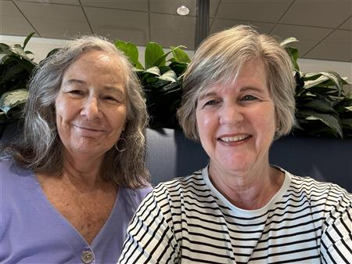
Thank you, Debora & HEIDI
THE SPOKE
Club website
SignUp Genius
Meeting Setup / Announcements

Slide 9
Community Service & Environmental Committee Achievements
What has been our impact in the first 6 months of this Rotary year?
Notes:
This section highlights the key service projects and initiatives undertaken by the CS&E Committee, focusing on their impact and volunteer contributions over the last six months.

Slide 10
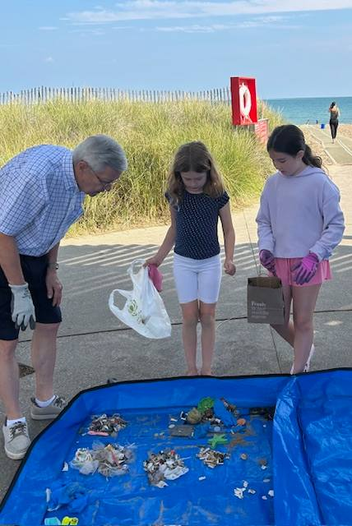
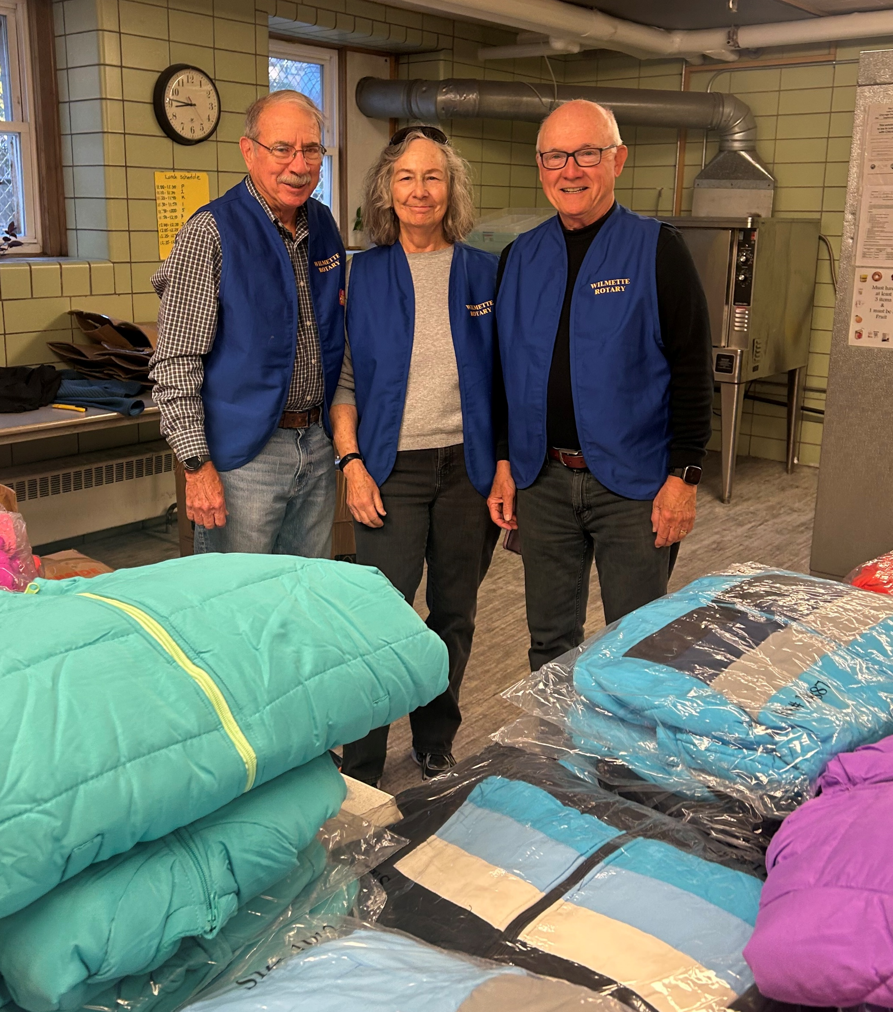
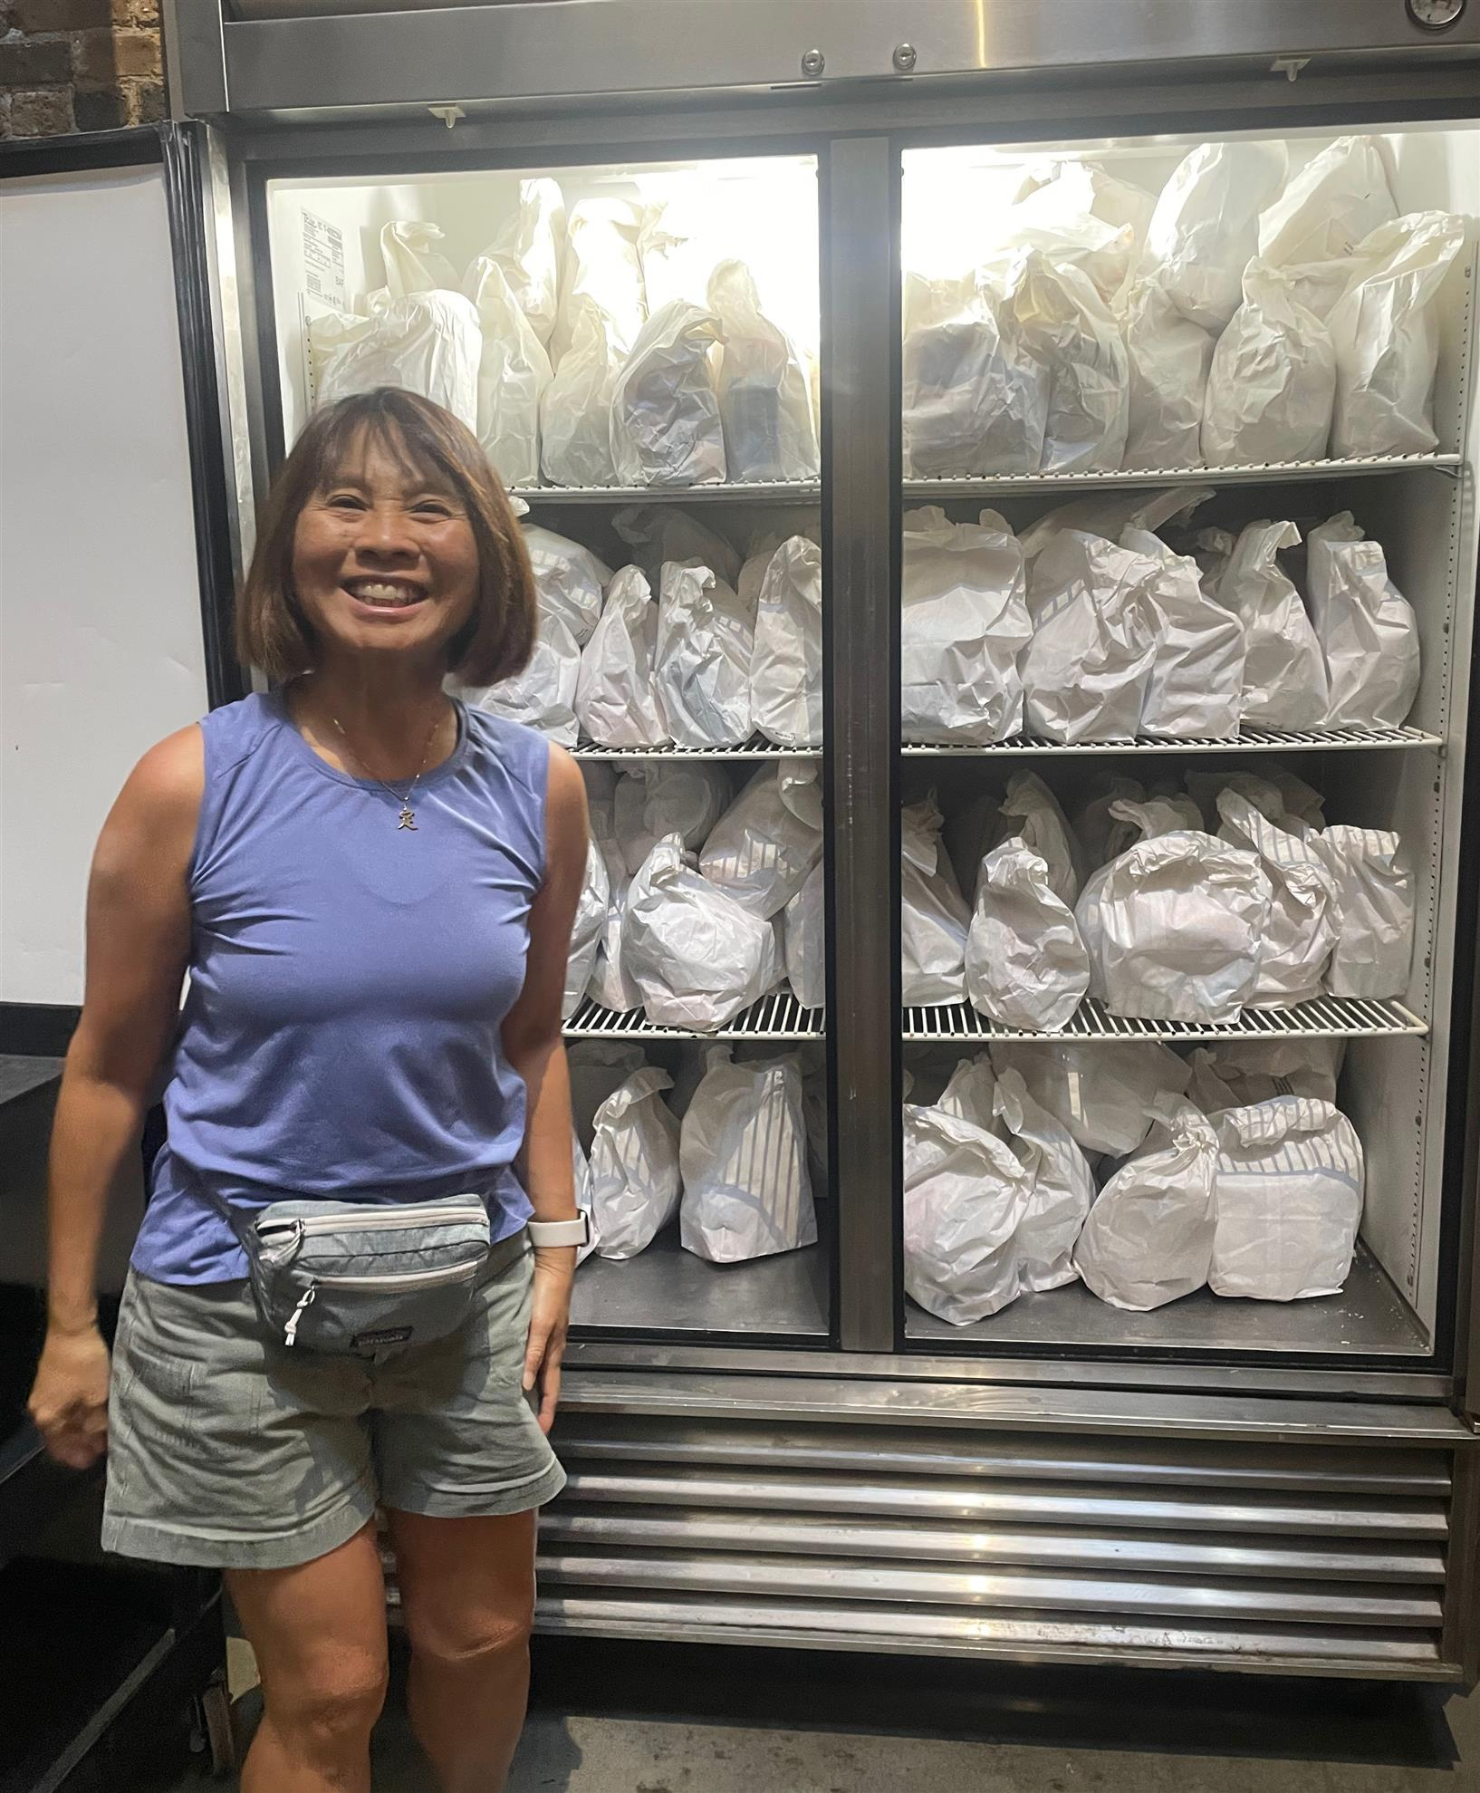
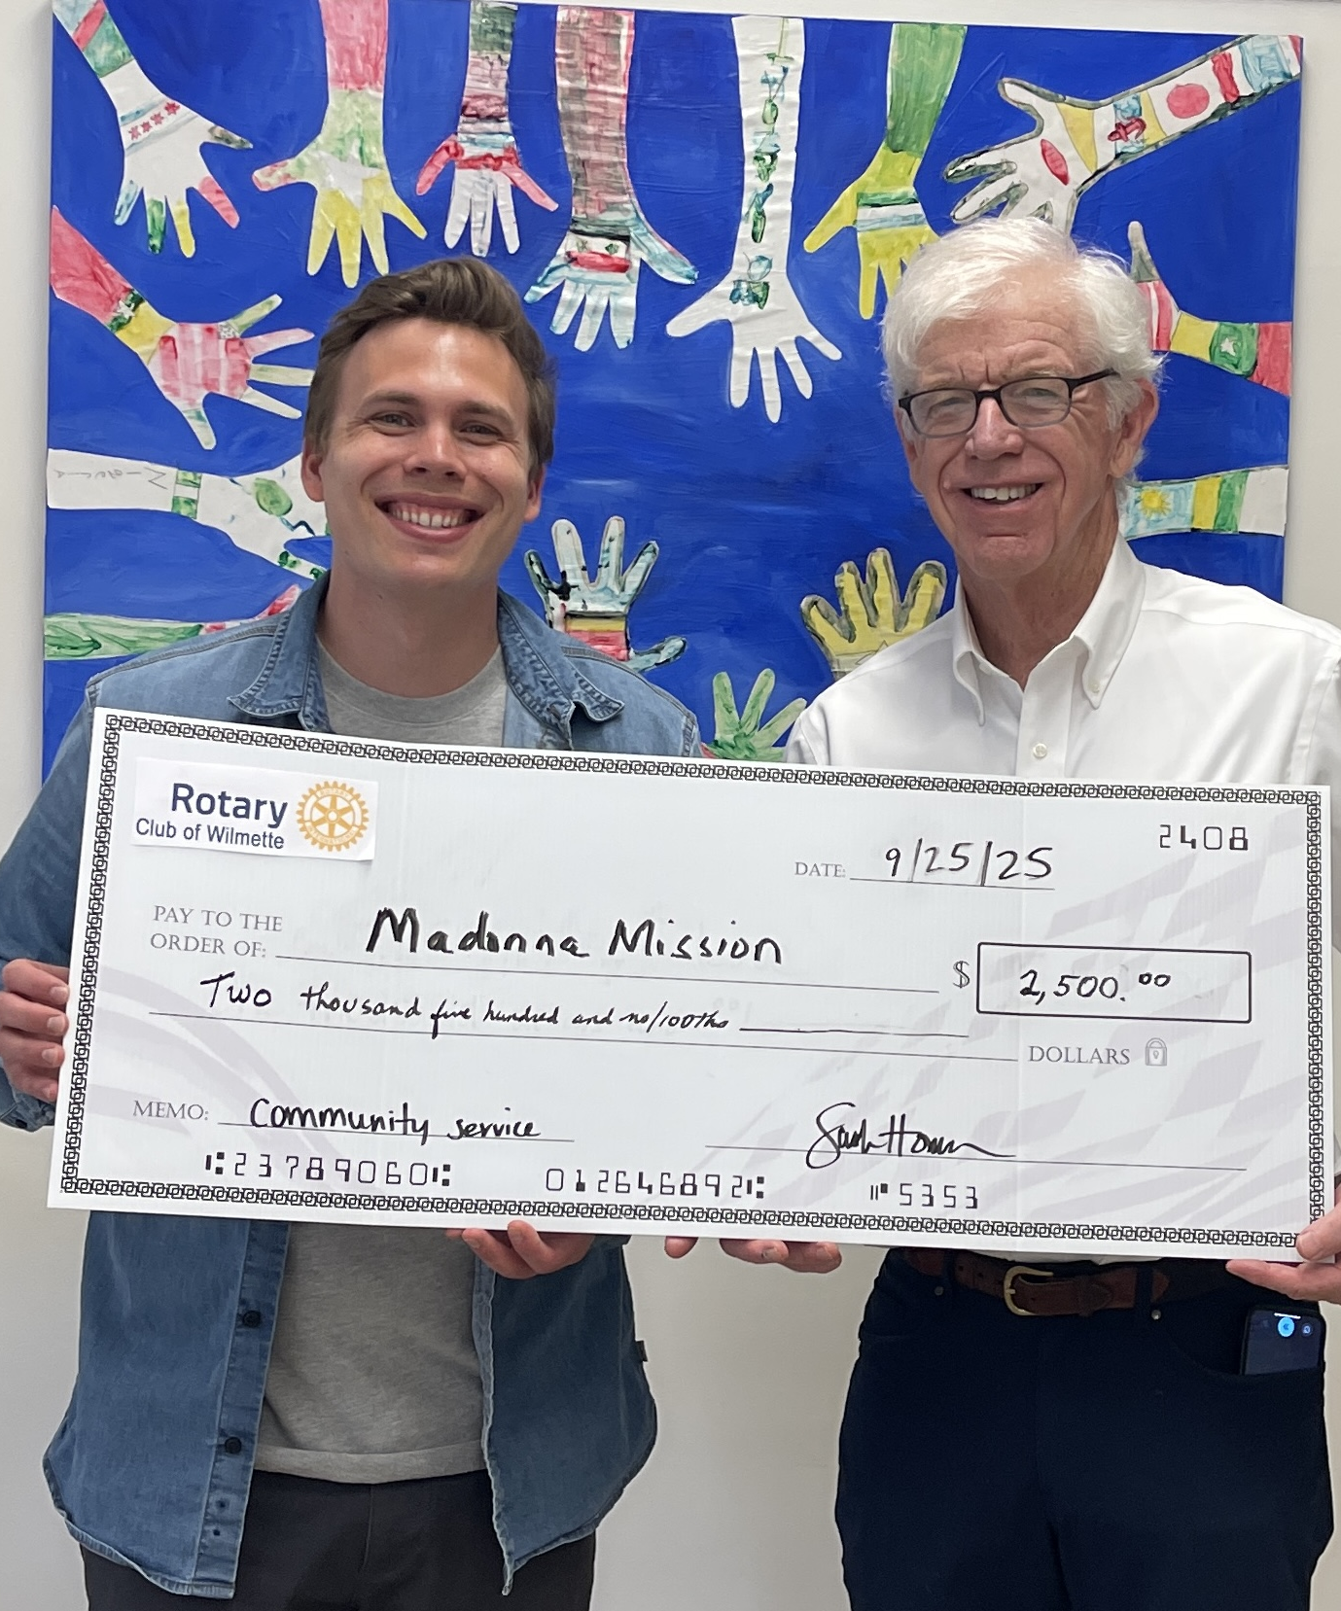
CS&E COMMITTEE ENGAGEMENT
July–December 2025
5
10
8
Monthly Meetings
Committee Members
CS&E Service Event &
Grant Leads
4th Mondays via Zoom
Lead | Service Project | Grant Application
George Pearce | Wilmette Block Party St Thomas Coat Drive
Brian Bradly | Lunch Packing Halloween Party
Sarah Homan | HomeComing | HODC
Ben Ivory | Beach Sweep Village Cleanup | Our Place
Debora Morris |  | Lemons of Love
Jim Pockross |  | Noggins Builders Fndn
Doug Oettinger |  | Youth Job Center
Mariana Alfar |  | ICNA Relief
Notes:
Connect “public image” to role of “service leads” --- The CS&E Committee has launched multiple service projects ranging from environmental cleanups to community support programs. These initiatives have strengthened local partnerships and addressed important community needs. Image source: Microsoft 365 content library

Slide 11
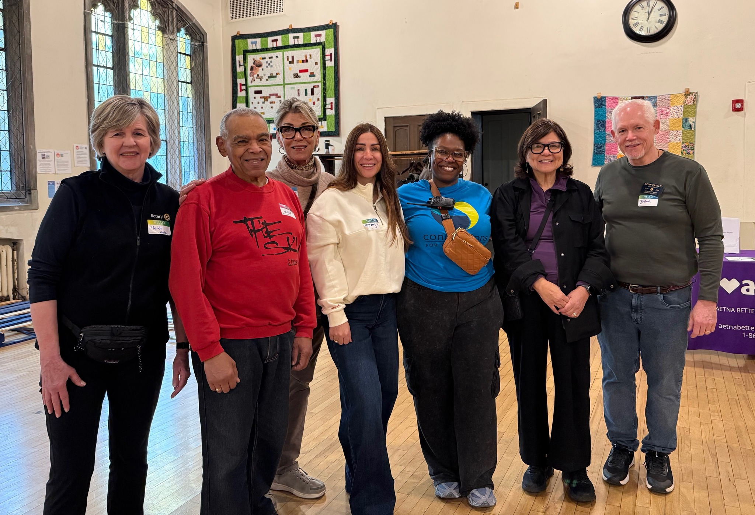
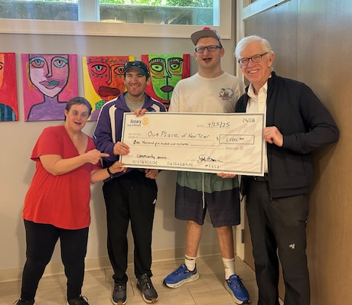
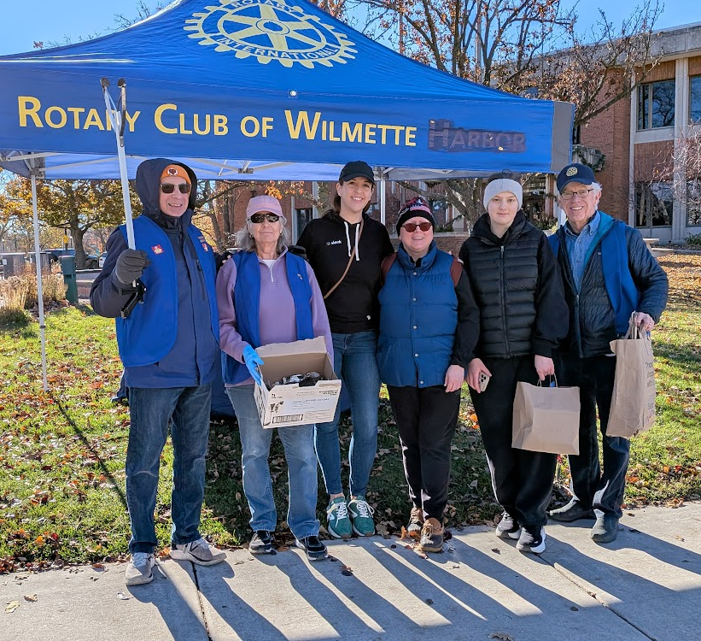
Summary of Service ProjectS & Initiatives
Environmental Projects
Environmental cleanup efforts to promote sustainability.
Beach Sweep
Village Cleanup
Operation Pollinator
Community Engagement Programs
Programs aim to engage with local communities and share the mission of Rotary Club of Wilmette.
Wilmette Block Party
Connections for the Homeless Block Party
HODC HomeComing
Strengthening Local Partnerships
Cross-club service initiatives have built stronger local partnerships to enhance community impact and resource sharing.
Operation Warm
Connections for the Homeless
Go Green Wilmette
St Thomas of Canterbury
Notes:
--- The CS&E Committee has launched multiple service projects ranging from environmental cleanups to community support programs. These initiatives have strengthened local partnerships and addressed important community needs. Image source: Microsoft 365 content library

Slide 12
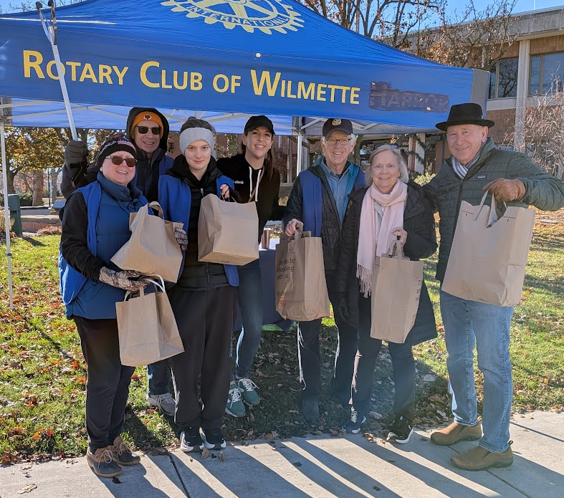
Impact Metrics and Volunteer Hours
12
~140
Service Events
Total Volunteer Hours
~960
120+
Lunches Provided
Coats Distributed
~185lbs
Trash Collected
Notes:
--- Volunteer engagement has been robust, with hundreds of hours contributed. We track impact metrics such as the volume of waste collected, number of beneficiaries served, and measurable improvements in community wellbeing. Image source: Microsoft 365 content library

Slide 13
Grant Application and Review Process Enhancements
Where can we streamline our processes for clarity and continuity?
Notes:
This section details improvements made to the grant application process to increase transparency and efficiency in awarding funds.

Slide 14
Grant Application & REVIEW PROCESS
$30,250
CS&E Budget for RY26
78% priority grant recipients already funded
14
grant recipients funded
(including Service Projects &
Community Engagement)
Budget Planning: Priority grant recipients planned in committee budget for streamlined approval
Application Form: Updated for improved clarity and usability
Timeline: Encouraged early submissions for faster processing
Coming Up
Evaluation Criteria: Decision matrix with weighted criteria to guide committee review and standardize grant application approvals
Notes:
--- We currently follow a structured application process requiring detailed proposals, budgets, and timelines. This ensures alignment with club priorities and effective resource allocation. Image source: Microsoft 365 content library

Slide 15
Proposed Annual Calendar of Events
What opportunities for service do we want to offer consistently each year?
Notes:
This section outlines upcoming events and improvements to operational structures, aimed at increasing efficiency and member engagement.

Slide 16
Formalized Events and Timeline
Monthly Recurring
Quarterly Events
Annual Campaigns
Lunch packing for Connections for the Homeless
Environmental cleanup initiatives
Community engagement events
Fall/Winter coat drives and distribution
Summer community block parties
Back-to-school support programs
Beach Sweep
Improved Planning
A comprehensive club calendar and related materials support better planning, coordination, and resource management.
Event Type Branding
Visual consistency creates brand/event recognition and encourages greater recognition and participation.
Service Leads & Documentation
Increased ability to delegate responsibility for recurring service projects engages more club members in leadership roles.
Increased Participation
Formalized event planning and promotion encourages higher engagement and involvement from members and community.
Committee Support
Committee meetings with rolling agenda
Regular social media content (pre/post service projects)
Quarterly grant application review cycle
Assigned Leads for each service project and/or grant application
Notes:
--- A detailed calendar of planned events for the next six months has been developed to improve planning and participation across committees and members. Image source: Microsoft 365 content library

Slide 17
Proposed rotary year calendar of CS&E events
JULY Lunch packing Connections Block Party | AUGUST Lunch packing Grant review | SEPTEMBER Lunch packing Wilmette Block Party Beach Sweep (Go Green/ Springman) | OCTOBER Lunch packing Coat drives / distribution Book drive
NOVEMBER Lunch packing Village cleanup Grant review | DECEMBER Lunch packing | JANUARY Lunch packing | FEBRUARY Lunch packing Environmental? Grant review
MARCH Lunch packing | APRIL Lunch packing Earth Day / Operation Pollinator | MAY Lunch packing Grant review / call for new applications | JUNE Lunch packing Leadership transitions & training (as applicable)

Slide 18
Future Plans and Next Steps
What is our focus in these next 6 months and beyond?
Notes:
The final section discusses goals and strategies for the upcoming six months to sustain progress and expand community impact.

Slide 19
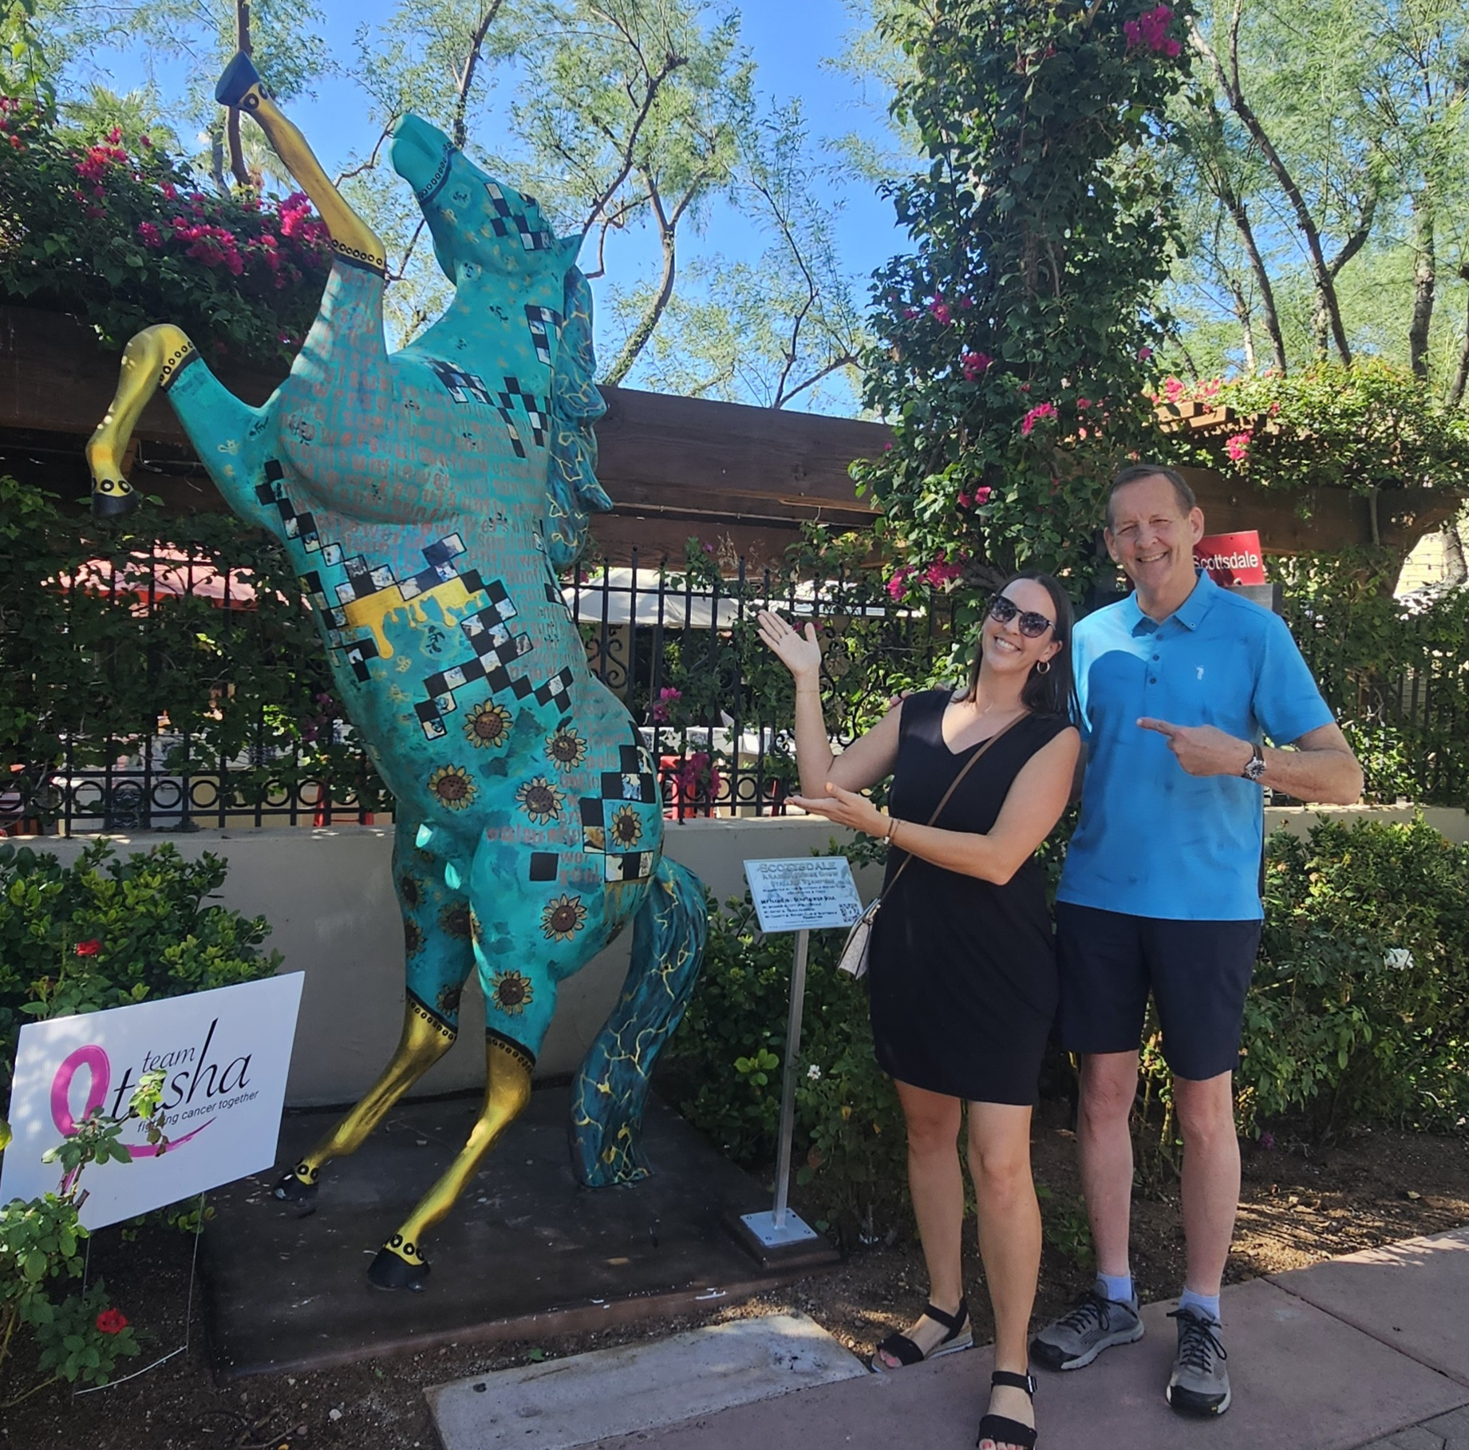
Refine public image strategy to Increase Club Engagement & recruit new members
Platform-specific Content
Further tailoring themes of content to the strengths and audience of each platform.
Event Branding
Creating consistently branded images associated with each service project type to increase familiarity and promote greater engagement.
Promote Club & Committee Leadership Engagement
Diversify voices and perspectives representing our club across social media platforms.
Notes:
--- New engagement campaigns are designed to boost member involvement through interactive activities, recognition programs, and community challenges. Image source: Microsoft 365 content library

Slide 20
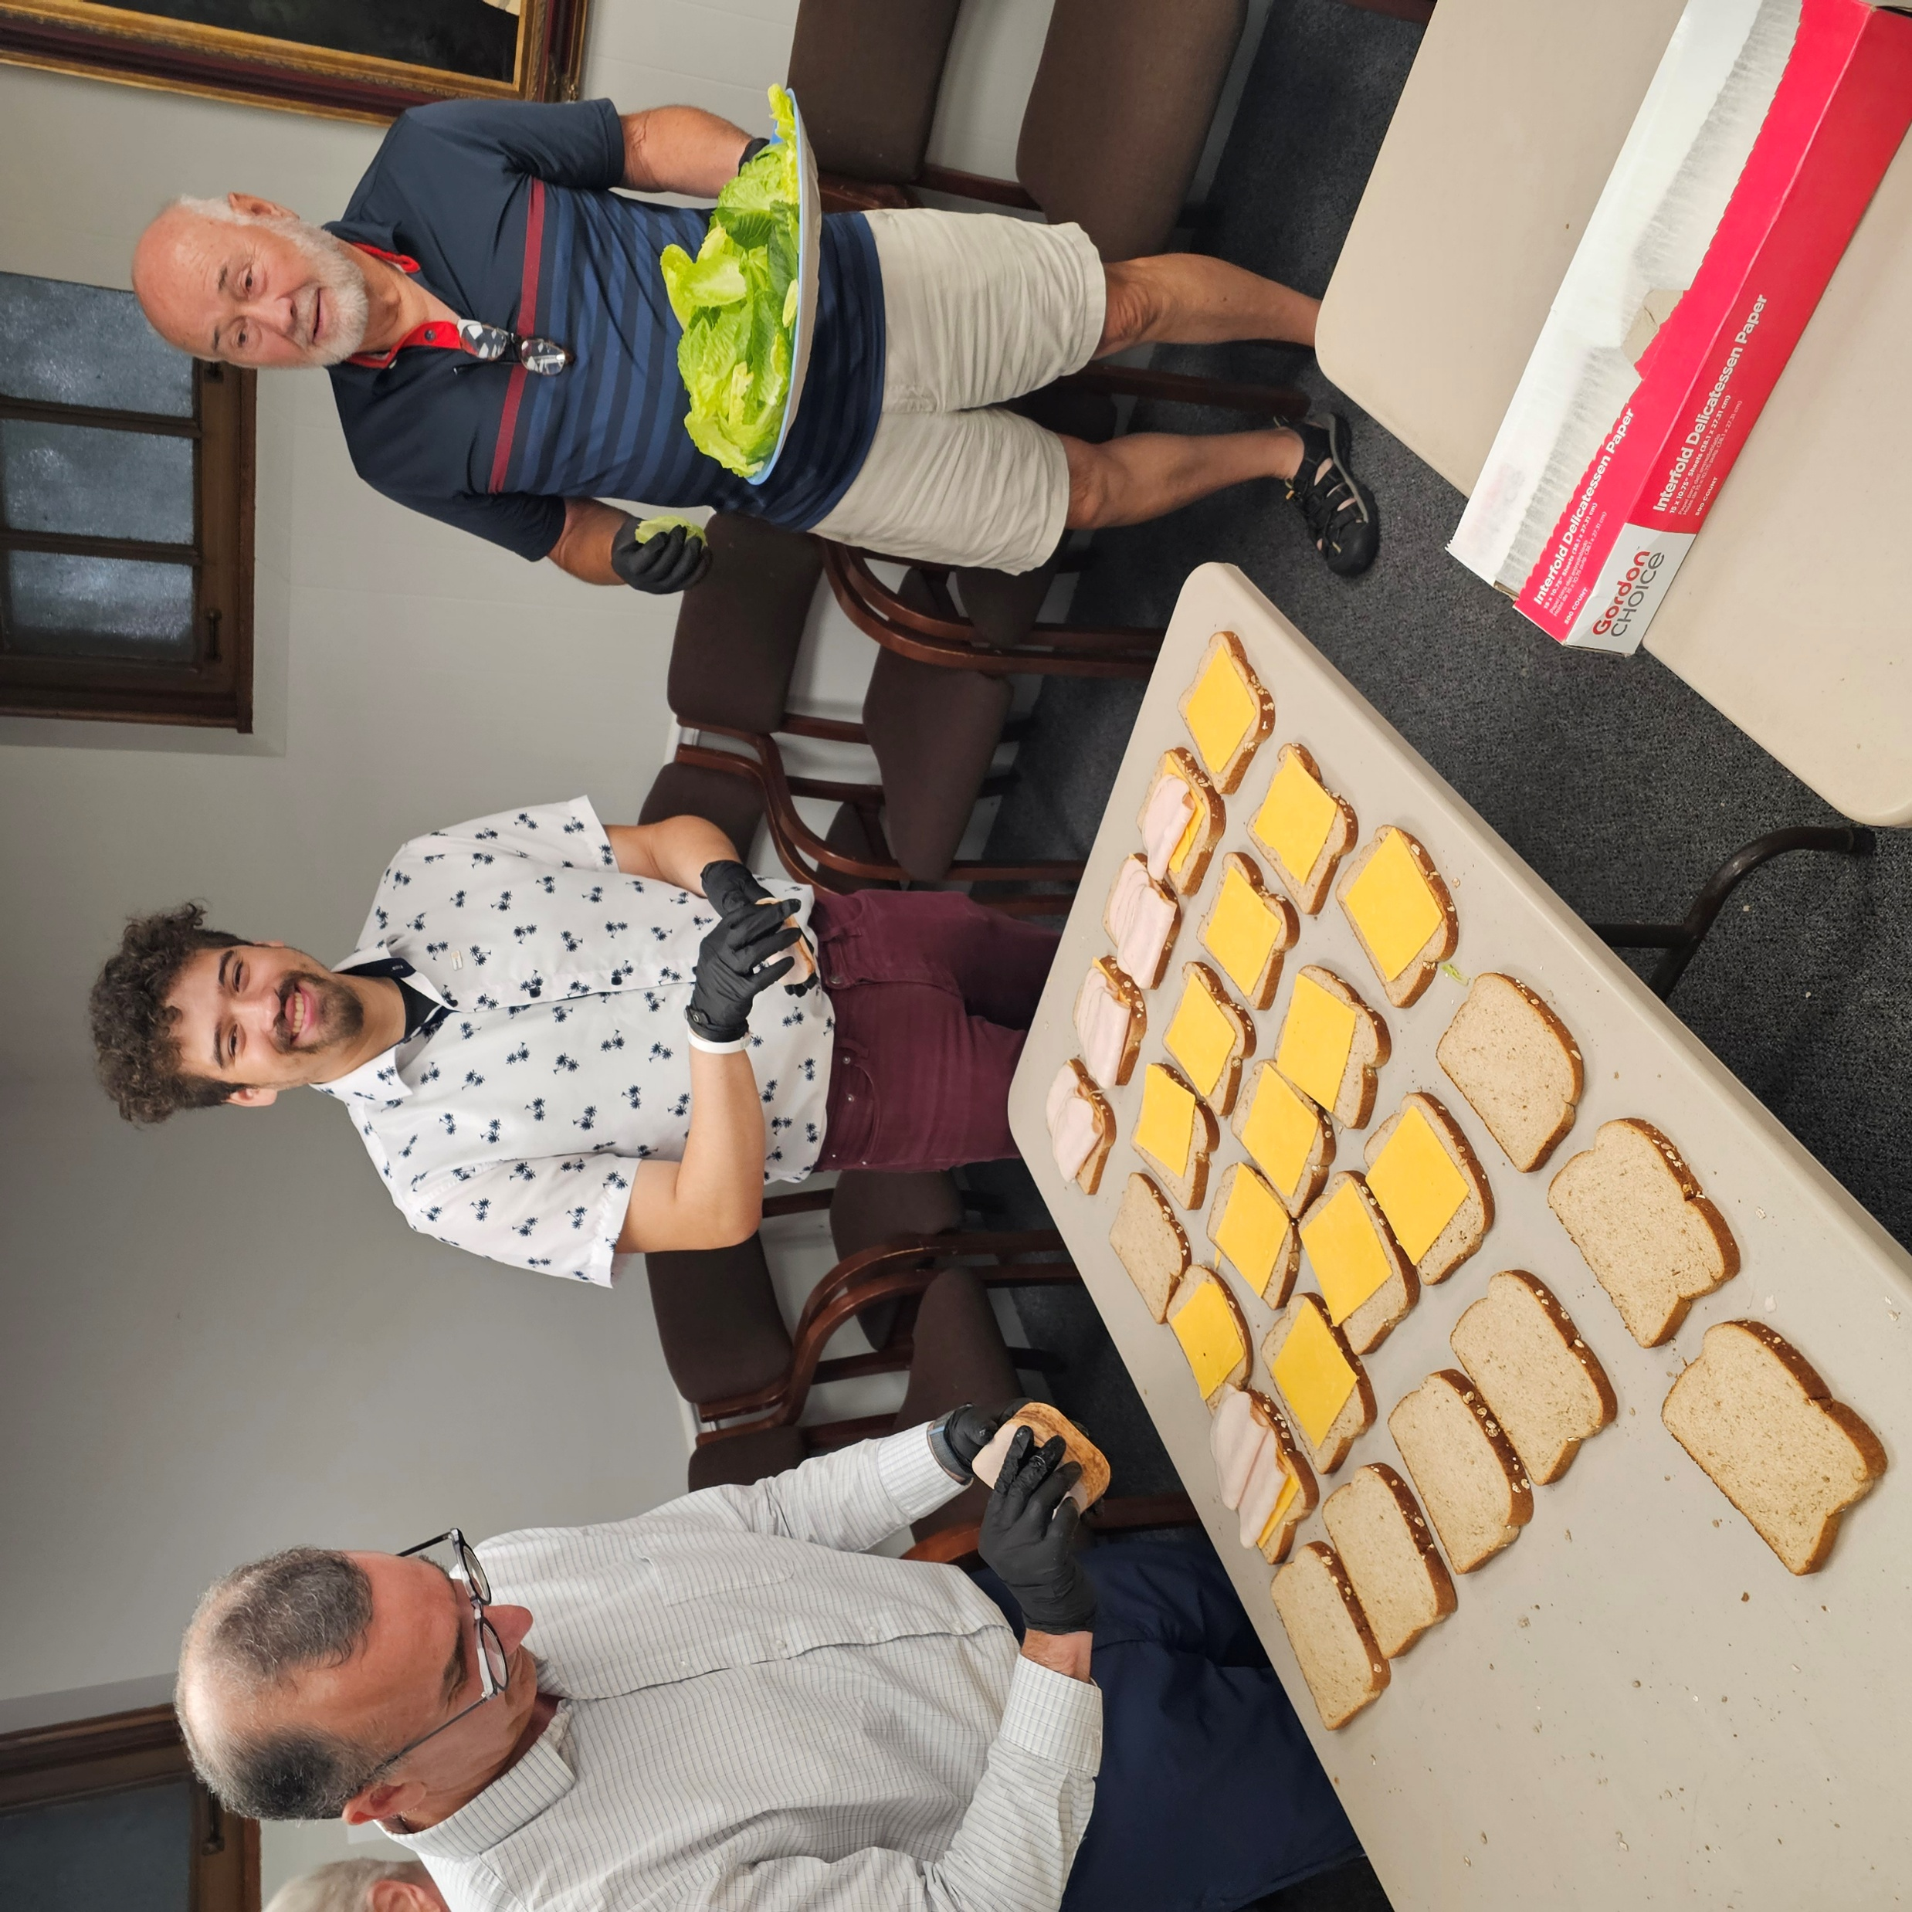
Improve Service project PROCESS & impact
Operational Efficiency
Establish Costco business account for streamlined supply purchasing and expense tracking
Update policies and procedures to retain institutional knowledge and train additional members to support service projects
Quarterly grant review cycle with implemented decision matrix to standardize and expedite grant approvals
Annual Calendar
Adopt standard annual calendar of service projects with supporting resources for greater member and community participation
Partnership Development
Leverage district grants to increase impact in cooperation with other clubs
Continuing to strengthen partnerships with other organizations to support community and responsibly manage resources, enhancing project effectiveness
Notes:
--- Adjustments to the lunch packing delegation aim to streamline responsibilities, enhance volunteer coordination, and improve event execution. Image source: Microsoft 365 content library

Slide 21
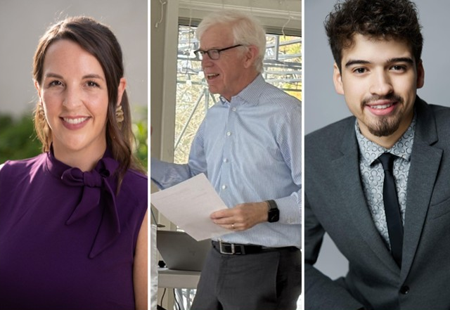
Q&A
CS&E Committee Meetings
Monthly, 4th Mondays
5 – 6pm via Zoom
Sarah Homan sarah.homan@ymail.com
Ben Ivory benjamindivory@gmail.com
Gabriell Doyle doyleg2012@gmail.com
Notes:
The Rotary Club has made significant progress in both community service and public image over the past six months. Continued focus on strategic improvements and member engagement will drive future success and deepen our community contributions.

