Slide 1
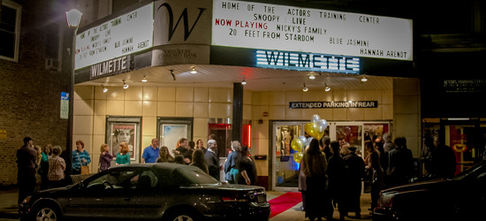
Wilmette Theatre

Slide 2
Who We Are
Not for profit since July 2011.
Tremendous support from North Shore Community Bank.
Community resident Board of Directors.
Programming includes movies, a growing list of live events and we are home to the Actors Training Center.
One theatre seats 110 with event space and the other 140 with a stage, sound system and lighting.
Core staff of 3 at the Theatre and 3 at ATC.

Slide 3
Renovated Jerome Mirza Theatre

Slide 4
What We Offer
Unique Programming
Venue for the Community
Life Changing Education
Economic Contribution

Slide 6
See something different at the Mette
Movies often exclusive or only shown at a few theatres in the Chicago area.
Special programming includes Science on Screen® partnering with Field Museum, Asian Pop Up Cinema, Writers Theatre Series, One Earth Film Festival, Chicago Independent Film Critics Circle and Chicago International Children’s Film Festival.
Independent film screenings with director and cast talkbacks.
Live events include Jenniffer Weigel’s author series, live music and Story Jam featuring award winning story tellers and original songs.

Slide 7
Host Many Schools & Organizations
Evanston YWCA | McKenzie School
Warming House | Romona School
Food Allergy Research & Education | Loyola Academy
New Trier High School | Chairavalle Montessori School
Central School Wilmette | St. Francis School
Wilmette Park District | Kenilworth Historical Society
Garden Guild Winnetka | Illinois Policy Action
Rotary Club Wilmette Harbor | Field Museum

Slide 8
We have a loyal and growing customer base
2016 over 32,000 patrons – a 24% increase over 2015, 18,000 patrons through June 2017.
Google reviews for last 12 months averaged 4.4
Over 4,300 email subscribers with an average open rate of about 1,200 per week.
Monthly web site traffic 6,000 sessions with over 9,000 page views. Primary geographic locations are Evanston 29%, Chicago 28%, Wilmette 7%.
Patrons are well educated and affluent:
90% have at least a Bachelor’s degree and 56% having a Masters degree
74% have household income of at least $100,000 and 17% over $300,000.

Slide 9
Benefit to the local community
Pay sales and property taxes.
Attract patrons from all over the Chicago who frequent other local businesses .
Host community meetings and discussion groups.
Venue for private independent film screenings and community celebrations.
Generate favorable press coverage and exposure for the community.

