Slide 1
New Member Orientation - Elements
Introductions—Getting to know you
Getting to know Rotary
Who we are and what we do
Guiding Principles
Organization of Rotary
International
District
Club

Slide 2
New Member Orientation
July, 2022
Rotary Club of Dove Mountain, Marana, AZ

Slide 3
Why Did You Join Rotary?
What attracted you to Rotary?
What do you hope to contribute to the Club?
How do you hope to benefit from being a Rotarian?

Slide 4
Mission of Rotary International
The Motto of Rotary International is Service Above Self
The mission of Rotary International is to provide service to others, promote integrity, and advance world understanding, goodwill, and peace through its fellowship of business, professional, and community leaders.
The Rotary Foundation (TRF) – Founded 1917 Motto: Doing Good in the World
The Mission of The Rotary Foundation is to enable Rotarians to advance world understanding, goodwill, and peace through the improvement of health, the support of education, and the alleviation of poverty.
Rotary is a global network of 1.4 million neighbors, friends, leaders, and problem-solvers who see a world where people unite and take action to create lasting change – across the globe, in our communities, and in ourselves.
RI’s theme for RY2022-23 is “Imagine, a world that deserves our best, where we get up each day knowing that we can make a difference.”

Slide 5
This is Rotary

Slide 6
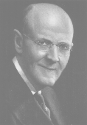
In the beginning…
Rotary Founder
Paul Harris
First Rotary Club was organized in Chicago in 1905, by Paul P. Harris.
The original four-member club, (a lawyer, coal dealer, mining engineer and tailor) met for fellowship, in rotation, at members’ offices . . .thus the name Rotary.
There are currently more than 35,000 clubs with greater than 1.4 million members.

Slide 7
History of Rotary International
Paul Harris, a Chicago attorney formed the Rotary Club of Chicago on
February 23, 1905, so professionals with diverse backgrounds could exchange
ideas, form meaningful, lifelong friendships, and give back to their communities.
The first clubs chartered in Southern Arizona were Tucson and Miami-Copper Cities on April 1,1921 and Nogales on December 28, 1921.
Over 1.4 million Rotarians in 46,000 clubs around the world (more than 200 countries)

Slide 8
The Wheel is the Rotary International Symbol
You are the Key!
Members are Key . .
. . . to ensure the gear turns and works, when the shaft rotates.

Slide 9
Guiding Principles of Rotary

Slide 10
Motto: “Service Above Self”
It wasn’t long before Rotary realized fellowship alone would not keep a group together. There needed to be a purpose!
First project was creation of public washrooms in downtown Chicago.
Rotary became world’s 1st “service club”
1910 – Rotary Club of Winnipeg, Manitoba chartered and made Rotary International.

Slide 11
Object of Rotary
The Object of Rotary is to encourage and foster the ideal of service as a basis of worthy enterprise and, in particular, to encourage and foster:
FIRST: The development of acquaintance as an opportunity for service;
SECOND: High ethical standards in business and professions; the recognition of the worthiness of all useful occupations; and the dignifying of each Rotarian’s occupation as an opportunity to serve society;
THIRD: The application of the ideal of service in each Rotarian’s personal, business, and community life;
FOURTH: The advancement of international understanding, goodwill, and peace through a world fellowship of business and professional persons united in the ideal of service.

Slide 13
Rotary’s Avenues of Service are the Foundation of Club Activity
Club Service focuses on making clubs strong. A thriving club is anchored by strong relationships and an active membership development plan.
Vocational Service calls on every Rotarian to work with integrity and contribute their expertise to the problems and needs of society.
Community Service encourages every Rotarian to find ways to improve the quality of life for people in their communities and to serve the public interest.
International Service exemplifies our global reach in promoting peace and understanding. We support this service avenue by sponsoring or volunteering on international projects, seeking partners abroad, and more.
Youth Service recognizes the importance of empowering youth and young professionals through leadership development programs such as Rotaract, Interact, Rotary Youth Leadership Awards, and Rotary Youth Exchange.

Slide 14
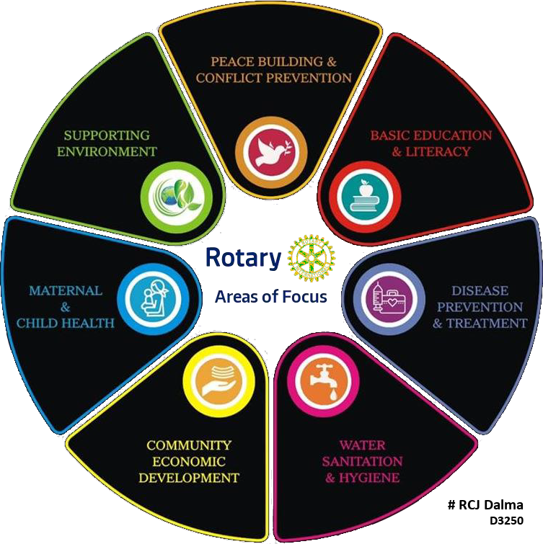

Slide 15
THE FOUR-WAY TEST of the things we think, say or do
1. Is it the TRUTH?
2. Is it FAIR to all concerned?
3. Will it build GOODWILL and BETTER FRIENDSHIPS?
4. Will it be BENEFICIAL to all concerned?

Slide 17
The Rotary Foundation
District Grants
Global Grants

Slide 18
End Polio Now!
https://www.youtube.com/watch?v=hR1f-ejMcGU

Slide 19
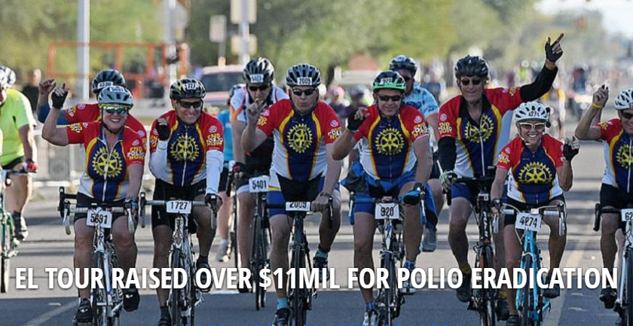
EREY & Polio Plus
The Ride to End Polio
This is the largest fundraiser for polio in the world!

Slide 20
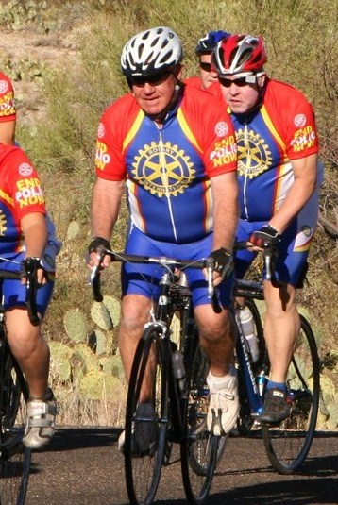
Ride to End Polio
Saturday, Nov. 19, 2022

Slide 21
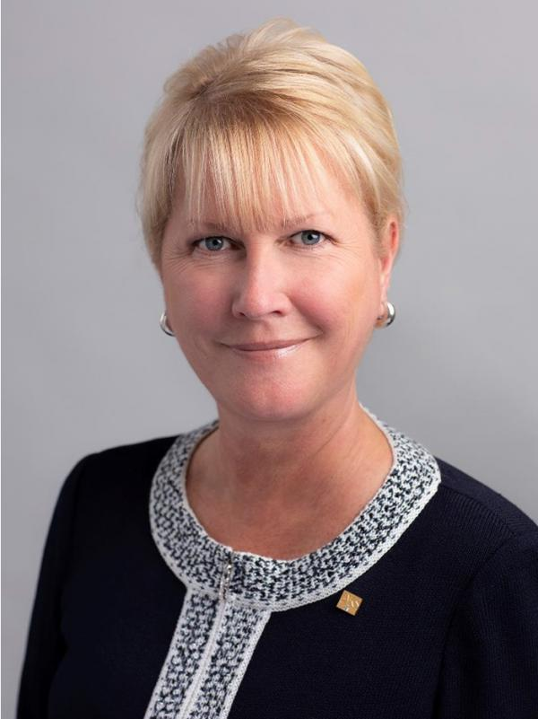
Organization of Rotary
Rotary International is headquartered in Evanston, Illinois
The President of RI, currently Jennifer Jones, of Ontario, Canada, can be from anywhere in the world
The Organization of Rotary International is divided into:
Zones – Our district is part of RI Zones 26/27
Districts – Our District is 5500, which includes the Southern and Central Arizona
Clubs – There are currently 52 clubs in D5500

Slide 22
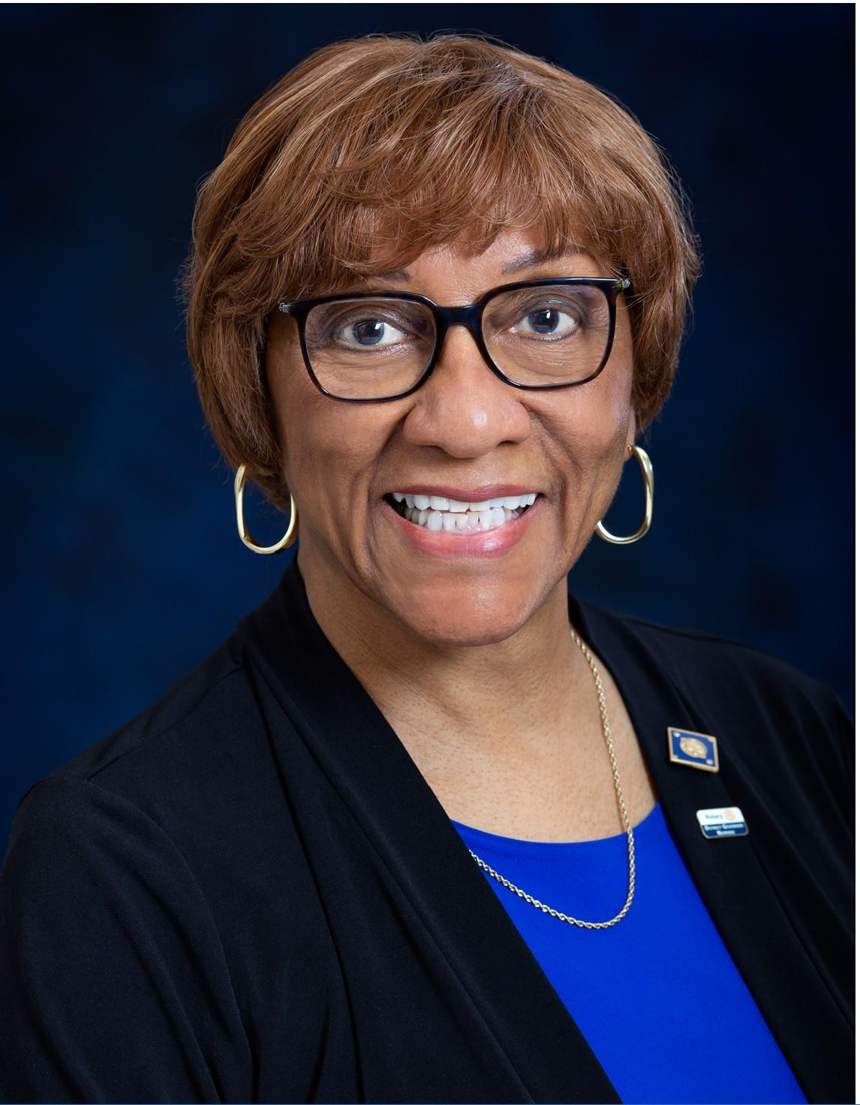
Organization of Rotary
District 5500 is led by a District Governor, currently Anita McDonald(Catalina Rotary), who serves for one year
The District Organization includes:
Assistant Governors who work with specific clubs
District Committees with local specialists in areas of:
Membership
Foundation
Youth
Public Image
Literacy

Slide 23
Rotary is an International Organization
Divided into 35 Zones and 530 Districts, throughout 200 countries and geographical areas, worldwide.
District 5500, is part of Zone 26 which has 52 clubs and about 1,400 members.
District 5500 = All of Arizona, south of the Salt River.

Slide 24
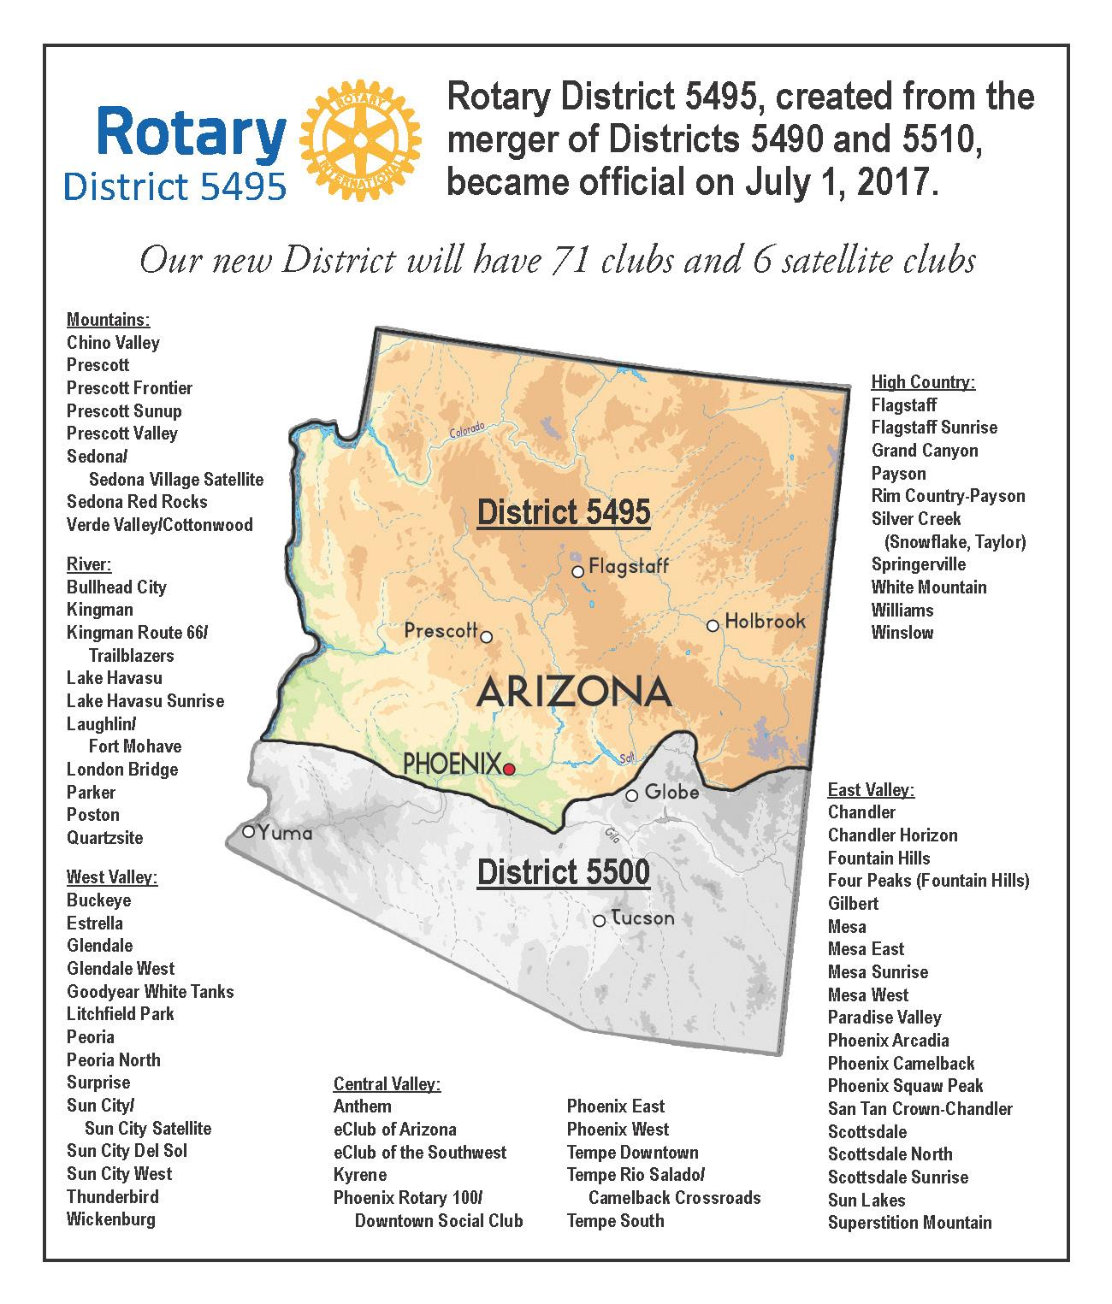
Arizona Districts

Slide 25
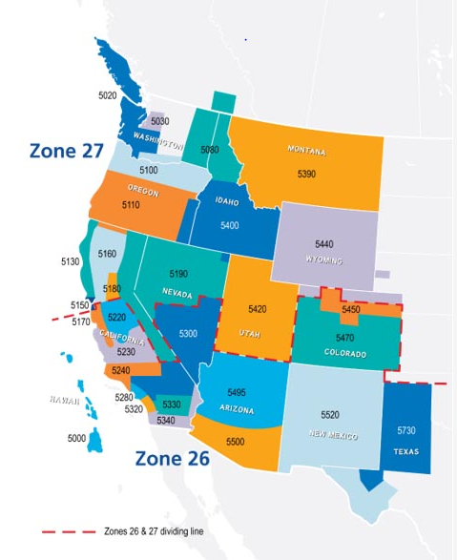
District 5500 is in Zone 26 Part of the “Big West”
Notes:
There are 34 Zones in the world; 10 in US (covers parts of Canada and Mexico); 535 Districts

Slide 26
Organization of Rotary
The Dove Mountain Rotary Club (club # 72360) was chartered on March 23, 2006, and its charter night banquet was held April 6, 2006.
The club was sponsored by the SaddleBrooke Rotary Club.

Slide 27
The Dove Mountain Rotary Clubs Character:
Small but mighty club, people of action, innovative fundraisers
Interesting meetings & attractive venue (Highlands Clubhouse)
Welcoming to guests & new members
In support of:
Youth, education, girls, veterans
Service projects benefiting the community
Adults developing a new career path (TRVFA)
In-need families/women/youth -- thru an immediate crisis
Helping others to help themselves – mentoring
Improving the lives of nursing home seniors
Applying the Four-way test to individual, youth, & business ethics
International service projects benefiting the world
Peacebuilder club in support of world peace

Slide 28
Organization of Rotary
Club leaders for 2022-23 are:
President – Prudy Abeln
President Elect – Joe Hentges
Immediate Past President – Fred Novick
President Nominee - TBD
Board of Directors consisting of:
Secretary – Fred Novick
Treasurer – Teree Bergman
Club Charitable Fund President – Jeff Penfil
Board also includes Chairs of the following committees:
Membership – Jim Jansen, Aleta Wiener (co-chairs)
Rotary Foundation – Teree Bergman
Club Administration – Joe Hentges
Service Projects – Jeff Penfil, Ralph Harding (co-chairs)
Public Image – Prudy Abeln

Slide 29
Organization of Rotary
The Dove Mountain Rotary Charitable Fund is the club’s own, separate 501(c)(3) foundation, used to fund the club’s charitable projects.
Board of Directors of this foundation consist of:
President – Jeff Penfil
Treasurer – Teree Bergman
Secretary – Fred Novick
Directors – Randy Long, Carol Long

Slide 30
Benefits of Membership in Rotary
Opportunities to:
Make a difference thru “bigger, better, bolder service which changes lives” in the community and the world
Develop skills such as public speaking, project management, event planning
Network with other professionals
Build lifelong friendships
Make international connections

Slide 31
Financial
Dues & Other Costs:
The dues are $100 per quarter or $400 per year. This includes all club, District, and RI dues.
Appetizers are $5 per meeting, when attending in-person at a club meeting.
RI Foundation is a suggested (but not mandatory) minimum of $100 per year.

Slide 32
Service in Rotary Motto – Service Above Self
Service Opportunities –
Community Food Bank Hunger Walk
Salvation Army Bell Ringing
Feed-My-Starving Children volunteer night
El Tour de Tucson Aid Station support
Homeless Veteran “stand down” meal serving
TRVFA Scholarships - Interviewing candidates
Imago dei Middle School
Roadrunner Elementary School
Literacy Project…and many others…..
Support Club’s Fundraising (eg. committee work, sales, marketing, etc.)

Slide 33
Club Committees
Rotary Foundation: Teree Bergman
Membership: Jim Jansen, Aleta Wiener (co-chairs)
Public Image: Prudy Abeln
Youth Service: Scott Parfrey
International Service: TBD
Fundraising: Teresa Baker
Club Administration: Joe Hentges
Service Projects: Jeff Penfil, Ralph Harding (co-chairs)
Peacebuilder: Jeff Penfil
Fellowship/Social Activities: TBD
Scholarships, Tatum Memorial Scholarships: JoAnn Ullery
TRVFA Scholarships: Joe Hentges
MVHS Interact Club Liaison: Scott Parfrey
Sergeant-at-Arms: Brigitte Hentges
Club Website: Teree Hentges
Facebook, Newsletter: TBD

Slide 34
Social Activities
Installation event – June/July
Christmas / Hanukkah / Holiday Party – December
Club Picnic
Social Mixers
Informal Dinners ( restaurants, club members homes)
Business tours paired with dinner out together

Slide 35
Responsibilities of a Rotarian
There are no attendance rules, but you are encouraged to make it a priority and attend as often as possible.
You have joined Rotary because you are a service-minded person who wants to help your community.
You will be assigned to a committee – you can volunteer for one as well.
Networking is a good by-product of being a Rotarian but should not be the main reason for joining Rotary.
You will be assigned a mentor so you will continue to learn more about Rotary and help you integrate into the club and feel welcome.
Fellowship with other club members.
High ethical standards - The Four-Way Test (Is it the truth? Is it fair to all concerned? Will it build goodwill and better friendships? Will it be beneficial to all concerned?)
Have Fun!!!! (many clubs consider this an essential addition to the Rotary Four-Way Test)

Slide 36
Connect for Good Online
Rotary International Website
https://www.rotary.org/
Sign Up for My Rotary Account
District 5500 Website
https://rotaryd5500.org/
Stay Up-to-Date with what is happening in the District
District 5500 Facebook Page
https://www.facebook.com/groups/196945414392403
Club Website, Clubrunner and Facebook Page
https://www.dovemountainrotary.org

Slide 37
Orientation Resources (from RI Website)
Use these resources to celebrate new members, develop an orientation program, and get them involved early and often.
Welcome to Rotary — Sharing this inspiring video with new members when they join.
Kick-start Your New Member Orientation — This Learning Center course shows how to make your club's new members feel welcome, appreciated, and valued.
Introducing New Members to Rotary: An Orientation Guide — Find ideas for engaging new members, getting them involved, and giving them a meaningful Rotary experience.
Connect for Good — Encourage members to get involved in their club, community, and the Rotary world for a more meaningful experience.
New Member Welcome Kit — Order a welcome kit from your local, licensed Rotary vendor or put one together using the resources in this section.

