Slide 1
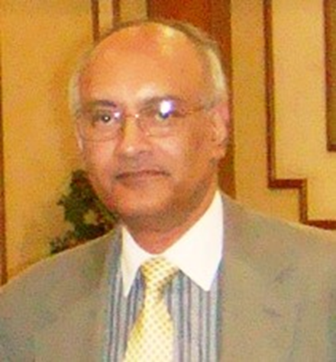
Topic:
“North Korean nukes and population density”
by
Qadir Mohiuddin
BA-ucla, MPL-usc, MS-usc, PhD-u of pennsylvania

Slide 2
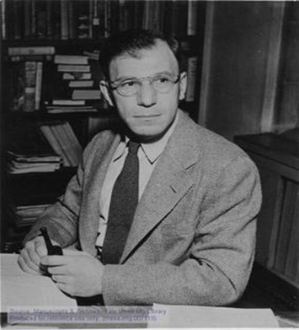
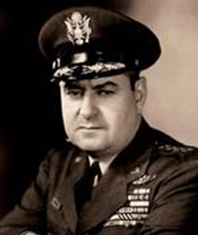
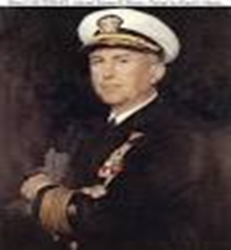
Topic: “North Korean nukes and population density” by Qadir Mohiuddin, PhD
CONTENTS:
1- TODAY’S TOPIC
2- WHO AM I?
3- MY INTEREST IN DEFENSE STRATEGY – a multidisciplinary perspective
Dr. Bernard Brodie, colleague of USAF General Curtis LeMay
Admiral Thomas Moorer, Retired US Chairman Joint Chiefs of Staff
- Dr. Lawrence Klein, Nobel winner in Economics
5- MY INTEREST IN SOUTH KOREA – the implications of nuclear conflict
6- POPULATION DENSITY IN NUCLEAR COUNTRIES – an evolutionary consequence
7- DENSITY STATISTICS IN ASIA, RUSSIA AND USA – growth and necessity
8- HIROSHIMA AND EQUIVALENT AREAS IN CALIFORNIA – 3.5 to 7 ‘tremor’
9- NUKE-ASSETS IMPACT on POPULATION DENSITIES – radiation and EPW
10-AVOIDING ARMAGEDDON IN ASIA?

Slide 3
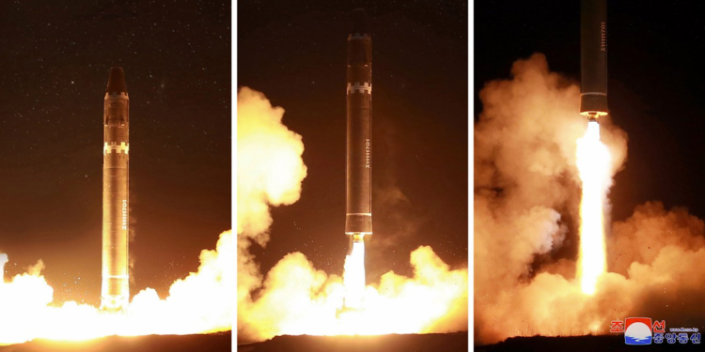
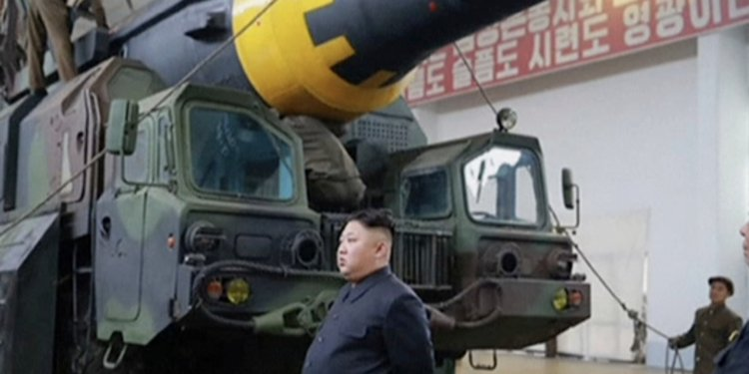
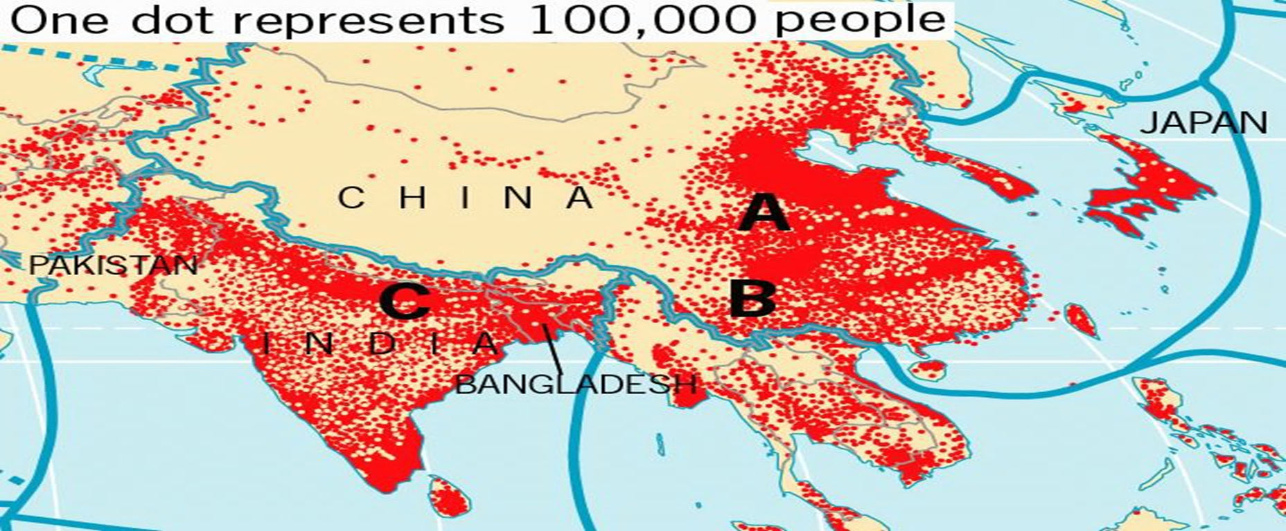
Topic: “North Korean nukes and population density”

Slide 4
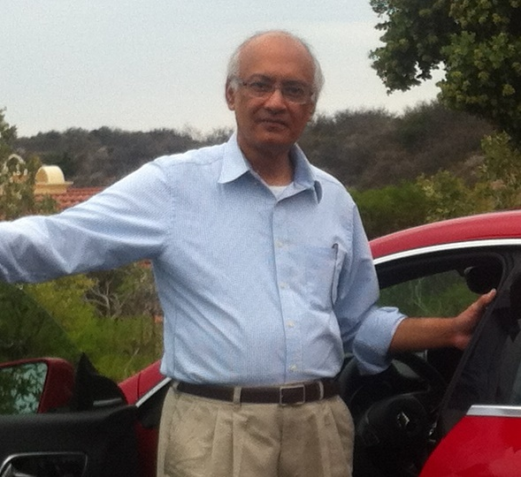
Who am I?
I am a Full Professor and Dean of Graduate Studies
-Earlier, I was Director Strategic Initiatives for NYIT in China, and Local Dean and Chief Academic Officer at NYIT-Bahrain. I was also Acting Local President-Campus Dean briefly.
-In Arizona, I was the Interim Business Programs Chair at Argosy University, and Taught DBA-doctoral courses.
:::::::::::::::::::::::::::::::::::::::::::::::::::::::::::::::
PhD- University of Pennsylvania
MS-Management – University of Southern California
MPL-Planning – University of Southern California
BA- UCLA – Economics & Political Science-international relations

Slide 5
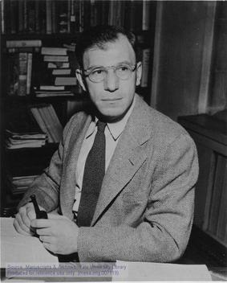
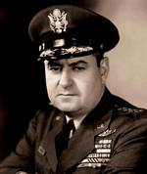
I studied US Defense Strategy under Dr. Bernard Brodie at UCLA
Initially a theorist about naval power, Brodie shifted his focus to nuclear strategy after the creation of the nuclear bomb. His most important work, written in 1946, was entitled The Absolute Weapon: Atomic Power and World Order, which laid down the fundamentals of nuclear deterrence strategy.
Professor Brodie was the American military strategist who authored several highly influential works on the subject of nuclear strategy, and who shaped the American debate on nuclear weapons for half a century.
He served in the office of the chief of naval operations from 1943 to 1945, and after WWII he taught at Yale University.
He became known as the American von Clausewitz, and after class he asked me if I wanted a copy of von Clausewitz’s scroll.
Dr. Brodie was a colleague of USAF General Curtis LeMay, who was moved from Germany to Japan during WWII. He was a star General over Japan, then during the Cuban Missile Crisis advised President Kennedy, and was the Head of SAC-Strategic Air Command, HQ I believe in El Segundo. There is also a small street named after him north of Balboa Park, Encino. Later he was George Wallace’s Vice Presidential candidate.

Slide 6
My involvement with Strategy began in 1979 when USSR invaded Afghanistan
Professor Brodie recruited one of my mentors, a NATO Consultant.
When the Soviets invaded Afghanistan, I had been studying an area of Pakistan to develop a New Town. I had studied the area and my father arranged for me to take pictures of where I wanted it to be. I had also studied New Town Planning under a Harvard Professor at USC, and traveled to see New Towns in Western Europe after Summer study in France, in 1979.
After the December, 1979 Soviet invasion, I further examined the area and concluded the Soviets wanted to keep moving on from Afghanistan to the Indian Ocean, a very easy drive, to realize the dream of Russian Czars for a warm water Port – and it would have been through Pakistan.
I wrote papers and discussed them with the NATO Consultant. He encouraged me to write/speak with Retired Admiral Thomas Moorer, who had been Chairman US Joint Chiefs of Staff. And, I did, in 1980 and 1981.
I also met his colleague, Dr. Alvin Cottrell at the CSIS in Washington, DC. They had written about the Soviets ‘interdicting’ oil supplies in the Persian Gulf. However, I thought it would be from another location, and the Soviets had to be stopped because it would have made them extremely powerful and that would have led to a direct conflict with the USA.

Slide 7
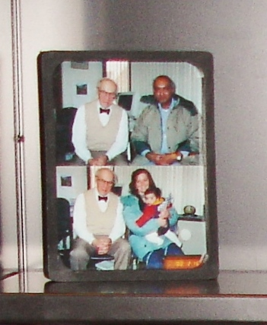
I also studied under Dr. Lawrence Klein, Nobel Laureate in Economics
Together we consulted for the US Business RoundTable and a US
Congressman in 1989, re. the high US debt burden and financials.
Reagan had been talking about Star Wars – increasing spending.
WE found that the US debt burden was not at dangerous levels –
A signal that spending was not unbearable.
The USSR collapsed in 1991.
Inspired by International Physicians for the Prevention
of Nuclear War, ECAAR was founded in 1989 as Economists
Against the Arms Race, ………EPS succeeded ECAAR.
Notable trustees of EPS include Kenneth Arrow and Lawrence
Klein (founding trustees); Amartya Sen, Robert Reich and Óscar Arias.
EPS = Economists for Peace and Security. I was not involved.

Slide 8
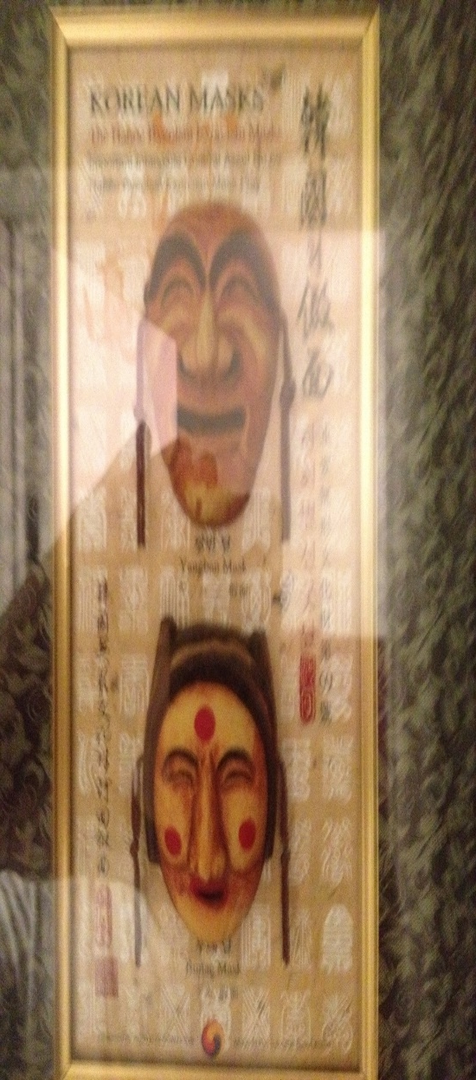
My interest in Korea & consequences of a Nuke War in Asia & US
I had a South Korean friend in my PhD program who urged me to
take a course with Professor Aron Katsenelinboigen, an Economist
of the Soviet kind. He was also an expert on the Soviet Union.
My High School classmate, a Harvard grad, became the country
Head of South Korea for an international agency and wrote a book
with a former South Korean President. I had studied SK in development economics
My South Korean student in the US gave ------------------------→
I think, after he got a good grade.
But mainly, it is horrifying to think that in a Nuke War on the Korean Peninsula,
30,000 US soldiers and 3 million Koreans and Japanese will perish,
at a cost or loss of $3 Trillion to the world economy, over a country that has a $30 billion GDP
and 30, possibly 60, working Nuke bombs.

Slide 9
Example of what Population Density looks like in ASIA
Note the comparisons below and judge for yourself:

Slide 10
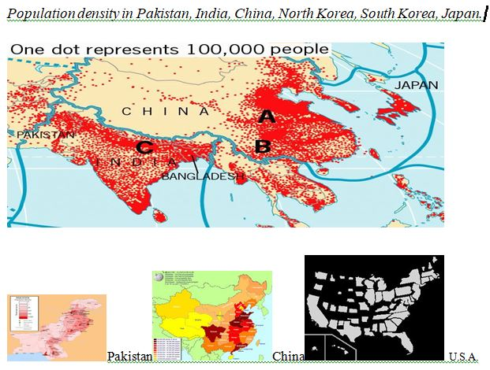
Population density in Pakistan, India, China, Koreas, Japan and USA

Slide 11
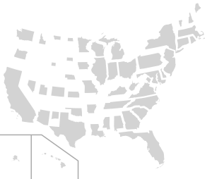
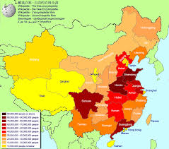
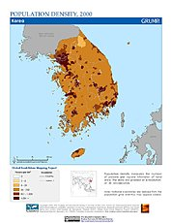
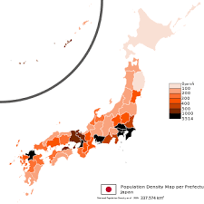
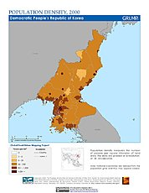
Detailed URBAN densities in Conurbations

Slide 12
1 square Km-kilometer= 0.38 square miles, OR, 1 sq mile= 2.59 sq km
Year Population Density (P/SqKm)
India 2016 446 persons per sq. km.
China 2016 147 (urban population increased 35% in
35 years & is 57% of Total)
Russian Federation remained 1985-2016 9 persons per sq. km.
(urban population declined 1%)
USA 2016 35 persons per sq. km.
(urban pop increased 9% in 35 years
and is 83% of total)
Korea, Dem. People’s Rep. (NORTH KOREA) 2016 211 persons per sq. km.
Korea, Rep. (SOUTH KOREA) 2016 522 per sq. km..
Japan 2016 350 per sq. km.

Slide 13
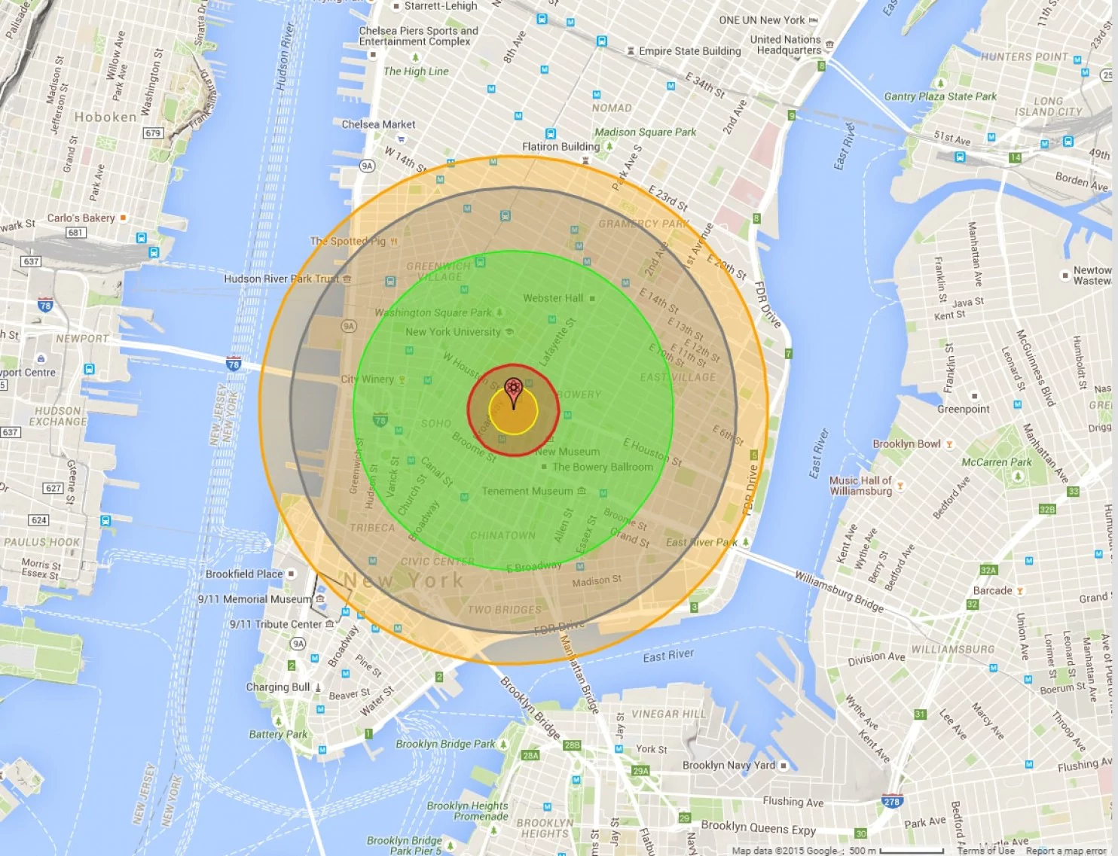
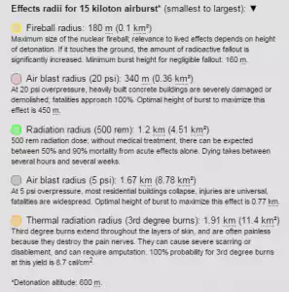
Hiroshima 15 kiloton bomb killed 90,000 to 146,000 over 3.38 square miles to 4.4 sq. mile area of destruction. Beverly Hills is 5.71 sq. miles. LA downtown is 4.73 sq. miles.

Slide 14
Why be concerned with Density in Nuclear confrontations?
Nuke-Impact & Liabilities- contiguous urbanization and high rises:
Up until even the Cuban missile crisis and Vietnam war, the nature of
vulnerabilities was different than it is today.
Since WWII the population of the world has doubled.
Wealth in certain countries has increased and so have high rise buildings.
Urbanization has become conurbanization, and urban density has increased.
Conurbations and high-rise urbanization have guaranteed high casualty rates
per kiloton in nuke-assets warfare – especially with population rising to 7 billion
from 3.5 billion during WWII.

Slide 15
Hiroshima was a 15 kiloton Nuke. Russia’s Satan-2 is 40,000 kiloton
Nuke-Impact & Population Density Liabilities:
A USA built W-87, 300 kiloton nuke bomb can take out all of Washington, D.C.
Russia’s Satan-2: is not the 15 kiloton Hiroshima bomb, it is a 40,000 kiloton nuke bomb
-and can destroy all of France - means it is 2,667 times Hiroshima,
-therefore can cause 160 million casualties and leave about 184 million injured.
5-Satans will destroy India’s 1.4 billion people, since it is 5 times the area of France, and extremely dense.
Population densities & hostages: North Korea basically holds the USA, Japan (348 persons per
square kilometer-psqk) and South Korea (526 psqk) hostage, even though USA can wipe out NK.
Seoul is 10,400 persons psqk. Busan 4,600 psqk.
Tokyo is 6,158 psqk. Osaka-Kobe-Kyoto is 5,200 psqk.

Slide 16
15-kiloton Hiroshima 150,000 casualties VERSUS USA’s modern W-87, which is 300-kiloton and results in 1,500,000 (1.5 million) casualties EPW = Earth Penetrating Weapon

Slide 17
Conclusion: Armageddon (?) if a Nuke War breaks out in East ASIA
Country Year NUKES Population Density (P/SqKm)
Russian Federation remained 1985-2016 4500-7000 9 persons per sq. km.
(urban population declined 1%)
USA 2016 4018-6800 35 persons per sq. km.
(urban pop increased 9% in 35 years)
AND, IS 83% OF TOTAL)
NORTH KOREA (Korea, Dem. People’s Rep.) 2016 30 211 persons per sq. km.
SOUTH KOREA (Korea, Republic) 2016 0 522 per sq. km.
Seoul, Capital of South Korea 10,400 per sq. km.
Busan 4,600 per sq. km.
JAPAN 2016 0 350 per sq. km.
Tokyo 6,158 per sq. km.
Osaka-Kobe-Kyoto 5,200 per sq. km.

