Slide 1
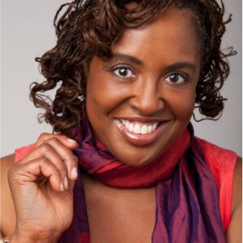
The following performance was
compiled from individual
vocal and instrumental
tracks recorded at a
“safe social distance.”
Warning: Don’t try doing this
face-to-face … YET!

Slide 2
There were bells! Opening bells!
But we never missed their ringing
No, we never missed it at all, Till there was Zoom!
There were songs! Opening songs!
But we never missed the singing!
No, we never missed it at all, Till there was Zoom!

Slide 3
And there were handshakes!
And wonderful fruit plates, fresh coffee
Kim’s smile at the podium, would fill the room;
There was love all around,
and the phones would stop their dinging
So we never saw it at all, Till there was Zoom.

Slide 4
And there was chicken!
And wonderful wait staff, more coffee
We high-fived Rotarians, the mics would boom,
There was love, all around,
which Kim just keeps on bringing
So we never missed it at all – Even with Zoom!!!

Slide 5
There were smells, Lunchroom smells!
But we never missed the sneezing,
No, we never missed it at all, Till there was Zoom.
There were smiles, new hairstyles,
Lots’a hugging and some teasing
But we never noticed at all, Till there was Zoom

Slide 6
Enter Kim Moore!
And Mariah and Caroline, and headphones!
They keep Rotary going, and lift – our gloom –
There is love all around,
Kim’s smile just keeps on growing!
And she never lost it at all, even with Zoom!!
*Words by Linda Rough

