Slide 1
Rotary #4 Sustainability Committee in association with: The Sustainability Trust www.TheSustainabilityTrust.org
Rotarians for Sustainability
and Carbon Reduction
The Sustainability Trust - The CO2 Offset Trust
Initially sponsored by 11 Founding Clubs from 5 continents
A charity registered in the UK
Notes:
Please do not take the contents of this talk as criticism. I have been coming to the US since a Rotary GSE team visit in 1977 and regard myself as an honorary American. I own property here and love the country. A UK talk would contain similar facts and statistics

Slide 2
Environment To Sustainability Committee Transition in 2013
A desire of committee members to attempt to more directly address the biggest environmental issue of today.
A desire to maintain the positive local impacts achieved by the Environment Committee in past years.
A desire to join international Rotary action through integration with a world Rotary Movement – Rotarians for Sustainability; The Sustainability Trust.

Slide 3
Sustainability Committee Our Goals
A desire of committee members to attempt to more directly address the biggest environmental issue of today.
A desire to maintain the positive local impacts achieved by the Environment Committee in past years.
A desire to join international Rotary action through integration with a world Rotary Movement – Rotarians for Sustainability; The Sustainability Trust.

Slide 4
The Sustainability Committee Goals
A Global Rotary Club Project Member that aims to tackle these issues.
The 4-Way Sustainability Test for all Rotarians: Are we.....
EDUCATING - ourselves, our Rotary colleagues and the public about how - and why - we should all conserve energy, and adopt sustainable solutions.
DEMONSTRATING - how we can all save money in the process.
INNOVATING - with ideas promoted by your Rotary Club to switch to sustainable resources in all Rotary projects, especially those with humanitarian benefits.
DONATING - via The Sustainability Trust - to a Rotary Club project that offsets your unavoidable personal carbon emissions.

Slide 5
The Sustainability Trust The CO2 Offset Trust
11 Founding Member Clubs on 5 continents
500 e.mail contacts and growing
Now launched “Sustaining Members” at US $100 annually.
Also launched Gold 50 Member status for US $1,000
A Growing Presence on Facebook
Has supported sustainable Rotary Club Projects in Guatemala, England, South Africa.
Is building a network of contacts around the globe to advise Clubs on sustainable projects
Booths at RI Conventions in Salt Lake City, Los Angeles, Montreal and Birmingham (UK)
$4,000 donation to facilitate ‘SCSA 2010’
All done by Rotary volunteers
Seattle Rotary #4 a Gold 50 Member

Slide 6
Sustainability Committee Local Action Plans
Inform all other committees of the Rotary Sustainability Message and ask them to seek input from The Sustainability Committee on how to make their projects sustainable.
Review lunch program to encourage low waste and local foods, some or our venues already do this.
Advice Rotary #4 Foundation on how best to include sustainability into their plans.
Take local steps such as participation of the club in Earth Day on April ???

Slide 7
Sustainability Trust Achievements in Two Years
11 Founding Member Clubs on 5 continents
500 e.mail contacts and growing
Now launched “Sustaining Members” at US $100 annually.
Also launched Gold 50 Member status for US $1,000
A Growing Presence on Facebook
Has supported sustainable Rotary Club Projects in Guatemala, England, South Africa.
Is building a network of contacts around the globe to advise Clubs on sustainable projects
Booths at RI Conventions in Salt Lake City, Los Angeles, Montreal and Birmingham (UK)
$4,000 donation to facilitate ‘SCSA 2010’
All done by Rotary volunteers

Slide 8
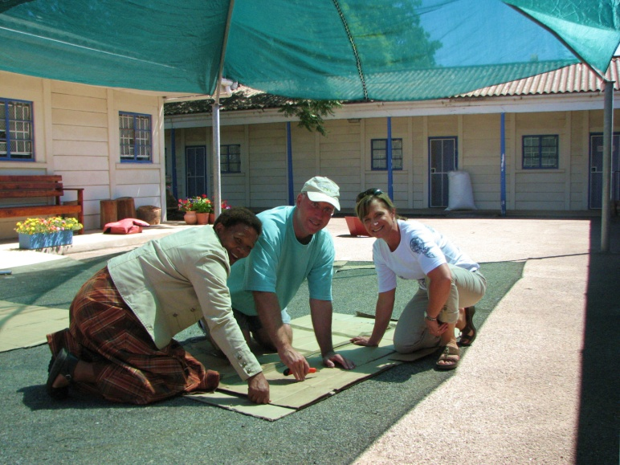
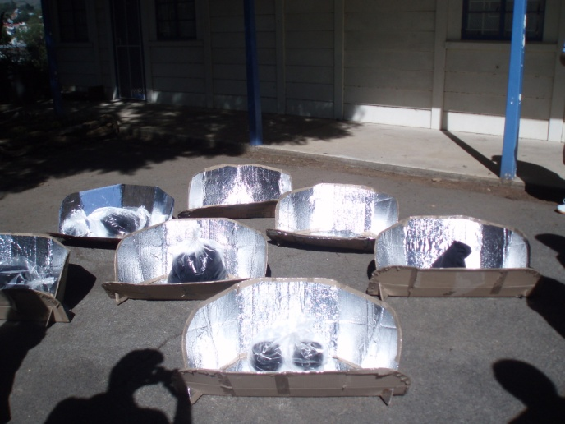
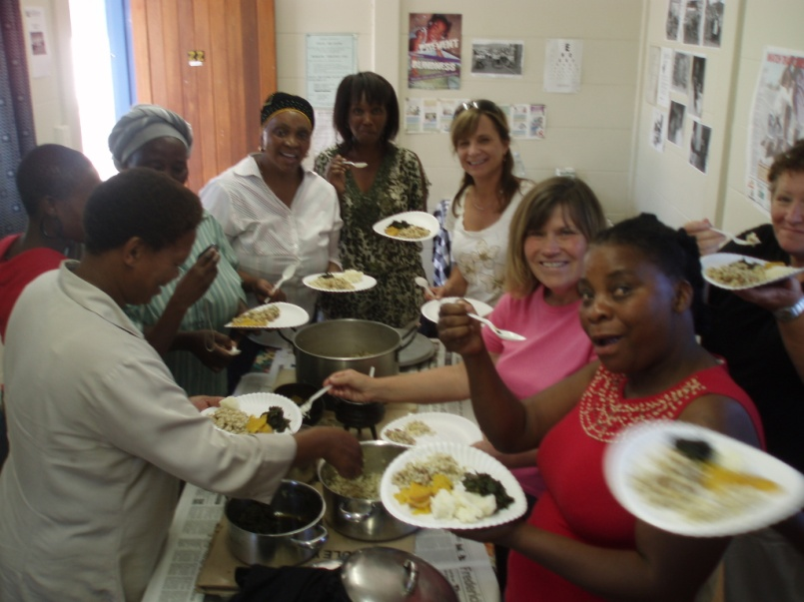
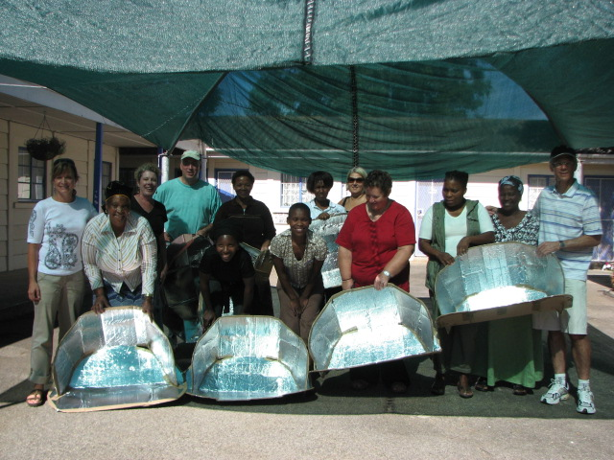
Solar Cooking South Africa 2010 Coordinated and funded through the Trust. Led by R.C. Fresno, California & R.C. Kirstenbosch, Cape Town, South Africa
Making the Solar Ovens
In Grahamstown, S.A.
Enjoying the Food..!

Slide 9
D.1220 Project - Sustainable Homes in D.3150, India
FROM THIS........
RIBI (UK + Ireland) District 1220 aims to build the homes.
The Sustainability Trust aims to make them sustainable homes

Slide 10
D.1270 Sheffield Club, UK, Project
Selling the Standby Saver to Rotarians at a discount. They save it’s cost in one year by cutting stand-by electricity......
.... and the Club donates $4 to the Trust for each one sold.
Combined TV, VCR, DVD, etc, powered off with one click
A different version does the same for computers, printers etc
A version will be available in the US and Canada in 2010

Slide 11
For those that believe Global Warming is accelerated by burning fossil fuels -
It makes sense to practice ‘Joined-up-Rotary’
A hotter planet means more weather extremes.
Leading to more floods, more hurricanes & drought...
Causing more human disasters in areas of existing poverty....
That requires more humanitarian aid...
Which needs more Rotary Club aid, like Shelter Boxes.
Sustainability becomes a sensible option...
We need to join up the dots in ‘Joined-up-Rotary’
By making all our activities Sustainable ones, so they don’t make global warming even worse!

Slide 12
In summary ......
The Sustainability Committee is now a member of the Sustainability Trust, a charitable foundation formed by concerned Rotarians
It aims to get all 32,000 Clubs aware of the challenges facing our planet, our communities and our lives.....
...and to make all Rotary projects Sustainable.
The Trust is a web-based forum to share projects, ideas, solutions, and information.
It raises funds to pay for the provision of services through Personal Carbon Offsetting and Sustaining Memberships

Slide 13
And finally......
Do we all know the 5th Test in
The Four-Way Test?
Is it Sustainable?

Slide 14
Visit the Website www.TheSustainabilityTrust.org

Slide 15
Rotary #4 Sustainability Committee in association with: The Sustainability Trust www.TheSustainabilityTrust.org
Rotarians for Sustainability
and Carbon Reduction
The Sustainability Trust - The CO2 Offset Trust
Initially sponsored by 11 Founding Clubs from 5 continents
A charity registered in the UK
Notes:
Please do not take the contents of this talk as criticism. I have been coming to the US since a Rotary GSE team visit in 1977 and regard myself as an honorary American. I own property here and love the country. A UK talk would contain similar facts and statistics

