Slide 1
Rotary Club of Ventura South
Community
Assessment
Summary
2021
1

Slide 2
Why conduct an assessment?
Grants.
Engagement.
Rotary brand.
Partnerships.
Membership.
2

Slide 3

Types of Community Assessments
Community Meeting
Asset Inventory
Survey
Interview
Focus Group
Community Mapping
“Survey” method is best suited to current conditions

Slide 4
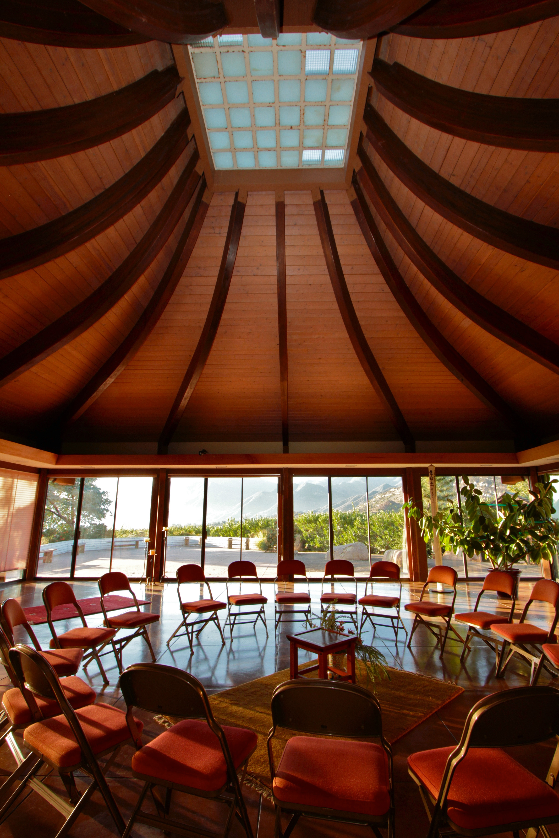
Assessment Approach
2019 State of the Region Report
29 Responses received from initial pool of over 700 nonprofits in City of Ventura
Follow up – Opportunities
Joint effort with Rotary Club of Ventura East

Slide 5
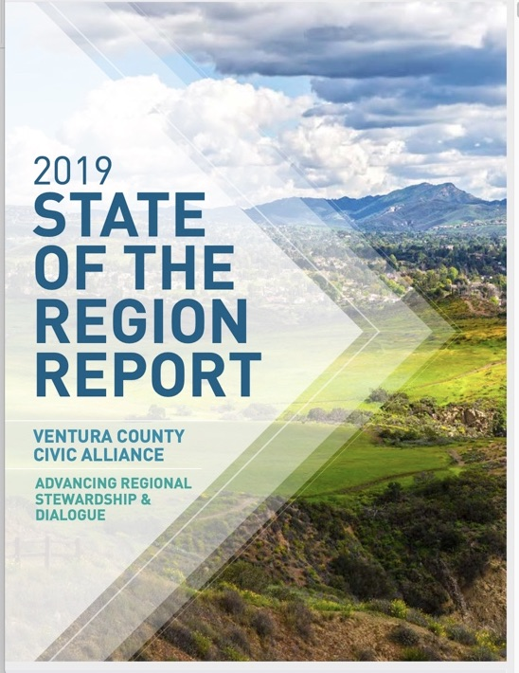
County and City Statistics
Every two years:
100 metrics
10 Domains of Interest
Areas of opportunity
Nonprofits
Public Library
English learners
Pre-school opportunities
Teen mental health
Homelessness

Slide 6
Ventura City Population
100,916 106,433 109,484
2000 2010 2019 Est.
8.1% Growth Since 2000

Slide 7
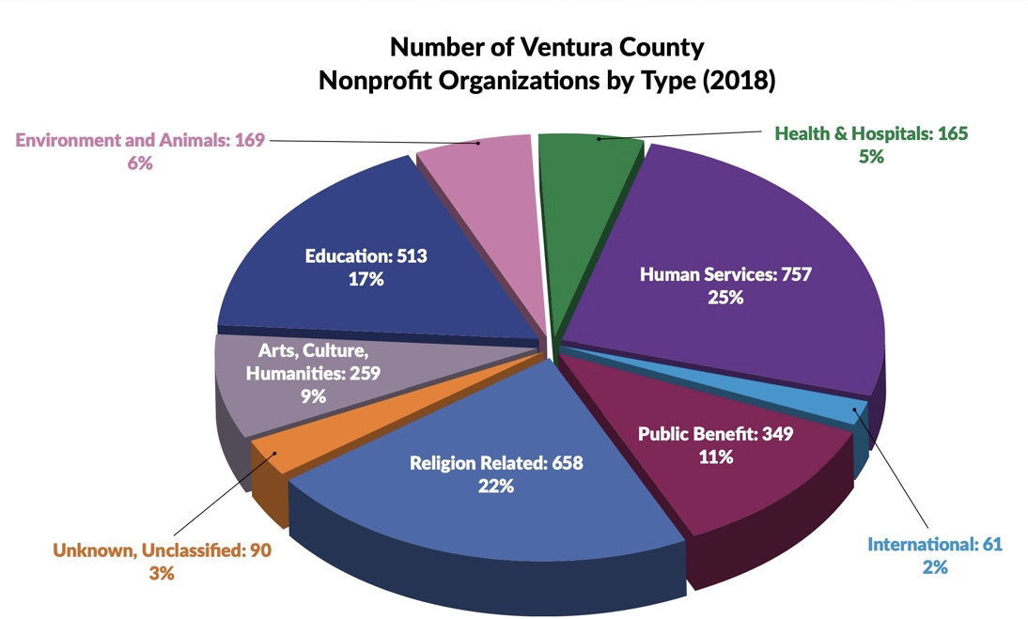
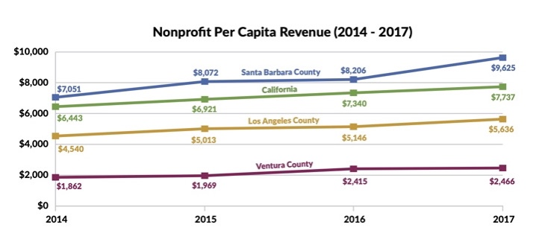
Number of Ventura County Nonprofit Organizations by Type (2018)
3021 Nonprofits
936 with revenue >$50,000
Largest in financial terms are hospitals.
Ventura County non profit
revenue per Capita
$2,246 vs $7,737
for California.
Nonprofits considered underdeveloped according to this measure.

Slide 8
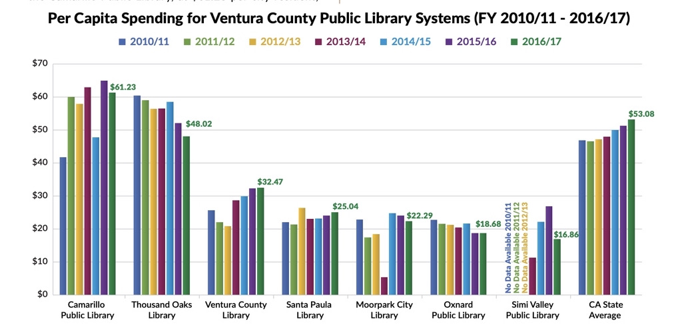
Ventura County Public Libraries a vital community resource
Ventura County $32.47, Camarillo $61.23, CA State Average $53.08 Per Capita

Slide 9
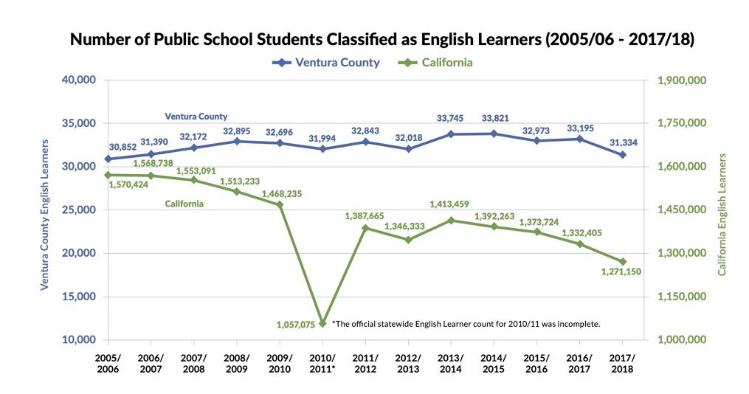
English Learners – 31,334 students
MORE THAN 1 IN 5 STUDENTS LACK FLUENCY

Slide 10
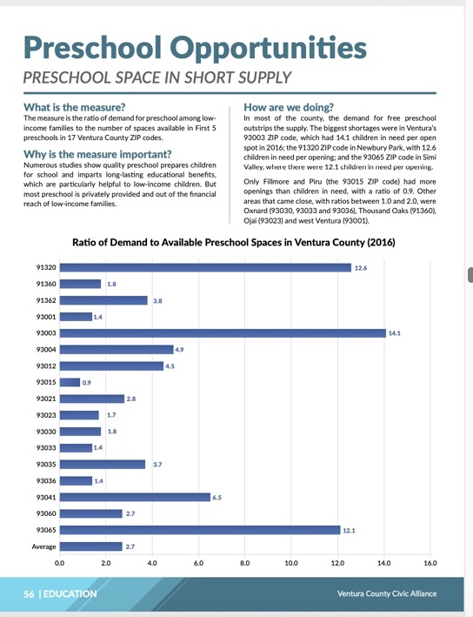
Graph depicts the 2016 demand for preschool per space available among low-income families.
Zip Code Demand/Opening
93003 Ventura 14.1
91320 Newbury Park 12.6
93065 Simi Valley 12.1
93001 Ventura 1.4
93015 Filmore/Piru 0.9
93033 Oxnard 1.4
Significant variance in preschool opportunities

Slide 11
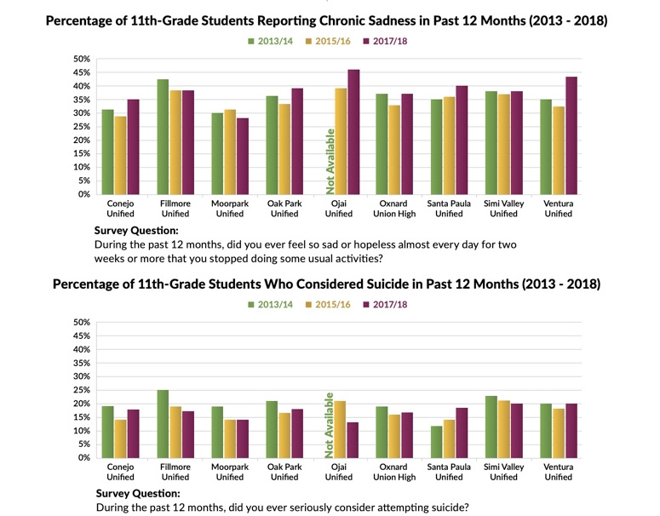
Teen Mental Health
43%
20%
National Average 16% - Rate has tripled since 1940’s

Slide 12
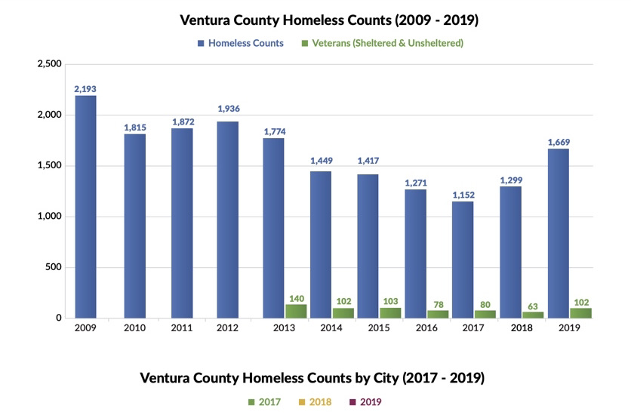
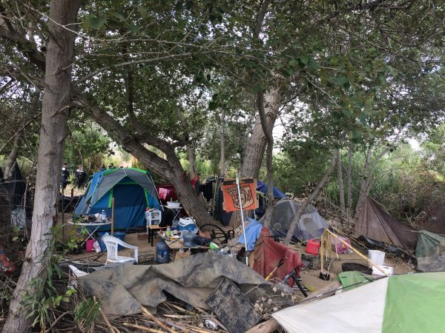
Ventura Homeless Population
County increase 44% 2017 to 2019
Ventura City increase 77%
  531 in 2020 vs 300 in 2017
Number living in shelters - 145
Number not in shelters - 386
Homeless children
  Ventura Unified - 725 in 2018
  Oxnard – 2519
  California - 265,671

Slide 13
Community Survey
Nonprofit Selections
700+ Nonprofits - IRS 990 reports - Ventura City zip codes.
240 selected
Input from Amber Stevens, Marilyn Scott and Dennis Longwill.
140 surveyed
29 responses received - 20% response rate

Slide 14
Rotary Clubs of Ventura South and East - Community Needs Assessment Survey
The Rotary Clubs of Ventura South and East are joining forces to issue Requests for Proposals to community groups for our Community Grants Program. We are surveying local groups to get a better sense of current needs in the community.
Please help us by proving answers to the following questions.
What is the primary function of your organization?
Please provide a statement of purpose.
What is your organization’s annual budget?
  $1+ million
  $500,000 to $1 million
  $100,000 to $500,000
  $50,000 to $100,000
  Under $50,000
Who do you serve? Who is your constituency?
What is the number of people you serve? If not people (Humane Society for example), how do
you measure the scale of your service?
Has your constituency been growing or shrinking
in recent years?
To what do you attribute these changes?
What is your No. 1 priority as an organization? Please be specific.
What needs do you currently have that are unmet?
How could the Rotary Club help fill those needs?
  Money for a specific program
  Volunteers with specific skills
  Partnership on programs
  Connect our organization with others with similar needs.
What are the projects that you have been involved in over the last three years?
  Who were the beneficiaries and how many were helped?
  What was the total cost of the project?
  How would you rate the effectiveness of the project on a scale of 1 to 10?
Do you have any programs that have proven successful in the past, but lack funds to revive them? Please describe them?
Do you have new projects you think would be successful? Please describe?
Used “Survey Monkey” to gather the feedback

Slide 15
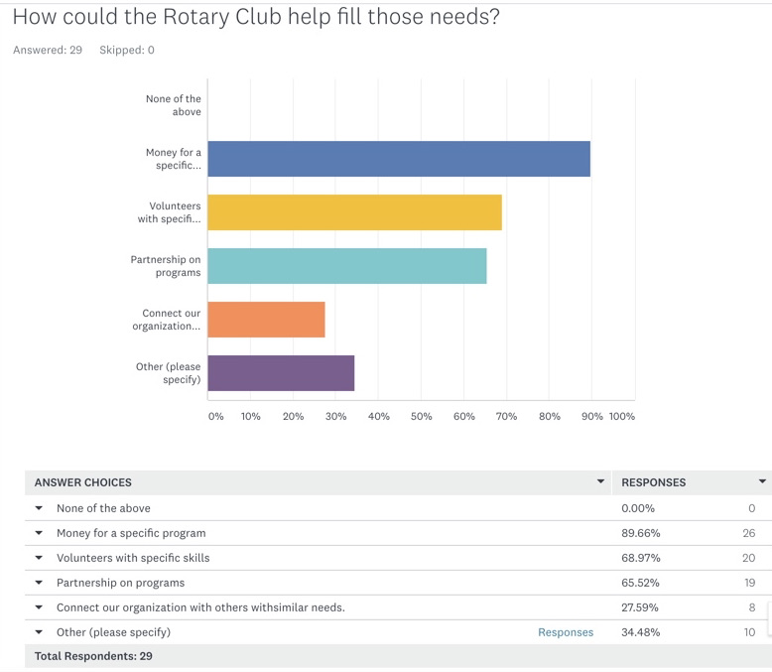

Slide 16
Projects that will be successful
Boys & Girls Club of Ventura
Human Services
Our Innovations Center that will be established at our club site on Olive Street and possibly another on Johnson Drive. This will not only allow for additional STEM programming, but true career exploration, job shadowing and mentorship.
Westside Community Council Environment and Animals
We certainly would like to provide 10 Chromebook computers with wifi hot spot & internet service to the Avenue library (like those in Ojai and at Hill Road) so community members could borrow them to attend community and city meetings. These would cost $5000. ($500 each) and $30/month for the library internet service. This is a small way to help bridge the digital divide.
The ARC of Ventura County Inc. Human Services
The National Alliance of Direct Support Professionals (NADSP) has developed a Learning Management System that is recognized nationally. The cost would be about $8000 per year (about $45 per DSP).

Slide 17
Schools on Wheels Inc. Education
We have a fairly new literacy program, and we need volunteers with literacy or academic background.
Projects that will be successful
Step Up Ventura
Human Services
A 2x's/wk. one-on-one literacy and basic math skills program for each disadvantaged preschool child at two preschool sites. Outdoor group activities program at two preschool sites 3x's/wk. for physical and social development of disadvantaged children.
Ventura College Foundation is in the early stages of developing a “free and open educational resources” program that can have a long-term, sustainable, and impactful solution to this ongoing problem.

Slide 18
Elmhurst elementary School Education
We would love to replace the playgrounds on campus. They're old and don't fully meet the requirements of the students with special needs. We were about to fund raise for it, but then everything was shut down for the pandemic.
Projects that will be successful
Vision Young Leaders Academy Inc. Human Services
Our most effective program has been our book club. We continue to keep it running, however it is difficult to provide books to each of our members as we have a difficult time raising money for that. However, having our youth immerse themselves is diverse books and hear stories of others has proven to be extremely successful in getting them to open up, trust, and try to better themselves.
Balboa Middle School Music Boosters
Arts, Culture and Humanities
Our fundraisers haven't made even close to the same amount as money as they have previously. New fundraisers that we have tried have also had low revenue. So our coaching is the main thing we are focusing on right now to help the kids in this difficult environment, but we are low on funds.

Slide 19
Follow up – Next Steps
Select from a number of possible opportunities for further consideration I.e.
Boys and Girls Club - Innovation Center
ARC - Learning Management System for Direct Support Professionals
Westside Community Council – Chromebook computers
Schools on Wheels - Literacy Program
Step Up Ventura - Program for disadvantaged preschool children
Ventura College - Text Books
Elmhurst elementary School - Playground equipment
Vision Young Leaders Academy Inc. – Books for their book club
Balboa Middle School Music Boosters – Funds for music programs
Identify potential for grants, hands on support activity, Rotary Meeting speakers and partnerships with other Rotary Clubs.
Are there any members interested in taking a
deeper look into one or more of these opportunities?

Slide 20
Appendix

Slide 21
NAME | STREET | Major Taxonomy Group | Principal Officer
BALBOA MIDDLE SCHOOL MUSIC BOOSTERS | 247 S HILL RD | Arts, Culture and Humanities | Amy Solomon
FOCUS ON THE MASTERS | 505 POLI ST STE 310 | Arts, Culture and Humanities | Donna Granata
PERFORMANCE THEATRE FOR YOUNG ARTISTS | 3451 FOOTHILL RD | Arts, Culture and Humanities | Performance Theatre for Young Artists
PIER INTO THE FUTURE | PO BOX 7553 | Arts, Culture and Humanities | Jenise Wagar
ELMHURST ELEMENTARY SCHOOL PARENTS STAFF AND FRIENDS ORGANIZATION | 5080 ELMHURST ST | Education | Jenna Kendzior
RIBBONS OF LIFE BREAST CANCER FOUNDATION | 1500 PALMA DR | Education | Sylvia Rosolek
SCHOOL ON WHEELS INC | PO BOX 23371 | Education | Joshua Fein
VENTURA COLLEGE FOUNDATION | 4667 TELEGRAPH RD | Education | Anne King
VENTURA UNIFIED EDUCATION ASSOCIATION INC | PO BOX 1416 | Education | Dan Nelson
CANINE ADOPTION AND RESCUE LEAGUE | PO BOX 5022 | Environment and Animals | Sharon L. Clark,
VENTURA BOTANICAL GARDENS INC | PO BOX 3127 | Environment and Animals | Joe Cahill, PhD.
WESTSIDE COMMUNITY COUNCIL | 35 W MAIN ST APT B 377 | Environment and Animals | James Forsythe
GENESIS ALUMNI ASSOCIATION INC | 1732 PALMA DR STE 208 | Health | Athena Naranjo
TURNING POINT FOUNDATION | PO BOX 24397 | Health | Jason Meeks
VENTURA COUNTY MEDICAL RESOURCE FOUNDATION | 199 FIGUEROA ST | Health | Patrick L. Miller
A HEART OF AN ANGEL | PO BOX 6643 | Human Services | Annette Mj Garcia
BOYS AND GIRLS CLUB OF VENTURA INC | 6020 NICOLLE ST STE D | Human Services | Patti Birmingham
CAREGIVERS VOLUNTEERS ASSISTING THE ELDERLY | 1765 GOODYEAR DRIVE | Human Services | Tammy Glenn
CITY CENTER TRANSITIONAL LIVING INC | 837 E THOMPSON BLVD | Human Services | James Duran
CIYMCA |  | Human Services | Amy Bailey
SOCIETY OF SAINT VINCENT DE PAUL COUNCIL OF LOS ANGELES | 211 E MAIN ST | Human Services | Fr. Tom Elewaut
STEP UP VENTURA INC | PO BOX 7565 | Human Services | Jan Zatorski, MPA
THE ARC OF VENTURA COUNTY INC | 5103 WALKER ST | Human Services | Patricia Schulz
VENTURA COUNTY FAMILY JUSTICE CENTER FOUNDATION INC | 3170 LOMA VISTA ROAD | Human Services | Michael Jump
VENTURA SOCIAL SERVICE TASK FORCE INC | 5364 QUEENS ST | Human Services | Judy Alexandre
VISION YOUNG LEADERS ACADEMY INC | 1746F S VICTORIA AVE 214 | Human Services | Heather Hatchman
DIVERSITY COLLECTIVE VENTURA COUNTY | 2471 PORTOLA RD STE 100 | Public, Societal Benefit | Tess Allen
VENTURA COUNTY LEADERSHIP ACADEMY INC | PO BOX 537 | Public, Societal Benefit | Robert Albertson
WESTSIDE COMMUNITY DEVELOPMENT CORPORATION | 110 N OLIVE ST STE J | Public, Societal Benefit | Jackie Micaela Pearce

Slide 22
Do you have any programs that have proven successful but lack funds?
Elmhurst Elementary School Parents Staff Education
I'm not too sure (I'm still new to the team) but things have been impacted by the pandemic.
3/8/2021 1:10 PM
Ventura College Foundation Education
Not Applicable
3/5/2021 5:31 PM
Ventura Unified Education Association Education
not really
3/4/2021 1:18 PM
Heart of an Angel Human Services
Kids Get Fit Classes are being held Mon-Wed-Thur. and Fri, all donation based. Some parents are not in a position to donate, but we never turn kids away. We cover all areas of fitness and have fun. We run, hike, set up agility drills and do group exercises, warm ups strength and breathing exercises. We also plant seeds of encouragement, love, kindness, determination as well the golden rule and gratitude
3/2/2021 2:48 PM
Ventura Botanical Gardens Environment & Animals
We aren't engaged in any programs right now due to Covid, but we will be providing educational programs once schools reopen.
3/1/2021 10:34 AM
Step Up Ventura Human Services
Child Development classes at an alternative high school for homeless or at risk for homelessness teen parents of children ages 0 - 5 years. The teen parents bring their children to class to get hands on instruction on how to support their children's healthy development.
2/26/2021 11:43 AM
Turning Point Health
River Haven is always in need of support because there are no government grants for transitional housing.
2/22/2021 1:45 PM

Slide 23
Do you have any programs that have proven successful but lack funds?
Performance Theater for Young Artists Arts, Culture and Humanities
Our Musical Theater Production Program has been very successful over the past 20 years, presenting 4 popular musicals per year, but due to less funding, these large scale musical productions had to be cut back to 3 per year, and a smaller program was added in its place.
2/19/2021 2:20 PM
Westside Community Council Environment and Animals
Pre-covid we translated our public meetings with the help of community volunteers. When covid shut us down we found translation services to be cost prohibitive. We are currently seeking funding for translation of our meetings as close to 50% of our community are not native speakers of English
2/18/2021 7:20 PM
Focus on the Masters Arts, Culture and Humanities
The Artist Spotlight Series. We need assistance adapting the artist's interviews to a online format.
2/18/2021 3:18 PM
Canine Adoption & Rescue League Environment and Animals
Specialized dog training - If we have or can raise the funds we can send dogs who need extra attention to specialized training.
2/18/2021 2:25 PM
Ribbons of Life Breast Cancer Foundation Education
No. We have adapted by providing our services via Zoom, other technology and drop off. Ribbons of Life has grown since opening our breast cancer resource center in 2007. We also have a Create 4 Life Studio that opened in 2019, which supports our arts program for thriver-survivors and supporters. Before COVID, professional volunteers were able to meet in-person with breast cancer survivor-thrivers and provide care bags and other needed items for women undergoing treatment. And thrivers and supporters could take educational workshops in the Create 4 Life Studio. Due to COVID this is no longer possible. We will need to consolidate our spaces if or when we dip into our emergency funds. We are learning how to adapt due to COVID. Our monthly breakfast programs as well as our successful Create 4 Life program is all being held via Zoom.
2/18/2021 1:28 PM
Boys and Girls Club of Ventura Human Services
Our music program.
2/18/2021 11:41 AM
Balboa Middle School Music Boosters Arts, Culture and Humanities
We are having difficulty raising funds since COVID started. Our fundraisers haven't made even close to the same amount as money as they have previously. New fundraisers that we have tried have also had low revenue. So our coaching is the main thing we are focusing on right now to help the kids in this difficult environment, but we are low on funds.
2/18/2021 9:32 AM

Slide 24
Do you have any programs that have proven successful but lack funds?
Channel Islands YMCA Human Services
Despite our Fundraising efforts we continue to subsidize most of our cause driven programs in some capacity through our operations.
2/18/2021 8:23 AM
Society of St. Vincent De Paul of Los Angeles Human Services
Sometimes we can’t help as much as we would like but we help them on a smaller scale.
2/17/2021 1:10 PM
City Center Transitional Living Inc. Human Services
Yes, we need about $2500 to put our parents in a year long training that promotes self-worth and self-esteem.
2/12/2021 5:57 AM
Westside Community Development Corp Public Societal Benefit
We initiated a great Avenue Ambassador pilot program that was covered for 3months by very limited CDBG funds. The "ambassador" was tasked to canvas 26 blocks along Ventura Avenue and do light clean-up work 2 days per week. Very well received by residents and businesses with positive results. Unfortunately when we asked if residents and businesses would like to contribute financially to sustain the program we were repeatedly told that it would be an economic hardship to commit to another monthly due.
2/11/2021 2:17 PM
Caregivers Volunteers Assisting the Elderly Human Services
volunteer recognition event used to be a BBQ hosted by one of the clubs.
2/11/2021 6:20 AM
Ventura County Leadership Academy Public Societal Benefit
na
2/10/2021 5:36 PM
Genesis Alumni Association Inc. Health
Genesis Alumni Association is very new and lacks funds for Art and music therapy programs as well family events.
2/10/2021 5:16 PM

Slide 25
Do you have any programs that have proven successful but lack funds?
The ARC of Ventura County Inc. Human Services
Use of a Learning Management System for DSPs. From 2006-2009, we subscribed to the College of Direct Support for professional development of our DSPs. The renewal amount increased significantly and we were unable to continue using the platform.
2/10/2021 5:13 PM
Ventura Social Service Task Force Human Services
Yes. Social and educational classroom enrichment program offering cooking & nutrition, music & movement, drama & story-telling and a learning garden
2/10/2021 2:20 PM
Pier into the future Arts, Culture and Humanities
Yes. Many of the Pier benches are in need of replacement. Due to winds and weather they take a beating and many need to be replaced. This requires funding. In addition we would like to continue the Pier flag program but need to secure funds to purchase new flags.
2/10/2021 2:04 PM
Diversity Collective Ventura County Public Societal Benefit
No. Each of the above programs are still striving to stay available.
2/10/2021 11:54 AM
Vision Young Leaders Academy Inc. Human Services
Our most effective program has been our book club. We continue to keep it running, however it is difficult to provide books to each of our members as we have a difficult time raising money for that. However, having our youth immerse themselves is diverse books and hear stories of others has proven to be extremely successful in getting them to open up, trust, and try to better themselves.
2/10/2021 11:24 AM
Ventura County Family Justice Foundation Human Services
CampHOPE (see previous descriptions)
2/10/2021 11:07 AM

Slide 26
Do you have any new projects that you think will be successful?
Elmhurst elementary School Education
We would love to replace the playgrounds on campus. They're old and don't fully meet the requirements of the students with special needs. We were about to fund raise for it, but then everything was shut down for the pandemic.
3/8/2021 1:10 PM
Ventura College Foundation Education
The Ventura College Foundation understands that the cost of textbooks is often the greatest cost encountered by a student at Ventura College. In fact, the cost of textbooks often surpasses the cost of tuition and the pace at which the cost of textbooks is rising is extremely problematic. According to the College Board, the average American student spends approximately $1,200 per year on textbooks. Further, a study conducted by the United States Bureau of Labor Statistics reports that textbook prices rose a staggering 1,041% between 1997 and 2015. As a result, many Ventura College students – particularly low-income and disadvantaged students – do not purchase textbooks and would have no access to textbooks if not for the Textbook Lending Library. A study conducted by the College Board in 2017 found that approximately 85% of community college students delay the purchase of textbooks and, of those 85%, 90% cite the high price of textbooks as the reason for this delay and 50% report that their grades were negatively impacted by the delay in the purchase of textbooks. While the foundation’s Textbook Lending Library has been instrumental in addressing this problem, the Ventura College Foundation is in the early stages of developing a “free and open educational resources” program that can have a long-term, sustainable, and impactful solution to this ongoing problem.
3/5/2021 5:31 Pam
Ventura Unified Education Association Education
we'd like to help figure out childcare for working parents
3/4/2021 1:18 PM
Heart of an Angel No Response
No Reponse
Ventura Botanical Gardens Environment and Animals
When schools open, educational programs.
3/1/2021 10:34 AM

Slide 27
Do you have any new projects that you think will be successful?
Step Up Ventura Human Services
A 2x's/wk. one-on-one literacy and basic math skills program for each disadvantaged preschool child at two preschool sites. Outdoor group activities program at two preschool sites 3x's/wk. for physical and social development of disadvantaged children.
2/26/2021 11:43 AM
Turning Point Foundation
We are in the process of developing more housing for people permanently disabled by their mental health, including seniors. Did you know that only 60% of psychiatrists accept Medicare?
2/22/2021 1:45 PM
Performance theater for young artists Arts, Culture and Humanities
We have several new projects in the works. A new original play has been written by PTYA and production is in the works for Spring of 2021. The play is called "The Cleopatra Emerald Caper" and was written so it could be successfully rehearsed and performed online. We are also planning a new in-person production for the fall/winter 2021 (depending on COVID status) of "The Little Mermaid". The Little Mermaid is a very popular musical show and has been very successful for PTYA in the past.
2/19/2021 2:20 PM
Westside Community Council Environment and Animals
We certainly would like to provide 10 Chromebook computers with wifi hot spot & internet service to the Avenue library (like those in Ojai and at Hill Road) so community members could borrow them to attend community and city meetings. These would cost $5000. ($500 each) and $30/month for the library internet service. This is a small way to help bridge the digital divide.
2/18/2021 7:20 PM
Focus on the Masters Arts, Culture and Humanities
We would love assistance in transcribing and editing our oral histories so that we can make them available to the public. Thank you so much for your interest in Focus on the Masters. Keep up the great work! Donna Granata Rotary International Alum GSE 2000 Sub-Sahara Africa District 5140
2/18/2021 3:18 PM
Canine Adoption & Rescue Environment and Animals
Kennel improvement projects that are in need of funds to implement or are close to getting enough funds raised to implement. Some being installing dog house heaters in the sleeping area of each kennel. Continue to install clear, weather-proof tarps along the kennels and on the roofs to keep warm air in and cool air out. Installing LED lights in all of the kennels, for the safety of the dogs and the kennel staff.
2/18/2021 2:25 PM
Ribbons of Life Breast Cancer Foundations Education
We have grown and continue to be successful. Because we are an all-volunteer non-profit, we need others within our community to find new ways to raise funds for us.
2/18/2021 1:28 PM

Slide 28
Do you have any new projects that you think will be successful?
Boys & Girls Club of Ventura Human Services
Our Innovations Center that will be established at our club site on Olive Street and possibly another on Johnson Drive. This will not only allow for additional STEM programming, but true career exploration, job shadowing and mentorship.
2/18/2021 11:41 AM
Balboa Middle School Music Boosters Arts, Culture and Humanities
The coaching isn't really new, but taking the after school lessons that used to be provided and translating it to an online format. Also increasing the amount of lessons since the kids aren't at school to get an instruction time.
2/18/2021 9:32 AM
Channel Islands YMCA Human Services
We would love to start a summer / school year gap learning program for youth to help them with tutoring and homework especially seeing the disparity with children now due to distance learning.
2/18/2021 8:23 AM
Society of St. Vincent De Paul Human Services
We are waiting until after the Pandemic is over and then we will bring ideas to the table to discuss with members.
2/17/2021 1:10 PM
City Center Transitional Living Inc. Human Services
Yes, the one just mentioned.
2/12/2021 5:57 AM
Westside Community Development Corp Public Societal Benefit
Yes, the Pop-up Makerspace workforce development program that we are embarking on has a lot of potential in addressing major needs in the community. Participants will be trained in a skill so that they are employable; they will be taught entrepreneurship skills and possibly come out with a business plan, and lastly they will be taught "life skills" all through a free 10 week training program.
2/11/2021 2:17 PM
Caregivers, Volunteers Assisting the Elderly Human Services
Yes, outlined above and more than eager to meet with you to discuss in greater detail.
2/11/2021 6:20 AM
Ventura County Leadership Academy Public Societal Benefit
Again, I need funds or I need volunteers to help with outreach. thank you!
2/10/2021 5:36 PM

Slide 29
Do you have any new projects that you think will be successful?
Genesis Alumni Association Inc. Health
We're soon to have a LGBTQ+ programs and Spanish program. Both will be successful and very much in need for this community!
2/10/2021 5:16 PM
The ARC of Ventura County Inc. Human Services
The National Alliance of Direct Support Professionals (NADSP) has developed a Learning Management System that is recognized nationally. The cost would be about $8000 per year (about $45 per DSP).
2/10/2021 5:13 PM
Ventura Social Service Task Force Inc. Human Services
Matching volunteers with individual children needing one-on-one instruction time for literacy and math skills development; physical education enrichment program for preschool children during outdoor time
2/10/2021 2:20 PM
Pier Into the Future Arts, Culture and Humanities
We would love to be able to partner with the Downtown Ventura Organization to expand the ambassador program to include the Pier. Currently the staff are not funded to walk on the Pier. WE have met with them, but we do not have the funds to pay the staff to include the Pier. If we had this program it would ensure the Pier was safer and cleaner. The staff could clean up graffiti quickly, remind people not to smoke on Pier, clean up trash on the Pier, etc.
2/10/2021 2:04 PM
Diversity Collective Ventura County Public Societal Benefit
YES! Our LEAD program (Leadership, Empowerment and Development is currently being created and we are currently soliciting for grant funding. This is a 4-step program for youth paired with a mentor and working together on a project to benefit the community.
2/10/2021 11:54 AM
Vision Young Leaders Academy Inc. Human Services
We are working on a summer reading challenge, which we think will be successful. It will be open to anyone wanting to participate regardless of if you are a current member of our organization.
2/10/2021 11:24 AM
Schools on Wheels Inc. Education
We have a fairly new literacy program, and we need volunteers with literacy or academic background.
2/10/2021 11:19 AM
Ventura county Family Justice Foundation Human Services
Pathways is a new concept in which we build upon CampHOPE and create monthly year-long STEM based activities for the CampHOPE kids to keep them connected to positive peer pressure, their camp counselors and ultimately a "college bound" program that would be focused on getting kids excited and hopeful about attending college.
2/10/2021 11:07 AM

Slide 30
Categories of the 29 Organizations that Responded
Arts, Culture and Humanities
4
Education
5
Environment and Animals
3
Health
3
Human Services
11
Public, Society Benefit – and Other
3
Areas that were not covered by survey responses
International , Foreign Affairs
Religion Related
Mutual/
Membership Benefit

Slide 31
Of the 29 Nonprofits, 22 of them work in Rotary International’s Areas of Focus
Taxonomy Category
Rotary International Areas of Focus
Human Services
11
Promoting Peace
Providing clean water sanitation, and hygiene
Education
5
Supporting Education
Public, Society Benefit – and Other
3
Saving Mothers and Children
Fighting Disease
Health
3
Growing Local Economies
Environment and Animals
3
We should be able to identify viable
grant opportunities.
Arts, Culture and Humanities
4

Slide 32
Suggested criteria for selection of nonprofit grant candidates: Rotary International Areas of Focus
Promoting Peace
Fighting Disease
Providing clean water, sanitation, and hygiene
Saving Mothers and Children
Supporting Education
Growing Local Economies
Dante Honorico
5

Slide 33
Suggested Ventura City Assessment Process
City Demographics: Quantify teen births, premature deaths, homeless population, general population and growth, age grouping, etc.
Select from 725 Ventura non-profits with Rotary Club member input for survey. (Relationships, Rotary Int’l Areas of Focus)
Refine questionnaire and distribute
Gather survey responses.
Follow up non-profits of interest.
Joint effort with Rotary Club of Ventura East
6

Slide 34
Rotary Club of Ojai - Community needs assessment survey
Each year, the Rotary Club of Ojai issues Requests for Proposals to community groups for our annual Community Grants Program. We are surveying local groups to get a better sense of actual needs in the community. Please help us by filling out this survey form.
1.What is your organization’s annual budget?
a. $1 million and over
b. $1 million to $500,000
c. $500,000 to $100,000
d. $100,000 to $50,000
e. Under $50,000
2.Who do you serve? Who is your constituency?
3.What is the number of people you serve? If not people (Humane Society for example), how do you measure your services?
4. Has your constituency been growing or shrinking in recent years?
5.To what to do attribute these changes?
6. What is your No. 1 priority as an organization? Please be specific.
7.What needs do you currently have that are unmet?
8. How could the Rotary Club help fill those needs?
a. Money for a specific program.
b. Volunteers with specific skills
c. Partnership on programs
d. Connect your organization with others with similar needs.
9. Do you have any programs that have proven successful in the past, but lack funds to revive? Please describe.
10. Do you have new projects you think would be successful? Please describe.
4

Slide 35
Ventura Chamber of Commerce
Guidestar.org – Wayne Harris
Candid
Funding Information Network (FIN)
IRS file of annual 990 reports for Ventura
Ventura County Community Foundation – “Vanessa”
Newport Beach Sunrise Rotary Club – Ross Minion
Cal Lutheran Center for Non-profit Leadership – Dena Jensen
Ventura College Foundation – Julie Harvey
Turning Point – Suki Sir
Community Assessment Information Sources
Final nonprofit list to be determined with RC input

Slide 36
Population
Percent
Population
Percent to total

Slide 37
Assessment partner…
RC of Ventura East
Club President - Margarida Eidson, Email: margarida@live.com Cell: 805-216-7277
CS Chair - Amber Stevens, Email: amber.stevens@ciymca.org Biz: 805-642-2131 ext 17
Amber has offered to partiipate

Slide 38
Ventura Chamber of Commerce
Directory of non-profits
  Family, Community & Civic Organizations
  Provides listing of 104 Non-Profits that are registered in the city
  List on next page
Additional source of non-profit information is Guidestar
Directory of non-profits
  Total listing of 725 non-profits
  Listing not included in this report
Final contact list will require screening.

Slide 39
TIPS FOR DESIGNING A GOOD SURVEY
􏰁 Explain why you’re asking the questions.
􏰁 Keep it short and simple.
􏰁 Make sure your questions are unbiased.
􏰁 Conduct a small pilot of the survey.
Request RC member input for design of final survey questions.

Slide 40
TIPS FOR DESIGNING A GOOD SURVEY – from District’s 24 page document outlining assessment tools and suggestions.
􏰁 Explain why you’re asking the questions. Participants are more likely to respond if they feel there will be a valuable outcome, such as the possibility of a future project.
􏰁 Keep it short and simple. If your survey is too long, respondents may rush their responses or even drop out of the survey before completing it. Make sure your questions are brief and specific.
􏰁 Make sure your questions are unbiased. Avoid leading questions such as “Would you like to see a new library in the vacant lot instead of a playground?” in favor of more neutral wording:
“What would you like to see developed in the vacant lot? a) library b) playground c) other (please describe).”
􏰁 Conduct a small pilot of the survey. Testing your survey can reveal whether your questions are clear and specific.

Slide 41
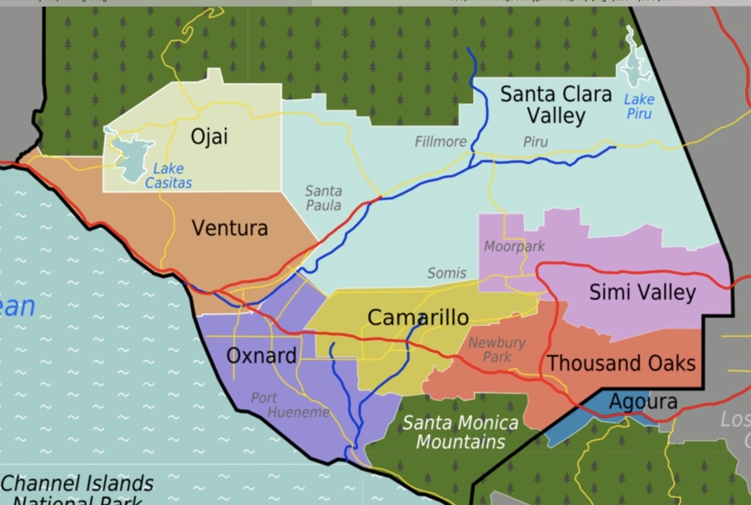

Slide 42
Ventura City non-profits
Girl Scouts of California's Central Coast
Global Society for Female Entrepreneurs
Goleta Valley Chamber of Commerce
Goodwill Industries of Ventura and Santa Barbara Counties
Greater Conejo Valley Chamber of Commerce
Herman Bennett Foundation
Hospital Association of Southern California
Housing Trust Fund VC
Humane Society of Ventura County
IBEW Local Union No. 952
Interface Children & Family Services
Kids & Families Together
Kiwanis Club of Ventura
MERITO Foundation
Mission FISH
Moorpark Chamber of Commerce
Namba Performing Arts Space, Inc.
National Multiple Sclerosis Society
Ojai Film Festival
Ojai Valley Chamber of Commerce
Oxnard Chamber of Commerce
PathPoint
Peoples' Self-Help Housing Corporation
Port Hueneme Chamber of Commerce
Project Bicycle Love
Rancho Ventura Conservation Trust
Reality Improv Connection Inc. DBA BRITE
Reins of H.O.P.E.
Rotary Club of Ventura
Rotary Club of Ventura East
Santa Paula Chamber of Commerce
SCORE
SEEAG
Tri County GLAD
Simi Valley Chamber of Commerce
SPARC Second Chance Store
A Voice Discovered
Alzheimer's Association
American Cancer Society, Central & Greater Ventura
American Red Cross - Central California Region
Autism Society Ventura County
Big Brothers/Big Sisters of Ventura County
Bike Ventura
Boys & Girls Club of Greater Ventura
CA Coastal Horse Rescue
Cabrillo Economic Development Corporation
Cal Vet Veterans Home of Ventura
California Chamber of Commerce
Camarillo Chamber of Commerce
Camarillo Wings Association
Carpinteria Valley Chamber of Commerce
CASA of Ventura County
Casa Pacifica for Children & Families
Chambers of Commerce Alliance
Child Development Resources of Ventura County, Inc.
CLEAN International
Clean Power Alliance of Southern California
Coastal Energy Alliance
Commemorative Air Force Southern California Wing
Diversity Collective
Downtown Ventura Partners
Easter Seals So Cal
Economic Development Collaborative
Epic Leadership Center
Fillmore Chamber of Commerce
First 5 Ventura County
Food Forward
FOOD Share - Ventura County's Food Bank
Step Up Ventura
The Arc Foundation of Ventura County
The Arc of Ventura County
The City Center Transitional Living
The Ojai Tennis Club
Tri-County Teen Challenge
Turning Point Foundation
United Way of Ventura County
Ventura Botanical Gardens, Inc.
Ventura Chamber of Commerce
Ventura Chamber Toastmasters
Ventura College Foundation
Ventura Commerce and Education Foundation
Ventura Community Partners Foundation
Ventura Counseling & Wellness Center
Ventura County Ballet
Ventura County Coalition of Labor, Agriculture, and Business
Ventura County Family Justice Center Foundation
Ventura County Professional Women's Network
Ventura County Rescue Mission
Ventura County Surfrider Foundation
Ventura County Transportation Commission
Ventura Downtown Lions Club
Ventura Education Partnership
Ventura Elks Lodge #1430
Ventura Family YMCA
Ventura Friends of the Library
Ventura Land Trust
Ventura Music Festival
Ventura Police Activities League Inc.
Ventura Police Community Foundation
Ventura Visitors Center & Convention Bureau
Vitalant
Women's Economic Ventures

Slide 43
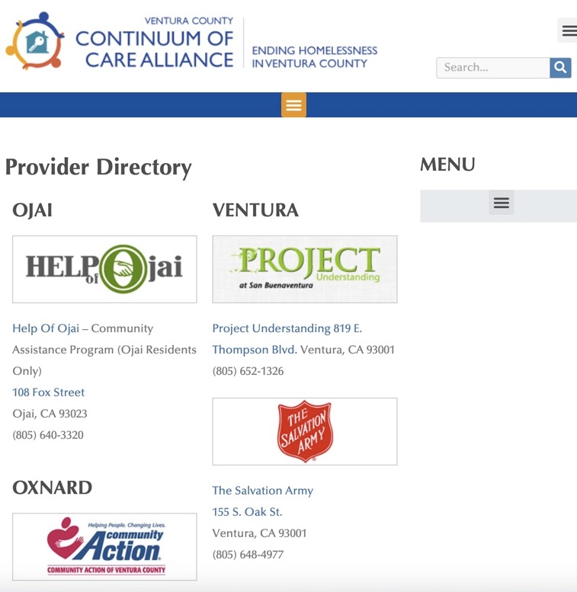
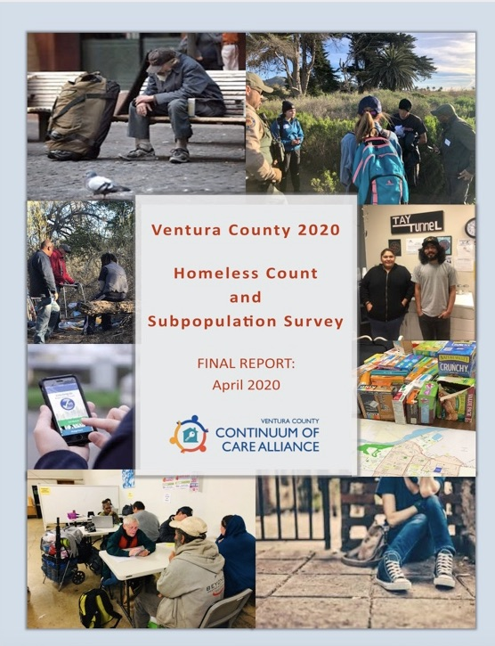
City Demographics
Identify the critical areas of need that align with Rotary Club objectives:
I.e. Education, Saving Mothers and Children

Slide 44
Ventura Chamber of Commerce
Guidestar.org -
Candid
Funding Information Network (FIN)
IRS file of annual 990 reports for Ventura zip codes
Ventura County Community Foundation
Newport Beach Sunrise Rotary Club
Cal Lutheran Center for Non-profit Leadership
Ventura College Foundation
The Survey - 700+ Nonprofits in Ventura City
Sources of nonprofit information
Final nonprofit target determined with club member input

Slide 45
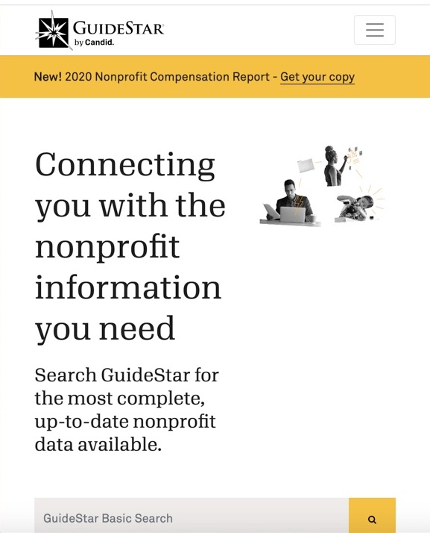
Nonprofit Information Sources
Newport Beach Sunrise Rotary Club – Ross Minion – FIN member
Ventura Chamber of Commerce listing of non-profits
Ventura County Community Foundation
Vccf.org/programs/nonprofit_leadership
Funding Information Network Member (FIN) - “Vanessa” Nonprofit contact info.
Cal Lutheran Center for Non-profit Leadership” - Dena Jensen
IRS-Exempt Organizations Business Master File Extract:
https://www.irs.gov/charities-non-profits/exempt organizations-business-master-file-extract-eo-bmf
Ventura College Foundation – Julie Harvey
Objective: Identify 150 to 200 nonprofits for survey.

Slide 46
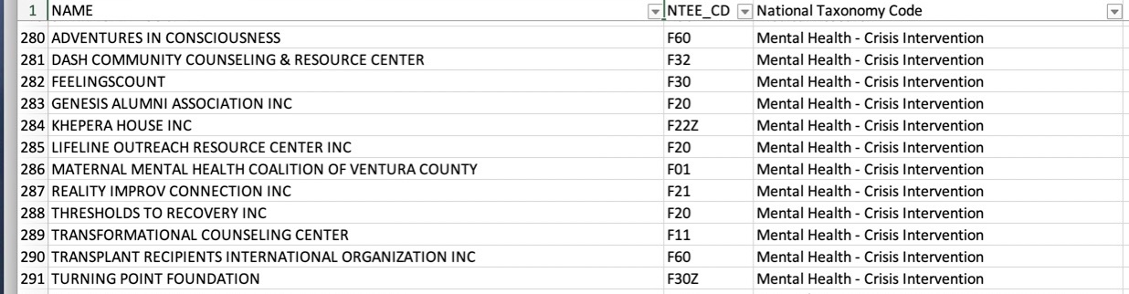
Nonprofit List Refinement
Identify nonprofits that have Rotary Club member relationships
Align with RI Areas of Focus - Grants
Identify Ventura City areas of most critical need
Support may include financial and hands-on support
Goal: Reduce survey targets from 700 to 150 to 200 for questionnaire
What organizations mean the most to Rotary Club of Ventura South members?

Slide 47
Ojai performs a community survey each year.
HELP of Ojai https://helpofojai.org/
Budget: $1 million plus.
Constituency includes anyone in the Ojai Valley who meets various qualifications for HELP’s nine programs. Primarily seniors, low-income families and homeless individuals.
Served 2,500 unduplicated clients, 10,000 total.
As people continue to age, demand for services and programs has grown. Ojai has the oldest average age for Ventura County, and that gap is continuing to grow.
Priority is to meet unmet needs in the areas of food, safe housing and access to medical care. Particularly, to provide health and well-being services for isolated and abandoned seniors.
Needs: Volunteers and partnerships with programs.
One project HELP would like to revive is home rehabilitation and home-sharing programs.
New programs: HELP is beginning a program of case management and monitoring for isolated and abandoned senior citizens. They could use volunteers for monitoring, and skilled volunteers to help with home repairs.
Sample

Slide 48
What can we do today 10/19?
  Volunteer to help select a subset of 700+ non-profits for survey.
    Suggest 150 to 200 for survey (Ojai surveyed approx. 65 non-profits with a 35% return rate)
    Anticipate 60 to 70 responses.
  Screen the State of the Region and Point in Time Reports to identify the needs that most closely align with Rotary Club areas of focus.
  Engage Rotaract in project survey and follow-up.
Tony Suleiman and Dennis Longwill have offered to assist.
Amber Stevens from Rotary Club of Ventura East is also participating
Please let me know if you would like to participate in the assessment.
7

