Slide 1
People of Action
Rotary is where neighbors, friends, and problem-solvers share ideas, join leaders, and take action to create lasting change
Notes:
Presented by: Kathy Timm
Welcome message

Slide 2
New Member Orientation
Notes:
Presented by: Kathy Timm

Slide 3
Today’s Objectives
1
2
Learn where to find Rotary resources
3
Connect with board and other members
Familiarize yourself with the basics of Rotary
Notes:
Presented by: Kim Erickson

Slide 4
Rules of the Road

Slide 5
Introductions
1
2
Classification/Employer
3
Sponsor
Name
4
Something new in your life this year
Notes:
Presented by: Kim Erickson
Brief exercise to get to know everyone better. 15 – 20 seconds each.

Slide 6
ROTARY BASICS
There are 1.2 million Rotarians in 35,000 clubs doing good all over the world.
This network of clubs makes up Rotary International.
Notes:
Presented by: Kim Erickson

Slide 7
Rotary’s Structure
Rotary International
District 5010
Susitna Rotary Club
Notes:
Presented by: Kim Erickson

Slide 8
Mission
The mission of Rotary International is to
support its member clubs in fulfilling the Object of Rotary by:
Fostering unity among member clubs;
Strengthening and expanding Rotary around the world;
Communicating worldwide the work of Rotary; and
Providing a system of international administration.
Notes:
Presented by: Kim Erickson

Slide 9
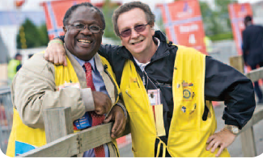
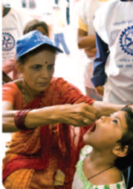
Guiding Principals
Founded in 1905, for more than 110 years, Rotary’s guiding principles have been the foundation upon which our values and tradition stand.
The Four-Way Test, Object of Rotary, and the Avenues of Service express our commitment to service, fellowship, diversity, integrity, and leadership.
Notes:
Presented by: Kim Erickson

Slide 10
Notes:
Presented by: Kim Erickson
From the earliest days of the organization, Rotarians were concerned with promoting high ethical standards in their professional lives. One of the world's most widely printed and quoted statements of business ethics is The Four-Way Test, which was created in 1932 by Rotarian Herbert J. Taylor when he was asked to take charge of a company that was facing bankruptcy.
Adopted by Rotary in 1943, The Four-Way Test has been translated into more than a hundred languages and published in thousands of ways. It

Slide 11
Object of Rotary
The Object of Rotary is to encourage and foster the ideal of service as a basis of worthy enterprise and, in particular, to encourage and foster:
FIRST. The development of acquaintance as an opportunity for service;
SECOND. High ethical standards in business and professions, the recognition of the worthiness of all useful occupations, and the dignifying of each Rotarian's occupation as an opportunity to serve society;
THIRD. The application of the ideal of service in each Rotarian's personal, business, and community life;
FOURTH. The advancement of international understanding, goodwill, and peace through a world fellowship of business and professional persons united in the ideal of service.
Notes:
Presented by: Kim Erickson

Slide 12
Five Avenues of Service
Club Service
Community Service
International Service
New Generations
Vocational Service
Notes:
Presented by: Kim Erickson
Based on the Object of Rotary, the Five Avenues of Service are Rotary's philosophical cornerstone and the foundation on which club activity is based:
We channel our commitment to service at home and abroad through five Avenues of Service, which are the foundation of club activity.
Club Service focuses on making clubs strong. A thriving club is anchored by strong relationships and an active membership development plan.
Vocational Service calls on every Rotarian to work with integrity and contribute their expertise to the problems and needs of society. Learn more in An Introduction to Vocational Service and the Code of Conduct.
Community Service encourages every Rotarian to find ways to improve the quality of life for people in their communities and to serve the public interest. Learn more in Communities in Action: A Guide to Effective Projects and this Community Service presentation (PPT).
International Service exemplifies our global reach in promoting peace and understanding. We support this service avenue by sponsoring or volunteering on international projects, seeking partners abroad, and more.
Youth Service recognizes the importance of empowering youth and young professionals through leadership development programs such as Rotaract, Interact, Rotary Youth Leadership Awards, and Rotary Youth Exchange.

Slide 13
Rotary’s Mottos
“They profit most who serve best.”
“Service Above Self”
Notes:
Presented by: Kim Erickson

Slide 14
Areas of Focus
Notes:
Presented by: Kim Erickson
Peace & Conflict Prevention/Resolution
Disease Prevention & Treatment
Water & Sanitation
Maternal & Child Health
Basic Education & Literacy
Economic & Community Development

Slide 15
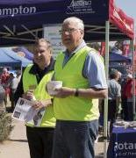
Rotary International Board of Directors
Board is made up of Rotarians from all over the world.
Ian H.S. Riseley
2017-2018 RI President
Rotary Club of
Sandringham, Victoria
Australia
Notes:
Presented by: Kim Erickson

Slide 16
Rotary’s Themes through the Years
Notes:
Presented by: Kim Erickson
Hand out list of themes from previous years.

Slide 17
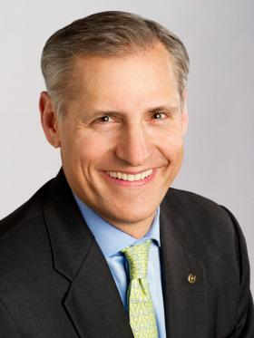
Rotary International General Secretary
Manages a staff of 800 eight offices around the world.
John Heweko
Rotary Club of
Kyiv, Ukraine
Notes:
Presented by: Kim Erickson

Slide 18
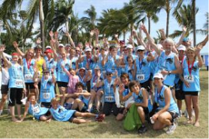
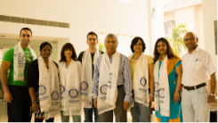
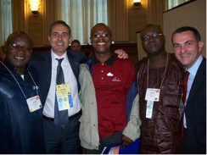
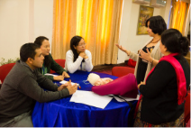
Rotary International Programs
Interact
Rotary Action Groups
Rotary Fellowships
Rotary Friendship Exchanges
Rotaract
Youth Exchange
Rotary Volunteers
RYLA
Notes:
Presented by: Kim Erickson

Slide 19
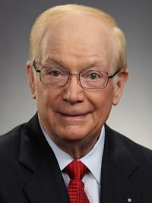
The Rotary Foundation
Foundation Trustees
Paul A. Netzel
2017-2018 Trustee Chair
Rotary Club of
Los Angeles, InUSA
Notes:
Presented by: Kim Erickson

Slide 20
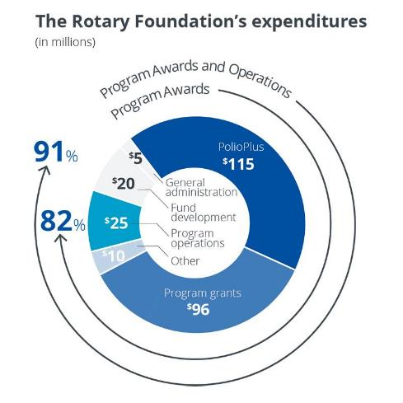
The Rotary Foundation
Public Charity operated exclusively for charitable purposes governed by a Board of Trustees
Notes:
Presented by: Kim Erickson
Brief discussion that this is the 501(c)(3) foundation for Rotary.
Separate entity from Rotary International.
Donations to The Rotary Foundation are tax deductible.
Donated funds are invested by TRF then 50% go back to the district three years later for club/district projects.
Remaining 50% is used to fund service project grants and other Rotary programs (scholarships, PolioPlus, Peace Centers, etc.)

Slide 21
Rotary Foundation named
World's Outstanding Foundation for 2016
by the Association of Fundraising Professionals
Notes:
Presented by: Kim Erickson

Slide 22
The Rotary Foundation (TRF)
Funds projects by Rotarians and partners in communities around the world.
Bill & Melinda Gates Foundation
Centers for Disease Control and Prevention
Global FoodBanking Network
ShelterBox
UNESCO-IHE
UNICEF
United Nations
World Health Organization
TRF Ambassadorial Scholarships
World’s largest, privately funded scholarship program.
Notes:
Presented by: Kim Erickson

Slide 23
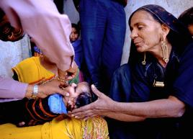
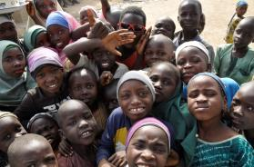
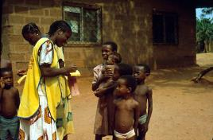
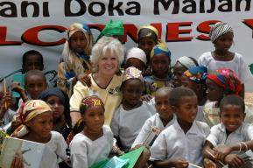
Notes:
Presented by: Rob Grogan
In our club, we raise money for End Polio Now through a Iditarod Restart Party the first Sunday in March at Tryg and Kim Erickson’s home.
Click on images for: Rotary International End Polio Now PSA 1:59 sec

Slide 24
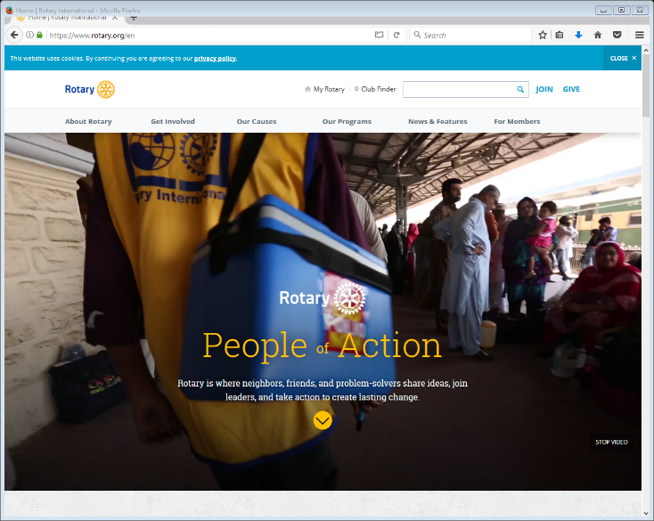
www.Rotary.org
Notes:
Presented by: Chuck Foster
Discuss resources from Rotary International.
Click image to go to RI website.
Next slide to introduce My Rotary.

Slide 25
My Rotary
Use your email and Rotary International password
Notes:
Presented by: Chuck Foster
Explain My Rotary

Slide 26
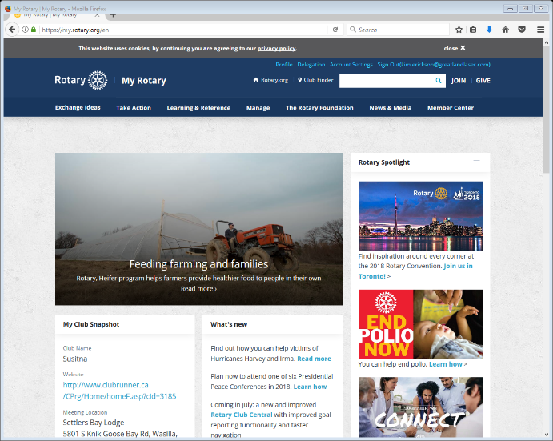
My Club Snapshot
Notes:
Presented by: Chuck Foster
Explain Club Snapshot

Slide 27
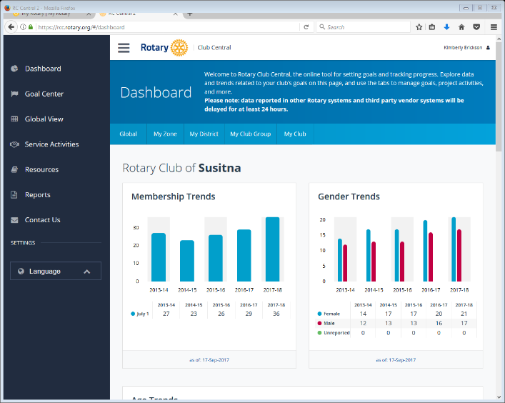
Rotary Club Central
Notes:
Presented by: Chuck Foster
Explain Rotary Club Central

Slide 28
District Resources
1
2
District committees
3
Financial & Admin information
4
District Newsletters
5
6
Rotary Youth Exchange
RYLA Forms & Info
7
Seminars
District Conference Link
Notes:
Presented by: Marty Metiva
Briefly discuss the resources available from District 5010.
Ask members in audience to raise their hand if they have served on a district committee.

Slide 29
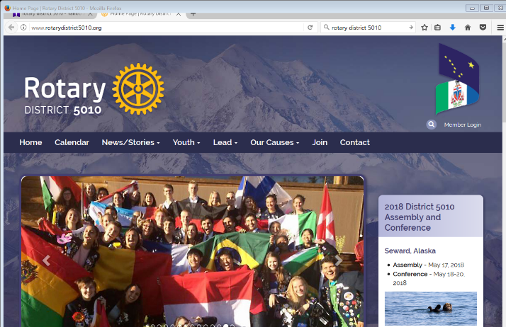
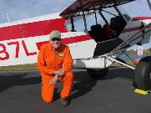
www.RotaryDistrict5010.org
Use your ClubRunner username and
password
Harry Kieling
2017-2018
District 5010 Governor
Rotary Club of Anchorage
Notes:
Presented by: Marty Metiva
Click image to open district website.
Point out resources on home page
Plug to register for district conference
Log into site then go to next page.

Slide 30
Rotary District 5010 Member Area
Notes:
Presented by: Marty Metiva
Point out how to do a member search to find contact information on a member of another club in the district.

Slide 31
Rotary Club of Susitna
Notes:
Kim will introduce a 10 minute break before the 2nd half of the presentation, which is focused on our club and activities.

Slide 32
Board of Directors
Club President
President Elect Jack Timm
Foundation Rob Grogan
Membership Kathy Timm and Lanissa Grogan
Service Projects Marty Metiva and Claire Horton
Secretary Cathy Kochendorfer
Treasurer Evelyna Kuhr
Immediate Past President Chuck Foster
Public Relations Rylee Rudd
Sgt. at Arms Kelly Kochendorfer
Youth Lana Kosek
Cheryl Metiva
2017-2018 Club President
Rotary Club of Susitna
Notes:
Presented by: Cheryl Metiva
Club Officers (president, president-elect, secretary and treasurer) are elected by members each December.
Remainder of board is appointed by club president.
Procedure is outlined in Club Bylaws.

Slide 33
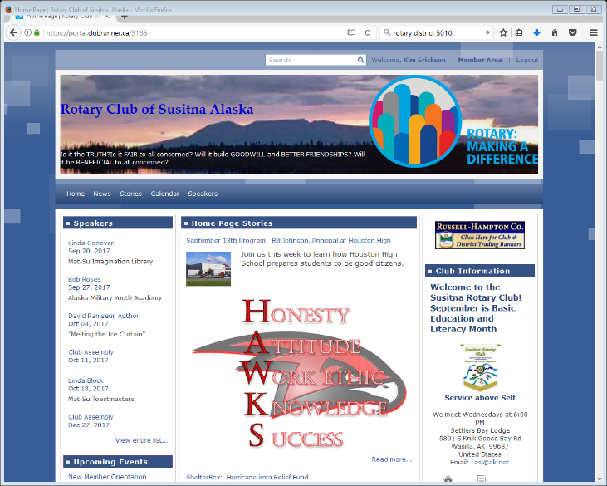
Susitna Rotary Club Runner
Notes:
Presented by: Cathy Kochendorfer
Highlight that the website is the best source to see upcoming speakers, events, download files, etc.
Click on image to go into the club website.

Slide 34
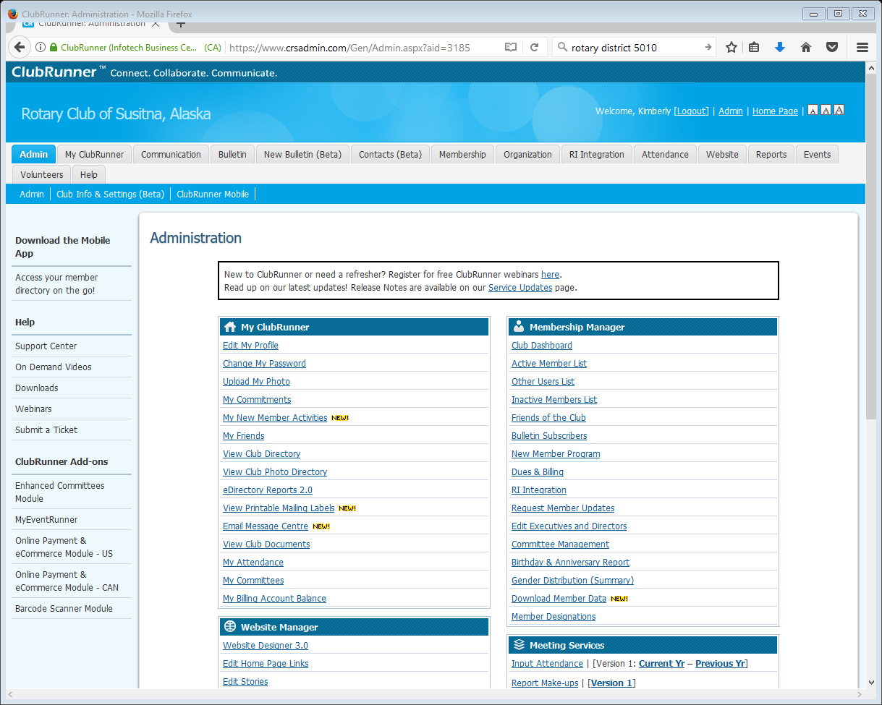
Member Area
Use your ClubRunner username and
password
Notes:
Presented by: Cathy Kochendorfer
Briefly discuss resources available in member area of website.

Slide 35
Attendance & Make-Ups
Rotarian
Attend another Rotary Event:
Firesides
Service Projects
Committee Meetings
Rotary Conferences
Rotary Seminars
Rotary Webinars
Fellowship Events
Another Club (use Club Finder)
Make it a habit!
Notes:
Presented by: Cathy Kochendorfer
Explain make-ups.

Slide 36
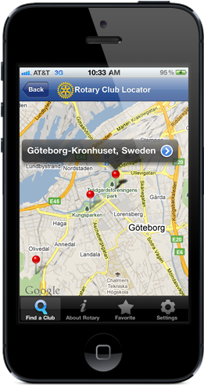
Cool Rotary Apps
Notes:
Presented by: Kathy Timm
Click on the images to open the websites explaining the apps.
Rotary Club Locator App – explain how it works
ClubRunner App – 1:42 video explaining how it works

Slide 37
Club Finances
Balance Sheet
Profit & Loss Statement
Annual Budget
Income: $28,100
Expenses: $32,700
Cash on hand
$12,207
As of 8/31/17
Income: $5,467
Expenses: $2,954
As of 8/31/17
Notes:
Presented by: Jack Timm on behalf of Evelyna Kuhr
Annual budget is approved by the board.
Links to monthly financial statements are included in the bulletin.

Slide 38
How to Propose a New Member
Invite them to a meeting as your guest
Tell them about Rotary
Complete a Proposed New Member Form
Board votes on proposed membership
New Member Orientation Handbook
Announce to club
Induct into membership
Assigned a mentor
Notes:
Presented by: Cathy Timm on behalf of Lanissa Grogan
1. Invite them to meetings as your guest. Important: At this time, introduce them as a guest - not as a prospective member. Your fellow Rotarians are bright enough to know that when you bring a local business associate or friend to a meeting there is potential for them to be proposed as a new member.
2. Tell them about Rotary The Rotary.org website is a great resource.
3 Complete a Proposed New Member Form and turn it in to the club secretary or the club membership chair. Be sure to include the proposed classification, contact data (including email) and any information that would be helpful when considering their application, i.e. work history, community service activities, awards, etc.
4. Board will review the application and vote on their proposed membership.
5. New Member Orientation Handbook The handbook will be reviewed with the prospective member to be certain they understand the privileges and responsibilities of membership. You can find the handbook on the right hand side of the home page of the club website under "home page download files"
6. Announced to club The prospective new member is announced to the club and members have seven days to submit a written objection, including the reasons for the objection, to the Board. Once the proposed member's name has been approved by the board and presented to the club you may introduce them as a prospective member at club meetings.
6. Inducted into membership If seven days have passed with no objections, they will be inducted into membership on a mutually agreeable date. The sponsor should obtain a brief bio on the new member that can be used to more formally introduce them to the club at their induction.
7. Assigned a mentor The new member will be assigned a mentor --- ideally someone other than their sponsor --- to help guide them through the new member "red ribbon" requirements and make them feel at home in the club.
Refer to the Club Bylaws "Article 10 - Method of Electing Members" for a formal description of the process.

Slide 39
Red Ribbon Program
Assist with a club meeting.
Attend a Board of Directors’ meeting.
Attend at least one meeting at a different Rotary Club.
Give a 3 minute classification talk.
Join a committee.
Participate in a club service activity.
Serve as a greeter.
Participate in Every Rotarian Every Year (EREY) .
Create a My Rotary account
Notes:
Presented by: Lanissa Grogan
Briefly discuss each requirement.
Assist with a club meeting…
Help set up room
Coordinate with president Cheryl to lead the Pledge, recite the Four Way Test, give a Thought for the Day
Collect happy bucks during the meeting
Help clean up after the meeting
Board of Directors’ Meetings….
Last week of each month after regular club meeting
Everyone is welcome
Attend another Rotary Club’s meetings
List of where clubs meet is in the handbook
Google club to get updated information on location/program
Use Club Locator App to find club
Join a Committee
Service Projects
Membership
Foundation
Youth
Let’s Go to the Movies
The French Connection
Participate in a Club Service Activity
Josh the Otter
Kids Don’t Float
Little Su Clean-up
Reading in schools
Every Rotarian, Every Year (EREY)
Make a donation to The Rotary Foundation
Suggested annual donation is $100 but any amount is OK
Serve as a Greeter
Arrive early to a club meeting, grab a “greeter” badge and welcome people as they come into the meeting.

Slide 40
Classification Principal
Professional Diversity
Notes:
Presented by: Lanissa Grogan
By assigning each member a classification based on his or her business or profession, this system ensures that the club’s membership reflects the business and professional composition of its community.
Goal is professional diversity, which enlivens the club’s social atmosphere and provides a rich source of occupational expertise to carry out service projects and provide club leadership.

Slide 41
What you didn’t know about me…
Notes:
Presented by: Lanissa Grogan
…get to know your fellow members!

Slide 42
Service Projects
Water Safety
Josh the Otter
Kids Don’t Float Kiosks
Literacy
Books signed by speakers and donated to schools
Read to students in elementary schools
Coats for Kids….School Supplies….Backpack Project
Mat Su Food Bank…Upper Susitna Food Pantry
Little Su Classic
Community Service
Clean Up Big Lake Library Grounds
International
Dolpa Project, Nepal
KIVA
ShelterBox
Notes:
Presented by: Claire Horton
Touch on the types of service projects in our club.
Encourage participation in at least one or more projects every year.

Slide 43
Youth Programs
Rotary Youth Leadership Awards
Youth Exchange
Interact
Rotaract
Notes:
Presented by: Kim Erickson on behalf of Lana
RYLA:
Each year our District holds a "Rotary Youth Leadership Awards (RYLA)" event. This is a leadership training program that encourages and rewards outstanding young people who want to become better leaders.
RYLA consists of an all-expense paid two and a half-day conference that brings together a special group of young men and women from across Alaska/Yukon to share ideas about becoming better leaders. Action-packed activities, like problem solving games, challenge course, group discussions and team-building activities, help participants build confidence and leadership skills.
Youth Exchange Our club is not hosting but members can participate.
Interact High School clubs
Rotaract
18 – 30 year old college students and young professionals

Slide 44
Public Relations
Telling our story
By increasing the public's understanding of Rotary, we're strengthening our ability to make an impact in communities around the world.
Notes:
Presented by: Kim Erickson on behalf of Rylee Rudd
Promoting Rotary to the general public can be as simple as wearing your Rotary pin or as elaborate as organizing an integrated marketing campaign.
Including a public relations component in your project plan will help ensure your club’s projects and events get the attention and support they deserve.
There are many ways to promote Rotary:
Hold a special event
Write a press release
Advertise on cable and public access TV
Create a public service announcement
Write op-eds and letters to the editor
Distribute club brochures, media kits, and fact sheets
Post on your club website and social media outlets, including blogs, Facebook, Twitter, YouTube,

Slide 45
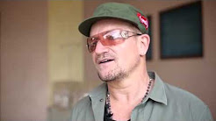
Rotary PSA’s
Notes:
Presented by: Rylee Rudd
Bono’s Message to the world about Rotary International 1:16 sec

Slide 46
Club Meetings
Regular Meeting
Weekly
Club Assemblies
Quarterly
Board Meetings
Monthly (all members welcome)
Committee Meetings
As needed
Fellowship Events
Firesides, Fundraisers, etc.
Notes:
Presented by: Kelly Kochendorfer
Briefly discuss the types of meetings a member might attend.

Slide 47
Club Meetings
Responsibilities
&
Etiquette
Notes:
Presented by: Kelly Kochendorfer
Review responsibilities of the Sgt. at Arms
Meeting Etiquette – show respect by…..
Arriving on time;
Silencing cell phones;
Not taking calls during meeting;
Not texting or reading emails during the meeting (photos are OK);
Not talking while someone is presenting or giving happy bucks

Slide 48
Weekly Programs/Speakers
Monthly Program Themes
July Start of New Rotary Year | August Membership and Club Development | September Basic Education and Literacy
October Economic and Community Development | November The Rotary Foundation | December Disease Prevention and Treatment
January Vocational Service | February Peace and Conflict Resolution | March Water and Sanitation
April Maternal and Child Health | May Youth Service | June Rotary Fellowship
Notes:
Presented by Julie Foster
Good Programs are key to a successful club!
Send speaker information to Julie Foster (program coordinator) and Kim Erickson to publish in the bulletin/website. Ideally, programs are arranged and published at least one month in advance. This is your month to make the club shine so have fun with it!
Book early. Interesting topics bring in more members. Speaker information on our website and in the bulletin encourages attendance and guests.
Consider having one program a month that correlates to the Rotary Theme for that month. Alternatively, you may have a “Rotary Minute” during the meeting to educate members on the topic. Ask a board member or look at the Rotary International website for ideas. Any extra things you wish to do during the club meeting should be scheduled with the club president so that she/he can include it on the weekly agenda. An informed club president is a happy club president. J
Speakers have 20-25 minutes (which includes time for questions) to present.
The speaker is a guest of the club for dinner. The club will pay for up to two people for the program each week. Give the bill for their dinner to the club treasurer (Evelyna Kuhr) for payment.
Coordinate audio/visual equipment when you schedule the program. Come early to help them set up, and have a short "bio" to use to introduce them before their presentation.
Remind speaker (and members, if necessary) that Rotary is a non-political, nonreligious organization; we don’t take stands or make political or religious endorsements.
When selecting your speakers, please choose a balance of topics that would be of interest to most of the members. For example, not all non-profits, not all political candidates in a month. The most successful presentations are those that are a mixture of information, humor, and thought provoking. Think back to some of the best presentations you attended and that will help in your decision of who to invite to speak.
Last but not least, send the presenter a thank you note expressing the club’s appreciation for taking the time to speak to us.

Slide 49
Becoming a Rotarian
Lead
Participate
Projects Worked On
Get Familiar
Time Spent
Notes:
Wrap up by Kim Erickson

Slide 50
Notes:
Wrap up by Kim Erickson

Slide 51
Thank you!
Notes:
Wrap up by Kim Erickson

