Slide 1
Work Study Program

Slide 2
Work Study Program
Juniors and Seniors in the program for the ‘20– ‘21 academic year
Eligible students will use program as capstone project to meet all their academic credits for graduation
Work study revenue will offset part of the cost of education for the student
www.bkhs.org

Slide 3
About our Students
Work Study Program
Bishop Kearney students score 20% higher on the SAT vs National Average
For the last nine years, 100% of our graduating seniors have been accepted to a 4 year college and university
Bishop Kearney is a diverse population ethnically and geographically. Our students come to BK from 15 Monroe county school districts, 16 different US States as well as China, Korea, Germany, Iceland and Canada.
www.bkhs.org

Slide 4
Work Study Program
Work Study Program
Corporate Sponsor
Staffing Agency Trains and coaches student workers Orientation Programs
Students provide needed entry level support to the corporate sponsor
Corporate sponsors pay fee for students’ work
Academics
Work study job covers 33% of the cost of education at a college prep program Experiential learning is tied into the classroom allowing real work experiences to enhance classroom theory

Slide 5
Student Worker Skills
Work Study Program
The following Microsoft Suite skills are taught specifically in our business technology course and are also blended into our curriculum:
Word – Including mail merge, editing, and formatting
PowerPoint – Formatting and editing
Excel – Basic spreadsheet creating, graphs and tables, formatting and editing
Access – Basic data base creation, data entry, and editing
Publisher – Creation of flyers, brochures, and other marketing tools
Outlook – email etiquette, calendar invitation
www.bkhs.org

Slide 6
Student Worker Course Work
Work Study Program
Required classwork for all students includes:
Public Speaking
Personal Finance
Leadership and Ethics
Business Technology
Employability skills are embedded into our curriculum
Examples: Teamwork, Problem Solving, Punctuality, Meeting Deadlines, Organization, Professional Communication (written and verbal)
Major Area of Interest Program
Allows students to focus their high school coursework to meet their desired career pathway
High School students take a sequence of courses in the following areas:
Business
Science and Technology
Fine Arts
Humanities
Cum Laude (All AP or Honors Courses)
www.bkhs.org

Slide 7
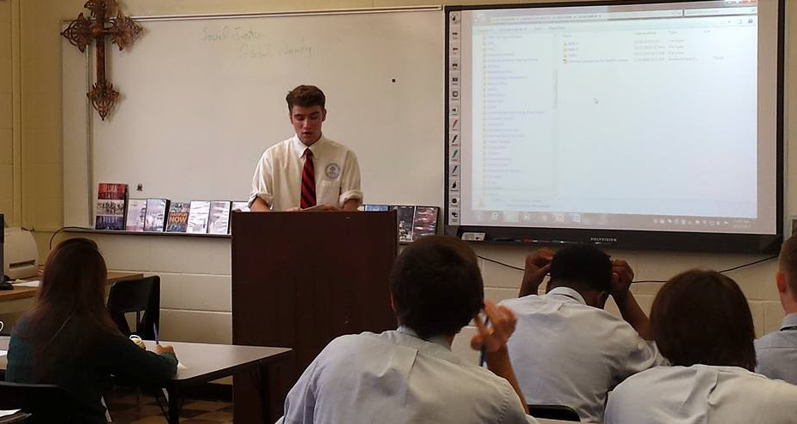
Student Workers Supporting Business Departments
Work Study Program
General Office and Reception Support
Mail Services
Human Resources
Information Technology
Communications
Marketing
Finance and Operations
www.bkhs.org

Slide 8
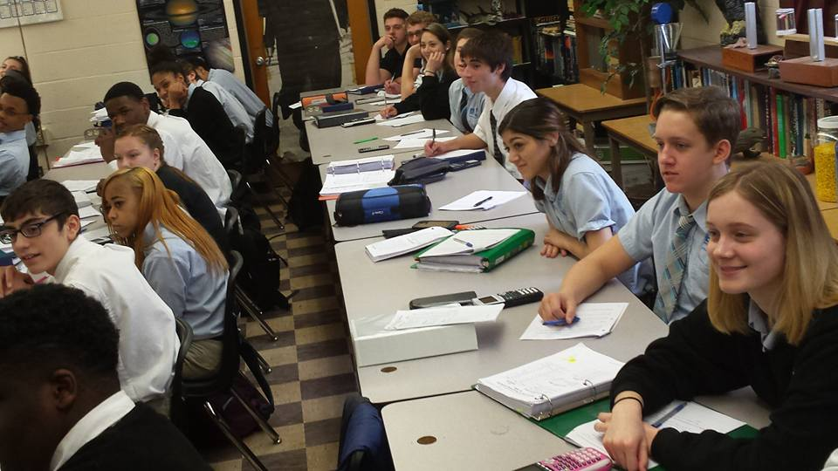
Work Study Program Information
Work Study Program
- School and work study program are separate entities
Students are employees of the Bishop Kearney work study program
- Separate Business and Student Orientation programs
Use of OneNote to ensure consistency between employees each day
- Being part of this program allows your business to take a leadership role in a revolutionary experiential learning program - The Bishop Kearney work study program assumes responsibility for all benefits including: Legal and Workers’ Compensation
www.bkhs.org

Slide 9
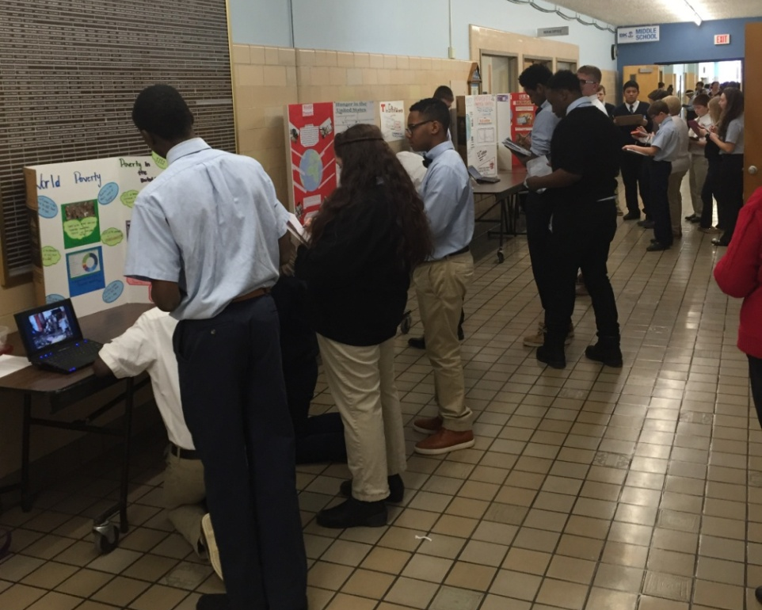
Student Supervision and Mentoring
Work Study Program
The program is academically driven so every student will receive academic credit and will be graded throughout the program.
- A member of the Bishop Kearney Administrative staff will be the point of contact for the business.
Student Teams are required to meet each day with the BK supervisor prior to leaving campus.
- Students will receive on going job site training at school as well as the business partner.
- The BK Supervisor will be available to the businesses for regular on site visits and evaluation of the student performance.
www.bkhs.org

Slide 10
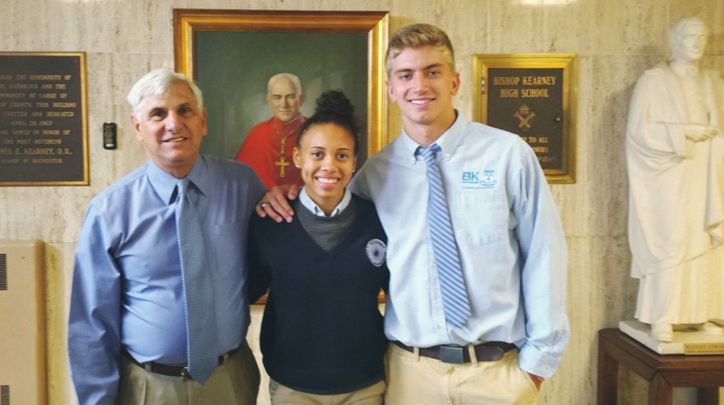
Reasons for hiring a student
Work Study Program
Helps your organization operate more efficiently and effectively, by relieving busy employees of low level work and allows your company to get work done that no one else has time to do, which will in turn, help with improved customer satisfaction.
Provides a positive impact on employee morale. The staff sees that their employer is committed to the community and takes part in a program that has a positive impact
Because your company is committed to our community, students from lower socioeconomic backgrounds will complete high school and continue on to college.
Provides an opportunity for young employees to gain supervisory experience.
Diversifies the workplace
Trains the workforce of the future. This allows your company to create a relationship with future employees , customers and suppliers.
www.bkhs.org

Slide 11
Why Bishop Kearney High School works!
Work Study Program
100% of our graduating seniors have been accepted to a 4 year college and university including:
Alabama State
Alfred State College Allegheny College Ashland University Bowling Green Brockport State College Canisius College Case Western Clarkson Cortland State University Dayton University D’Youville College
Fordham University Franciscan University Gannon University Iona College
LeMoyne College Mansfield Monmouth University Nazareth College Niagara University Notre Dame University Ohio University Ohio State University
RIT Siena College St. Bonaventure University St. John Fisher College St. Vincent College SUNY Geneseo
Syracuse University SUNY Polytechnic Institute Temple University University of Buffalo University of Pennsylvania Univ. Southern California Wagner University
www.bkhs.org

Slide 12
Contact Us
Work Study Program
Steve Salluzzo President Office: 585-342-4000 x203 email: ssalluzzo@bkhs.org
Vernon Banks ‘95 Director of Student Support and Retention Office: (585) 342-4000 x245 email: vbanks@bkhs.org
www.bkhs.org

