Slide 2
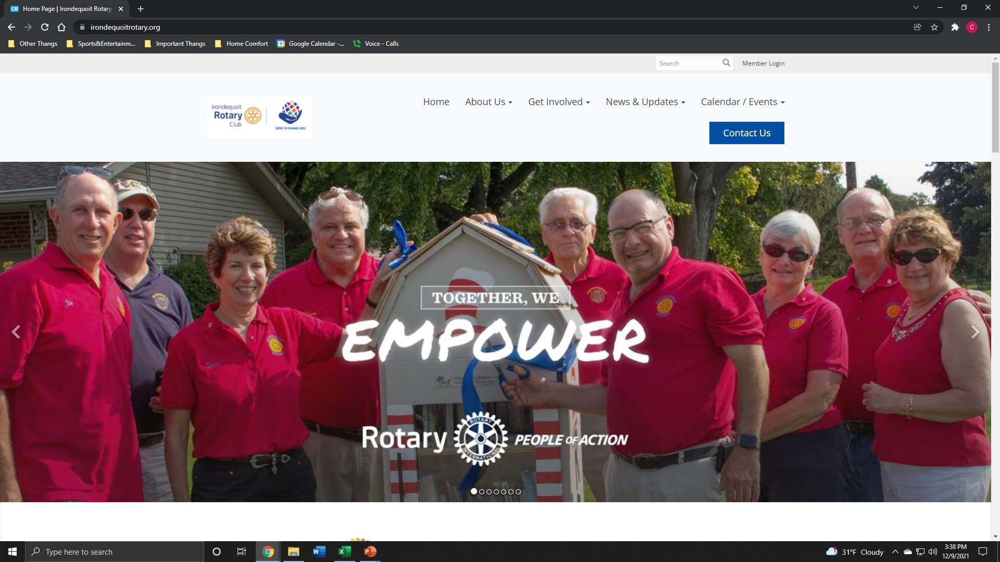

Slide 3
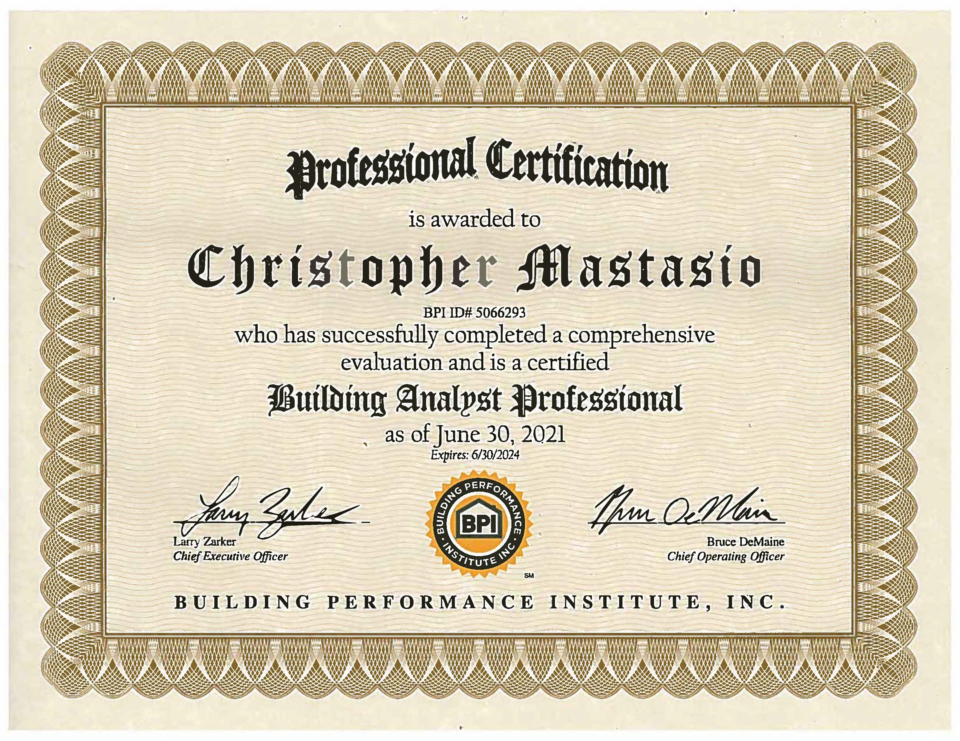

Slide 4
Building Performance Institutes highest level of home performance certifications. Home efficiency is when all the systems in your home work together to create the most comfortable, efficient living space, according to Energy Star. A contractor who understands how all the systems in your home work together is well versed in building science.
A BPI certified contractor will know the home projects that yield the greatest comfort for your house and energy savings. Those projects include:
- Sealing air leaks in your home and adding insulation.
- Sealing your ductwork.
- Improving your HVAC systems.
- Upgrading lighting, appliances, and water heating equipment.
- Installing renewable energy systems.

Slide 5
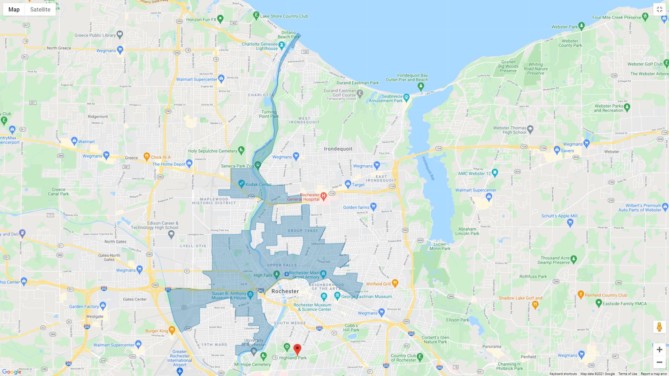
The locations within the blue map are pre-qualified for EmPowerNY

Slide 6
EmPowerNY - What to Expect
“Whole House Approach”
During the initial visit, your EmPower New York contractor will evaluate your electricity use and cost and may provide some minor improvements at no cost.
Examples include:
Install high efficiency lighting as needed
Review and adjust your thermostat setting for maximum comfort and savings
Check and adjust your hot water temperature
Evaluate the need for high efficiency showerheads and aerators, and install if needed
Measure the energy use of your refrigerators and freezers. These may be replaced with new ENERGY STAR models, at no cost to you, if your old appliances use a lot of energy
Check for carbon monoxide and evaluate the need for CO and smoke detectors
Evaluate your heating system and conduct a combustion efficiency test
Inspect the heating distribution system: the ducts or pipes that bring you heat.
Assess the insulation levels in the home, which usually involves probing the walls for insulation, inspecting the attic or roof insulation, measuring the home, and ensuring that insulation is in all the right places
Measure the air leakage in the home, using a “blower door”. This device helps us determine if the house is drafty, find the leaks, and make sure that the home still has sufficient fresh air after the work is done.
Check for gas leaks if natural gas or propane are in use at the dwelling

Slide 7
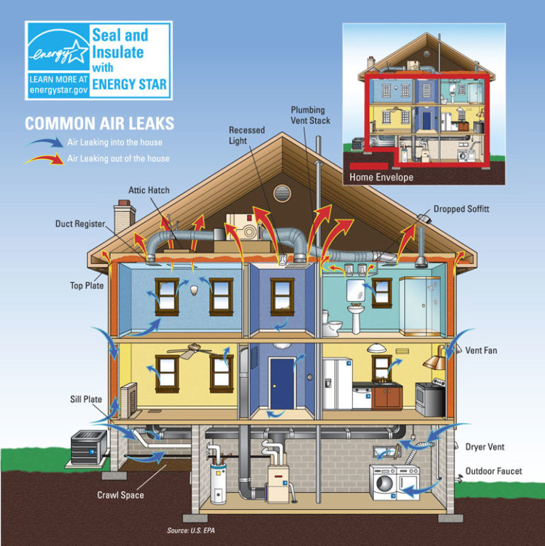
The Big Three:
Weatherization:
Insulation in attic/crawl spaces, basement Rim Joists, as well as finished/conditioned living spaces
Health and Safety:
Mold/Mildew, Asbestos, Gas Leaks/Carbon Monoxide, Vermiculite, Knob and Tube wiring
Efficiency of Major Mechanical Appliances:
Primary Heating Source, DHW, Refrigerator, etc…
Fossil Fuel Initiatives ending early 2022

Slide 8
Assisted Home Performance w/ Energy Star Program
Provides those who qualify with a discount covering 50% of the cost of eligible energy efficiency improvements up to $5,000 per project for single-family homes. Two- to four-unit residential homes with income-eligible residents may qualify for a discount of up to $10,000. The program is available for both renters and owners
State financing available to help match this grant.
Smart Energy Loan:
3.49% over 5 or 15 years
No pre-payment penalties
Easily attainable with lower/moderate credit and income

Slide 9
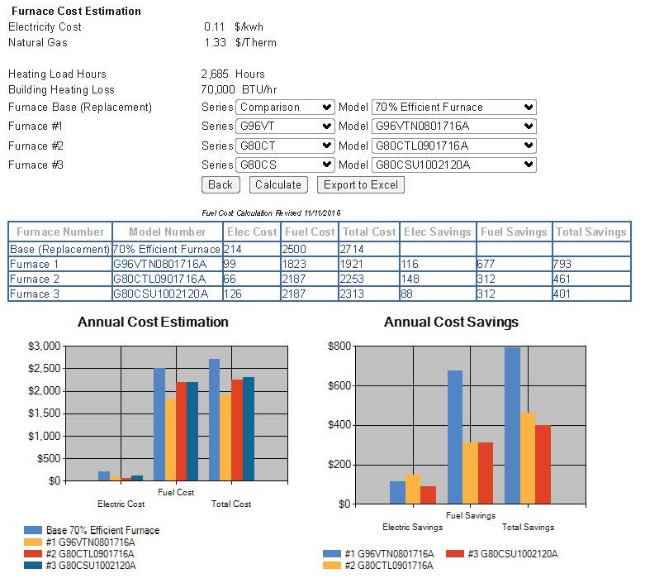
What does all this translate to in terms of savings?

Slide 10
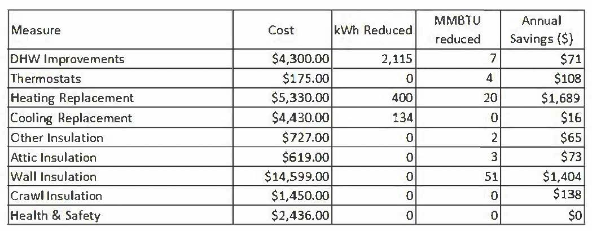
With EmPowerNY, Assisted Home Performance & the State Financing = $50/month

Slide 11
FAQ:
Q: Who pays for the energy services delivered through EmPower New York? A: The program is funded through a “System Benefits Charge” included in the bills of participating electric and natural gas utilities. This means that everyone who is a customer of a participating utility is chipping in to pay for this program. Additional funding is provided from other sources as well, such as the Regional Greenhouse Gas Initiative, which provides funding for energy efficiency upgrades to lower carbon emissions.
Q: How do I know if I qualify? A: You may be eligible if the following are true:
Your total household gross income meets the income guidelines or if you are receiving HEAP, SNAP, or public assistance.
You are an electricity or natural gas customer of Central Hudson, Con Edison, National Fuel, National Grid (Upstate, Metro and Long Island), NYSEG, Orange and Rockland, Rochester Gas & Electric—or heat with oil, propane, kerosene, wood, coal, or pellets.
The person on the utility account resides in the household.
You reside in a building with 100 units or less.
Q: What are some services that EmPower New York does not provide? A: EmPower NY does not provide:
Generally, roofs, windows, doors, and stoves.

Slide 12
FAQ: cont…
Q: If I accept improvements from EmPower New York, are you going to put a lien on my home? Am I required to pay the program back if I move or my income changes? A: No—there is no cost or future obligation when you participate in EmPower New York.
Q: Can I hire my own contractor? A: No—we assign all work to a predefined list of program-approved contractors. These contactors are accredited by the Building Performance Institute (BPI), a national organization that sets the technical standards for contractors in energy-efficient building performance, so you know they’re applying the latest knowledge and technology to the energy efficiency of your home.
Q: Can I get paid back for work I have already performed? A: No—EmPower New York cannot fund work that has already been completed.
Q: Does EmPower New York provide services to renters? A: Yes—EmPower New York provides energy services to anyone who owns or rents a home and meets all of the eligibility requirements.
Q: Does my landlord have to be involved? A: No—EmPower New York can provide some limited electric reduction services to your apartment where possible but landlords are encouraged to participate in order to provide you with a more comprehensive work project.
Q: Does my landlord have to pay anything? A: If an eligible tenant directly benefits from the energy services being provided through EmPower New York, those services will be completed at no cost to the landlord. Some services, such as adding insulation, require the landlord to sign an agreement allowing the upgrade to be installed. A landlord investment may be required for certain upgrades or if EmPower New York is providing energy services to multiple units in a building.

Slide 13
Household Income Guidelines
60% State Median Income for EmPowerNY
80% State Median Income for Assisted Home Performance with Energy Star

Slide 14
How To Get Started:
Call to schedule a phone consultation
Chris Mastasio
BPI Certified Residential Energy Consultant at Energy Smart NY
(585)340-7164
Chris@energysmartny.com
Direct link to online application
https://nyserda-portal.force.com/customer/apex/Core_Registration_Page?programName=Energy_Affordability_and_Equity_Residential&ccode=41aa383111b18b1e
NYSERDA Programs:
https://www.nyserda.ny.gov/All-Programs

Slide 15
What you will need to provide:
Proof of income documentation for all income earning adult household members.
Copy of your utility bills / account information
12 months energy usage history report, if applicable
Completed Combined Residential Application (can be done via paper application, electronically, or over the phone)
Accompanying documentation requested by contractor unique to each situation once application approved.
Continuous communication with your Residential Energy Consultant.
The comprehensive “whole house approach” requires patience, communication, and understanding in
order to provide the best answer for your home’s efficiency and comfort.

Slide 16
Acceptable Income Eligibility Documents
Important Notes:
Income Eligibility Documents should include all sources of income for each household member who is 18 years of age or older and who is not a full-time student.
If a household member has multiple sources of income, add a
separate line item for each income source.
Applicants can choose to use tax returns instead. Applicants can only use this option if all members of the household who were required to file a tax return did so. Additionally, all sources of income must be documented within the tax return for each household member.
Tax returns must be the most recent Federal Income Tax Return
(Form 1040, 1040A, or 1040EX)
If documenting Rental, Business, or Farm income, Applicants must submit corresponding schedules (C, E, and F)
(Sensitive personal information such as Social Security Numbers may be redacted)
Income Type | Document | Acceptable Date Range
Social Security | Award Letter or Benefit Statement | Within 12 months
Social Security Disability (SSD) | Award Letter or Benefit Statement | Within 12 months
Pension | Pension check stub showing gross amount or letter from Pension Board | Within 12 months
Disability (Short Term or Long Term) | Benefit Statement | Within 60 days
Child Support / Alimony | Court Award Letter or printout from domestic relations | Within 12 months (within 60 days if using printout from DR website)
Foster Care Payment | Statement from Social Services | Within 60 days
Workers Compensation | Award Letter or Benefit Statement | Within 60 days
Unemployment | Letter of Determination | Within 60 days
Veterans Benefits | Award Letter or Benefit Statement | Within 12 months
Annuities | Bank Statement | Within 60 days
Salaries/Wages | Pay Stubs | Four weeks of paystubs from the last 60 days
Interest Income | Bank Statement | Within 60 days
Rental Income | Current Lease or Rent Receipt | Within 12 months
Business or Farm Income | Tax Return, IRS Report of Quarterly Earnings, business records. | Tax Return: Previous Year IRS Report: Previous 3 months Business Records: Previous 3 months
Tax Documentation | Form 1040, 1040A, or 1040EX | Most recent year tax return

