Slide 1
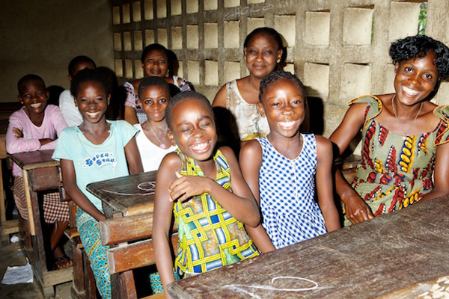
IF YOU EDUCATE A GIRL YOU EDUCATE A FAMILY AND CREATE A BRIGHT FUTURE
Ivory Coast (Côte d’Ivoire) West Africa
Notes:
This Rotary International humanitarian project is designed to create opportunities for girls in the West Africa nation of Ivory Coast or Côte d’Ivoire (pronounce like COAT DEE VWAH) -- opportunities that are denied young women in this small nation because of historical and social dynamics affecting their educational and economic opportunities. Through educational initiatives the girl, her family, and her community benefit.

Slide 2
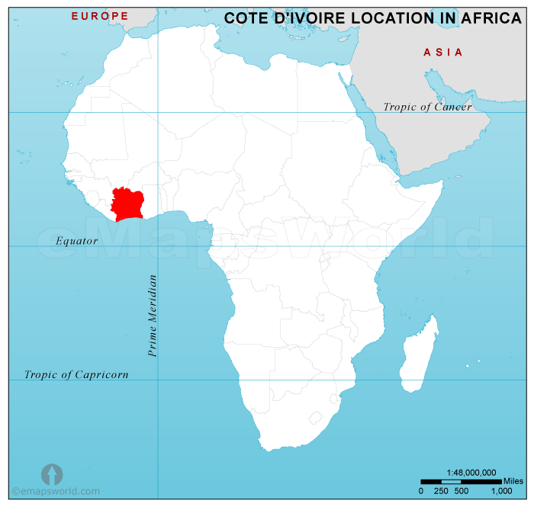
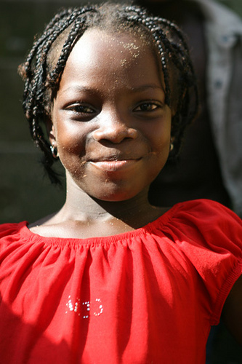
IF YOU EDUCATE A GIRL YOU EDUCATE A FAMILY AND CREATE A BRIGHT FUTURE
Ivory Coast
Notes:
This is the location of the Ivory Coast.
This project will take place in the West Africa nation of Ivory Coast.
Traditional cultural values mean girls are not viewed as potential contributors to society, community, or families (beyond child rearing)
• Schooling is discounted (when get home must care for siblings and do housework)
• Only time to study after dark; only light is kerosene lanterns which are expensive and cause great health damage
• Girls drop out of school – tend not to be able to complete homework and aren’t encouraged to be educated; no opportunity for higher education or for jobs that require knowledge
• Girls not given opportunity to develop skills to earn an income
Her value is in marriage and a hoped-for bride price for her family.

Slide 3
IF YOU EDUCATE A GIRL Challenge: Limited Educational Opportunity
Most women in the Ivory Coast are illiterate.
Very low enrollment of females in secondary school (24%)
Few girls are prepared to pass the university entrance exam.
Girls are not prepared to be financially self-reliant and respected community members.
High rates of unemployment upon graduation
Notes:
The educational challenges are substantial, especially for girls and women.

Slide 4
IF YOU EDUCATE A GIRL Opportunity: Increase Educational Success Two Part Global Project
Part 1: Improve curriculum for girls in ways that encourage them to finish their secondary education:
a. Train teachers to improve instruction for girls.
b. Add education in electricity to enhance understanding of relevance of science subjects.
c. Teach practical uses of electricity.
20 Teachers Trained in New Curriculum
Notes:
Addressing these challenges is the purpose of this Rotary International humanitarian project.
It consists of two related parts. The first part focuses on the secondary school curriculum and will train 10 teachers and 10 additional educators and, ultimately, countless school girls.
This training will be designed by an Ann Arbor expert in science education for developing countries in conjunction with women who are University of Michigan engineering graduate students.

Slide 5
IF YOU EDUCATE A GIRL Opportunity: Increase Educational Success Two Part Global Project
Part 2: Teach practical skills based on science education (electricity) to promote employment, entrepreneurship, and self-reliance:
a. Teach girls to build and maintain solar home lighting units.
b. Provide kits to support development of solar business start ups.
80 Girls Learn Practical Skills
Notes:
The second part focuses on practical skills and the development of entrepreneurship and self reliance, and 80 girls will receive this education. We will make use of a successful, Rotary Club of Ann Arbor, project developed and implemented in Guatemala. It taught women how to build and maintain small home solar lighting units which are highly sought after by families because they are much less expensive than lighting with kerosene; they are also much healthier because fumes from kerosene lanterns are toxic.

Slide 6
IF YOU EDUCATE A GIRL Results
1. Improved educational outcomes of girls (secondary school completion, university enrollment).
2. Increased economic self-reliance -- support themselves and their families.
3. Increased value of female children in their communities.
Bonus
4. Improved family health by replacing expensive kerosene lanterns with inexpensive solar light
Inhaling fumes from kerosene lamps = smoking two packs of cigarettes a day.
Notes:
Instead of being unemployed and helpless, they will now be respected and contributing members of their communities.
An added bonus – a major health problem identified by the World Health Organization for developing nations – the use of kerosene lanterns for lighting -- will be addressed.
Not only are the fumes from the lanterns hazardous, but half of the people seeking hospital treatment for severe burns in Africa have received their burns from overturned or exploding kerosene lamps.

Slide 7
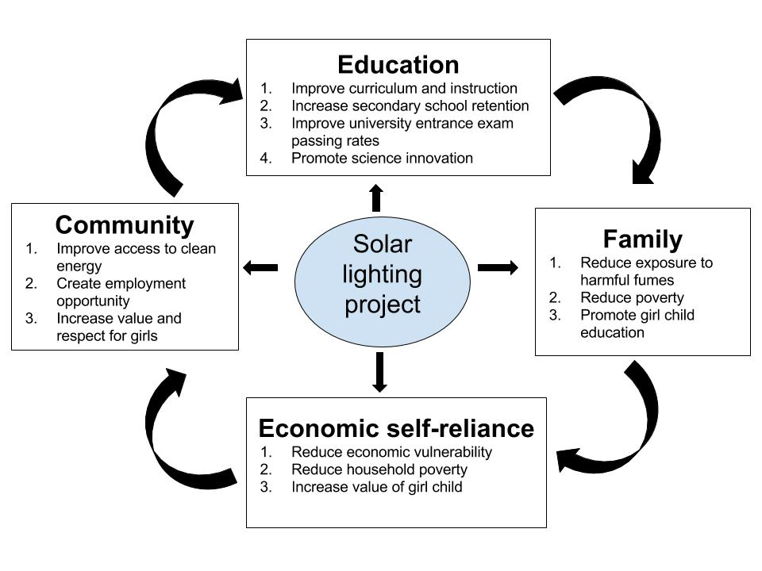
IF YOU EDUCATE A GIRL Results
Notes:
And, as this slide shows, the impact of this program will be broad indeed, changing not only the girls but their families and the communities in which they live.

Slide 8
IF YOU EDUCATE A GIRL Committed Supporters
In-Country
Ministry of Education endorsement of enhanced curriculum.
Two non-governmental organizations (e.g. Center for the promotion of Human Rights and Development, Women’s Center for Democracy and Human rights in Cote d’Ivoire)
Rotary Club of Abidjan Bietry
USA
Institute for Education of Women in Africa and the Diaspora (involving project leaders Massy Mutumba and Susan Frazier-Kouassi)
Society of Women Engineers at the University of Michigan.
Rotary Club of Ann Arbor
Expert trainers in Solar lighting and entrepreneurship (Rotarians, UM Professors)
Notes:
While this is a pilot project –it is being implemented with the support of local organizations that create a sustainable approach through long-lasting changes in the school curriculum and the education of indigenous trainers who will continue the program.

Slide 9
Budget Summary
IF YOU EDUCATE A GIRL
Expenses
Electronics and Solar Teaching Kits $22,000
Training Materials and Support $10,000
Curriculum Design and Teacher Training $ 8,000
TOTAL $40,000
Contributions
Rotary Club of Ann Arbor $10,000
Rotary Foundation (Global Grant) $20,000
Additional Contributions Required $10,000
TOTAL $40,000
Notes:
In summary, the project will cost $40,000 over two years. The program will train 100 people: 10 teachers, 10 trainers, and 80 girls.
Given the support already committed by the Rotary Club of Ann Arbor and assuming a successful Global Grant, we will have raised $30,000. Our challenge now is to raise the final $10,000 from other Rotary clubs, organizations, and individuals. We hope you will consider a contribution.

Slide 10
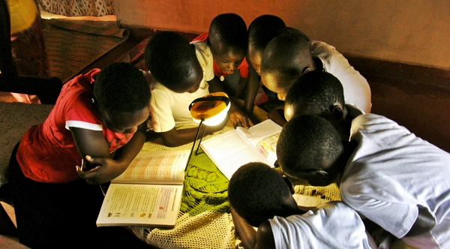
IF YOU EDUCATE A GIRL YOU EDUCATE A FAMILY
AND CREATE A BRIGHT FUTURE
Lighting Their Futures!
Notes:
This is an opportunity to create a brighter future for girls in the Ivory Coast –girls who will grow up to be the women who shape their society through their own lives and the lives of the children of the future.
As poignantly stated by a West African woman involved with this project: “If a girl could do something as simple as buy a bicycle for her family it would begin to change her family’s and her neighbor’s views of women and their role in society.”
Through this educational initiative we will light the way to their future.

