Slide 1
THE ROTARY CLUB OF CONCORD
2018 Visioning Workshop & Report
A Plan For The Future

Slide 2
The Rotary Club of Concord Mission Statement
The Rotary Club of Concord is a friendly, welcoming and fun group, which strives to engage and involve all its members, focusing on signature projects that serve the local community and the wider world.

Slide 3
Benefits of Visioning
Defines a shared commitment
Provides long-term direction
Creates a framework to establish goals and objectives
Optimizes use of resources

Slide 4
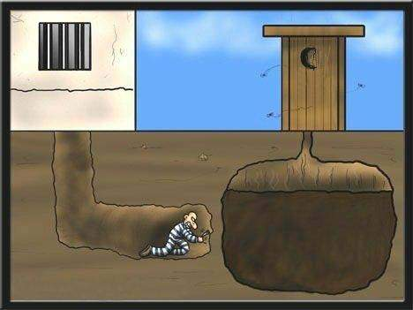
Why Have A Plan

Slide 5
Planning Steps…
Vision
Plan to Action
Vision to Plan
Notes:
Solid organizations employ these steps to a solid action plan… The visioning exercise that we will present today starts the cycle toward a long range plan that your club can put into practice for a number of years. The clarity that will come from this process will provide the alignment within your club of activities and direction promoting club health. As the Club gets stronger, so will membership strength increase for retention and growth.

Slide 6
Process
Writing Exercise
Club Vision
Recording Ideas
Prioritizing Ideas
Consolidating Ideas
Developing Action Plans

Slide 7
Top Picks Voted on In Each Category
VISION PURSUED (What does your Club "Stand For' in your Community)
# blue dots | # red dots | Below, enter all of the items listed on the Stands For wall sheet. | (Red + Blue) Dots
8 | 14 | Community w/international outreach | 22
11 | 10 | diverse group of people making positive difference | 21
8 | 12 | Fun group that everyone wants to join | 20
7 | 9 | service + support locally and abroad | 16
9 | 4 | fill "gaps" in the community | 13

Slide 8
Top Picks Voted on In Each Category
CLUB SIZE
# blue dots | # red dots | Below, enter all of the items listed on the Club Size wall sheet. | (Red + Blue) Dots
7 | 0 | 100 | 7
5 | 0 | 90 | 5
3 | 0 | 80 | 3
2 | 0 | 70 active | 2
2 | 0 | 75 quality | 2

Slide 9
Top Picks Voted on In Each Category
ATTRIBUTES (What are your characteristics, features or demographics)
# blue dots | # red dots | Below, enter all of the items listed on the Attributes wall sheet. | (Red + Blue) Dots
12 | 19 | Hands On | 31
12 | 11 | engaged | 23
5 | 15 | Active in community concerns/issues | 20
5 | 11 | Diverse | 16
5 | 5 | caring + dedicated | 10

Slide 10
Top Picks Voted on In Each Category
CLUB ADMINISTRATION (CLUB SERVICE)
# blue dots | # red dots | Below, enter all of the items listed on the Club Service wall sheet. | (Red + Blue) Dots
10 | 20 | Keep new members engaged | 30
14 | 15 | Service projects that members are passionate about | 29
9 | 8 | Diverse speakers / Challenging Topics | 17
5 | 12 | New member's orientation | 17
5 | 3 | Work w/ other community service clubs for common goals | 8

Slide 11
Top Picks Voted on In Each Category
VOCATIONAL SERVICE
# blue dots | # red dots | Below, enter all of the items listed on the Vocational Service wall sheet. | (Red + Blue) Dots
12 | 10 | Developing youth leadership | 22
8 | 9 | High School mentoring program | 17
6 | 9 | Support and build leaders in Interact/Rotaract | 15
5 | 7 | Annual reality fair - a stunning success! | 12
4 | 8 | Lectured on business ethics at CCHS | 12

Slide 12
Top Picks Voted on In Each Category
COMMUNITY SERVICE PROJECTS
# blue dots | # red dots | Below, enter all of the items listed on the Community Service Projects wall sheet. | (Red + Blue) Dots
11 | 15 | Build Concord Bike Sharing Program | 26
11 | 14 | Minuteman Arc program | 25
11 | 11 | Expand Veterans programs | 22
4 | 11 | Expanding projects with Boys & Girls Club of Assabet Valley | 15
6 | 1 | Go-to Club for Autism and mental health help | 7

Slide 13
Top Picks Voted on In Each Category
YOUTH SERVICE (NEW GENERATIONS)
# blue dots | # red dots | Below, enter all of the items listed on the Youth Service wall sheet | (Red + Blue) Dots
13 | 16 | Created program to fight opioid crisis | 29
15 | 11 | Youth Speakers | 26
11 | 12 | Financial Literacy program (middle school) | 23
6 | 5 | Assist Uganda programs (youth) | 11
6 | 5 | Mindfulness training for youth | 11

Slide 14
Top Picks Voted on In Each Category
INTERNATIONAL SERVICE
# blue dots | # red dots | Below, enter all of the items listed on the International Service wall sheet. | (Red + Blue) Dots
12 | 12 | Continue to work with Sharing Foundation in Cambodia | 24
7 | 17 | Final Stage of polio eradication | 24
10 | 13 | Supporting successful egg & poultry farm in Haiti | 23
7 | 7 | Support literacy + education for impoverished country | 14
8 | 4 | Send someone to Worthy Village every year | 12

Slide 15
Top Picks Voted on In Each Category
FUNDRAISING |  |  | (Red + Blue) Dots
# blue dots | # red dots | Below, enter all of the items listed on the Fundraising wall sheet.
9 | 15 | Pops $25,000 | 24
8 | 15 | Oktoberfest $100,000 | 23
8 | 14 | Scholarship/Golf Tournament - 25,000 | 22
7 | 6 | Winter Fundraiser - $25,000 "Casino night" | 13
5 | 5 | Dancing w/stars $40,000 | 10

Slide 16
Top Picks Voted on In Each Category
ROTARY FOUNDATION (Annual giving, Paul Harris Fellows, etc.)
# blue dots | # red dots | Below, enter all of the items listed on the Foundation wall sheet. | (Red + Blue) Dots
9 | 19 | Biggest Party EVER for the eradication of polio | 28
11 | 16 | 80% participation in EVERY ROTARIAN EVERY YEAR | 27
12 | 13 | 100% Paul Harris | 25
9 | 11 | 100% sustaining members | 20
6 | 1 | EVERY ROTARIAN EVERY YEAR | 7

Slide 17
Top Picks Voted on In Each Category
PUBLIC IMAGE (PUBLIC RELATIONS)
# blue dots | # red dots | Below, enter all of the items listed on the Public Image wall sheet. | (Red + Blue) Dots
11 | 17 | Share accomplishments on social media | 28
13 | 14 | Rotary logos on all bikes in bike sharing program | 27
9 | 9 | Designate Rotarian as a Humanitarian of the year by town | 18
6 | 11 | Each events has been promoted as Rotary | 17
5 | 0 | Liason from Rotary to other organizations in town | 5

Slide 18
Action Plan
BY WHEN |  | ACTION PLAN
2/8/2018 |  | 1. Compile the wall chart information | Boris – DONE
2/20/2018 |  | 2. Develop a vision statement or "elevator speech" | Using existing vision statement - DONE
3/1/2018 |  | 3. Schedule a Club Assembly to share the vision | Club - DONE
ongoing |  | 4. Assemble a President's Development team | Rosario, Karl, Helen, Steve K., Leigh Ann, Jean, Henry
ongoing |  | 5. Choose a Club Vision Champion | Rosario

Slide 19
Questions and Comments

Slide 20
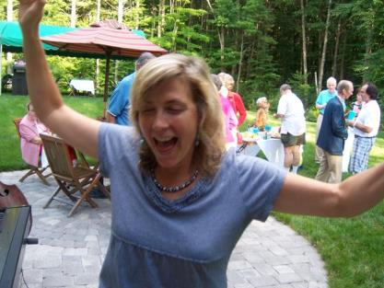
Remember – We Are A Fun Club – Ann Knows!!!

Slide 21
For More Information
ROTARY CLUB OF CONCORD
www.concordmarotary.org
www.facebook.com/RotaryClubofConcordMA

