Slide 1
CHALKFEST FOR CHARITY
WHEN: Sunday, October 22^{nd*}
TIME: 11:00 am – 3:00 pm
WHERE: Wrentham Village Premium Outlets
Sponsorship Participation Form
YES! I want to be a sponsor and help support the Franklin Rotary Club & Associated Charities. I understand I will have my company’s name displayed at an artists masterpiece during the Wrentham Village Premium Outlets Chalkfest for Charity!
Name You Want to Appear At the Chalk Drawing:
______________________________________________________________________________
SPONSORS NAME: ______________________________________________________________
CONTACT NAME: _______________________________________________________________
PHONE: _______________________________________________________________________
EMAIL: ________________________________________________________________________
MAILING ADDRESS: ______________________________________________________________
CITY/STATE/ZIP: ________________________________________________________________
Squares are available on a first come, first served basis and location of squares is up to Wrentham Village Premium Outlets. Your logo will be displayed prominently at your square.
Squares are available for both adults & students. Please circle the option you are choosing:
Students: 3’ x 3x for $150
Adults: 8’ x 10’ for $250
SIMON.COM

Slide 2
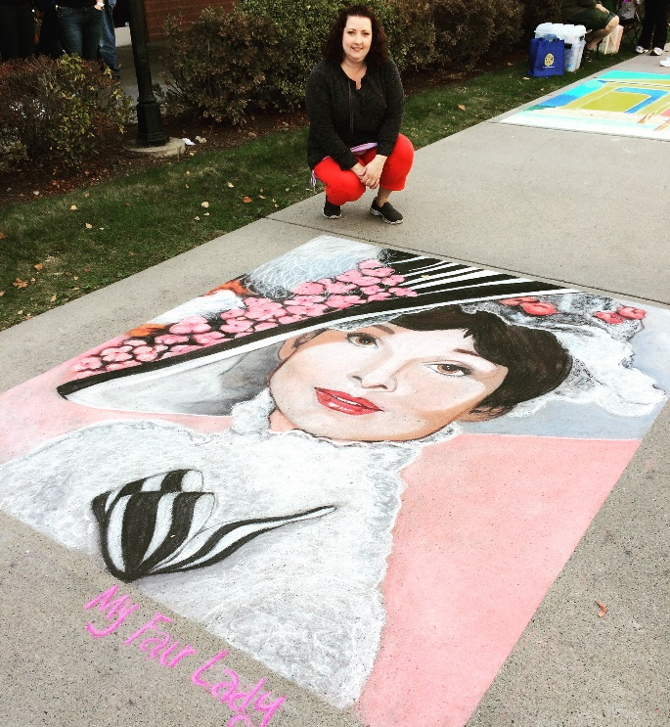
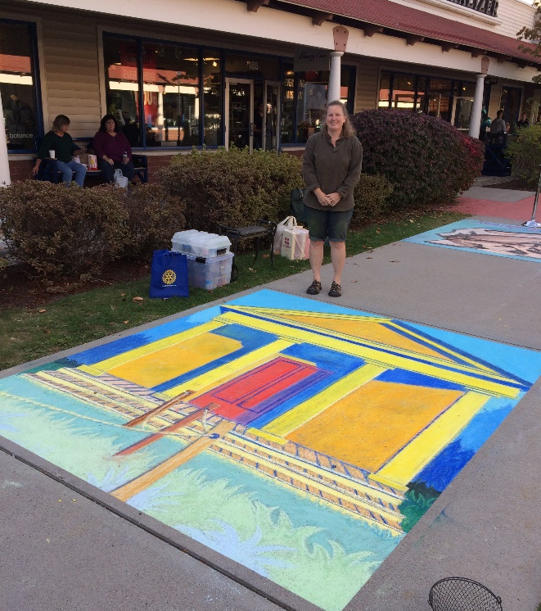
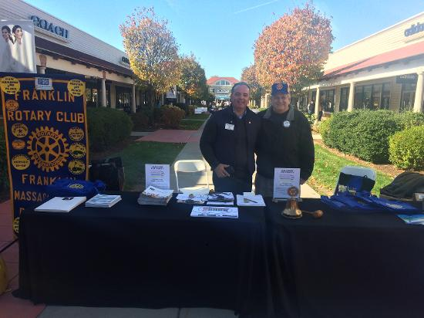
CHALKFEST FOR CHARITY
WHEN: Sunday, October 22nd
TIME: 11:00 am – 3:00 pm
WHERE: Wrentham Village Premium Outlets
“My Fair Lady” by Kerry St. Pierre of Attleboro, MA – Won 1st Place ($500 Visa Giftcard) and also People’s Choice ($100 Visa Giftcard)
“Beach House” by Lee Ball of Franklin, MA – Won 2nd Place ($300 Visa Giftcard)
The Franklin Rotary raised $5,050 during the Chalkfest for Charity event in 2016!
SIMON.COM

Slide 3
CHALKFEST FOR CHARITY
WHEN: Sunday, October 22^{nd*}
TIME: 11:00 am – 3:00 pm
WHERE: Wrentham Village Premium Outlets
Sponsorship Participation Form (cont.)
There are two options as a sponsor:
I will find my own artist! (If choosing this option you must have the artist also complete an Artist Participation Form)
Please match me with an artist
Payment Information
All proceeds will benefit local charities chosen by the Franklin Rotary Club. The full price of your donation to Chalkfest for Charity is tax-deductible. Thank you very much for your participation. A receipt is available upon request.
Please return this form, along with any questions, no later than Tuesday, October 8^{th.} Checks can be made payable to the Franklin Rotary Club, P.O. Box 148, Franklin, MA 02038.
Terry Katsaros
Email: theodosios.katsaros@rocklandtrust.com
Phone: 508-245-4127
Scott Martin
Email: scottm@hockymca.org
Phone: 774-235-2756
SIMON.COM

