Slide 1
The Maine Behavioral Health
Crisis System
Kiley Wilkens-O’Brien
Director of Crisis System Reform
Office of MaineCare Services
Department of Health & Human Services

Slide 2
Notes:
If you’ve read the news lately you’ve probably read about the mental health system in Maine, the lack of adequate resources, and the catastrophic consequences. A Harvard Business Review study has shown major trends of worsening mental health for individuals across the world, with 85% of those surveyed reporting a general decline of well-being.
This new wave of the public health emergency is having a disproportionate impact on Maine’s most vulnerable, most isolated, and most insecure individuals.
Campbell, M., & Gavett, G. (2021, February 10). What Covid-19 Has Done to Our Well-Being, in 12 Charts. Harvard Business Review. https://hbr.org/2021/02/what-covid-19-has-done-to-our-well-being-in-12-charts.

Slide 3
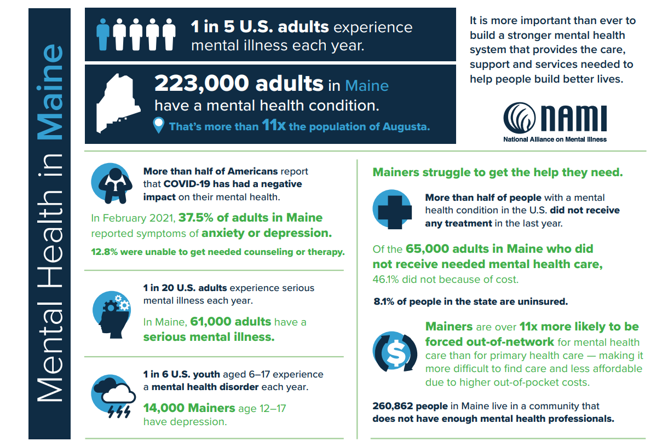
Notes:
Here are some quick facts about the status of mental distress in Maine

Slide 4
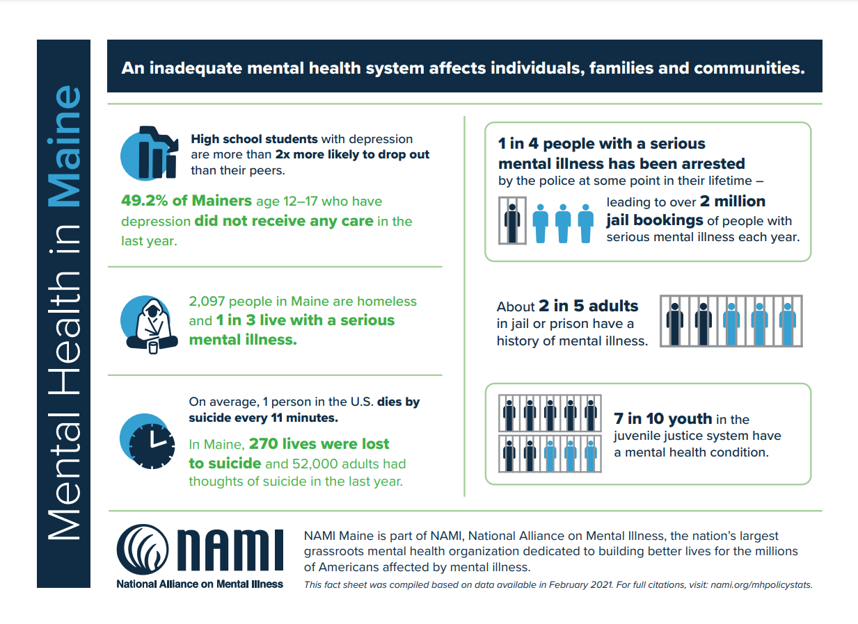

Slide 5
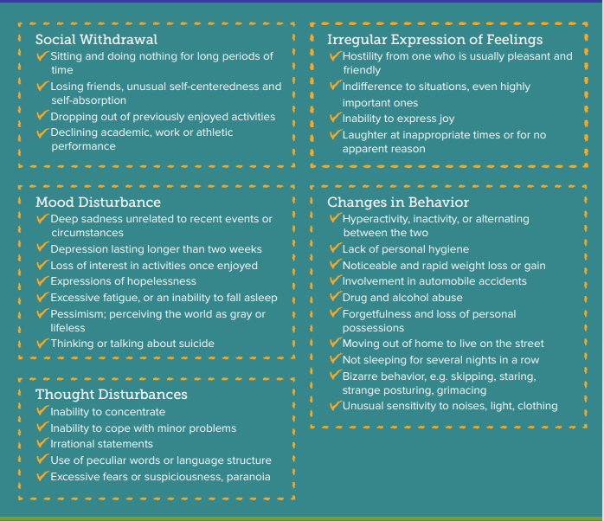
Behavioral health generally refers to mental health and substance use disorders, life stressors and crises, and stress-related physical symptoms.
Notes:
Mental illnesses are medical conditions that disrupt a person’s thinking, feeling, mood, daily functioning and ability to relate to others. A mental illness is a disorder of the brain that can make it difficult to cope with the ordinary demands of life. No one is to blame—not the person and not the family.
Other conditions may also be present that further complicate the difficulties created by mental illness. This is referred to as cooccurring, co-morbid conditions or dual diagnosis— meaning that there is more than one condition causing the difficulties. This can include physical illness, trauma, intellectual or developmental disabilities, cognitive disorders such as dementia etc.

Slide 6
What is a crisis?
Situations that can lead or contribute to a crisis include:
Home or Environmental Stressors
Changes in relationship with others (boyfriend, girlfriend, partner, spouse)
Losses of any kind due to death, estrangement or relocation
Conflicts or arguments with loved ones or friends
Trauma or exposure to violence
School or Work Stressors
Worrying about upcoming projects or tasks
Feeling singled out by co-workers/peers; feeling lonely
Lack of understanding from peers, co-workers, teachers or supervisors
Real or perceived discrimination
Failing grades, losing a job
Other Stressors
Being in crowds or large groups of people
Experiencing community violence, trauma, natural disasters, terrorism
Pending court dates
Using or abusing drugs or alcohol
Starting new medication or new dosage of current medication
Treatment stops working
Stopping medication or missing doses
Crisis is any situation in which an individual’s state of mind renders them unable to cope with or adjust to the everyday stresses of life. Crisis is defined by the individual and can range from frustrating to life-threatening. In the most acute situations, individuals may be is threatening immediate harm to self or others, be severely disoriented or out of touch with reality, or is otherwise out of control.
Notes:
I refer to crisis care as the safety net beneath the safety net services. It catches people who slip through the cracks. Crisis is the most basic element of behavioral health care because it immediately and unconditionally accepts everyone seeking assistance. It needs to represent real-time access to services for an individual in need. Crisis care is crucial to reducing the fragmentation of mental health care. It provides a viable solution to the drains of law enforcement resources in the community due to the criminalization of behavioral health issues resulting in the disproportionate incarceration of individuals with mental illness and/or substance use disorders. It also limits psychiatric bed overuse and is an essential resource to reduce psychiatric boarding in Emergency Departments (EDs). All of these are critical priorities in Maine.

Slide 7
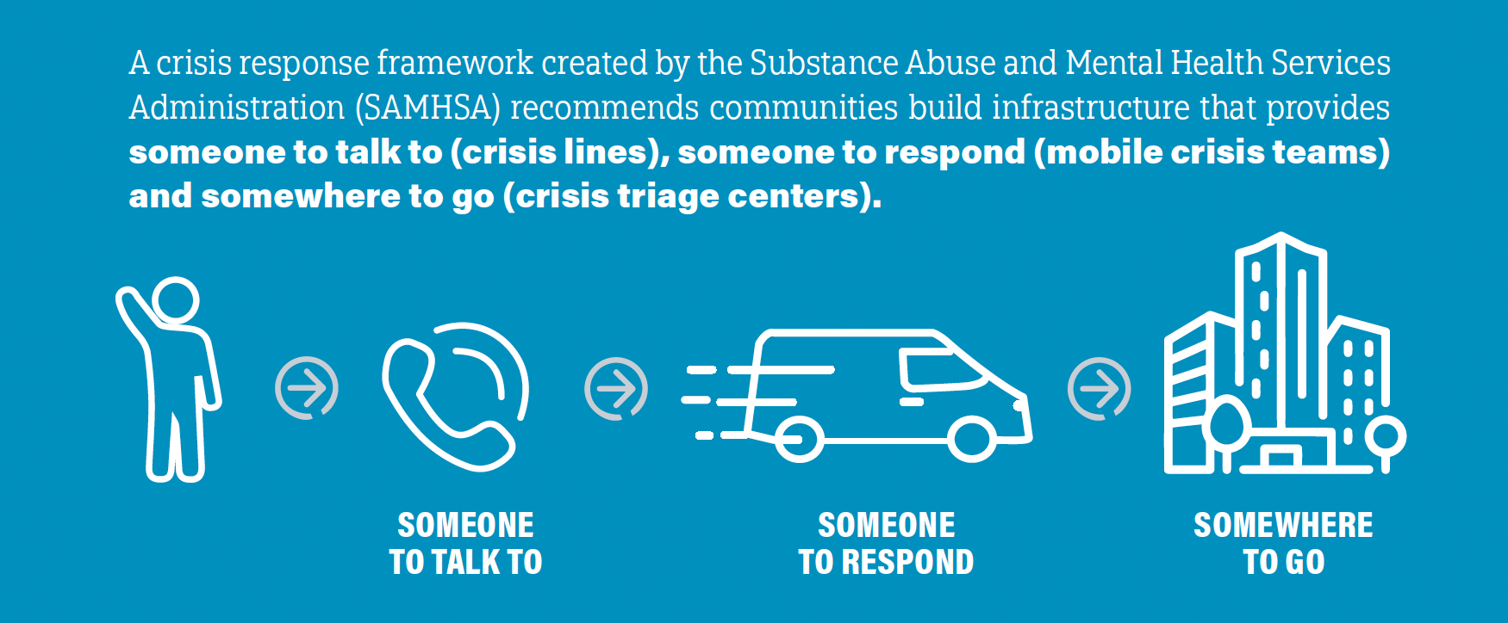
Notes:
During his first State of the Union address, President Biden outlined a four-part unity agenda focused on areas where members of both parties can come together and make additional progress for the American people. The first of which was Prioritize Mental Health. To address this crisis, the President’s Budget proposes reforms to health coverage and major investments in the mental health workforce.
Expanded Coverage and Reduced Costs for Mental Health Services.
More Mental Health Providers.
A Better National Suicide Prevention Lifeline.
The President’s Budget strengthens access to crisis services by building out the National Suicide Prevention Lifeline, which will transition from a ten-digit number to 988 in July 2022. It also supports the implementation of the Veterans Crisis Line’s 988 expansion initiative.
Federal funding has been the catalyst for the crisis system reform work in Maine. Research in the field of crisis and communities of practice now exist. It’s an exciting time in the field.

Slide 8
Maine Crisis System Mission
To ensure immediate equitable access to welcoming, hopeful, trauma-informed, recovery-oriented behavioral health crisis services in the most supportive, least restrictive setting. Ensure every person gets the right response every time prioritizing safety and promoting future well-being.
Notes:
Since October of 2020 I have been working to
Build relationships and gather information from across the silos of state government
Develop coalitions of community stakeholders and individuals with personal experience
Facilitate conversations regarding administration, finance, service continuum and capabilities, and clinical practices
In order to create a unified vision for Maine’s ideal crisis system.

Slide 9
Safety is foundational.
The crisis experience is more than a single event.
The Maine Behavioral Health Crisis System must have the capacity for complexity.
Guiding Principles
Notes:
Crisis services serve people during the most acute periods when the risk of self-harm, overdose, suicide, homicide, or other adverse outcomes are at their peak. Processes must be in place to ensure safety for individuals receiving crisis services, staff providing crisis services, community referents, and the community as a whole.
A crisis is an episode of care which should be addressed with services that are easy to access, tightly coordinated, and have a timeframe that supports the goal of providing active crisis resolution and stabilization efforts until the person can smoothly transition back to more routine community-based care.
Maine’s reformed crisis system shall be equipped to respond to a crisis as early as possible with the expectation of comorbidity and complexity. Services are deigned to offer and safe voluntary and involuntary services for all populations, all ages, and people from all cultural backgrounds and welcoming individuals with active substance use in all settings across the continuum

Slide 10
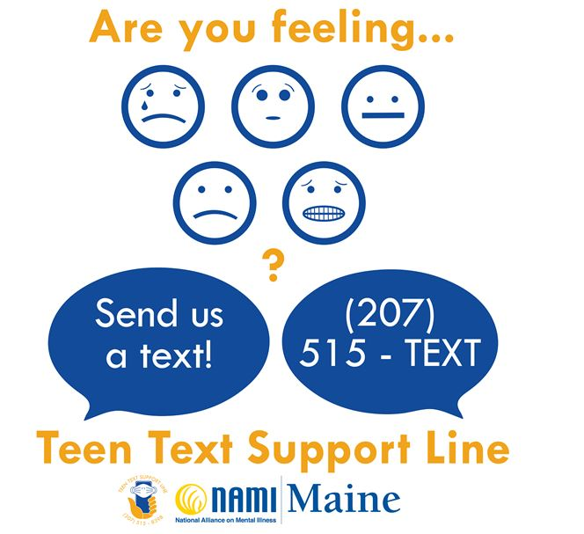
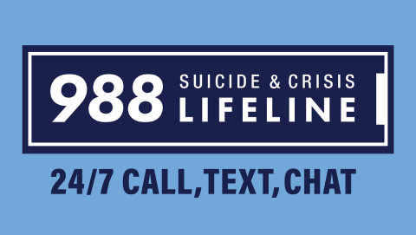
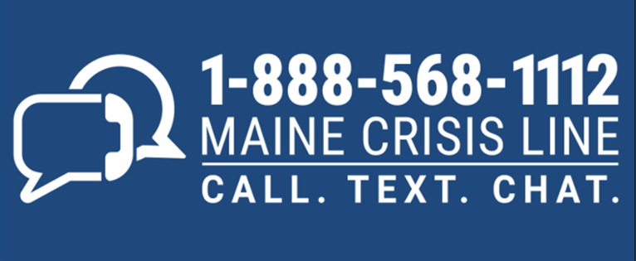
Notes:
Maine’s centralized crisis number serves as both the Lifeline/National Suicide Prevention Hotline and the state’s mental health crisis line.
The MCL is staffed 24/7 by State certified trained crisis workers who provide crisis intervention support by telephone, text and chat.
Operators can also connect those in crisis with services in their area including community resources.
In October 2020, the federal National Suicide Hotline Designation Act became law. This was a historic victory for the suicide prevention community and a national recognition of the importance of responding to suicide and mental health crises.
The NAMI teen text line was developed when teens were isolated during the pandemic. It allows teens to chat with trained youth peers rather than behavioral health professionals.

Slide 11
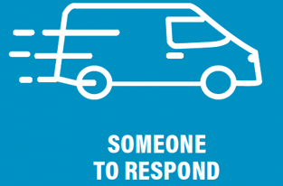
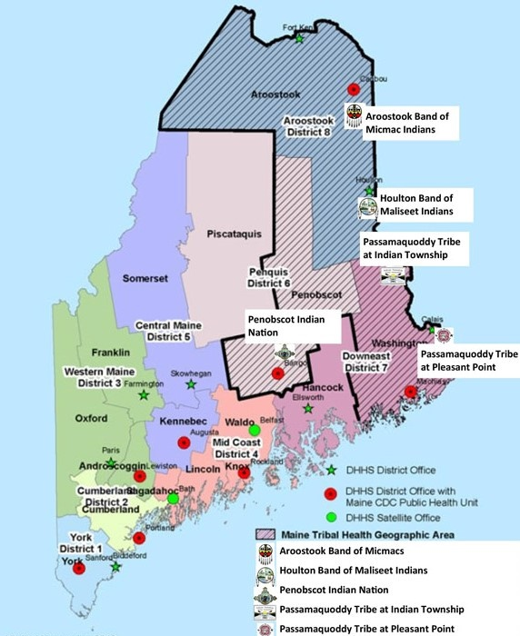
District | Agency
1 York | Sweetser
2 Cumberland | The Opportunity Alliance
3 Western | Sweetser subcontracted to Oxford Mental Health Services and Western Maine Behavioral Health
4 Mid Coast | Sweetser
5 Central | Crisis & Counseling
6 Penquis | Community Health & Counseling Centers, Inc.
7 Downeast | Aroostook Mental Health
8 Aroostook | Aroostook Mental Health
9 Tribal | Wabanaki Health & Wellness
Notes:
The Maine Department of Health and Human Services (DHHS) Offices of Behavioral Health (OBH), Child and Family Services (OCFS), and MaineCare Services (OMS) Maine’s Medicaid program; are the predominant funders of Maine’s crisis system of care. Each region has a contracted provider for mobile crisis services. Mobile crisis teams are responders specially trained to de-escalate mental health crises, assess needs, and provide an appropriate level of care in the least restrictive setting. Mobile crisis teams are dispatched to regional providers and respond to the location of the person in crisis. Services are subject to Medicaid (MaineCare) Rule. State-contracted mobile crisis providers offer limited walk-in crisis stabilization services during business hours.

Slide 12
Spurwink in Portland is the first crisis receiving center in the State. The Office of Behavioral Health is reviewing data from it’s first year of operation to inform plans to expand the model to other areas of the state.

Slide 13
Advocate for behavioral health integration and parity to require all insurers cover the improved community-based mobile crisis response service.
Develop crisis management software to allow for streamlined point-in-time data collection and a shared crisis record across care continuum to allow for seamless transitions, reduced re-traumatization for individuals accessing service, and continuous quality improvement.
Engage in cross office and inter-departmental behavioral health data integration efforts to ensure clear understanding of community behavioral health needs currently being met by other systems due to limited crisis system capacity.
Align terms, definitions, and requirements across licensing, policy, contract, court filings and data collection; providing technical assistance to ensure universal adoption with the goal of creating shared common language statewide.
Continue efforts to strengthen crisis workforce and require continuing education.
Develop clear marketing and public messaging and provide outreach and education regarding access and service availability.
The Path Forward

Slide 14
Ask yourself:
Is the person in danger of hurting themselves, others or property?
Do you need emergency assistance?
Do you have time to start with a phone call for guidance and support from a mental health professional
Techniques that may help de-escalate a crisis:
Keep your voice calm
Listen to the person
Express support and concern
Avoid continuous eye contact
Ask how you can help
Keep stimulation level low
Offer options instead of trying to take control
Avoid touching the person unless you ask permission
Gently announce actions before initiating them
✘Don’t make judgmental comments
✘ Don’t argue or try to reason with the person If you can’t de-escalate the crisis yourself, you can seek additional help from mental health
✘Don’t make them feel trapped
Things that may exacerbate a crisis:
If you’re worried that you or your loved one is in crisis or nearing a crisis, seek help.
Notes:
Make sure to assess the immediacy of the situation to help determine where to start or who to call.
A person experiencing a mental health crisis can’t always clearly communicate their thoughts, feelings, needs or emotions. It’s important to empathize and connect with the person’s feelings, stay calm and try to de-escalate the crisis.

Slide 15
Get involved!
https://www.namimaine.org/events?category=MHFA

