Slide 1
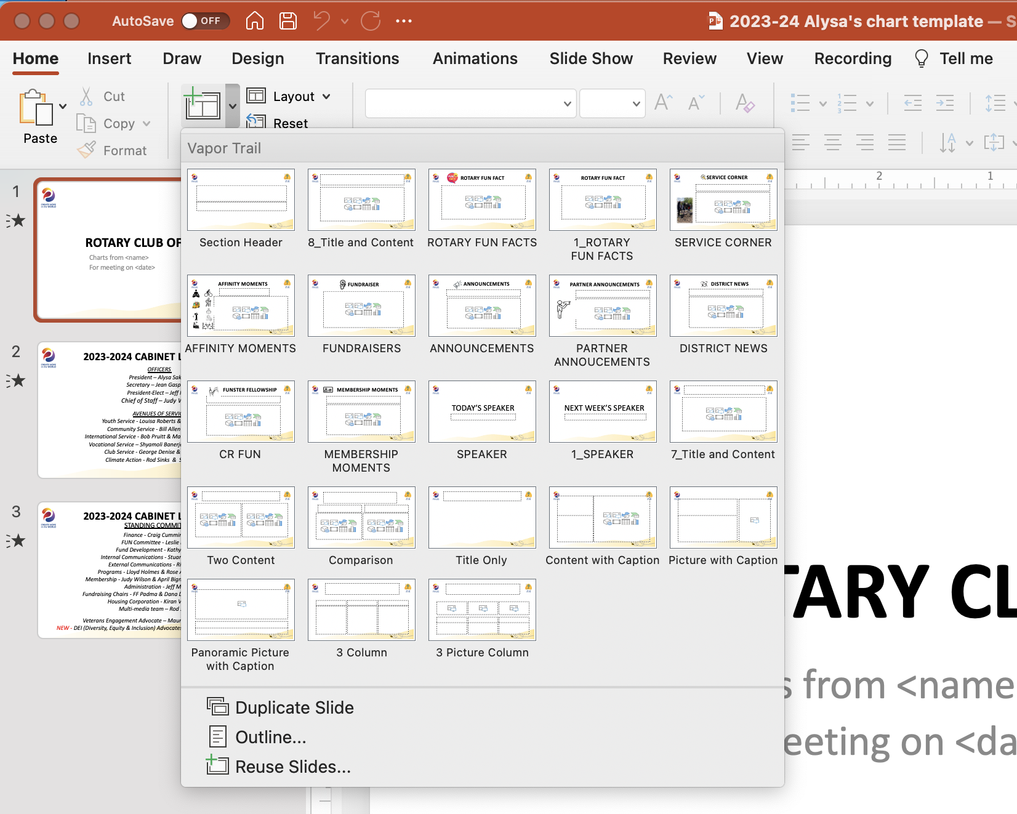
HOW TO USE THIS CHART TEMPLATE
On the next slide, fill in
<name>
<date to be presented>
2) To create new Slide(s):
Choose “New Slide”
- Or -
Choose the down arrow
Pick a Slide template to start with
3) Rename the .pptx file with your name/topic
in the filename title
4) Email slides to asakkas@gmail.com
- Or -
Upload slides to: https://tinyurl.com/2324crupload
to have your slides added to the meeting
slide deck

Slide 2
Rotary Club of Cupertino
Charts from <name>
Charts for meeting on <date>

