Slide 1
Public Image Committee

Slide 2
Mission Statement
The Public Image Committee tells Rotary’s story to the public and promotes the club’s projects and activities. We do this by collaborating with club members and club committees.

Slide 3
Members
Derick Meadows
Frank Nance
Terri Cook
Mason Peres
Susan Passmore
Rebecca Colllins
Marie Kilbourn
Crystal Redden

Slide 4
Committee Serves as Focal Point for
Public Image Campaigns
Strategic Planning (for PI matters)
Social media techniques / best practices
Website effectiveness
Understanding branding and related best practices
Training to accomplish Public Image Tasks

Slide 5
Process
We have a strategic plan that includes a number of process items
Manage photography, videography, presentation needs for club events
Provide tools and resources to help each chair in respective PI goals to promote club
Specific Items
1. Club brochure
2. Press release templates/information
3. Club website/social media
4. Training tools and sessions
5. Event resources, flags, banners, etc.
6. Collaboration w/ other committees

Slide 6
Branding, Public Image, Social Media

Slide 7
Rotary’s Brand is Important
Old Logo
New Logos

Slide 8
Internal vs. External Communications
Internal Only
Internal and External

Slide 9
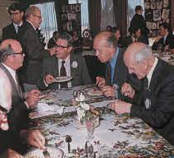
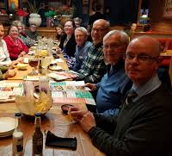
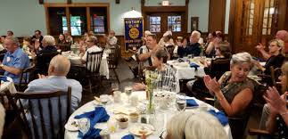
People of Action Campaign
Some people think Rotary is all about eating…wonder why?
Many don’t know what Rotary is or the great work Rotarians do in our communities and around the world
We need to change that!
Rotary membership needs to grow – need to engage.

Slide 10
What does POA Campaign Accomplish?
Brings Rotary story to life in a way that narrows gap between public awareness and understanding
Essence of Rotary and our values reflected in campaign
We build lifelong relationships
We honor our commitments
We connect diverse perspectives
We apply our leadership and expertise to solve social issues

Slide 11
People of Action Campaign
Who is our audience?
Fewer photos of meals/club banners
More pictures of Rotarians actively serving/doing
Show the “why” not just the “what”
Use at least one photo with an overlay when posting to media
Also use in other marketing resources

Slide 12
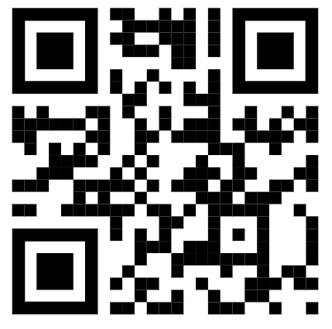
People of Action Overlays
app.poaphotos.com
Together we…
Connect Inspire Save Lives
Empower Learn Transform
End Polio Mentor Have Fun
Fight Hunger Promote Peace
Overlays also available for Interact and Rotaract

Slide 13
Social Media
Is here to stay
Is a powerful tool
Can help build up our club
Club is on these
Lots more

Slide 14
Social Media Post Tips
Public Image Committee will help ensure consistency with message and tools
Use POA overlays on photos
Use hashtags # and @ to extend reach
#ForLaPorte #ServiceAboveSelf
#PeopleofAction #ServetoChangeLive
#EndPolio
@TheWheelhouse
@Joy2TheWorld
Tag people
Share and like posts!

Slide 15
Social Media Posts
Call to action in everything we post
Rotary does not support any specific political view or religion
3 second attention span with mobile users
Appropriately represent diversity in our club and community
Timely
Videos increase search engine engagement

Slide 16
Public Image is More than Press Releases and Media Coverage
Wear your Rotary lapel pin all the time, not just on meeting day
Wear swag with Rotary logo around town
Proud member/supporter decals
4-way test in office
Bring sign at functions to advertise
Update your profile on social media – make it clear you are a Rotarian
Share Rotary and club news on your social media pages
Invite a friend to Rotary
Talk about Rotary

Slide 17
More Information
Visit the Rotary Brand Center @ my.rotary.org
Logos
Templates
Media materials
Visit the Learning Center @ my.rotary.org
Professional and easy e-learning modules (multi-media)
Some as short as 5 minutes

Slide 18
Questions?

