Slide 1
New Member Orientation
2023-2024
Mineral Wells
Rotary Club

Slide 2
Orientation Goals:
To Gain Appreciation for and Understanding of Rotary
To Recognize and Understand the Responsibilities of Membership
To Provide Information that Will Help You Become a Successful Rotarian
Mineral Wells
Rotary Club

Slide 3
What is Rotary?
Rotary is a global network of 1.4 million neighbors, friends, leaders, and problem-solvers who see a world where people unite and take action to create lasting change – across the globe, in our communities, and in ourselves.
There are over 46,000 clubs throughout the world who work together to:
Promote peace
Fight disease
Provide clean water, sanitation, and hygiene
Save mothers and children
Support education
Grow local economies
Protect the environmentotary is a global network of 1.4 million neighbors, friends,
Visit: www.rotary.org for more information
leaders, and problem-solvers who see a world where people unite and take action to create lasting change – across the globe, in our communities, and in ourselves.
Mineral Wells
Rotary Club

Slide 4
Rotary International Origins:
Rotary started with the vision of one man — Paul Harris.
The Chicago attorney formed the Rotary Club of Chicago on 23 February 1905, so professionals with diverse backgrounds could exchange ideas and form meaningful, lifelong friendships.
Over time, Rotary’s reach and vision gradually extended to humanitarian service. Members have a long track record of addressing challenges in their communities and around the world.
Visit: www.rotary.org for more information
leaders, and problem-solvers who see a world where people unite and take action to create lasting change – across the globe, in our communities, and in ourselves.
Mineral Wells
Rotary Club

Slide 5
Rotary Structure
Rotary International President
Board of Directors
District Governors
Club President
Club President Elect
Club Chairs, Board Members
Annually, each district elects a district governor, and each club elects a new club president.
Rotary year runs July 1st – June 30th
Visit: www.rotary.org for more information

Slide 6
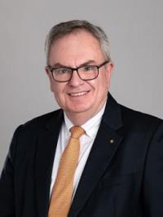
R. Gordon R. McInally
Rotary International President 2023-2024
Rotary Club of Rotary Club of South Queensferry, Scotland
educated at the Royal High School in Edinburgh and at the University of Dundee, where he earned his graduate degree in dental surgery. He operated his own dental practice in Edinburgh until 2016.
joined Rotary in 1984 at age 26. A member of the Rotary Club of South Queensferry, he has served as president and vice president of Rotary International in Great Britain and Ireland. He has also served RI as a director and on several committees, most recently as an adviser to the 2022 Houston Convention Committee and chair of the Operations Review Committee.

Slide 7
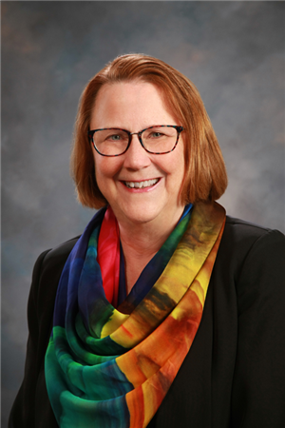
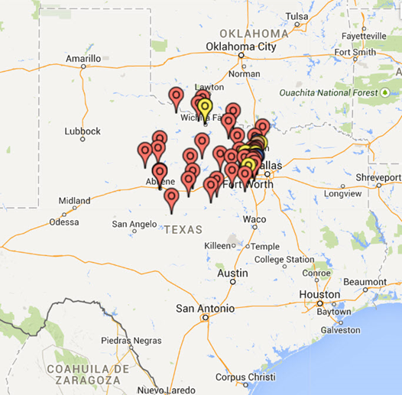
Pat Peters
District Governor 5790 2023-2024
Rotary Club of Decatur
www.rotary5790.org

Slide 8
Object of Rotary
The Four-Way Test
Five Avenues of Service
Moto:
“Service Above Self”
Mineral Wells
Rotary Club

Slide 9
Object of Rotary:
To encourage and foster the idea of service as a basis of worthy enterprise by:
First: The development of acquaintance as an opportunity for service;
Second: High ethical standards in business and professions; the recognition of the worthiness of all useful occupations; and the dignifying of each Rotarian’s occupation as an opportunity to serve society;
Third: The application of the ideal of service in each Rotarian’s personal, business and community life;
Fourth: The advancement of international understanding, goodwill, and peace through a world fellowship of business and professional persons united in the ideal of service.
Mineral Wells
Rotary Club

Slide 11
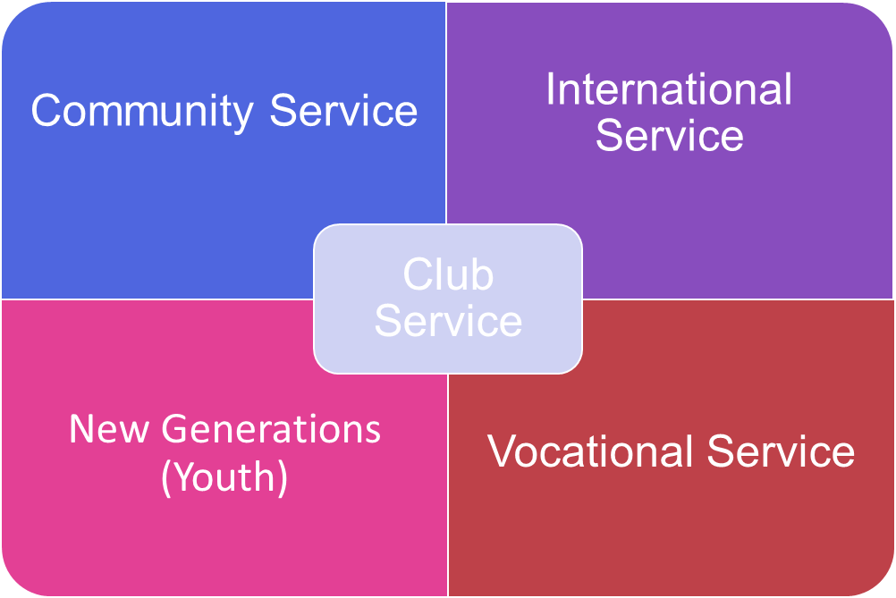
Five Avenues of Service:

Slide 12
Club Service: Focus is on strengthening the club by achieving its goals through strong relationships and an active membership development plan.
Vocational Service: Rotarians serve others by their expertise to the problems and needs of society and by contributing high ethical standards.
Community Service: Rotarians participate in activities that make the community a better place in which to live by finding ways to improve the quality of life for people in their communities.
International Service: Rotarians foster the advancement of understanding and good will among people of the world and promote humanitarian efforts around the globe.
New Generations / Youth Service: Recognizes the positive change implemented by youth and young adults through leadership development activities, involvement in community and international service projects, and exchange programs that enrich and foster world peace and cultural understanding.
Mineral Wells
Rotary Club

Slide 13
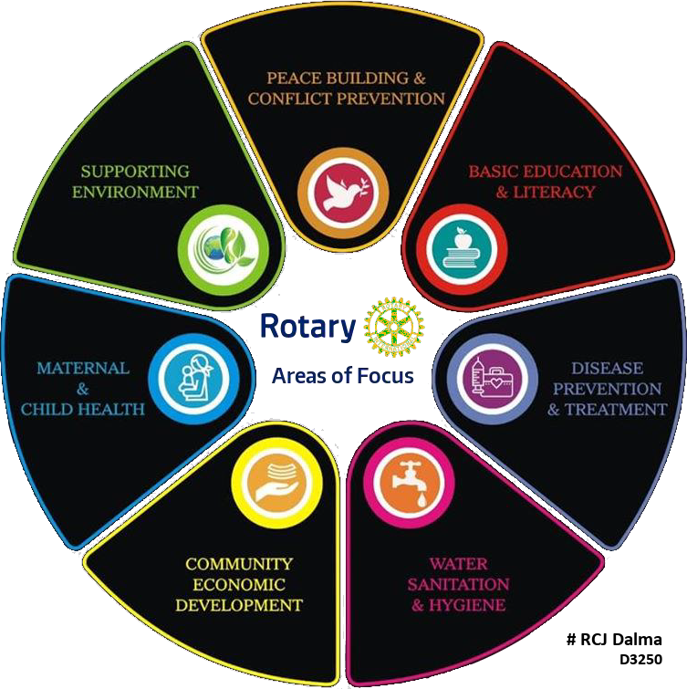
Seven Areas of Focus:

Slide 14
Mineral Wells
Club History
Est. June 25, 1918
Mineral Wells
Rotary Club

Slide 15
Mineral Wells Rotary Club:
The club began on June 25, 1918 and was sponsored by the Rotary Club of San Antonio.
The club is the oldest civic club in the area and has been recognized as a leader in all civic matters.
Its members have likewise been recognized as leaders in their respective fields, “Service Above Self” if more than a club moto.
Mineral Wells
Rotary Club

Slide 16
Mineral Wells Rotary Club:
The club has met at the Holiday Hills Country Club for decades until it closed and went public. We currently meet at the Southside Church of Christ.
The club has hosted many fundraisers over the years most predominantly the Flag Program in 1998 by providing subscription-based flag placement in residences and businesses 6x a year and has grown to hundreds of flags throughout Mineral Wells. They also sponsor the Crazy Kicker Bike Ride annually.
They have supported numerous local projects including:
Meals on Wheels
Local Public Libraries
Various Donations to City Parks
Various Non-Profit Organizations
Mineral Wells
Rotary Club

Slide 17
Ideal Members of Mineral Wells Rotary Club:
Male & female business owners, managers and professionals interested in fellowship with other members of the local business community and a desire to serve the overall community in ways that require the talents and efforts of many people.
Membership is by invitation and approval only.
Mineral Wells
Rotary Club

Slide 18
2022-2023 Mineral Wells Rotary Leadership Team:
Dianne Templar, President
Mike Rankin, President Elect
Karyn Bullock, Immediate past president
Sarah Hahs, Secretary
Cary Steele, Treasurer
Tonya Gary, Membership Chair
Harris Brooks, Foundation Co-Chair
Wesley Wermuth, Foundation Co-Chair
Connie Ball, Community Service
Karyn Bullock, Public Image & Youth Svcs.
Connie Parker, Sergeant-at-Arms
Dan Steele, District Governor 5790
Program Chair: Rotates with each member
Mineral Wells
Rotary Club

Slide 19
A new board is elected to take office on July 1 of each year.
Board of Directors meets monthly to discuss finances and club business
1 July
1 July
Monthly
All Officer and Director positions in Mineral Wells Rotary are one-year terms that change on July 1st.

Slide 20
New Member Tasks:
Read the Materials in Your Orientation Packet
Meet Financial Obligations
Pay Admission Fee & Dues
EREY commitment
Attend Meetings (50% minimum)
Serve as a board/chair member
Read and Make Use of Various Communication Media
Participate in Events & Projects
Honor the Four-Way-Test
HAVE FUN, ROTARIAN!
Mineral Wells
Rotary Club

Slide 21
Get Involved:
Meals On Wheels
Find a Program
Contribute to the Foundation
EREY: min $25 annual donation
Help market the Flag Program
Help with the Crazy Kicker Bike Ride
Help in other fundraisers
4-Way Speech Contest
RYLA
RI Projects
Mineral Wells
Rotary Club

Slide 22
Rotary History:
Rotary Timeline
Paul Harris
Foundation
Eradicate Polio
History of Rotary Logo
Mineral Wells
Rotary Club

Slide 24
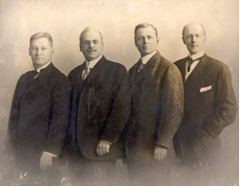
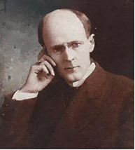
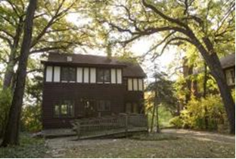
PAUL HARRIS:
Born in 1868 in Wisconsin
Grew up in Vermont with Paternal Grandparents
Attended University of Vermont and Princeton
Received law degree of University of Iowa in 1891
Opened law practice in 1896 in Chicago
Met fellow attorney Bob Frank who helped Paul Harris channel his idea to bring together other businessmen to help their community.
Harris eventually persuaded several business associates to discuss the idea of forming an organization for local professionals. On 23 February 1905, several men including Harris met in an office in downtown Chicago for what would become known as the first Rotary club meeting.
In February 1907, Harris was elected the third president of the Rotary Club of Chicago.

Slide 25
Rotary Foundation:
The Rotary Foundation transforms your gifts into service projects that change lives both close to home and around the world.
Since it was founded more than 100 years ago, the Foundation has spent more than $4 billion on life-changing, sustainable projects.
With your help, we can make lives better in your community and around the world.
Mineral Wells
Rotary Club

Slide 26
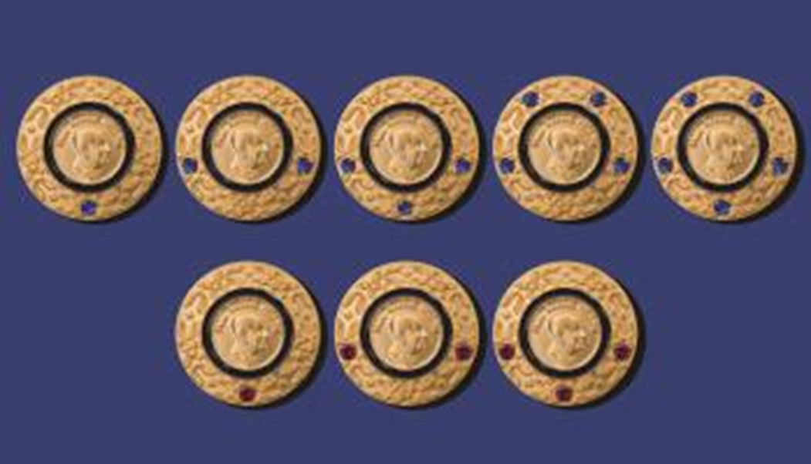
Paul Harris Fellow:
With your help, we can make lives better in your community and around the world.
Mineral Wells
Rotary Club
Level Pin
+1: $2,000 to $2,999 one sapphire
+2: $3,000 to $3,999 two sapphires
+3: $4,000 to $4,999 three sapphires
+4: $5,000 to $5,999 four sapphires
+5: $6,000 to $6,999 five sapphires
+6: $7,000 to $7,999 one ruby
+7: $8,000 to $8,999 two rubies
+8: $9,000 to $9,999 three rubies

Slide 27
Rotary’s Goal to Eradicate Polio:
Polio or poliomyelitis, is a paralyzing and potentially deadly infectious disease that most commonly affects children under the age of 5. The virus spreads from person to person, typically through contaminated water. It can then attack the nervous system.
Rotary has been working to eradicate polio for more than 35 years. Our goal of ridding the world of this disease is closer than ever.
As a founding partner of the Global Polio Eradication Initiative, we've reduced polio cases by 99.9 percent since our first project to vaccinate children in the Philippines in 1979.
Rotary members have contributed more than $2.1 billion and countless volunteer hours to protect nearly 3 billion children in 122 countries from this paralyzing disease. Rotary’s advocacy efforts have played a role in decisions by governments to contribute more than $10 billion to the effort.
Today, polio remains endemic only in Afghanistan and Pakistan. But it’s crucial to continue working to keep other countries polio-free. If all eradication efforts stopped today, within 10 years, polio could paralyze as many as 200,000 children each year.

Slide 28
History of the Rotary Logo

Slide 29
Member Access:
: Mineral Wells Rotary Club
-Club Runner (app)
-www.mineralwellsrotary.org
-user name: Your Email
-password: 1st time set-up
: Rotary International
-www.rotary.org/en
-user name: Your Email
-password: 1st time set-up
Club Secretary can help with access.
Mineral Wells
Rotary Club

Slide 30
Member Access:
Mineral Wells
Rotary Club
Download on your Apple or Android device!
Instant access to all the club members e-mail and phone numbers

Slide 31
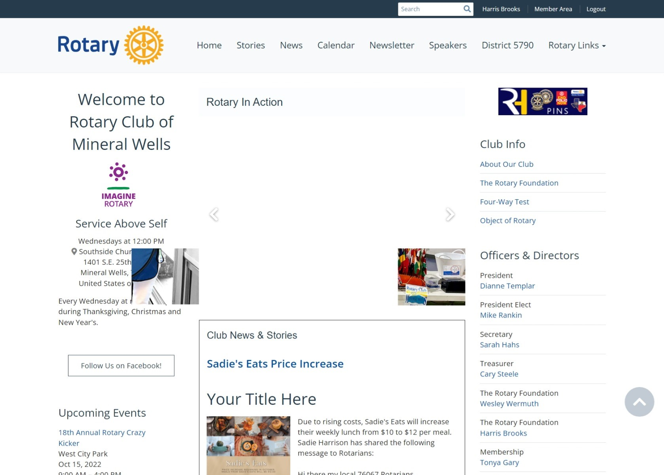
Mineral Wells Rotary Club Homepage (Club Runner)

Slide 32
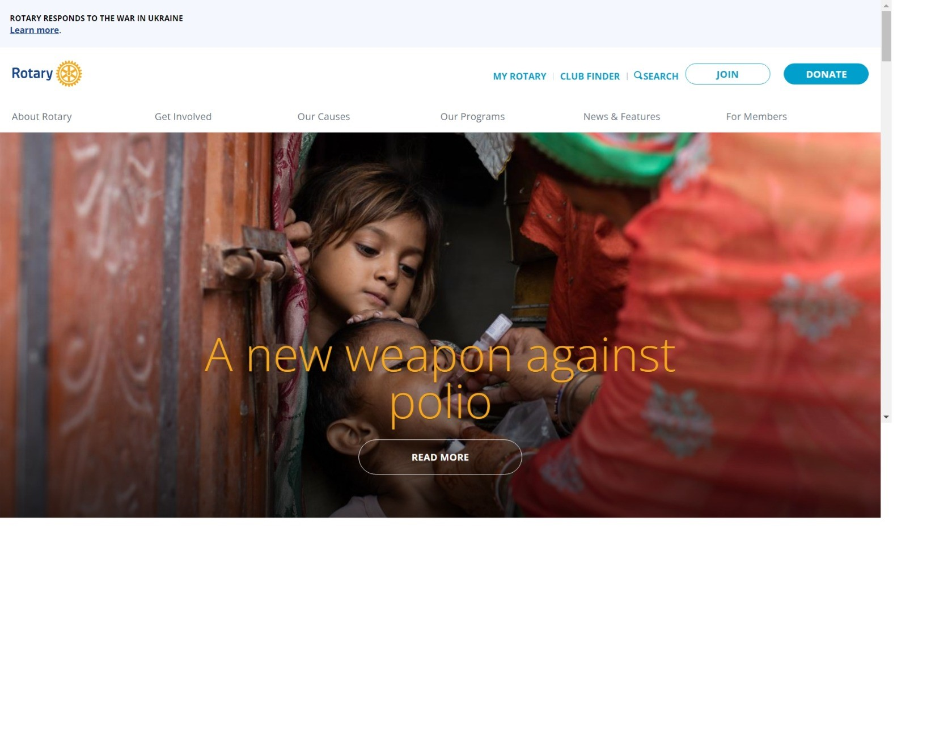
Rotary International Homepage

Slide 33
New Member Orientation
2023-2024
Thank you for attending orientation!
Mineral Wells
Rotary Club

