Slide 1
Branchville Scarecrow Photo-Bomb Contest
2024

Slide 2
Sponsored by the

Slide 3
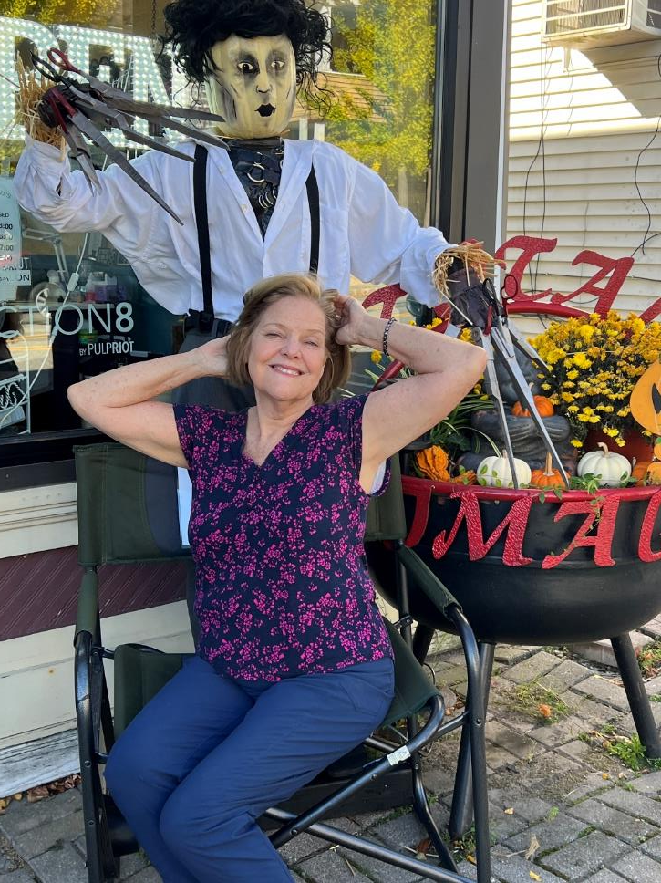
Photo #1

Slide 4
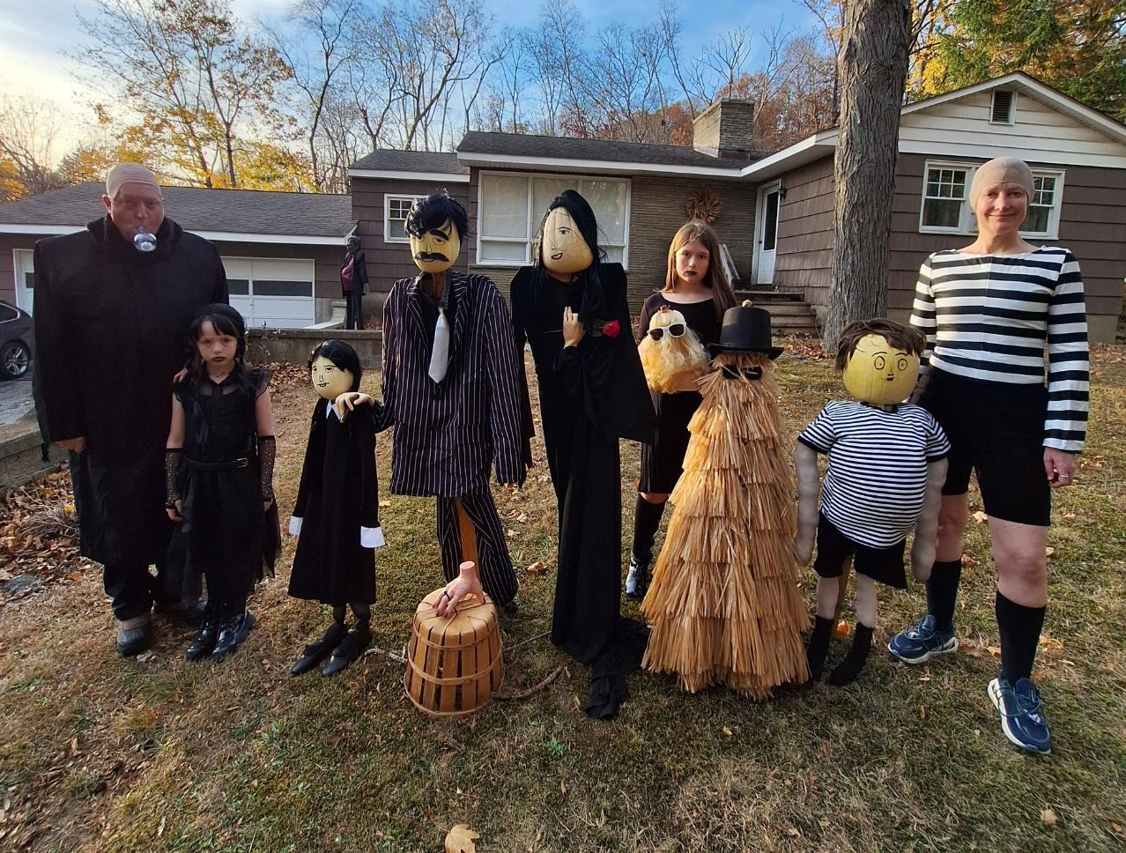
Photo #2

Slide 5
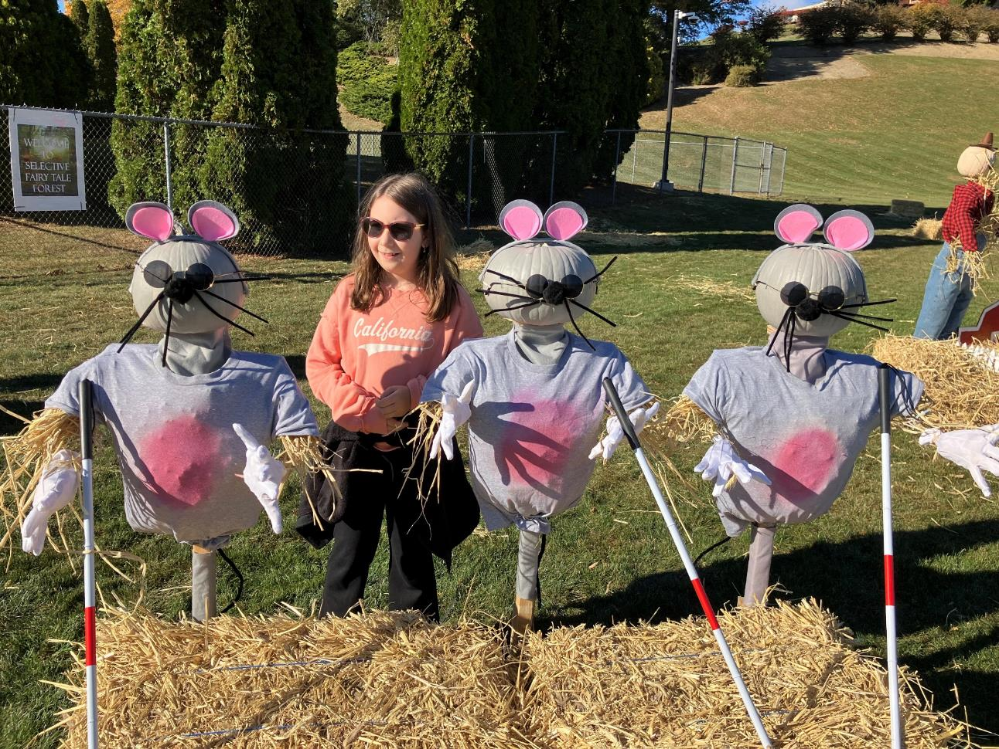
Photo #3

Slide 6
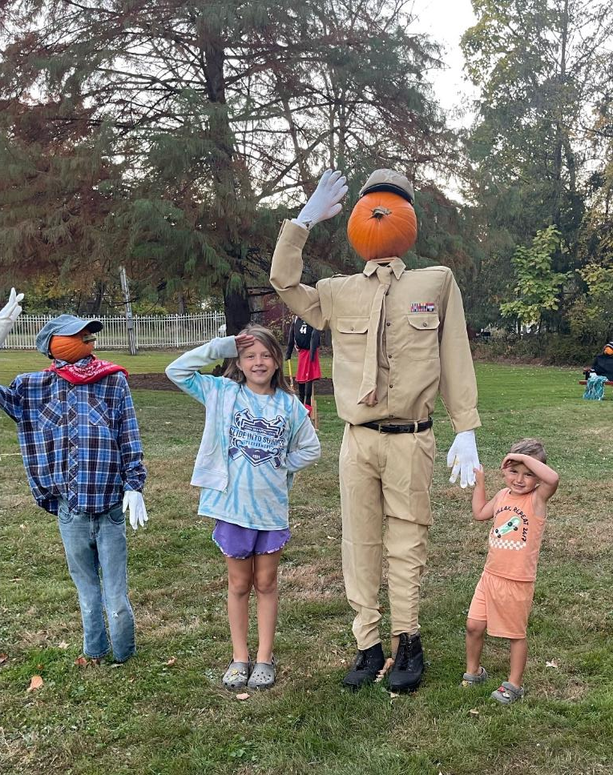
Photo #4

Slide 7
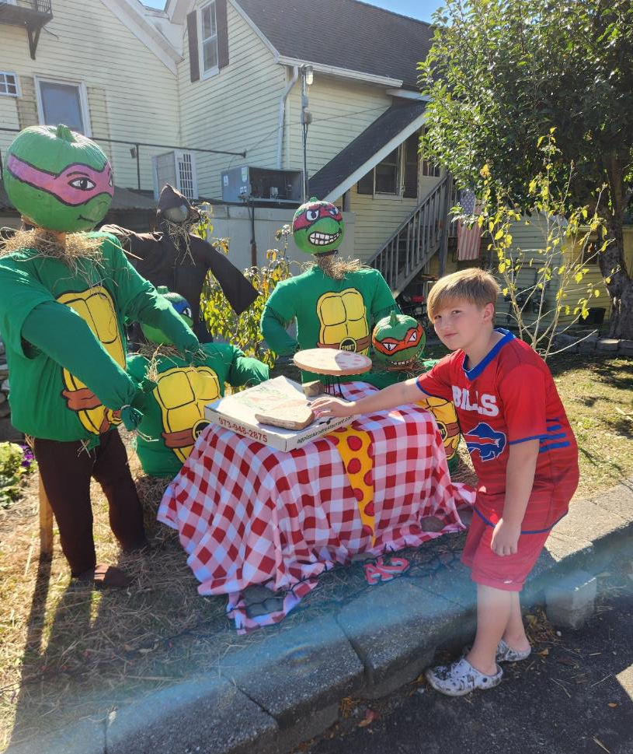
Photo #5

Slide 8
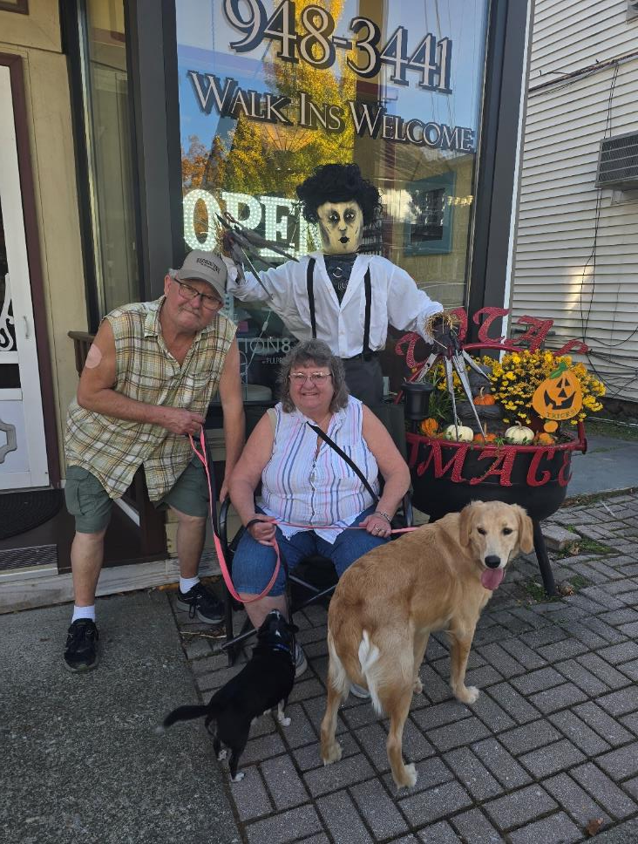
Photo #6

Slide 9
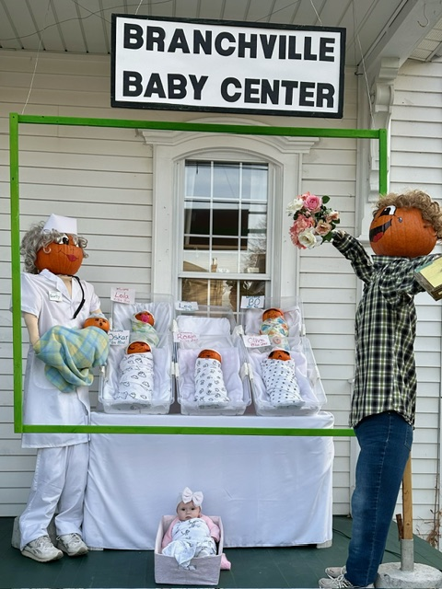
Photo #7

Slide 10
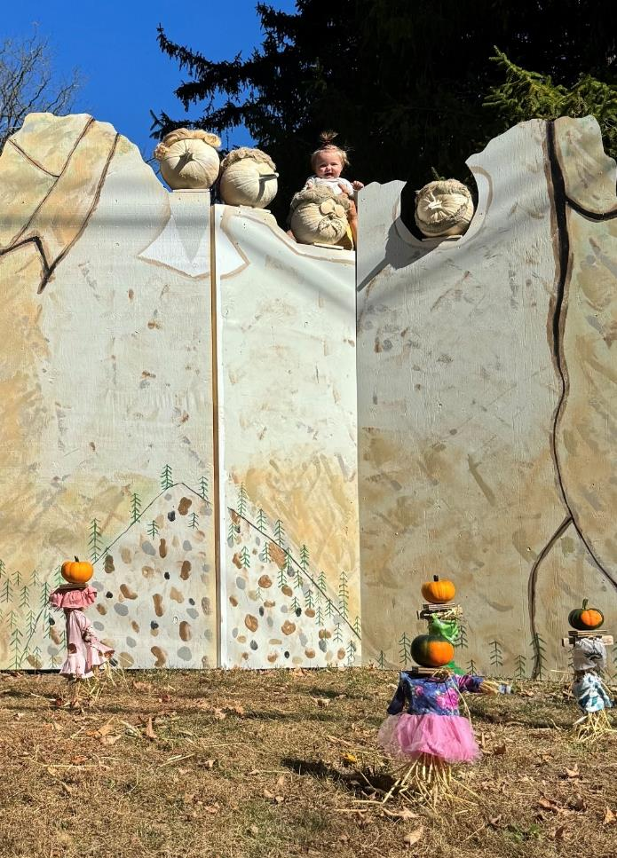
Photo #8

Slide 11
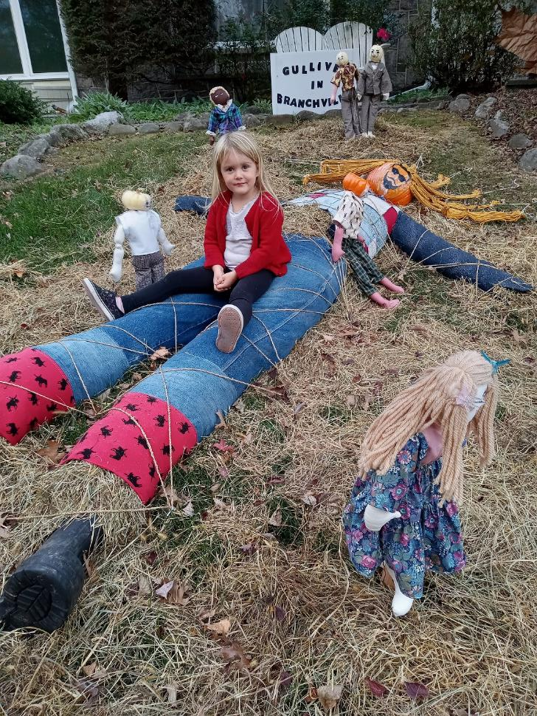
Photo #9

Slide 12
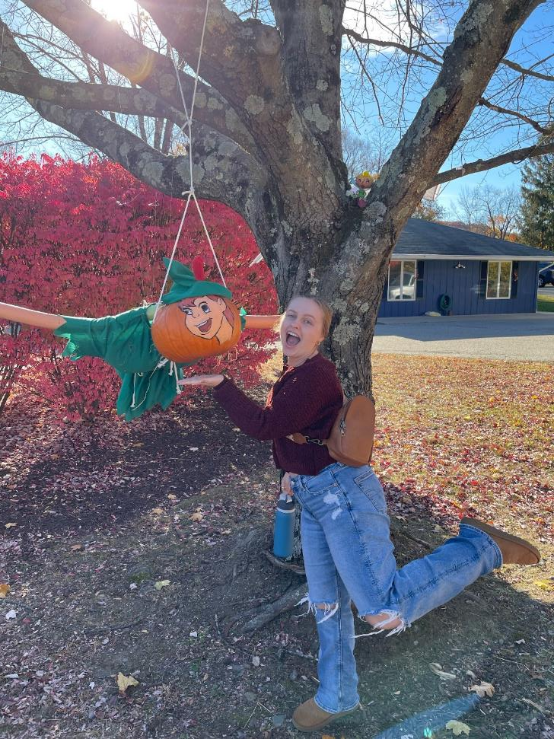
Photo #10

Slide 13
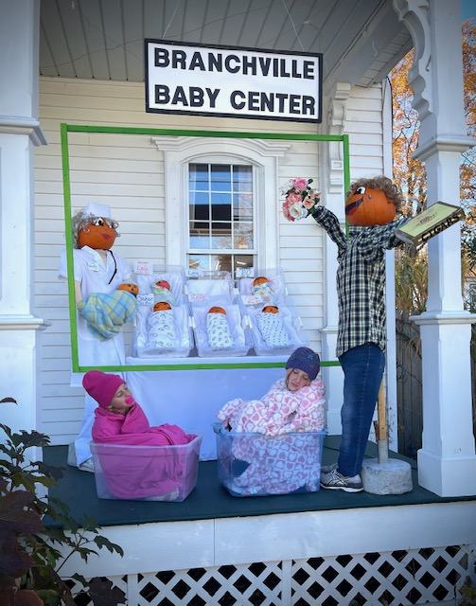
Photo #11

Slide 14
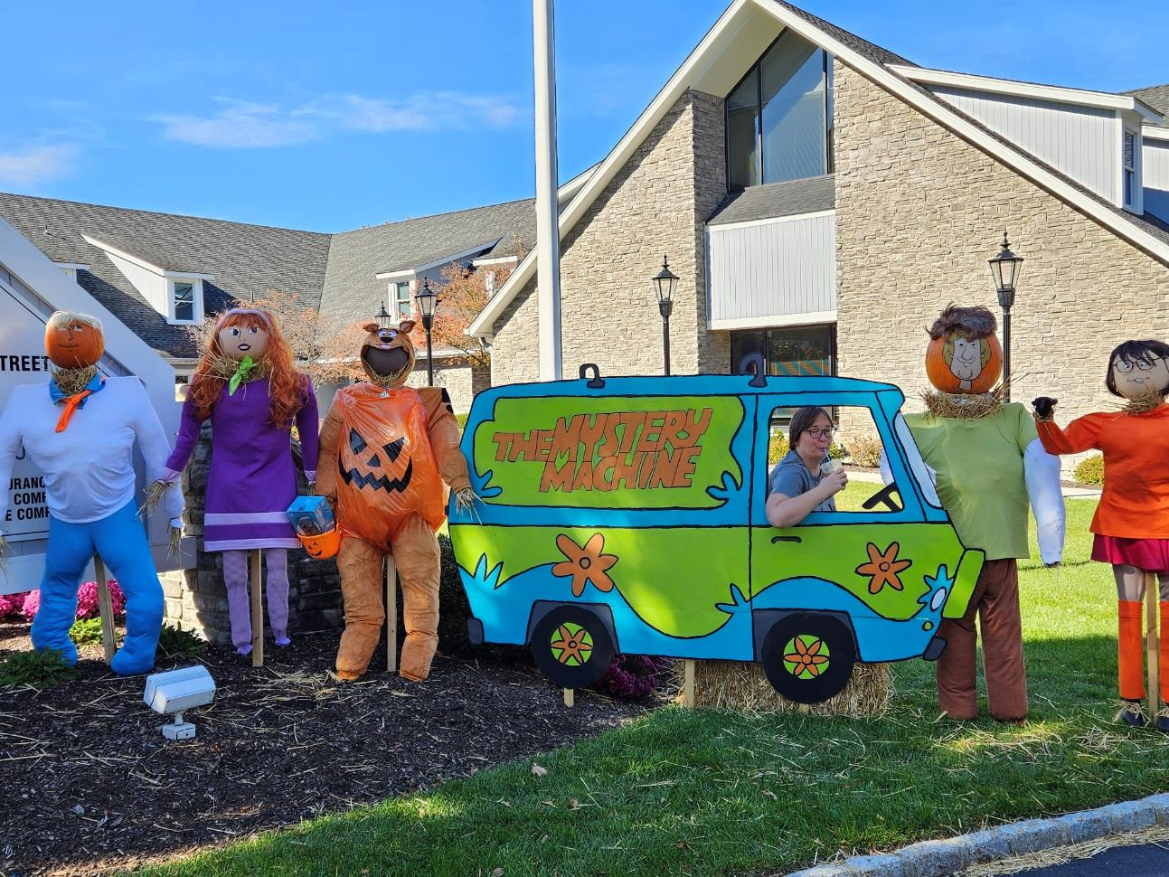
Photo #12

Slide 15
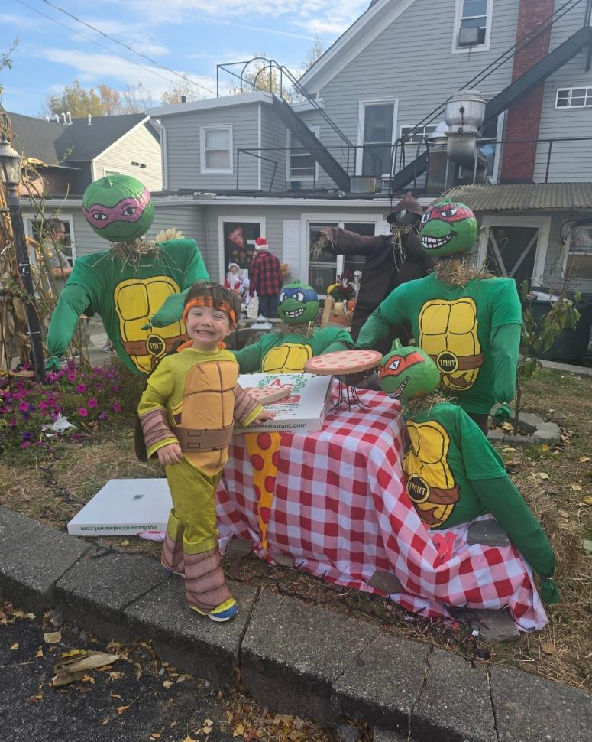
Photo #13

Slide 16
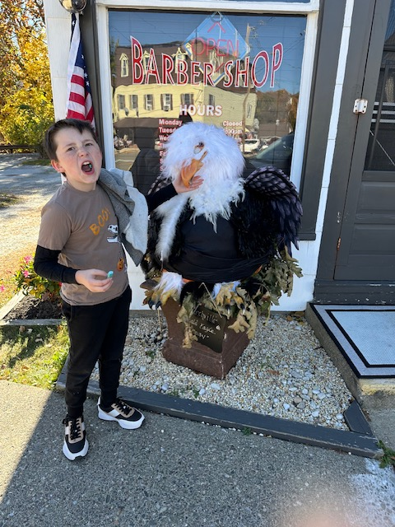
Photo #14

Slide 17
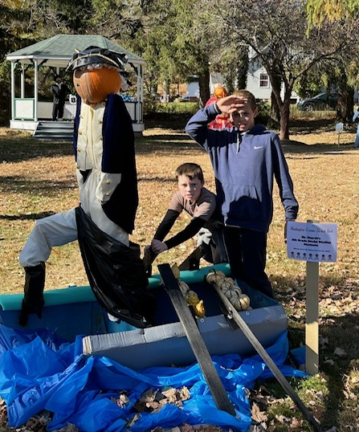
Photo #15

Slide 18
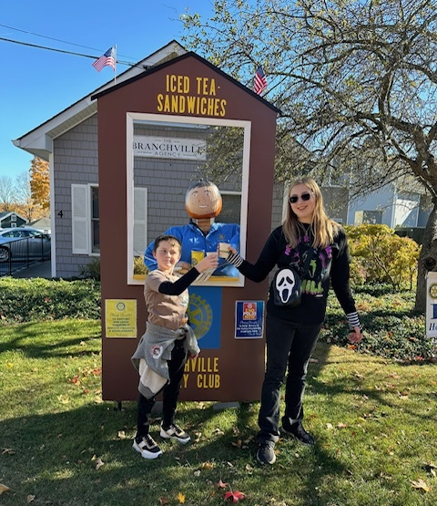
Photo #16

Slide 19
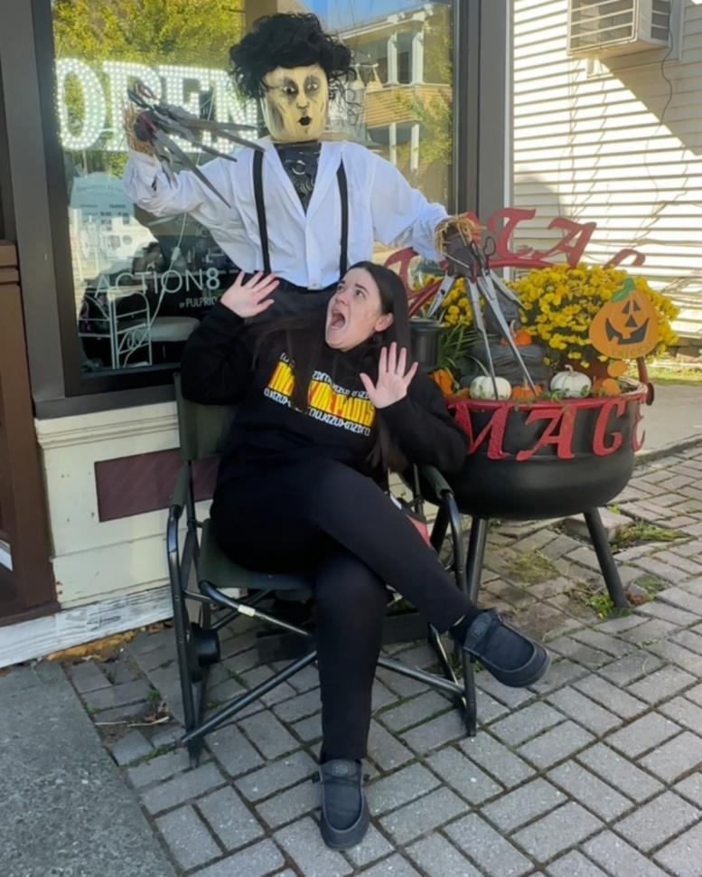
Photo #17

Slide 20
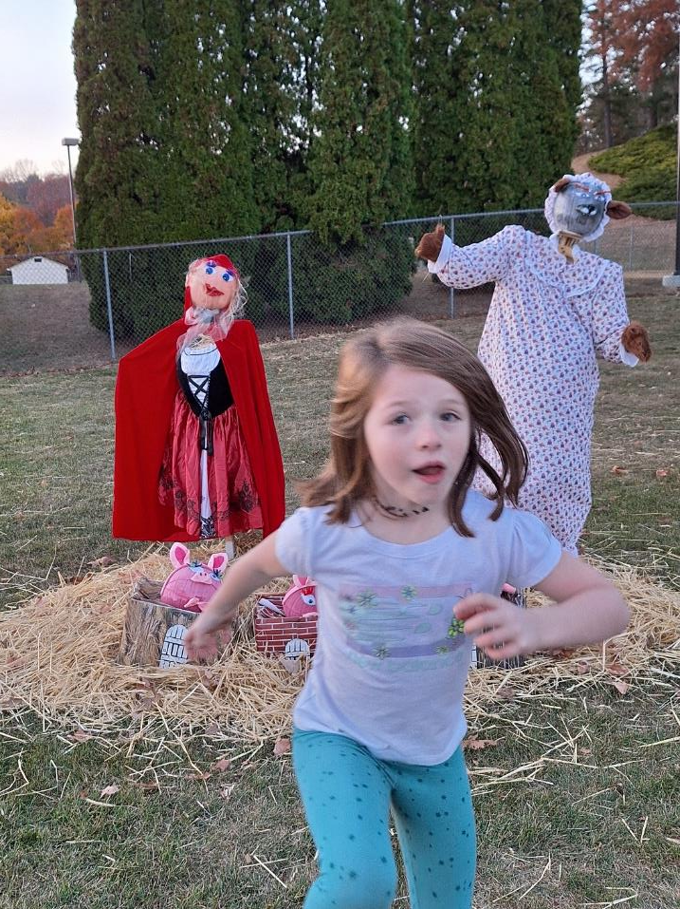
Photo #18

Slide 21
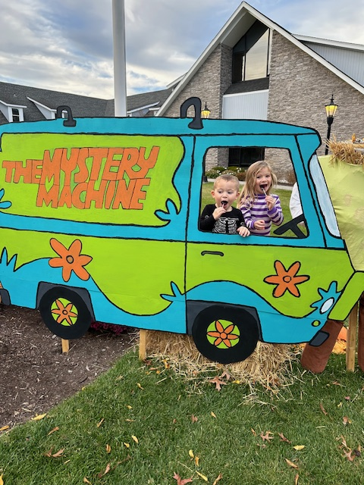
Photo #19

Slide 22
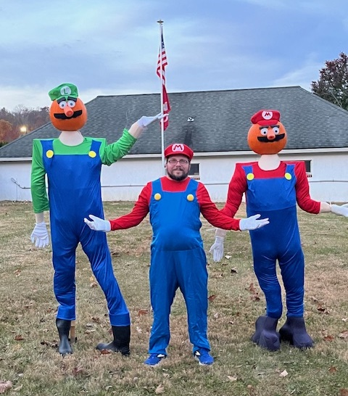
Photo #20

Slide 23
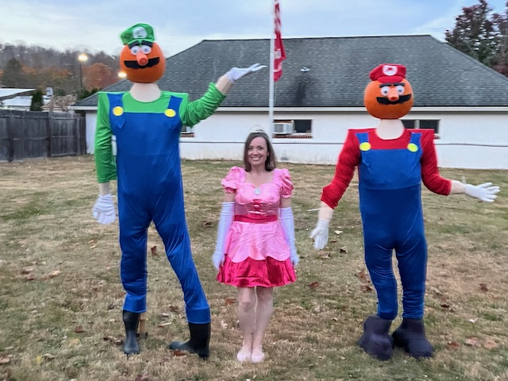
Photo #21

Slide 24
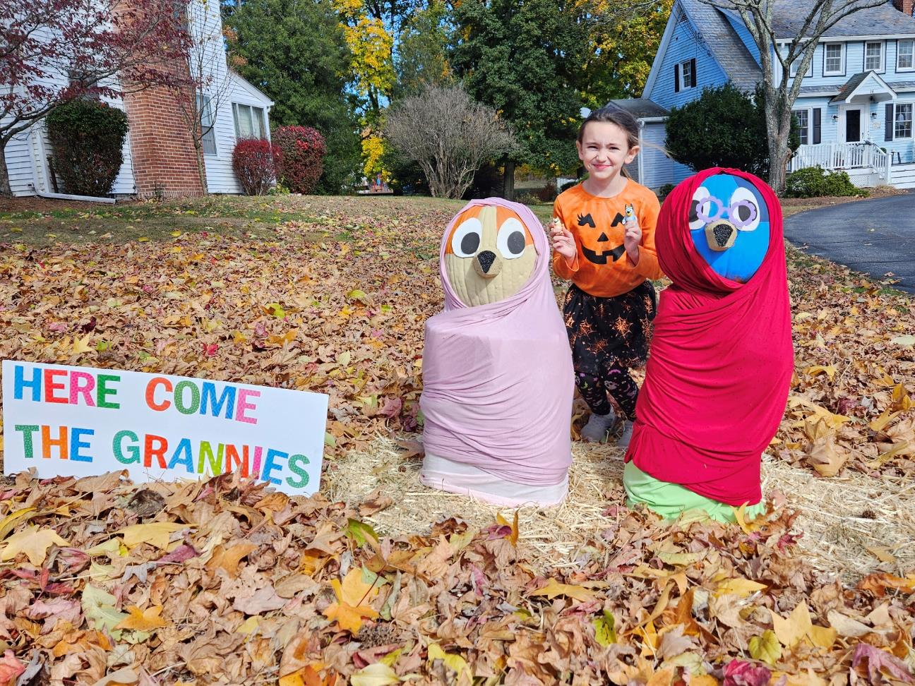
Photo #22

Slide 25
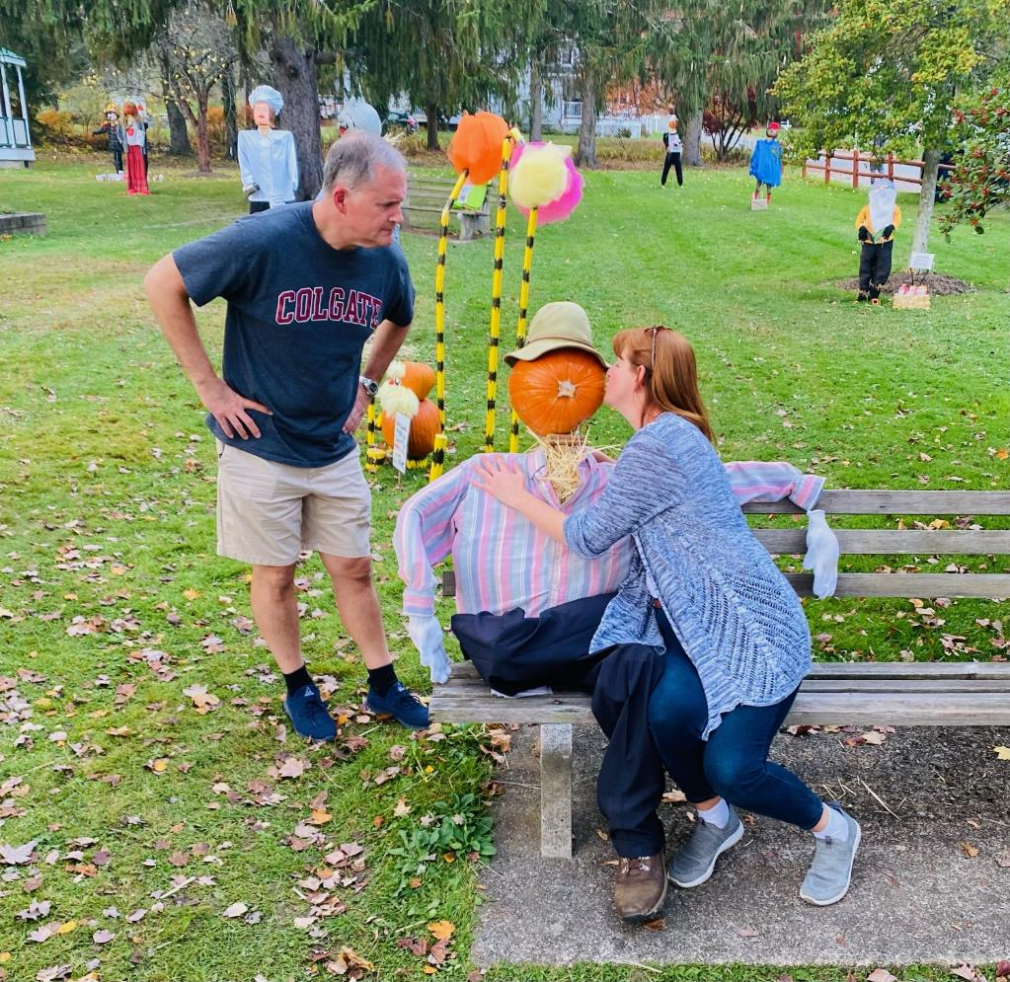
We hope you enjoyed the show and have picked your favorites! Pictured here is the 2023 Winner.

