Slide 1
Madison CNA
“Grow Back Better”
Summary & Results
Club Presentation
January 27, 2022
Notes:
TITLE PAGE

Slide 2
WHY DID MADISON ROTARY SPONSOR THIS CNA?
One of Madison Rotary’s three stated missions is:
“Partner with other local organizations to enrich the Madison community for all”
As Madison starts to emerge from the pandemic, the local organizations that serve our community have an opportunity to help Madison grow back better
All these organizations have new understandings and perspectives of the needs of the community constituents that they serve

Slide 3
OUR GOALS:
Understand the top 3-5 critical and or emerging needs of our community, through the eyes of our Madison community leaders
Madison Rotary partnering with community leaders to create projects/working solutions that benefit all residents of Madison.
Longer term, our community knows who Madison Rotary is and what we do, therefore increasing membership and member engagement
This is our opportunity to Serve our Community to Change Lives..

Slide 4
THE CNA EVENT
32 Madison community leaders, 6 Rotarians and a professional facilitator
came together for a two-hour discussion that captured each leader’s
understanding and perspective of what our challenges are.
Below are the questions we asked:
How is our community doing on a scale of 1-10?
What’s working well in our community?
What’s not working in our community?
What’s missing in our community?
What’s a PERFECT 10 community look like?
What’s important to you and to our community citizens/neighbors? And
what is what do you see in your role that the rest of us don’s see?
The facilitator documented all the input and shared it with all participating
leaders.
Notes:
So, What did the event look like and how was it structured. We had several Rotarians who took their Rotary hats off and put on their work hats; Diane Mann, Deb Starker, Tanya Van Order, John Hoover and of course our Mayor, Bob Conley, Who was a tremendous resource to us throughout this process.

Slide 5
CNA RESULTS
Making Madison a Vibrant Community for All
Fortifying Community Organizations & Volunteerism
An Accessible School System for All
Improving Borough Government, Services & Management
Identify Opportunities to Further Strengthen the School System
Assuring Housing for a Diverse Population
Expanding Mental Health Services
Embracing Diversity & Building New Traditions
Creating a Centralized & Curated Community Information Network
Affordable Housing & Transportation Services
Elevate Those Who Need a Lift
Access to Enrichment Programs for All Students
Coordination of Basic Services (food, shelter & clothing)
A Trusted Connection between the Police & the Community
Reducing Barriers for the Disabled
More and Better Indoor & Outdoor Gathering Space
Enhance an Aging Downtown Structurally & Aesthetically
Notes:
These are not in any particular order

Slide 6
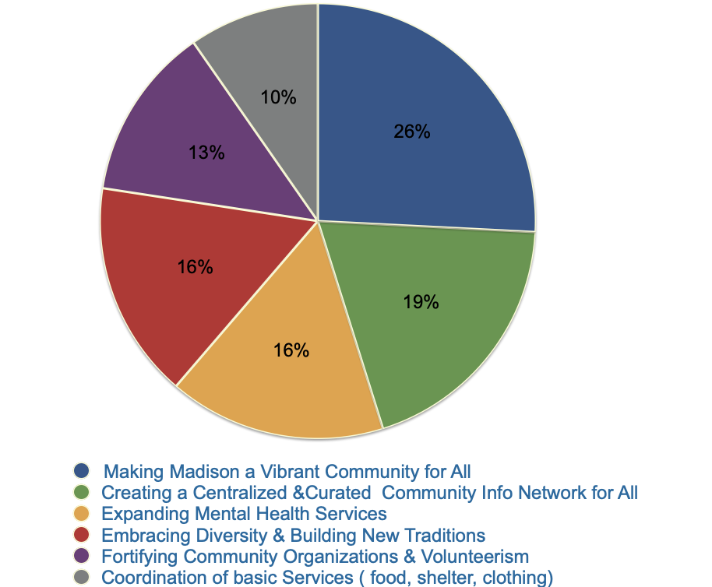
Notes:
We then Surveyed the participants asking them to prioritize their top 1 & 2 themes. The percentages reflect 22 responses out of a total of 32 participants

Slide 7
CNA THEME PRIORITIZATION (Cont.)
1. Making Madison a Vibrant Community for All
Participants expressed concern about aging residents leaving because they didn’t create strong enough roots and high real estate taxes.
Others expressed concern that vibrancy depends on attracting young people to live in and visit Madison, noting that Madison needs to be affordable and there need to be ways for young people to easily get involved
Some community members struggle when after-school care programs end in middle school and adults need that support in order to continue to work

Slide 8
CNA THEME PRIORITIZATION (Cont.)
2. Centralized, Curated Community Information
Provide information in English and Spanish
Educate parents so they can support kids who are given chrome books. Teach parents how to use them too. Teach parents about how to navigate other aspects of the school system that are hard without tech knowledge or facility with English
Create ways to share resources; consider establishing a community page to include tools for how to do XYZ, resources, classes, how government works, how to get involved. Hold classes on these topics every 6 months for those who are not apt to look at an online resource
There needs to be more communication to get more involvement.
Look for ways to provide services to the elderly; get information to others on who needs help with what
One hub for communication for all organizations & activities; it needs to be aggregated and curated, not just links to other sites

Slide 9
CNA THEME PRIORITIZATION (Cont.)
3. Expanding Mental Health Services
Improve mental health; help people find jobs with local companies, especially for those with disabilities
Make people aware of resources to help them reduce stress, mental health and other concerns
Mental health – how to access support either in person, virtually, with or without insurance. Is there a role for Project Community Pride?
Invest in well-prepared mental health counselors
Notes:
Rotary has an opportunity to partner with MAASA ( Madison Alliance Addressing Substance Abuse) to help educate the community on mental health. Thank you, Ray Freaney for developing this initiative

Slide 10
CNA THEME PRIORITIZATION(Cont.)
4. Expanding Diversity & Embracing New Traditions
Build new traditions that embrace all community members music, dancing, art and incorporate different racial backgrounds. Have a day for Latino residents – dancing, food, music, culture
Be more inclusive, less binary, diversity, more transparency Include all cultures in our community activities, One in which we constantly strive to know one another
Opportunities to deepen relationship with the Latino Community
More complete integration of public schools, including the Latino Community
Understand the police department (Madison Police Initiative)
More welcoming Hartley Dodge Memorial
Notes:
Examples of Community leaders who have already taken action based on these themes are;
Mark Shwartz; Superintendent of Schools, has included diversity initiatives into his 2021 State of the Schools Address . Initiatives that will be most immediate next points of focus; such as:
EMPOWER EVERY CHILD Building bridges across race, culture and identity to create a community where all are valued.
Police Chief John Miscia:
Created a newly formed Community Relations Unit to develop sensitivities and communication

Slide 11
CNA THEME PRIORITIZATION (Cont.)
5. Fortifying Community Organizations & Volunteerism and Enhance an Aging Downtown Structurally & Aesthetically
Create “pocket park” effect
Focused effort to further enhance facilities; build our facilities – create a multi-purpose field house
Include an environmental lens in our community (Styrofoam collection)
Placemaking, land use that prioritizes people over profits
Replace Waverly Place with a Piazza (foot traffic only).
Turn Dodge Field into Madison’s Central Park.
Integrate Public/interactive art in the community

Slide 12
CNA THEME PRIORITIZATION (Cont.)
6. Coordination of Basic Services (food, shelter & clothing)
Affordable housing
Harvest Day, End Hunger, Interact Food Collection in conjunction with
Interfaith Food Pantry
Dress for Success
Madison Eagle Christmas Fund Cloths Drive
Other ideas??????
Notes:
Harvest Day: Dennis Budinick example and how it pertains to our club

Slide 13
Next Steps
Rotary is leading the discussion creating an Executive Committee to keep the CNA Process moving forward
The Committee will be reaching out to leaders to develop a set of goals and timelines
Initial priority will be to develop a centralized, curated information hub for all on the rosenet.org website
Impact will not just effect Madison residents but those in surrounding towns as well
Create buy in and commitment with project ideas from Madison Rotarians
Notes:
Committee consists of Doug, Me, Tom Honohan (Lead) Guillermo Gill
This will be on going for at least the next year or two and if we come up with some great project ideas we may have long lasting impact on our community.
Project ideas?

Slide 14
Questions/ Ideas ??

