Slide 1
Foundation
A newly formed 501 c(3) organization dedicated to Scholarships & the charitable needs of the communities we serve
Pequannock Riverdale Lincoln Park
District 7470

Slide 2
Pequannock Valley Rotary Foundation is a newly formed 501 c(3) Corporation, formed, guided and managed by the Pequannock Valley Rotary;
a community minded group of men and women who’s guided by the motto “Service above Self”, work together to raise money for a variety of local causes. PV Rotary has given hundreds of thousands of dollars in college scholarships to local high school seniors, provided hundreds of hot meals to local residents affected by the floods, raised funds for local Food Pantries, donated many thousands of dollars worth of lifesaving equipment to local Police, Fire, and First Aid Squads, brought children from third world countries for life saving operations, and so much more ….

Slide 3
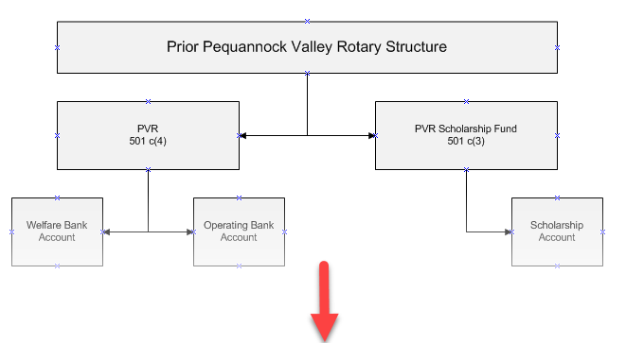
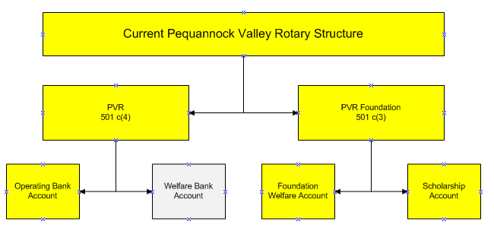

Slide 4
Why have the Foundation vs. our existing Welfare Account
Current Welfare is a 501 c(4) which means contribution from non club members are not eligible for an IRS deduction.
Stronger base of support and growth of the scholarship fund
Simplifies year end Tax reporting

Slide 5
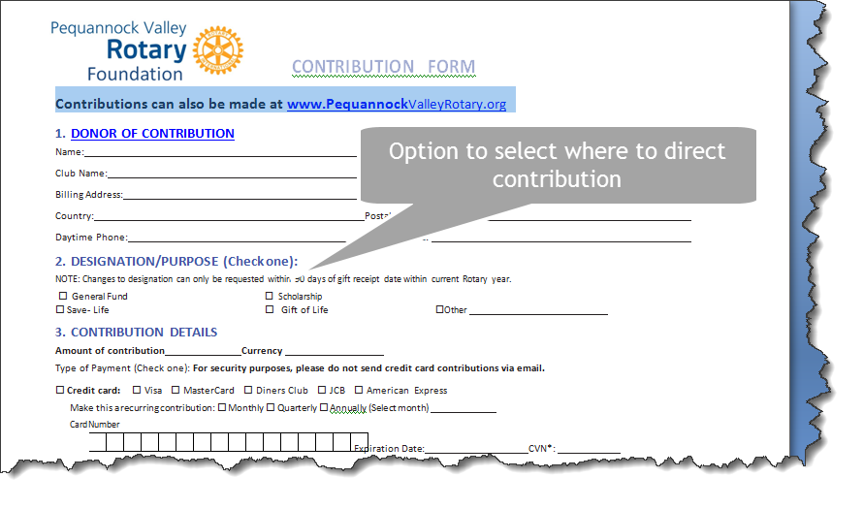

Slide 6
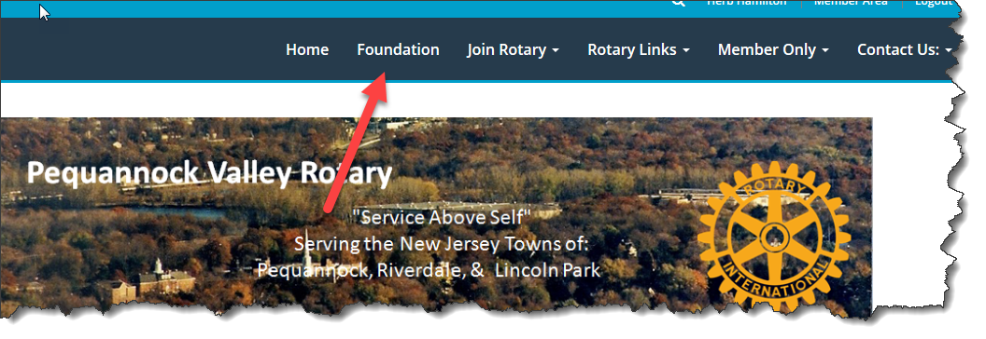
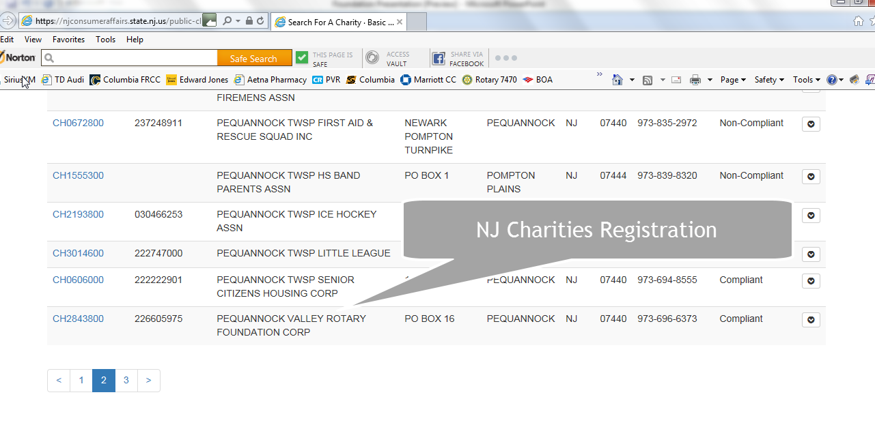

Slide 7
What’s the next step:
Build a transition team to do:
Revise P&P from Scholarship to Foundation
Establish organization structure & relationship with PVR Board
Set up Foundation Bank accounts
Work with Bob Petersen to:
Establish QuickBooks accounts
Year end Tax reporting
Modify Web Site establish Foundation Tab
Press Releases
Marketing Brochure

Slide 8
NOTE: The Pequannock Valley Rotary Foundation, Corp is recognized by the IRS as a charity under section 501(c)(3) of the Internal Revenue Code. Your contributions to the Foundation are fully deductible to the extent allowed by law.

