Slide 1


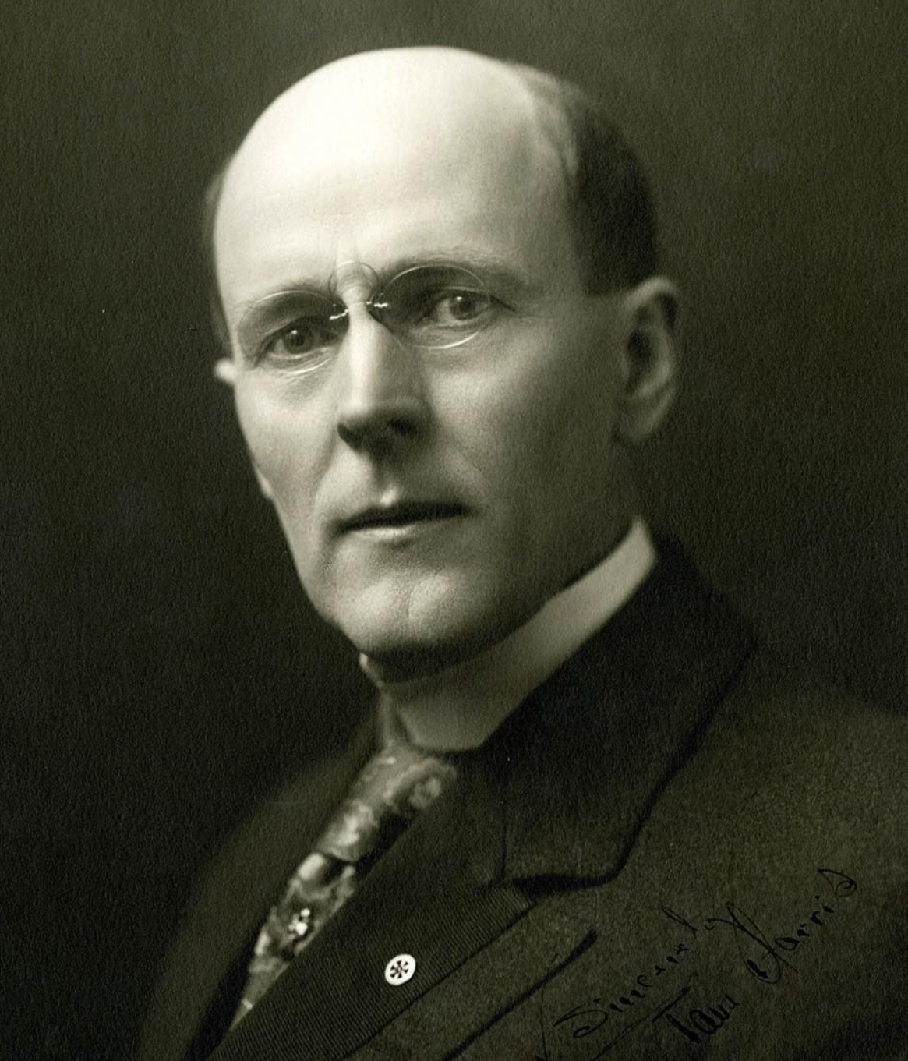
The Rotary Foundation & Paul Harris Fellows
“Paul Harris Fellows represent Rotary’s way of recognizing individuals whose contributions support the Rotary Foundation and advance Rotary’s mission of doing good in the world.”

Slide 2




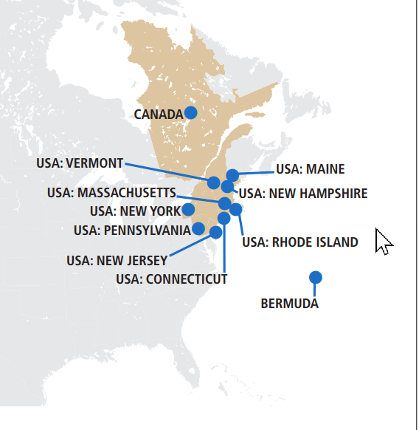

Districts 500+
Clubs 27,000
Members 1,400,000
Zones 32
Rotary International

Slide 3

The Rotary Foundation
Arch Klumph created the endowment for doing good in the world in 1917
Initial contribution of $26.50 from Rotarians
First project: public toilet in Chicago
Transformed millions of lives since then
Today:
Assets >$1 billion
4-stars from Charity Navigator
92% of all donations goes to projects

Slide 4
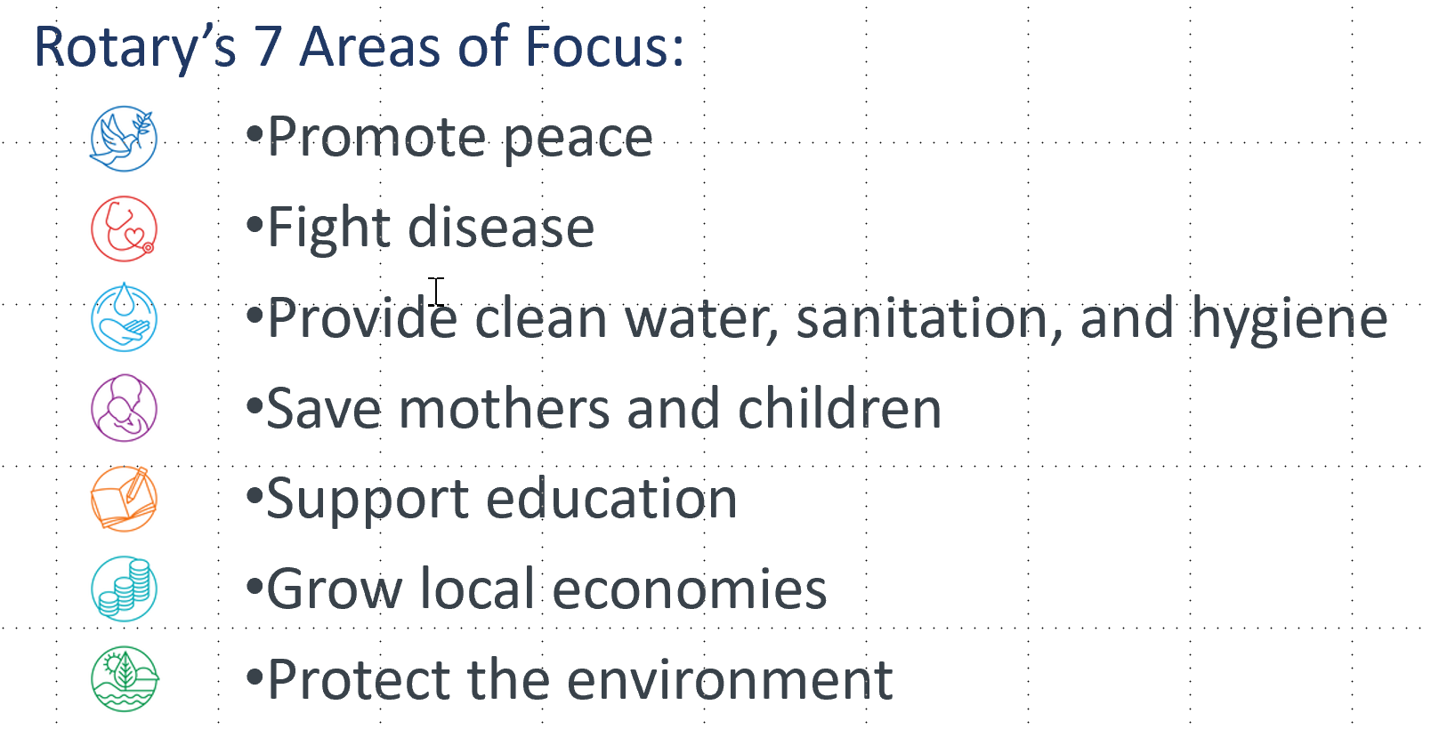
Your contribution to the Rotary Foundation … how it helps in advancing Rotary’s mission of doing good in the world
Brazil Flood Refief

Slide 5

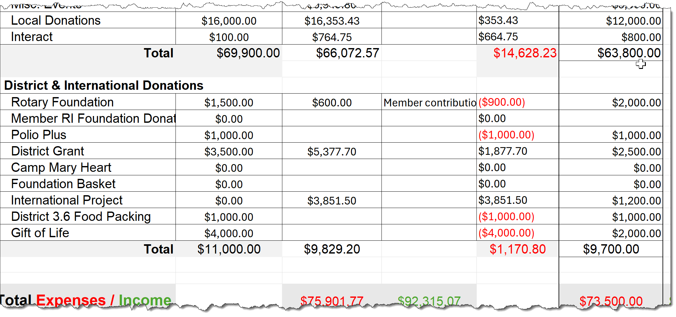
Budget 80% Local / 20% District & International

Slide 6
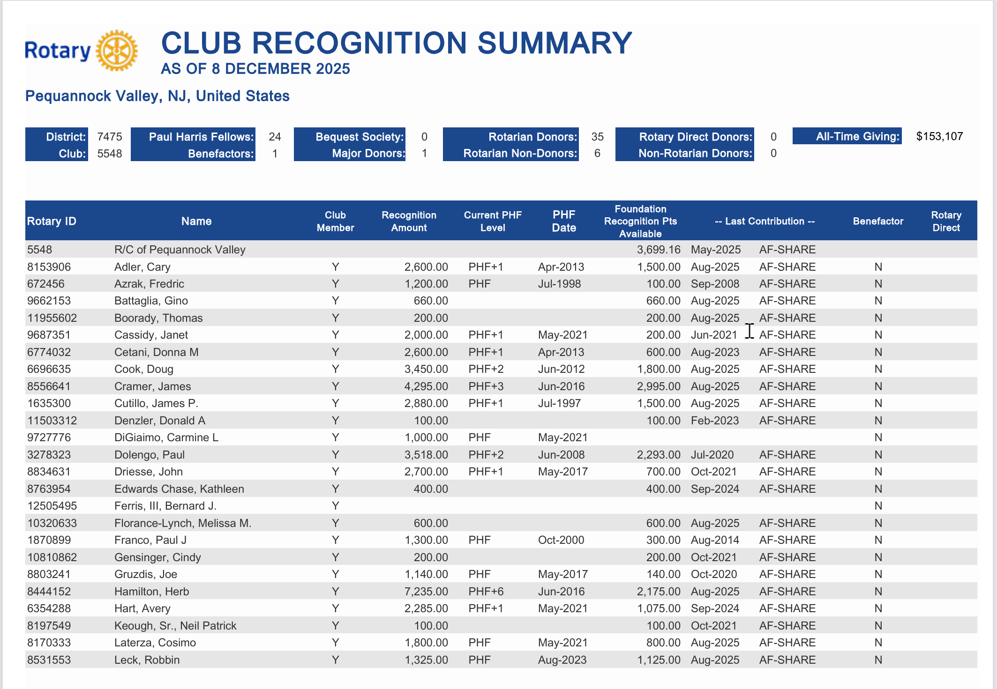
Club Points
Members
Points
Reconciliation Amount
The reconciliation amount refers to the total number of points that represent either donations you have made or points that have been So So awarded to you. For that then I’ll get tomorrow for hours
For every 1,000 points accumulated, you become eligible for an additional Paul Harris Award.
Foundation Recognition Points Available
Foundation Recognition Points are generated from your personal contributions to the Rotary Foundation.
These points not only recognize your individual support but also can be transferred to others, allowing you to help fellow members become eligible for Paul Harris Awards.

Slide 7
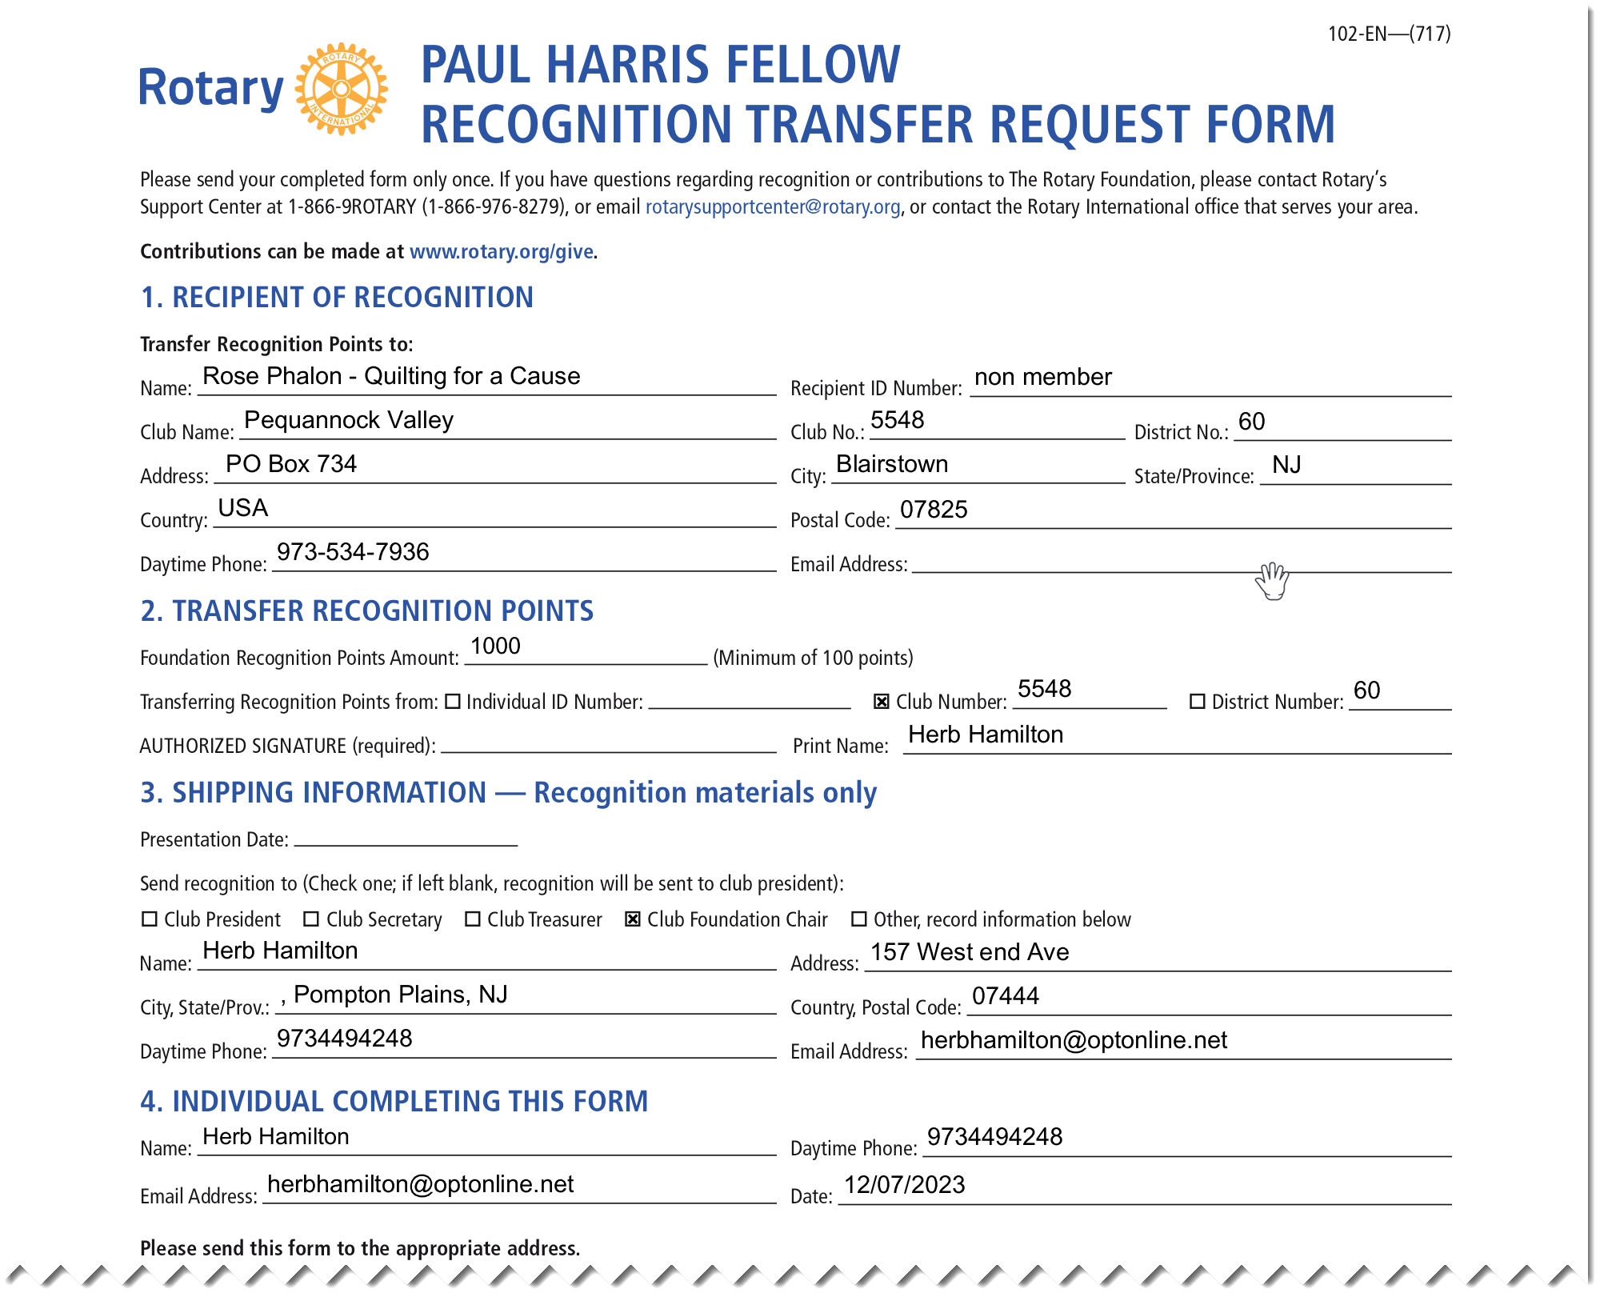

Slide 8
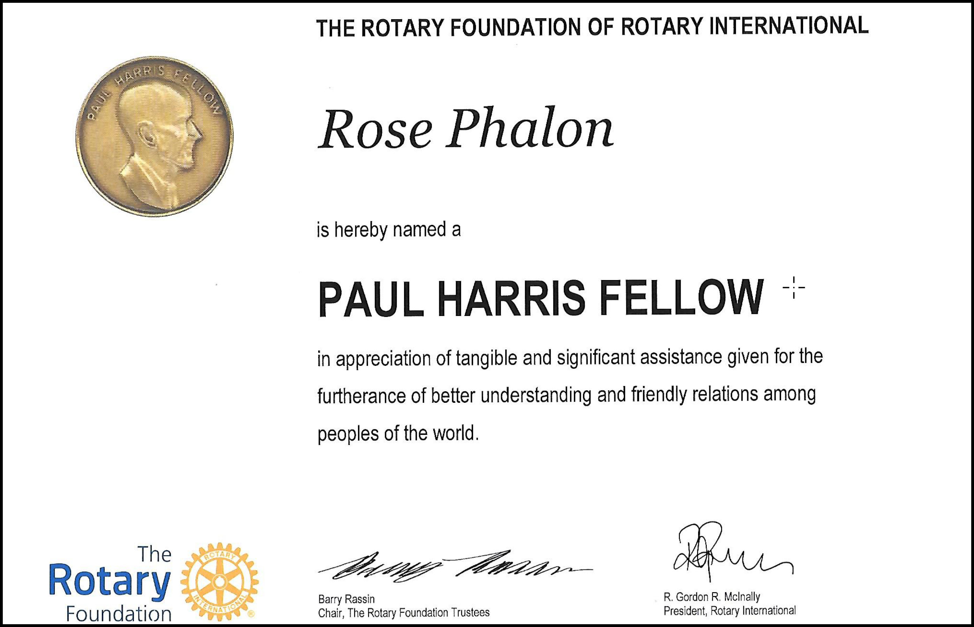
This Years Awards:
Rose Phalon PHF
Robin Leck PHF
Donna Cetani PHF+1
Patty Odenbrett PHF+2
Jim Cramer PHF+3
Herb Hamilton PHF+6
Azrak, Fredric | PHF
DiGiaimo, Carmine L | PHF
Franco, Paul J | PHF
Gruzdis, Joe | PHF
Laterza, Cosimo | PHF
Leck, Robbin | PHF
Petersen, Robert | PHF
Adler, Cary | PHF+1
Cassidy, Janet | PHF+1
Cetani, Donna M | PHF+1
Cutillo, James P. | PHF+1
Driesse, John | PHF+1
Hart, Avery | PHF+1
Pizza, Ernest M. M. | PHF+1
Scheck, Jennifer Michelle | PHF+1
Shah, Shreyans S | PHF+1
Cook, Doug | PHF+2
Dolengo, Paul | PHF+2
Odenbrett, Patricia Ann | PHF+2
Cramer, James | PHF+3
Newton, Alma | PHF+3
Hamilton, Herb | PHF+6
Who’ Who among 950,000 PH world wide:
Mother Theresa
Nelson Mandela,
Kofi Anann,
Prince Charles,
Indira Gandhi,
Luciano Pavarotti
King Hussein of Jordan
Pope John Paul II

Slide 9
Questions????

