Slide 1
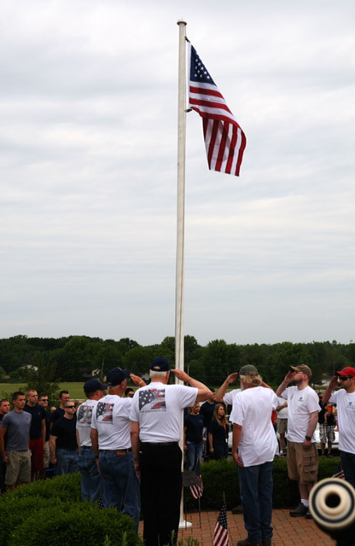
THE MILITARY FAMILY CENTER
COLLABORATIVE PROJECT INITIATED THROUGH THE GLOBAL GRANT OF ROTARY INTERNATIONAL DISTRICT 6650

Slide 2
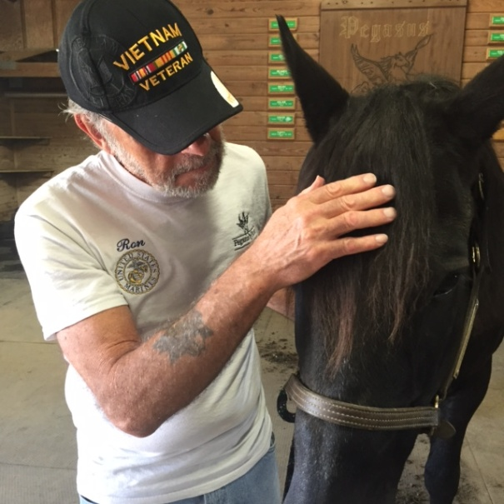
The Military Family Center Will Provide:
1. Equine assisted therapy, Physiotherapy, Occupational therapy
& Clinical therapy to the veterans and the military families.
---- Both the Gold Star and the Blue Star Families.
2. A place and the environment where the families would come together, during crisis or for healing 24 X 7 basis.
3. At no cost to the veterans or their families.
*********
The community serving the community veterans and their families.

Slide 3
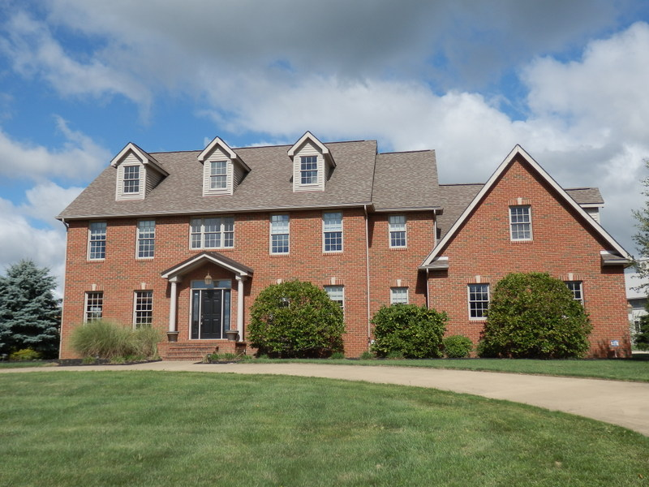
The Military Family Center.
This 20 acres property has 2 story building,
with basement that opens at the back

Slide 4
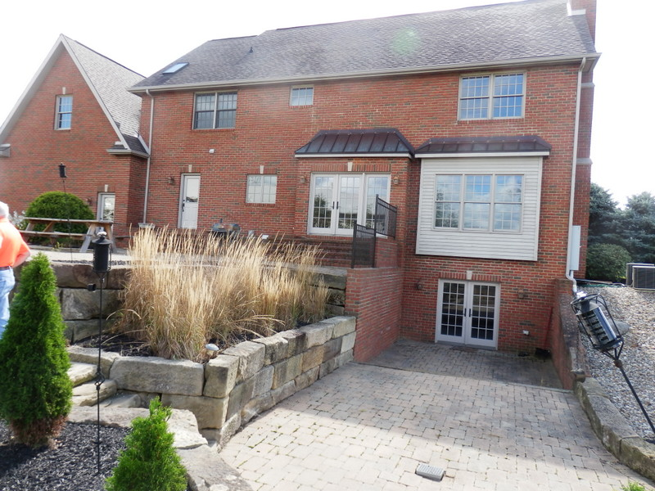
The basement door that opens in the back

Slide 5
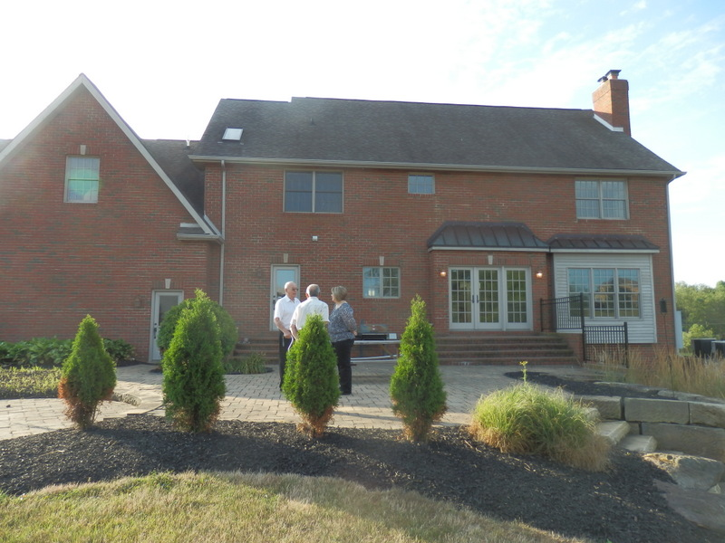
Back yard of the Military Family Center

Slide 6
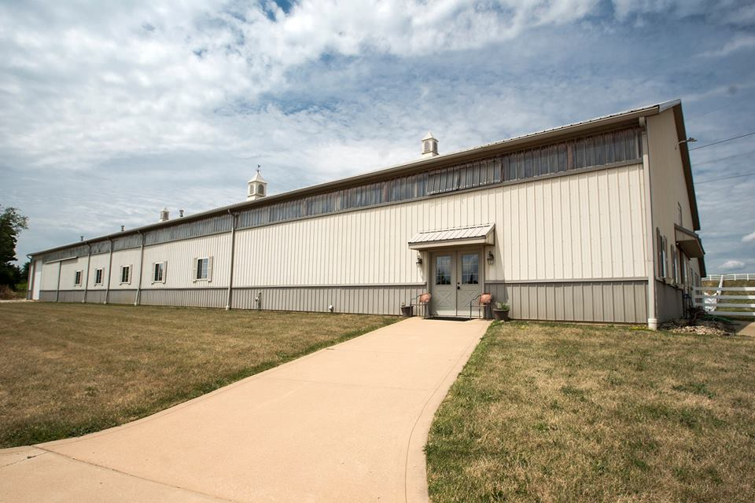
State of the art stables beautifully built

Slide 7
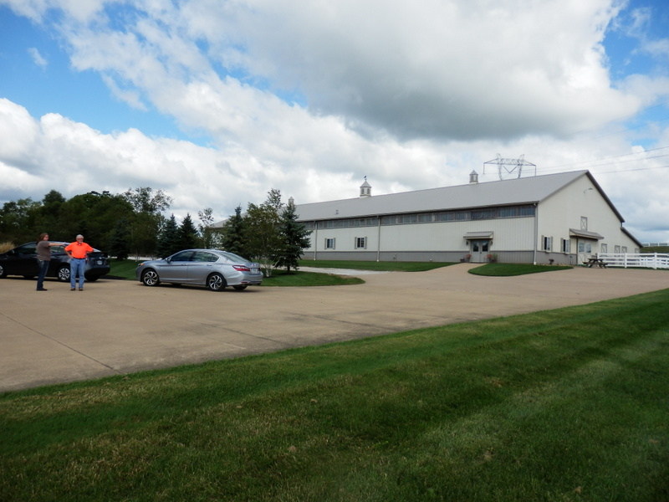
The stables located just a few yards away from the house.
It has beautiful riding arena.

Slide 8
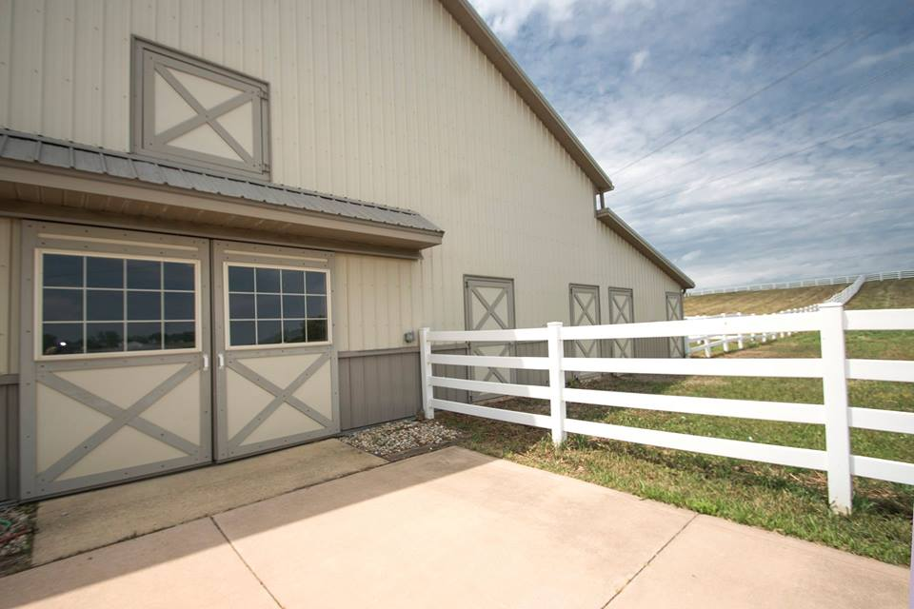
Front entrance of the stables.

Slide 9
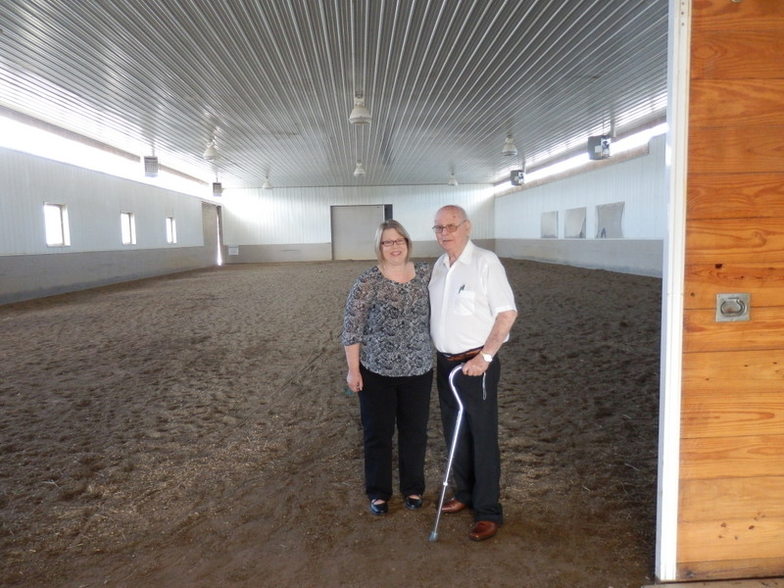
Riding Arena
The Korean War Veteran was very happy to visit the stables.

Slide 10
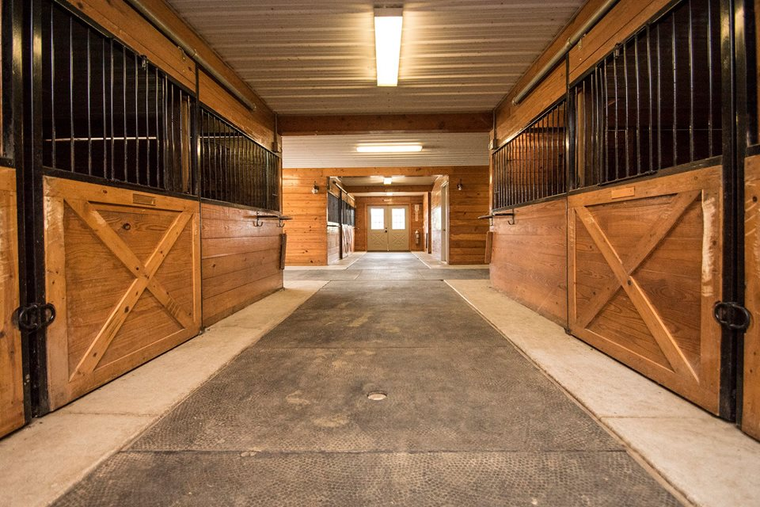
Top notch stables on either side

Slide 11
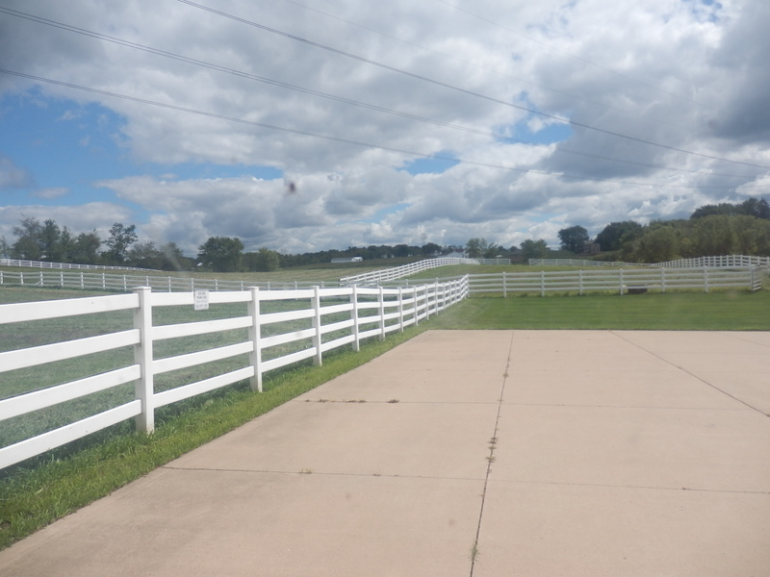
Great pastures for the horses.

Slide 12
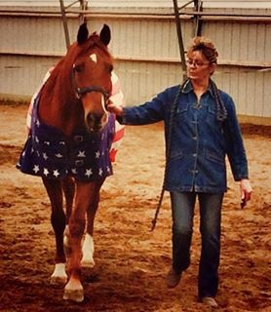
*Susan is a mother of 4 veterans.
*Three sons were deployed between Iraq and Afghanistan.
* Susan says, “the horse saved Mike’s life”, her youngest.
Courtesy of Solid Rock Stables

Slide 13
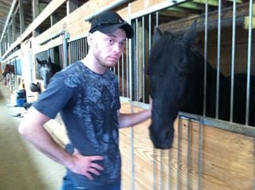
Mike has just returned from Afghanistan with PTSD:
No life in his eyes.
( Courtesy of Solid Rock Stables )

Slide 14
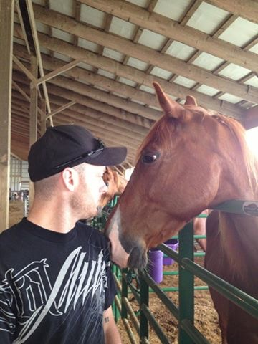
Silent Communication between friends.
Courtesy of from Solid Rock Stables

Slide 15
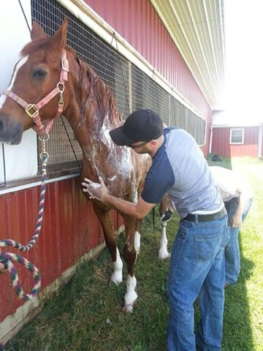
Both love the routine of
Bathing
&
grooming
Courtsey of Solid Rock Stables

Slide 16
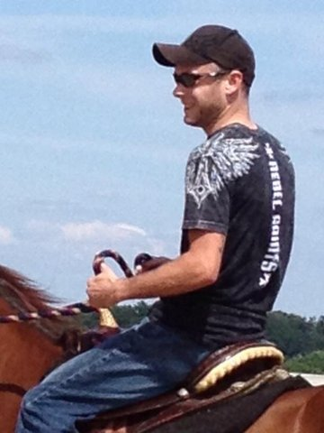
Horse Did Save Mike !
Mike loves his buddy
&
His Job Now.
Courtesy of Solid Rock Stables

Slide 17
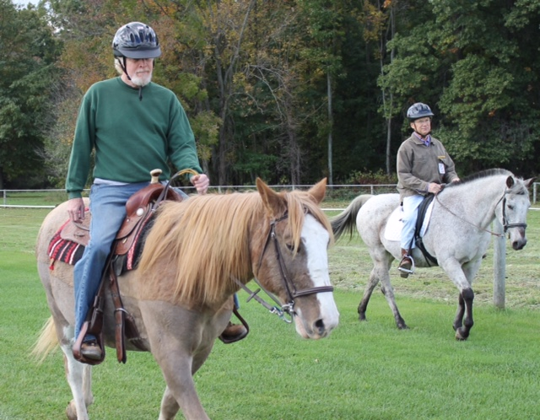
(Picture from Pegasus Farms)
VETERANS SALUTE PROGRAM

Slide 18
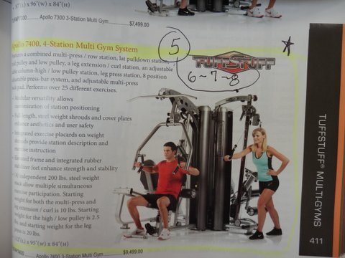
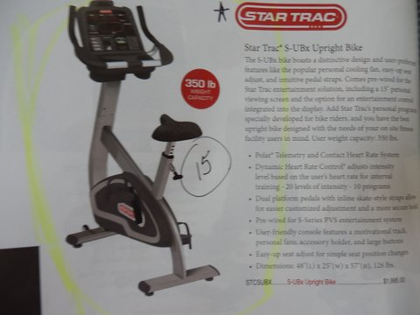
Some of the physiotherapy and occupational therapy equipment in several next slides from the
Global Grant of Rotary District 6650

Slide 19
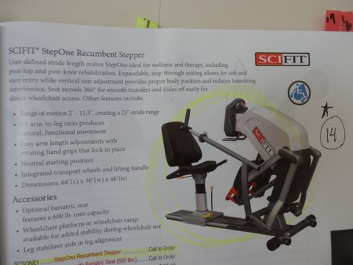
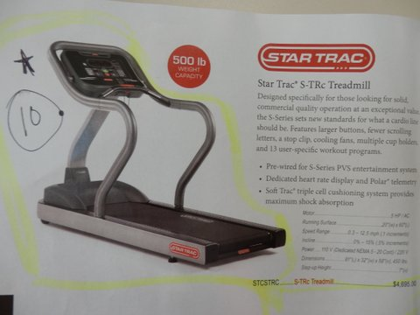

Slide 20
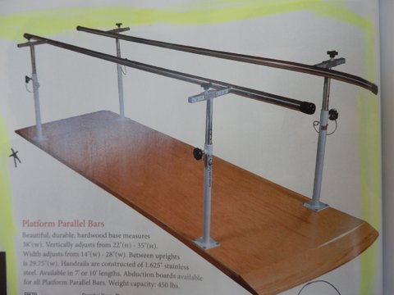

Slide 21
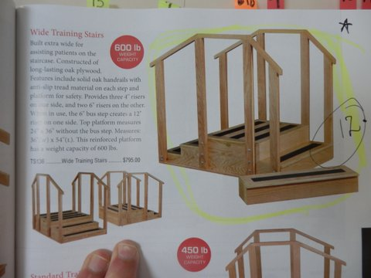

Slide 22
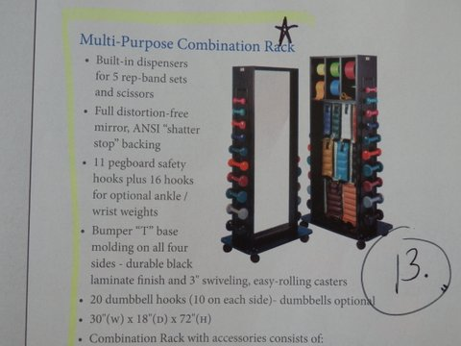

Slide 23
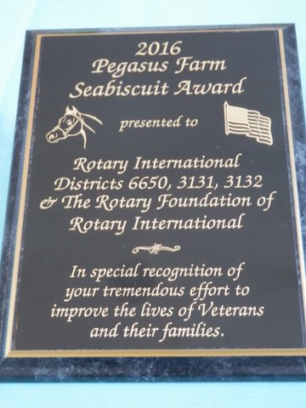
SEABISCUIT
Was an Amazing
Thoroughbred Race Horse in America.
During the time of Great Depression,
His Wins gave many
A Hope!

Slide 24
Rotary International District 6650 Rotarians (Ohio),
Rotary International Districts 3131 & 3132 Rotarians (India)
&
The Rotary Foundation of Rotary International
---- are extremely happy to support this project, and
grateful to Pegasus Farms for providing Equine Assisted Therapy, and
Equally grateful to Walsh University for their support to our veterans and the military families with duly needed physiotherapy, occupational and clinical therapies.
God Bless America
&
Our Veterans.
---- Meena Patel
Past District Governor
R.I. District 6650

