Slide 1
Every child has a chance – it’s you

Slide 2
WHAT IS CASA?
Court Appointed
Special Advocates
Our mission is to assign trained volunteers
to advocate in court for the safety and well-being
of abused and neglected children in Jefferson and Gilpin Counties.

Slide 3
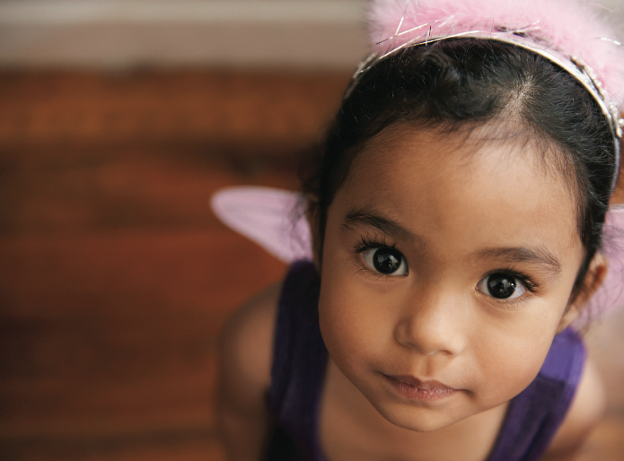
CASA TODAY
NATIONAL
948 Local Programs in 49 states and D.C.
Over 95,000 advocates served over 280,000
children in 2019
COLORADO
18 Local Programs in Colorado
Just last year- over 2,000 advocates served
over 5,000 children
JEFFCO/GILPIN
329 CASA volunteers served over 400 children in 2020
YOUR VOICE COULD BE MY ONLY CHANCE
EVERY CHILD DESERVES A CHANCE — IT’S YOU.
CASA volunteers get to know the child and everyone involved in the child’s life to advocate for the child’s best interests while in the system.

Slide 4
WHO ARE CASA VOLUNTEER ADVOCATES?
Ordinary people- just like you
At least 21 years of age
Pass a background check
Complete 30-hour Volunteer Training
Commit to a child for the life of the case - at least 12-18 months
For more information, www.casajeffcogilpin.com

Slide 5
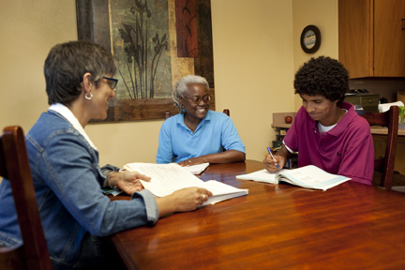
VOLUNTEER ADVOCATE TRAINING
Training
30 hours, over 5 weeks
Topics include:
child welfare system;
child development;
abuse and neglect;
courts and testifying;
family dynamics;
cultural competence;
community resources;
And MUCH more!
Swearing-In with a CASA Jeffco/Gilpin Judge at end of training
CHANGE A CHILD’S STORY

Slide 6
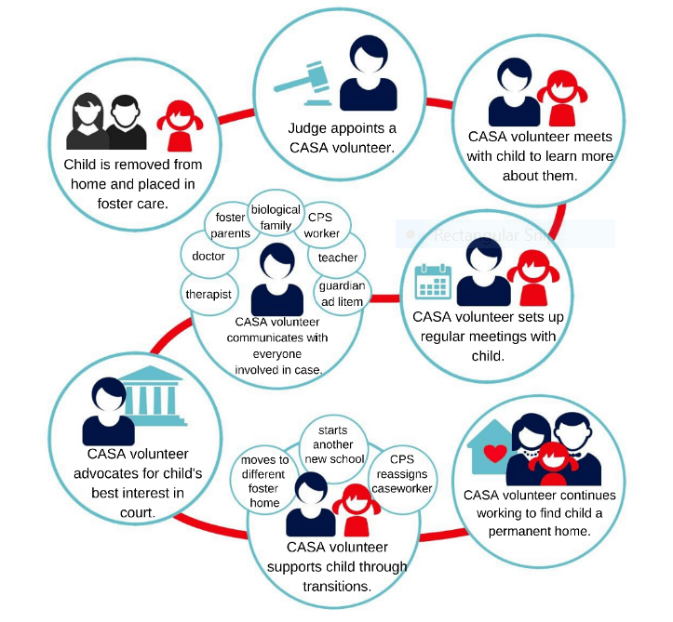
WHAT TO EXPECT AFTER SWEARING-IN
Assigned a case with help from your Case Coordinator
Weekly contact with Case Coordinator & your team
Visit your CASA child weekly for at least one hour
Attend court every 60-90 days to share your recommendations
Document time, miles & notes

Slide 7
THE VOLUNTEER’S ROLE
ARE NEEDS BEING MET?
Emotional, Physical, Educational and Medical Well-Being of Child
CONTACT
Keep in weekly contact with child and others on the case
RECOMMEND
Permanent Placement for Child (i.e. return home, adopted into new family, remain in relative care)
Other necessities (tutoring, therapy, sibling visits, school activities, etc)
CHANGE A CHILD’S STORY

Slide 8
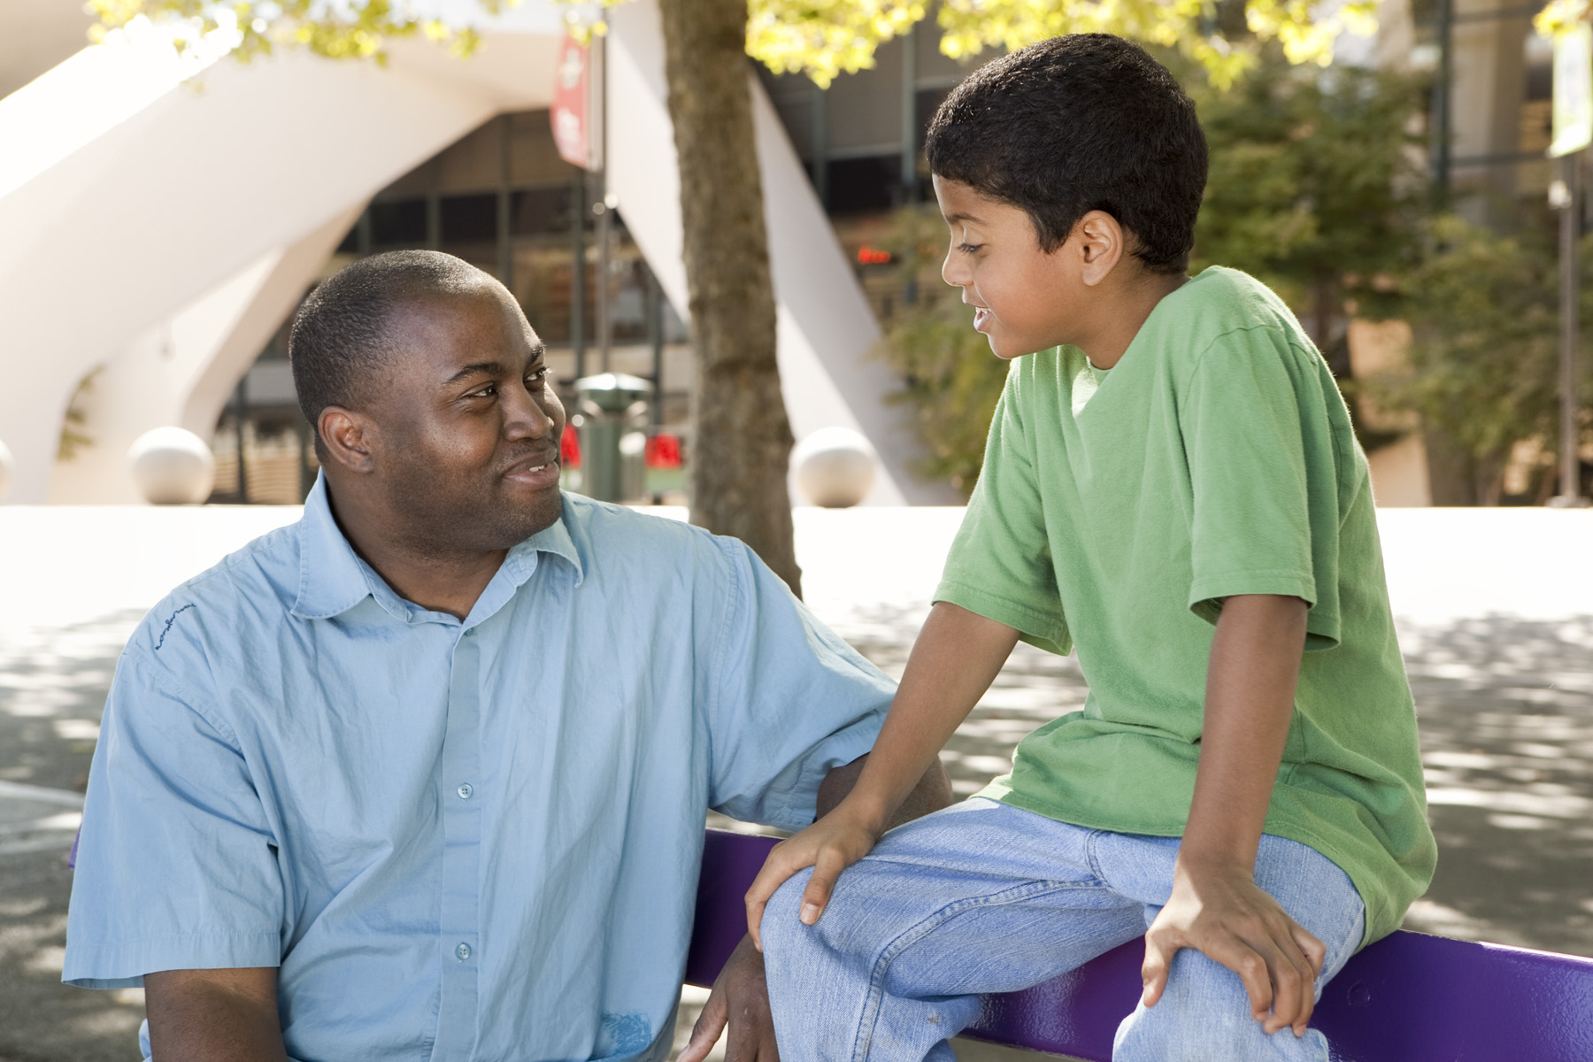
BENEFITS OF CASA
ONE CASE AT A TIME
Ability to build a close relationship
INDEPENDENT AND OBJECTIVE
CASA Volunteers serve as a voice for children in court
THE CASA DIFFERENCE
Children with CASA volunteers are
More likely to do better in school
Have better access to resources
Experience fewer placement changes
Spend less time in the system
CHANGE A CHILD’S STORY

Slide 9
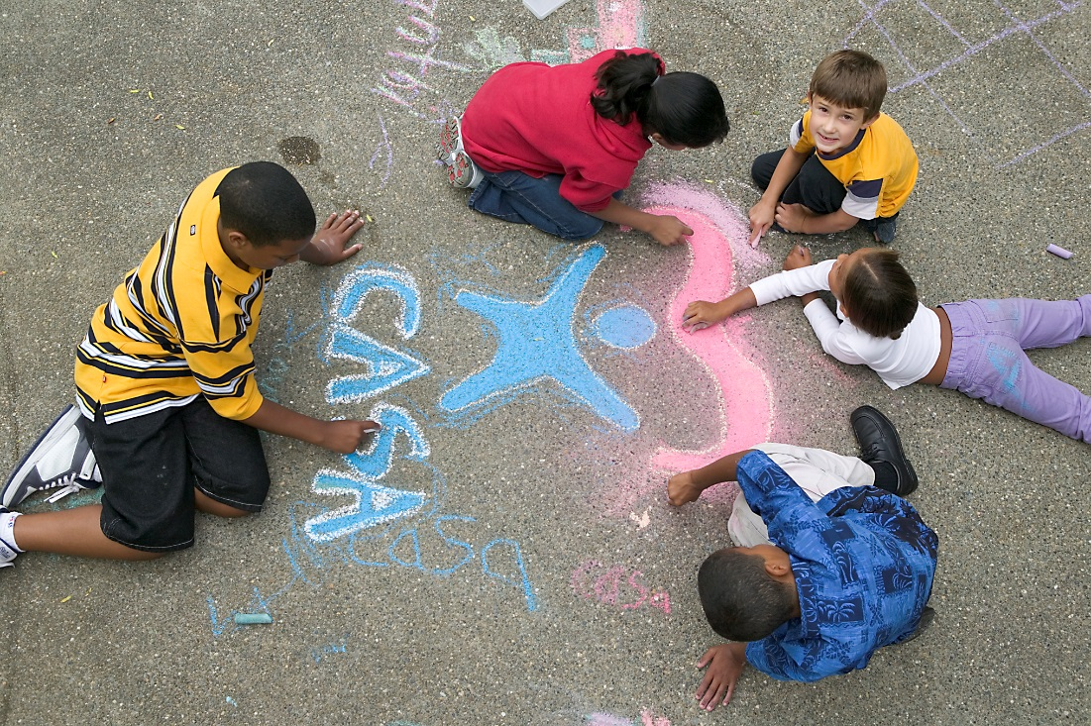
HOW CAN YOU HELP?
VOLUNTEER
Advocate & become a CASA volunteer! Apply on our website TODAY!
Community Champions
Fund Raising (restaurant events, movie nights, happy hours, etc.)
Public Awareness (community events, presentations, etc.)
APPLY to become a CASA at www.casajeffcogilpin.com

Slide 10
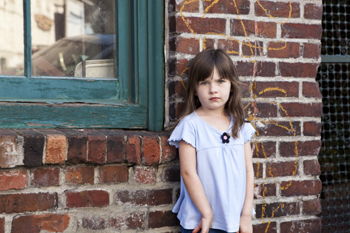
HOW CAN I HELP?
DONATE
Monetary Gift
Individual Donation
Honorarium
Birthday
Anniversary
In-Kind Contributions
Tickets to local events or museums
Quilts, blankets, throws
New clothing items
Toys- for younger or older children
School Supplies
Online Giving Opportunities at www.casajeffcogilpin.com

Slide 11
CHANGE A CHILD’S STORY
alisonhedgepath@casajeffcogilpin.com
COURT APPOINTED SPECIAL ADVOCATES
www.casajeffcogilpin.com

