Slide 4
If you want to build a ship, don't drum up people to collect wood and don't assign them tasks and work, but rather teach them to long for the endless immensity of the sea.
Antoine de Saint-Exupery

Slide 5
MEETING AGENDA: MAY 11, 2021
Special Guest
Bob Loffler, Incoming Area 8 Assistant Governor
Upcoming events
Updates on projects/donations
Speaker
Amanda Weedman: Conflict Management Strategies

Slide 6
Conflict Management

Slide 7
Why do people engage in conflict?
1. Perceived incompatible goals
2. Perceived scarce resources
3. Interference

Slide 8
Destructive Conflict
If all participants in a conflict are dissatisfied with the outcome of a conflict and think they have lost as a result
Four Horsemen of the Apocalypse
When these four behaviors “ride in” to a relationship,
the end is near
Criticizing
Defensiveness
Stonewalling
Contempt

Slide 9
Background Systems
Avoidant
Collaborative
Aggressive / Coercive

Slide 10
Avoidant Systems
Conflict doesn’t exist, and if it does, don’t recognize it
If there is a conflict, figure out what to do about it on your own
Don’t tell anyone else if there is a struggle
Walk away if something starts to feel uncomfortable or threatening
Don’t ever raise your voice
Snide comments are ignored, even though
resentment builds
Sulking and the silent treatment are necessary strategies
If someone has a concern, don’t respond to it
Don’t express strong feelings

Slide 11
Collaborative Systems
Have meetings or mealtime talks to discuss issues
Use good listening skills when someone has a concern
Deal with people directly
Say openly what you are feeling
Regular interaction is important
Dirty tricks such as sulking are not allowed
Strong feelings are seen as normal and are allowed

Slide 12
Aggressive Systems
Survival of the strongest describes the general climate
Be brutally honest regardless of the impact
Show your emotions strongly even if that hurts someone
Establish your position early
Have an audience present when you engage someone
Don’t back down-hold your ground no matter what
If someone attacks you have to fight back

Slide 13
Gender in Conflict
WOMEN
Fewer competitive strategies
Avoidant and compromising behavior
Verbal aggression
MEN
More competitive strategies
Dominating/competitive behavior
Physical aggression

Slide 14
Power Struggles
High-Power
Show restraint
Empower low-power people
Don’t become blind to problems
Be aware that power can distort your view of self
Low-Power
Focus on interdependence
Calm persistence
Stay actively engaged
Keep behavior consistent with your priorities/values

Slide 15
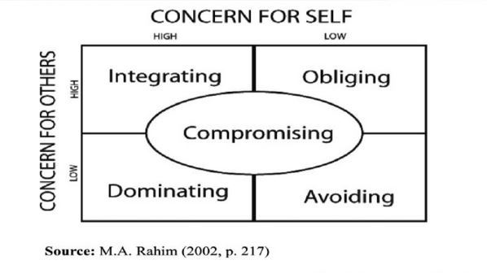
Conflict Styles

Slide 16
Avoiding
Advantages
Buy time to think
Useful for lower-priority issues
Can prevent harm if one is in a dangerous situation
Prevents others’ influence
Disadvantages
Signals to others that you don’t care
Gives the impression that you can’t change
Sometimes prevents resolution
Sets the stage for an explosion

Slide 17
Dominating
Advantages
Useful when decisive action is needed (emergencies)
Useful when the goal is more important than the relationship
Demonstrates commitment
Disadvantages
Can harm relationships
Harmful if the other party is avoiding
Encourages other party to engage in covert means
Reduces conflicts to winning/losing

Slide 18
Compromising
Advantages
Quicker resolution than integrating
Useful when time is limited
Appears reasonable to both parties
Works when other styles fail
Disadvantages
Easy way out, not necessarily the best choice
Prevents creative options to be considered
Both parties often feel they have “lost” something

Slide 19
Obliging
Advantages
Demonstrates reasonableness
Can minimize losses if one is “losing” anyway
Protects the relationship
Allows one to defer to a more experienced person’s judgment
Disadvantages
Competition about “who is nicer”
Tends to reduce creative options
Can further a low-power person’s situation
Signals that the obliger is not invested or does not care

Slide 20
Integrating
Advantages
Satisfies all parties
Generates new ideas
Good for long-term, committed relationships
Prevents the conflict from becoming destructive
Disadvantages
Easy for one person to manipulate the other
Can be used to maintain a power imbalance
Takes time and energy

Slide 21
For more information…
Maintaining Peace Webinar
https://portal.clubrunner.ca/50085/sitepage/training
Conflict management styles assessment
http://www.blake-group.com/sites/default/files/assessments/Conflict_Management_Styles_Assessment.pdf

