Slide 1
Our Mission
To help disabled and disadvantaged youth in our community to achieve their fullest potential in a world that's stacked against them.
Quick Facts
Established in July 2020
99% of donations go directly to those we serve
501(c)(3)
Nonprofit Organization

Slide 2
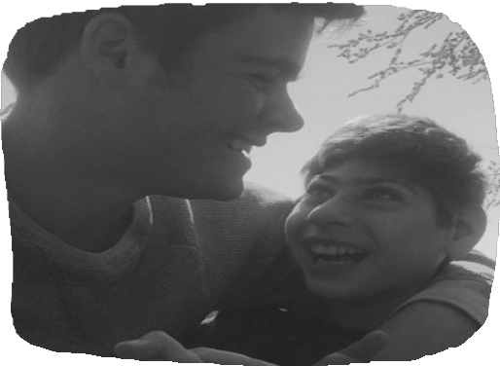
Our Story
Do Better 4 Steve was established to honor our son Steve Cammarota's legacy. Steve was known for dedicating his life to others in his community. He impacted all those who met him and were touched by his kindness.
Despite being diagnosed with an autoimmune disease as a young child, Steve made it his mission to serve others and "do better." The disease ultimately took his life, but his memory lives on.
Do Better 4 Steve aims to inspire others to
Do Better, as Steve wanted.

Slide 3
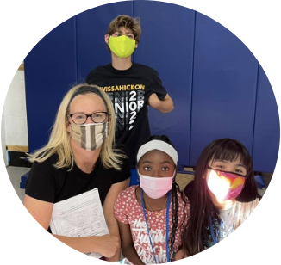
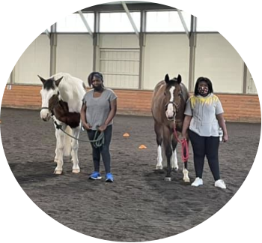
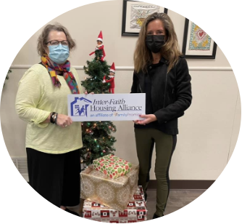
How we operate
Do Better 4 Steve, in partnership with teachers, social workers, and community leaders, raises and distributes funds to programs for disabled or disadvantage children including:
Summer camp
Music lessons and instruments Child care
Learning services Tutoring Learning devices
YMCA program attendance

Slide 4
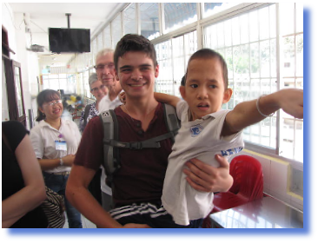
Our Partners
We are so grateful for our amazing community partners that share our vision for making the world more accessible for disabled and disadvantaged children. Partners include:
Ambler Savings Bank
Mattie N. Dixon Community Cupboard Ivy Experience
Whitpain Recreation Association The YMCA
Rotary Club of Blue Bell
Want to learn more?
Contact us if you'd like to partner with us or know of someone who could benefit from our programs.
contact@dobetter4steve.org

