Slide 2
Chefs ‘24 Our Club Roll Out
Overview of BBRC’s signature fund raiser
Big Picture, where we are starting
What are we expect to achieve
Our leadership team
Everyone involved- table group discussions
Next Steps

Slide 3
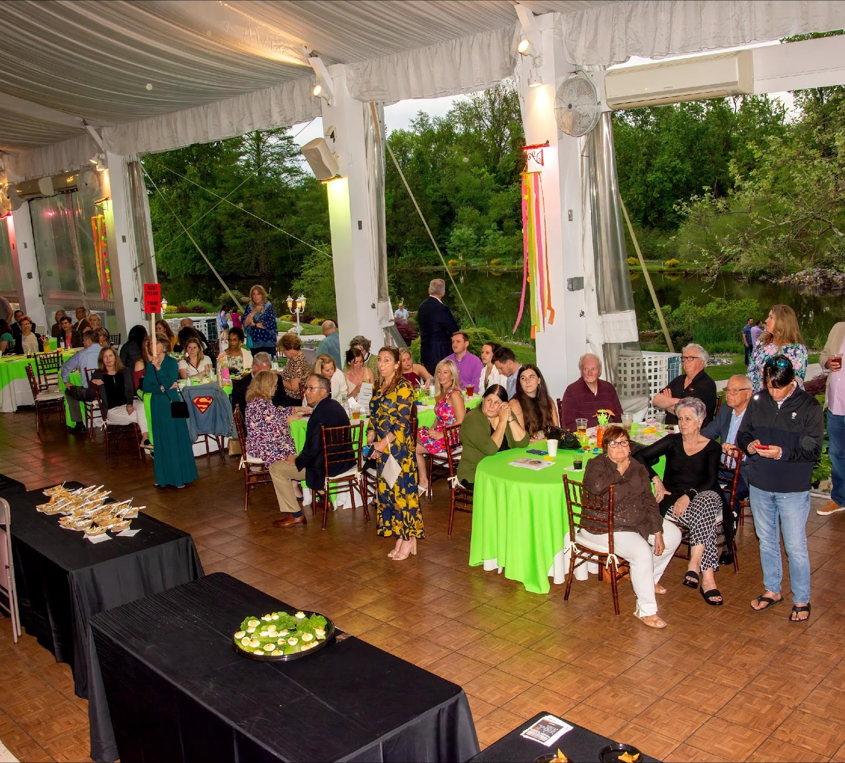
Chefs of the Burbs 2024 The Big Picture

Slide 4
Starting Place
Date: May 22, 2024
Location: Manor House
Host: Robert Fair, Whitpain Township
Auctioneer: Mike Ivankovich
Event Platform: OneCause
Preliminary Budget: In Place
Tickets Available: Ready for Purchase as Holiday Gifts- $85 each
Operating principles: engage, collaborate, enhance

Slide 5
What we are intending to achieve
Full club engagement of Blue Bell Rotarians, it’s what we do best
Chefs 2024 - Key Objectives
Deliver a memorable and outstanding community event
Raise funds so that beneficiaries can implement their efforts for the community
Provide sponsors & restaurants the opportunity to partner with us
Raise awareness about Blue Bell Rotary’s outreach to the local and global communities, engage new members and partners

Slide 6
Chefs 2024 Committee Leads and Co-Leads
Restaurants Teal Mercer; Mary Vila
Communications Daniel Watson-Bey; Tandra Bowers
Sponsors Lei Barry; Bill Messerschmidt
Beneficiaries John Ferraro; Allan Syphers
Auctions Judy Paulsworth; Tony Griffiths
Venue Bob Brockway; Joanne Messerschmidt
OneCause/Budget Bill Messerschmidt; Elena Sickles

Slide 7
Everyone Involved!!
This is where BBRC really shines.
Doing it all together makes a huge difference to the success of our event…and more fun.
Looking for practical ways to make enhancements

Slide 8
Chefs Table Group Discussions
Join a table based on your interest (see handout)
Learn about the team’s top priorities from Team Leads
Discuss (Team Leads listen): “What will make this team’s effort most successful?” (2-3 success factors)
Ready to provide a 1-minute highlights report on success factors

Slide 9
Table Group Discussion Highlights
1 minute Report of success factors

Slide 10
What’s Next?
Teams formed and activated
Complete the planning work with your team
Identify practical enhancements to Chefs
Get ready for actions in first quarter
Chefs leadership team meets monthly
Dedicated whole club discussions: 1st and 2nd quarters

Slide 11
BB Rotarians
THANK YOU!!

