Slide 1
AUGUST 15 CLUB meeting
Rotary Club of Blue Bell
Title Page Option

Slide 2
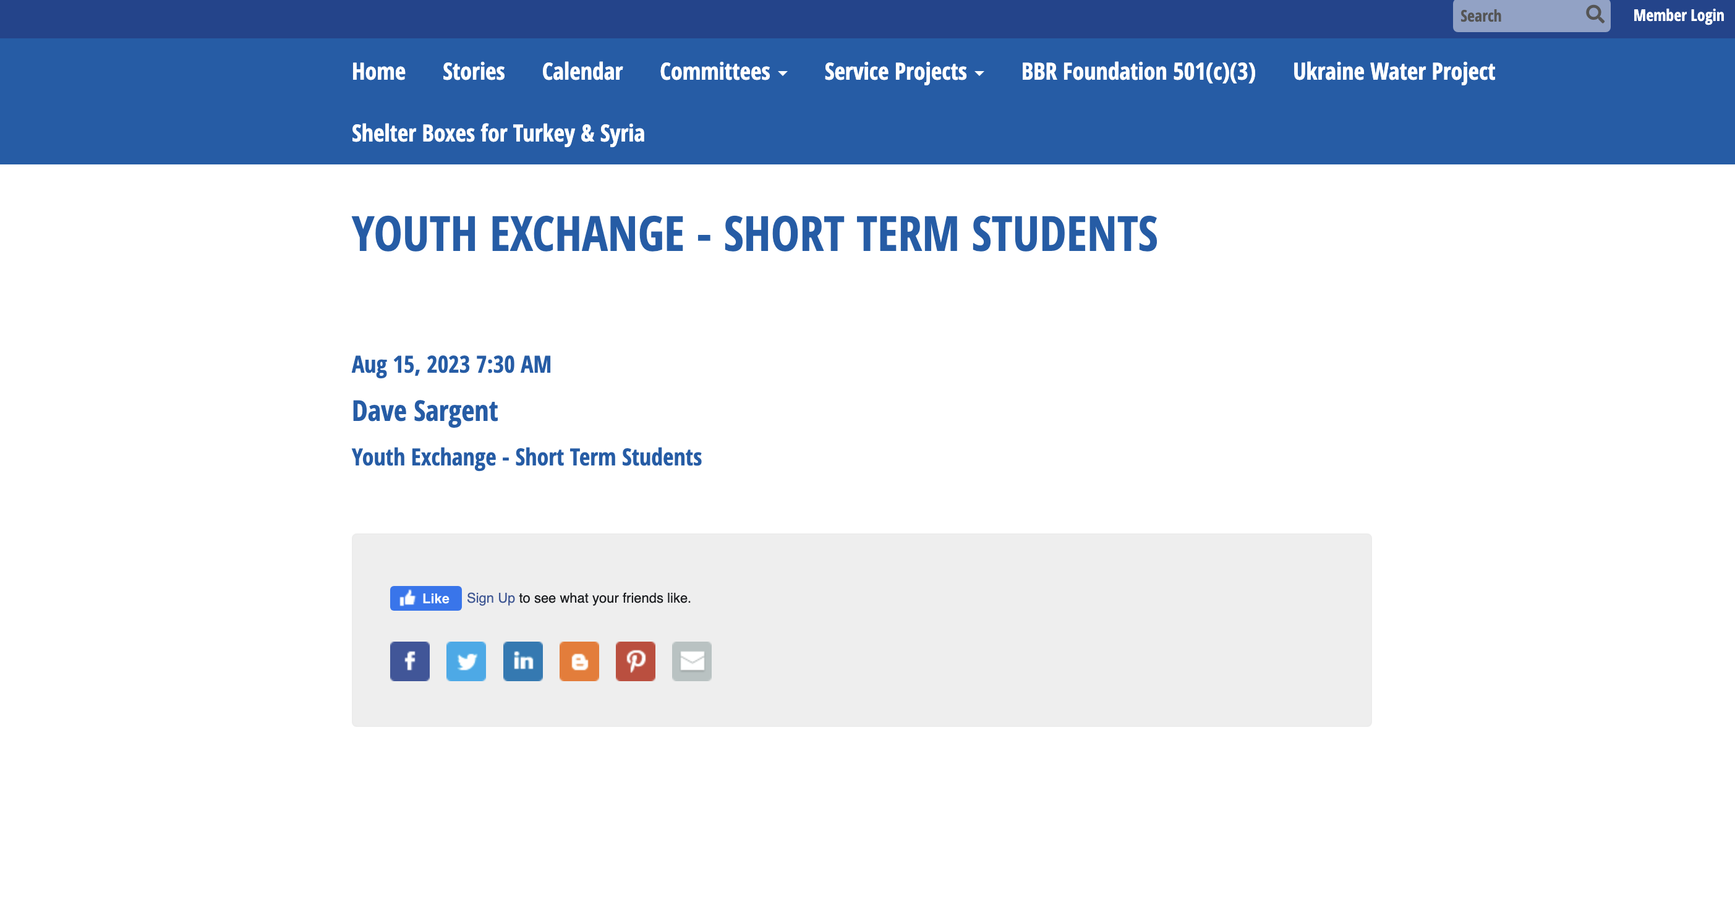

Slide 3


Slide 4


