Slide 1
AUGUST 22 CLUB meeting
Rotary Club of Blue Bell
Title Page Option

Slide 2
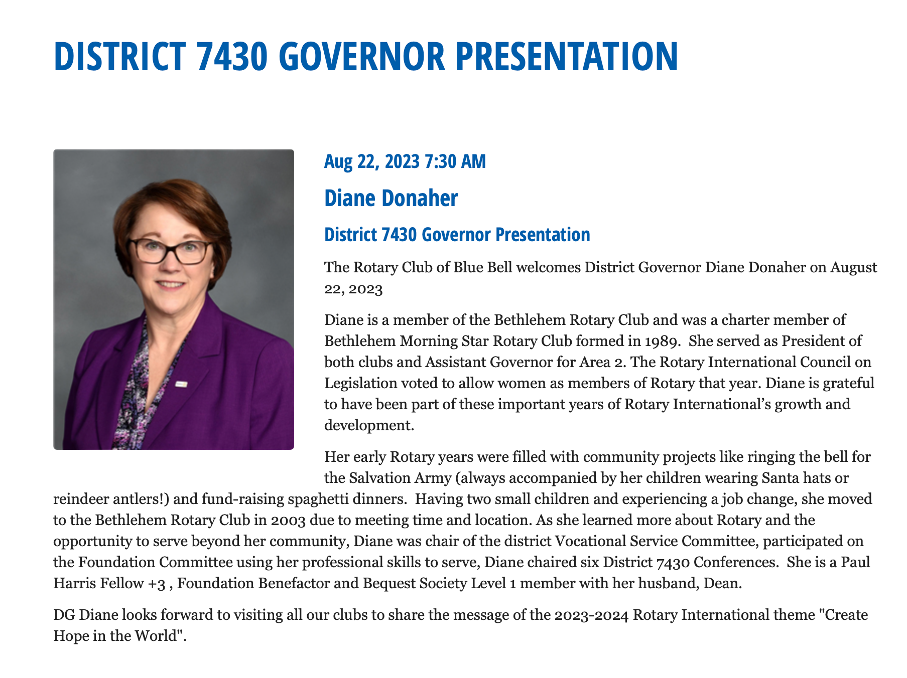

Slide 3
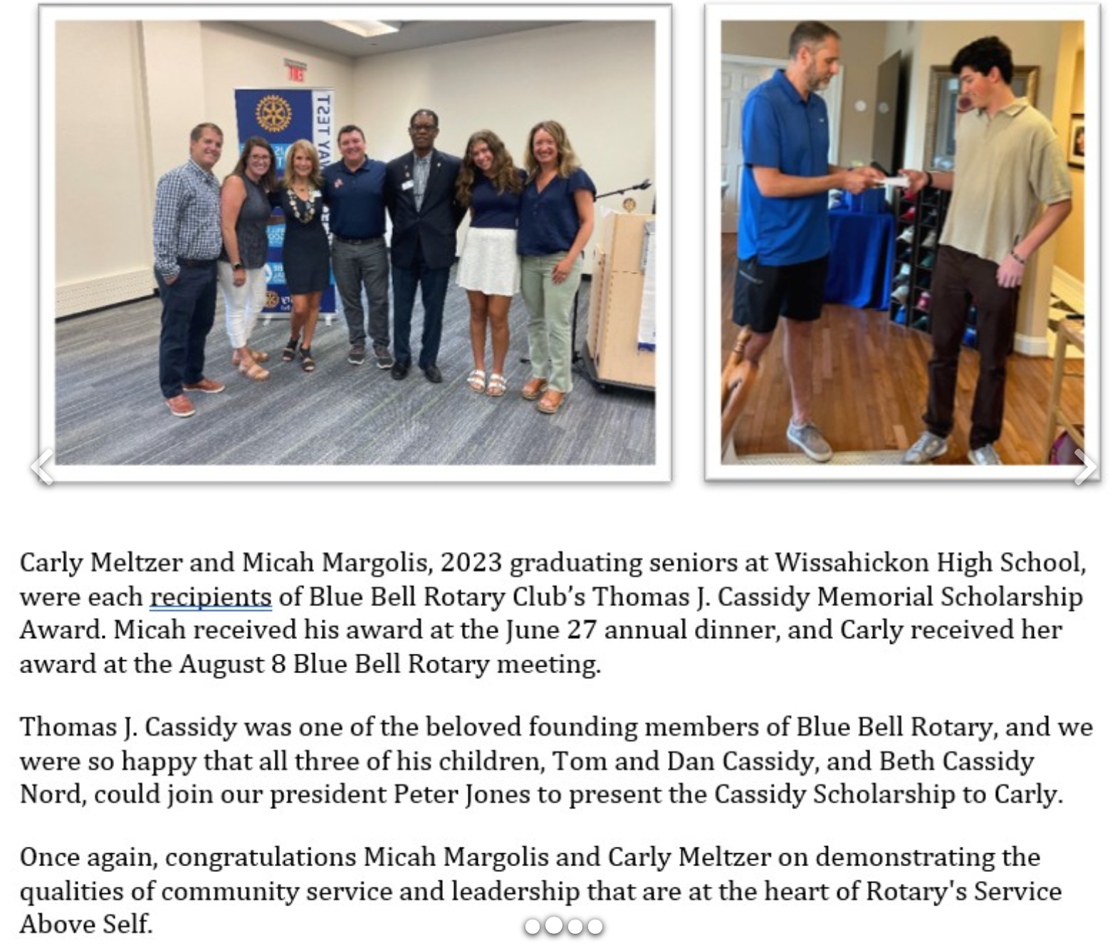
Thomas j. Cassidy memorial scholarship award
Presentation:
August 8, 2023

Slide 4
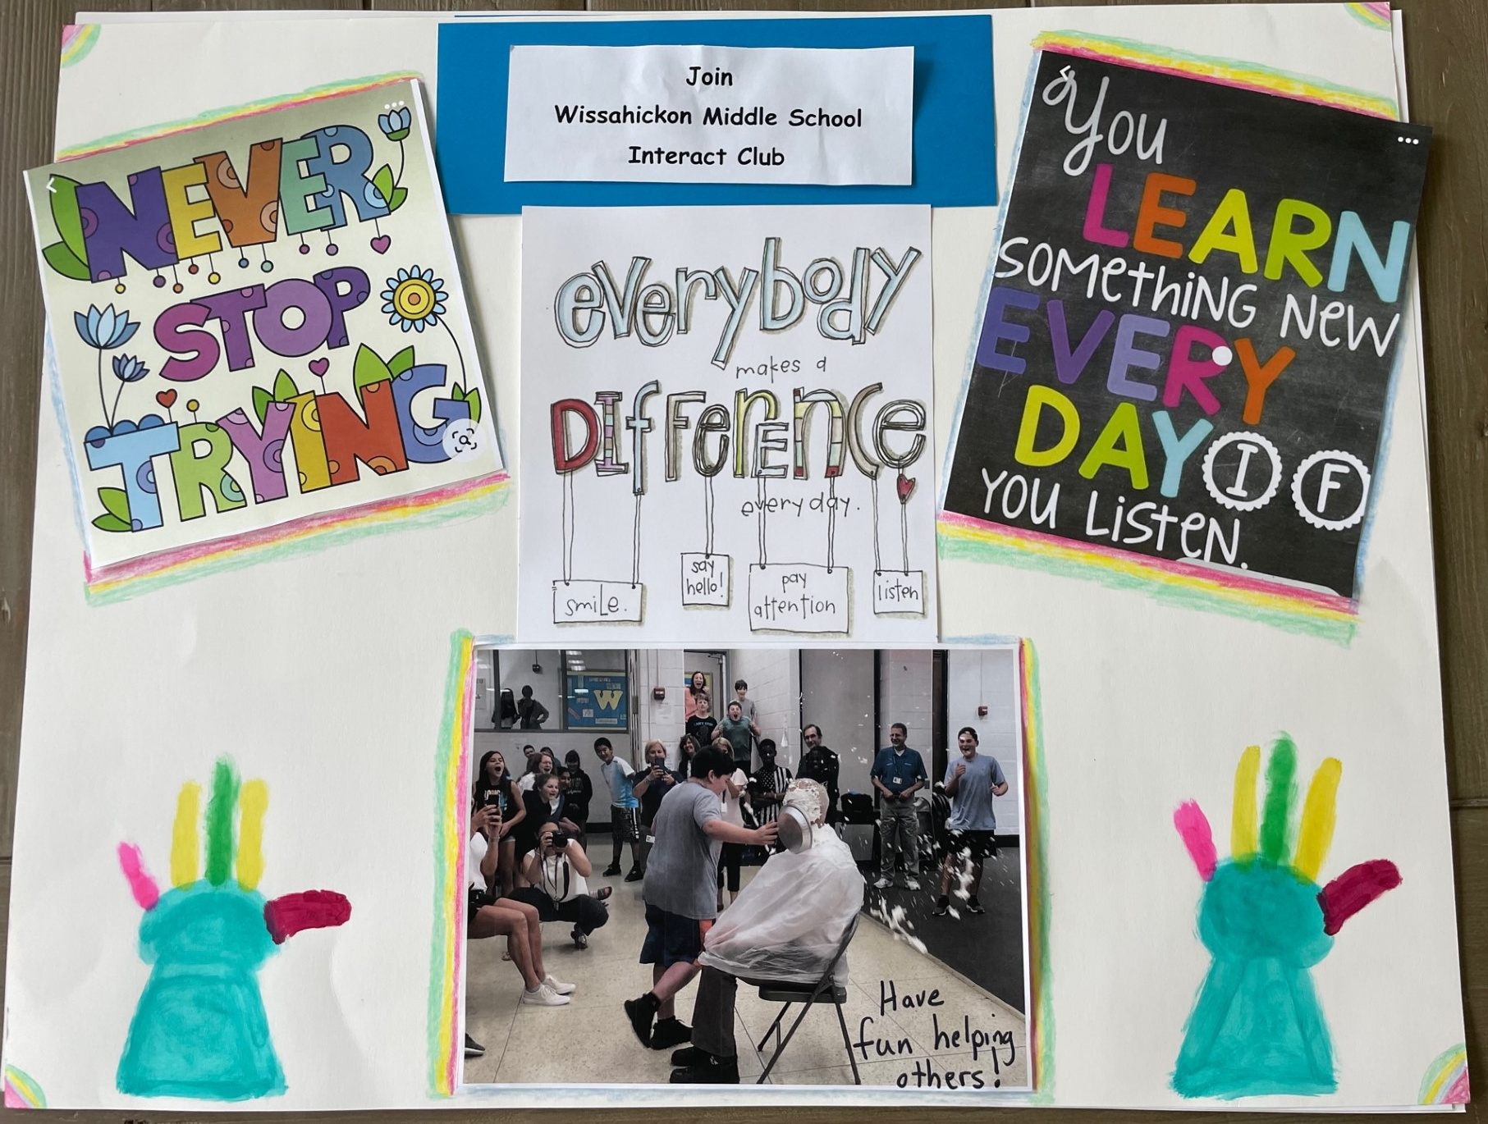
Interact display at
Back-to-School night Wed Aug 23
Wissahickon Middle School is sponsoring Back-to-School night on 8/23 for incoming 6th graders to acquaint them with clubs and activities that they can look forward to as they become 6th graders.
Addie Eveland (Leilani’s granddaughter & member of Interact) and Tandra Bowers and her daughter (Alexa-also member of Interact) will be talking about Interact with the incoming 6th graders.
Addie made this poster for the event.

Slide 5
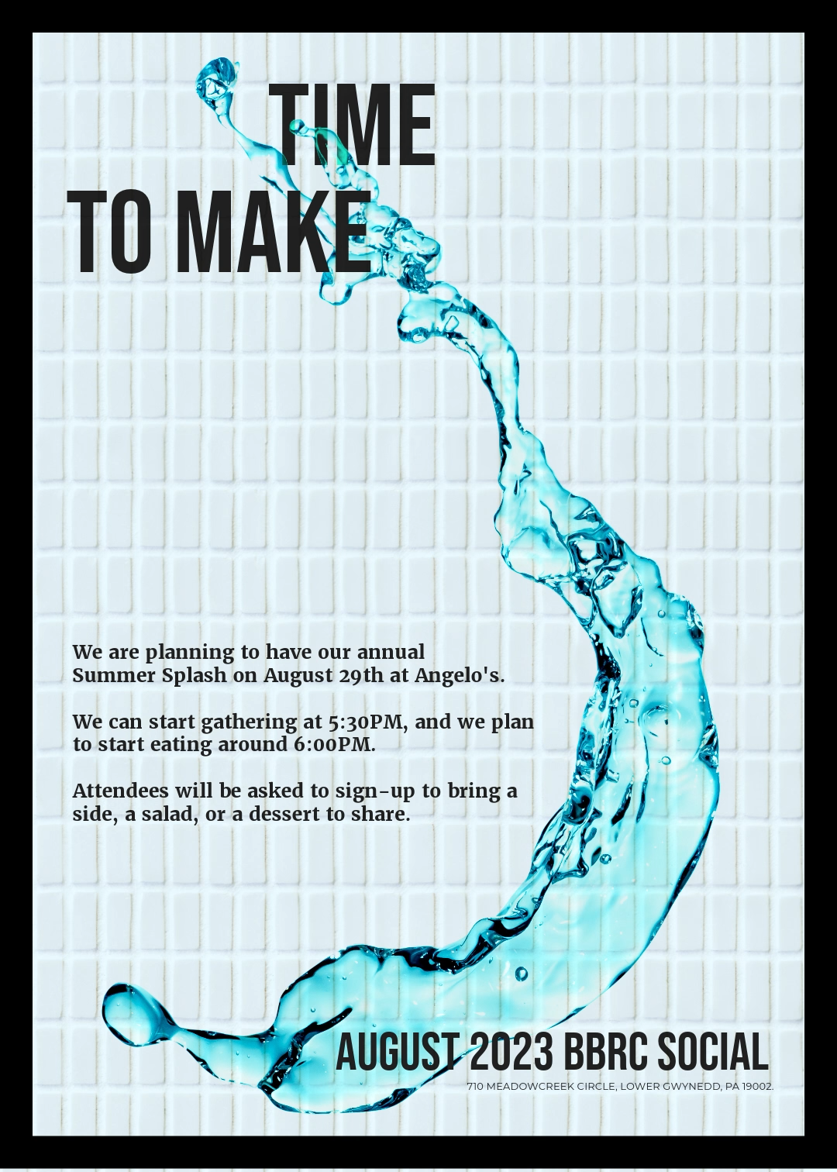

Slide 6


Slide 7
