Slide 1
AUGUST 8 CLUB meeting
Rotary Club of Blue Bell
Title Page Option

Slide 2
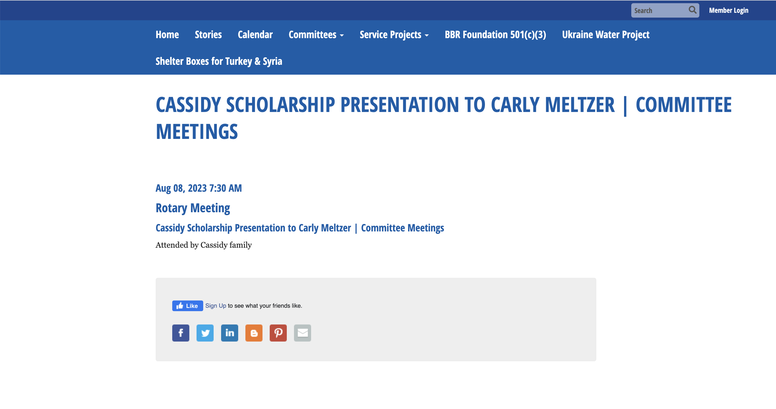

Slide 3


Slide 4
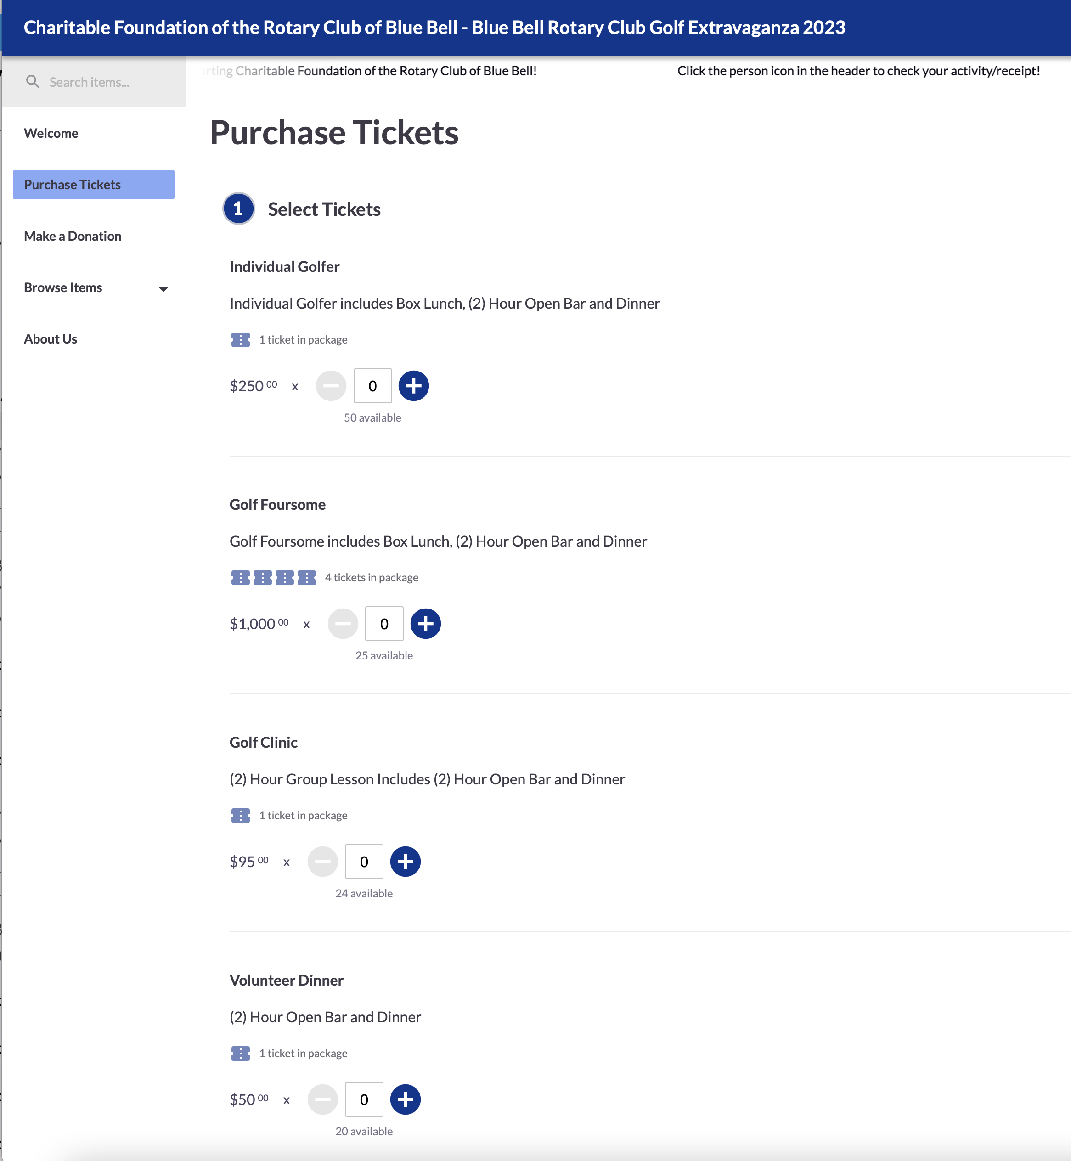

Blue Bell Rotary Golf Extravaganza 2023
https://one.bidpal.net/bbrcgolf/welcome

Slide 5


