Slide 1
PHILADELPHIA, USA

Slide 2
ICHS Mission:
ICHS promotes transformational growth through Biblical truth and engaged faculty, preparing students to reach their full potential in a multicultural community.

Slide 3
ICHS Vision:
To provide an excellent education in a safe, caring, and Christ-Centered community.

Slide 4
International Christian High School
ICHS was founded in 1968 as a result of low performing and failed school systems in Philadelphia.
Grades 9 - 12
Students: 160 ( Local: 150 International Students: 10 ) ICHS is a SEVIS school recognized by Homeland Security to issue I-20 / F1 VISA’s

Slide 5
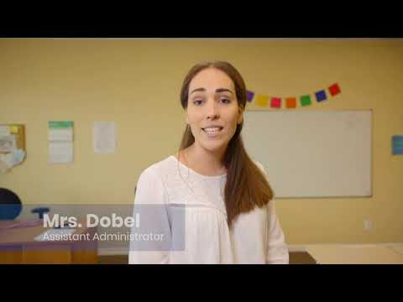
School Tour
https://www.youtube.com/watch?v=cRQsb84ZKr0

Slide 6
ICHS As A Refuge

Slide 7
Opportunities to Partner with ICHS
Mentoring Program with Male students and Female Students during Lunch.
Organizational Partnerships.
Program Development (Internships, Trades, Ministry Partnerships)
Mission Trip Training & Support
Scholarship Opportunities. Redirecting your PA State Taxes.

Slide 8
Directing State Taxes to Eligible Schools / Students
https://dced.pa.gov
https://dced.pa.gov/programs/opportunity-scholarship-tax-credit-program-ostc/
Special Purpose Entity, Opportunity Scholarship Tax Credit, Education Incentive Tax Credit
Are you interested in choosing where your PA taxes go?
Do you have a Private school that you believe in?
Have an Scholarship Organization (SO) walk you through the process (start - end 2 hours) $100 = $1,000

Slide 9
PHILADELPHIA, USA
Benjamin Brittin
bbrittin@ichsphila.org or 267-900-2000

